Slide 1
Exploratory Data Analysis
Amy Rafferty

Slide 2
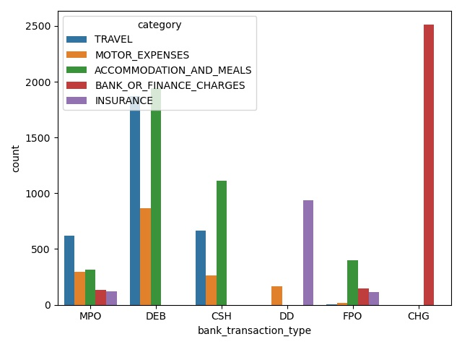
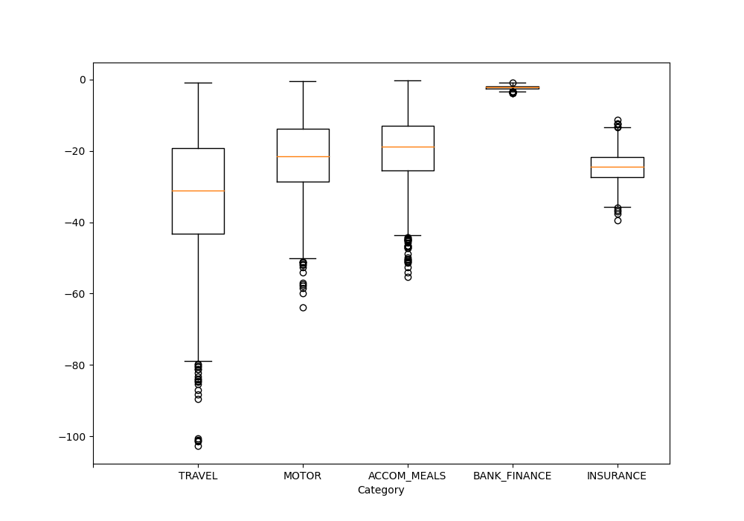
Amounts and Types
In order to determine whether there were any differences between types/definitions/amounts of transactions between categories, I decided that I had to represent each quality in a different way.
The transaction amounts, as numerical values, I felt should be represented as box plots, showing the spread of data for each category as well as the means and edge values.
Transaction type, as categorical values, I represented in a bar chart, showing the split of each type into categories and the count of each. This was possible because there are only 6 transaction types, so it is easy to display.
From the graphs, it’s clear that transactions in different categories have very different types. For example, the CHG type is used exclusively by transactions in the Bank/Finance category.
It’s also clear that the different categories cover transactions with different amounts. The Bank/Finance category in particular is very different from the rest, with a much narrower range of values spanning over higher values than the other categories. The Motor and Accommodation/Meals categories seem to cover transactions with similar amounts.

Slide 3
Descriptions
Transaction descriptions, although categorical, includes 9474 unique values, which means this quality is not representable in a graph. Instead, I found the top 5 descriptions for each category, and the number of unique descriptions, for each category.
From the top 5 of each category, it’s immediately clear that there are duplicate descriptions for the same entity, for example “travelodge” and “TRAVELODGE”. Also, a lot of the descriptions involve dates, such as “ON 12 Jul NANDOS CONTACTLESS”, and such most descriptions only occur once.
Obviously, the descriptions between categories are mutually exclusive, since the description is directly related to the nature of the transaction, and therefore the category. For each category there are a significant number of descriptions, so there is no way to represent them in the way I did with the transaction types.
 | TRAVEL | MOTOR | ACCOM/MEALS | FINANCE | INSURANCE
Most Common | TRAVELODGE | tesco pay at pump | macdonalds | Fee | enterprise car insurance
2nd | tfl.gov | parking | COSTA COFFEE | Bank Charges | hiscox
3rd | TFL TRAVEL | ENTERPRISE CAR RENTAL | starbucks | paypal | insurance
4th | tfl travel | admiral insurance | GREGGS PLC | PAYPAL | INSURANCE
5th Most Common | travelodge | PARKING | MACDONALDS | Fin: | HISCOX INSURANCE
# Unique | 2620 | 1363 | 2928 | 1736 | 964

Slide 4
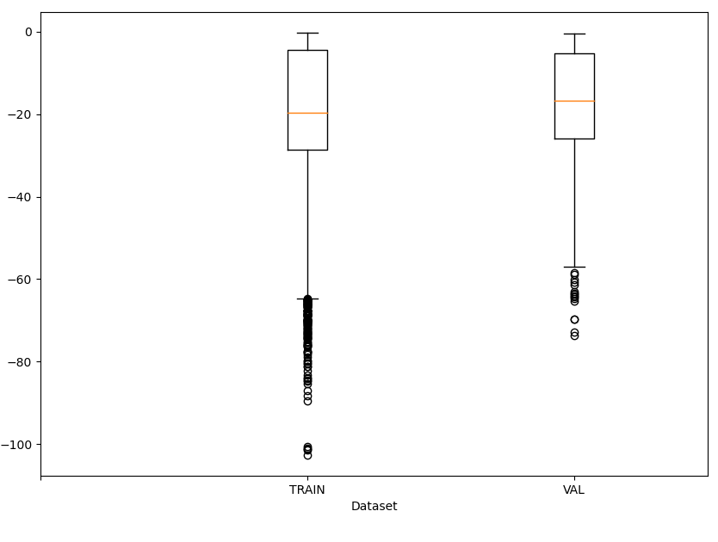
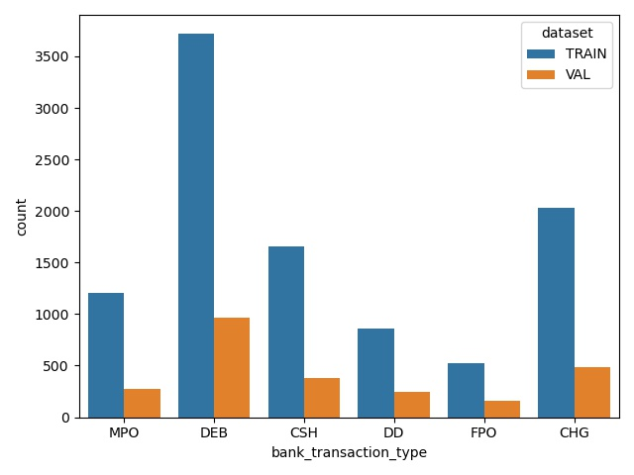
Validation / Testing
The training data (10,000 entries) and validation data (2500 entries) are laid out in the same way as previous.
In terms of amounts, the numbers seem to be equally distributed between the two sets, with slightly more outliers on the lower side for the training set, which is to be expected as there are more values.
In terms of types, the distribution seems even between the sets, when the numbers of transactions in each set is taken into account.
In terms of descriptions, it’s interesting that most of the top descriptions in the training set are from the financial class. There is an overlap of Bank Charges between the sets, but otherwise the most popular transaction descriptions are different.
 | TRAIN | VAL
Most Common | Fee | Bank Charges
2nd | paypal | transferwise
3rd | Bank Charges | Sundry debit:
4th | PAYPAL | PRET A MANGER
5th Most Common | AMZNMKTPLACE | HALIFAX
# Unique | 7728 | 2188

Slide 5
Transaction Classification Model
Amy Rafferty

Slide 6
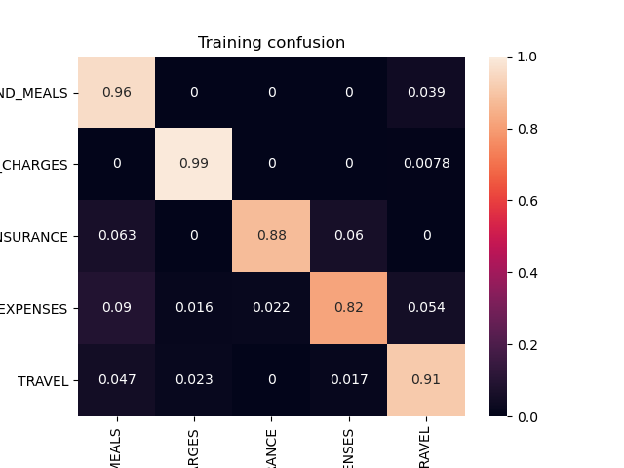
Data Pre-Processing
Testing Accuracy Score | 0.937
Validation Accuracy Score | 0.854
3Before any classification could take place, the data itself needed to be pre-processed to be more manageable. This process involved:
Removing all unnecessary columns, leaving only the description, category and dataset of each transaction
Converting descriptions to lowercase to avoid any inconsistencies (eg. travelodge / TRAVELODGE being classified differently)
Removing any transactions with a description that only occurred once in the dataset
Converting the categorical description value into integer values in the form of one-hot encoding, so that they could be classified
I decided to remove transactions with unique descriptions as in this case they are unlikely to re-occur, for example “somewhere on 12Aug20” is a transaction unlikely to be seen again after a specific day. Doing this also made the dataset much more manageable without losing any of the underlying patterns in the data.
The Model
After splitting the pre-processed data into the test and validation sets, I applied a Logistic Regression model to the data, and retrieved the accuracy scores displayed at the top of this slide. As you can see, my model performed very well on both sets of data.
I decided to use Logistic regression because in my experience it performs well on categorical data with lots of possible values when encoded.
The labels are slightly cut off here but are, in order, “ACCOMODATION_AND_MEALS”, “BANK_OR_FINANCE_CHARGES”, “INSURANCE”, “MOTOR_EXPENSES”, and “TRAVEL”

Slide 7
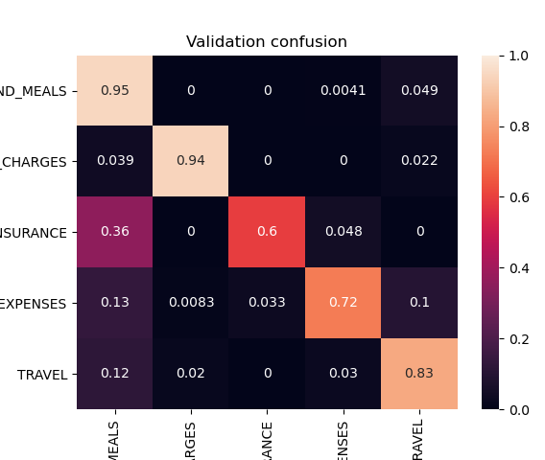
Analysing the Validation Results
With an accuracy score of 0.854, my model performed generally well on the validation set.
As you can see from the confusion matrix, the main source of error occurs with the “ACCOMODATION_AND_MEALS” category. The model predicts that a significant number of transactions exist within this category, when they actually do not – these are false positives with regards to this category. The errors seem to mostly occur for the “INSURANCE” category, but also happen for the “MOTOR_EXPENSES” and “TRAVEL” categories.
Suggesting Improvements for My Model
During pre-processing, I removed transactions that had unique descriptions. To improve my model, I could have done one of two things.
I could have removed transactions with descriptions that appeared less than 125 (1% of full dataset) times – this would have ensured that any patterns coming from purchases with dates, or irregular sources, would have been disregarded.
I could also have directly reformatted any descriptions involving dates, so that they only stated the source of the transaction and not, for example, “on 2Aug20”. This would have given me more data to work with, as I wouldn’t have been deleting the transactions with this type of description.
The labels are slightly cut off here but are, in order, “ACCOMODATION_AND_MEALS”, “BANK_OR_FINANCE_CHARGES”, “INSURANCE”, “MOTOR_EXPENSES”, and “TRAVEL”
Testing Accuracy Score | 0.937
Validation Accuracy Score | 0.854

Slide 8
Suggesting Improvements for My Model Continued
I could also have experimented with other model types, and perhaps used a logical regression model in conjunction with a linear regression model, for better accuracy results.
Suggesting Improvements for the Dataset
Transaction descriptions containing dates in general is bad practise if transaction classification is something you want to be able to do. Removing these dates would allow transactions to be further grouped – for example, “Travelodge” and “Travelodge on 3Feb” would be classified as the same without fail. Introducing pre-formatting of descriptions would aid this.
Another smaller thing is that for someone new to this dataset, the transaction types are not intuitive as to what they mean – better type labelling would make the dataset as a whole easier to intuitively understand and visualise.

