Slide 1
Single-Player Monte-Carlo Tree Search on SameGame
Presenter: Shan Lu

Slide 2
Outline
The Puzzle: SameGame
Related Work
Methodology
Experimental Results
Conclusion and Future Work

Slide 3
The Puzzle: SameGame
Rules:
A removable group:
A group that contains more than one piece
All pieces have the same color and are orthogonally connected
The game ends when there is no removable group
Game Score:

Slide 4
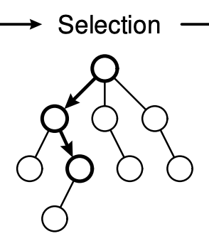
Related Work: Single-player Monte-Carlo tree search for SameGame
The Selection Strategy:
Schadd, M.P., Winands, M.H., Tak, M.J. and Uiterwijk, J.W., 2012. Single-player Monte-Carlo tree search for SameGame. Knowledge-Based Systems, 34, pp.3-11.

Slide 5
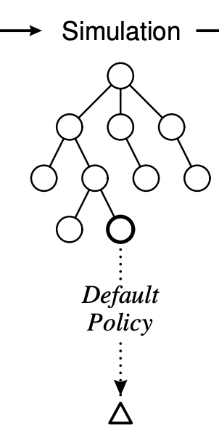
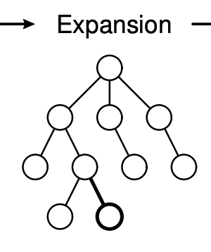
Related Work: Single-player Monte-Carlo tree search for SameGame
Expansion:
The Simulation Strategy:
TabuRandom:
Selecting a color randomly at the beginning of the simulation.
Until the game ends, it selects a child move of non-selected colors
If not available, it randomly selects a child move of the selected color.
TabuColorRandom:
Selecting the most frequently color at the beginning of the simulation
Other steps are the same as the TabuRandom strategy
Schadd, M.P., Winands, M.H., Tak, M.J. and Uiterwijk, J.W., 2012. Single-player Monte-Carlo tree search for SameGame. Knowledge-Based Systems, 34, pp.3-11.

Slide 6
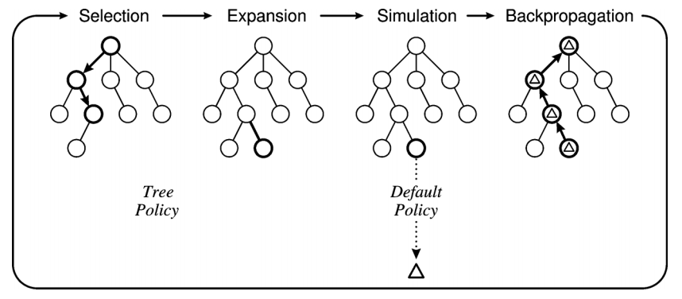
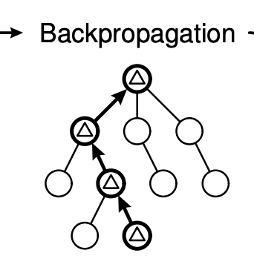
Related Work: Single-player Monte-Carlo tree search for SameGame
Backpropagation:
Schadd, M.P., Winands, M.H., Tak, M.J. and Uiterwijk, J.W., 2012. Single-player Monte-Carlo tree search for SameGame. Knowledge-Based Systems, 34, pp.3-11.
Browne, C.B., Powley, E., Whitehouse, D., Lucas, S.M., Cowling, P.I., Rohlfshagen, P., Tavener, S., Perez, D., Samothrakis, S. and Colton, S., 2012. A survey of monte carlo tree search methods. IEEE Transactions on Computational Intelligence and AI in games, 4(1), pp.1-43.

Slide 7

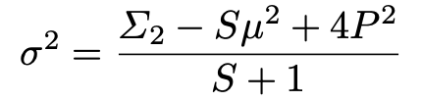
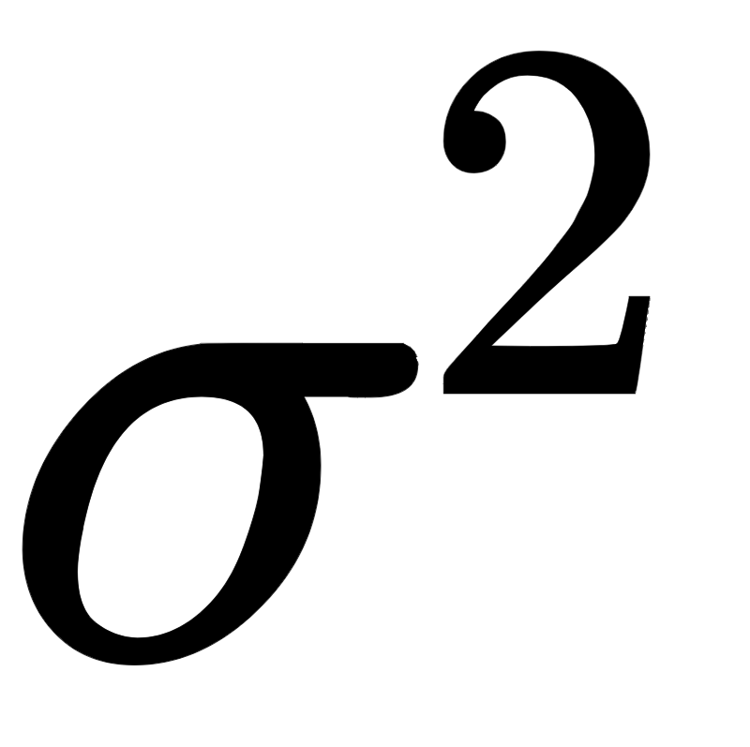


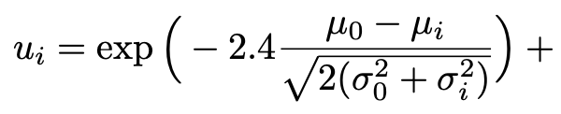
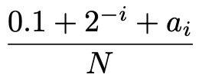
Related Work: Efficient selectivity and backup operators in Monte-Carlo tree search
Crazy Stone’s selectivity algorithm:
Compute the estimated value (the opposite of the average score) and the variance for each child move.
Sort child moves so that
Compute the probability of being better than the current best move for each child move.
Each child move is selected with a probability proportional to .
Coulom, R., 2006, May. Efficient selectivity and backup operators in Monte-Carlo tree search. In International conference on computers and games (pp. 72-83). Springer, Berlin, Heidelberg.

Slide 8
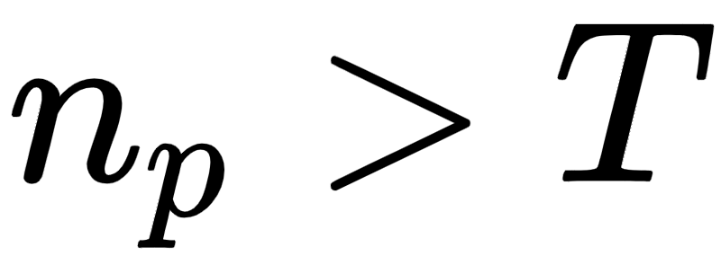
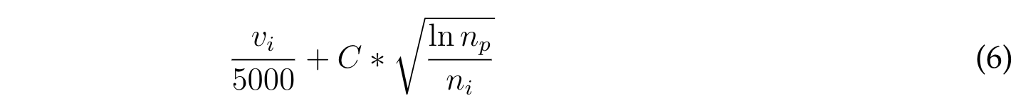
Methodology
Using prior knowledge in the selection strategy at the early stage of SP-MCTS:
When , the selection strategy maximizes one of the following UCT formulas:
Klein, S., 2015. Attacking SameGame using Monte-Carlo tree search: using randomness as guidance in puzzles

Slide 9
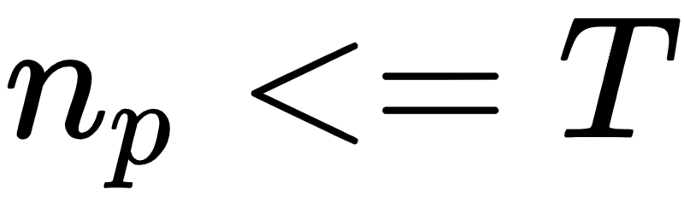
Methodology
Using prior knowledge in the selection strategy at the early stage of SP-MCTS:
When , the selection strategy using prior knowledge to choose the child node with the maximum heuristic score:

Slide 10
Methodology
The selection strategy that is similar to Crazy Stone’s selectivity algorithm
For each child node, compute its variance using the following formula:
Sort child nodes by their top game scores so that
Compute the probability of being better than the current best move for each child move
Each child node is selected with a probability proportional to
Coulom, R., 2006, May. Efficient selectivity and backup operators in Monte-Carlo tree search. In International conference on computers and games (pp. 72-83). Springer, Berlin, Heidelberg.

Slide 11
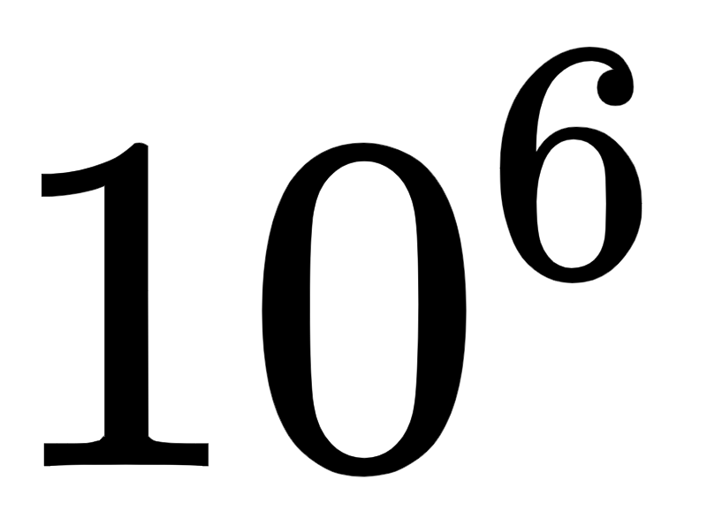
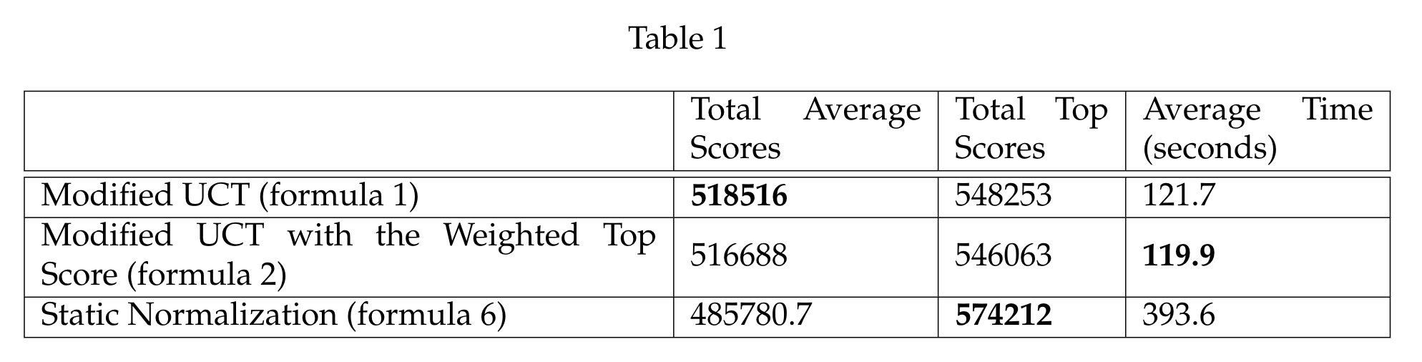
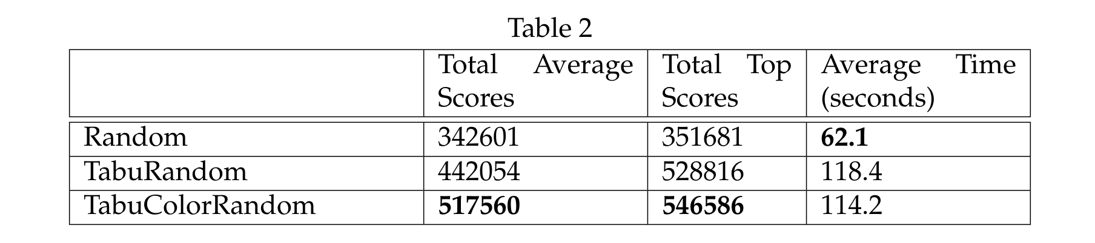
Experimental Results
All experiments are tested on the same 250 game boards. The number of nodes expanded in the Monte-Carlo Tree is

Slide 12
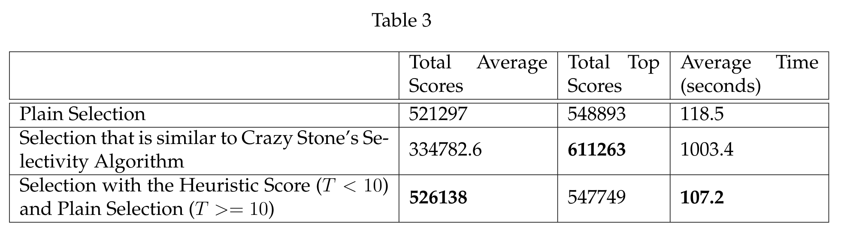
Experimental Results

Slide 13
Conclusion and Future Work
The TabuColorRandom strategy is better than Random and TabuRandom strategies for SameGame
The selection strategy that is similar to Crazy Stone’s selectivity algorithm improves the top game score noticeably
However, the selection strategy that is similar to Crazy Stone’s selectivity algorithm is more computationally expensive.
One possible improvement: Using a priority queue, whose key is the top score, to sort the child nodes during the construction of the search tree.
Schadd, M.P., Winands, M.H., Tak, M.J. and Uiterwijk, J.W., 2012. Single-player Monte-Carlo tree search for SameGame. Knowledge-Based Systems, 34, pp.3-11.

Slide 14
Thank you!
Questions?

