Slide 1
Baseline selection and pseudo-labelling
1.1 Widened U-Net
1.2 USCL initialisation
2.1 / 2.2 Collapse: learning rate or underfitting?

Slide 2
1. 1 Did the widened U-Net have any impact?
Model | Params | Dice (5-fold, TN3K test) | IoU
U-Net | 31.04 M | 0.7812 ± 0.0068 | 0.6834
U-Net widened | 43.77 M | 0.7830 ± 0.0040 | 0.6853
MTNet | 43.2 M | 0.7991 ± 0.0079 | 0.7078
TRFE+ | 45.4 M | 0.8035 ± 0.0106 | 0.7077
41% more parameters moved Dice by +0.0018, so MTNet’s advantage is not explained by capacity.
gland data helps?

Slide 3
1. 2 USCL weights for initialisation
USCL checkpoint contains weights shaped for a ResNet-18. The U-Net’s encoder is plain DoubleConv blocks — no layer matches in name or shape, so the weights cannot be loaded into it. Using USCL requires a model that contains a ResNet-18: a ResNet18-UNet (ResNet-18 encoder + U-Net decoder, 14.34 M)
All three rows are that same ResNet18-UNet. Only the encoder’s starting weights differ. TN3K fold 0, identical lr / schedule / data.
Encoder init | Numbers in the encoder at the start | Dice | IoU | HD95 | Empty preds
random | fresh random numbers — no prior learning | 0.7550 | 0.6569 | 22.88 | 13
ImageNet | a ResNet-18 that learned to classify photographs | 0.8134 | 0.7196 | 19.23 | 2
USCL | a ResNet-18 that learned from US-4 ultrasound | 0.7372 | 0.6384 | 25.16 | 20
ImageNet on the same model gains +0.0584 over random init at the same lr — so prior learning does help here, and lr isn’t what hurt USCL; the weights are. Most likely domain mismatch: US-4 contains no thyroid. Matches the generic-US verdict in the ThyroidSegmentation journal, June 2026.

Slide 4
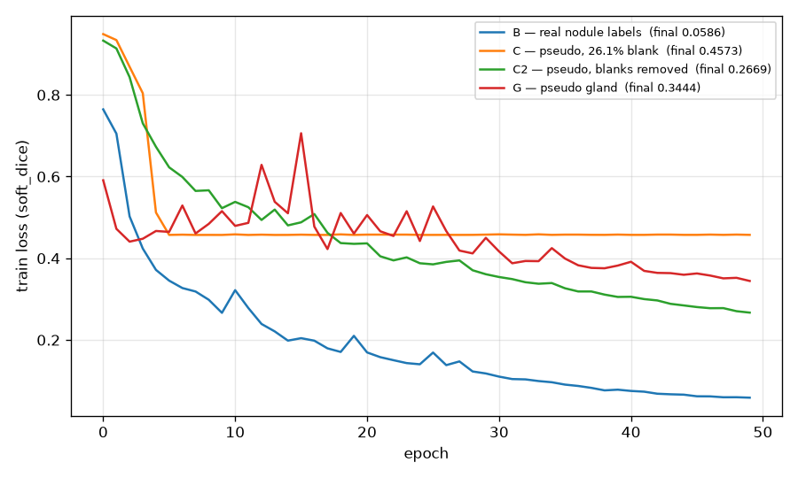
2.1 / 2.2 · Four curves
Arm | Training labels | Blank in train | Final train loss | Learning-curve shape | Dice | Diagnosis
Control | real nodule masks | 6 / 2,879 (0.2%) | 0.0586 | smooth descent, nearly flat by ep 49 | 0.7918 | converged
Student C2 | pseudo nodule, blank frames removed | 0 / 2,235 (0.0%) | 0.2669 | descending throughout, still falling at ep 49 | 0.2060 | underfitting
Student C | pseudo nodule, as generated | 791 / 3,026 (26.1%) | 0.4573 | drops to 0.457 by ep 5, then flat for 45 epochs | 0.0000 | Converged by epo 5
Student G | pseudo gland | 58/2,879 (2.0%) | 0.3444 | spikes to 0.70 at ep 15, still falling at 49 | 0.7318 | unstable + underfitting
C’s collapse was not lr. C2 trains smoothly at the same 1e-2 on the same data minus the blank frames. If lr were the cause, C2 would have collapsed too. The lr point does land on G, which spikes above its own starting loss at epoch 15.
underfitting is right for C2 and G, not for C. C’s loss is flat from epoch 5 onward: a converged degenerate solution, not a model still learning.

