Slide 1
Insight Toy Company 2017
Amy Snowhill
ISM4547-11460
April 19, 2026

Slide 2
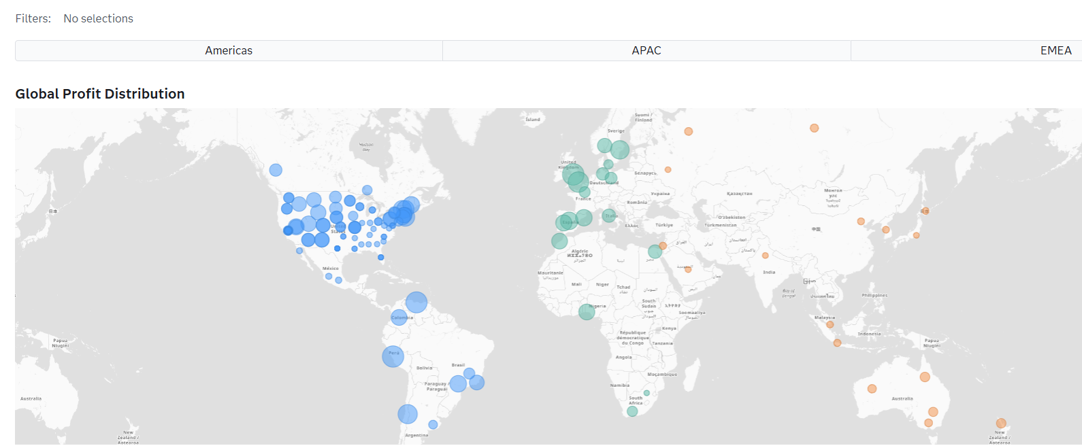
Company Overview (Geographic)
Global toy company with operations across six continents.
Presence in developed and emerging markets creates growth opportunities.
Facility locations help serve customers around the world.

Slide 3
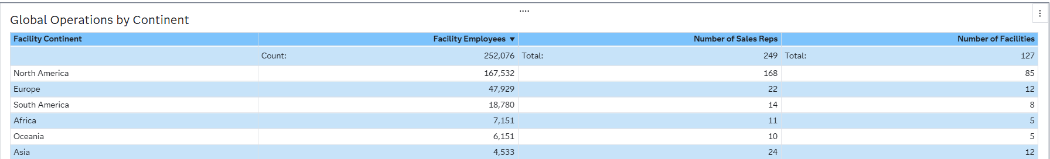
Global Operations by Continent
Opened between 1985-2015
252,076 employees
249 sales reps worldwide
127 facilities globally

Slide 4
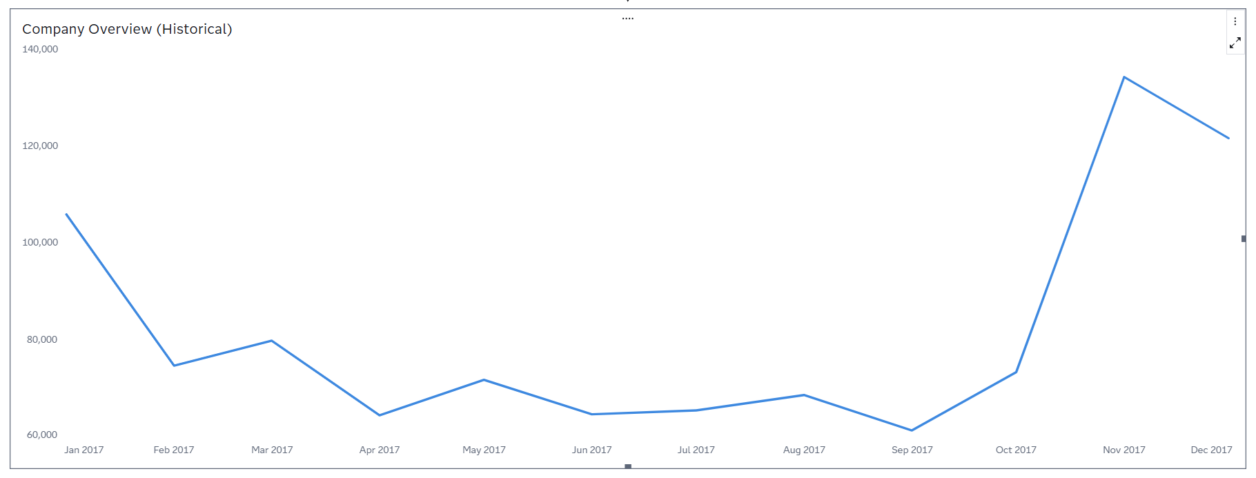
Company Overview (Historical)
Profit starts at $105K in January and declines to a low of $62K in September.
A strong Q4 recovery peaks at $135K in November, indicating higher year-end demand.
The mid-year decline from April to September suggests a consistent seasonal pattern.

Slide 5
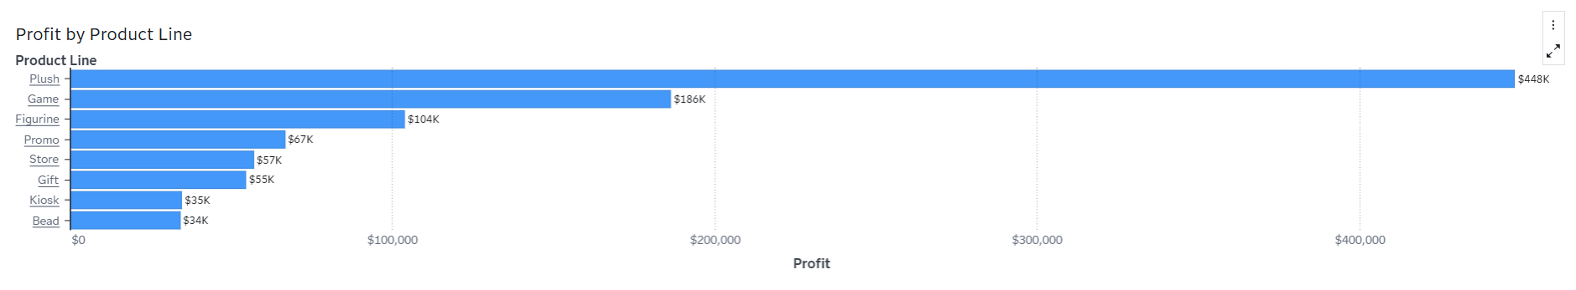
Total Profit by Product Line
Plush generates $448K in profit, nearly 3x more than Game at $186K
Plush, Game, and Figurine together drive over 73% of total profit
Kiosk and Bead each generate about $35K despite Kiosk’s high volume

Slide 6
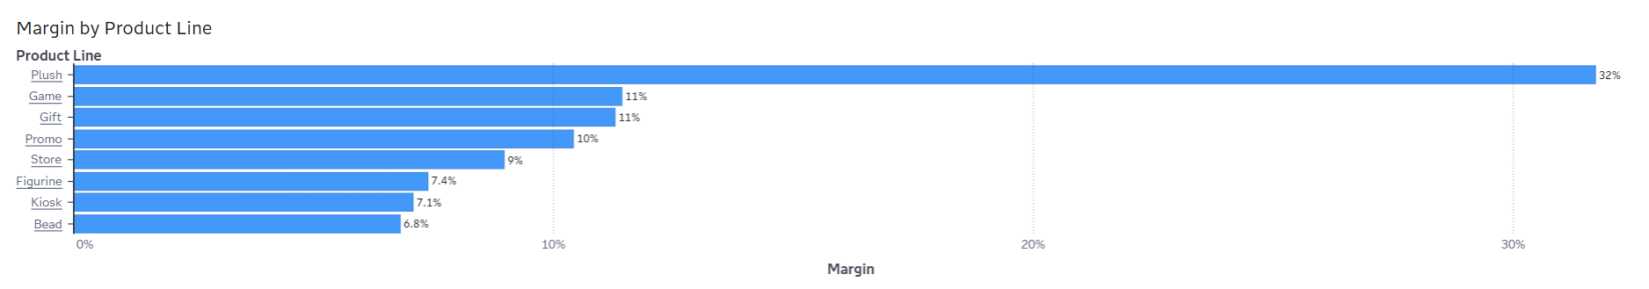
Profit Margin by Product Line
Plush has an exceptional margin of 32%
Most product lines cluster between 7-11% margin
Kiosk and Bead have the lowest margins

Slide 7
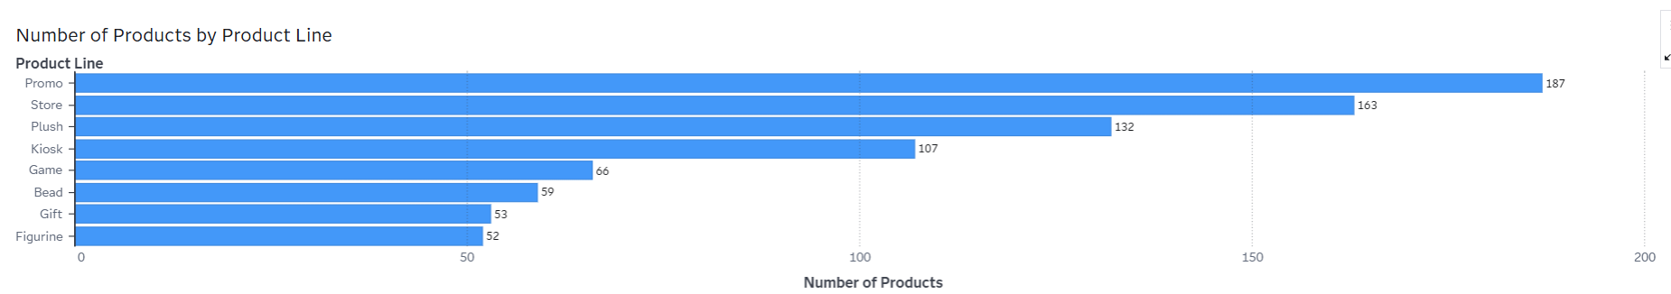
Number of Products (by Product Line)
Promo and Store carry the largest product ranges (187 and 163 products)
Figurine and Gift have the smallest product ranges (52 and 53 products)

Slide 8
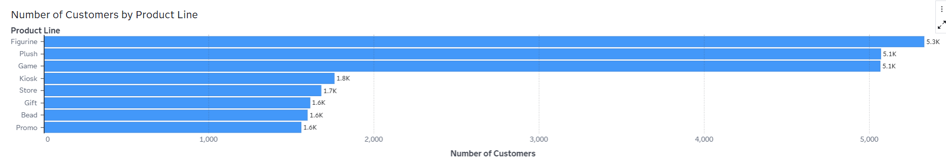
Number of Customers by Product Line
Figurine, Plush and Game have the largest customer bases
There is a significant drop after the top 3
Promo has the fewest customers despite carrying the most products

Slide 9
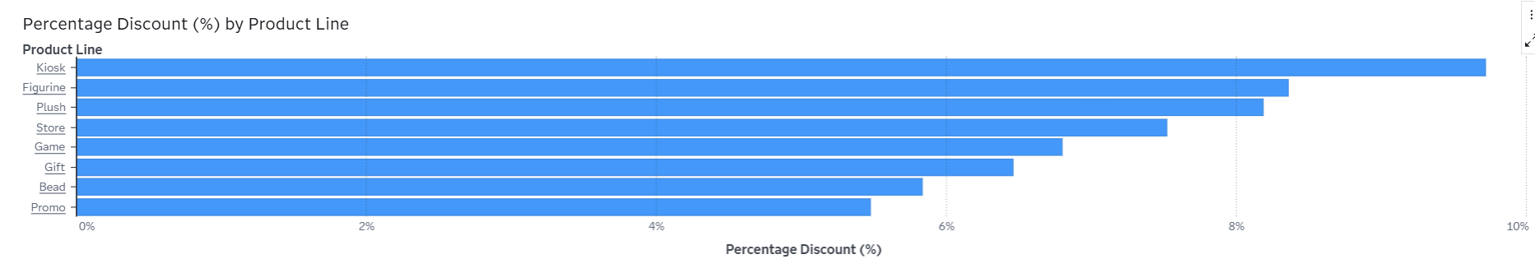
Discount Percentage by Product Line
Kiosk has the highest discount (10%) but low profit ($35K)
Promo has the lowest discount (5.5%) and the fewest customers
Discounts are consistent across all product lines (5.5%–10%)

Slide 10
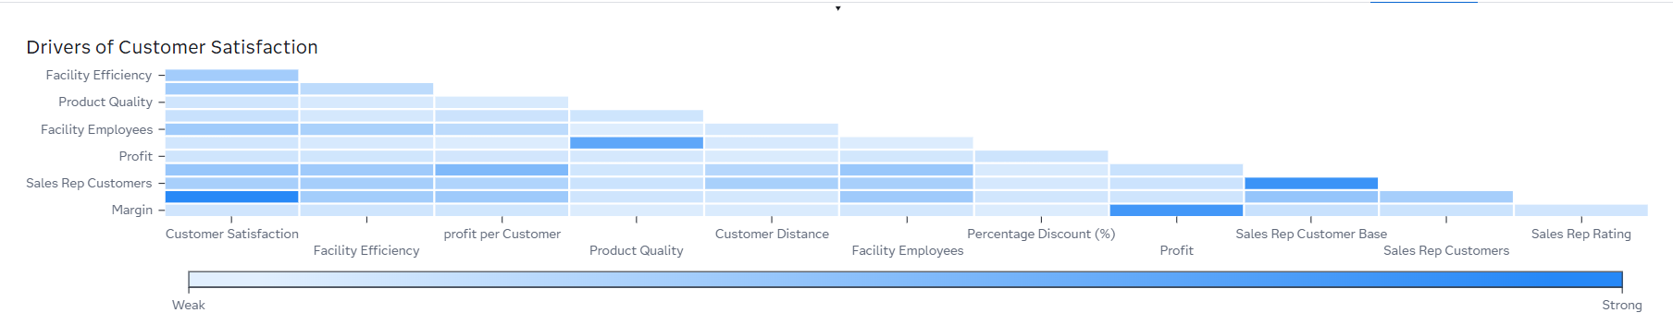
Drivers of Customer Satisfaction
Sales Rep Rating is the strongest driver of customer satisfaction across products and regions.
Sales Rep Customers shows a moderate link, suggesting larger customer loads may lower satisfaction.
Product quality, facility efficiency, and discounts show weak links to customer satisfaction.

Slide 11
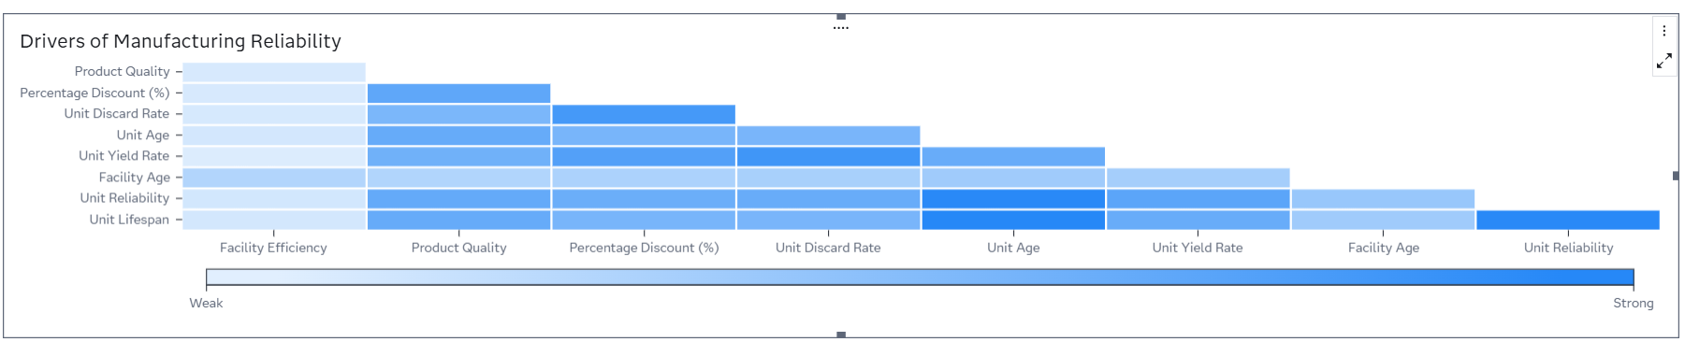
Drivers of Manufacturing Reliability
Unit Lifespan has the strongest link to reliability; units near end of life should be replaced first.
Unit Age and Yield Rate also strongly affect reliability; older, lower performing units drive inefficiency.
Discounts correlate with discard rate and age, suggesting reactive pricing tied to poor performance.

Slide 12
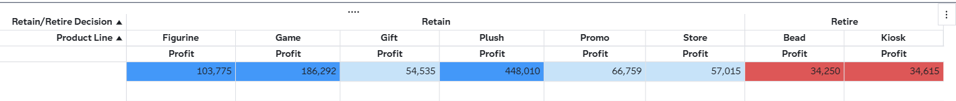
Product Lines to Retain
Plush, Game, and Figurine exceed $100K and should be retained
Promo, Store, and Gift should be monitored
Kiosk and Bead fall below $50K and should be retired

Slide 13
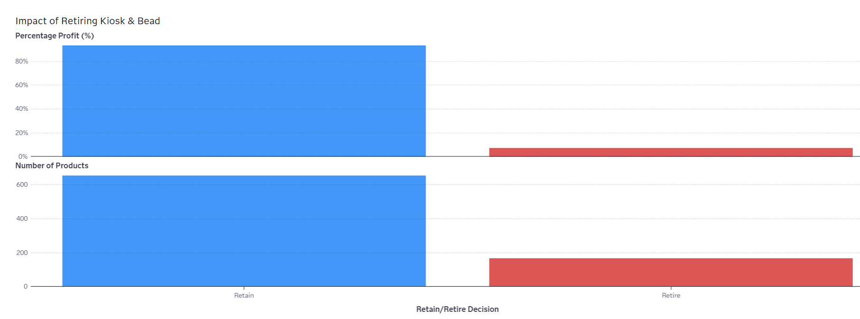
Impact of Simplification
Retiring Kiosk and Bead retains 93% of total profit
Portfolio reduced by 20% with 166 products eliminated

Slide 14
Key insights
Plush drives $448K profit (32%), nearly 3x Game, from only 13% of products, making it the top investment opportunity
Sales Rep Rating is the strongest driver of customer satisfaction, which remains below 52% despite high quality and reliability
Figurine has 5,300 customers but only $104K profit, indicating pricing upside
Kiosk sells 80K+ items but only $35K profit with the highest discount (10%)
Retiring Kiosk and Bead cuts 166 products (20%) while keeping 93% of profit
The Americas dominate with 85 facilities, while EMEA and APAC offer growth potential

Slide 15
Thank you!

