Slide 1

Ethereum Experiencing --build a pet shop with truffle
BoB Jiang
HiBlock blockchain developer community

Slide 2
Agenda
Introduce Ethereum
Prepare Developer Environment
Create project
Program your first smart contract with solidity
Compile and migrate your contract with truffle
User Interface (UI)

Slide 3
What is Ethereum
Ethereum is a decentralized platform that runs smart contracts: applications that run exactly as programmed without any possibility of downtime, censorship, fraud or third-party interference.
On traditional server architectures, every application has to set up its own servers that run their own code in isolated silos, making sharing of data hard. If a single app is compromised or goes offline, many users and other apps are affected. (E.g Lazada)
On a blockchain, anyone can set up a node that replicates the necessary data for all nodes to reach an agreement and be compensated by users and app developers. This allows user data to remain private and apps to be decentralized like the Internet was supposed to work.

Slide 4
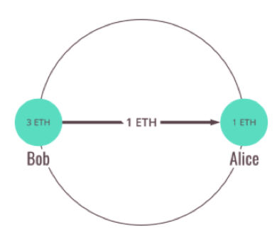
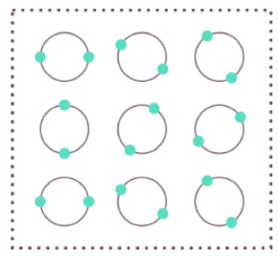
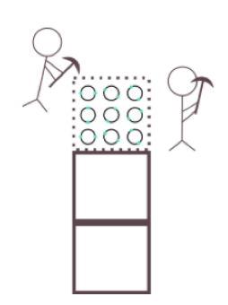

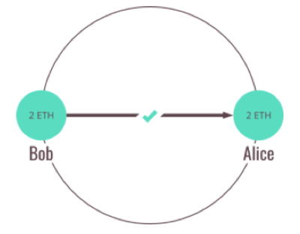

Blockchain basis
NODE
P2P
NETWORK
P2P
… more ethereum nodes

Slide 5
What is Ethereum Virtual Machine
The Ethereum Virtual Machine or EVM is the runtime environment for smart contracts in Ethereum.
Accounts
Transactions
Gas
https://solidity.readthedocs.io/en/v0.4.23/introduction-to-smart-contracts.html#overview

Slide 6
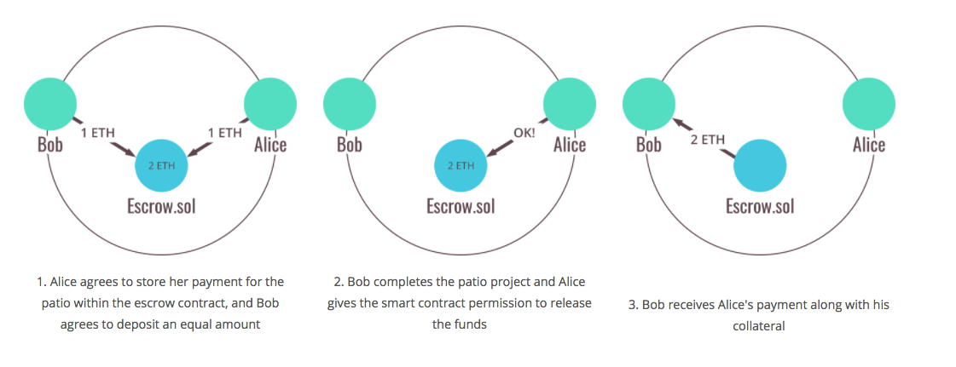
What is Smart Contract

Slide 7
Let’s do IT

Slide 8
Agenda
Introduce Ethereum
Prepare Developer Environment
Create project
Program your first smart contract with solidity
Compile and migrate your contract with truffle
User Interface (UI)

Slide 9
Context
BoB would like to hold a pet shop for adopting pets. The shop has only 16 pets at this time, and they are already there. As an initial PoC, BoB wants to see a dapp which associates an Ethereum address with a pet to be adopted.
In this example, website structure will be supplied, so we will focus on program our smart contract and front-end logic.
Our focus: smart contract with solidity, and interact with smart contract with web3

Slide 10
Developer environment
Node.js 6+ with npm (bundled)
Git
Compile/migrate(deploy): truffle
Ethereum private(test) chain: ganache
http://truffleframework.com/ganache

Slide 11
Create project
Truffle box - http://truffleframework.com/boxes
truffle unbox pet-shop
truffle init

Slide 12
Program & Compile & Deploy
Compile
Deploy
Smart Contract
.json
bytecode or
ABI…
Ethereum;
Address of contract
Font-end
web3 provider
initiate
call function
https://github.com/ethereum/wiki/wiki/JavaScript-API#web3setprovider

Slide 13
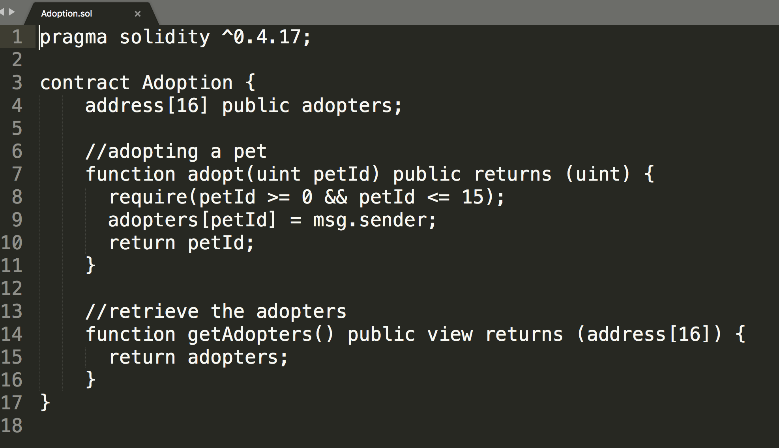

Slide 14
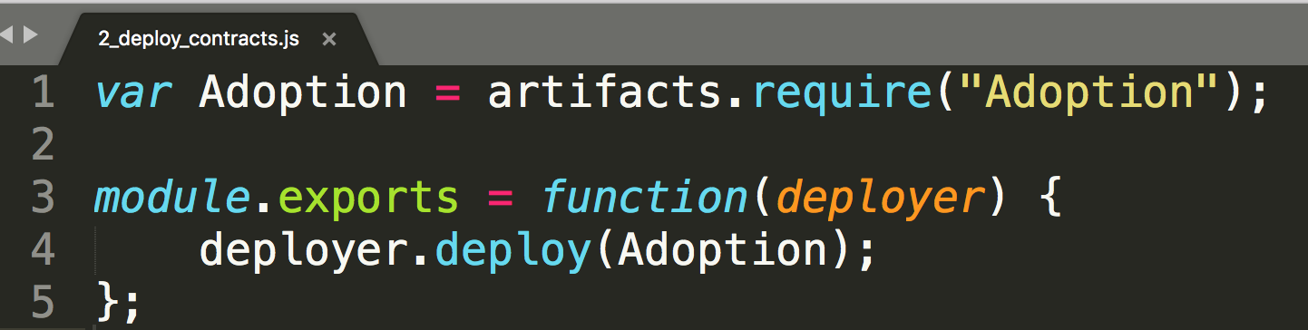
Compile & Migrate
truffle compile
prepare migration script -
truffle migrate

Slide 15
UI
init
initWeb3
initContract
markAdopted
handleAdopt
https://github.com/ethereum/web3.js/

Slide 16
Solidity basic

Slide 17
Structure of a Contract
Contracts in Solidity are similar to classes in object-oriented languages.
Each contract can contain declarations of
State Variables,
Functions,
Function Modifiers,
Events,
Struct Types and
Enum Types.
Furthermore, contracts can inherit from other contracts.Furthermore, contracts can inherit from other contracts.

Slide 18
Types
Value Types
Booleans
Integers
Fixed point Numbers
Address
Fixed-size byte arrays
Dynamically-sized byte arrays
string
Reference Types
Data location (storage, memory, calldata)
Arrays
Members
Structs
Mappings
mapping(_KeyType => _ValueType)

Slide 19
Function Types of solidity
Functions can be specified as being external, public, internal or private, where the default is public. For state variables, external is not possible and the default is internal.
external: External functions are part of the contract interface, which means they can be called from other contracts and via transactions. An external function f cannot be called internally (i.e. f() does not work, but this.f() works). External functions are sometimes more efficient when they receive large arrays of data.
public: Public functions are part of the contract interface and can be either called internally or via messages. For public state variables, an automatic getter function (see below) is generated.
internal: Those functions and state variables can only be accessed internally (i.e. from within the current contract or contracts deriving from it), without using this.
private: Private functions and state variables are only visible for the contract they are defined in and not in derived contracts.

Slide 20
References
https://solidity.readthedocs.io/
http://truffleframework.com/tutorials/ethereum-overview
http://truffleframework.com/tutorials/pet-shop
https://github.com/etherchina/ethereum (source code)
https://github.com/HiBlock/ethereum-public-course (public course slides)

Slide 21
HiBlock区块链社区
开放 / 协作 / 透明 / 链接 / 分享
链接全球区块链开发者
https://hiblock.net/wiki/about

Slide 22
Contact me:
slides will be shared in telegram group:
https://t.me/hiblock
twitter: https://twitter.com/HiBlock_Net
Thanks!
Notes:
在 “幻灯片放映”模式，单击箭头进入 PowerPoint 入门中心。

Slide 23
Easter Egg 1
Assignment
https://github.com/Olympus-Labs/community
By 5/15/2018
Each complete the assignment, will win 20 MOT
code
test pass
pull request
leave your ether wallet address, e.g AlphaWallet
Best one will win 200 MOT

Slide 24

Easter Egg 2

