Slide 1
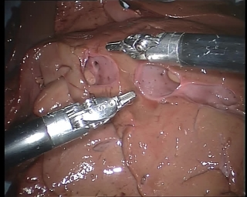
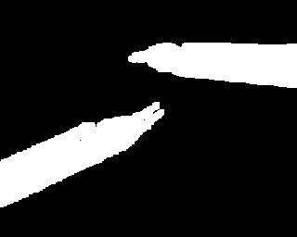
Image-based segmentation and localization of surgical instruments using deep neural networks
Amelie Wagner
bachelor thesis presentation
Notes:
- Amelie Wagner
- Present my bachelor thesis: Image-based segmentation and localization of surgical instruments using deep neural networks
- The MOTIVATION for my work:

Slide 2
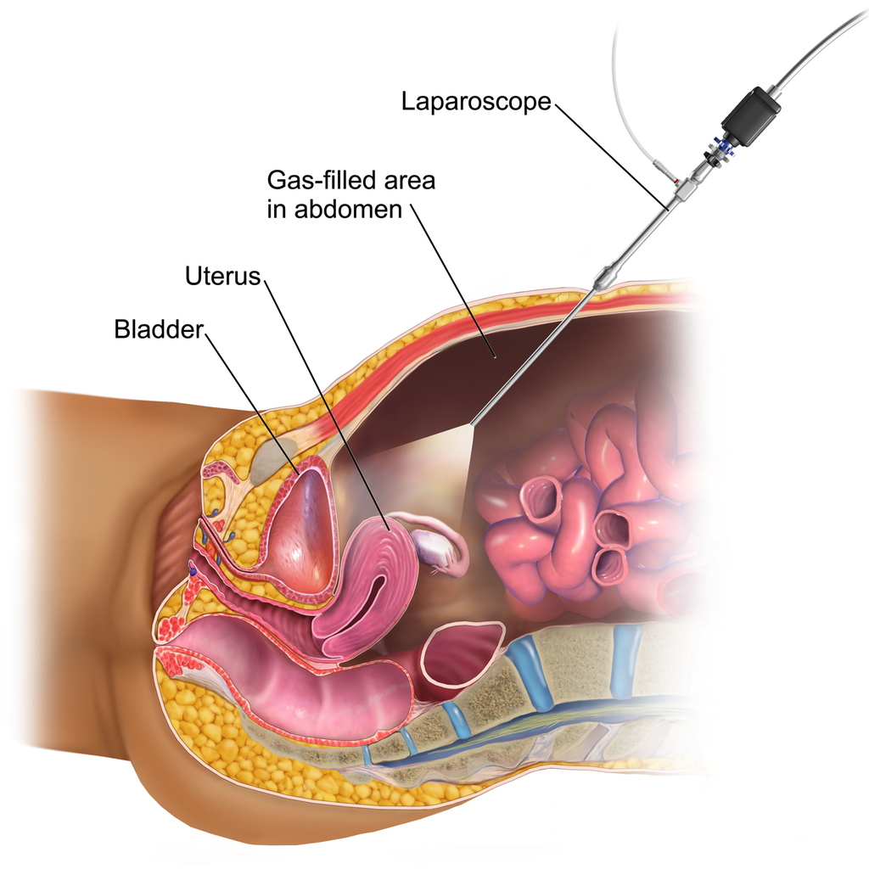
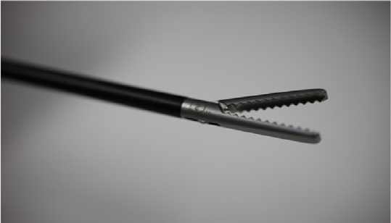
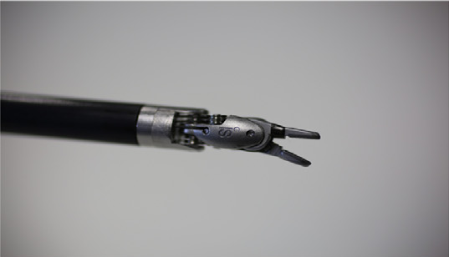
Motivation
Minimally Invasive Surgery (MIS)
Laparoscopic Instruments
[4]
[5]
1
Notes:
MOTIVATION: support MIS: is specific kind of surgery, laparoscopic instr., endoscope
- MIS > conventional open surgical approach: recovery time of patient, shorter hospital stay
- field of view reduced – surgeon only has camera – harder estimate position
GOAL: gain position of cp surgical instruments.
Useful for:
- surgeon can be warned: instrument is near critical structure.
- surgery evaluated: position of instruments is known

Slide 3


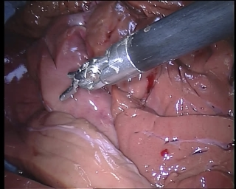


Overview
Segmentation
Localization
2
Notes:
TASK OVERVIEW (deep learning part):
Segmentation & Localization:
- segm: divide instr & background
- localiz: gaussian distribution around center point
→ METHOD

Slide 4
Methods
3
Notes:
Propose deep learning method: CNN

Slide 5
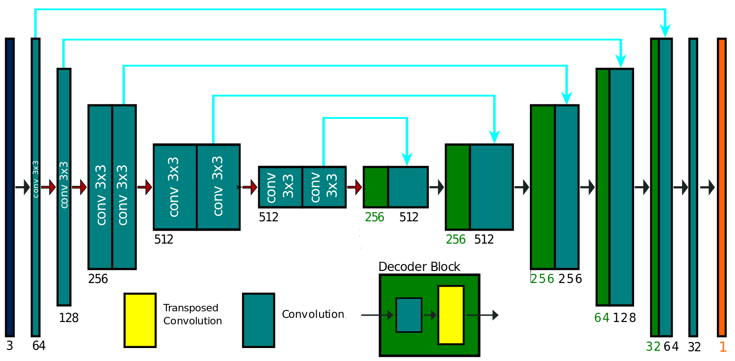
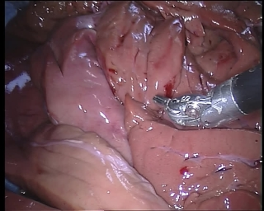

Method: Segmentation Network TernausNet-11 [1]
Network Input:
Output
Segmentation:
4
Notes:
My main method is based on this network:
Solves segmentation task:
- network by Shvets et al.
INPUT → PREDICTS SEGMENTATION ONLY
- based on the commonly known UNet
- structure:
- typical CNN: encoder – decoder phase,
- 3x3 convolutions ,
- skip connections -> blue arrows

Slide 6
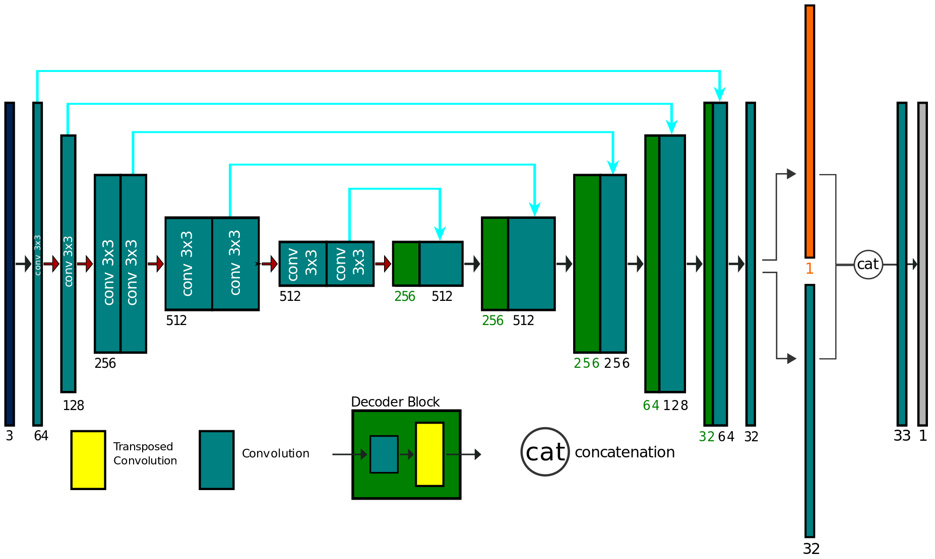

Method: Localization Network [7]
Output
Segmentation:
Output
Localization:
Network Input:
[7]
[7]
5
Notes:
This is the main method of my work:
- has 3 more layers than the segmentation network.
Localization CNN: INPUT -> predicts SEGM and LOCALITATION
Segmentation: still is given by segm. output layer.
Localization: is given by localization output layer
Idea: Segmentation and Localization tasks share weights over network → information of segm.for improving localization
- approach: Laina et al.
→ LOSS

Slide 7
Concurrent Segmentation and Localization
Segmentation + Localization: Combined Loss
6
Notes:
→ combined loss function.
Input: y_seg is network output for segm.layer
t_seg is gt for input to segm
y_loc is network output of loc_layer
t_loc is gt for input of y_loc
Factor gamma: scale impact of segm / localization part
Here you can see:
Segm loss = actually a binary cross entropy loss combined with a jaccard loss
Localiz. Loss = Mean squared error loss
→ POINT OUT OF HEATMAP

Slide 8


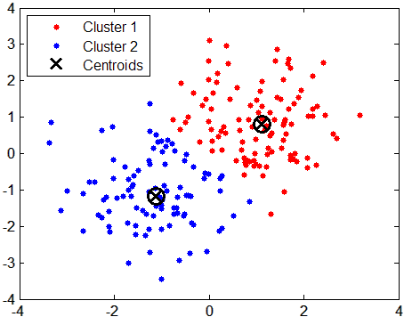

Method: Localization Network
Output Localization:
weighted k-means, k=1
[8]
weighted k-means, k=2
7
Notes:
Network predicts heatmap.
- how get instrument position out of heatmap?
using k-means algorithm.
Clustering algorithm: given number of clusters as *k*, calculates CENTERPOINTS of each cluster according to the DISTANCE of each point
Weighted: pixel value of each point is included to find cluster center
Result: get coordinates of instrument cp

Slide 9
Data
8
Notes:
Now I will propose the data used for training and testing the network models.

Slide 10
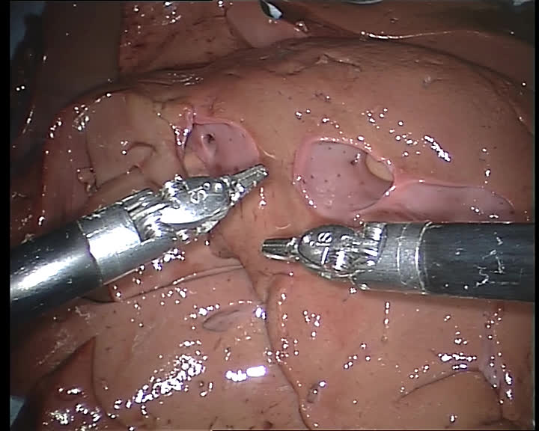
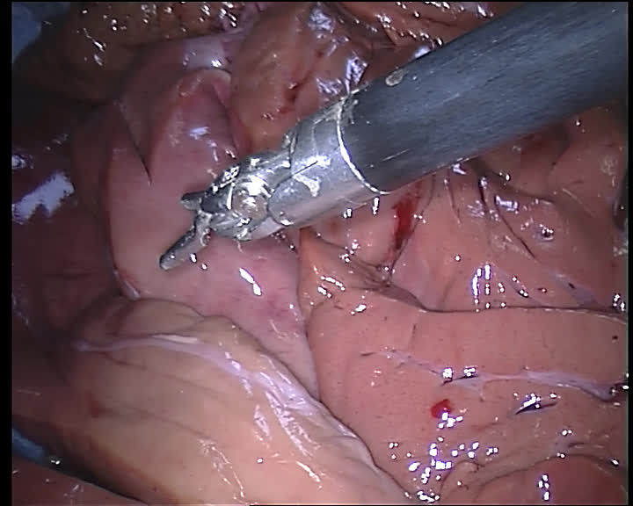
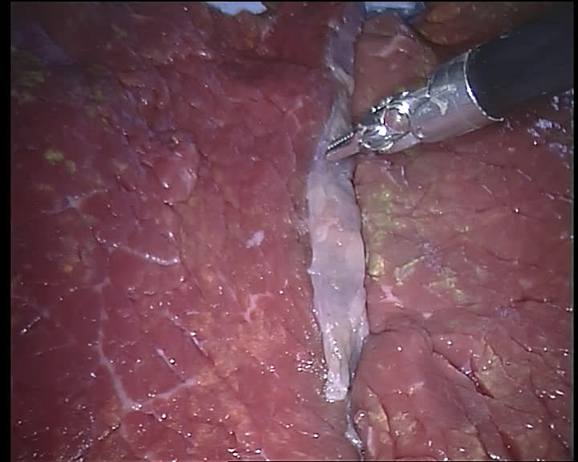
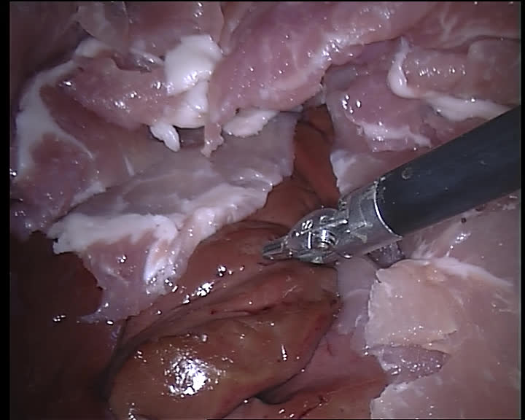
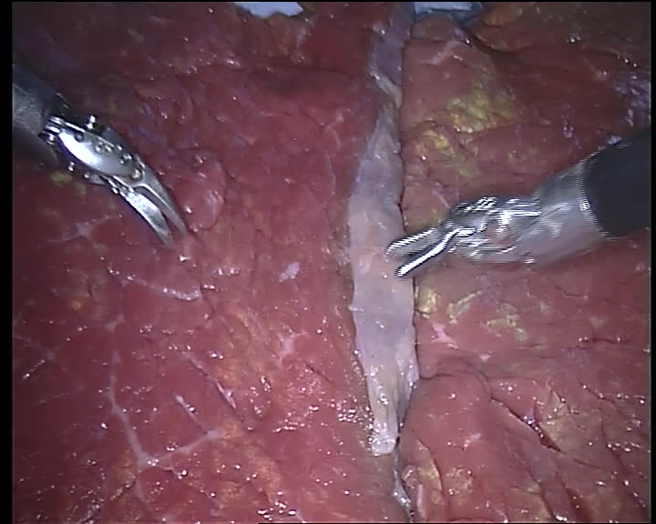
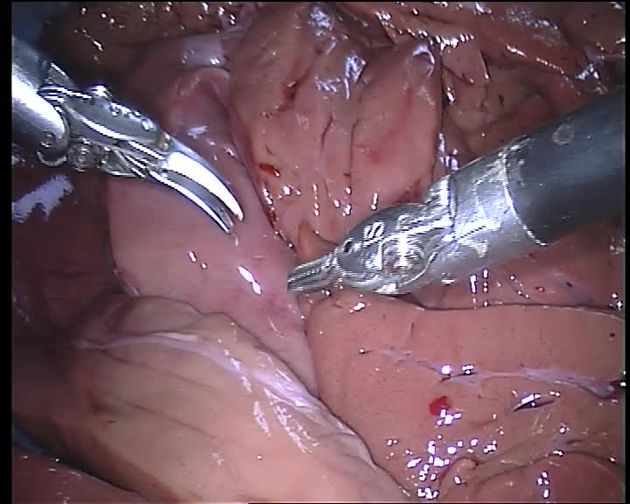
Data: Endoscopic Vision Challenge 2015 [2]
4 Training Datasets
2 Testing Datasets
8
Notes:
Endoscopic Vision challenge 2015:
4 Training sets, 2 Test sets
- robotic instruments acquired from davinci surgical system
- surgery performed: ex-vivo, means that the pictures are taken in artificial environment (not actual body of a person or an animal)
- notably: first dataset contains 2 instruments,
Testsets contain 2 instruments
→ GROUND TRUTH

Slide 11
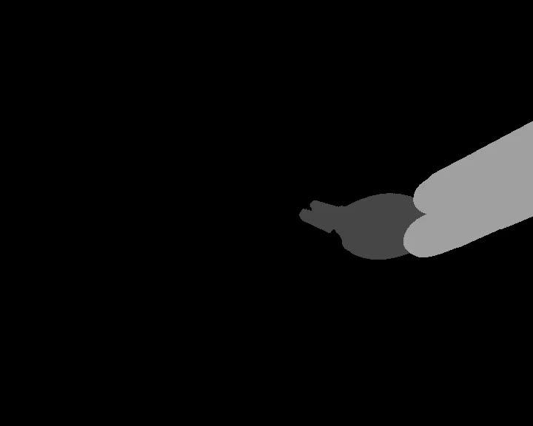
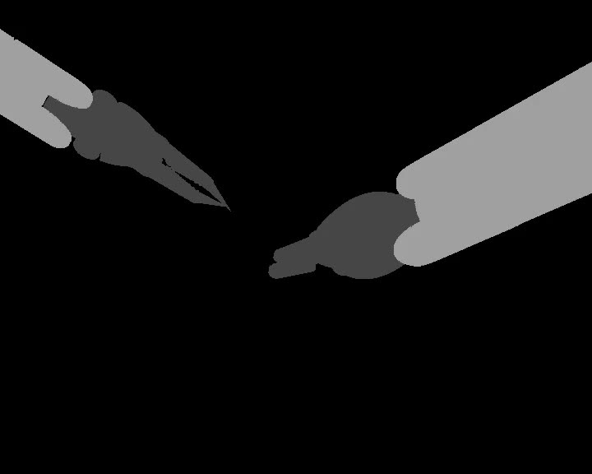

Data: Endoscopic Vision Challenge 2015 [2]
Ground Truth Segmentation
Ground Truth Localization
9
Notes:
- EndoVis15: ground truth data:
-segmentation is given in greyscale masks
- every instrument part is highlighted in other color
Ground truth for localization coordinates of instrument position in image: stored in a textfile

Slide 12
Data Preparation
10
Notes:
For training and testing, necessary to prepare the given data

Slide 13
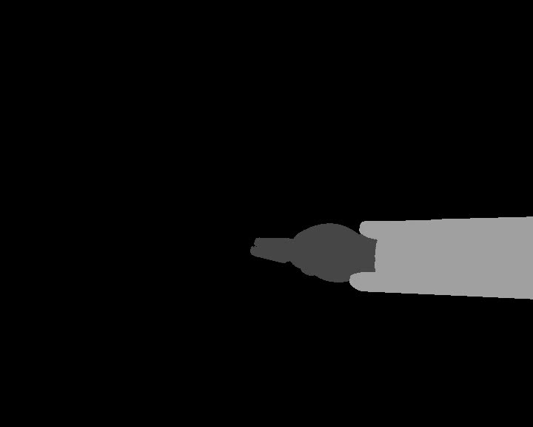


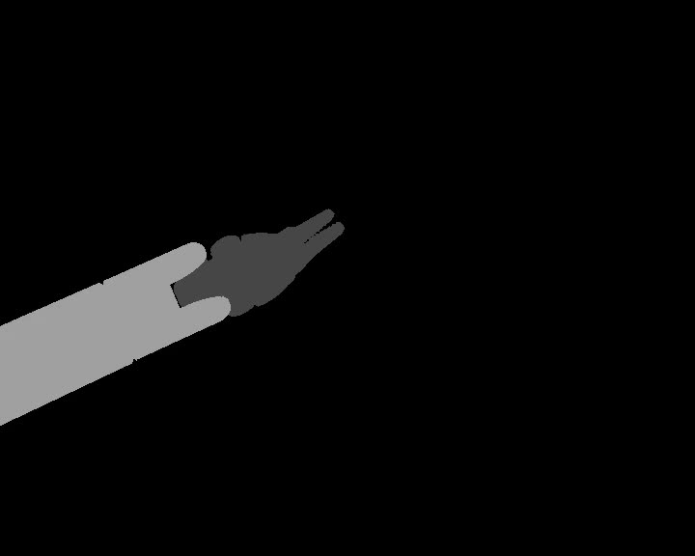
Data Preparation: EndoVis15 [2]
Network Input
Ground Truth Segmentation
320×265 px
720×576 px
11
Notes:
Following steps:
Network input:
- dimension reduced to 320 by 256 to increase training time
Segmentation Ground truth:
- when there are two instruments visible at the same time: merge mask with 2 instruments
- conversion from greyscale to binary mask

Slide 14


Data Preparation: Localization EndoVis15 [2]
Instrument
Right
Instrument
Left
Instrument
12
Notes:
localization ground truth preparation:
Take the provided textfile with instr. Center point position.
Apply 2-dimensional gaussian function → Resulting heatmap (with gaussian distr. around center point) is used for training the network for loc. task
When two instruments are visible at the same time:
Same procedure, centerpoint distributions are merged into one heatmap.
→ Instruments aren’t distinguished by the network
This approach: originally proposed by Laina et al.

Slide 15
Results
cross-validation
testsets
13
Notes:
Show results achieved with the proposed method.
- ONLY localization results: focus on localiz.
Segmentation as basis for localization
! Two kinds of evaluation methods:
First, cross-validation with the 4 training datasets - Where one of the four trainingsets was used as test set each time.
Second eva method: trained model on all training sets, tested on each test set

Slide 16
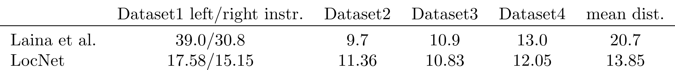
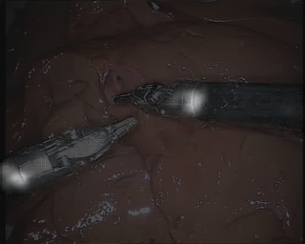
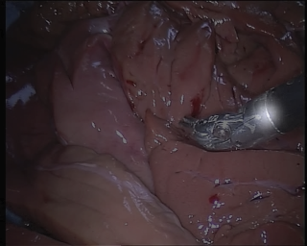
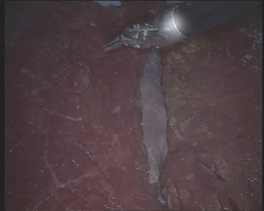
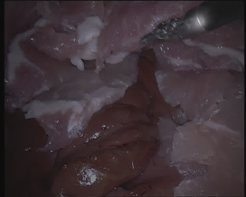
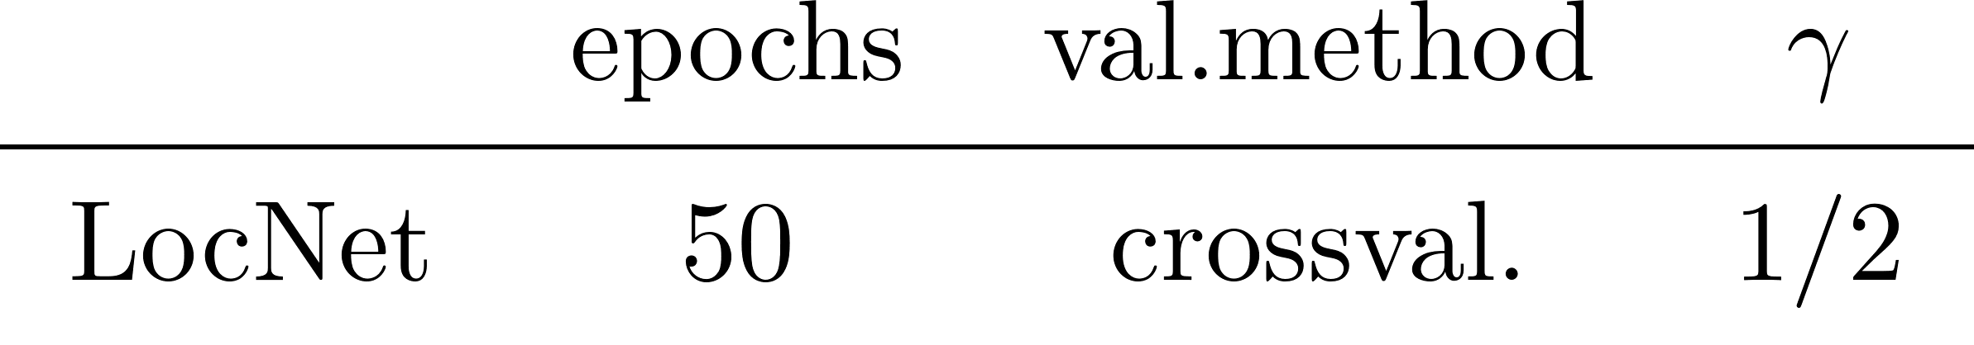
Results Cross Validation
14
Notes:
Results cross val:
Comparison between state of the art and my method: results Laina et al, my method LocNet
LocNet > model Laina et al
These are 4 example predictions of the network, put them on the corresponding input image
training conditions for my model:
50 epochs, loss factor gamma ½
(reminder: regulates impact of segmentation and localization loss. In this case: both same impact

Slide 17
Results Cross Validation
15
Notes:
Results cross val:
Trained different models, third model achieves best performance.
These are 4 example predictions of the network, put them on the corresponding input image

Slide 18
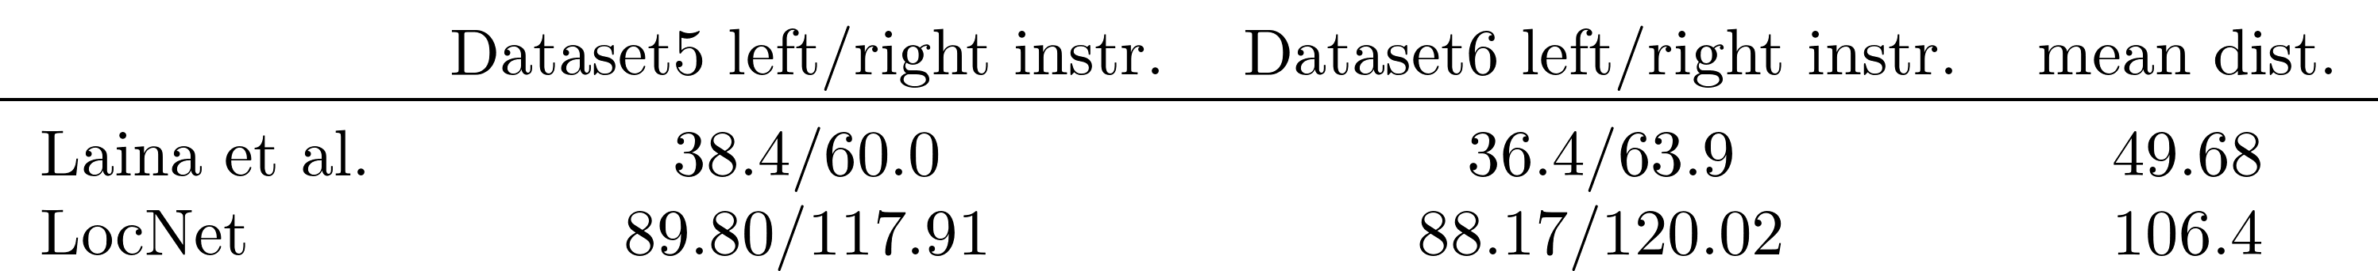
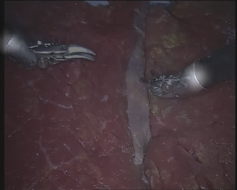
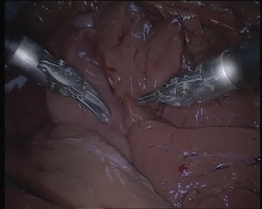
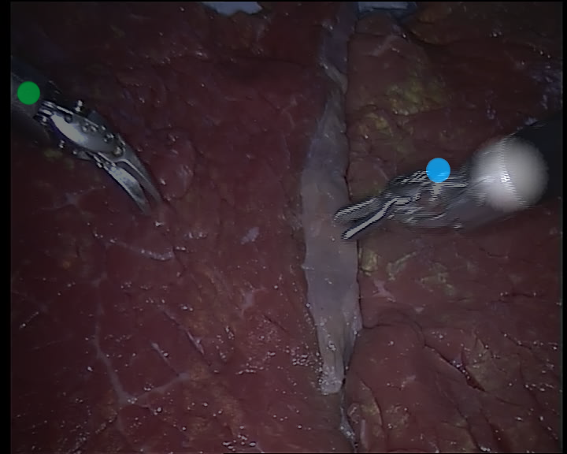
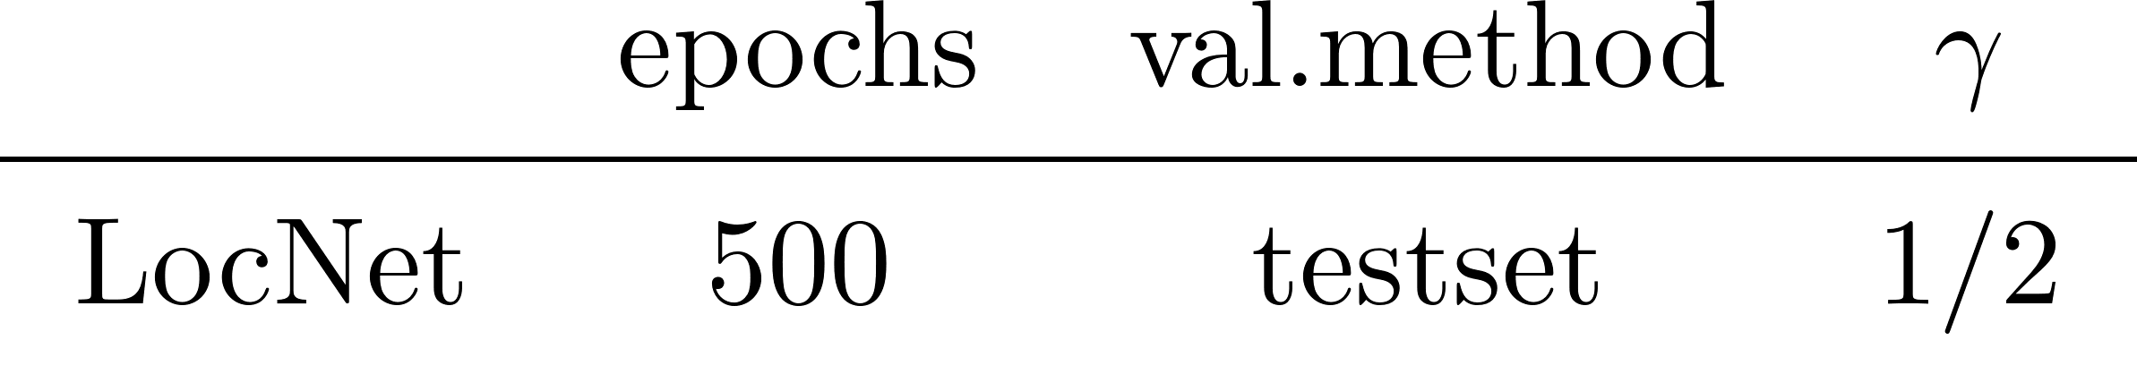
Results Testsets
16
Notes:
Results testsets:
→ model Laina et al > LocNet
- two example pictures of the prediction of the model.
- ! CONDITIONS of my best model
-> 2 things are interesting:
- ground truth is probably not correct → green, blue: gt
- K-MEANS doesn’t work well on this dataset

Slide 19
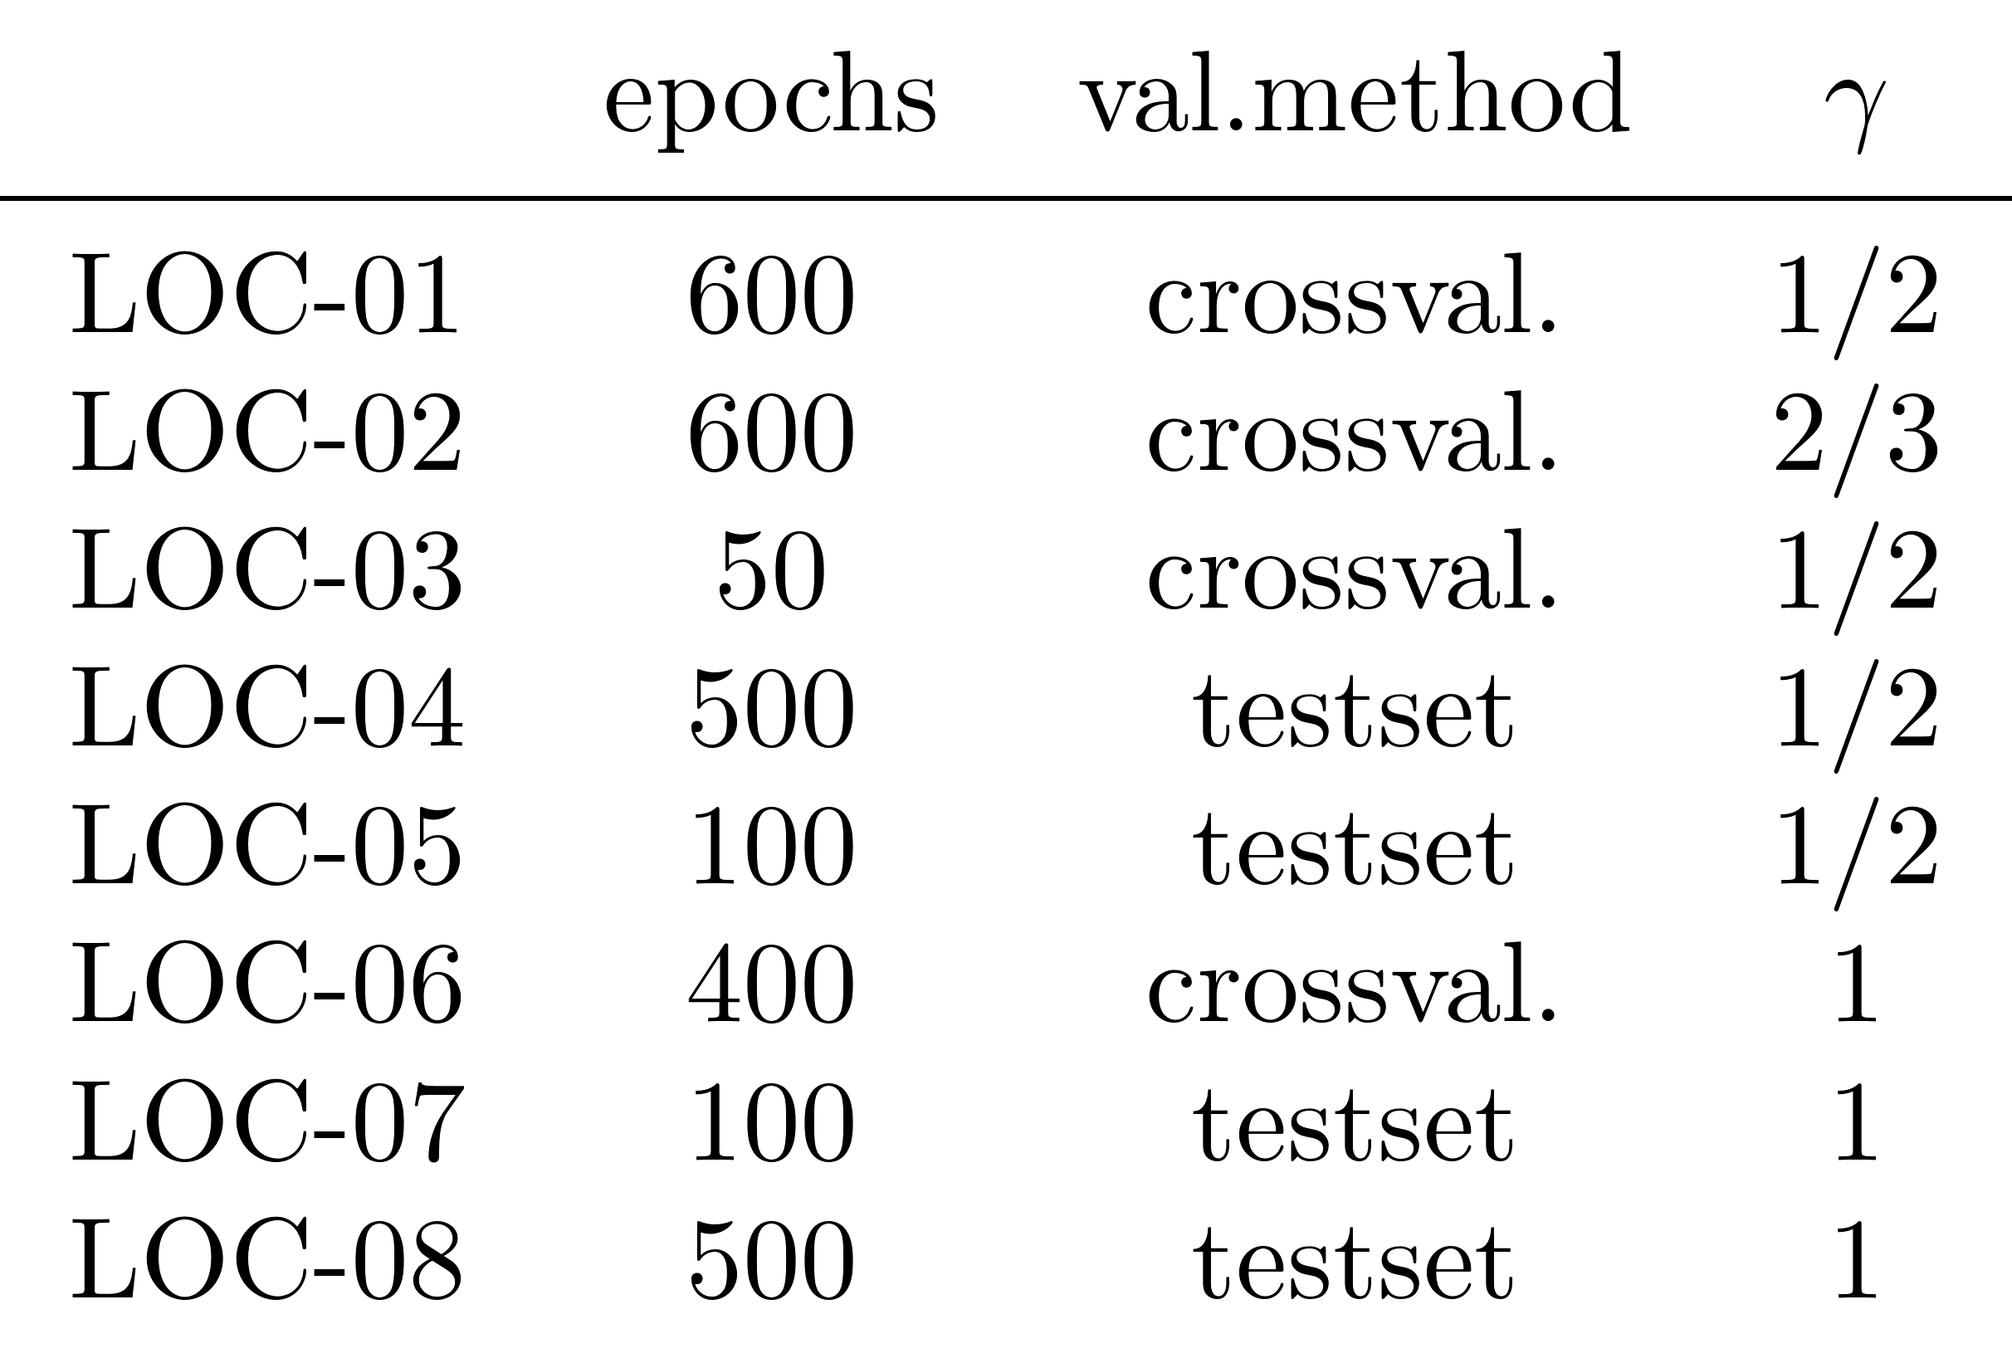
Evaluation Conditions
17
Notes:
Short overview over evaluation conditions:
3.model, 4. model give the best results → when gamma is ½
- means when segmentation and localization loss have exactly the same impact -
Seems to be good value for training.
For crossval.50 epochs sufficient → many epochs not necessary

Slide 20
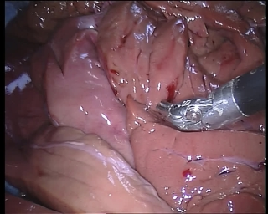
Conclusion
CNN
k-means
18
Notes:
In conclusion:
In my work, propose method:
Prediction segmentation and localization of instrument with CNN
Afterwards: extracting the instrument centerpoint with k-means.

Slide 21
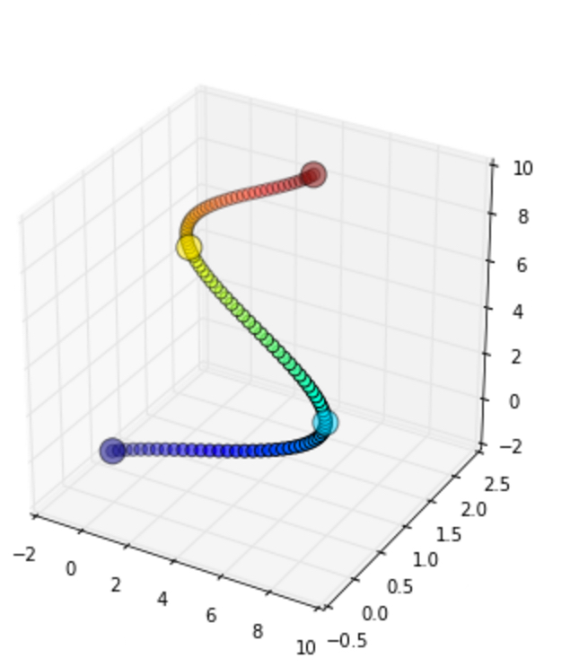

Future Work
y
z
x
[9]
19
Notes:
Future work:
TWODIMENSIONAL endosc. camera:
- model predicts: cp x2
- calculate 3d position
- information as input for tracking filter: Kalman
→ good evaluation method for surgeon
→ THAT WAS presenatation of my BA..

Slide 22
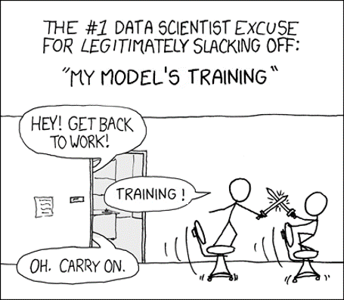
Thank you for your attention.
[6]
20
Notes:
This was the presentation of my bachelor thesis, I hope you enjoyed it.
Thank you for your attention.
…
(sources)

Slide 23
Sources
[1] A. Shvets, A. Rakhlin, A. A. Kalinin, and V. Iglovikov, “Automatic Instrument
Segmentation in Robot-Assisted Surgery Using Deep Learning”
[2] “MICCAI Endoscopic Vision Challenge: Subchallenge Instrument Segmentation and
Tracking,” https://endovissub-instrument.grand-challenge.org/, accessed: 2018-09-15
[3] “MICCAI Endoscopic Vision Challenge: Subchallenge Robotic Instrument Segmen-
tation,” https://endovissub2017-roboticinstrumentsegmentation.grand-challenge.org,
accessed: 2018-09-15
[4] S. Blausen, “Medical gallery of Blausen Medical 2014,” WikiJournal of Medicine, 2014
[5] D. Bouget, M. Allan, D. Stoyanov, and P. Jannin, “Vision-based and marker-less
surgical tool detection and tracking: a review of the literature,” Medical Image
Analysis, 2017
[6] “#1 data scientist excuse slacking off”, https://me.me/i/the-1-data-scientist-excuse-for-legitimately-slacking-off-my-2aa76556da934f79b5818a02e7f23cf9, accessed: 2018-11-20
[7] I. Laina, N. Rieke, C. Rupprecht, J. P. Vizcaı́no, A. Eslami, F. Tombari, and N. Navab,
“Concurrent segmentation and localization for tracking of surgical instruments,” Lecture
Notes in Computer Science (including subseries Lecture Notes in Artificial Intelligence
and Lecture Notes in Bioinformatics), 2017
[8] “k-means example”, http://mines.humanoriented.com/classes/2010/fall/csci568/portfolio_exports/mvoget/cluster/kmeans_diagram.png, accessed: 2018-11-22
[9]”3d trajectory” https://mikeroberts3000.github.io/flashlight/. accessed: 2018-11-23
21

Slide 24
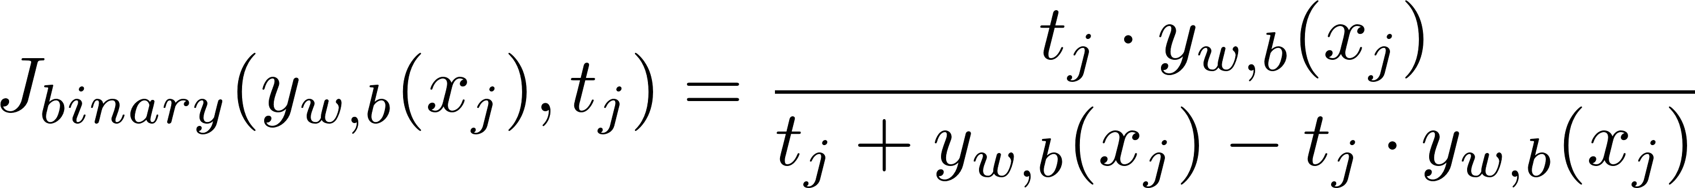
Method: Localization Network
22

Slide 25
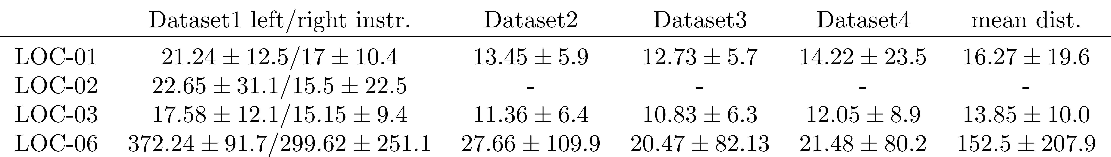
Results Cross Validation
23
Notes:
Results cross val:
Trained different models, third model achieves best performance.
These are 4 example predictions of the network, put them on the corresponding input image

Slide 26
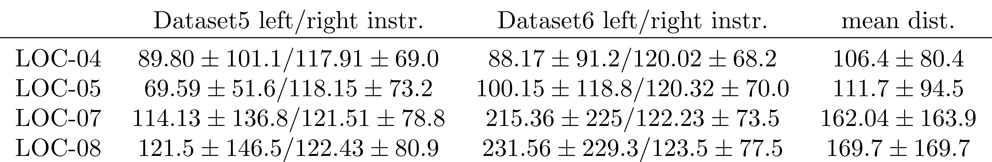
Results Testsets
Notes:
Results testsets:
The first model achieves best results.
These are two example pictures of the prediction of the model.
Notably, the distance values are worse than for the training set but the prediction seems to have the same “quality” → this is probably because the ground truth proposed for these two testsets has errors.
Example frame: blue and green point are the center points according to ground truth,
The white distribution is the prediction of network
→ notably: for left instr, the centerpoint is actually not visible in the image. For right instr, center point is located right from gt notation

Slide 27

Data Preparation: Segmentation EndoVis15 [2]
Ground Truth
Binary Mask
Notes:
- conversion from greyscale to binary mask
- and when there are two instruments visible at the same time: merge mask with 2 instruments
- notably: after conversion to binary image, mask shows white artefacts

Slide 28
Data Preparation: Segmentation EndoVis15 [2]
Ground Truth
Morphology Opening
Downsampling
320×265 px
Notes:
- to reduce the white artefacts: morphology opening is applied
- then mask is downsampled,
At the end has size of 320 by 265 pixels

Slide 29
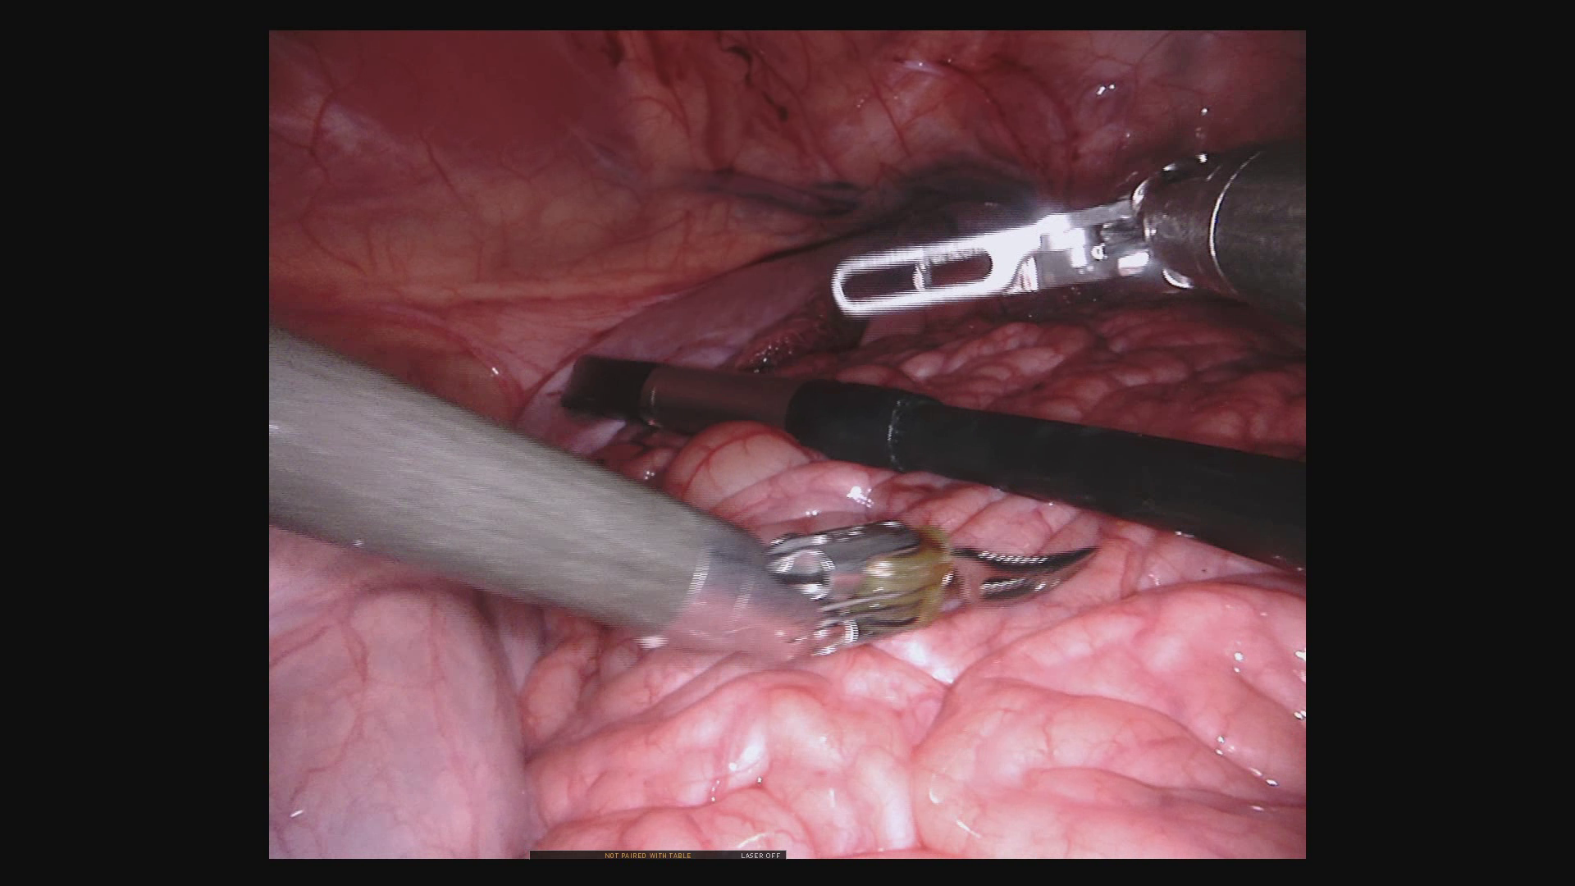
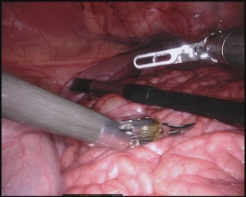
Data Preparation: Segmentation EndoVis17 [3]
Input Images
Cropping
Downsampling
320×265 px
1280×1024 px
Notes:
- input image EndoVis17 preparation:
- cropping black border
- downsample image to increase training time

Slide 30



Data Preparation: Segmentation EndoVis17 [3]
Ground Truth
Cropping
Merging Instruments
Binary Mask
Downsampling
320×265 px
1280×1024 px
Notes:
preparation of ground truth:
-Cropping black borders
- merging the masks of different instruments into one mask
- convert to binary mask
- downsample the mask to 320×265 px

Slide 31
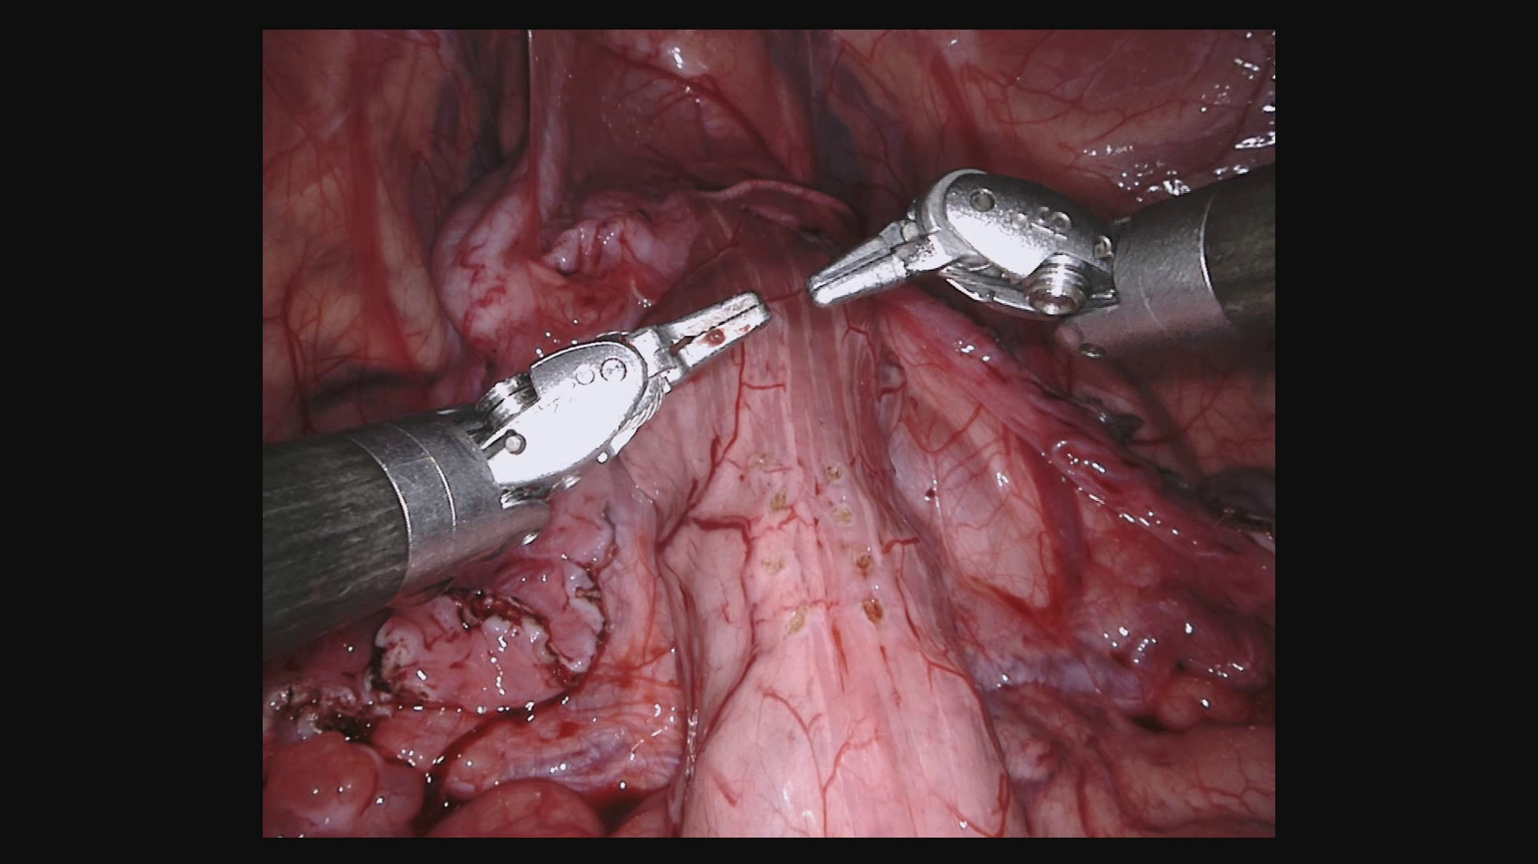
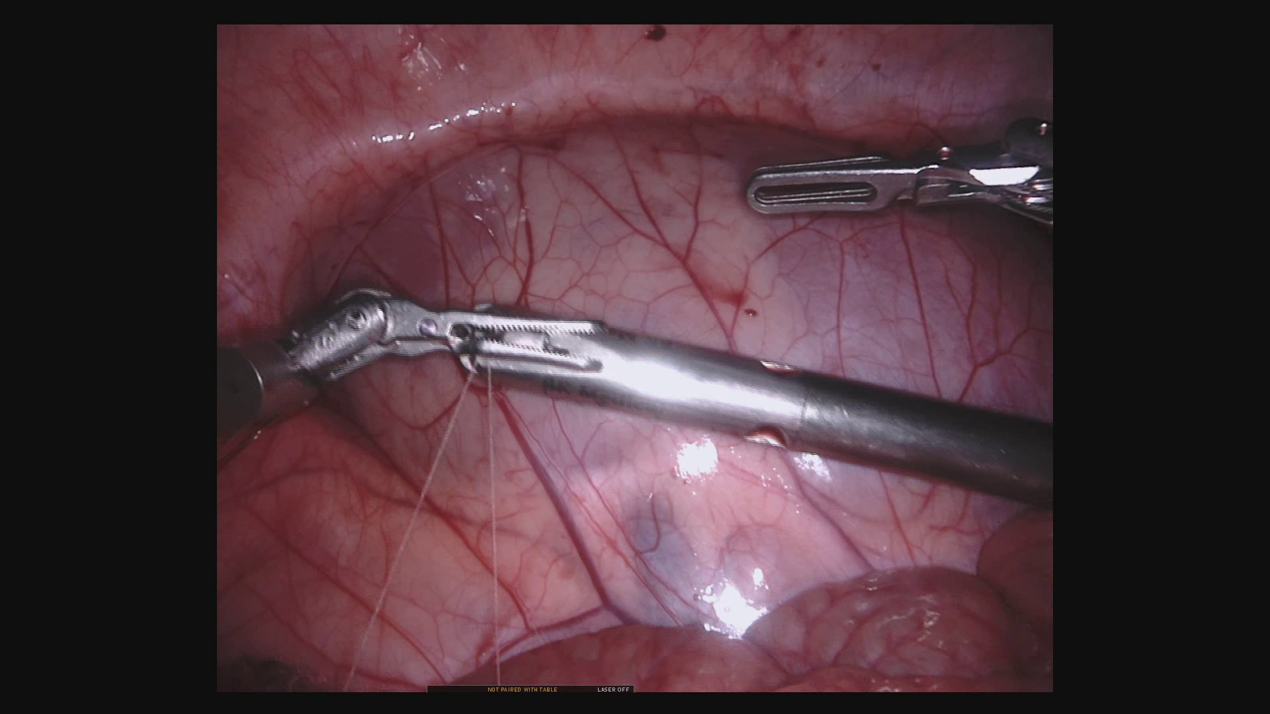
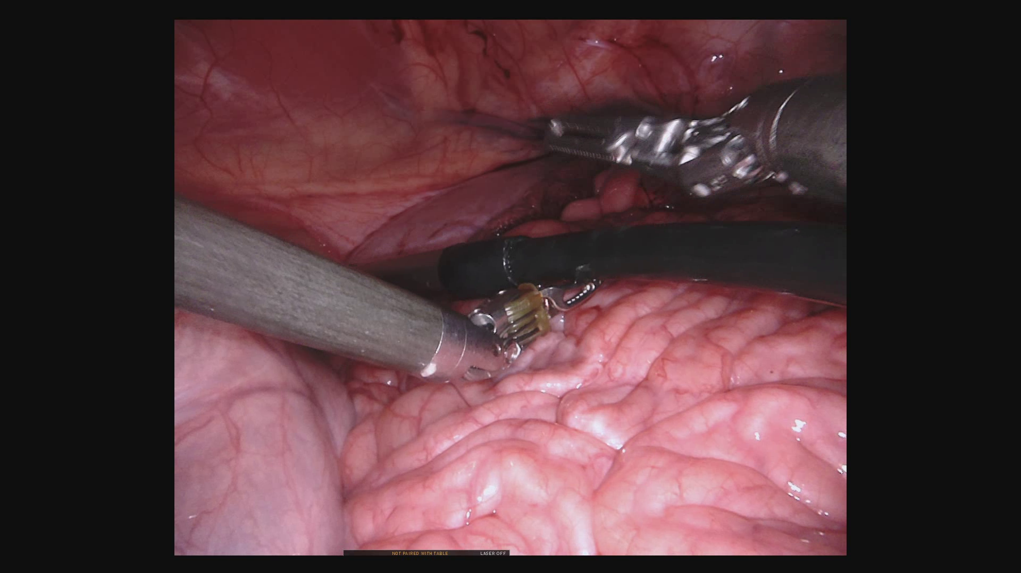
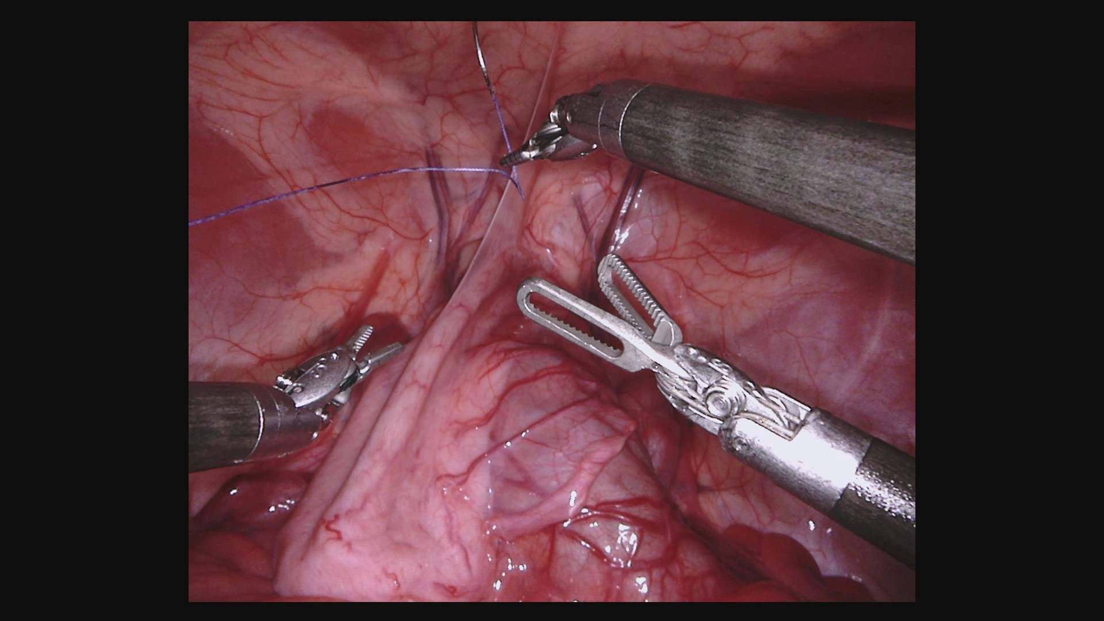
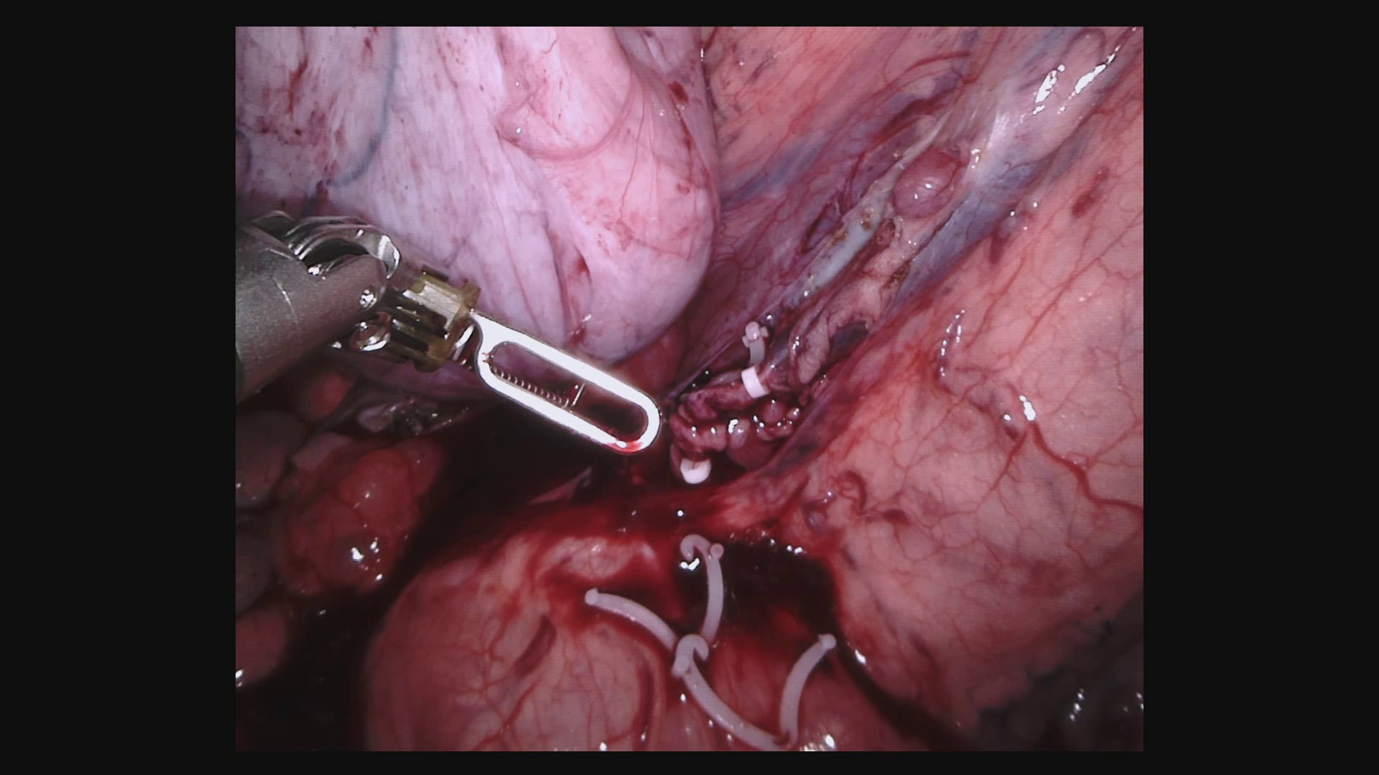
Data: Endoscopic Vision Challenge 2017 [3]
8 Training Datasets, 10 Testing Datasets
...
Notes:
Data for segmentation from Endoscopic Vision Challenge 2017:
- notably, other instruments than in EndoVis15
- in-vivo data: pictures are taken inside of a pig
- from now on: abbreviated as EndoVis17

Slide 32

Data: Endoscopic Vision Challenge 2017 [3]
Ground Truth Segmentation
...
Notes:
- gt as for EndoVis15: segmentation masks
- notably, no gt for localization: localization of instruments no part of this challenge

Slide 33
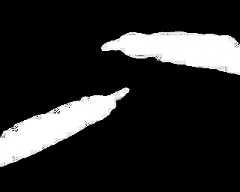
Method: Segmentation Network TernausNet-11 [1]
Network Input:
Output Segmentation:
Ground Truth Segmentation:
Notes:
Vlt unnötig?

Slide 34

Method: Localization Network
Output Segmentation:
Ground Truth Segmentation:
Network Input:
Output Localization:
Ground Truth Localization:
Notes:
Show you: predictions of the network
Given this input image.
This is the pred. for segmentation, with correspond. Gt → output of segmentation layer
This is the pred. for localization, with correspond. Gt → output of localization layer
To train these two tasks: -> network has combined loss function

Slide 35

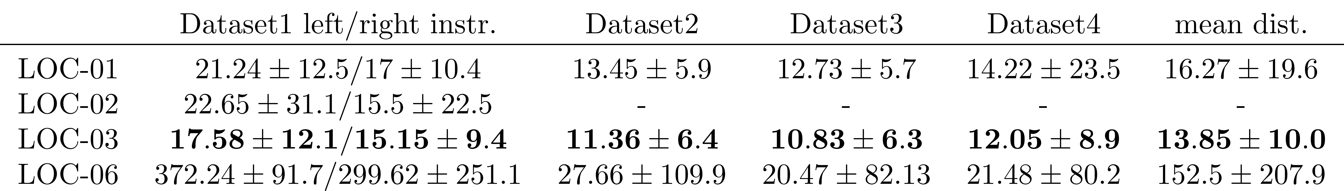
Rests

Slide 36
Satzschrift 1, 20pt
Auszeichnung
Betonung
Satzschrift 2, 16 pt
Auszeichnung
Betonung
Satzschrift 3, 14 pt
Auszeichnung
Betonung
Satzschrift 1, 20pt
Auszeichnung
Betonung
Satzschrift 2, 16 pt
Auszeichnung
Betonung
Satzschrift 3, 14 pt
Auszeichnung
Betonung

