Slide 1

LINEAR REGRESSION MODEL FOR PROPERTY PRICE PREDICTION

Slide 2

AGENDA
Data Processing –Cleaning , Sample statistics, EDA and Insights
Model Creation –Sampling ,Model measures , Best Fit model
Model Comparison
RMSE Calculation
Validating Assumptions
Autocorrelation
Prediction of “Test” data set values

Slide 3
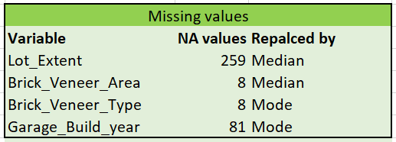
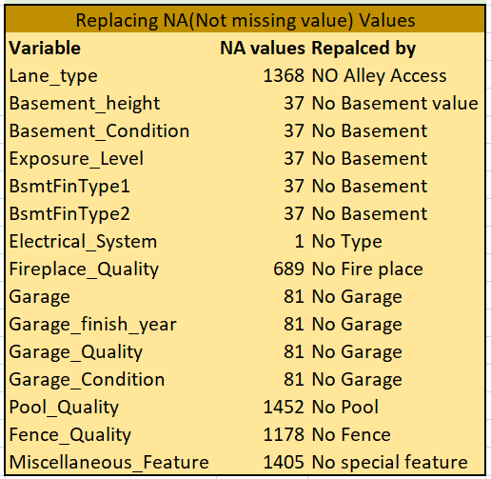
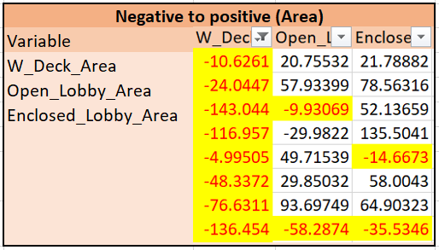
DATA PROCESSING - CLEANING

Slide 4
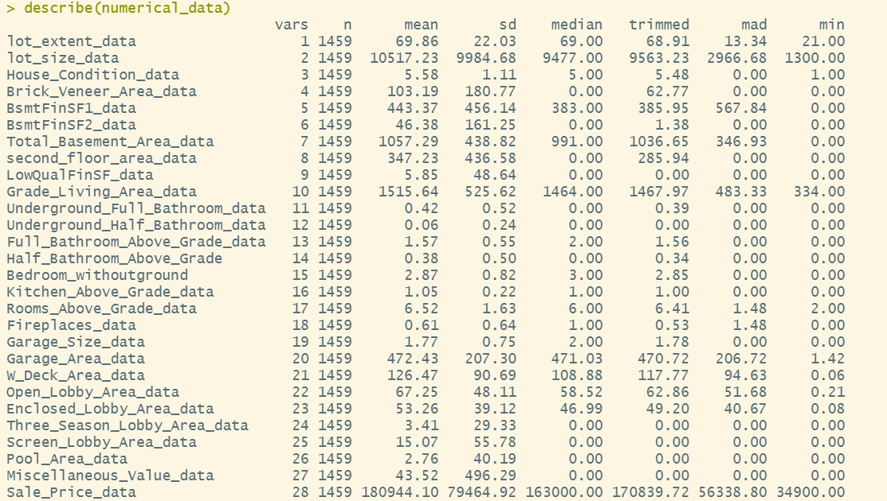
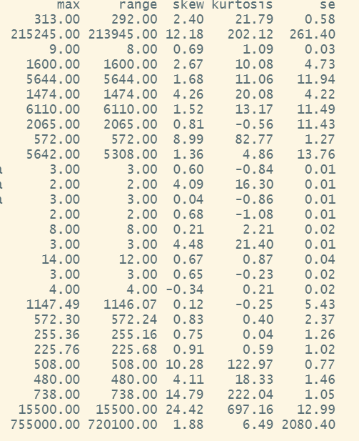
DATA PROCESSING – SAMPLE STATISTICS

Slide 5
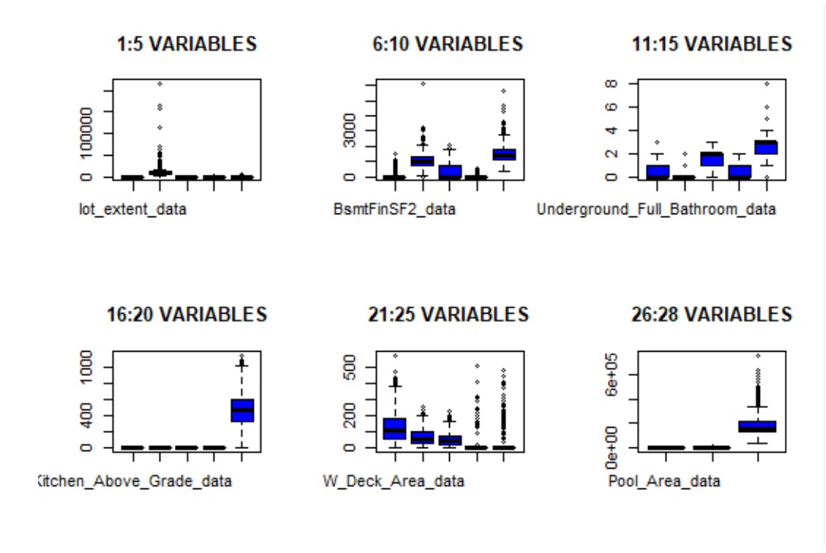
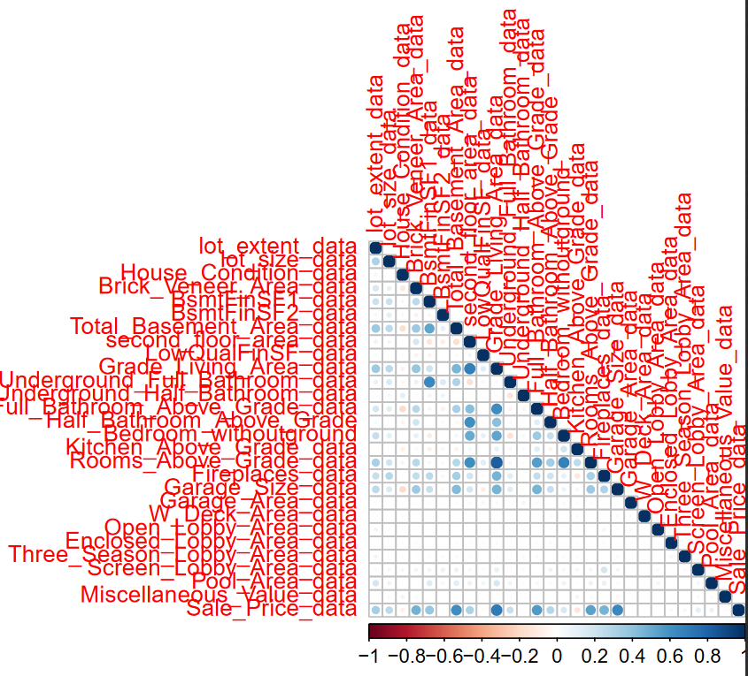
DATA PROCESSING - EDA

Slide 6
EDA AND SAMPLE STATISTICS -INSIGHTS
Building class - Most of building classes are 1-STORY 1946 & NEWER ALL STYLES
Zoning Class - Most of Zoning classes are Residential low density
House Type - Most of houses are Single-family Detached
House Design - Most of houses are single story
Construction_Year - Most of houses are build in 2006 (67)
Roof_Design- Most of roof design are of type Gable
Garage- Most of garage were built in 2005

Slide 7
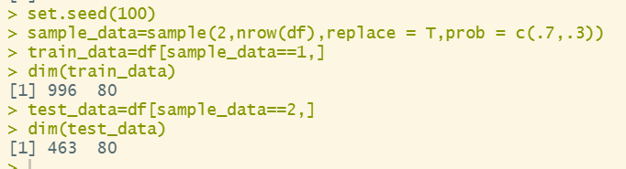
MODEL CREATION -SAMPLING (70:30)
Out of 1459 observations 996 are in “Train” data and 463 are in “Test” data
Data split ratio is 7:3

Slide 8
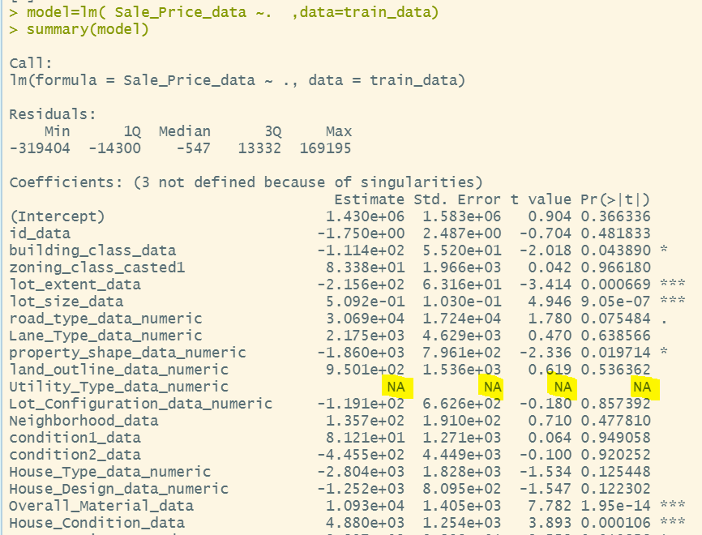
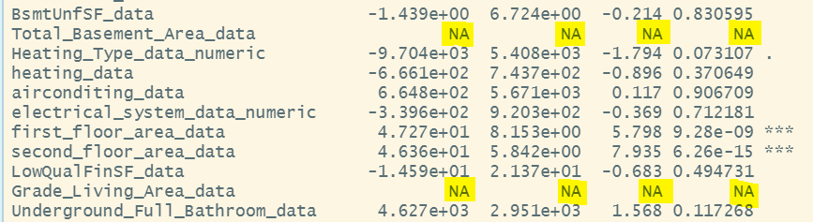
MODEL CREATION-
3 variables are not defined due to
singularities (We removed those 3 variables due to Multicolinearity) :
Utility_Type_data_numeric has all AllPub (All public Utilities)
AllPub NoSeWa
1458 1
1 2
Total_Basement_Area_data=BsmtFinSF1_data+BsmtUnfSF_data
Grade_Living_Area_data=first_floor_area_data+second_floor_area_data

Slide 9
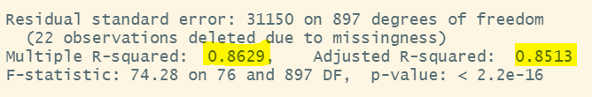
MODEL1 MEASURES
R square=86% , Adjust R square is 85%
Optimization of predictors with factors like cost and stability is achieved using model 1

Slide 10
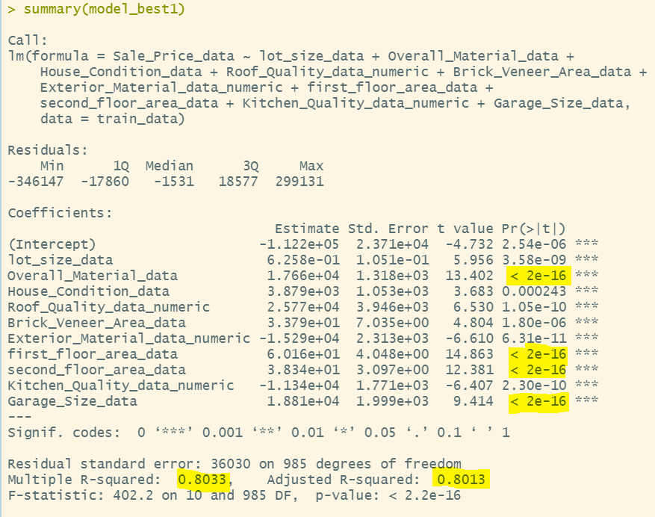
MODEL SELECTION -BEST FIT MODEL
we selected only most significant variables
We got multiple R square 80% and Adjusted R square 80%
“Overall material data”, “First floor area data”,”Second floor area data”,”Garage size data are most important predictors

Slide 11

MODEL COMPARISION
Model 1 – we have 76 predictors
Best Fit Model – we have 10 predictors

Slide 12
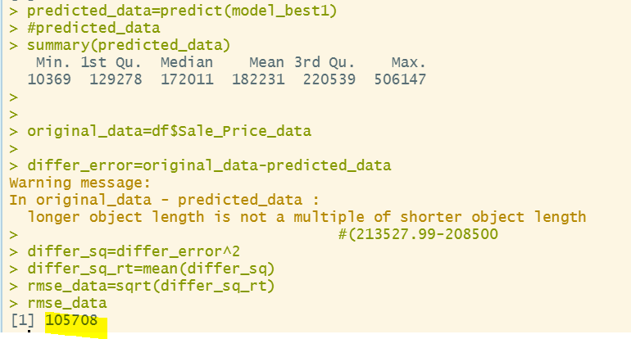
RMSE CALCULATION

Slide 13
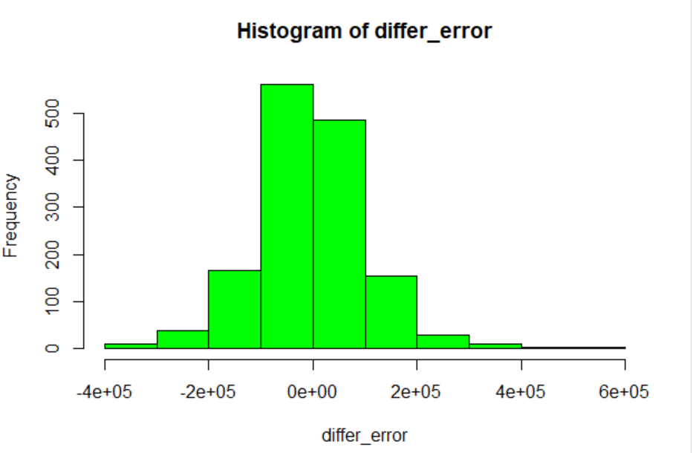
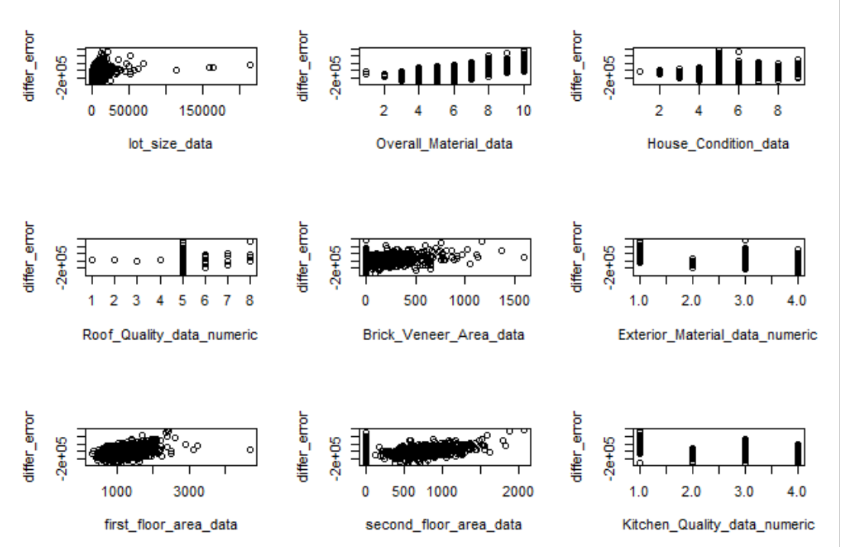
VALIDATING ASSUMPTIONS
Normality – Residuals are normally distributed
Linearity - We did not find any specified pattern in plot, variables have linear relationship

Slide 14
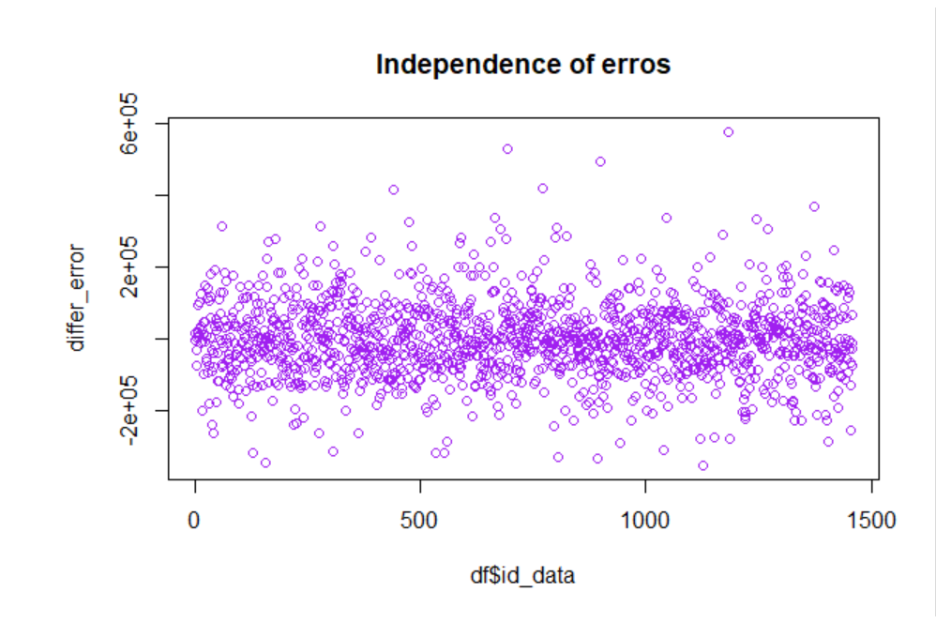
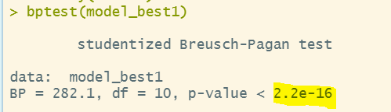
VALIDATING ASSUMPTIONS
independence of errors - We did not find any specified pattern in plot, Residuals are independent
Heteroscedasticity:
Null hypothesis :H0 heteroscedasticity is not present
p value is less than 0.05, fail to reject H0 ,variance of residuals is constant

Slide 15
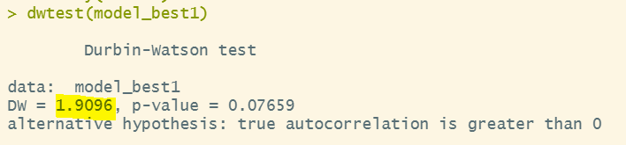
AUTOCORRELATION
Test Statistics lies between 0 to 2 mean +Ve autocorrealtion, if it is exactly 2 then no autocorrelation , >2 and <4 - then negative autocorrelation

Slide 16
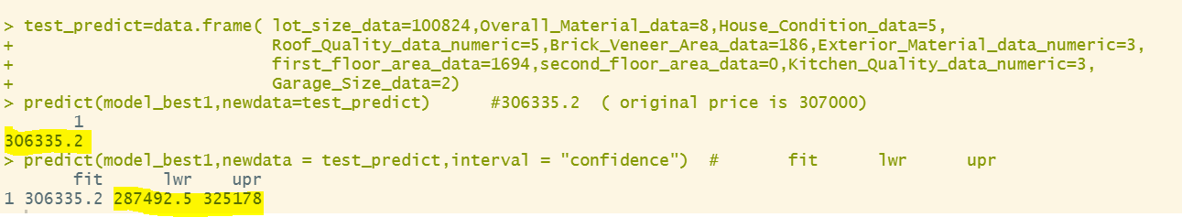
PREDICTION OF TEST DATA SET VALUES
Predicting house price on “Test” data with value 306335.2 and original value is 307000
In terms of interval predictor value may vary between 287492.5 and 325178

Slide 17

THANK YOU

