Slide 1

JETCAT –
Prof. Dr. Werner Winiwarter
Japanese-English Translation Using
Corpus-based Acquisition of Transfer Rules

Slide 2

Outline
  Introduction
  System Architecture
  Tagging and Parsing
  Transfer Rules
    Word Transfer Rules
    Constituent Transfer Rules
    Phrase Transfer Rules
  Acquisition and Consolidation
  Transfer and Generation
  Conclusion

Slide 3
Introduction – State of the Art in MT
  Research on machine translation has a long tradition
  The state of the art in machine translation is that there are quite good solutions for narrow application domains with a limited vocabulary and concept space
  It is the general opinion that fully automatic high quality translation without any limitations on the subject and without any human intervention is far beyond the scope of today‘s machine translation technology and there is serious doubt that it will be ever possible in the future

Slide 4
Introduction – State of the Art in MT (2)
  It is very disappointing to notice that the translation quality has not much improved in the last 10 years
  One main obstacle on the way to achieving better quality is seen in the fact that most of the current machine translation systems are not able to learn from their mistakes
  Most of the translation systems consist of large static rule bases with limited coverage, which have been compiled manually with huge intellectual effort
  All the valuable effort spent by users on post-editing translation results is usually lost for future translations

Slide 5
Introduction – Statistical MT
  As a solution to this knowledge acquisition bottleneck, corpus- based machine translation tries to learn the transfer knowledge automatically on the basis of large bilingual corpora for the language pair
  Statistical machine translation basically translates word-for- word and rearranges the words afterwards in the right order
  Such systems have only been of some success for very similar language pairs
  For applying statistical machine translation to Japanese several hybrid approaches have been proposed that also make use of syntactic knowledge

Slide 6
Introduction – Example-based MT
  The most prominent approach for the translation of Japanese has been example-based machine translation
  The basic idea is to collect translation examples for phrases and to use a best match algorithm to find the closest example for a given source phrase
  The translation of a complete sentence is then built by combining the retrieved target phrases

Slide 7
Introduction – Example-based MT (2)
  Whereas some approaches store structured representations for all concrete examples, others explicitly use variables to produce generalized templates
  However, the main drawback remains that most of the representations of translation examples used in example- based systems of reasonable size have to be manually crafted or at least reviewed for correctness

Slide 8
Introduction – PETRA
  In our approach we use a transfer-based machine translation architecture, however, we learn all the transfer rules automatically from translation examples by using structural matching between the parse trees
  Our current research work originates from the PETRA project (Personal Embedded Translation and Reading Assistant) in which we had developed a translation system from Japanese into German

Slide 9
Introduction – JENAAD
  One main problem for that language pair was the lack of training material, i.e. high quality Japanese-German parallel corpora
  Fortunately, the situation looks much brighter for Japanese- English as there are several large high quality parallel corpora available
  In particular, we use the JENAAD corpus, which is freely available for research or educational purposes and contains 150,000 sentence pairs from news articles

Slide 10
Introduction – Amzi! Prolog
  For the implementation of our machine translation system we have chosen Amzi! Prolog because it provides an expressive declarative programming language within the Eclipse Platform
  It offers powerful unification operations required for the efficient application of the transfer rules and full Unicode support so that Japanese characters can be used as textual elements in the Prolog source code
  Amzi! Prolog has proven its scalability during past projects where we accessed large bilingual dictionaries stored as fact files with several 100,000 facts

Slide 11
Introduction – Amzi! Prolog (2)
  Finally, it offers several APIs which makes it possible to run the translation program in the background so that the users can invoke the translation functionality from their familiar text editor
  For example, we have developed a prototype interface for Microsoft Word using Visual Basic macros

Slide 12
Outline
  Introduction
  System Architecture
  Tagging and Parsing
  Transfer Rules
    Word Transfer Rules
    Constituent Transfer Rules
    Phrase Transfer Rules
  Acquisition and Consolidation
  Transfer and Generation
  Conclusion

Slide 13
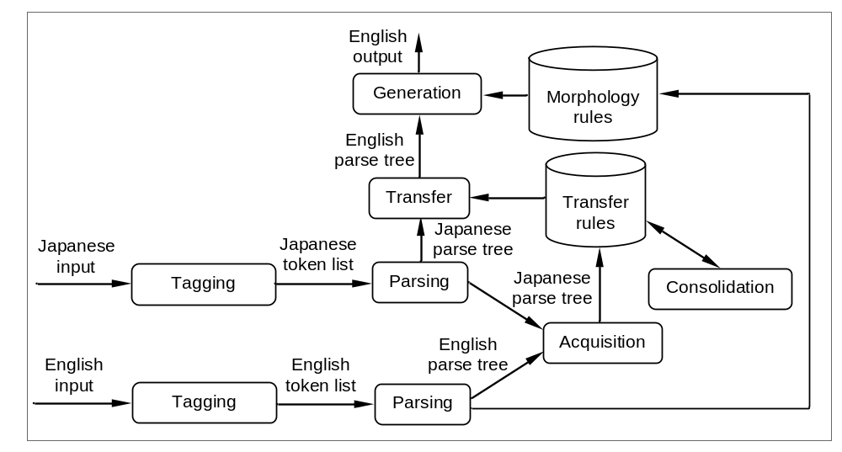
System Architecture

Slide 14
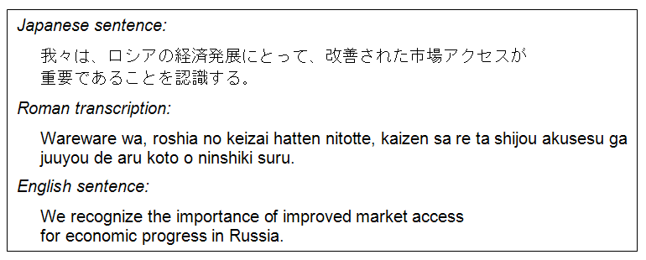
System Architecture – Running Example

Slide 15
Outline
  Introduction
  System Architecture
  Tagging and Parsing
  Transfer Rules
    Word Transfer Rules
    Constituent Transfer Rules
    Phrase Transfer Rules
  Acquisition and Consolidation
  Transfer and Generation
  Conclusion

Slide 16
Tagging and Parsing – ChaSen
  We use Python scripts for the basic string operations to import the sentence pairs from the JENAAD corpus
  For the part-of-speech tagging of Japanese sentences we use ChaSen
  ChaSen segments the Japanese input into morphemes and tags each morpheme with its pronunciation, base form, part- of-speech, conjugation type, and conjugation form

Slide 17
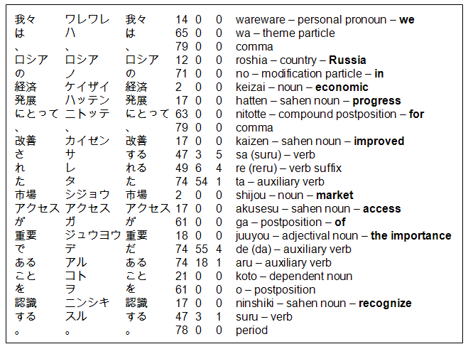
Tagging and Parsing – Japanese Token List

Slide 18
Tagging and Parsing – MontyTagger
  The English input is tagged by using MontyTagger, which is freely available from MIT Media Lab as part of MontyLingua
  The MontyTagger segments the English input into morphemes, and tags each morpheme with its base form and part-of-speech tag from the Penn Treebank tagset
  As MontyTagger – in contrast to ChaSen – is a rather simple tagger with comparatively low accuracy, we had to add a postprocessing stage in Prolog to correct wrong part-of- speech tags

Slide 19
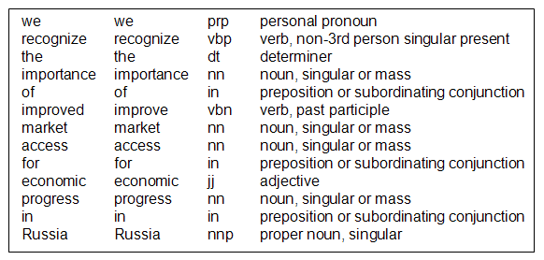
Tagging and Parsing – English Token List

Slide 20
Tagging and Parsing – Grammars
  The parsing modules compute the syntactic structure of sentences based on the information in the token lists
  We use the Definite Clause Grammar (DCG) preprocessor of Amzi! Prolog to write the grammar rules
  A sentence is modeled as a list of constituents

Slide 21
Tagging and Parsing – Constituents
  A constituent is defined as a compound term of arity 1 with the constituent category as principal functor
  We use three-letter acronyms to encode the constituent categories
  Regarding the argument of a constituent we distinguish two types:
    simple constituents represent words or features
      (atom/atom or atom)
    complex constituents represent phrases as lists of
    subconstituents

Slide 22
Tagging and Parsing – Japanese Parsing
  Since the Japanese language uses postpositions and the general structure of a simple sentence is sentence-initial element, pre-verbal element, and verbal, it is much easier to parse a Japanese sentence from right to left
  Therefore, we reverse the Japanese token list before we start with the parsing process

Slide 23
Tagging and Parsing – Japanese Parse Tree
  [vbl([hea(する/47), hef(3/1), sjc(認識/17)]), dob([apo(を/61),
  hea(こと/21), mvp([vbl([hea(だ/74), hef(55/4),
  aux([hea(ある/74), hef(18/1)]), cap([hea(重要/18)])]),
  sub([apo(が/61), hea(アクセス/17), mno([hea(市場/2)]), mvp([vbl([hea(する/47), hef(3/5), aux([hea(れる/49), hef(6/4)]), aux([hea(た/74), hef(54/1)]), sjc(改善/17)])])])])]),
  aob([apo(にとって/63), hea(発展/17), mno([hea(経済/2)]), mnp([apo(の/71), hea(ロシア/12)])]), sub([apo(は/65),
  hea(我々/14)])]

Slide 24
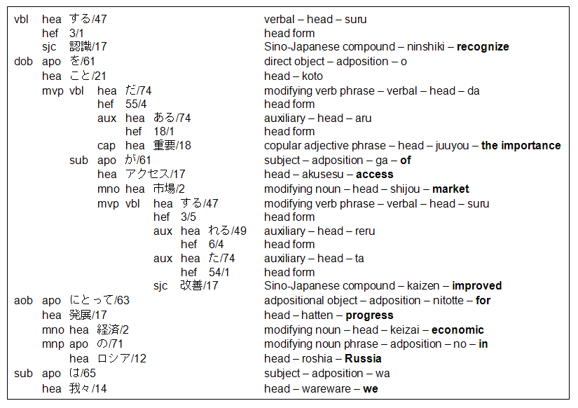

Slide 25
Tagging and Parsing – English Parsing
  English sentences are parsed from left to right
  To facilitate the structural matching between Japanese and English parse trees during acquisition we tried to align the use of constituent categories in the English grammar as best as possible with corresponding Japanese categories
  In addition, we have chosen the same order of subconstituents as in the Japanese parse tree

Slide 26
Tagging and Parsing – English Parse Tree
  [vbl([hea(recognize/vb)]), dob([hea(importance/nn), det(def), mnp([apo(of/in), hea(access/nn), mno([hea(market/nn)]), maj([hea(improved/vbn)])])]), aob([apo(for/in), hea(progress/nn), maj([hea(economic/jj)]), map([apo(in/in), hea(Russia/nnp)])]), sub([hea(we/prp), num(plu)])]

Slide 27
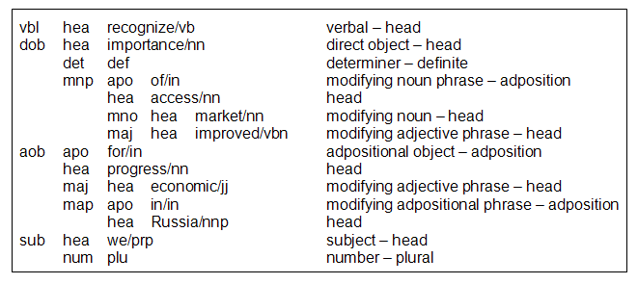

Slide 28
Tagging and Parsing – Morphology Rules
  As an important byproduct of parsing English sentences we derive irregular inflections (e.g. plural forms, past participle forms, etc.) from the information in the English token list and store them as morphology rules
  Those rules are later used by the generation module to produce the correct surface forms of inflected words

Slide 29
Outline
  Introduction
  System Architecture
  Tagging and Parsing
  Transfer Rules
    Word Transfer Rules
    Constituent Transfer Rules
    Phrase Transfer Rules
  Acquisition and Consolidation
  Transfer and Generation
  Conclusion

Slide 30
Transfer Rules
  One characteristic of our approach is that we model all translation problems with only three generic types of transfer rules
  The transfer rules are stored as Prolog facts in the rule base
  We have defined three Prolog predicates for the three different rules

Slide 31
Outline
  Introduction
  System Architecture
  Tagging and Parsing
  Transfer Rules
    Word Transfer Rules
    Constituent Transfer Rules
    Phrase Transfer Rules
  Acquisition and Consolidation
  Transfer and Generation
  Conclusion

Slide 32
Word Transfer Rules
  For simple context-insensitive translations at the word level, the argument A1 of a simple constituent is changed into A2 by applying the following predicate, i.e. if the argument of a simple constituent is equal to argument condition A1, it is replaced by A2:
  wtr(A1, A2).
  Example 1: The default transfer rule to translate the Japanese noun 世界 into the English counterpart world is stated as the fact:
  wtr(世界/2, world/nn).

Slide 33
Outline
  Introduction
  System Architecture
  Tagging and Parsing
  Transfer Rules
    Word Transfer Rules
    Constituent Transfer Rules
    Phrase Transfer Rules
  Acquisition and Consolidation
  Transfer and Generation
  Conclusion

Slide 34
Constituent Transfer Rules
  The second rule type concerns the translation of complex constituents to cover cases where both the category and the argument of a constituent have to be altered:
  ctr(C1, C2, Hea, A1, A2).
  This changes a complex constituent C1(A1) to C2(A2) if the category is equal to category condition C1, the head is equal to head condition Hea, and the argument is equal to argument condition A1

Slide 35
Constituent Transfer Rules (2)
  Example 2: The modifying noun (mno) with head 国際 is translated as modifying adjective phrase (maj) with head international:
  ctr(mno, maj, 国際/2, [hea(国際/2)], [hea(international/jj)]).
  The head condition serves as index for the fast retrieval of matching facts during the translation of a sentence and significantly reduces the number of facts for which the argument condition has to be tested

Slide 36
Constituent Transfer Rules – Shared Variables
  Constituent transfer rules can contain shared variables for unification, which makes it possible to replace only certain parts of the argument and to leave the rest unchanged
  Example 3:
  ctr(mvp, map, 向ける/47, [vbl([hea(向ける/47), hef(6/4), aux([hea(た/74), hef(54/1)])]), aob([apo(に/61) | X])], [apo(toward/in) | X]).
  C1(A1)=mvp([vbl([hea(向ける/47), hef(6/4), aux([hea(た/74), hef(54/1)])]), aob([apo(に/61), hea(民主/2), suf(化/31)])])
  C2(A2)=map([apo(toward/in), hea(民主/2), suf(化/31)])

Slide 37
Outline
  Introduction
  System Architecture
  Tagging and Parsing
  Transfer Rules
    Word Transfer Rules
    Constituent Transfer Rules
    Phrase Transfer Rules
  Acquisition and Consolidation
  Transfer and Generation
  Conclusion

Slide 38
Phrase Transfer Rules
  The most common and most versatile type of transfer rules are phrase transfer rules, which allow to define elaborate conditions and substitutions on phrases, i.e. arguments of complex constituents:
  ptr(C, Hea, Req1, Req2).
  Rules of this type change the argument of a complex constituent with category C from A1 = Req1 ∪ Add to
  A2 = Req2 ∪ Add if hea(Hea) ∈ A1

Slide 39
Phrase Transfer Rules – Set Property
  To enable the flexible application of phrase transfer rules, input A1 and argument condition Req1 are treated as sets and not as lists of subconstituents, i.e. the order of subconstituents does not affect the satisfyability of the argument condition
  The application of a transfer rule requires that the set of subconstituents in Req1 is included in the argument A1 of the input constituent C1(A1) to replace Req1 by Req2

Slide 40
Phrase Transfer Rules – Additional Constituents
  Besides Req1 any additional constituents can be included in the input, which are transferred to the output unchanged
  This allows for an efficient and robust realization of the transfer module because one rule application changes only certain aspects of a phrase whereas other aspects can be translated by other rules in subsequent steps

Slide 41
Phrase Transfer Rules – Special Constant notex
  It is also possible to use the special constant notex as argument of a subconstituent in Req1, e.g. sub(notex)
  In that case the rule can only be applied if no subconstituent of this category is included in A1, e.g. if A1 includes no subject

Slide 42

Phrase Transfer Rules – Generalized Categories
  In addition to an exact match the generalized constituent categories np (noun phrase) and vp (verb phrase) can be used in the category condition
  The category condition is satisfied if the constituent category C is subsumed by the generalized category (e.g. mvp vp)

Slide 43
Phrase Transfer Rules – Head Condition
  The head condition is again used to speed up the selection of possible candidates during the transfer step
  If the applicability of a transfer rule does not depend on the head of the phrase, then the special constant nil is used as head condition
  Another special case is the head condition notex
  In analogy to the corresponding use in the argument condition this indicates that the rule can only be applied if A1 does not contain a head element

Slide 44
Phrase Transfer Rules – Example
  Example 4: The Japanese verbal with head する and Sino- Japanese compound 認識 is translated into an English verbal with head recognize:
  ptr(vbl, する/47, [hea(する/47), sjc(認識/17)],
  [hea(recognize/vb)]).
  A1 = [hea(する/47), hef(3/1), sjc(認識/17)]
  A2 = [hea(recognize/vb), hef(3/1)]

Slide 45
Phrase Transfer Rules – Shared Variables
  Example 5:
  ptr(np, こと/21, [hea(こと/21), mvp([vbl([hea(だ/74), hef(55/4),
  aux([hea(ある/74), hef(18/1)]), cap([hea(重要/18)])]),
  sub([apo(が/61) | X ])])],
  [hea(importance/nn), det(def), mnp([apo(of/in) | X ])]).
  A1 = [hea(こと/21), mvp([vbl([hea(だ/74), hef(55/4),
  aux([hea(ある/74), hef(18/1)]), cap([hea(重要/18)])]),
  sub([hea(アクセス /17), apo(が/61), mno(Y), mvp(Z)])])]
  A2 = [hea(importance/nn), det(def), mnp([apo(of/in),
  hea(アクセス /17), mno(Y), mvp(Z)])]

Slide 46
Outline
  Introduction
  System Architecture
  Tagging and Parsing
  Transfer Rules
    Word Transfer Rules
    Constituent Transfer Rules
    Phrase Transfer Rules
  Acquisition and Consolidation
  Transfer and Generation
  Conclusion

Slide 47
Acquisition and Consolidation
  The acquisition module traverses the Japanese and English parse trees and derives new transfer rules, which are added to the rule base
  We start the search for new rules at the sentence level by calling vp_match(vp, JapSent, EngSent)

Slide 48
Acquisition and Consolidation – vp_match
  This predicate matches two verb phrases VPJ and VPE, the constituent category C is required for the category condition in the transfer rules:
  vp_match(C, VPJ, VPE) :-
  reverse(VPJ, VPJR),
  reverse(VPE, VPER),
  vp_map(C, VPJR, VPER).
  The predicate first reverses the two lists so that the leftmost constituents (in the sentences) are examined first, which facilitates the correct mapping of subconstituents with identical constituent category, e.g. several modifying nouns

Slide 49
Acquisition and Consolidation – vp_map
  This predicate is implemented as recursive predicate for the correct mapping of the individual subconstituents of VPJ:
  vp_map(_, [], []).
  ...
  vp_map(C, VPJ, VPE) :-
  map_dob(C, VPJ, VPE, VPJ2, VPE2),
  vp_map(C, VPJ2, VPE2).
  ...
  vp_map(_, _, _).
  Each rule for the predicate vp_map is responsible for the mapping of a specific Japanese subconstituent (possibly together with other subconstituents)

Slide 50
Acquisition and Consolidation – vp_map (2)
  ...
  vp_map(C, VPJ, VPE) :-
  map_dob(C, VPJ, VPE, VPJ2, VPE2),
  vp_map(C, VPJ2, VPE2).
  ...
  For example, map_dob looks for a subconstituent with category dob in VPJ and tries to derive a transfer rule to produce the corresponding translation in VPE
  All subconstituents in VPJ and VPE that are covered by the new transfer rule are removed from the two lists to produce
  VPJ2 and VPE2
  Each rule is added to the rule base if it is not included yet

Slide 51
Acquisition and Consolidation – map_default
  Each predicate of type map_dob both covers special mappings as well as the default treatment:
  ...
  map_dob(_, VPJ, VPE, VPJ2, VPE2) :-
  map_default(dob, VPJ, VPE, VPJ2, VPE2).
  ...
  map_default(C, J, E, J2, E2) :-
  remove_constituent(C, J, ArgJ, J2),
  remove_constituent(C, E, ArgE, E2),
  map_argument(C, ArgJ, ArgE).
  ...
  map_argument(dob, J, E) :-
  np_match(dob, J, E).

Slide 52
Acquisition and Consolidation – Consolidation
  The transfer rules that are derived by the acquisition module are very specific because they consider all context-dependent translation dependencies in full detail to avoid any conflict with existing rules in the rule base
  This guarantees correct translations but leads to a huge number of complex rules, which has negative effects on computational efficiency
  It also badly affects the coverage for unseen sentences

Slide 53
Acquisition and Consolidation – Consolidation (2)
  To avoid this overtraining we perform a consolidation step to prune the transfer rules as long as such new generalized rules are not in conflict with other rules
  The relaxation of rules mainly concerns contextual translation dependencies of adpositions, head nouns, determiners, the number feature, and verbals
  The most commonly performed transformations are:
    to simplify a phrase transfer rule or to replace it with a word
    transfer rule
    to use the generalized categories np or vp
    to split a phrase transfer rule in two simpler rules

Slide 54
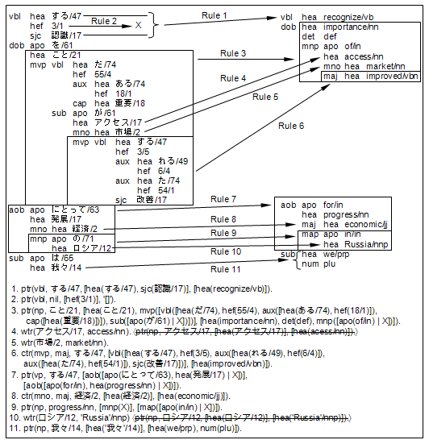

Slide 55
  vbl hea する/47
  hef 3/1
  sjc 認識/17
  dob apo を/61
  hea こと/21
  mvp vbl hea だ/74
  hef 55/4
  aux hea ある/74
  hef 18/1
  cap hea 重要/18
  sub apo が/61
  hea アクセス/17
  mno hea 市場/2
  mvp vbl hea する/47
  hef 3/5
  aux hea れる/49
  hef 6/4
  aux hea た/74
  hef 54/1
  sjc 改善/17
  aob apo にとって/63
  hea 発展/17
  mno hea 経済/2
  mnp apo の/71
  hea ロシア/12
  sub apo は/65
  hea 我々/14
  vbl hea recognize/vb
  dob hea importance/nn
  det def
  mnp apo of/in
  hea access/nn
  mno hea market/nn
  maj hea improved/vbn
  aob apo for/in
  hea progress/nn
  maj hea economic/jj
  map apo in/in
  hea Russia/nnp
  sub hea we/prp
  num plu
ptr(np, 我々/14, [hea('我々'/14)], [hea(we/prp), num(plu)]).

Slide 56
  vbl hea する/47
  hef 3/1
  sjc 認識/17
  dob apo を/61
  hea こと/21
  mvp vbl hea だ/74
  hef 55/4
  aux hea ある/74
  hef 18/1
  cap hea 重要/18
  sub apo が/61
  hea アクセス/17
  mno hea 市場/2
  mvp vbl hea する/47
  hef 3/5
  aux hea れる/49
  hef 6/4
  aux hea た/74
  hef 54/1
  sjc 改善/17
  aob apo にとって/63
  hea 発展/17
  mno hea 経済/2
  mnp apo の/71
  hea ロシア/12
  sub apo は/65
  hea 我々/14
  vbl hea recognize/vb
  dob hea importance/nn
  det def
  mnp apo of/in
  hea access/nn
  mno hea market/nn
  maj hea improved/vbn
  aob apo for/in
  hea progress/nn
  maj hea economic/jj
  map apo in/in
  hea Russia/nnp
  sub hea we/prp
  num plu
ptr(vp, する/47,
[aob([apo(にとって/63), hea(発展/17) | X])],
[aob([apo(for/in), hea(progress/nn) | X])]).

Slide 57
  vbl hea する/47
  hef 3/1
  sjc 認識/17
  dob apo を/61
  hea こと/21
  mvp vbl hea だ/74
  hef 55/4
  aux hea ある/74
  hef 18/1
  cap hea 重要/18
  sub apo が/61
  hea アクセス/17
  mno hea 市場/2
  mvp vbl hea する/47
  hef 3/5
  aux hea れる/49
  hef 6/4
  aux hea た/74
  hef 54/1
  sjc 改善/17
  aob apo にとって/63
  hea 発展/17
  mno hea 経済/2
  mnp apo の/71
  hea ロシア/12
  sub apo は/65
  hea 我々/14
  vbl hea recognize/vb
  dob hea importance/nn
  det def
  mnp apo of/in
  hea access/nn
  mno hea market/nn
  maj hea improved/vbn
  aob apo for/in
  hea progress/nn
  maj hea economic/jj
  map apo in/in
  hea Russia/nnp
  sub hea we/prp
  num plu
ptr(np, progress/nn, [mnp(X)], [map([apo(in/in) | X])]).

Slide 58
  vbl hea する/47
  hef 3/1
  sjc 認識/17
  dob apo を/61
  hea こと/21
  mvp vbl hea だ/74
  hef 55/4
  aux hea ある/74
  hef 18/1
  cap hea 重要/18
  sub apo が/61
  hea アクセス/17
  mno hea 市場/2
  mvp vbl hea する/47
  hef 3/5
  aux hea れる/49
  hef 6/4
  aux hea た/74
  hef 54/1
  sjc 改善/17
  aob apo にとって/63
  hea 発展/17
  mno hea 経済/2
  mnp apo の/71
  hea ロシア/12
  sub apo は/65
  hea 我々/14
  vbl hea recognize/vb
  dob hea importance/nn
  det def
  mnp apo of/in
  hea access/nn
  mno hea market/nn
  maj hea improved/vbn
  aob apo for/in
  hea progress/nn
  maj hea economic/jj
  map apo in/in
  hea Russia/nnp
  sub hea we/prp
  num plu
ptr(np, ロシア/12,
[hea(ロシア/12)], [hea('Russia'/nnp)]).
⇒ wtr(ロシア/12, 'Russia'/nnp).

Slide 59
  vbl hea する/47
  hef 3/1
  sjc 認識/17
  dob apo を/61
  hea こと/21
  mvp vbl hea だ/74
  hef 55/4
  aux hea ある/74
  hef 18/1
  cap hea 重要/18
  sub apo が/61
  hea アクセス/17
  mno hea 市場/2
  mvp vbl hea する/47
  hef 3/5
  aux hea れる/49
  hef 6/4
  aux hea た/74
  hef 54/1
  sjc 改善/17
  aob apo にとって/63
  hea 発展/17
  mno hea 経済/2
  mnp apo の/71
  hea ロシア/12
  sub apo は/65
  hea 我々/14
  vbl hea recognize/vb
  dob hea importance/nn
  det def
  mnp apo of/in
  hea access/nn
  mno hea market/nn
  maj hea improved/vbn
  aob apo for/in
  hea progress/nn
  maj hea economic/jj
  map apo in/in
  hea Russia/nnp
  sub hea we/prp
  num plu
ctr(mno, maj, 経済/2,
[hea(経済/2)], [hea(economic/jj)]).

Slide 60
  vbl hea する/47
  hef 3/1
  sjc 認識/17
  dob apo を/61
  hea こと/21
  mvp vbl hea だ/74
  hef 55/4
  aux hea ある/74
  hef 18/1
  cap hea 重要/18
  sub apo が/61
  hea アクセス/17
  mno hea 市場/2
  mvp vbl hea する/47
  hef 3/5
  aux hea れる/49
  hef 6/4
  aux hea た/74
  hef 54/1
  sjc 改善/17
  aob apo にとって/63
  hea 発展/17
  mno hea 経済/2
  mnp apo の/71
  hea ロシア/12
  sub apo は/65
  hea 我々/14
  vbl hea recognize/vb
  dob hea importance/nn
  det def
  mnp apo of/in
  hea access/nn
  mno hea market/nn
  maj hea improved/vbn
  aob apo for/in
  hea progress/nn
  maj hea economic/jj
  map apo in/in
  hea Russia/nnp
  sub hea we/prp
  num plu
ptr(np, こと/21, [hea(こと/21), mvp([vbl([hea(だ/74),
hef(55/4), aux([hea(ある/74), hef(18/1)]),
cap([hea(重要/18)])]), sub([apo(が/61) | X])])],
[hea(importance/nn), det(def),
mnp([apo(of/in) | X])]).

Slide 61
  vbl hea する/47
  hef 3/1
  sjc 認識/17
  dob apo を/61
  hea こと/21
  mvp vbl hea だ/74
  hef 55/4
  aux hea ある/74
  hef 18/1
  cap hea 重要/18
  sub apo が/61
  hea アクセス/17
  mno hea 市場/2
  mvp vbl hea する/47
  hef 3/5
  aux hea れる/49
  hef 6/4
  aux hea た/74
  hef 54/1
  sjc 改善/17
  aob apo にとって/63
  hea 発展/17
  mno hea 経済/2
  mnp apo の/71
  hea ロシア/12
  sub apo は/65
  hea 我々/14
  vbl hea recognize/vb
  dob hea importance/nn
  det def
  mnp apo of/in
  hea access/nn
  mno hea market/nn
  maj hea improved/vbn
  aob apo for/in
  hea progress/nn
  maj hea economic/jj
  map apo in/in
  hea Russia/nnp
  sub hea we/prp
  num plu
ctr(mvp, maj, する/47, [vbl([hea(する/47), hef(3/5),
aux([hea(れる/49), hef(6/4)]),
aux([hea(た/74), hef(54/1)]),
sjc(改善/17)])],
[hea(improved/vbn)]).

Slide 62
  vbl hea する/47
  hef 3/1
  sjc 認識/17
  dob apo を/61
  hea こと/21
  mvp vbl hea だ/74
  hef 55/4
  aux hea ある/74
  hef 18/1
  cap hea 重要/18
  sub apo が/61
  hea アクセス/17
  mno hea 市場/2
  mvp vbl hea する/47
  hef 3/5
  aux hea れる/49
  hef 6/4
  aux hea た/74
  hef 54/1
  sjc 改善/17
  aob apo にとって/63
  hea 発展/17
  mno hea 経済/2
  mnp apo の/71
  hea ロシア/12
  sub apo は/65
  hea 我々/14
  vbl hea recognize/vb
  dob hea importance/nn
  det def
  mnp apo of/in
  hea access/nn
  mno hea market/nn
  maj hea improved/vbn
  aob apo for/in
  hea progress/nn
  maj hea economic/jj
  map apo in/in
  hea Russia/nnp
  sub hea we/prp
  num plu
wtr(市場/2, market/nn).

Slide 63
  vbl hea する/47
  hef 3/1
  sjc 認識/17
  dob apo を/61
  hea こと/21
  mvp vbl hea だ/74
  hef 55/4
  aux hea ある/74
  hef 18/1
  cap hea 重要/18
  sub apo が/61
  hea アクセス/17
  mno hea 市場/2
  mvp vbl hea する/47
  hef 3/5
  aux hea れる/49
  hef 6/4
  aux hea た/74
  hef 54/1
  sjc 改善/17
  aob apo にとって/63
  hea 発展/17
  mno hea 経済/2
  mnp apo の/71
  hea ロシア/12
  sub apo は/65
  hea 我々/14
  vbl hea recognize/vb
  dob hea importance/nn
  det def
  mnp apo of/in
  hea access/nn
  mno hea market/nn
  maj hea improved/vbn
  aob apo for/in
  hea progress/nn
  maj hea economic/jj
  map apo in/in
  hea Russia/nnp
  sub hea we/prp
  num plu
ptr(np, アクセス/17,
[hea(アクセス/17)], [hea(acess/nn)]).
⇒ wtr(アクセス/17, access/nn).

Slide 64
  vbl hea する/47
  hef 3/1
  sjc 認識/17
  dob apo を/61
  hea こと/21
  mvp vbl hea だ/74
  hef 55/4
  aux hea ある/74
  hef 18/1
  cap hea 重要/18
  sub apo が/61
  hea アクセス/17
  mno hea 市場/2
  mvp vbl hea する/47
  hef 3/5
  aux hea れる/49
  hef 6/4
  aux hea た/74
  hef 54/1
  sjc 改善/17
  aob apo にとって/63
  hea 発展/17
  mno hea 経済/2
  mnp apo の/71
  hea ロシア/12
  sub apo は/65
  hea 我々/14
  vbl hea recognize/vb
  dob hea importance/nn
  det def
  mnp apo of/in
  hea access/nn
  mno hea market/nn
  maj hea improved/vbn
  aob apo for/in
  hea progress/nn
  maj hea economic/jj
  map apo in/in
  hea Russia/nnp
  sub hea we/prp
  num plu
ptr(vbl, する/47, [hea(する/47), sjc(認識/17)],
[hea(recognize/vb)]).

Slide 65
  vbl hea する/47
  hef 3/1
  sjc 認識/17
  dob apo を/61
  hea こと/21
  mvp vbl hea だ/74
  hef 55/4
  aux hea ある/74
  hef 18/1
  cap hea 重要/18
  sub apo が/61
  hea アクセス/17
  mno hea 市場/2
  mvp vbl hea する/47
  hef 3/5
  aux hea れる/49
  hef 6/4
  aux hea た/74
  hef 54/1
  sjc 改善/17
  aob apo にとって/63
  hea 発展/17
  mno hea 経済/2
  mnp apo の/71
  hea ロシア/12
  sub apo は/65
  hea 我々/14
  vbl hea recognize/vb
  dob hea importance/nn
  det def
  mnp apo of/in
  hea access/nn
  mno hea market/nn
  maj hea improved/vbn
  aob apo for/in
  hea progress/nn
  maj hea economic/jj
  map apo in/in
  hea Russia/nnp
  sub hea we/prp
  num plu
✗
ptr(vbl, nil, [hef(3/1)], '[]').

Slide 66
Outline
  Introduction
  System Architecture
  Tagging and Parsing
  Transfer Rules
    Word Transfer Rules
    Constituent Transfer Rules
    Phrase Transfer Rules
  Acquisition and Consolidation
  Transfer and Generation
  Conclusion

Slide 67
Transfer and Generation
  The transfer module traverses the Japanese parse tree top- down and searches for transfer rules that can be applied
  The chosen design of the transfer rules guarantees the robust processing of the parse tree
  One rule only changes certain parts of a constituent into the English equivalent, other parts are left unchanged to be transformed by other rules in subsequent processing steps
  Therefore, our transfer algorithm is able to work efficiently on a mixed Japanese-English parse tree, which gradually turns into a fully translated English parse tree

Slide 68
Transfer and Generation – transfer
  At the top level we first apply phrase transfer rules to the sentence before we try to translate each constituent in the sentence individually:
  transfer(JapSent, EngSent) :-
  apply_ptrules(vp, JapSent, IntermediateResult),
  transfer_const(IntermediateResult, EngSent).

Slide 69
Transfer and Generation – apply_ptrules
  The predicate apply_ptrules applies phrase transfer rules recursively until no further rule can be applied successfully:
  apply_ptrules(C, JapSent, EngSent) :-
  apply_ptr(C, JapSent, IntermediateResult),
  apply_ptrules(C, IntermediateResult, EngSent).
  apply_ptrules(_, Sent, Sent).

Slide 70
Transfer and Generation – apply_ptr
  The application of a single phrase transfer rule is divided in two steps
  First, we select all rule candidates that satisfy the category, head, and argument condition in the rule
  Second, we rate each rule and choose the one with the highest score

Slide 71
Transfer and Generation – Ranking of Rules
  The score is calculated based on the complexity of the argument condition
  In addition, rules are ranked higher if:
    the head condition is not nil
    the argument condition does not depend on the head
    the argument condition contains notex

Slide 72
Transfer and Generation – Selection of Candidates
  The most challenging task for selecting rule candidates is the verification of the argument condition
  This involves testing for set inclusion (argument condition ⊆ input) at the top level
  In addition, we have to recursively test for set equality of arguments of subconstituents

Slide 73
Transfer and Generation – split
  This is achieved by using the predicate split, which retrieves each element in the argument condition AC from the input I (at the same time binding free variables through unification) and returns the remaining constituents from the input as list of additional elements Add, which are then appended to the instantiated argument condition:
  split(I, AC, Add) :-
  once(split_rec(I, AC, AC, Add)).
  split_rec(Add, [], [], Add).
  split_rec(I, [ConAC|ReAC], [ConAC2|ReAC2], Add) :-
  once(retrieve_const(ConAC, I, ConAC2, I2)),
  split_rec(I2, ReAC, ReAC2, Add).

Slide 74
Transfer and Generation – retrieve_const
  A constituent can be retrieved from the input, if the corresponding element from the argument condition can be directly unified or if the two categories are identical and the two arguments are equal sets:
  retrieve_const(Con, [Con|ReI], Con, ReI).
  retrieve_const(ConAC, [ConI|ReI], ConAC, ReI):-
  ConAC =.. [Category, ArgAC],
  ConI =.. [Category, ArgI],
  equal_args(ArgI, ArgAC).
  retrieve_const(ConAC, [ConI|ReI], ConAC2, [ConI|ReI2]):-
  retrieve_const(ConAC, ReI, ConAC2, ReI2).

Slide 75
Transfer and Generation – equal_args
  The equality of the arguments is tested by retrieving the argument condition subconstituents from the input argument until a free variable as tail or the end of the list is reached:
  equal_args(ArgI, ArgAC):-
  once(unify_args(ArgI, ArgAC, ArgAC)).
  unify_args(ArgI, ArgAC, ArgAC2):-
  var(ArgAC), ArgAC2 = ArgI.
  unify_args([], [], []).
  unify_args(ArgI, [ConArAC|ReArAC], [ConArAC2|ReArAC2]):-
  once(retrieve_const(ConArAC, ArgI, ConArAC2, ArgI2)),
  unify_args(ArgI2, ReArAC, ReArAC2).

Slide 76
Transfer and Generation – transfer (repeated)
  At the top level we first apply phrase transfer rules to the sentence before we try to translate each constituent in the sentence individually:
  transfer(JapSent, EngSent) :-
  apply_ptrules(vp, JapSent, IntermediateResult),
  transfer_const(IntermediateResult, EngSent).

Slide 77
Transfer and Generation – transfer_const
  After applying phrase transfer rules at the sentence level, the predicate transfer_const examines each individual subconstituent
  It first tries to apply constituent transfer rules before calling a predicate trans(C, JapArg, EngArg) for the category- specific transfer of the argument
  For simple constituents this means the application of a word transfer rule, for complex constituents it involves again the application of phrase transfer rules (apply_ptrules), the recursive call of the predicate transfer_const, and some post-editing, e.g. removing the theme particle from a subject

Slide 78
  vbl hea する/47
  hef 3/1
  sjc 認識/17
  dob apo を/61
  hea こと/21
  mvp vbl hea だ/74
  hef 55/4
  aux hea ある/74
  hef 18/1
  cap hea 重要/18
  sub apo が/61
  hea アクセス/17
  mno hea 市場/2
  mvp vbl hea する/47
  hef 3/5
  aux hea れる/49
  hef 6/4
  aux hea た/74
  hef 54/1
  sjc 改善/17
  aob apo にとって/63
  hea 発展/17
  mno hea 経済/2
  mnp apo の/71
  hea ロシア/12
  sub apo は/65
  hea 我々/14
  vbl hea する/47
  hef 3/1
  sjc 認識/17
  dob apo を/61
  hea こと/21
  mvp vbl hea だ/74
  hef 55/4
  aux hea ある/74
  hef 18/1
  cap hea 重要/18
  sub apo が/61
  hea アクセス/17
  mno hea 市場/2
  mvp vbl hea する/47
  hef 3/5
  aux hea れる/49
  hef 6/4
  aux hea た/74
  hef 54/1
  sjc 改善/17
  aob apo for/in
  hea progress/nn
  mno hea 経済/2
  mnp apo の/71
  hea ロシア/12
  sub apo は/65
  hea 我々/14
ptr(vp, する/47,
[aob([apo(にとって/63),
hea(発展/17) | X])],
[aob([apo(for/in),
hea(progress/nn) | X])]).

Slide 79
  vbl hea する/47
  hef 3/1
  sjc 認識/17
  dob apo を/61
  hea こと/21
  mvp vbl hea だ/74
  hef 55/4
  aux hea ある/74
  hef 18/1
  cap hea 重要/18
  sub apo が/61
  hea アクセス/17
  mno hea 市場/2
  mvp vbl hea する/47
  hef 3/5
  aux hea れる/49
  hef 6/4
  aux hea た/74
  hef 54/1
  sjc 改善/17
  aob apo for/in
  hea progress/nn
  mno hea 経済/2
  mnp apo の/71
  hea ロシア/12
  sub apo は/65
  hea 我々/14
  vbl hea する/47
  hef 3/1
  sjc 認識/17
  dob apo を/61
  hea こと/21
  mvp vbl hea だ/74
  hef 55/4
  aux hea ある/74
  hef 18/1
  cap hea 重要/18
  sub apo が/61
  hea アクセス/17
  mno hea 市場/2
  mvp vbl hea する/47
  hef 3/5
  aux hea れる/49
  hef 6/4
  aux hea た/74
  hef 54/1
  sjc 改善/17
  aob apo for/in
  hea progress/nn
  mno hea 経済/2
  map apo in/in
  hea ロシア/12
  sub apo は/65
  hea 我々/14
ptr(np, progress/nn, [mnp(X)],
[map([apo(in/in) | X])]).

Slide 80
  vbl hea する/47
  hef 3/1
  sjc 認識/17
  dob apo を/61
  hea こと/21
  mvp vbl hea だ/74
  hef 55/4
  aux hea ある/74
  hef 18/1
  cap hea 重要/18
  sub apo が/61
  hea アクセス/17
  mno hea 市場/2
  mvp vbl hea する/47
  hef 3/5
  aux hea れる/49
  hef 6/4
  aux hea た/74
  hef 54/1
  sjc 改善/17
  aob apo for/in
  hea progress/nn
  mno hea 経済/2
  map apo in/in
  hea ロシア/12
  sub apo は/65
  hea 我々/14
  vbl hea する/47
  hef 3/1
  sjc 認識/17
  dob apo を/61
  hea こと/21
  mvp vbl hea だ/74
  hef 55/4
  aux hea ある/74
  hef 18/1
  cap hea 重要/18
  sub apo が/61
  hea アクセス/17
  mno hea 市場/2
  mvp vbl hea する/47
  hef 3/5
  aux hea れる/49
  hef 6/4
  aux hea た/74
  hef 54/1
  sjc 改善/17
  aob apo for/in
  hea progress/nn
  mno hea 経済/2
  map apo in/in
  hea ‘Russia’/nnp
  sub apo は/65
  hea 我々/14
wtr(ロシア/12, 'Russia'/nnp).

Slide 81
  vbl hea する/47
  hef 3/1
  sjc 認識/17
  dob apo を/61
  hea こと/21
  mvp vbl hea だ/74
  hef 55/4
  aux hea ある/74
  hef 18/1
  cap hea 重要/18
  sub apo が/61
  hea アクセス/17
  mno hea 市場/2
  mvp vbl hea する/47
  hef 3/5
  aux hea れる/49
  hef 6/4
  aux hea た/74
  hef 54/1
  sjc 改善/17
  aob apo for/in
  hea progress/nn
  mno hea 経済/2
  map apo in/in
  hea ‘Russia’/nnp
  sub apo は/65
  hea 我々/14
  vbl hea する/47
  hef 3/1
  sjc 認識/17
  dob apo を/61
  hea こと/21
  mvp vbl hea だ/74
  hef 55/4
  aux hea ある/74
  hef 18/1
  cap hea 重要/18
  sub apo が/61
  hea アクセス/17
  mno hea 市場/2
  mvp vbl hea する/47
  hef 3/5
  aux hea れる/49
  hef 6/4
  aux hea た/74
  hef 54/1
  sjc 改善/17
  aob apo for/in
  hea progress/nn
  maj hea economic/jj
  map apo in/in
  hea ‘Russia’/nnp
  sub apo は/65
  hea 我々/14
ctr(mno, maj, 経済/2,
[hea(経済/2)],
[hea(economic/jj)]).

Slide 82
  vbl hea する/47
  hef 3/1
  sjc 認識/17
  dob apo を/61
  hea こと/21
  mvp vbl hea だ/74
  hef 55/4
  aux hea ある/74
  hef 18/1
  cap hea 重要/18
  sub apo が/61
  hea アクセス/17
  mno hea 市場/2
  mvp vbl hea する/47
  hef 3/5
  aux hea れる/49
  hef 6/4
  aux hea た/74
  hef 54/1
  sjc 改善/17
  aob apo for/in
  hea progress/nn
  maj hea economic/jj
  map apo in/in
  hea ‘Russia’/nnp
  sub apo は/65
  hea 我々/14
  vbl hea recognize/vb
  hef 3/1
  dob apo を/61
  hea こと/21
  mvp vbl hea だ/74
  hef 55/4
  aux hea ある/74
  hef 18/1
  cap hea 重要/18
  sub apo が/61
  hea アクセス/17
  mno hea 市場/2
  mvp vbl hea する/47
  hef 3/5
  aux hea れる/49
  hef 6/4
  aux hea た/74
  hef 54/1
  sjc 改善/17
  aob apo for/in
  hea progress/nn
  maj hea economic/jj
  map apo in/in
  hea ‘Russia’/nnp
  sub apo は/65
  hea 我々/14
ptr(vbl, する/47,
[hea(する/47), sjc(認識/17)],
[hea(recognize/vb)]).

Slide 83
  vbl hea recognize/vb
  hef 3/1
  dob apo を/61
  hea こと/21
  mvp vbl hea だ/74
  hef 55/4
  aux hea ある/74
  hef 18/1
  cap hea 重要/18
  sub apo が/61
  hea アクセス/17
  mno hea 市場/2
  mvp vbl hea する/47
  hef 3/5
  aux hea れる/49
  hef 6/4
  aux hea た/74
  hef 54/1
  sjc 改善/17
  aob apo for/in
  hea progress/nn
  maj hea economic/jj
  map apo in/in
  hea ‘Russia’/nnp
  sub apo は/65
  hea 我々/14
  vbl hea recognize/vb
  dob apo を/61
  hea こと/21
  mvp vbl hea だ/74
  hef 55/4
  aux hea ある/74
  hef 18/1
  cap hea 重要/18
  sub apo が/61
  hea アクセス/17
  mno hea 市場/2
  mvp vbl hea する/47
  hef 3/5
  aux hea れる/49
  hef 6/4
  aux hea た/74
  hef 54/1
  sjc 改善/17
  aob apo for/in
  hea progress/nn
  maj hea economic/jj
  map apo in/in
  hea ‘Russia’/nnp
  sub apo は/65
  hea 我々/14
✗
ptr(vbl, nil, [hef(3/1)], '[]').

Slide 84
  vbl hea recognize/vb
  dob apo を/61
  hea こと/21
  mvp vbl hea だ/74
  hef 55/4
  aux hea ある/74
  hef 18/1
  cap hea 重要/18
  sub apo が/61
  hea アクセス/17
  mno hea 市場/2
  mvp vbl hea する/47
  hef 3/5
  aux hea れる/49
  hef 6/4
  aux hea た/74
  hef 54/1
  sjc 改善/17
  aob apo for/in
  hea progress/nn
  maj hea economic/jj
  map apo in/in
  hea ‘Russia’/nnp
  sub apo は/65
  hea 我々/14
  vbl hea recognize/vb
  dob hea importance/nn
  det def
  mnp apo of/in
  hea アクセス/17
  mno hea 市場/2
  mvp vbl hea する/47
  hef 3/5
  aux hea れる/49
  hef 6/4
  aux hea た/74
  hef 54/1
  sjc 改善/17
  aob apo for/in
  hea progress/nn
  maj hea economic/jj
  map apo in/in
  hea ‘Russia’/nnp
  sub apo は/65
  hea 我々/14
ptr(np, こと/21, [hea(こと/21), mvp([vbl([hea(だ/74),
hef(55/4), aux([hea(ある/74), hef(18/1)]),
cap([hea(重要/18)])]), sub([apo(が/61) | X])])],
[hea(importance/nn), det(def),
mnp([apo(of/in) | X])]).

Slide 85
  vbl hea recognize/vb
  dob hea importance/nn
  det def
  mnp apo of/in
  hea アクセス/17
  mno hea 市場/2
  mvp vbl hea する/47
  hef 3/5
  aux hea れる/49
  hef 6/4
  aux hea た/74
  hef 54/1
  sjc 改善/17
  aob apo for/in
  hea progress/nn
  maj hea economic/jj
  map apo in/in
  hea ‘Russia’/nnp
  sub apo は/65
  hea 我々/14
  vbl hea recognize/vb
  dob hea importance/nn
  det def
  mnp apo of/in
  hea access/nn
  mno hea 市場/2
  mvp vbl hea する/47
  hef 3/5
  aux hea れる/49
  hef 6/4
  aux hea た/74
  hef 54/1
  sjc 改善/17
  aob apo for/in
  hea progress/nn
  maj hea economic/jj
  map apo in/in
  hea ‘Russia’/nnp
  sub apo は/65
  hea 我々/14
wtr(アクセス/17, access/nn).

Slide 86
  vbl hea recognize/vb
  dob hea importance/nn
  det def
  mnp apo of/in
  hea access/nn
  mno hea 市場/2
  mvp vbl hea する/47
  hef 3/5
  aux hea れる/49
  hef 6/4
  aux hea た/74
  hef 54/1
  sjc 改善/17
  aob apo for/in
  hea progress/nn
  maj hea economic/jj
  map apo in/in
  hea ‘Russia’/nnp
  sub apo は/65
  hea 我々/14
  vbl hea recognize/vb
  dob hea importance/nn
  det def
  mnp apo of/in
  hea access/nn
  mno hea market/nn
  mvp vbl hea する/47
  hef 3/5
  aux hea れる/49
  hef 6/4
  aux hea た/74
  hef 54/1
  sjc 改善/17
  aob apo for/in
  hea progress/nn
  maj hea economic/jj
  map apo in/in
  hea ‘Russia’/nnp
  sub apo は/65
  hea 我々/14
wtr(市場/2, market/nn).

Slide 87
  vbl hea recognize/vb
  dob hea importance/nn
  det def
  mnp apo of/in
  hea access/nn
  mno hea market/nn
  mvp vbl hea する/47
  hef 3/5
  aux hea れる/49
  hef 6/4
  aux hea た/74
  hef 54/1
  sjc 改善/17
  aob apo for/in
  hea progress/nn
  maj hea economic/jj
  map apo in/in
  hea ‘Russia’/nnp
  sub apo は/65
  hea 我々/14
  vbl hea recognize/vb
  dob hea importance/nn
  det def
  mnp apo of/in
  hea access/nn
  mno hea market/nn
  maj hea improved/vbn
  aob apo for/in
  hea progress/nn
  maj hea economic/jj
  map apo in/in
  hea ‘Russia’/nnp
  sub apo は/65
  hea 我々/14
ctr(mvp, maj, する/47, [vbl([hea(する/47), hef(3/5),
aux([hea(れる/49), hef(6/4)]),
aux([hea(た/74), hef(54/1)]),
sjc(改善/17)])],
[hea(improved/vbn)]).

Slide 88
  vbl hea recognize/vb
  dob hea importance/nn
  det def
  mnp apo of/in
  hea access/nn
  mno hea market/nn
  maj hea improved/vbn
  aob apo for/in
  hea progress/nn
  maj hea economic/jj
  map apo in/in
  hea ‘Russia’/nnp
  sub apo は/65
  hea 我々/14
  vbl hea recognize/vb
  dob hea importance/nn
  det def
  mnp apo of/in
  hea access/nn
  mno hea market/nn
  maj hea improved/vbn
  aob apo for/in
  hea progress/nn
  maj hea economic/jj
  map apo in/in
  hea ‘Russia’/nnp
  sub hea we/prp
  num plu
ptr(np, 我々/14, [hea('我々'/14)], [hea(we/prp), num(plu)]).

Slide 89
Transfer and Generation – Generation
  As last processing step of a translation, the generation module generates the surface form of the sentence as a character string
  For that purpose we traverse again the parse tree in a top- down fashion and transform the argument of each complex constituent into a list of surface strings
  This list is computed recursively from its subconstituents as nested list and flattened afterwards
  As mentioned before, we use morphology rules derived while parsing English training sentences to produce the correct surface forms for words with irregular inflections

Slide 90
Transfer and Generation – Sequence Numbers
  The order of the subconstituents in the argument of a complex constituent could have been arbitrarily rearranged through the application of phrase transfer rules
  Therefore, the generation module cannot derive the original sequence of several subconstituents with identical category from the information in the parse tree
  However, to maintain the original sequence in the translation is an important default choice in such a case

Slide 91
Transfer and Generation – Sequence Numbers (2)
  We have added an additional processing step after parsing a Japanese source sentence in which we add a sequence number as simple constituent seq(Seq) to each argument of a complex constituent
  As a consequence we had to extend the transfer component so that it ignores but preserves this sequence information during the application of transfer rules

Slide 92
Outline
  Introduction
  System Architecture
  Tagging and Parsing
  Transfer Rules
    Word Transfer Rules
    Constituent Transfer Rules
    Phrase Transfer Rules
  Acquisition and Consolidation
  Transfer and Generation
  Conclusion

Slide 93
Conclusion
  In my talk I have presented JETCAT, a Japanese-English machine translation system based on the automatic acquisition of transfer rules from a parallel corpus
  We have finished the implementation of the system including a prototype interface to Microsoft Word and have demonstrated the feasibility of the approach based on a small subset of the JENAAD corpus

Slide 94
Conclusion – Future Work
  Future work will focus on extending the coverage of the system so that we can process the full JENAAD corpus and perform a thorough evaluation of the translation quality using tenfold cross-validation
  We also plan to make our system available to students of Japanese studies at our university in order to receive valuable feedback from practical use

