Slide 1
EVA
Electronic Vaccination Analysis and Forecast

Slide 2
About Amzi! inc.
In business for 18 years
Rule-based software products
Contract development and consulting
Specializing in rule-based applications
Application-specific rule engines
www.amzi.com

Slide 3
EVA
A software tool for encoding and deploying vaccination knowledge
Accurately analyzes past vaccinations
Accurately forecasts next required vaccinations
Covers complete range of vaccines
Quickly and Easily responds to changes and new vaccines

Slide 4
Software Tool for Encoding and Deploying Vaccination Knowledge
Easy Excel-based user interface for encoding and testing vaccination knowledge
Hierarchies of vaccines
Tables for basic schedules
Rules for exceptions, picking tables, etc.
Binary export that can be deployed in any computing environment
Web – Java, .NET, ...
Standalone – Java, Delphi, VB, C++, ...

Slide 5
Covers complete range of vaccines
Covers all vaccines, MMRV, DTaP, Hib, ...
Covers combination hierarchies, e.g. Measles -> MMR -> MMRV
Deals with live virus constraints
Handles complex late start, missed dose schedules of Hib, PCV, etc.
Handles different types of vaccines, Hib either OMP or not, Polio IPV or OPV, etc.
Handles complex combo vaccines, Pediarix, Twinrix, MMRV, etc.
Seasonal vaccine schedules such as for Flu.

Slide 6
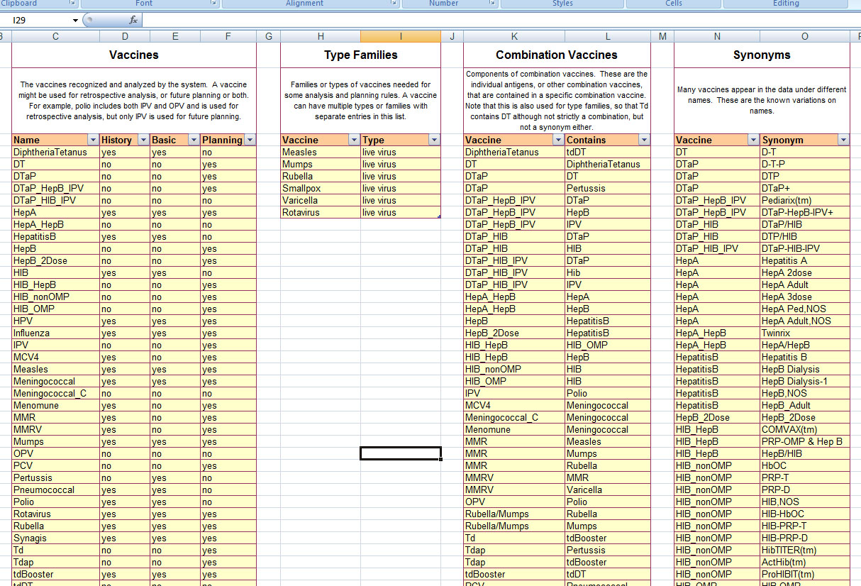
Complete Range of Vaccines
Full list of vaccines handled

Slide 7
Handles Combo Vaccine Hierarchies
Note the nested hierarchy used to define the MMRV family

Slide 8
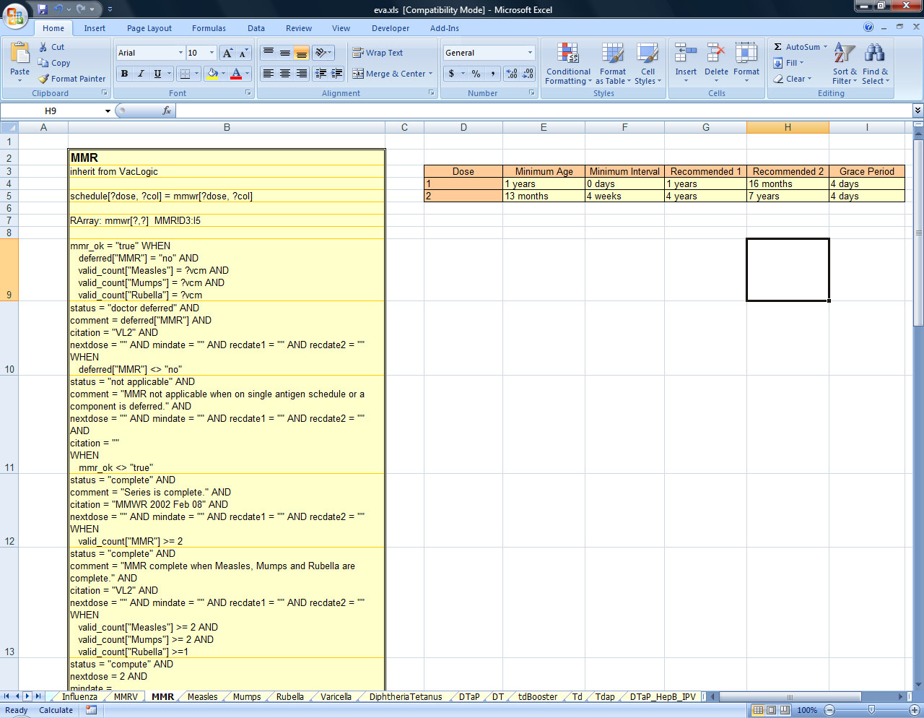
Each Vaccine has a Worksheet
A vaccine worksheet has schedule tables
And rules for when and how to apply schedules

Slide 9
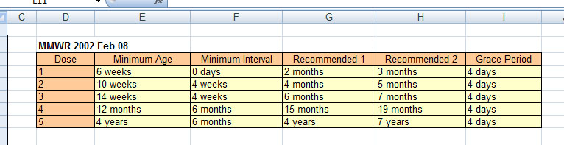
DTaP Worksheet Schedule

Slide 10
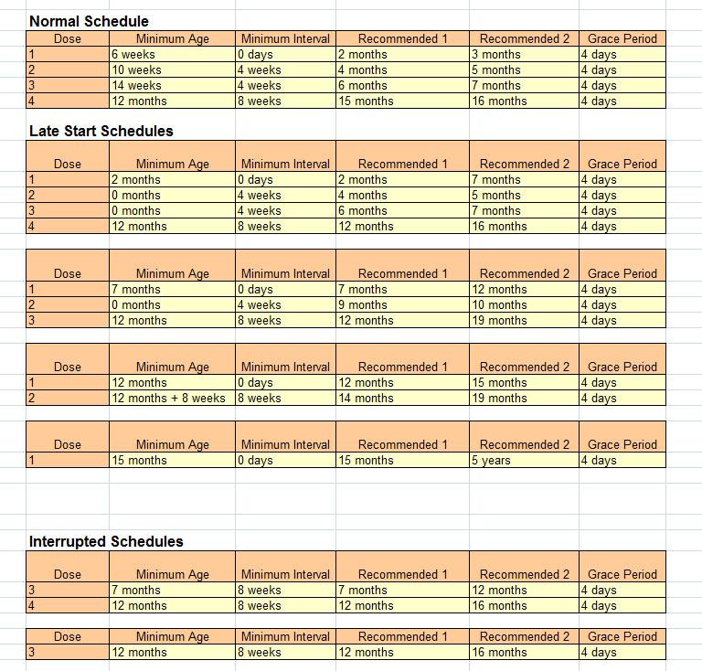
Complex Hib non-OMP schedules

Slide 11
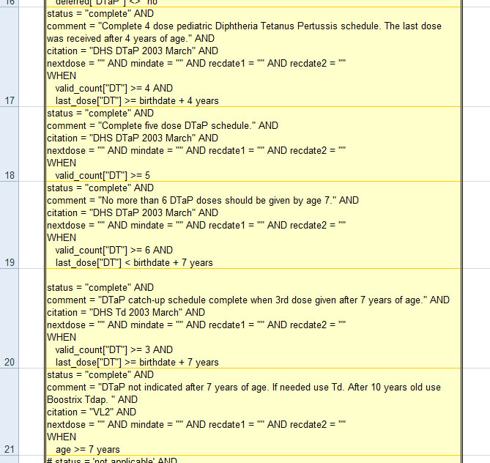
DTaP Rules for Series Completion

Slide 12
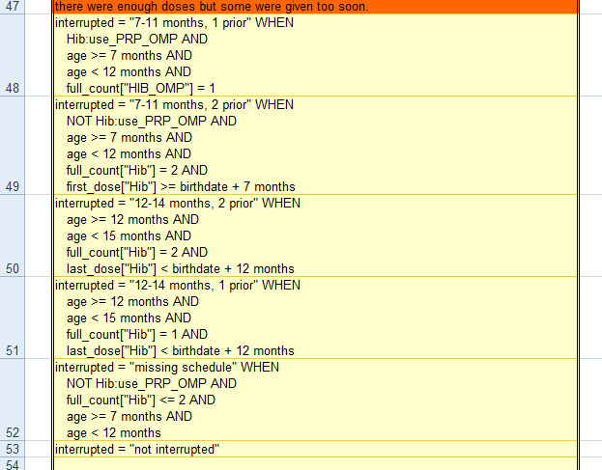
Hib non-OMP Rules for Selecting an Interrupted Schedule

Slide 13
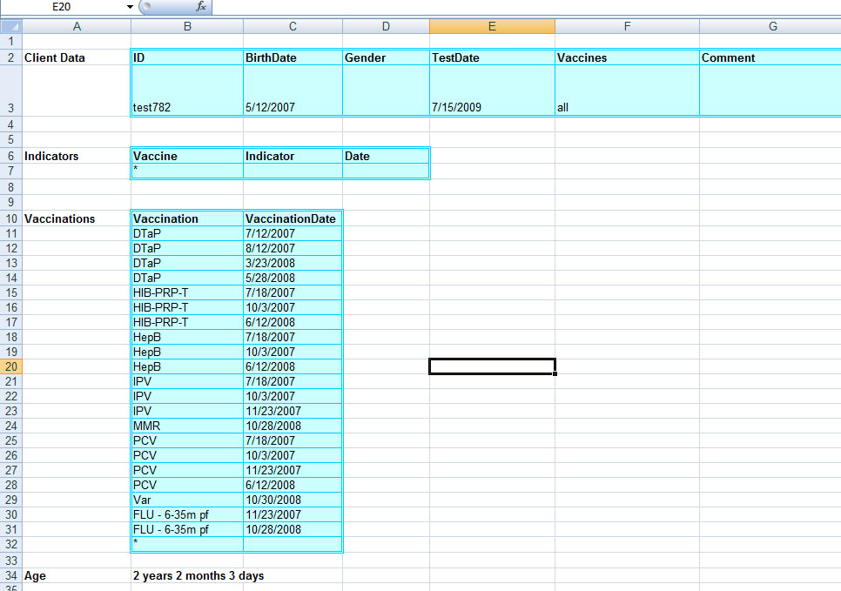
Input Data
The development environment has a full testing capability. This test case has faults in the DTaP and Varicella vaccinations.

Slide 14
Accurately analyzes past vaccinations
Within recommended ranges
Early but OK
Late but OK
Too early to count
Doctor exempted
Redundant
Extra

Slide 15
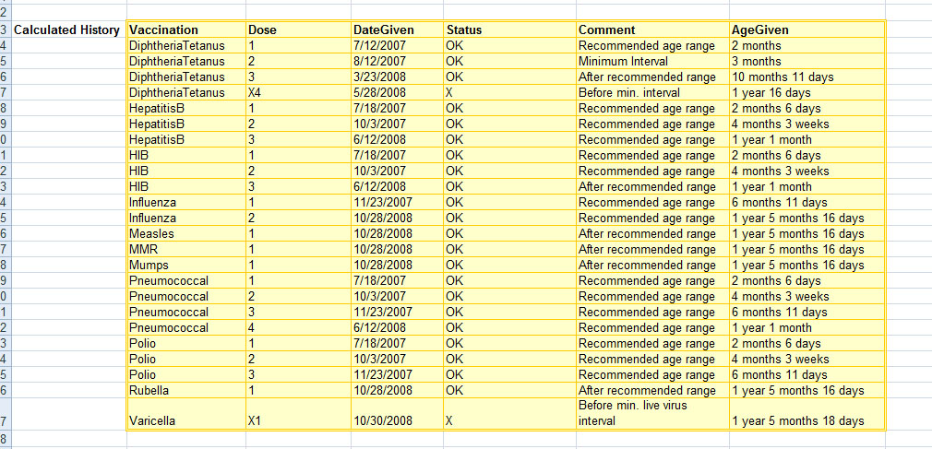
Output Historical Analysis

Slide 16
Accurately forecasts next required vaccinations
Status
Complete
Due
Eligible (not due yet, but OK to give)
Current
Behind
Optimal range for next dose
Earliest date for next dose
Comments about dose, reflecting issues related to combo vaccines etc.
Citations for recommendation

Slide 17
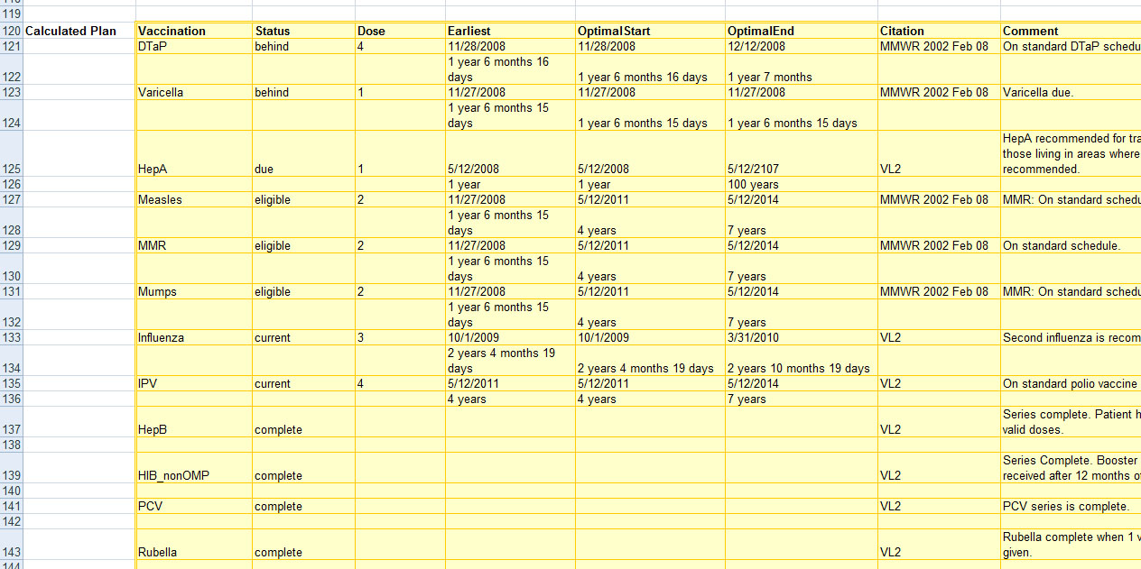
Output Forecast Plan

Slide 18
Quickly and Easily responds to changes and new vaccines
Initial coding of all vaccines took less than one month
Changes since then include:
Rotavirus – added in less than half hour (a new vaccine)
HPV – added in less than an hour (required adding gender as a field for reasoning)
MMRV – around 15 minutes (built on existing MMR and Varicella rules)

Slide 19
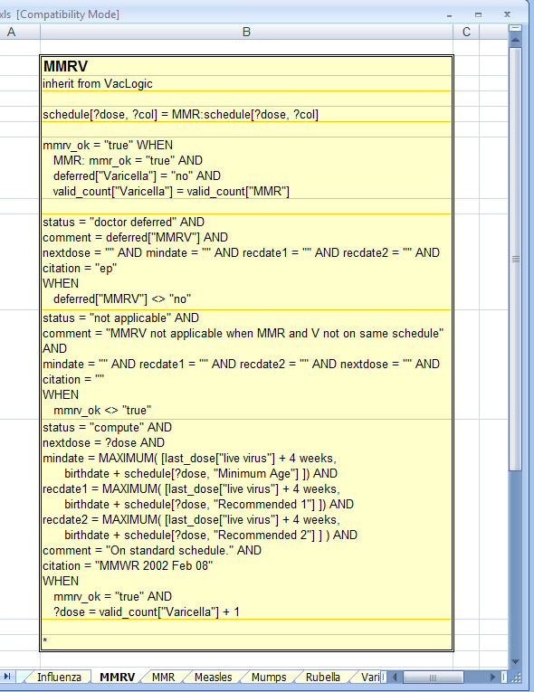
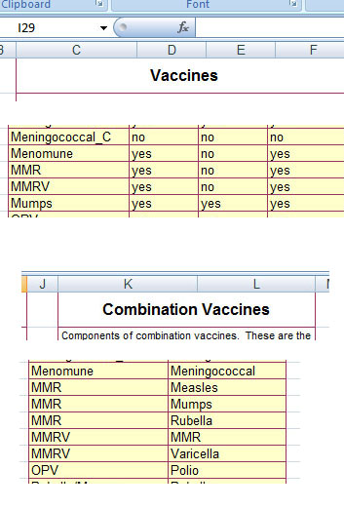
Adding MMRV
Step 1:
Add to list of vaccines
MMRV Rules:
Use the same schedule as MMR.
Use when MMR is OK and Varicella count is same as MMR count.
Use the schedule separations or last live virus separation.
Step 2:
Define MMRV components
Step 3:
Create new worksheet

Slide 20
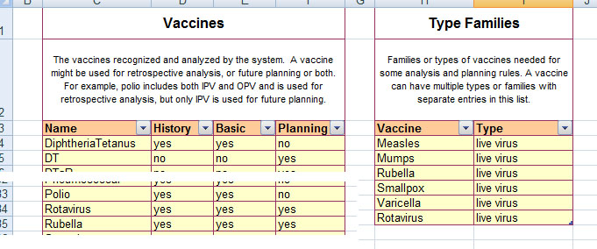
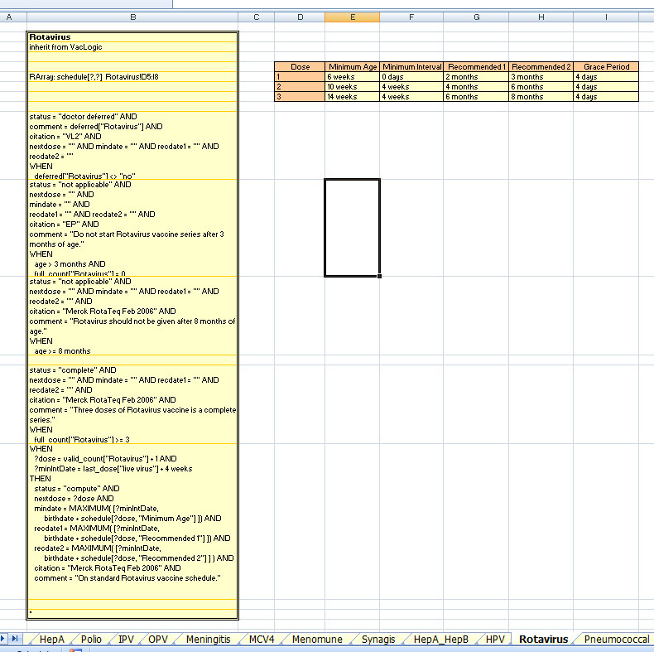
Adding Rotavirus
Rotavirus rules:
Not applicable if not started by 3 months or not finished by 8 months.
Complete if three valid doses.
Use schedule for separations or live virus constraint.
Step 1:
Add to list of vaccines
Step 2:
Define as a live virus vaccine
Step 3:
Add the schedule and rules to a new worksheet

Slide 21
Accurate
Easily vetted by vaccine experts who can read the rules directly without programmer intervention
Citations available for all rules
Full testing capability in Excel-based tool
Libraries of test cases, with expected results, stored for automatic analysis of the effects of any changes

Slide 22
Deploy Anywhere
Windows and/or Unix
C++, VB, Delphi, Java, .NET, ...
Uses XML for inputs and outputs

Slide 23
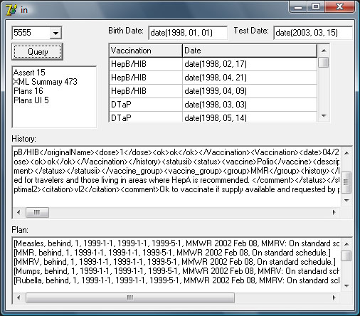
Simple Deployment Example
Runs in Delphi using binary export from development environment
Takes vaccination inputs
Outputs raw XML historical analysis
Outputs forecast plan as a list of lists

Slide 24
EVA
The perfect tool for vaccination analysis and forecast
Handles the most complex scenarios
Yet easily updated for constantly changing vaccines and combinations
Knowledge can be read and maintained directly by vaccine experts, not programmers
Knowledge can be easily deployed in any computing environment

