Slide 2
https://www.hackster.io/contests/board-designer/rules#challengeNav

Slide 3
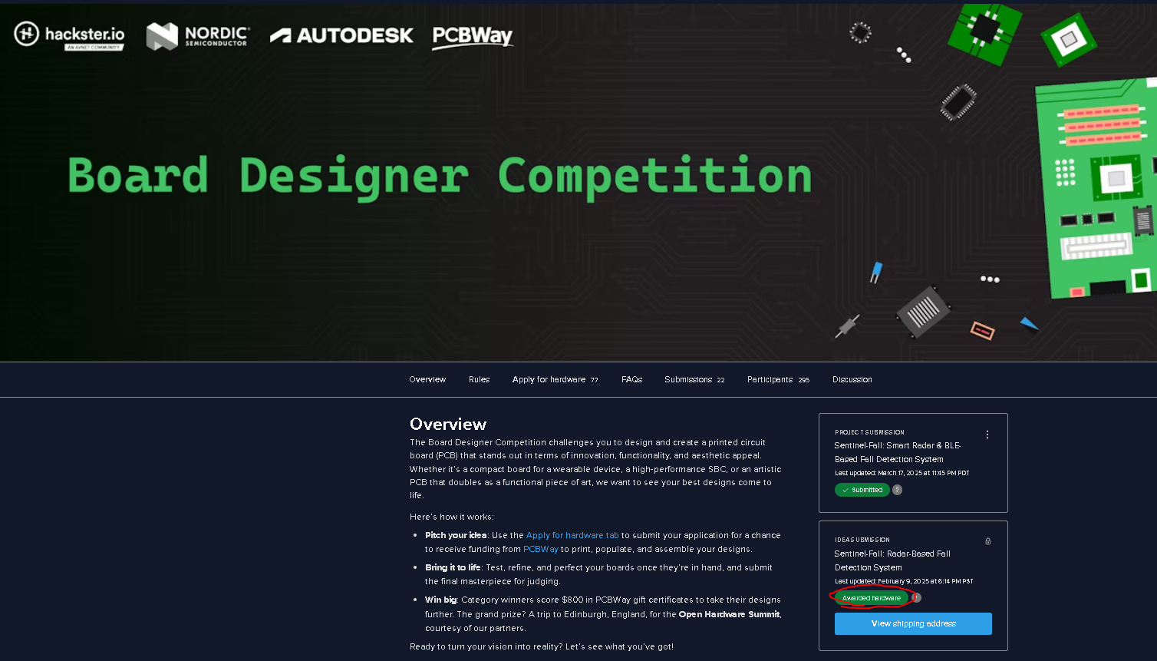
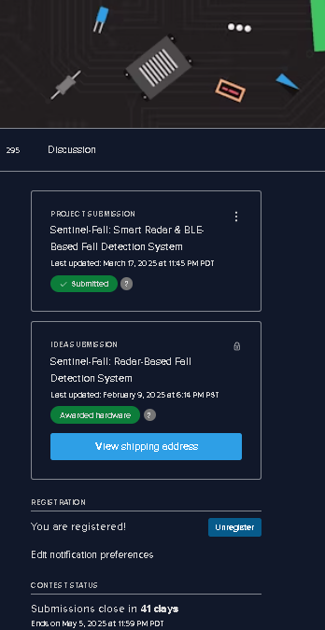
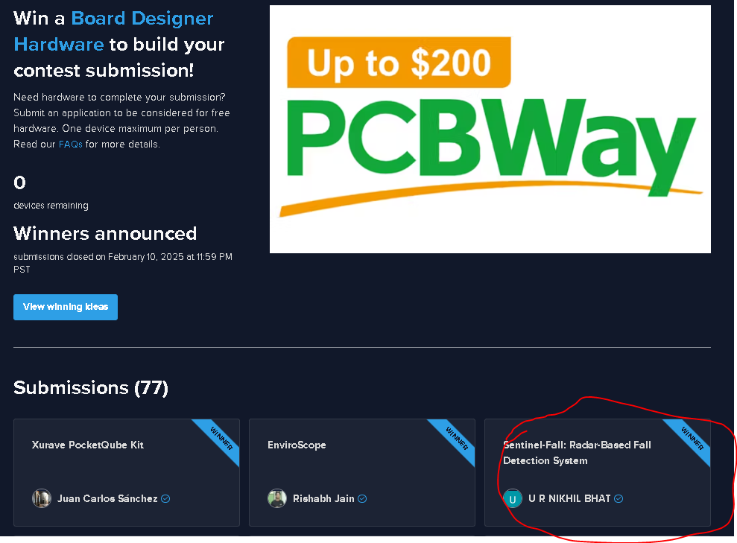

Slide 4
