Slide 1

by Anant Maheshwari
Under the guidance of- Dr Anjali ABV-IIITM Gwalior

Slide 2
The Data:
53000 rows with 6 independent variables
Issue_id: Completely uninformative - Can be dropped
Status: Categorical with cardinality 3
Can treat as Categorical
Resolution: Categorical with cardinality 9
Component: Categorical with 100+ cardinality
Need to convert into numbers which capture semantic meaning
Title: Short Text
Description: Long Text
1 Dependent variable
Priority: 5 classes. Extremely imbalanced - Need to handle Class Imbalance

Slide 3

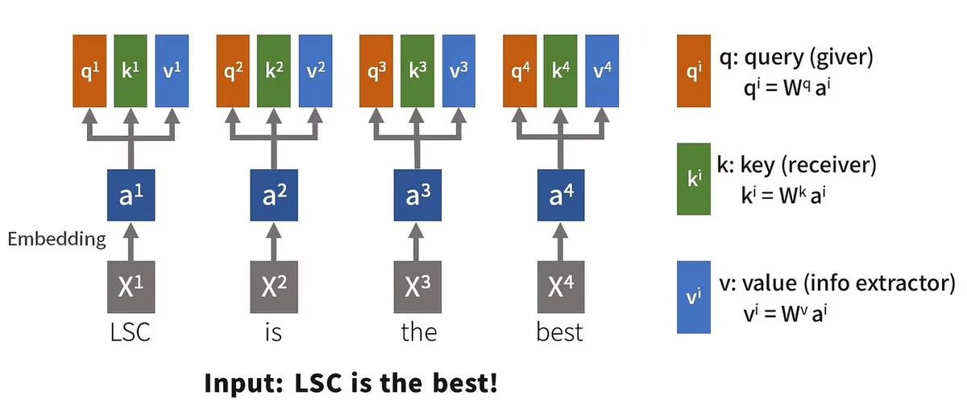
BERT: Bidirectional Encoder Representations from Transformers
Sounds cool? ✅ Yes Does it make sense? 🤔 Well… let’s break it down
Transformers – Uses self-attention to understand relationships in text.
Bidirectional because reads text from both left and right for better context.
Encoder – Encoder only model. Perfect for our Task!
Representations – Not just word meaning, but contextual & semantic meaning (e.g., bank vs. river bank).
Tell me who your friends are, and I'll tell you who you are

Slide 4

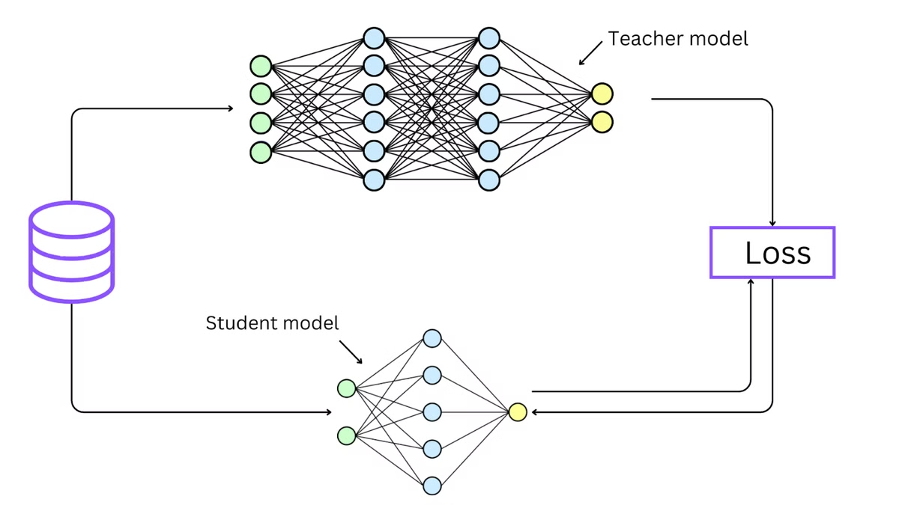
Leveraging DistilBERT
Issue: BERT is Huge!
📌 110 million parameters → Expensive to train 📌 For context: Fine tuning BERT (batch size 16, 2 epochs) = ~0.5 trillion multiplications
Distillation to the Rescue! 🔥
Train a smaller, simpler model on the logits of the parent model Child model learns to mimic the parent model’s behavior
Result → DistilBERT
✅ Only 60% of BERT’s parameters while retaining 97% of its accuracy ✅ Cuts training time by nearly 50%!!

Slide 5

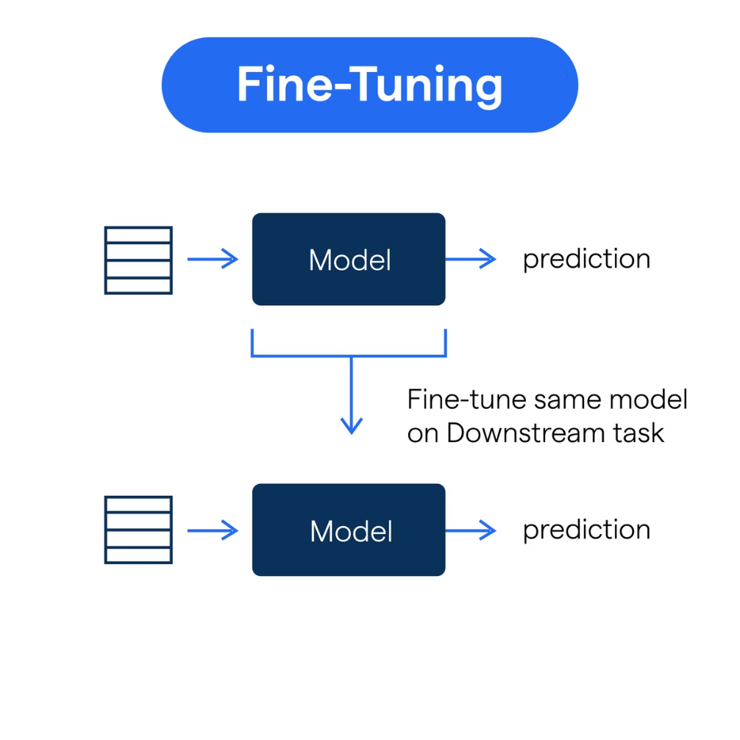
Fine-Tuning DistilBERT: Domain Adaptation
Very important Step-
🔹 Pretrained models learn general language patterns 🔹 Fine-tuning adapts them to domain-specific text
Load DistilBERT with a classification head (Shoutout to Hugging Face! Train on labeled data → Model learns text patterns tailored for classification Extract sentence-level embeddings → Use CLS token embeddings from the last attention layer
Inputs → Concatenation of Component, Title and Description Labels → Bug Priorities Outputs → Rich sentence embeddings
Use sample weights to handle class imbalance (more on this later)

Slide 6
What about Categorical data?
1
Frequency Encoding
2
Target Encoding
Replace categories with their occurrence frequency in the dataset
Replace categories with the mode target value for that category
Helps capture the importance of a category based on how often it appears
Helps capture relationships between categorical features and the target
Useful for handling high-cardinality categorical features
Works well when the category has a strong correlation with the label
Example: Component_X appears in 10% of data → Encoded as 0.10
Example: Resolution_X mostly has priority score of 2 → Encoded as 2
⚠ Caution: Can lead to data leakage if not handled correctly!
Use above techniques with combinations of Categorical Features to capture their interactions

Slide 7

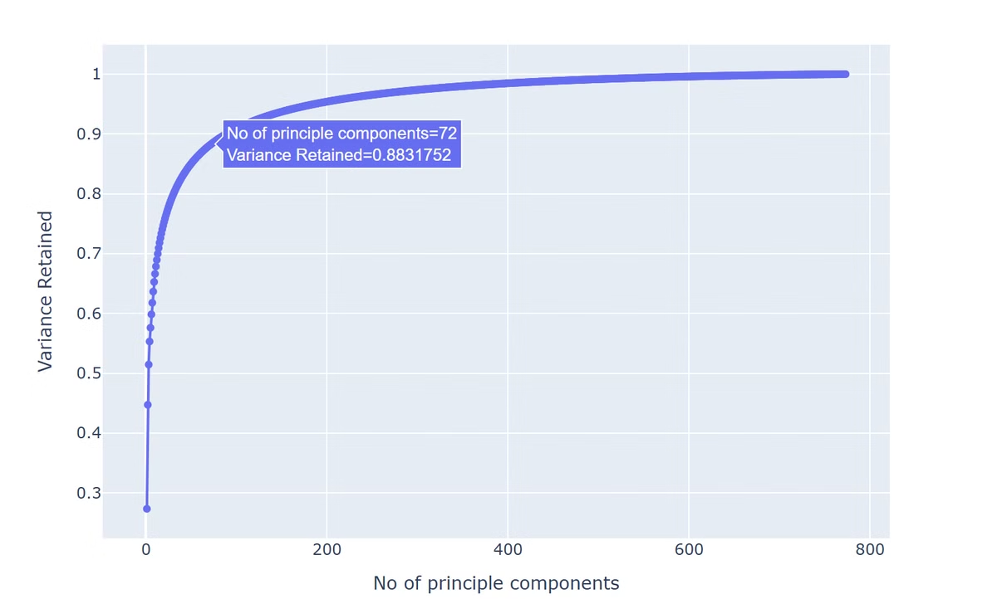
Dimensionality Reduction
📌 Embeddings are high-dimensional! 📌 DistilBERT embeddings = 768 dimensions!!
Curse of Dimensionality → More dimensions = Harder to model efficiently
Solution: PCA (Principal Component Analysis) ✅ Projects data onto a lower-dimensional space ✅ Retains maximum information while reducing complexity
Faster training, less overfitting, better efficiency!
Now we can also Cluster Encode this lower dimensional data using K-Means and use the cluster number as a feature
Notes:
add pca graph

Slide 8

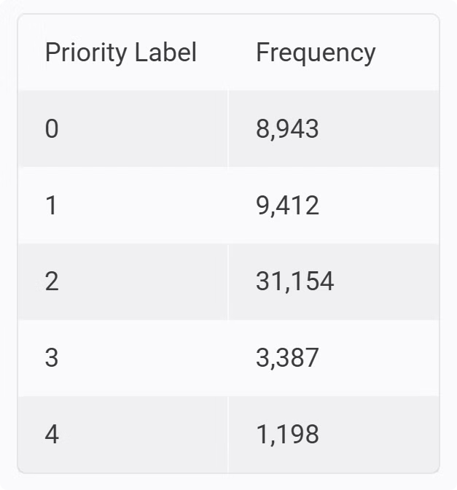
Addressing Class Imbalance
Sample Weights
SMOTE-NC
✅ Assign higher weights to minority class samples ✅ Guides model to learn more from less data without oversampling ✅ Simple & effective → Works with any kind of data!
✅ Generates synthetic samples for minority classes ✅ Allows categorical features (unlike standard SMOTE) ✅ Stronger technique, better suited for numerical data as it creates new synthetic samples
Implemented during DistilBERT finetuning
Implemented before downstream classification
Notes:
add priority value counts

Slide 9

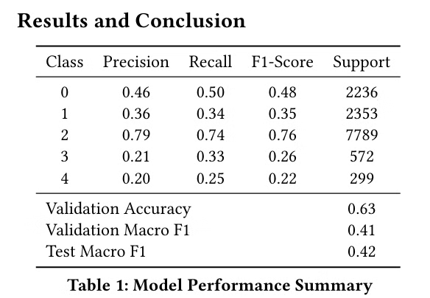
XGBoost for Classification
Combines weak learners (trees) to form a strong model
Incremental weak learners are trained on the error of the previous model
Built in support for Categorical Data
Further optimised by Optuna to find best model hyper paramaters

Slide 10

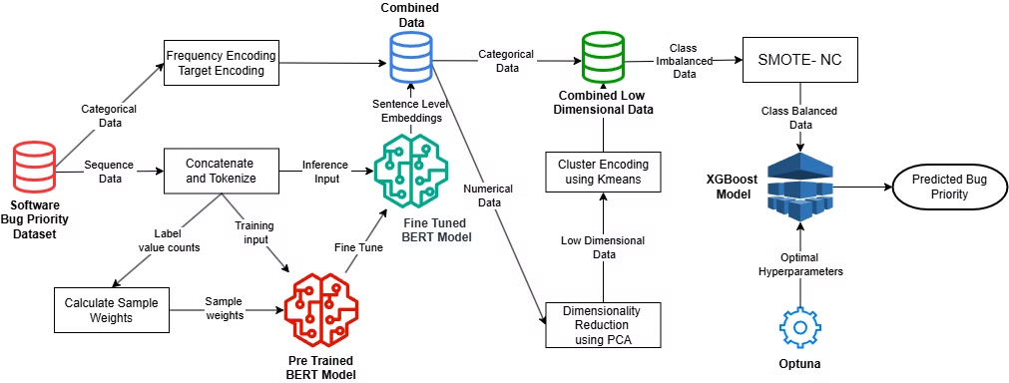
Final Pipeline
BugBERT achieves promising results, demonstrating the potential of NLP and ML in automating bug report prioritization. The model effectively captures patterns within the data, enabling efficient software maintenance.
Thank You for your Attention !!

