Slide 1
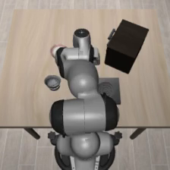
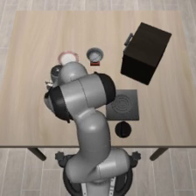
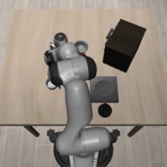
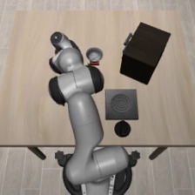
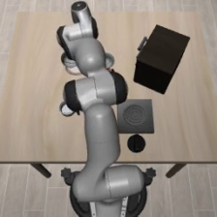
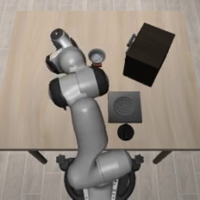
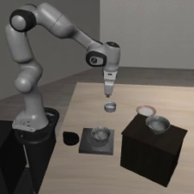
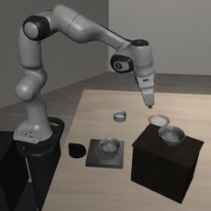
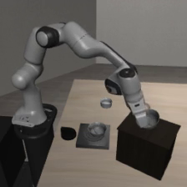
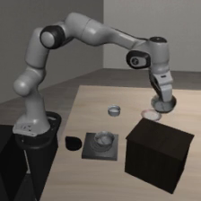
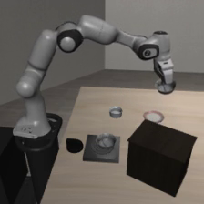
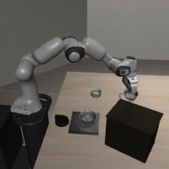
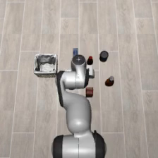
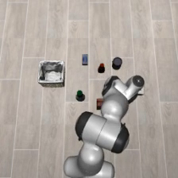
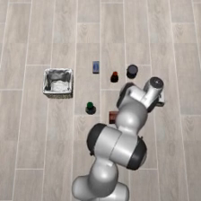
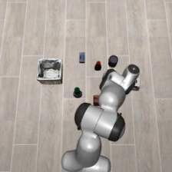
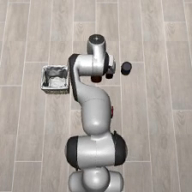
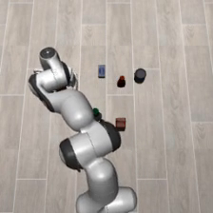
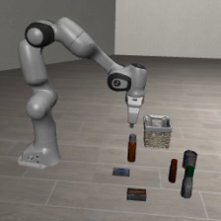
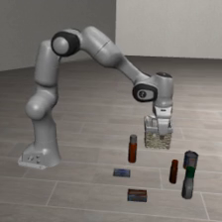
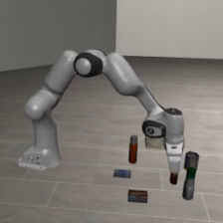
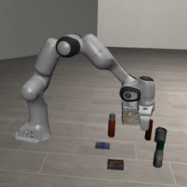
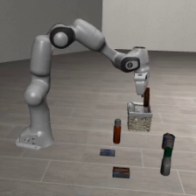
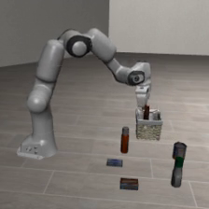
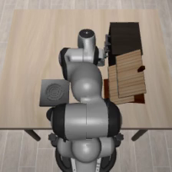
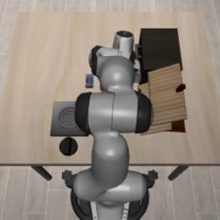
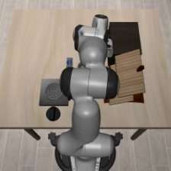
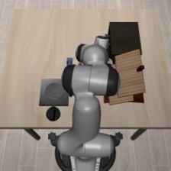
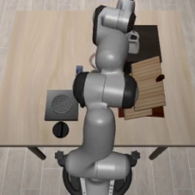
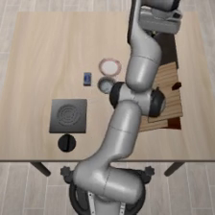
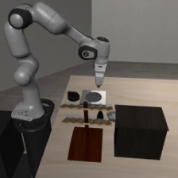
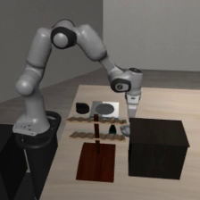
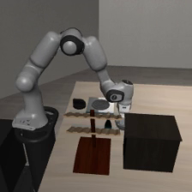
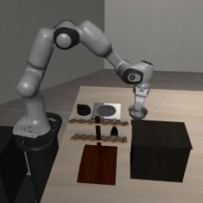
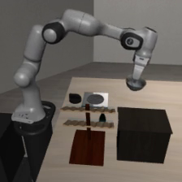
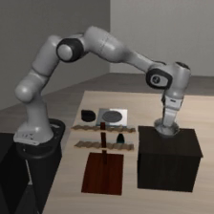
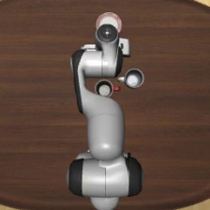
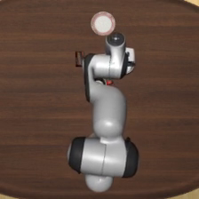
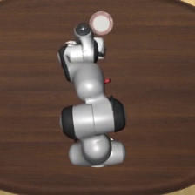
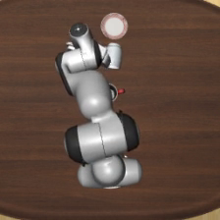
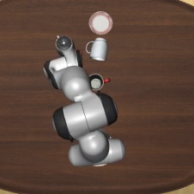
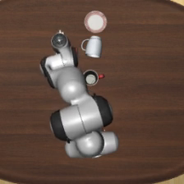
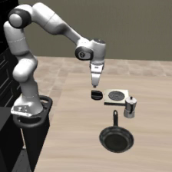
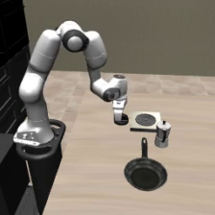
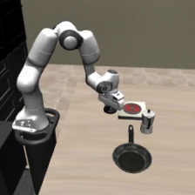
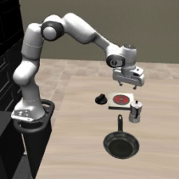
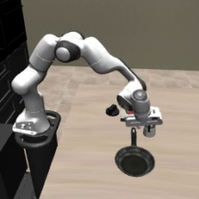
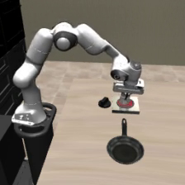
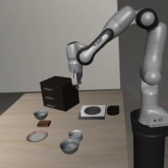
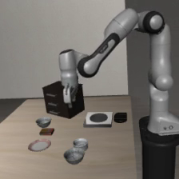














































(a) Back view
Episode progress →
(b) Left view
Episode progress →
Start
20%
40%
60%
80%
End
Start
20%
40%
60%
80%
End
Spatial
Bowl on ramekin → plate
Failure
Spatial
Bowl on cabinet → plate
Success
Object
Ketchup → basket
Success
Object
BBQ sauce → basket
Success
Goal
Wine bottle → cabinet top
Success
Goal
Bowl → cabinet top
Success
Long
Mug → plate; pudding → right of plate
Failure
Long
Turn on stove; moka pot → stove
Success
(c) Right view
Episode progress →
(d) Top view
Episode progress →
Start
20%
40%
60%
80%
End
Start
20%
40%
60%
80%
End
Spatial
Bowl beside ramekin → plate
Success
Spatial
Bowl on stove → plate
Success
Object
Milk → basket
Failure
Object
Ketchup → basket
Success
Goal
Turn on stove
Success
Goal
Wine bottle → rack
Failure
Long
Two mugs → left and right plates
Success
Long
Soup and tomato sauce → basket
Success
Notes:
ACPD only. Original closed-loop evaluation videos, not demonstration trajectories.
Random selection seed: 20261029. One independent uniform task/episode draw per view-suite cell, without outcome filtering.
Six uniformly spaced recorded frames include the first and last available frame. Percentages indicate progress through each recorded episode, not matched physical times across episodes.
Success/failure is the original evaluator outcome. The last image is the last recorded pre-action frame.
back/spatial, task 5, episode 23, failure: pick up the black bowl on the ramekin and place it on the plate
/opt/liutong/openpi-5090-evals/acpd-v2-training-trajectory/final-hidden/34999/spatial/videos/pick_up_the_black_bowl_on_the_ramekin_and_place_it_on_the_plate_23_failure.mp4
back/object, task 4, episode 26, success: pick up the ketchup and place it in the basket
/opt/liutong/openpi-5090-evals/acpd-v2-training-trajectory/final-hidden/34999/object/videos/pick_up_the_ketchup_and_place_it_in_the_basket_26_success.mp4
back/goal, task 2, episode 15, success: put the wine bottle on top of the cabinet
/opt/liutong/openpi-5090-evals/acpd-v2-training-trajectory/final-hidden/34999/goal/videos/put_the_wine_bottle_on_top_of_the_cabinet_15_success.mp4
back/long, task 6, episode 27, failure: put the white mug on the plate and put the chocolate pudding to the right of the plate
/opt/liutong/openpi-5090-evals/acpd-v2-training-trajectory/final-hidden/34999/libero_10/videos/put_the_white_mug_on_the_plate_and_put_the_chocolate_pudding_to_the_right_of_the_plate_27_failure.mp4
left/spatial, task 9, episode 46, success: pick up the black bowl on the wooden cabinet and place it on the plate
/opt/liutong/openpi-5090-evals/acpd-v2-trajectory-31k-34k/leftview/31999/spatial/videos/pick_up_the_black_bowl_on_the_wooden_cabinet_and_place_it_on_the_plate_46_success.mp4
left/object, task 3, episode 28, success: pick up the bbq sauce and place it in the basket
/opt/liutong/openpi-5090-evals/acpd-v2-trajectory-31k-34k/leftview/31999/object/videos/pick_up_the_bbq_sauce_and_place_it_in_the_basket_28_success.mp4
left/goal, task 4, episode 35, success: put the bowl on top of the cabinet
/opt/liutong/openpi-5090-evals/acpd-v2-trajectory-31k-34k/leftview/31999/goal/videos/put_the_bowl_on_top_of_the_cabinet_35_success.mp4
left/long, task 2, episode 45, success: turn on the stove and put the moka pot on it
/opt/liutong/openpi-5090-evals/acpd-v2-trajectory-31k-34k/leftview/31999/libero_10/videos/turn_on_the_stove_and_put_the_moka_pot_on_it_45_success.mp4
right/spatial, task 1, episode 42, success: pick up the black bowl next to the ramekin and place it on the plate
/opt/liutong/openpi-5090-evals/acpd-v2-trajectory-31k-34k/rightview/31999/spatial/videos/pick_up_the_black_bowl_next_to_the_ramekin_and_place_it_on_the_plate_42_success.mp4
right/object, task 7, episode 19, failure: pick up the milk and place it in the basket
/opt/liutong/openpi-5090-evals/acpd-v2-trajectory-31k-34k/rightview/31999/object/videos/pick_up_the_milk_and_place_it_in_the_basket_19_failure.mp4
right/goal, task 7, episode 0, success: turn on the stove
/opt/liutong/openpi-5090-evals/acpd-v2-trajectory-31k-34k/rightview/31999/goal/videos/turn_on_the_stove_00_success.mp4
right/long, task 4, episode 34, success: put the white mug on the left plate and put the yellow and white mug on the right plate
/opt/liutong/openpi-5090-evals/acpd-v2-trajectory-31k-34k/rightview/31999/libero_10/videos/put_the_white_mug_on_the_left_plate_and_put_the_yellow_and_white_mug_on_the_right_plate_34_success.mp4
top/spatial, task 7, episode 4, success: pick up the black bowl on the stove and place it on the plate
/opt/liutong/openpi-5090-evals/acpd-v2-multiview-35k/topview/31999/spatial/videos/pick_up_the_black_bowl_on_the_stove_and_place_it_on_the_plate_04_success.mp4
top/object, task 4, episode 17, success: pick up the ketchup and place it in the basket
/opt/liutong/openpi-5090-evals/acpd-v2-multiview-35k/topview/31999/object/videos/pick_up_the_ketchup_and_place_it_in_the_basket_17_success.mp4
top/goal, task 9, episode 2, failure: put the wine bottle on the rack
/opt/liutong/openpi-5090-evals/acpd-v2-multiview-35k/topview/31999/goal/videos/put_the_wine_bottle_on_the_rack_02_failure.mp4
top/long, task 0, episode 44, success: put both the alphabet soup and the tomato sauce in the basket
/opt/liutong/openpi-5090-evals/acpd-v2-multiview-35k/topview/31999/libero_10/videos/put_both_the_alphabet_soup_and_the_tomato_sauce_in_the_basket_44_success.mp4

Slide 2
ACPD · Back view
Episode progression →
Spatial
pick up the black bowl on the ramekin and place it on the plate
Step 0
Step 44
Step 88
Step 131
Step 175
Step 219 · Failure
Object
pick up the ketchup and place it in the basket
Step 0
Step 39
Step 79
Step 118
Step 158
Step 197 · Success
Goal
put the wine bottle on top of the cabinet
Step 0
Step 22
Step 43
Step 65
Step 86
Step 108 · Success
Long
put the white mug on the plate and put the chocolate pudding to the right of the plate
Step 0
Step 104
Step 208
Step 311
Step 415
Step 519 · Failure
Notes:
ACPD only. Original closed-loop evaluation videos, not demonstration trajectories.
Random selection seed: 20261029. One independent uniform task/episode draw per view-suite cell, without outcome filtering.
Six uniformly spaced recorded frames include the first and last available frame. Percentages indicate progress through each recorded episode, not matched physical times across episodes.
Success/failure is the original evaluator outcome. The last image is the last recorded pre-action frame.
back/spatial, task 5, episode 23, failure: pick up the black bowl on the ramekin and place it on the plate
/opt/liutong/openpi-5090-evals/acpd-v2-training-trajectory/final-hidden/34999/spatial/videos/pick_up_the_black_bowl_on_the_ramekin_and_place_it_on_the_plate_23_failure.mp4
back/object, task 4, episode 26, success: pick up the ketchup and place it in the basket
/opt/liutong/openpi-5090-evals/acpd-v2-training-trajectory/final-hidden/34999/object/videos/pick_up_the_ketchup_and_place_it_in_the_basket_26_success.mp4
back/goal, task 2, episode 15, success: put the wine bottle on top of the cabinet
/opt/liutong/openpi-5090-evals/acpd-v2-training-trajectory/final-hidden/34999/goal/videos/put_the_wine_bottle_on_top_of_the_cabinet_15_success.mp4
back/long, task 6, episode 27, failure: put the white mug on the plate and put the chocolate pudding to the right of the plate
/opt/liutong/openpi-5090-evals/acpd-v2-training-trajectory/final-hidden/34999/libero_10/videos/put_the_white_mug_on_the_plate_and_put_the_chocolate_pudding_to_the_right_of_the_plate_27_failure.mp4

Slide 3
ACPD · Left view
Episode progression →
Spatial
pick up the black bowl on the wooden cabinet and place it on the plate
Step 0
Step 23
Step 47
Step 70
Step 94
Step 117 · Success
Object
pick up the bbq sauce and place it in the basket
Step 0
Step 25
Step 50
Step 76
Step 101
Step 126 · Success
Goal
put the bowl on top of the cabinet
Step 0
Step 20
Step 40
Step 61
Step 81
Step 101 · Success
Long
turn on the stove and put the moka pot on it
Step 0
Step 46
Step 91
Step 137
Step 182
Step 228 · Success
Notes:
ACPD only. Original closed-loop evaluation videos, not demonstration trajectories.
Random selection seed: 20261029. One independent uniform task/episode draw per view-suite cell, without outcome filtering.
Six uniformly spaced recorded frames include the first and last available frame. Percentages indicate progress through each recorded episode, not matched physical times across episodes.
Success/failure is the original evaluator outcome. The last image is the last recorded pre-action frame.
left/spatial, task 9, episode 46, success: pick up the black bowl on the wooden cabinet and place it on the plate
/opt/liutong/openpi-5090-evals/acpd-v2-trajectory-31k-34k/leftview/31999/spatial/videos/pick_up_the_black_bowl_on_the_wooden_cabinet_and_place_it_on_the_plate_46_success.mp4
left/object, task 3, episode 28, success: pick up the bbq sauce and place it in the basket
/opt/liutong/openpi-5090-evals/acpd-v2-trajectory-31k-34k/leftview/31999/object/videos/pick_up_the_bbq_sauce_and_place_it_in_the_basket_28_success.mp4
left/goal, task 4, episode 35, success: put the bowl on top of the cabinet
/opt/liutong/openpi-5090-evals/acpd-v2-trajectory-31k-34k/leftview/31999/goal/videos/put_the_bowl_on_top_of_the_cabinet_35_success.mp4
left/long, task 2, episode 45, success: turn on the stove and put the moka pot on it
/opt/liutong/openpi-5090-evals/acpd-v2-trajectory-31k-34k/leftview/31999/libero_10/videos/turn_on_the_stove_and_put_the_moka_pot_on_it_45_success.mp4

Slide 4
ACPD · Right view
Episode progression →
Spatial
pick up the black bowl next to the ramekin and place it on the plate
Step 0
Step 21
Step 41
Step 62
Step 82
Step 103 · Success
Object
pick up the milk and place it in the basket
Step 0
Step 56
Step 112
Step 167
Step 223
Step 279 · Failure
Goal
turn on the stove
Step 0
Step 18
Step 36
Step 55
Step 73
Step 91 · Success
Long
put the white mug on the left plate and put the yellow and white mug on the right plate
Step 0
Step 51
Step 101
Step 152
Step 202
Step 253 · Success
Notes:
ACPD only. Original closed-loop evaluation videos, not demonstration trajectories.
Random selection seed: 20261029. One independent uniform task/episode draw per view-suite cell, without outcome filtering.
Six uniformly spaced recorded frames include the first and last available frame. Percentages indicate progress through each recorded episode, not matched physical times across episodes.
Success/failure is the original evaluator outcome. The last image is the last recorded pre-action frame.
right/spatial, task 1, episode 42, success: pick up the black bowl next to the ramekin and place it on the plate
/opt/liutong/openpi-5090-evals/acpd-v2-trajectory-31k-34k/rightview/31999/spatial/videos/pick_up_the_black_bowl_next_to_the_ramekin_and_place_it_on_the_plate_42_success.mp4
right/object, task 7, episode 19, failure: pick up the milk and place it in the basket
/opt/liutong/openpi-5090-evals/acpd-v2-trajectory-31k-34k/rightview/31999/object/videos/pick_up_the_milk_and_place_it_in_the_basket_19_failure.mp4
right/goal, task 7, episode 0, success: turn on the stove
/opt/liutong/openpi-5090-evals/acpd-v2-trajectory-31k-34k/rightview/31999/goal/videos/turn_on_the_stove_00_success.mp4
right/long, task 4, episode 34, success: put the white mug on the left plate and put the yellow and white mug on the right plate
/opt/liutong/openpi-5090-evals/acpd-v2-trajectory-31k-34k/rightview/31999/libero_10/videos/put_the_white_mug_on_the_left_plate_and_put_the_yellow_and_white_mug_on_the_right_plate_34_success.mp4

Slide 5
ACPD · Top view
Episode progression →
Spatial
pick up the black bowl on the stove and place it on the plate
Step 0
Step 36
Step 73
Step 109
Step 146
Step 182 · Success
Object
pick up the ketchup and place it in the basket
Step 0
Step 32
Step 64
Step 97
Step 129
Step 161 · Success
Goal
put the wine bottle on the rack
Step 0
Step 60
Step 120
Step 179
Step 239
Step 299 · Failure
Long
put both the alphabet soup and the tomato sauce in the basket
Step 0
Step 87
Step 175
Step 262
Step 350
Step 437 · Success
Notes:
ACPD only. Original closed-loop evaluation videos, not demonstration trajectories.
Random selection seed: 20261029. One independent uniform task/episode draw per view-suite cell, without outcome filtering.
Six uniformly spaced recorded frames include the first and last available frame. Percentages indicate progress through each recorded episode, not matched physical times across episodes.
Success/failure is the original evaluator outcome. The last image is the last recorded pre-action frame.
top/spatial, task 7, episode 4, success: pick up the black bowl on the stove and place it on the plate
/opt/liutong/openpi-5090-evals/acpd-v2-multiview-35k/topview/31999/spatial/videos/pick_up_the_black_bowl_on_the_stove_and_place_it_on_the_plate_04_success.mp4
top/object, task 4, episode 17, success: pick up the ketchup and place it in the basket
/opt/liutong/openpi-5090-evals/acpd-v2-multiview-35k/topview/31999/object/videos/pick_up_the_ketchup_and_place_it_in_the_basket_17_success.mp4
top/goal, task 9, episode 2, failure: put the wine bottle on the rack
/opt/liutong/openpi-5090-evals/acpd-v2-multiview-35k/topview/31999/goal/videos/put_the_wine_bottle_on_the_rack_02_failure.mp4
top/long, task 0, episode 44, success: put both the alphabet soup and the tomato sauce in the basket
/opt/liutong/openpi-5090-evals/acpd-v2-multiview-35k/topview/31999/libero_10/videos/put_both_the_alphabet_soup_and_the_tomato_sauce_in_the_basket_44_success.mp4

