Slide 1


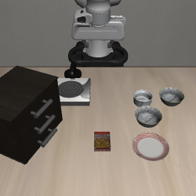
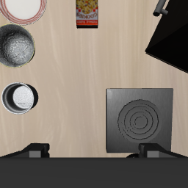







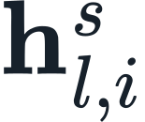
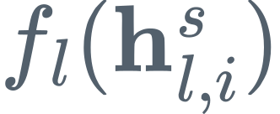
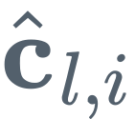

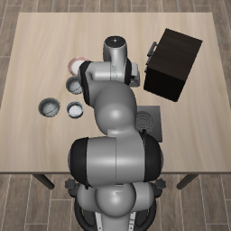

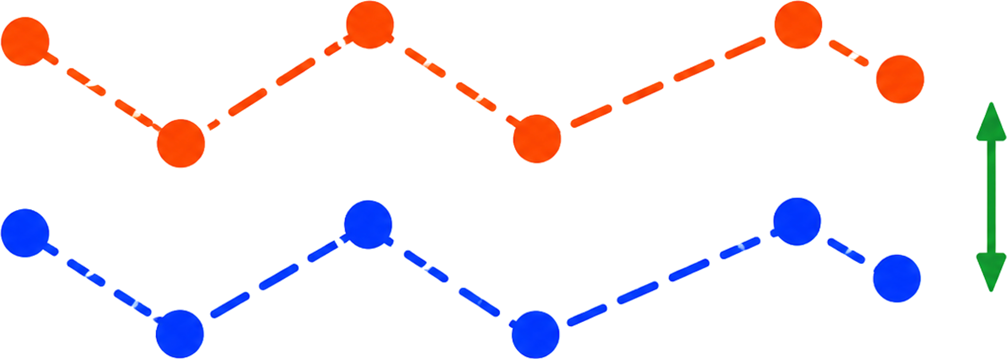




Training setup
ACPD
two complementary training-only objectives
Privileged teacher
A Privileged cue distillation
Privileged views
Teacher features
Cross-Attn
Selected Cue
Visual Backbone
Policy Backbone
Action Expert
Velocity
student query
+
agent wrist
language / state
cosine + variance
Student action state
Cue Predictor
Predicted Cue
Weak-view student
Weak view
Visual Backbone
Policy Backbone
Action Expert
Velocity
+
B Action correlation loss
visual tokens
language/state
H action tokens
Student velocity
language / state
Teacher velocity
relative action dynamics
Deployment
Back-view observation
Student VLA Policy
Robot Action
Frozen teacher + selector + predictor
No extra
inference cost
language / state
unchanged architecture
training only - removed after optimization
Notes:
[Sources]
Method content: user-provided AAAI 2027 manuscript, Action-Conditioned Privileged Distillation section.
Visual reference: user-provided ACPD framework sketch.
Observation frames: synchronized LIBERO episode 001500, timestep 0005 (agent, wrist, and back views), supplied in the Figure2 directory.
Diagram icons and action-correlation trajectory: user-provided PNG assets in the Figure2/materials directory (folder name in Chinese).

Slide 2








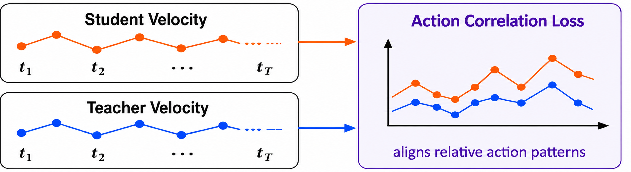


Privileged Teacher
Privileged Cue Distillation
multi-view cameras
Visual
Backbone
Action Head
Teacher View Backbone Feature
Policy
Backbone
Privileged
Information
Teacher Action Head Hidden State
language & state
Language/
State Encoder
k, v
Weak-view Student
weak-view cameras
CrossAttn
Cue
Selector
Privileged
Cue
Visual
Backbone
Action Head
Policy
Backbone
q
language & state
Student Hidden State
Cue
Predictor
$$ℒ_{cue}$$
Language/
State Encoder
Action Correlation Loss
Training Objective
$$ℒ_{\text{ACL}}$$
$$ℒ=ℒ_{\text{flow}}+λ_{\text{cue}}ℒ_{\text{cue}}+λ_{\text{ACL}}ℒ_{\text{ACL}}$$

Slide 3
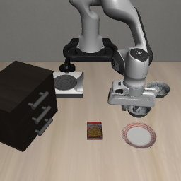
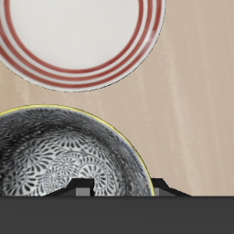
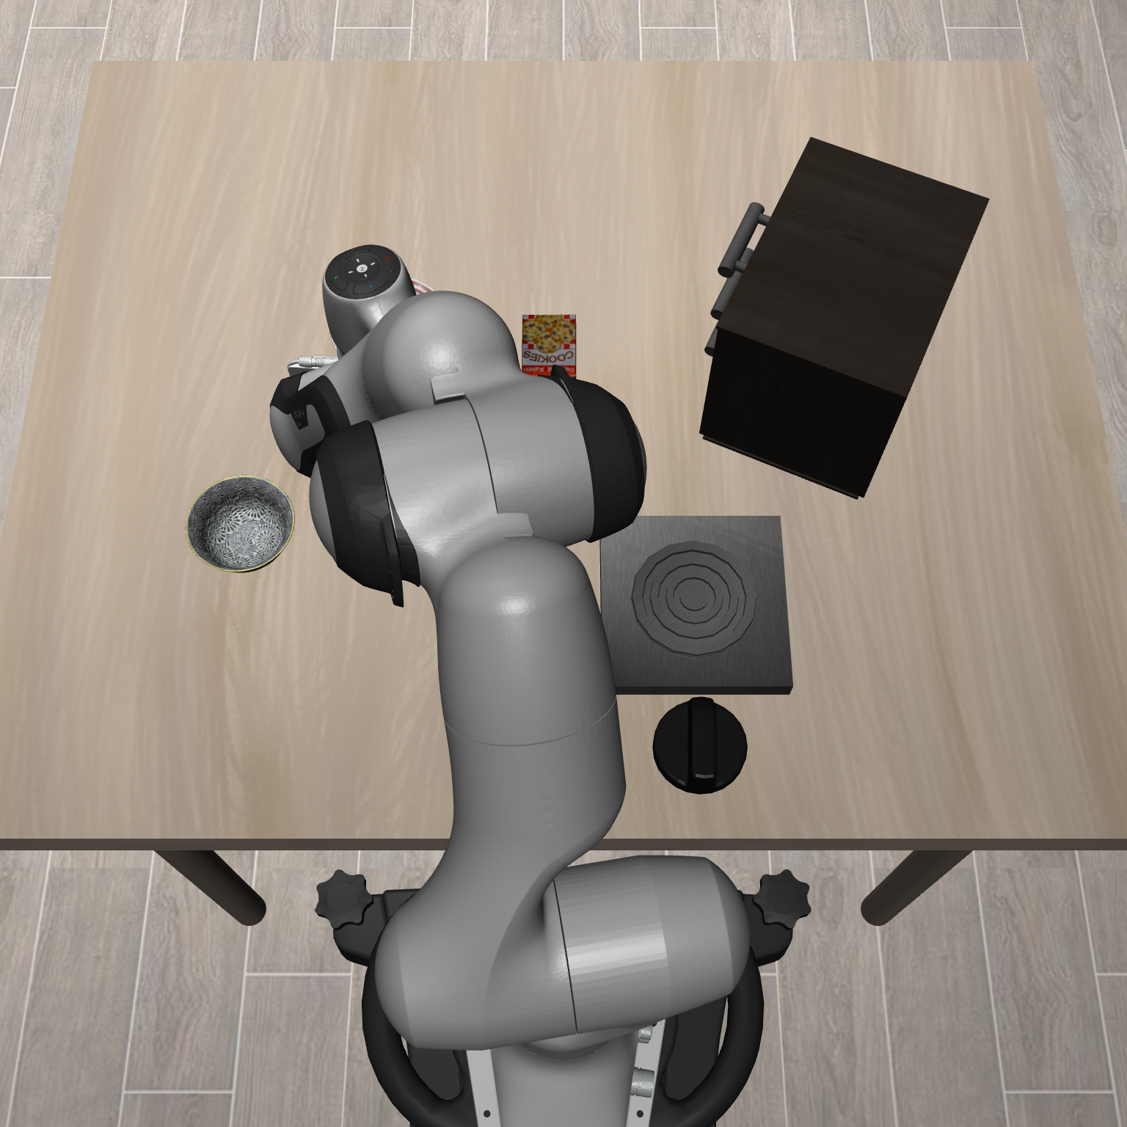
Multi-view teacher (frozen)
Forward
Supervision
Flow-matching
action expert
Cue extraction
VLA
backbone
C_{agent}
vᵗ
C_{wrist}
Teacher velocity
Layer 10
Agent
Wrist
Attention × values
PCD
ACL
Final action states
Projection + scaling
Single-view student
Flow-matching
action expert
Predicted cues
Gated cue fusion
VLA
backbone
Ĉ_{agent}
Cue
predictors
+
sg
Gate
Layer 10
Ĉ_{wrist}
Weak view
Final action states
LN + affine
+
Action
output
vˢ
Final action representations
Notes:
Compact third-slide replacement: title, shared-input banner and objective/deployment footer removed.
Teacher and student occupy adjacent rows in one continuous frame. PCD and ACL are embedded on the right; there is no full-width loss aisle.
Teacher cues use native action-token attention at layer 10, with original normalization, output projection and time-conditioned scaling.
PCD compares each view separately. The plus sign in the student path is only the sum for cue fusion.
Gate denotes tanh(gamma), initialized at zero. sg blocks action-loss gradients through predicted cues.
Cue predictors and the gate remain active at deployment. ACL uses the same noisy actions and flow times for both models.
Ground-truth flow supervision remains active; its full objective is omitted from this compact main figure.
Attention colors are schematic. Camera inputs are genuine synchronized Spatial images.

