Slide 1
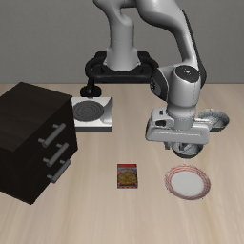
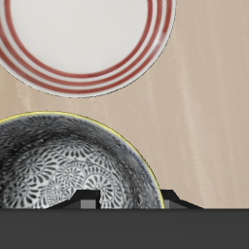
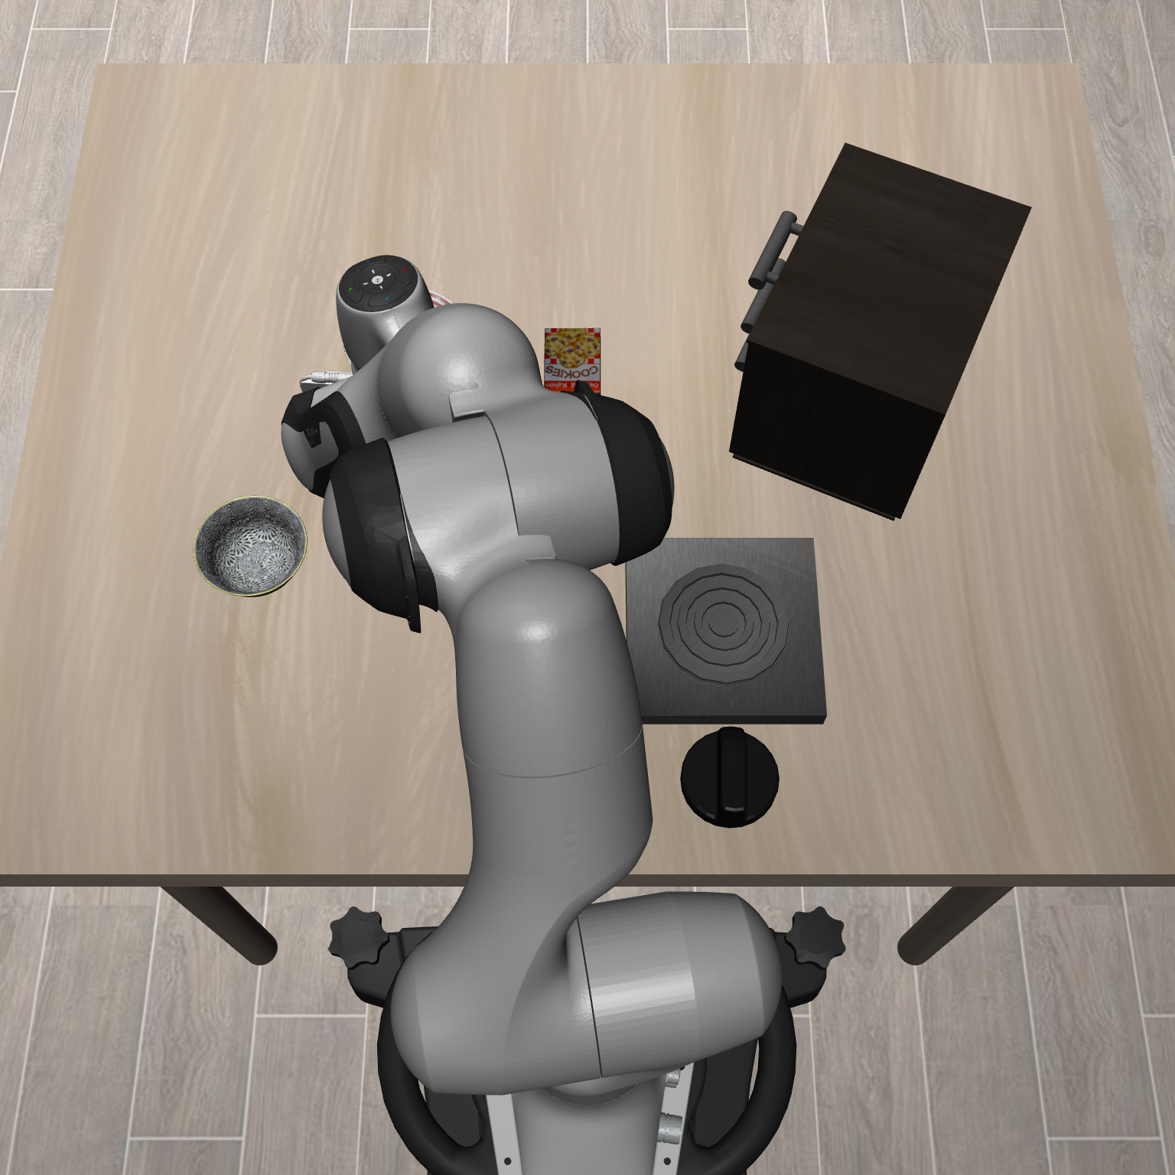
Multi-view teacher (frozen)
Forward
Supervision
Flow-matching
action expert
Cue extraction
C_{agent}
vᵗ
VLA
backbone
Teacher velocity
Layer 10
C_{wrist}
Agent
Wrist
Attention × values
PCD
ACL
Final action states
Projection + scaling
Single-view student
Flow-matching
action expert
Predicted cues
Gated cue fusion
VLA
backbone
Ĉ_{agent}
Cue
predictors
sg
+
Gate
Layer 10
Ĉ_{wrist}
Weak view
LN + affine
Final action states
+
Action
output
vˢ
Final action representations
Notes:
Compact third-slide replacement: title, shared-input banner and objective/deployment footer removed.
Teacher and student occupy adjacent rows in one continuous frame. PCD and ACL are embedded on the right; there is no full-width loss aisle.
Teacher cues use native action-token attention at layer 10, with original normalization, output projection and time-conditioned scaling.
PCD compares each view separately. The plus sign in the student path is only the sum for cue fusion.
Gate denotes tanh(gamma), initialized at zero. sg blocks action-loss gradients through predicted cues.
Cue predictors and the gate remain active at deployment. ACL uses the same noisy actions and flow times for both models.
Ground-truth flow supervision remains active; its full objective is omitted from this compact main figure.
Attention colors are schematic. Camera inputs are genuine synchronized Spatial images.

