Slide 1

Rayleigh Overview
Section 1: Building and Porting the Code

Slide 2
In This Section:
Obtaining the code
Code Dependencies
Compilation
Running an Accuracy Benchmark

Slide 3
Obtaining the code:
Rayleigh is available at:
https://github.com/geodynamics/Rayleigh
Clone repository or download the tarball

Slide 4
Rayleigh Dependencies: (Required to build and run rayleigh)
GNU Make
MPI (Message Passing Interface)
So far, tested on MPICH, MVAPICH, OpenMPI, Intel MPI, SGI MPT
Fortran 2003/MPI compiler
C++ compiler
Math libraries:
BLAS, LAPack, and FFTW 3.x or later
OR
Intel’s Math Kernel Library (MKL*)
* Intel’s MKL provides optimized interfaces to BLAS, LAPack, and FFTW
* It is HIGHLY recommended that you use MKL if running on Intel processors

Slide 5
Building THE CODE (Overview)
Build via the “configure / make / make install” process
From within the Rayleigh directory …
Run ./configure {options}
-- generates make.inc needed for compilation
Run make
-- compiles optimized and debugging versions of Rayleigh
Run make install
-- place executables and documentation in desired location

Slide 6
the Rayleigh configure script
Most important step in the build process
Invocation assigns machine-dependent values to variables usd by Rayleigh’s Makefile.
Variables defined in Rayleigh/src/build/Machine_Definitions
Some examples are shown on the following slides
Obtaining further help:
Run ./configure --help (enumerates all configure options)
Read Rayleigh/INSTALL (various configure examples)

Slide 7
Running configure
Usage:
./configure --option1=value1 … --option{N}=value{N}
Important Options
prefix={Rayleigh Root}
Defines root directory of Rayleigh installation
Executables placed in {Rayleigh Root}/bin
Documentation placed in {Rayleigh Root}/doc
Defaults to directory where configure is run
FC={Fortran MPI Compiler command}
CC={C++ Compiler command}

Slide 8
Porting to new machines:
Create a new Makefile_NAME and place it in the rayleigh/Makefiles directory
$ ./build_rayleigh NAME
See examples in Rayleigh/Makefiles:
Intel Compiler : Makefile_Pleiades
IBM Compiler : Makefile_Mira
GNU Compiler : Makefile_CIG

Slide 9
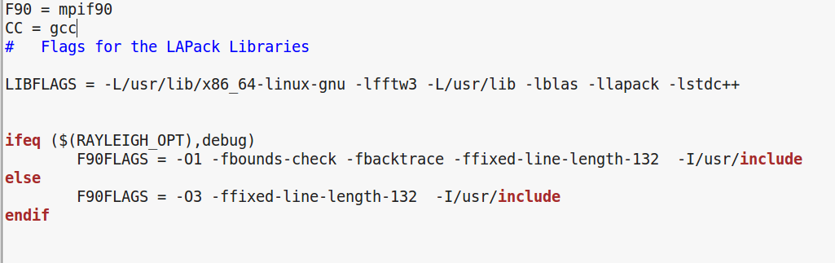
Makefile Customization
From rayleigh/Makefiles/Makefile_CIG
Link BLAS, LAPack, FFTW
Compiler Specific Flags
“Include” directories
RAYLEIGH_OPT1 is passed through build_rayleigh
Also RAYLEIGH_OPT2 and RAYLEIGH_OPT3

Slide 10
Using build_Rayleigh flags:
TRY THIS:
$ ./build_rayleigh CU debug
Sets $RAYLEIGH_OPT1 to debug
Enables debugging flags in Makefile_CIG
NO DEBUGGING FOR NOW PLEASE!
RERUN THIS:
$ ./build_rayleigh CU

Slide 11
OUR FIRST run: Prepwork (WINDOW 2)
We will run the code in WINDOW 2 from the scratch directory.
Change to scratch directory and create module1 subdirectory:
$ cd /scratch/summit/user00XX
$ mkdir module1
$ cd module 1
Summit Scratch
10 TB default (can be increased)
Wiped every 90 days (PERIOD)
No touching … or whining
Softlink the executable.
$ export RADIR=/projects/user00XX/rayleigh
$ ln –s $RADIR/build/rayleigh .

Slide 12
OUR FIRST run: Prepwork (WINDOW 2)
Each simulation requires an input file (run parameters)
Grab this file from input_examples:
$ cd /scratch/summit/user00XX/module1
$ cp $RADIR/input_examples/c2001_case0_minimal .
Rayleigh expects its input to be named “main_input”
Rename the file to “main_input”
$ mv c2001_case0_minimal main_input
Let’s edit main_input
$ nano main_input
..etc..

Slide 13
Quick Nano survival tips
We will use nano as our editor of choice
To open a file from shell prompt: nano filename
Some useful commands from within nano:
ctrl + o - save changes
ctrl + x - exit
ctrl + k - cut
ctrl + u - paste

Slide 14
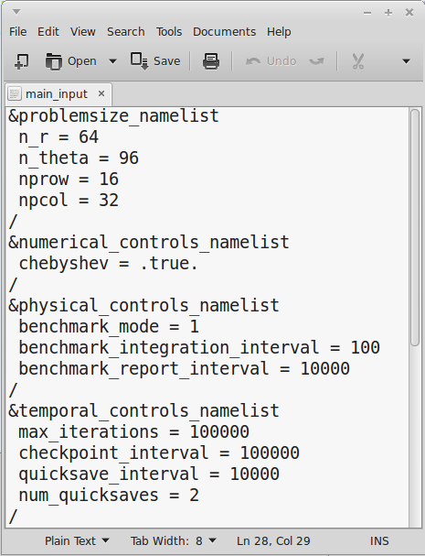
Main_input
Instructions from the user
Flags override defaults
Grouped into namelists
Namelists control different aspects of the simulation.

Slide 15
Main_input
Modify these values …
nprow = 8
npcol = 8
max_iterations = 30000
… and save.
Ctrl+o
Ctrl+x

Slide 16
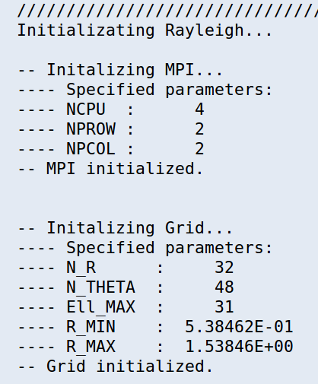
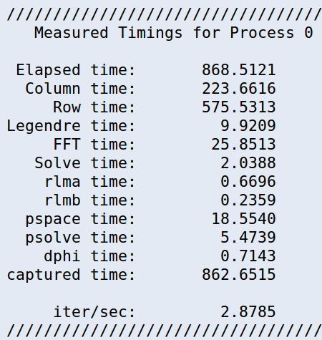
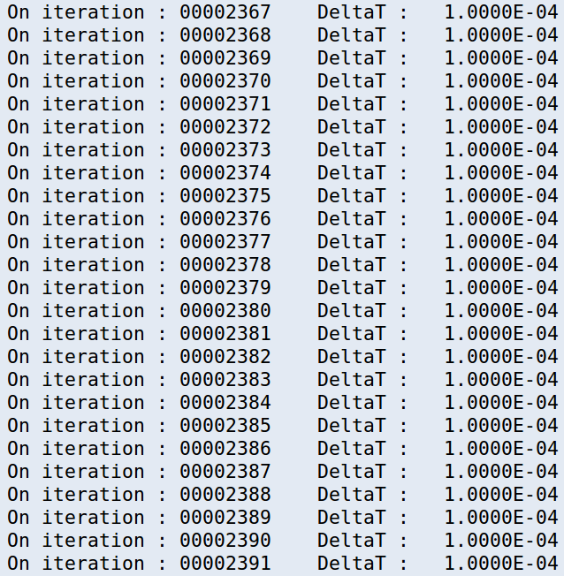
OUR FIRST run (WINDOW 2)
$ cp /projects/feathern/rayleigh_script .
$ sbatch rayleigh_script
$ more slurm*
Run the code…
You will see:
Completion:
Timing Info
Startup:
Preamble
Middle:
Timestep Info
…while we’re waiting…

Slide 17
In-Situ Benchmarking
Fully nonlinear, but low-Re
Steady-state with rotating pattern
Predefined set of analyses
When porting: run a benchmark!
Vr
Equatorial Plane
Benchmark Inputs
Boussinesq: Christensen et al. 2001, PEPI, 128, 25
c2001_case0_minimal (hydro)
c2001_case1_minimal (MHD)
Cheap!
Spherical Shell
Anelastic: Jones et al., 2011, Icarus, 216, 120
input_examples/j2011_hydro_steady_minimal
input_examples/j2011_mhd_steady_minimal

Slide 18
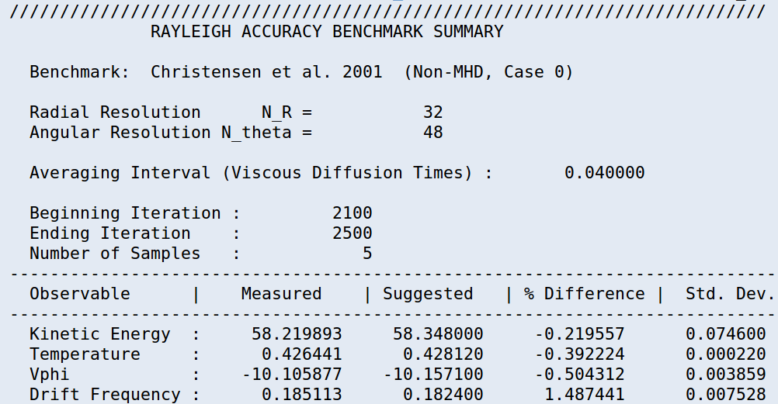
Check your results
$ more Benchmark_Reports/00030000
Normally % Difference will be well under 1%
This example is not equilibrated -- need ~ 30,000 time steps
Questions?

