Slide 1


Chain Store Management System
Friendly – Unified - Comprehensive
Presenters:
Ngô Công An
Đào Xuân Thủy

Slide 2


L
OREM IPSUM
A
aBb
C
c
Chain Store Management ?
ax
2
+
b
x + c = 0
ax
2
+
b
x + c
x
2
y

Slide 3



Current systems

Slide 4





Comprehensive system ?
Store Management Application
E-commerce on website
Admin System
Order Application
E-commerce on mobile app

Slide 5
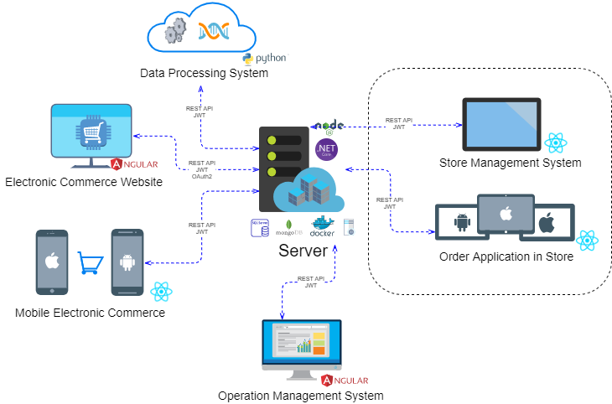
Architecture

Slide 6
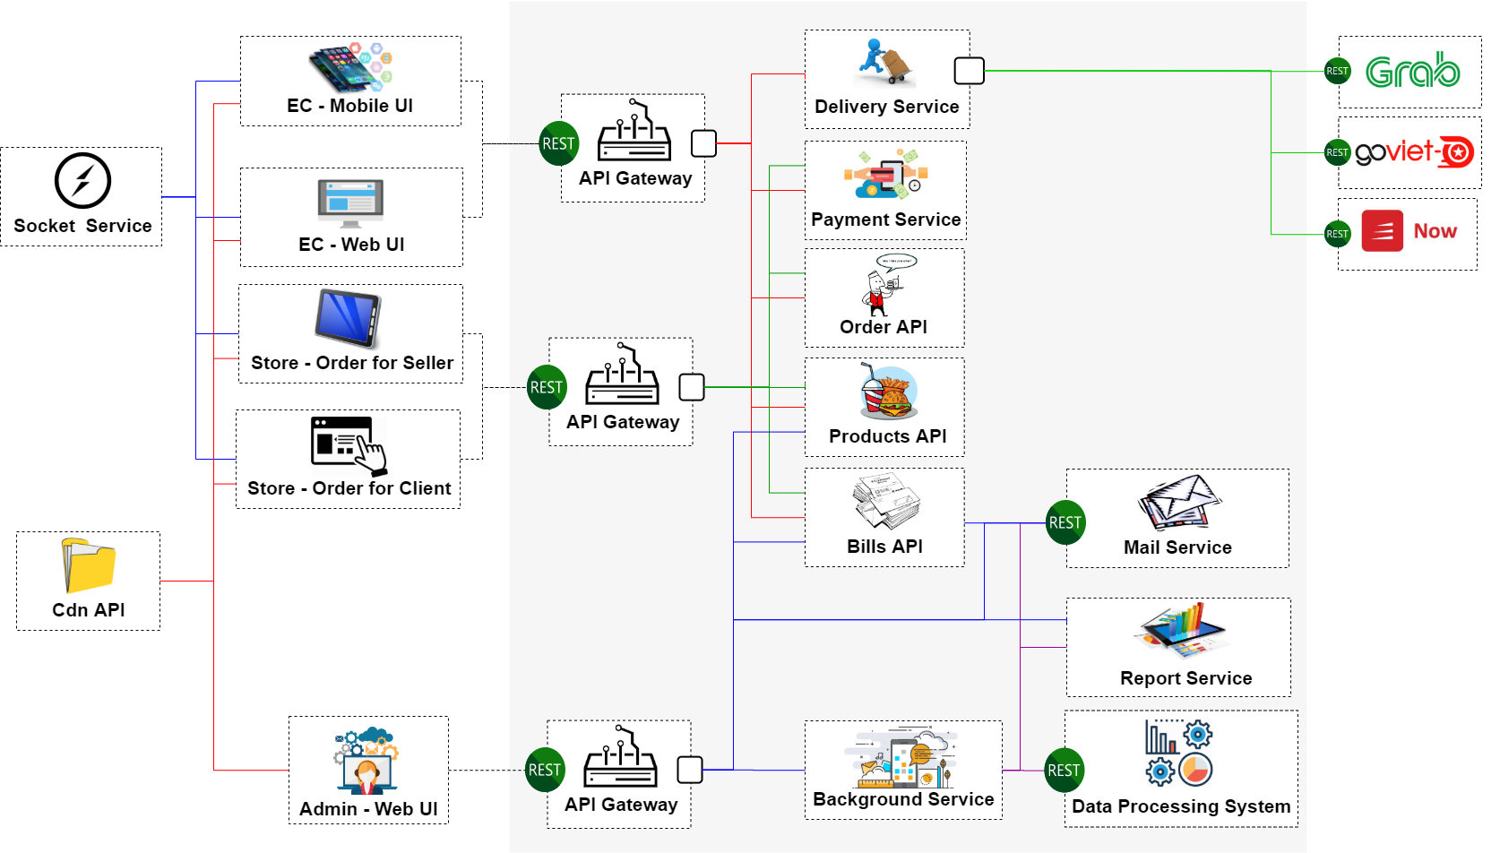
Component

Slide 7
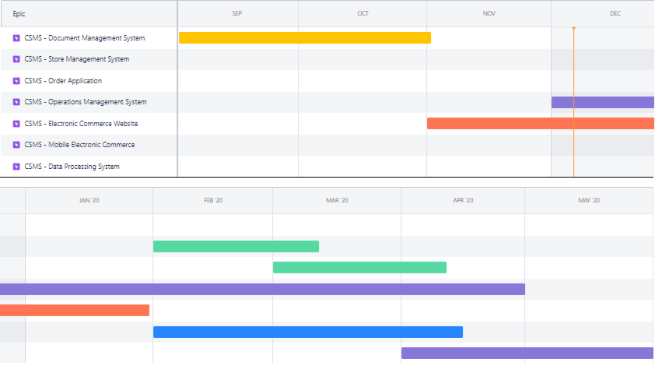
Road map

Slide 8

Authentication
& Authorization ?

Slide 9
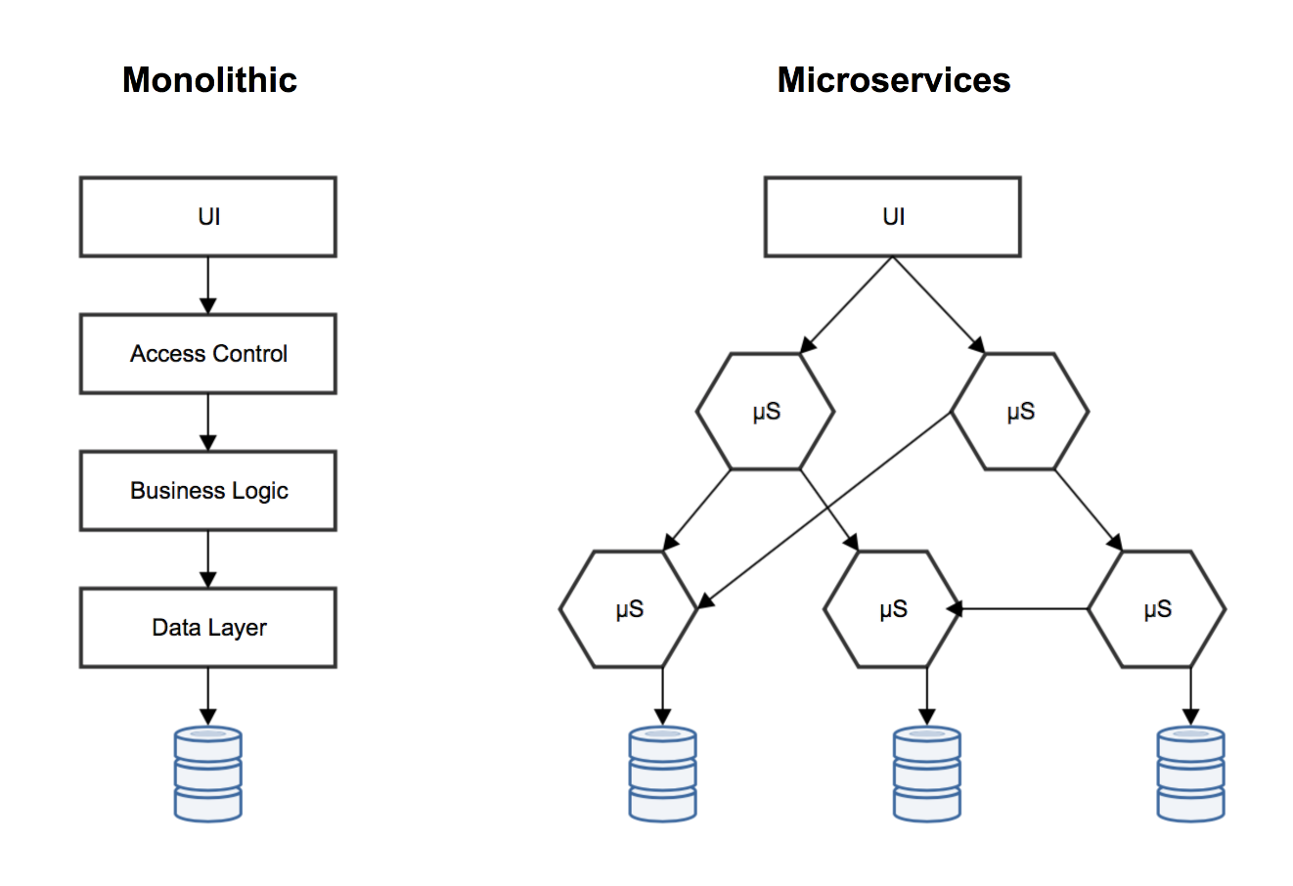
Monolithic
to
Microservices

Slide 10
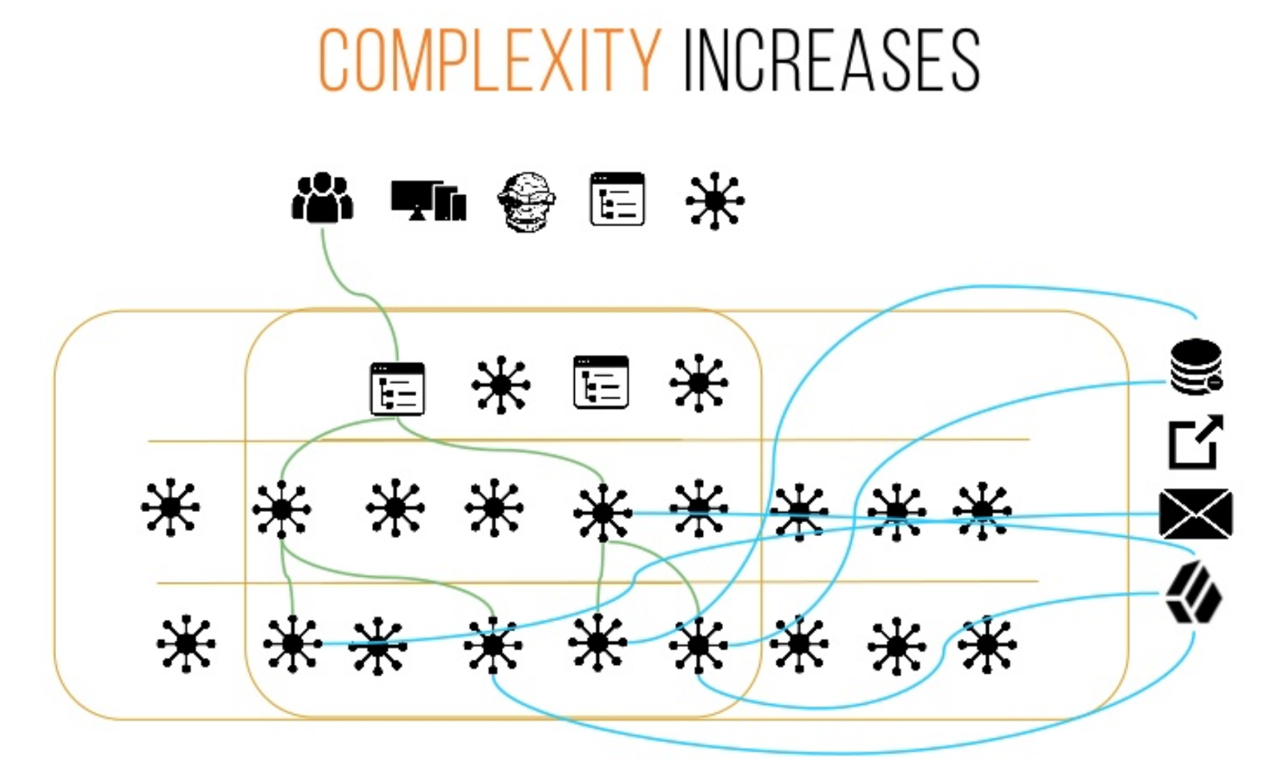
Monolithic
to
Microservices

Slide 11
Authentication Method ?

Slide 12
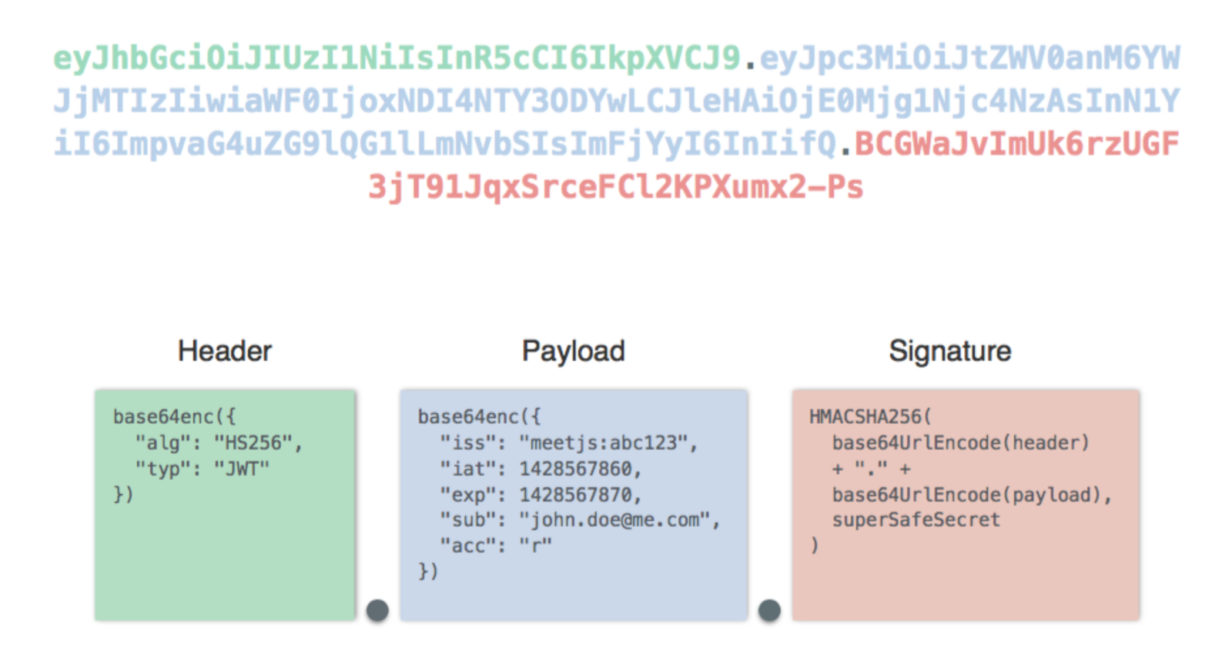
Json
Web Token

Slide 13
Opaque Token
Or
Transparent Token
Json
Web Token

Slide 14
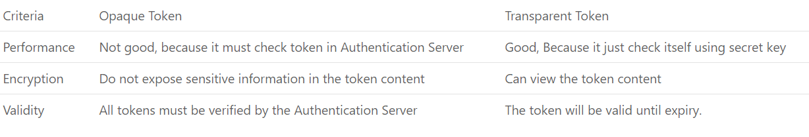
Json Web Token

Slide 15
Authentication position ?

Slide 16
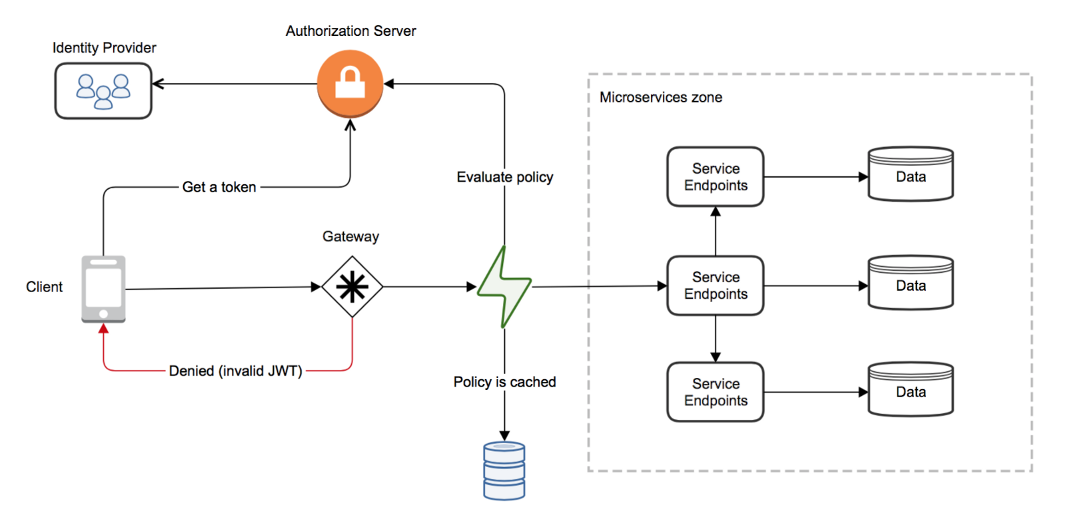
At
Gateway API

Slide 17
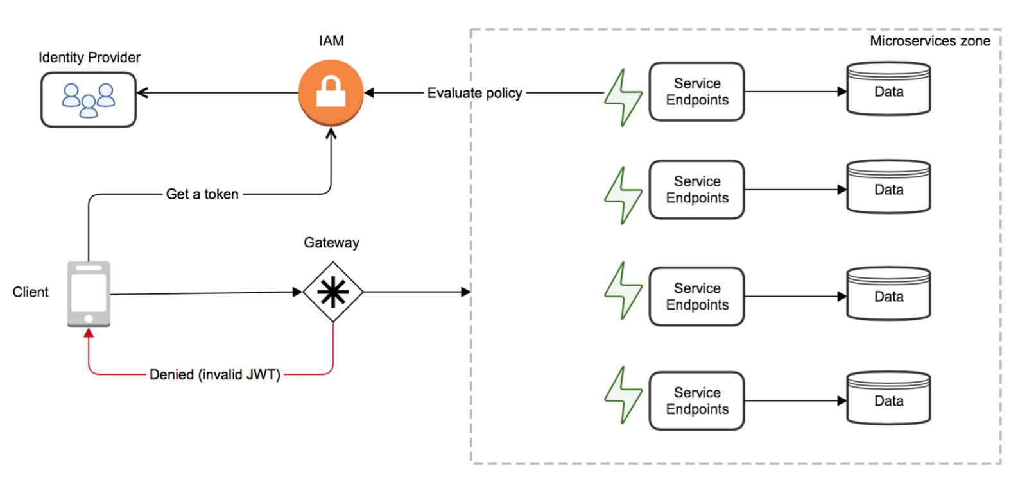
At
All Services

Slide 18
Access Control ?

Slide 19
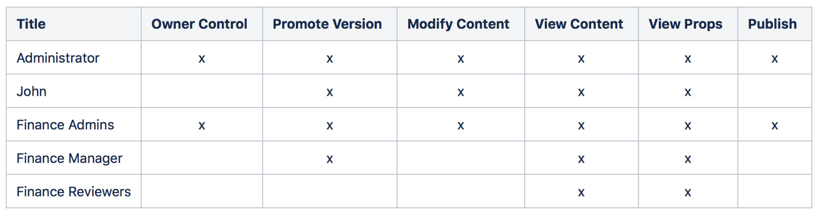
Access Control List

Slide 20
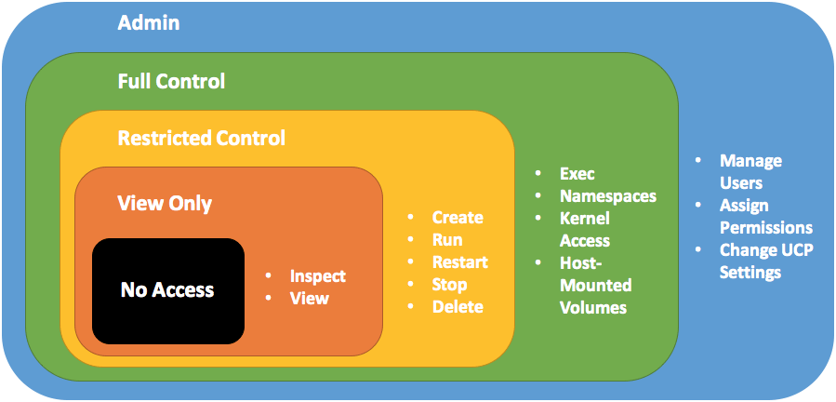
Role-Based Access Control

Slide 21
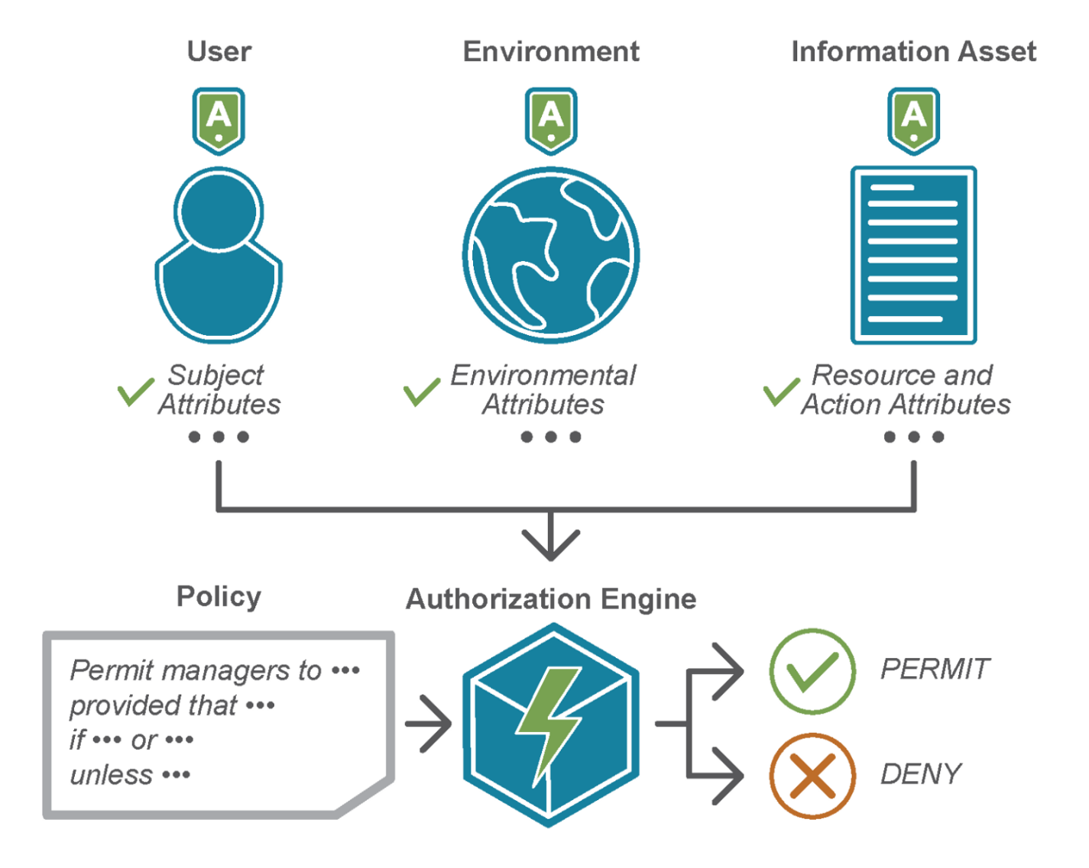
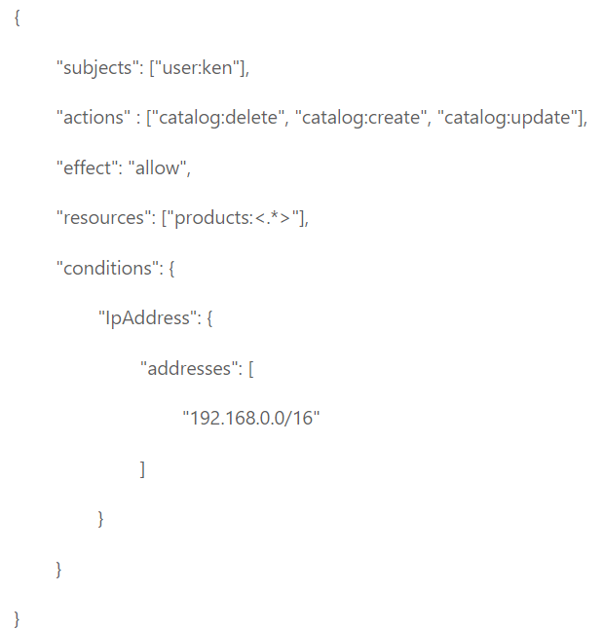
Policy-Based Access Control

Slide 22



Role list
Admin System
Admin Store
Security
Manager
Seller
Shipper
Guest
Customer

Slide 23
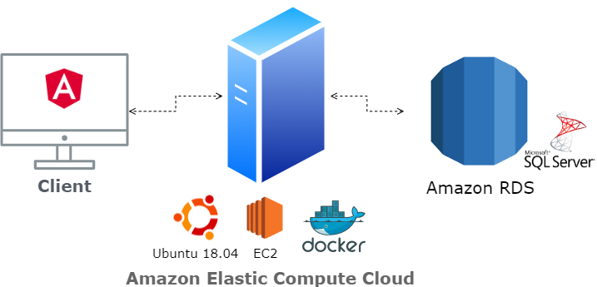
Document Management System
13.250.207.1:50001

Slide 24
Review Structure

