Slide 1

Facial Emotion Recognition Using Deep Learning
By Nguyễn Minh Quang (20520918)
By

Slide 2
Abstract
FER Systems
Deep Learning
In-depth analysis of FER systems and their applications.
Leveraging deep learning techniques for advancements.
Applications
Methodologies
Practical applications in healthcare, customer experience, and communication.
Insights into FER research methodologies and frameworks.

Slide 3
Introduction (1/2)
FER Definition
Applications
Automated detection and classification of human emotions through facial expressions.
Human-computer interaction, psychological analysis, education, and customer service.

Slide 4
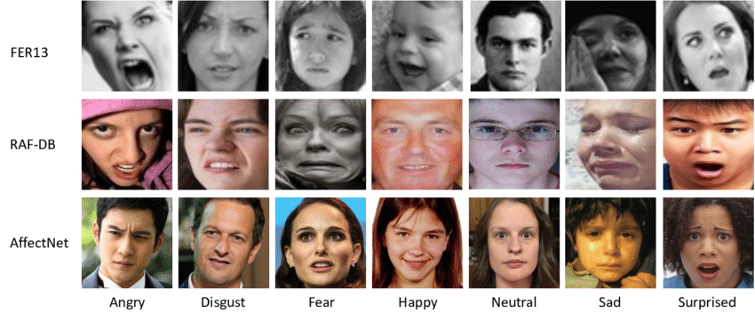
Introduction
Deep Learning Impact
Datasets
Improved FER through automated feature extraction and enhanced accuracy.
FER-2013, CK+, and AffectNet: benchmarks for FER research.
Objectives
Explore state-of-the-art methods, analyze deep learning impact, and present advancements.

Slide 5
Related Work
Traditional Methods
Challenges
Handcrafted features: edge detection, histogram analysis, statistical modeling.
Generalization and scalability across diverse datasets and scenarios.

Slide 6
Related Work
Deep Learning Solutions
Advancements
Transformers for contextual relationships, hybrid models combining CNNs and attention mechanisms.
CNNs and RNNs: automated, end-to-end solutions for feature learning and classification.
Limitations
High computational demands, sensitivity to input quality and dataset bias.

Slide 7




Proposal Overview
1
Deep Learning FER Model
Preprocessing
2
Standardizing and augmenting images.
Model Architecture
3
CNNs for feature extraction, transformers for contextual analysis.
Training and Evaluation
4
Robust methodologies for model reliability.

Slide 8

Dataset Description
Datasets
Data Augmentation
FER-2013, AffectNet: labeled emotions, diverse expressions.
Rotation, flipping, cropping, brightness and contrast adjustments.

Slide 9
Model Architecture (1/2)
Base Model
Dense Layers
CNN architecture with convolutional and pooling layers for spatial feature extraction.
Dense layers for classification, using ReLU activation for non-linear transformations.

Slide 10
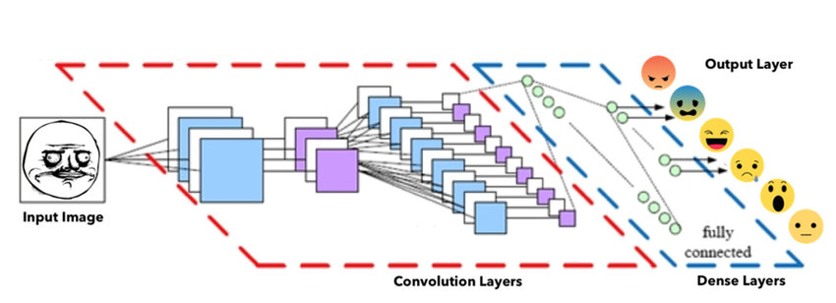

Model Architecture (2/2)
Output Layer
Softmax activation for predicting probabilities of multiple emotion categories.

Slide 11
Training Process: A Closer Look
Data Split
Hyperparameters
Hardware
Training: 70%
Learning rate: 0.0001
Google Collab GPU
Validation: 15%
Batch size: 64
Testing: 15%
Epochs: 48

Slide 12
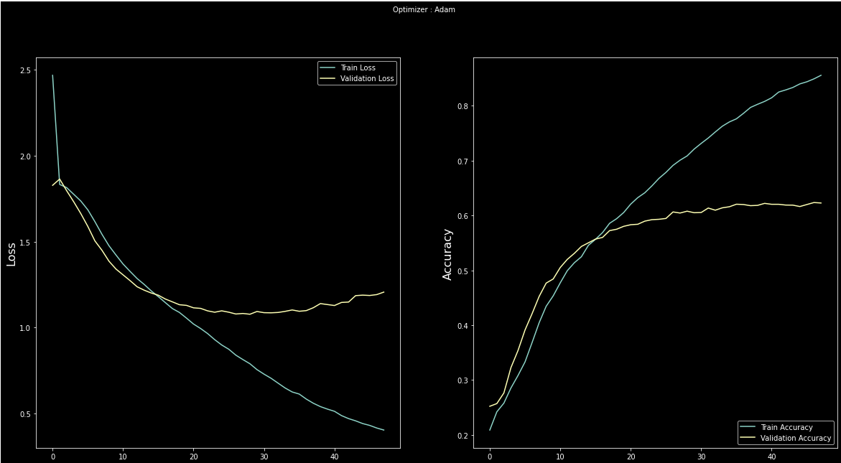
Experiment Results

Slide 13
Performance Analysis
Loss Analysis (Left Chart):
Training Loss: Consistently decreases over epochs, indicating the model is learning effectively from the training data.
Validation Loss: Initially decreases but starts increasing slightly after ~epoch 20. This suggests overfitting, where the model begins to memorize the training data rather than generalizing well to unseen data.
Accuracy Analysis (Right Chart):
Training Accuracy: Increases steadily and reaches a high value, showing the model performs well on the training set.
Validation Accuracy: Increases initially but plateaus around epoch 20-30, with a gap between training and validation accuracy growing wider. This again points to overfitting.

Slide 14
Evaluation
Strengths:
The model learns effectively on the training set, as reflected by consistent improvements in training loss and accuracy.
It performs decently on the validation set in the initial stages (before overfitting kicks in).
Weaknesses:
The model suffers from overfitting after around epoch 20, as seen by the increasing validation loss and the plateauing validation accuracy.
The widening gap between training and validation metrics highlights issues in the model's ability to generalize to new data.

Slide 15
Discussion
Strengths
Weaknesses
High accuracy across diverse datasets
Sensitivity to extreme occlusion and lighting
Resilience to variations in input quality
Limited generalization for highly imbalanced datasets

Slide 16
Performance Factors
Factors
Trade-offs
Dataset diversity and quality
Balancing accuracy with computational efficiency
Preprocessing and hyperparameter tuning
Model complexity and training resources

Slide 17



Applications of FER
Real-Time Communication
Gaming
Enhancing video calls by detecting participants' emotions
Adapting scenarios based on player emotions
Healthcare
Monitoring emotional well-being and identifying distress signals

Slide 18

Limitations of FER
1
Generalization Issues
Performance varies across ethnicities and cultural expressions
2
Occlusion Challenges
Difficulty in handling faces partially covered by masks or glasses
3
Computational Costs
High resource requirements for real-time applications

Slide 19

References
Mollahosseini, A., Hasani, B., Mahoor, M. H. (2019). AffectNet: A database for facial expression.
Hu, J., Shen, L., Sun, G. (2018). Squeeze-and-excitation networks.
He, K., Zhang, X., Ren, S., Sun, J. (2016). Deep residual learning for image recognition.
Beaudry, O., Roy-Charland, A. et al. (2013). Featural processing in emotional facial expressions.
Huang, Z.-Y. et al. (2023). Scientific Reports, 13, 8425.

