Slide 1
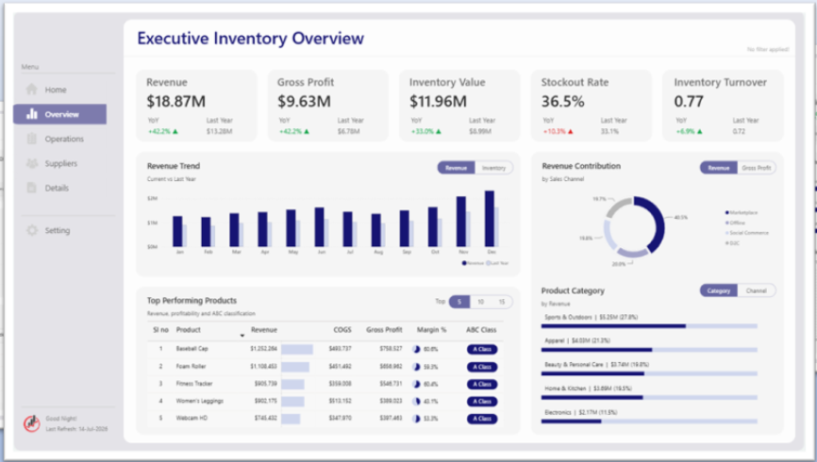

Overview 01/2017 – 08/2018

Slide 2
Customer Analysis, 01/2017 – 08/2018

Slide 3
Freight & Shipping Analysis, 01/2017 – 08/2018

Slide 4
Delivery Performance, 01/2017 – 08/2018
Purchase
Approval
Carrier
Customer

Slide 5
Customer Reviews, 01/2017 – 08/2018

