Slide 1
myVal Capstone Project
55%
8,309
Next-category recommendation for myVal households
of properties document only one category
assets across 795 properties in the source workbook
Multiclass classification over 7 categories. Random Forest models scored on Top-1 to Top-3 accuracy with splits grouped by property to prevent leakage.
24,634
55
AI candidate rows: 3 ranked candidates for each of 8,224 assets
predictors from documented assets, myVal AI, customer, property and video data
Python | scikit-learn | CatBoost | FastAPI
Notes:
Task: given the household state at a moment in time, predict the next category the customer documents for the first time. 440 of 795 properties in the workbook have only one category. The ai_analysis sheet has 24,634 rows because every analysed asset carries 3 ranked candidates (8,224 assets). Only the rank-1 candidate feeds the model. 431 prediction states remain from 234 properties after building first-time category targets.

Slide 2
Problem formulation with leakage controls
1
Time-aware state
2
Target definition
3
Leakage control
Target class share
Other Items
21%
One row per first-time category event. Features use only assets and AI outputs created at or before that timestamp.
Next category documented for the first time. Kept only when exactly one new category appears. Simultaneous events are excluded.
Split by Property_ID at 70/15/15 with zero property overlap. Imputers and encoders fit on train only. Identifiers are excluded from predictors.
Furniture
20%
Appliances
18%
Electronics
17%
Jewellery and Personal Items
14%
Clothings
8%
Vehicles
3%
Features used and why (55 predictors)
Bar length shows how many predictors each group contributes
12
Documented so far
Category counts, value and cost: current coverage
13
myVal AI outputs
Top-ranked AI guess: match, acceptance, value, counts
17
Customer profile
Age, income, engagement, tenure: segment context
8
Property details
Type, valuation, occupants: what the home holds
5
Video signals
Rooms, items, duration: optional, 22% coverage
2 / 5
Notes:
Target: the next category first documented by the property. A target is kept only when the next event introduces exactly one new category, because the order inside a simultaneous multi-category event is unknown. States without AI output are dropped since the recommender runs after myVal AI analysis. Split: GroupShuffleSplit twice with seed 42 (70 percent train then 50/50 validation and test). 309 / 67 / 55 rows and 163 / 35 / 36 properties. Preprocessing is a sklearn ColumnTransformer: median imputation and standard scaling for numeric columns and most-frequent imputation with one-hot encoding for categorical columns. Class weights are balanced. Feature groups: 12 documented, 13 AI, 17 customer, 8 property, 5 video. Video is zero-filled when absent and only about 22 percent of states have a video.

Slide 3
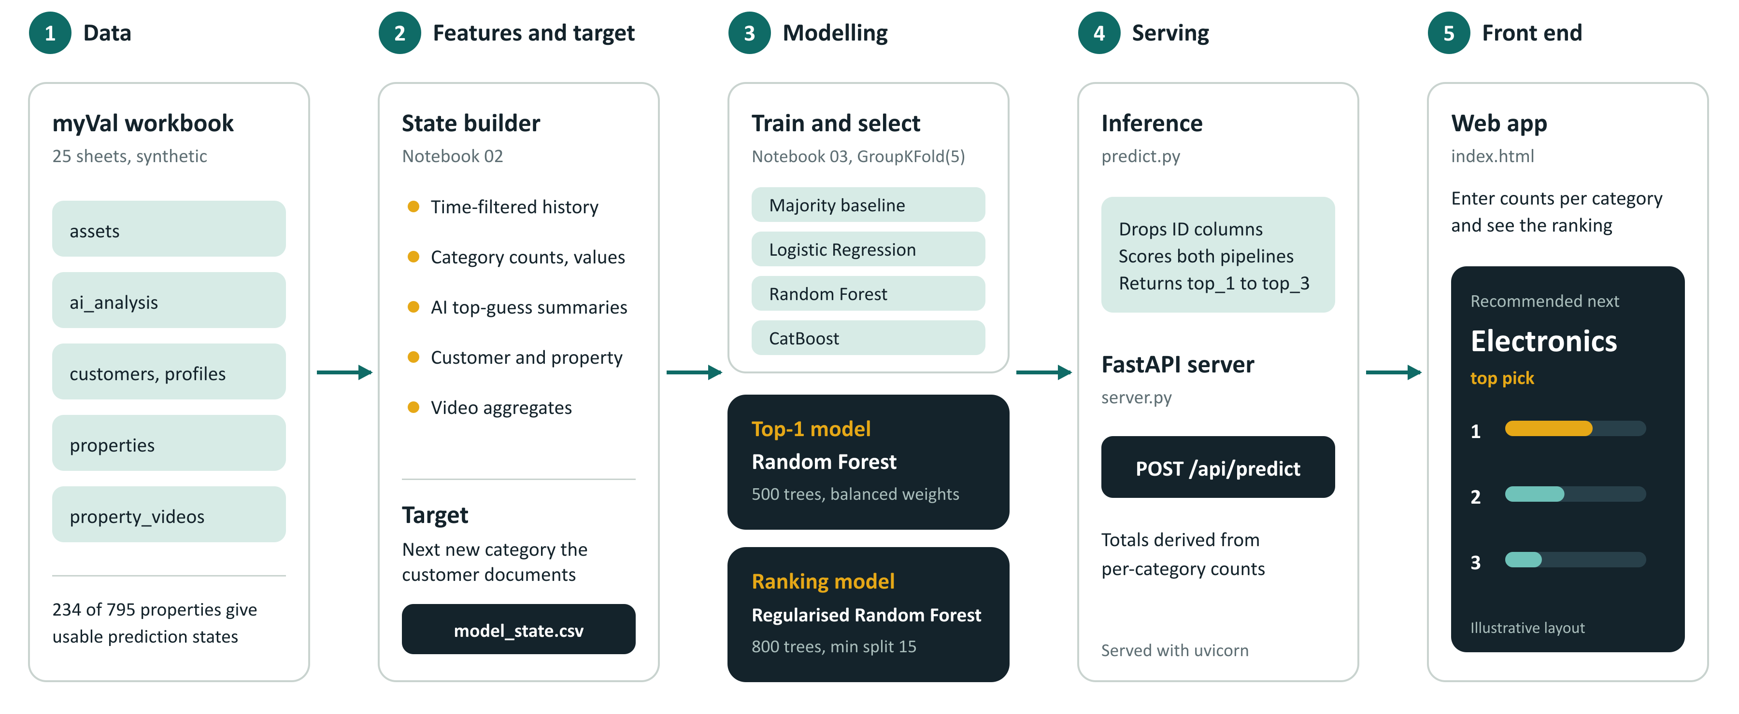
Architecture: from myVal data to a live recommendation
Both models are scikit-learn Pipelines (imputer, scaler, one-hot encoder, classifier) saved with joblib.
3 / 5
Notes:
Flow: notebook 01 inspects the workbook and checks keys. Notebook 02 builds time-filtered household states and first-time category targets and writes model_state.csv (431 rows by 60 columns). Notebook 03 trains a majority baseline, logistic regression, Random Forest and CatBoost with GroupKFold(5) on Property_ID and Macro F1 as the search metric. Two pipelines are kept: a default 500 tree Random Forest for the Top-1 pick and a regularised 800 tree Random Forest (min_samples_split 15) for ranking. Notebook 04 validates predict.py. server.py exposes predict_next_categories through FastAPI and derives the total counts from the per-category counts. The card in the last column is an illustrative layout and not real output.

Slide 4
Tuned Random Forest: 83.6% Top-3 on unseen properties
Holdout Top-k accuracy on unseen properties
Holdout Top-1 F1 by class
Validation comparison used for model selection
Model | Accuracy | Macro F1 | Top-2 | Top-3
Majority baseline | 0.224 | 0.061 | n/a | n/a
Logistic Regression | 0.358 | 0.335 | 0.567 | 0.806
Random Forest (Top-1 model) | 0.478 | 0.421 | 0.657 | 0.806
CatBoost tuned | 0.448 | 0.326 | 0.702 | 0.821
CatBoost regularised | 0.433 | 0.338 | 0.702 | 0.806
Random Forest regularised (ranking model) | 0.433 | 0.368 | 0.716 | 0.836
Regularised RF without AI features | 0.388 | 0.332 | 0.731 | 0.821
Holdout scored once after selection. Macro F1 on holdout is 0.34.
4 / 5
Notes:
Final holdout for the tuned regularised Random Forest: 55 rows from 36 unseen properties. Top-1 accuracy 49.1% (27 of 55), Top-2 70.9%, Top-3 83.6%. Macro F1 0.337 and weighted F1 0.431. The Top-1 figure was computed from the saved ranking model on the same split because the notebook only reported Top-2 and Top-3 for it. The default Random Forest scored 50.9% Top-1 and 0.322 Macro F1 on the same rows. Per-class Top-1 F1: Electronics 0.77, Furniture 0.58, Other Items 0.40, Appliances 0.35, Clothings 0.25, Jewellery and Personal Items 0, Vehicles 0. Tuning: RandomizedSearchCV with 40 candidates, GroupKFold(5) and Macro F1. Best CV Macro F1 0.4127 with 800 trees, min_samples_split 15, max_features sqrt and balanced_subsample weights. Selection used validation only. Top-1 model was chosen on validation Macro F1 (0.421 for the default Random Forest against 0.368 regularised) and the ranking model on Top-2 and Top-3 with a smaller generalisation gap. The AI ablation removes the 13 AI features from the regularised Random Forest: Macro F1 0.368 to 0.332 and accuracy 0.433 to 0.388. Top-2 is slightly higher without AI (0.731 against 0.716).

Slide 5
Where the model stands and what comes next
Ready today
Watch outs
Next steps
Two joblib pipelines: default RF for Top-1 and regularised RF for ranking
predict_next_categories() returns top_1, top_2 and top_3 with probabilities
FastAPI /api/predict with a web front end
Top-1 is harder than the ranked shortlist so the app shows Top-3
Jewellery and Vehicles are the hardest classes to predict
Trained on synthetic data so validation on real customer histories is next
Validate on real customer histories
Add behavioural features and retrain on a schedule
Repeated grouped cross-validation for tighter estimates
Probability calibration for the ranked shortlist
Validation lift over the majority baseline
0.06 to 0.37
Macro F1 from the majority baseline to the tuned Random Forest
+0.04
Macro F1 gained from myVal AI features in the ablation
100%
Electronics recall on the holdout
5 / 5
Notes:
Validation lift: majority baseline accuracy 0.224 and Macro F1 0.061 against logistic regression 0.358 / 0.335, Random Forest 0.478 / 0.421 and regularised Random Forest 0.433 / 0.368. AI ablation: removing the 13 AI features from the regularised Random Forest drops Macro F1 from 0.368 to 0.332 on validation. Electronics recall on the holdout is 1.00 (12 of 12). Top-1 on holdout is 27 of 55 so a normal-approximation 95 percent interval is roughly plus or minus 13 points. Vehicles has 11 target rows across the whole modelling dataset. Repeated grouped cross-validation and probability calibration are proposed next steps and are not implemented in the repository yet. If asked about overfitting: the default Random Forest scores 1.00 Macro F1 on training against 0.42 on validation and the regularised one 0.80 against 0.37, so all models fit the 309 training rows far better than unseen properties. The holdout numbers are the honest estimate.

