Slide 1
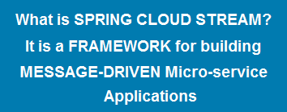
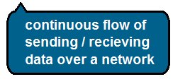
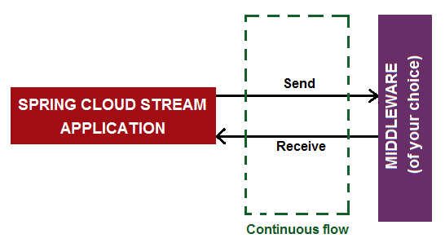
SPRING CLOUD STREAM
STREAM

Slide 2


SPRING CLOUD STREAM

