Slide 1
TITLE: IMPLEMENTATION OF PARALLELIZATION OF SEARCHING USING DATABASES
PARALLEL AND DISTRIBUTED COMPUTING-CSE4001
SLOT: C2/ L1+L2
J- COMPONENT REVIEW 3

Slide 2
GROUP MEMBERS:
ADITH KUMAR MENON(18BCE2311)
ANURAG PARCHA(18BCE2335)

Slide 3
PROBLEM STATEMENT
Word search searches for words in multiple text files parallely using openmp concepts. This reduces the execution time of the code as compared to the sequential word search.
The documents are scanned word by word and a dictionary is maintained so that words can be searched. Since documents can have several thousands of terms scanning each term can take a lot of time and hence there is a lot of scope for parallelization.
The purpose of this project to analysis which word search method is efficient to handle the multiple files. The conclusion of this project will give us the sufficient reasons to choose the method. This could be helpful for future word searing engines

Slide 4
ABSTRACT
As the name suggests "word search" is about searching for words in a document in parallel using Open MP.This is not just a simple word search but also ranks the document based on the relevance of the document with respect to the word searched The documents are scanned word by word and a dictionary is maintained so that words can be searched. Since documents can have several thousands of terms scanning each term can take a lot of time and hence there is a lot of scope for parallelization.
This project focuses on the principle of multithreaded systems. It uses multiple threads to read multiple files and perform the action. The action here being searching the word through the files, and doing so in very less time as compared to the sequential system. The parameters are similar to that of the sequential method, but the processors are used to do the sequential process on multiple files at the same time.

Slide 5
ABSTRACT
SEQUENTIAL METHOD: Panda and Hummingbird are highlighted as how important semantics in search is, in modern SEO strategies.
We are using simple method of sequential method to search the file of the given file. The Method is quite simple of input the file, read the file, input the word we are looking for, and search the file, and give output that it is found or not.
MULTITHREADED METHOD: The method here is using multithreaded library and declare multiple threads to handle each file. This system has perks as well as cons. Multithreading support was introduced in C++. Prior to C++, we had to use 3 POSIX threads or p threads library in C.

Slide 6
Literature Survey
Title | Author | Journal Name& Date | Key Concepts | ADVANTAGES DISADVANTAGES FUTURE ENHANCEMENT
OpenMPC: Extended OpenMP for Efficient Programming and Tuning on GPUs | Seyong Lee, Rudolf Eigenmann | 2010 ACM/IEEE International Conference | This paper proposes a directive-based, high-level programming model, called OpenMPC, which addresses both programmability and tunability issues on GPGPUs.coded CUDA programs. | This paper proposes a new programming interface, called OpenMPC, which is based on OpenMP but extended with a new set of directives and environment variables for efficient CUDA programming. OpenMPC provides programmers with abstractions of the complex CUDA programming and memory models and high-level control over the involved parameters and optimizations

Slide 7
Literature Survey
Title | Author | Journal Name& Date | Key Concepts | ADVANTAGES DISADVANTAGES FUTURE ENHANCEMENT
Parallelization of KMP String Matching Algorithm on Different SIMD architectures: Multi-Core and GPGPU’s | Akhtar Rasool, Nilay Khare | International Journal of Computer Applications (0975 – 8887) Volume 49– No.11, July 2012 | Application of the KMP algorithm with parallelization and to test its advantages and disadvantages. | The KMP algorithm with Parallelization greatly improves the matching efficiency if the text size is very large and a sufficient numbers of processors are available. The most important characteristic of the KMP algorithm is that by making better use of next bit characters, a maximum moving distance is achieved .Further parallelization of KMP algorithm provides parallel computing of pattern searching on the text in SIMD architecture.

Slide 8
Literature Survey
Title | Author | Journal Name& Date | Key Concepts | ADVANTAGES DISADVANTAGES FUTURE ENHANCEMENT
Scalable Parallel Word Search in Multi-Core/Multiprocessor Systems Parallel Quick Search Algorithm for the Exact String Matching Problem Using OpenMP | F. Drews , E. Petri , J. Lichtenberg , and L. Welch Sinan Sameer Mahmood Al-Dabbagh, Nawaf Hazim Barnouti, Mustafa Abdul Sahib Naser, Zaid G. Ali | The Journal of Supercomputing – January 2010 Journal of Computer and Communications, 2016, 4, 1-11 | Parallel algorithm for fast word search to search in input DNA sequence. Quick Search string matching algorithm are adopted to be implemented under the multi-core environment using OpenMP | This paper proposes a new, scalable parallel algorithm for determining the repeats in an input DNA sequence. In a series of experiments, it demonstrated that the algorithm performs well for large input sequences on a multiprocessor/multicore machine with a total of 8 cores. Concludes, multi-core environment as the suitable platform for parallelizing the Quick Search string matching algorithm. For future work the parallel Quick Search algorithm could be enhanced by parallelizing the preprocessing phase with the searching phase.

Slide 9
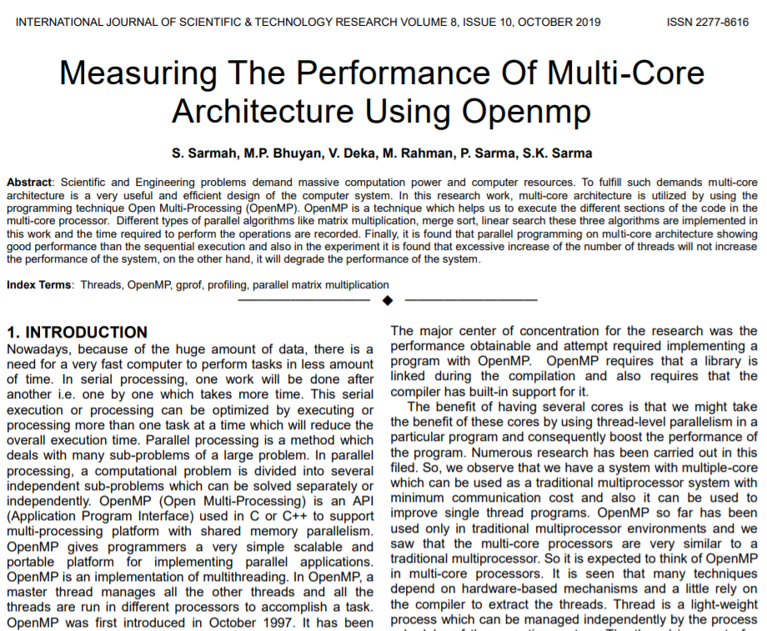
BASE PAPER:
Link of base paper for our project:
http://www.ijstr.org/final-print/oct2019/Measuring-The-Performance-Of-Multi-core-Architecture-Using-Openmp.pdf

Slide 10
AREAS OF PARALLELISM
An application built with the hybrid model of parallel programming can run on a computer cluster using both OpenMP and Message Passing Interface (MPI), such that OpenMP is used for parallelism within a (multicore) node while MPI is used for parallelism between nodes.
Work-sharing constructs can be used to divide a task among the threads so that each thread executes its allocated part of the code. Both task parallelism and data parallelism can be achieved using OpenMP in this way.

Slide 11
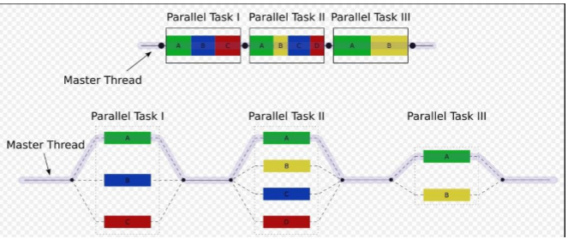
WORKFLOW FOR PARALLELISM

Slide 12
Algorithm and Analysis
The PageRank algorithm outputs a probability distribution used to represent the likelihood that a person randomly clicking on links will arrive at any particular page. PageRank can be calculated for collections of documents of any size.
It is assumed in several research papers that the distribution is evenly divided among all documents in the collection at the beginning of the computational process.
The PageRank computations require several passes, called “iterations”, through the collection to adjust approximate PageRank values to more closely reflect the theoretical true value. Cartoon illustrating the basic principle of PageRank.
The size of each face is proportional to the total size of the other faces which are pointing to it.

Slide 13
Related Work
Linear-search and parallel computation for Pattern-Matching algorithms for solving Puzzles and Jigsaws. Program search jigsaws are a variation where you must search for fragments of program syntax, rather than words, then put them together to make a working program.
Searching for Keywords , Key phrases or segments which represent the most relevant information contained in a document. These are then used for providing the meta data for some applications, this can mainly be seen in the search engines and optimizing it will require parallel processing to a very high degree.
DNA sequencing using parallelization to search for certain biological traits/words.
Use of CUDA on GPGPUs to boost the efficiency and reduce the run time of well known string/pattern matching algorithms.

Slide 14
RELATED WORK
As it can be observed from the related works, all the work related to searching of entities like DNA traits, puzzles, key-words and key-phrases and many more from a certain data store require the same word searching mechanism or in other words “pattern-matching” algorithms.
These algorithms heavily CPU intensive in most cases. Even though there is work going on to make them rely on GPU and get the maximum efficiency from GPGPUs, the work is not close to being complete. Hence, we see a massive void of computing to fill which can only be achieved with the right parallel processing techniques which are efficient and reliable.
Hence for the optimization of the of these techniques, there is a need to develop and test every new and old algorithm with sequential processing as well as parallel processing to get the observations and analysis.

Slide 15
Proposed Work
Word search is a subcategory of Pattern Matching. Word search is tasked with the automatic identification of terms that best describe the subject of a document. Key phrases, key terms, key segments or just keywords are the terminology which is used for defining the terms that represent the most relevant information contained in the document. Keyword extraction task is important problem in Text Mining, Information Retrieval and Natural Language Processing. There is a need to find improvements and heuristics that help solve them more quickly, encouraging the development of algorithmic thinking skills.
Implementing algorithms for pattern matching or word search needs to help reduce the time for computation and retrieving the particular words or a set of words/ patterns from a data store . These algorithms will be implemented in serial as well as parallel computing environments to get the results. These results will be comparatively analyzed.
The parallel computing will be performed using OpenMP. OpenMP uses a portable, scalable model that gives programmers a simple and flexible interface for developing parallel applications for platforms ranging from the standard desktop computer to the supercomputer

Slide 16
OpenMP is an implementation of multithreaded processing, a method of parallelizing whereby a master thread (a series of instructions executed consecutively) forks a specified number of slave threads and the system divides a task among them. The threads then run concurrently, with the runtime environment allocating threads to different processors. The Parallelism in a single multicore node is performed by OpenMP whereas the parallelism between nodes is done by the Message Passing Interface(MPI)
Word search searches for words in multiple text files (data store) parallelly using OpenMP concepts. The documents are scanned word by word and a dictionary is maintained so that words can be searched. Since documents can have several thousands of terms scanning each term can take a lot of time and hence there is a lot of scope for parallelization.
The ultimate purpose of this project is to identify after a thorough analysis of serial and parallel methods for word search is more robust and efficient for handling huge data stores to search from. The conclusion of the same will give us the most efficient method for word search and subsequently lead the future research in word search engines and pattern matching algorithms in the right direction.

Slide 17
Architecture for Sequential Word Search
Queue
Text File
(Data Store)
Sequential Code
Run pattern Matching and Find
Result

Slide 18

Architecture for Parallel Word Search
Parallel Fetch
Text File
(Data Store)
Sequential Code
Run pattern Matching and Find
Result
$$°$$
$$°$$
$$°$$
Run pattern Matching and Find
Result

Slide 19
Programming Language :
We have chosen C++ as the programming language to code the sequential and parallel algorithms in. This code is parallelized by OpenMP in case of parallel word search.
C++ is a programming language which can handle a lot of tasks which makes it very suitable to use in parallel as well as sequential computing. It is based on Object Oriented Programming which is very necessary when dealing with complex memory and CPU intensive operations for efficiency as well as clean code. It can also handle low level memory manipulation.
One distinguishing feature of C++ classes compared to classes in other programming languages is support for deterministic destructors, which in turn provide support for the Resource Acquisition is Initialization (RAII) concept.

Slide 20
System Implementation
The code is written in C++ which is using OpenMP to parallelize the code.
The data store (text files) are accessed in a parallel manner and all the data is collectively stored in a vector.
Then during the search algorithm, the vectors are received by the code and the consequently browses the document files.
Then the documents are ranked based on the highest word search.
The highest occurrence of a word is checked in every document and according mapping is done for displaying the same.

Slide 21
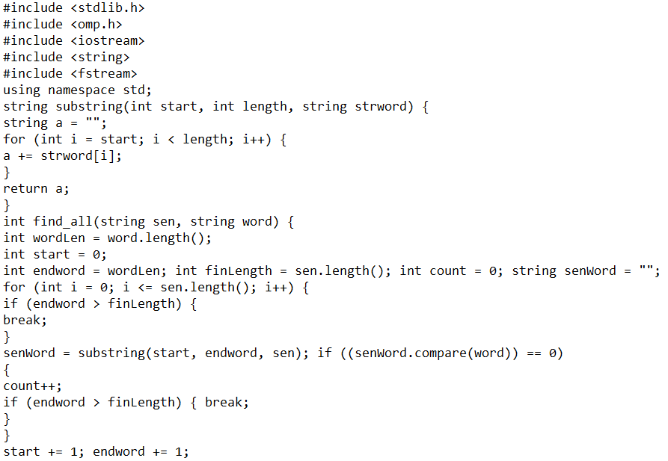
Sequential Algorithm Code

Slide 22
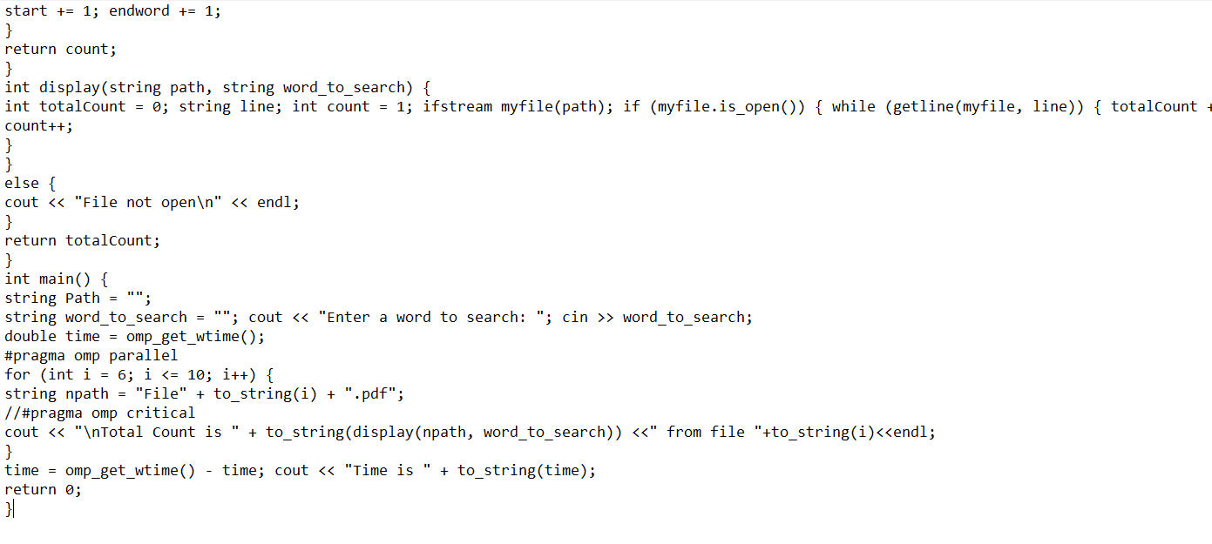
Sequential Algorithm Code

Slide 23
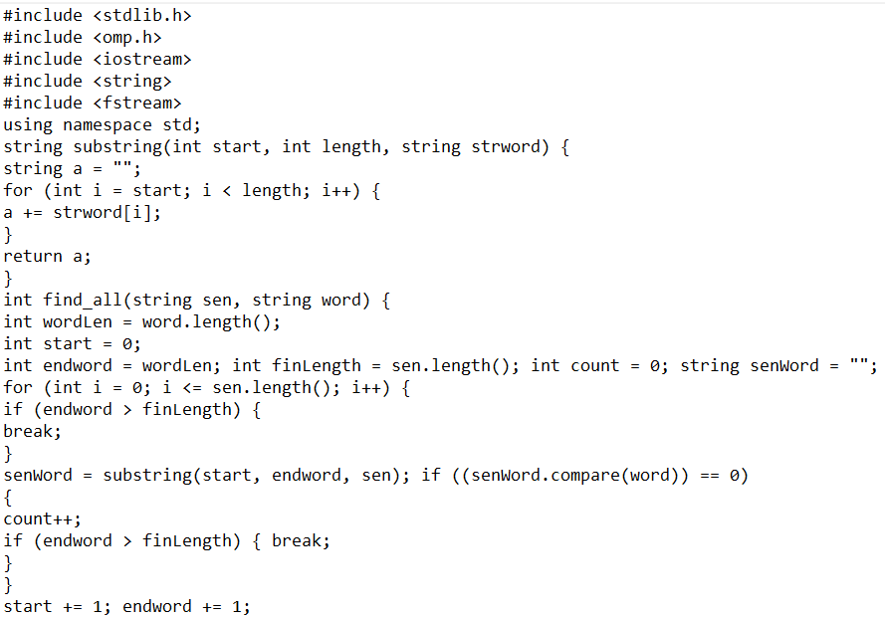
Parallel Algorithm Code

Slide 24
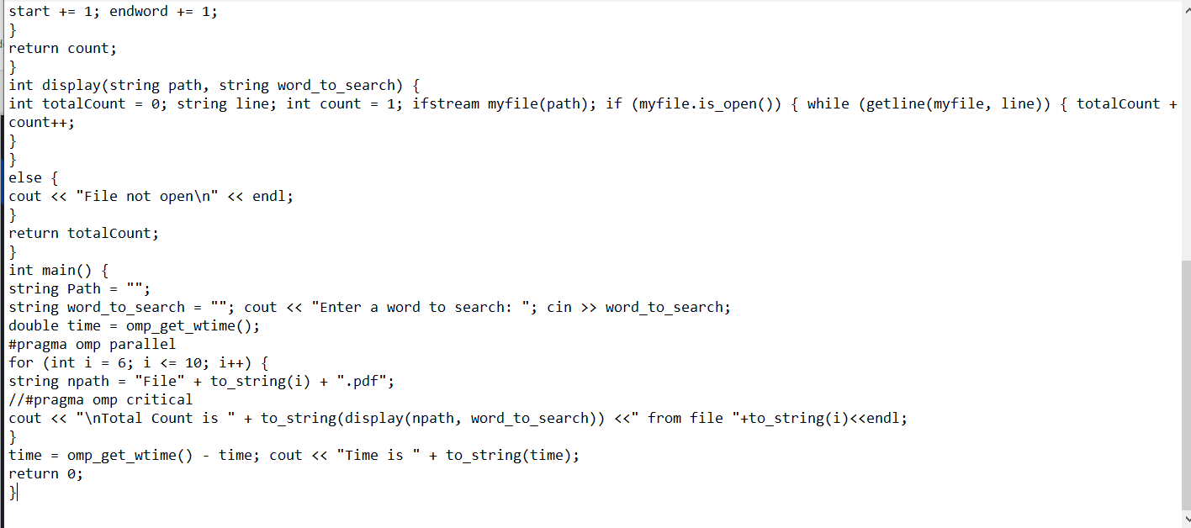
Parallel Algorithm Code

Slide 25
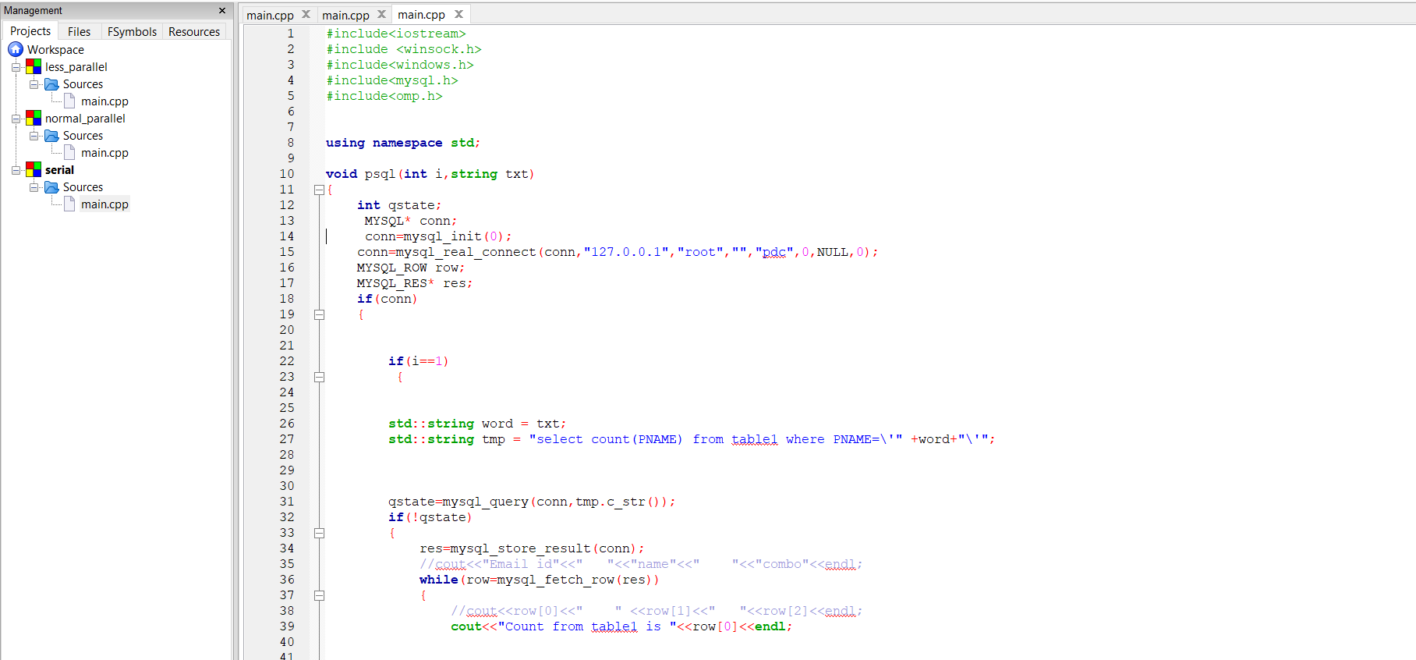
Serial Code related to the database

Slide 26
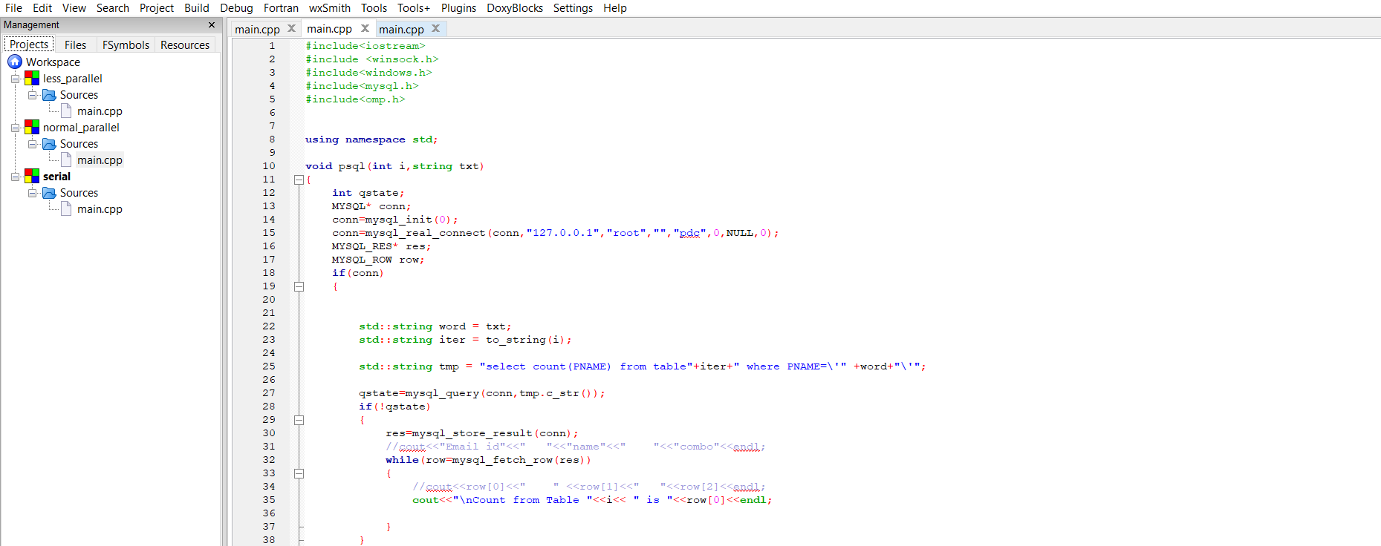
Parallel Code without pragma related to the database

Slide 27
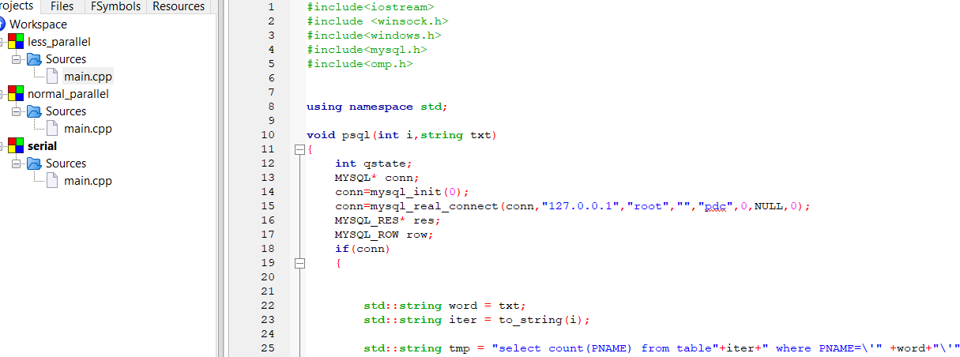
Parallel Code with pragma related to the database

Slide 28
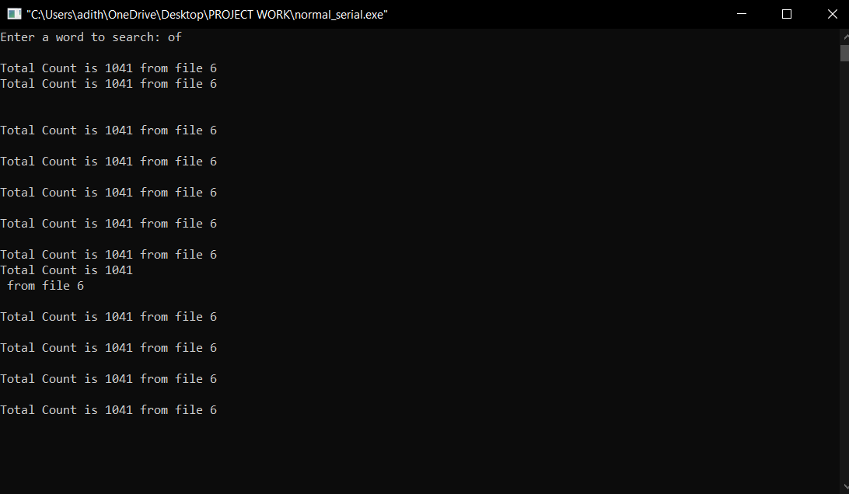
Output and Result

Slide 29
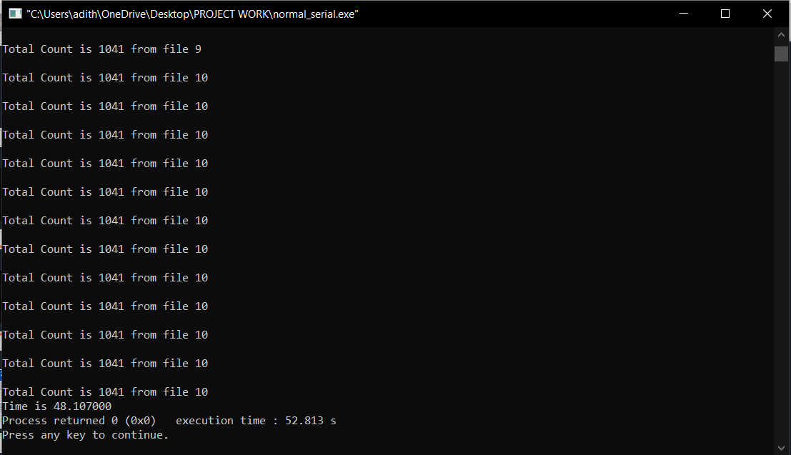
Output and Result

Slide 30
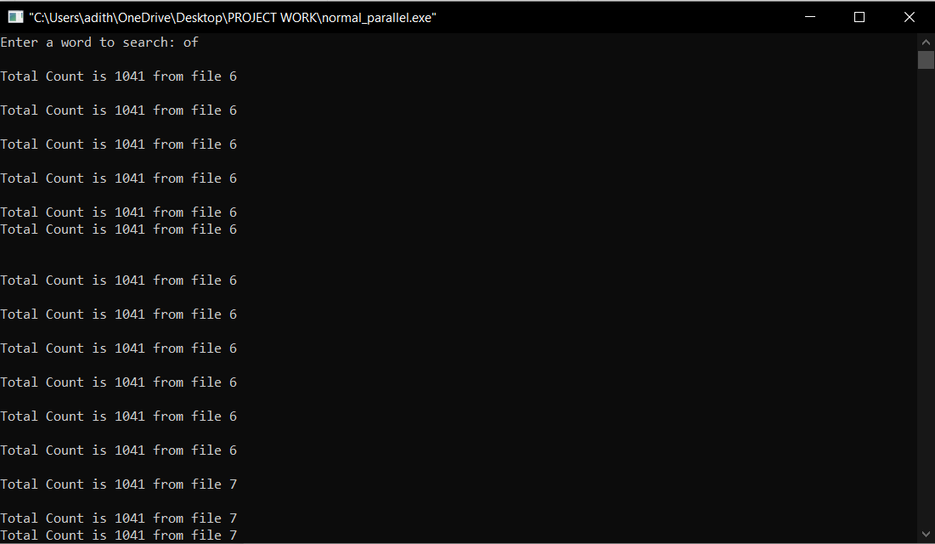
Output and Result

Slide 31
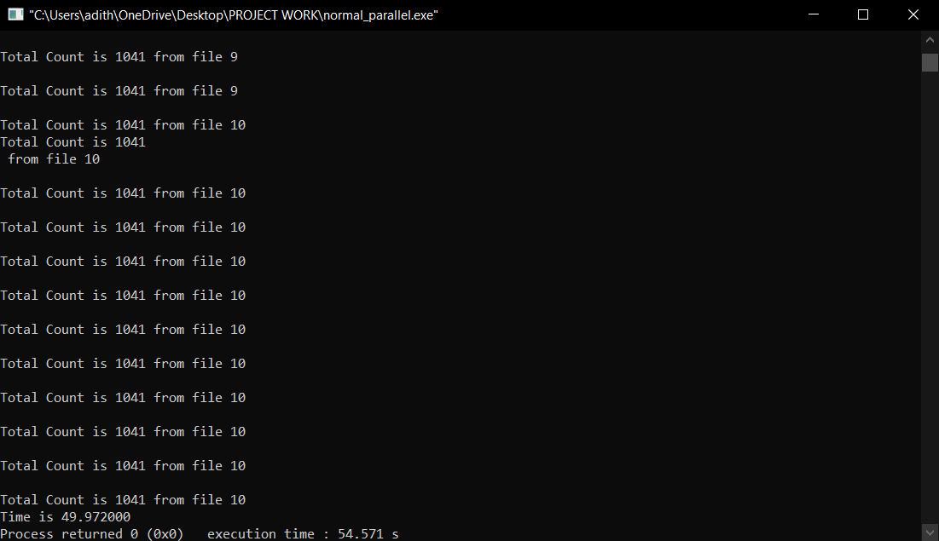
Output and Result

Slide 32
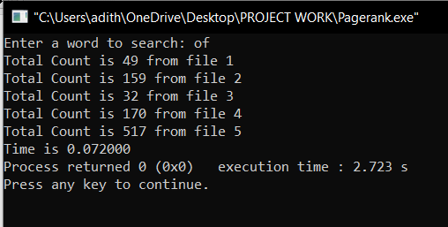
Output and Result

Slide 33
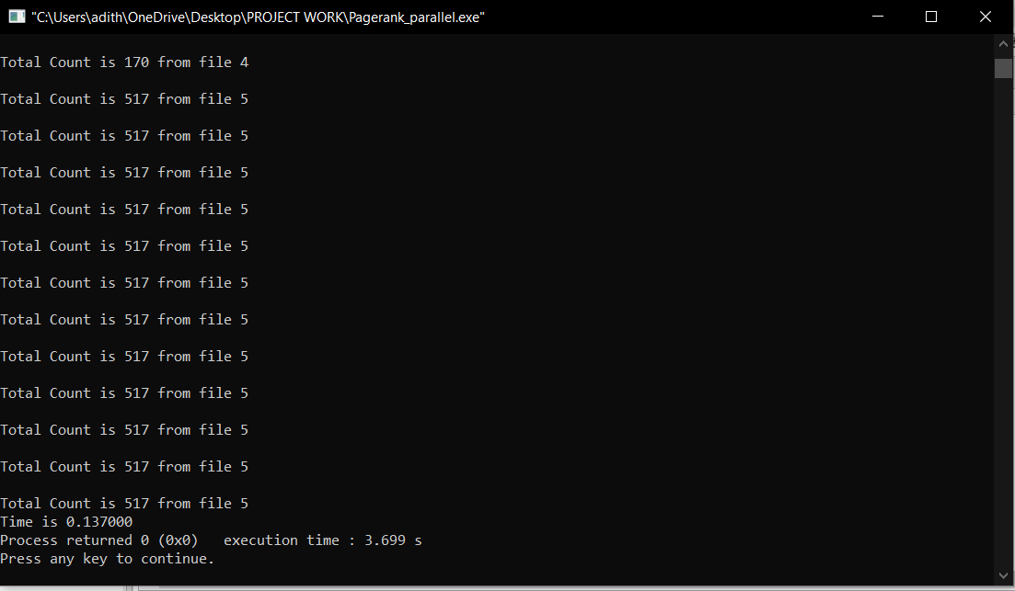
Output and Result

Slide 34
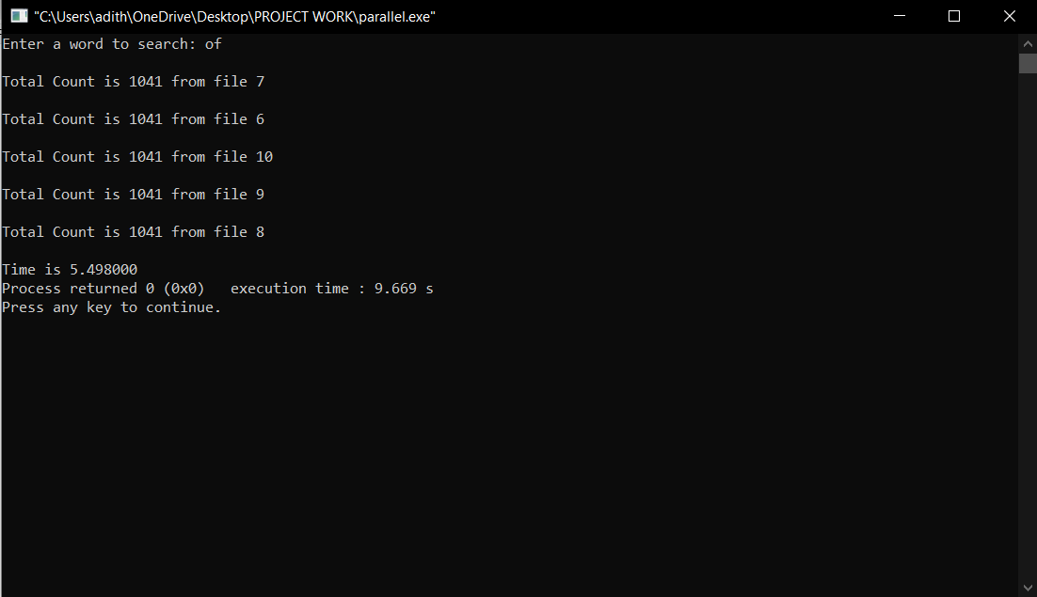
Output and Result

Slide 35
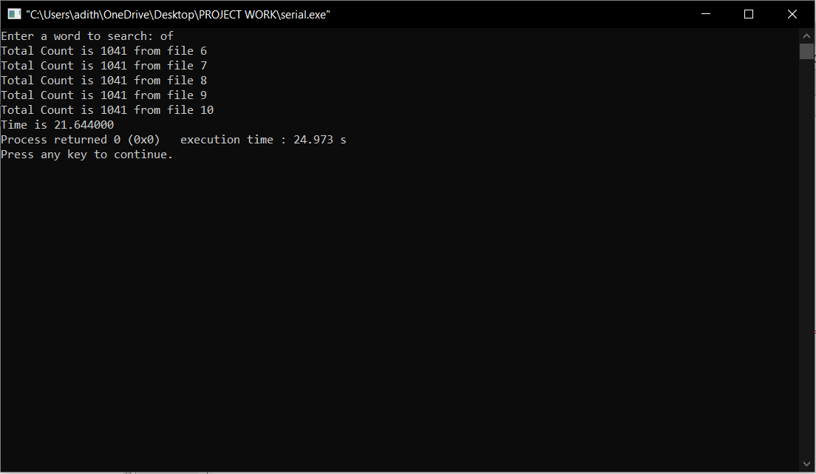
Output and Result

Slide 36
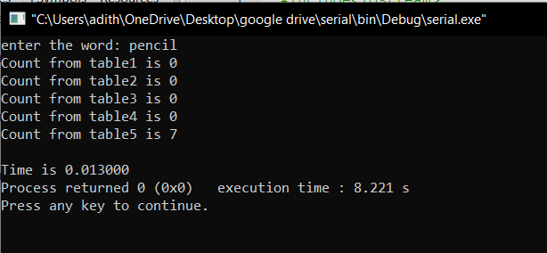
Output of Serial code with database

Slide 37
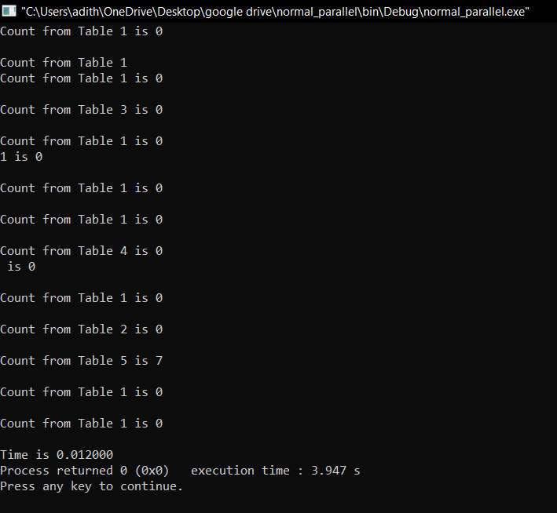
Output of parallel code without pragma

Slide 38
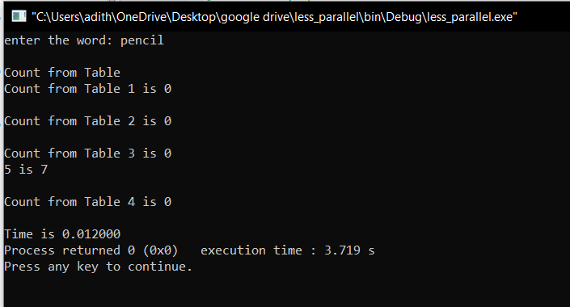
Output of parallel code with pragma

Slide 39
Result Analysis
Test case Number | Test case Id | Test case | Expected Result | Actual Result | Pass / Fail
1. | 1.1 | Sequential code: Reading 5 files to search for a word | The count of each word in each file | The count of each word in each file | PASS
 | 1.2 | Sequential code: Reading 5 files to search for a statement | The count of statement in each file | The count of statement in each file | PASS
2. | 2.1 | Parallel code: Reading 5 files concurrently to search for a word | The count of each word in each line | The count of each word in each line | PASS
 | 2.2 | Parallel code: Reading 5 files to search for a statement | The count of statement in each file | The count of statement in each file | PASS

Slide 40
EXPLANATION FOR ABOVE RESULTS
As we know open mp follows for join concept.Thus additional overheads incur when we create
threads for a program.Thus the number of threads chosen have to such that the parallel code
gives the best possible result.When we used number of threads to be 65 we were getting access
time which was less than the sequential time but due to the additional overhead of fork and join
of threads the result was not the most optimum. When we took the number of threads to be too
small, again we were getting getting the search time to be better than the sequential but not most
optimum.When we took the number of threads to be 10000, the search time came out to be 4
seconds which was far worse then the sequential search time.Thus after detailed analysis of the
code and taking different number of files and trying out with different number of threads we
came to conclusion that for the search time to be least, the number of threads should be around
half of the number of files used for less than 100 files to be read.
Result is depicted in the form of following graph for easy visualization.
X-Axis shows the number of threads.
Y-Axis shows the number search time in seconds

Slide 41
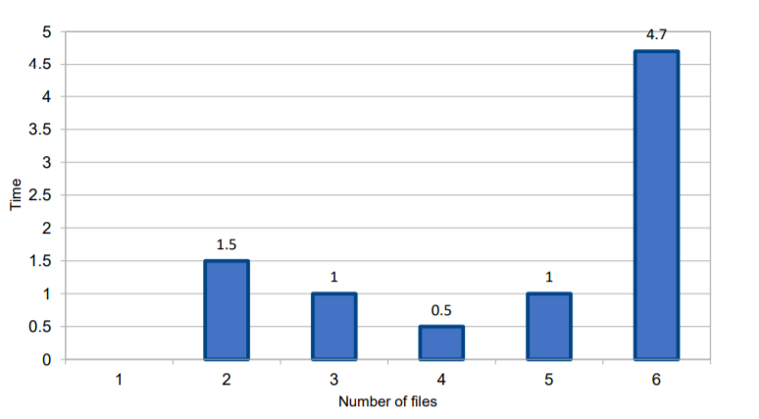
GRAPH

Slide 42
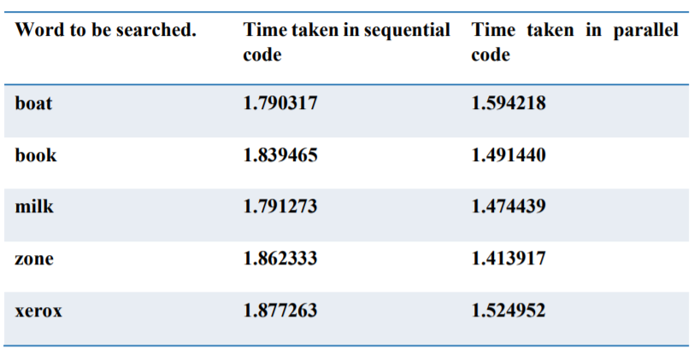
COMPARITIVE ANALYSIS

Slide 43
REFERENCES:
García-López, Félix, et al. &quot;The parallel variable neighborhood search for the p-median problem.&quot; Journal of Heuristics 8.3 (2002): 375-388.
Süß, Michael, and Claudia Leopold. &quot;Implementing irregular parallel algorithms with OpenMP.&quot; European Conference on Parallel Processing. Springer, Berlin, Heidelberg, 2006
Drews, Frank, Jens Lichtenberg, and Lonnie Welch. &quot;Scalable parallel word search in multicore/multiprocessor systems.&quot; The Journal of Supercomputing 51.1 (2010): 58-75
Rabenseifner, Rolf, Georg Hager, and Gabriele Jost. &quot;Hybrid MPI/OpenMP parallel programming on clusters of multi-core SMP nodes.&quot; Parallel, Distributed and Network-based Processing, 2009 17th Euromicro International Conference on. IEEE, 2009

Slide 44
REFERENCES:
Ballard, Clinton L. &quot;Query refinement method for searching documents.&quot; U.S. Patent No. 5,987,457. 16 Nov. 1999
Fisk, Arthur D., and Walter Schneider. &quot;Category and word search: generalizing search principles to complex processing.&quot; Journal of Experimental Psychology: Learning, Memory, and Cognition 9.2 (1983)
Lee, Seyong, and Rudolf Eigenmann. &quot;OpenMPC: Extended OpenMP programming and tuning for GPUs.&quot; Proceedings of the 2010 ACM/IEEE International Conference for High Performance Computing, Networking, Storage and Analysis. IEEE Computer Society, 2010
Parallel Quick Search Algorithm for the Exact String Matching Problem Using OpenMP
Sinan Sameer Mahmood Al-Dabbagh, Nawaf Hazim Barnouti, Mustafa Abdul Sahib Naser, (2016) .
Parallel Computing using OpenMP -Ms. Ashwini M. Bhugul(IJCSMC, Vol. 6, Issue. 2, February 2017).

Slide 45
REFERENCES:
Analysis of Parallel Boyer-Moore String Search Algorithm ByAbdulellah A. Alsaheel, Abdullah H. Alqahtani& Abdulatif M. AlabdulatifKing Saud University, Saudi Arabia(Global Journal of Computer Science and TechnologyHardware & Computation Volume 13 Issue 1 Version 1.0 Year2013 Type: Double Blind Peer Reviewed International Research JournalPublisher: Global Journals Inc. (USA)).
Parallel implementation of Doolittle Algorithm using OpenMP for multicore machines
Publisher: IEEE Date Added to IEEE:13 July 2015.
E. Ayguade, N. Copty, A. Duran, and J. Hoeflinger, ―TheDesign of OpenMP tasks,‖ IEEE Transaction on Parallel and Distributed systems, Vol. 20, Issue 3, June 2008, pp404-418

Slide 46
THANK YOU

