Slide 1
Privacy-Preserving Data with Differential Privacy
DP-SGD on UCI Adult Dataset

Slide 2
Motivation
Machine learning models may memorize training records
Personal data needs privacy in the training pipeline

Slide 3
Problem
Attacker may infer whether a person was in training data
UCI Adult contains personal tabular attributes

Slide 4
Differential Privacy
Smaller epsilon means stronger privacy
Delta is fixed at 1e-5 in this project

Slide 5
DP-SGD Workflow
Per-example gradients
L2 clipping
Gaussian noise
Privacy accounting

Slide 6
Source Paper
Abadi et al.: Deep Learning with Differential Privacy
Original benchmarks: MNIST and CIFAR-10

Slide 7
Dataset
UCI Adult / Census Income
30,162 train rows and 15,060 test rows after cleaning
104 processed input features

Slide 8
Threat Model
Attacker can query trained model
Attack goal: infer training membership
Defense: bound influence of one record

Slide 9
Experimental Pipeline
Preprocess data
Train baseline models
Run DP-SGD sweeps
Evaluate utility and MIA risk

Slide 10
Baseline Models
Logistic Regression accuracy = 0.8480
MLP baseline accuracy = 0.8487
MLP baseline F1 = 0.6645

Slide 11
Strong Baseline Check
Tuned classical baseline: HistGradientBoosting
Default accuracy = 0.8708
Threshold-tuned F1 = 0.7261
Clean 0.90 target was not reached

Slide 12
Boosted Feature Baseline
Tried XGBoost, LightGBM, CatBoost, HistGradientBoosting
Added numeric bins and interaction features
Best boosted F1 = 0.7273
Best boosted default accuracy = 0.8689

Slide 13
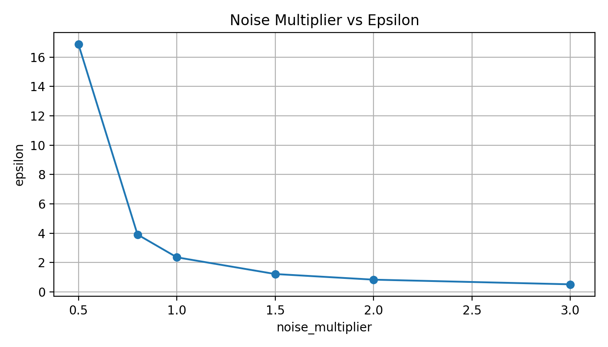
Noise Sweep
Balanced noise 1.5 epsilon = 1.2143
Accuracy = 0.8497
F1 = 0.6571

Slide 14
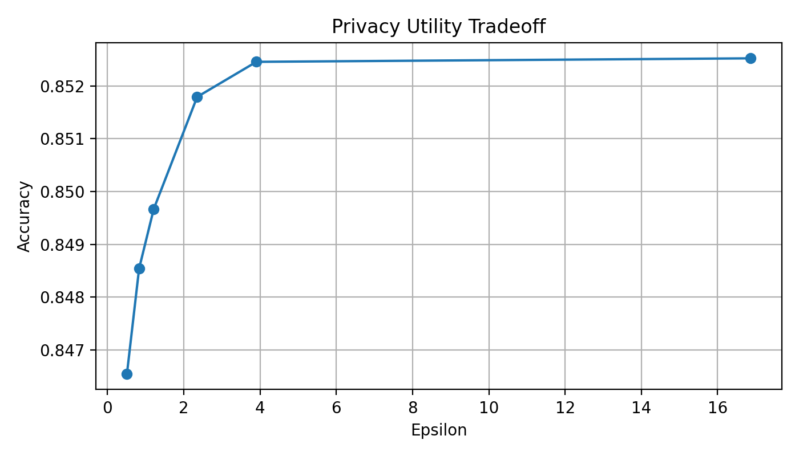
Privacy Utility Tradeoff
Higher noise reduces epsilon
Utility changes are modest on UCI Adult

Slide 15
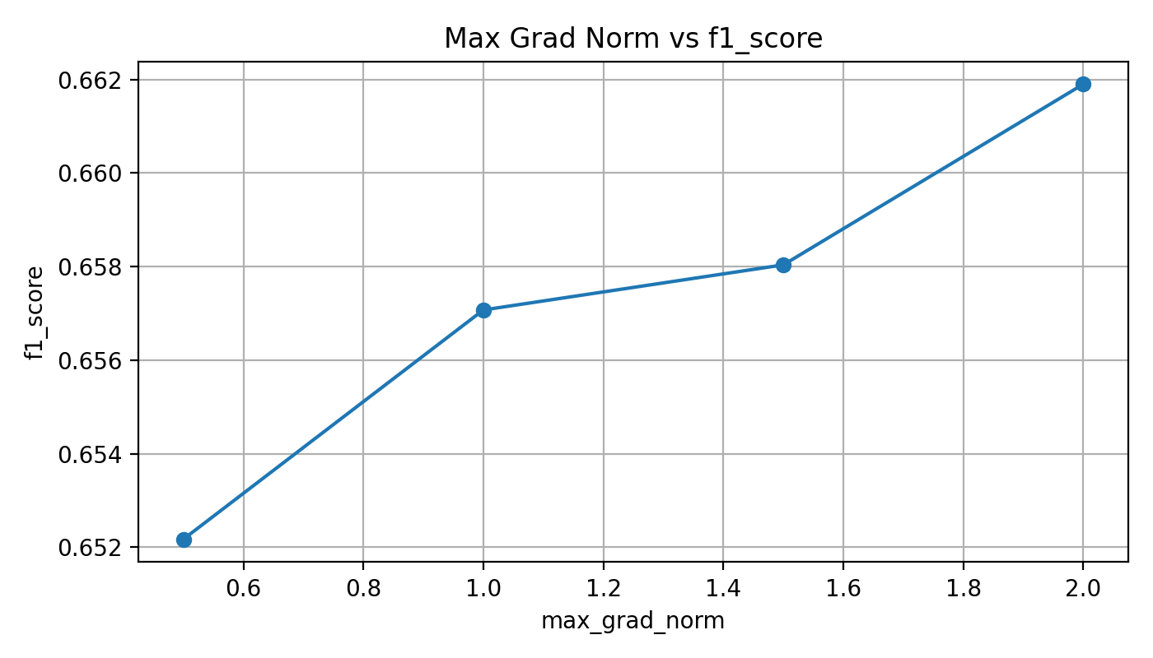
Max Grad Norm
Epsilon unchanged when noise/sample rate/epochs are fixed
Best F1 in final run: max_grad_norm = 2.0

Slide 16
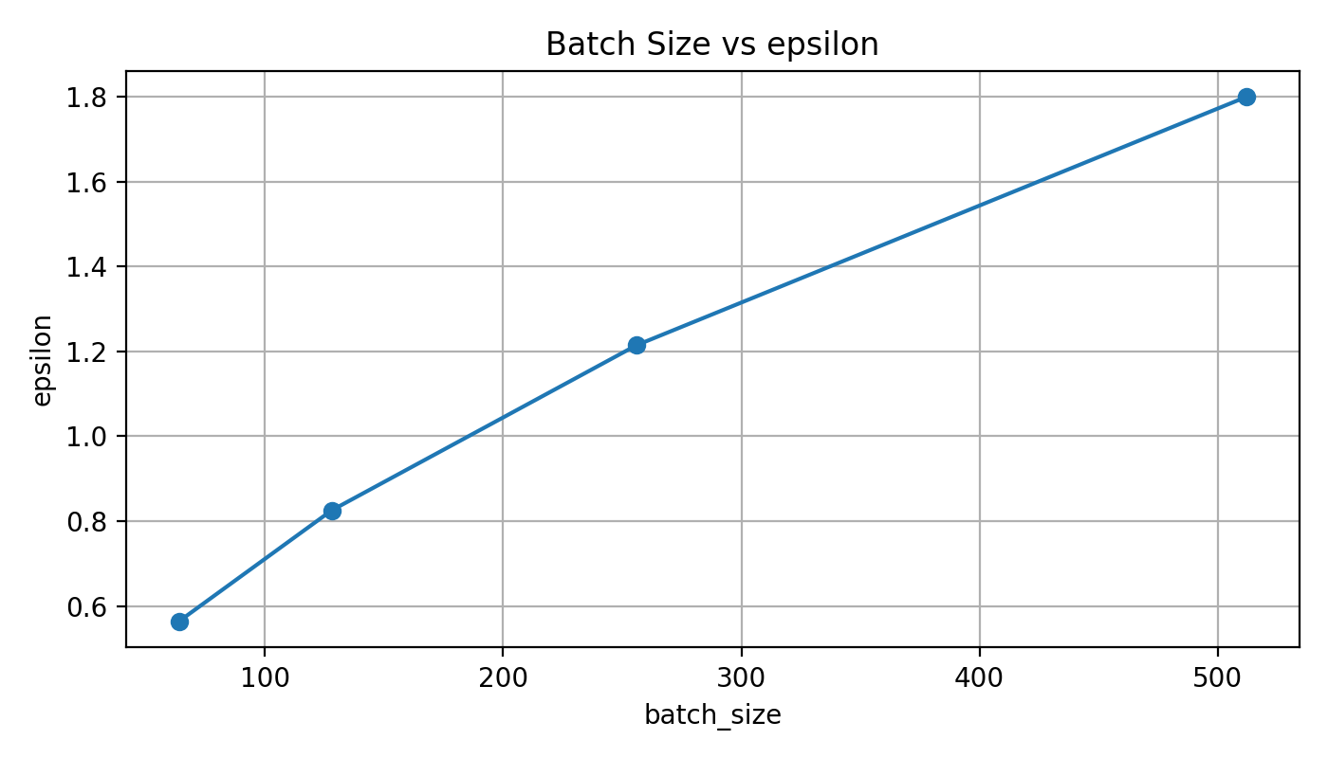
Batch Size
Batch size changes sampling rate
Batch 64 has lowest epsilon but much weaker F1
Batch 512 has stronger utility but higher epsilon

Slide 17
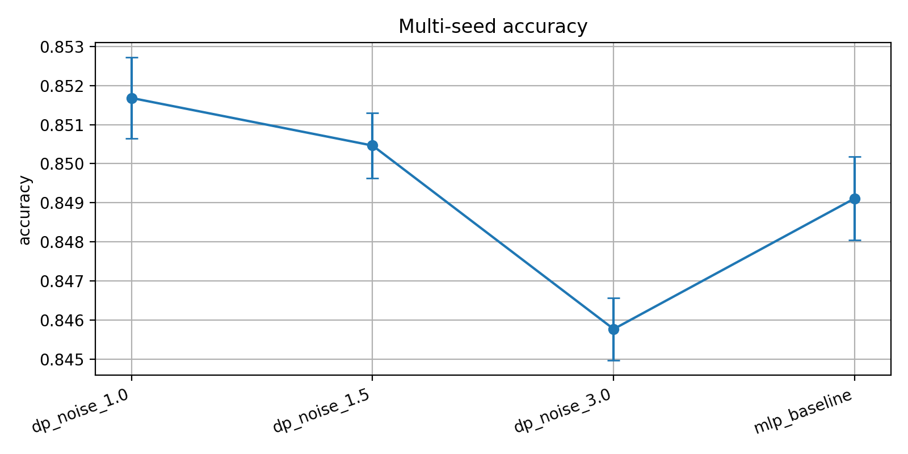
Multi-Seed Robustness
Small standard deviations across seeds
Noise 1.5 remains stable enough for discussion

Slide 18
Membership Inference Setup
Confidence-based attack
Train samples label 1, test samples label 0
Metric: attack AUC

Slide 19
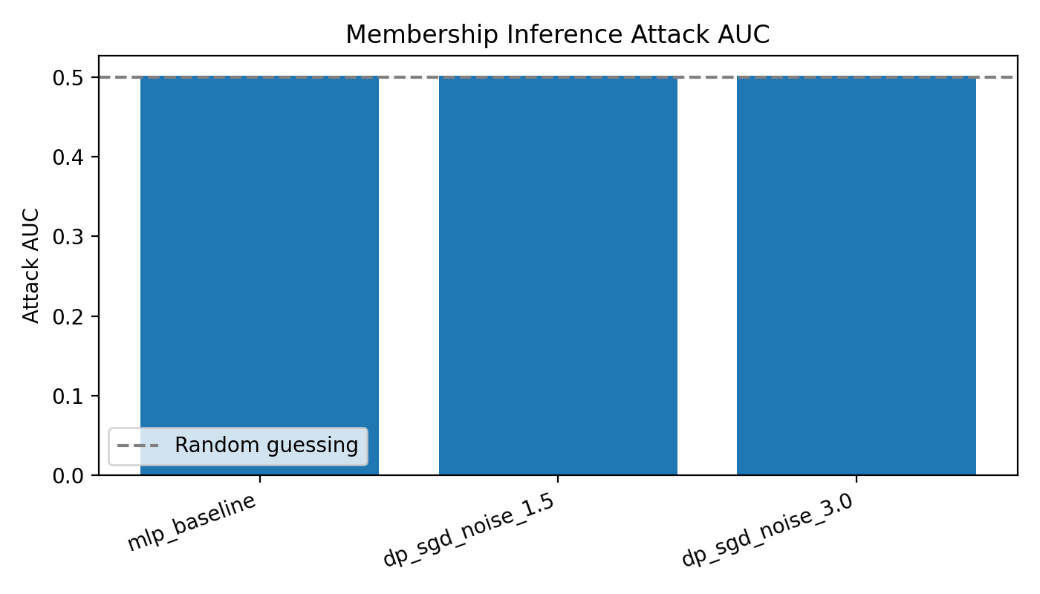
Membership Inference Result
Baseline attack AUC = 0.5021
DP-SGD attack AUC values are also near 0.5
Simple attack is close to random guessing

Slide 20
Recommended Configuration
Balanced: noise_multiplier = 1.5
Epsilon = 1.2143
Strongest privacy: noise = 3.0, epsilon = 0.5124

Slide 21
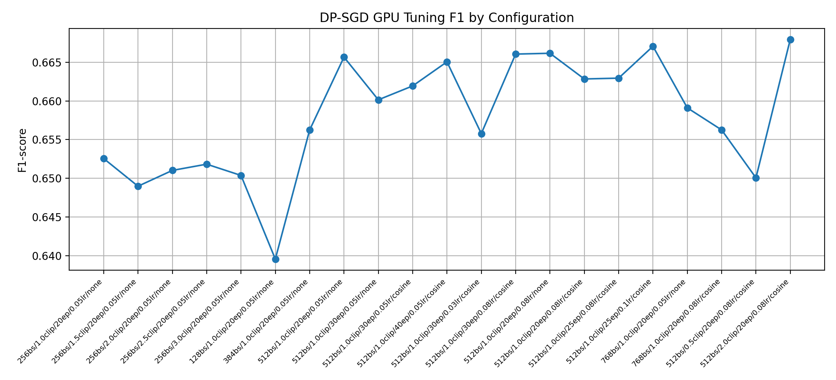
Tuned DP-SGD
GPU tuning focused on noise multiplier 1.5
Best F1 = 0.6680
clip=2.0000, batch=512
epochs=20, lr=0.0800

Slide 22
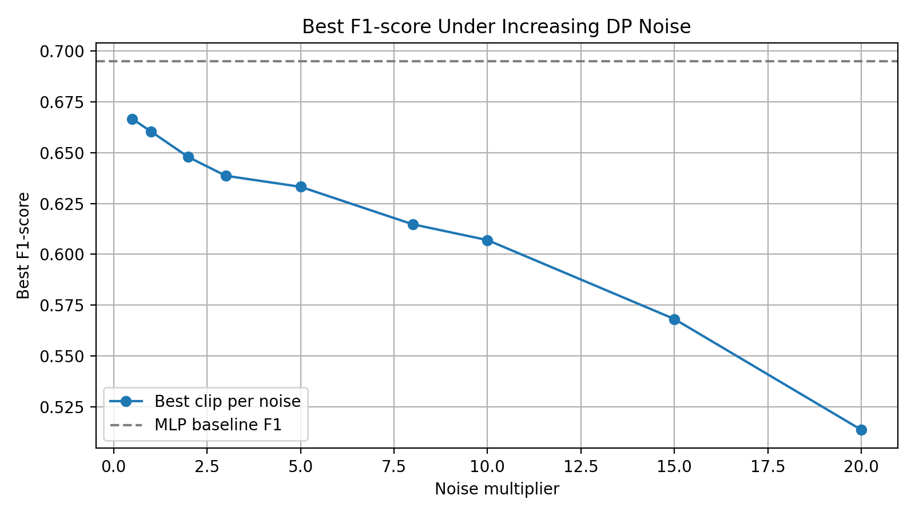
Noise Stress Test
Added joint grid: noise x clipping norm
Metric focus: F1-score
Tuned non-DP F1 = 0.6951
Best DP grid result is below tuned baseline
Noise 10-20 shows clear utility drop
Best F1 at noise 20 = 0.5135

Slide 23
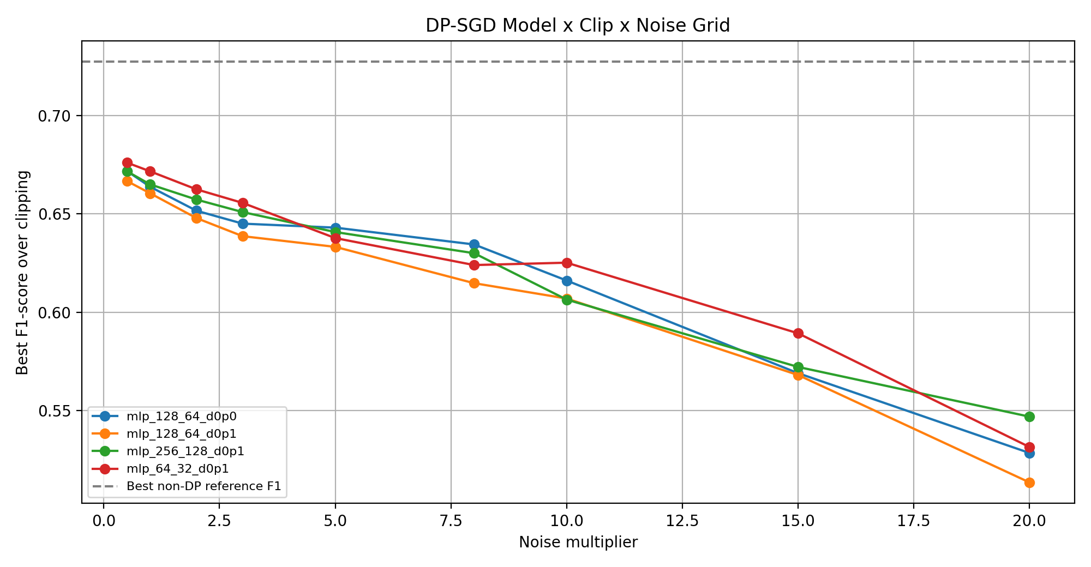
Model x Clip x Noise
Completed 144 DP-SGD GPU runs
Best DP grid F1 = 0.6760
Best DP model = mlp_64_32_d0p1
Worst DP grid F1 = 0.2413

Slide 24
Conclusion
DP-SGD can be integrated into PyTorch training
Privacy and utility should be reported together
MIA AUC complements but does not replace epsilon

