Slide 1


Slide 2
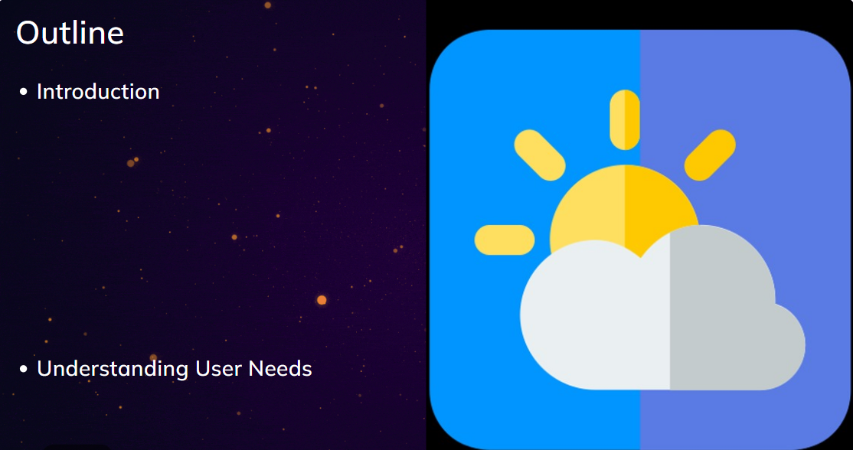

Slide 3
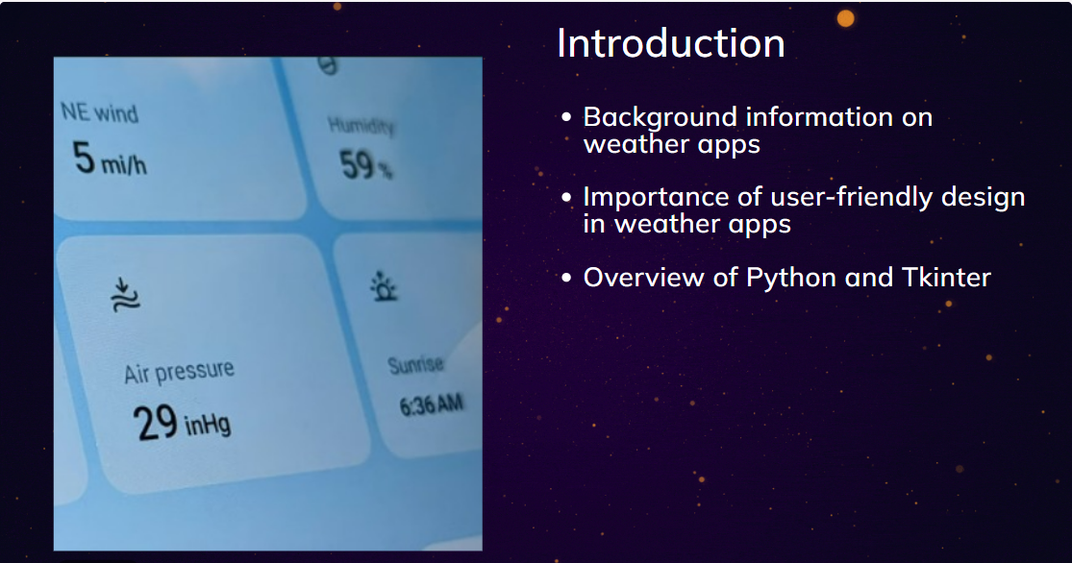

Slide 4


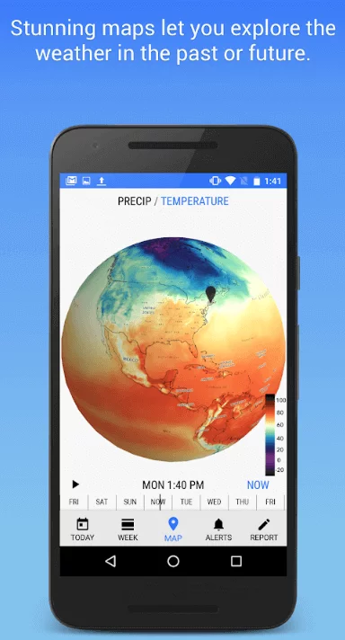
Advancements in Technology: The Use of Big Data, Machine Learning and AI

