Slide 1
CS22 MINI PROJECT
EXTENDING MARS FUNCTIONALITY
Animesh Kumar Sinha 2001CS07

Slide 2
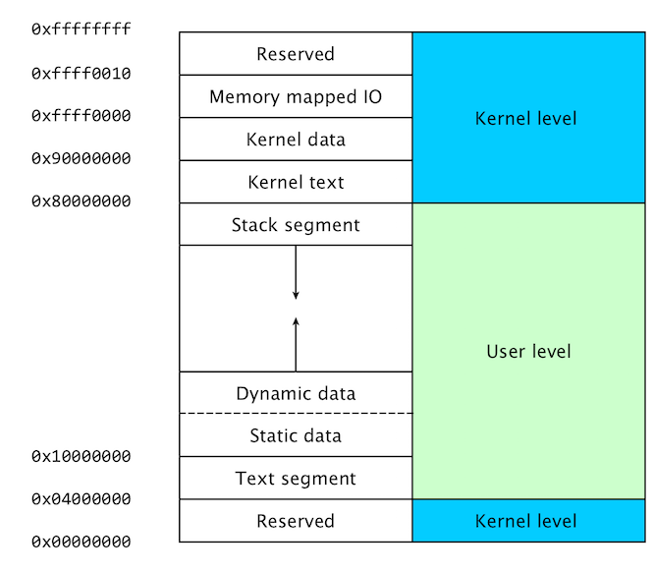
STACK:
Stack is one of the Memory segments in the main memory layout. The role of stack is the storage of temporary data while handling function calls, storage for local variables, passing of parameters in function calls, saving of registers during exception sequences etc.
Stack is mainly used in case of nested subroutine calls, where each of the subroutine may have a set of variables which are local to that subroutine, i.e. their scope is limited only to that function/subroutine call. This temporary data can be conveniently stored on the stack in a stack frame.

Slide 3
STACK FRAME:
Each function call gets its memory allocated on the stack in the form of a stack frame. Once the function has completed its execution, its stack frame(which contains all the pass arguments and local variables) gets erased from the main memory.
When a function is called, it creates a new frame onto the stack, which will be used for local storage. Before the function returns, it must pop its stack frame, to restore the stack to its original state.

Slide 4
THE MIPS STACK:
In MIPS machines, part of main memory is reserved for a stack. The stack grows downward in terms of memory addresses. — The address of the top element of the stack is stored (by convention) in the “stack pointer” register, $sp.
MIPS does not provide “push” and “pop” instructions. Instead, they must be done explicitly by the programmer.

Slide 5
MARS STACK VISUALIZER TOOL
In this project, I have implemented an in-built tool by extending the Abstract Tools class in MARS, which can visually simulate the stack memory in between function calls. It keeps track of:
It keeps track of:
Memory address referenced by the stack pointer
Registered being saved in the stack
Value or address contained in the given register

Slide 6
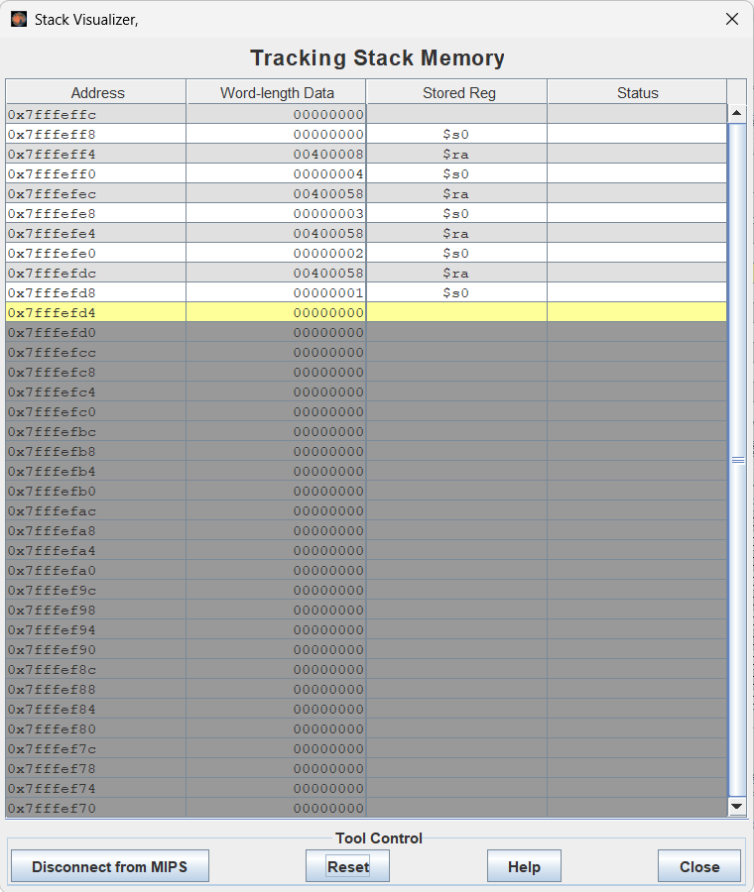
MARS STACK VISUALIZER TOOL
The highlighted (yellow) row indicates the current stack pointer location and the greyed rows have not been allocated yet. The rows above the $sp show the saved register name, value and the address in stack memory.

Slide 7
MARS STACK VISUALIZER TOOL
SIMULATION AND ANALYSIS:
For demonstration purpose, I will simulate the tool using the MIPS codes for:
Calculating factorial sequence
Calculating fibonacci sequence
Calculating fibonacci sequence using Dynamic Programming

Slide 8
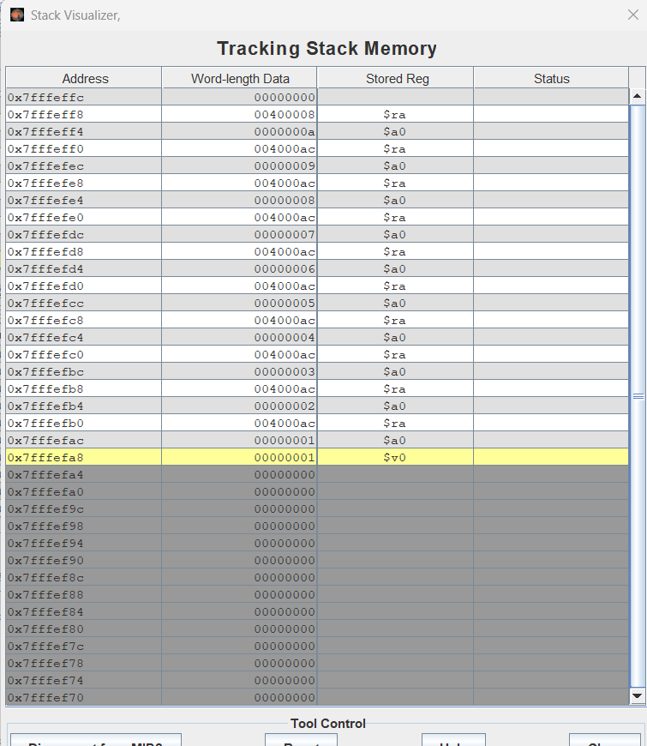
MARS STACK VISUALIZER TOOL

Slide 9
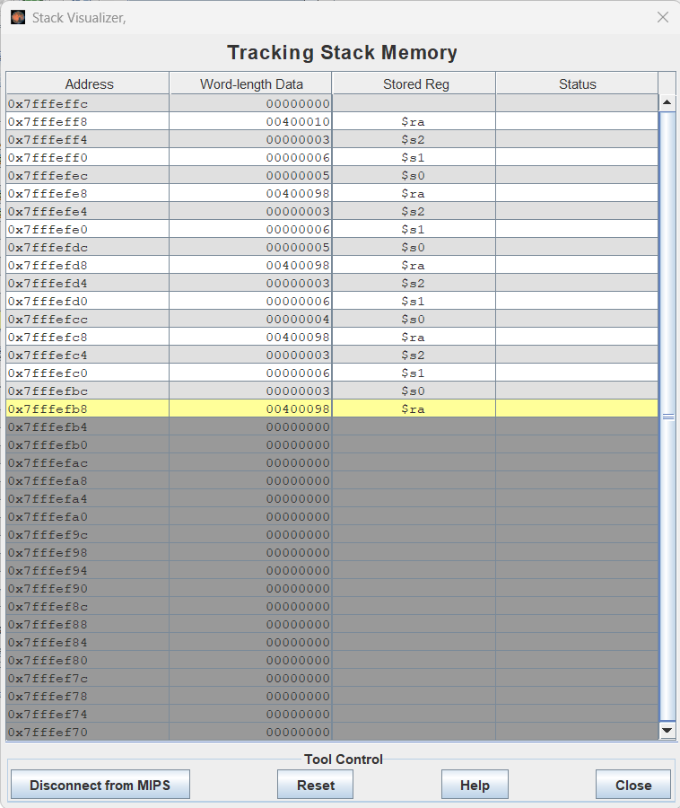
SUMMARY :
I have created a Stack Visualizer tool which keeps track of the stack pointer and visually simulates the stack memory in between nested function calls, storing local variables, caller and callee-saved registers, function parameters and arguments on the stack, in the form of stack frames which are erased at the end of function execution.
POLICY | REMARKS
RANDOM
FIFO | Might replace important blocks
LFU | Not Efficient
LRU | Excellent, but difficlt to implement, as it requires substantial hardware assistance
LRU - 2 | Efficiency increases as the size of cache increases

