Slide 1
Anomaly Detection and Event Prediction
in sensor networks
Om Jajulwar

Slide 2
Agenda
Introduction
Project Goals
Challenges
Data Collection and Preprocessing
Libraries Used
Data Analysis & Data Transformation EDA
Model Training and Evaluation
Results and Findings
Conclusion and Recommendations

Slide 3
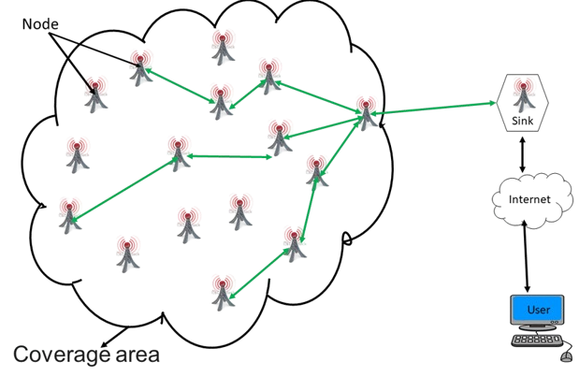
Introduction
The goal of this project is to develop an Anomaly Detection and Event Prediction system for sensor networks, aimed at significantly enhancing monitoring capabilities.
The system will enable proactive responses to potential issues, ultimately revolutionizing sensor network technology. By analyzing sensor data, identifying anomalies, and predicting events, the system will provide actionable insights to optimize resource allocation and operational efficiency.

Slide 4
Project Goals
Risk Mitigation: Mitigate risks associated with safety, security, and compliance by detecting anomalies and predicting events before they escalate.
Data-Driven Insights: Generate valuable insights into the performance and behavior of assets and processes, informing strategic planning and optimization efforts.
Competitive Advantage: Leverage advanced analytics and predictive capabilities to gain a competitive edge in the sensor technology market.

Slide 5

Challenges
Data Quality and Availability: Ensuring the availability and quality of data for analysis, as incomplete or inaccurate data can lead to unreliable results
Algorithm Selection: Choosing the most suitable algorithm for the specific task and optimizing its parameters for effective anomaly detection and event prediction.
Scalability: Handling large datasets efficiently to ensure timely analysis and accurate predictions.

Slide 6




Libraries Used
pandas: Data manipulation and analysis.
matplotlib: Data visualization.
seaborn: Statistical data visualization.
sklearn.model: Dataset splitting for training and testing.

Slide 7
Data Description
Dataset Overview:
Number of Instances: Total rows in the dataset are 182.
Number of Features: Columns in the dataset are 4.
Key Features:
The Area ranges from 5000 to 50000, with a mean of 24375.
Sensing Range varies from 15 to 40, with a mean of 27.5.
Transmission Range is between 30 and 80, with a mean of 55.
Number of Sensor nodes ranges from 100 to 400, with a mean of 250.
Number of Barriers varies widely, from 12 to 320, with a mean of about 94.

Slide 8
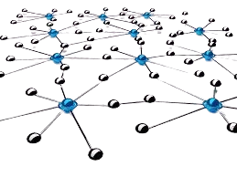

Data Analysis & Data Transformation EDA
Unique Values: Analyzed unique values for each column to understand the data distribution.
Box Plots: Created box plots for each feature to identify outliers and understand data variability.
Distribution Plots: Generated distribution plots to visualize the frequency distribution of each feature.

Slide 9
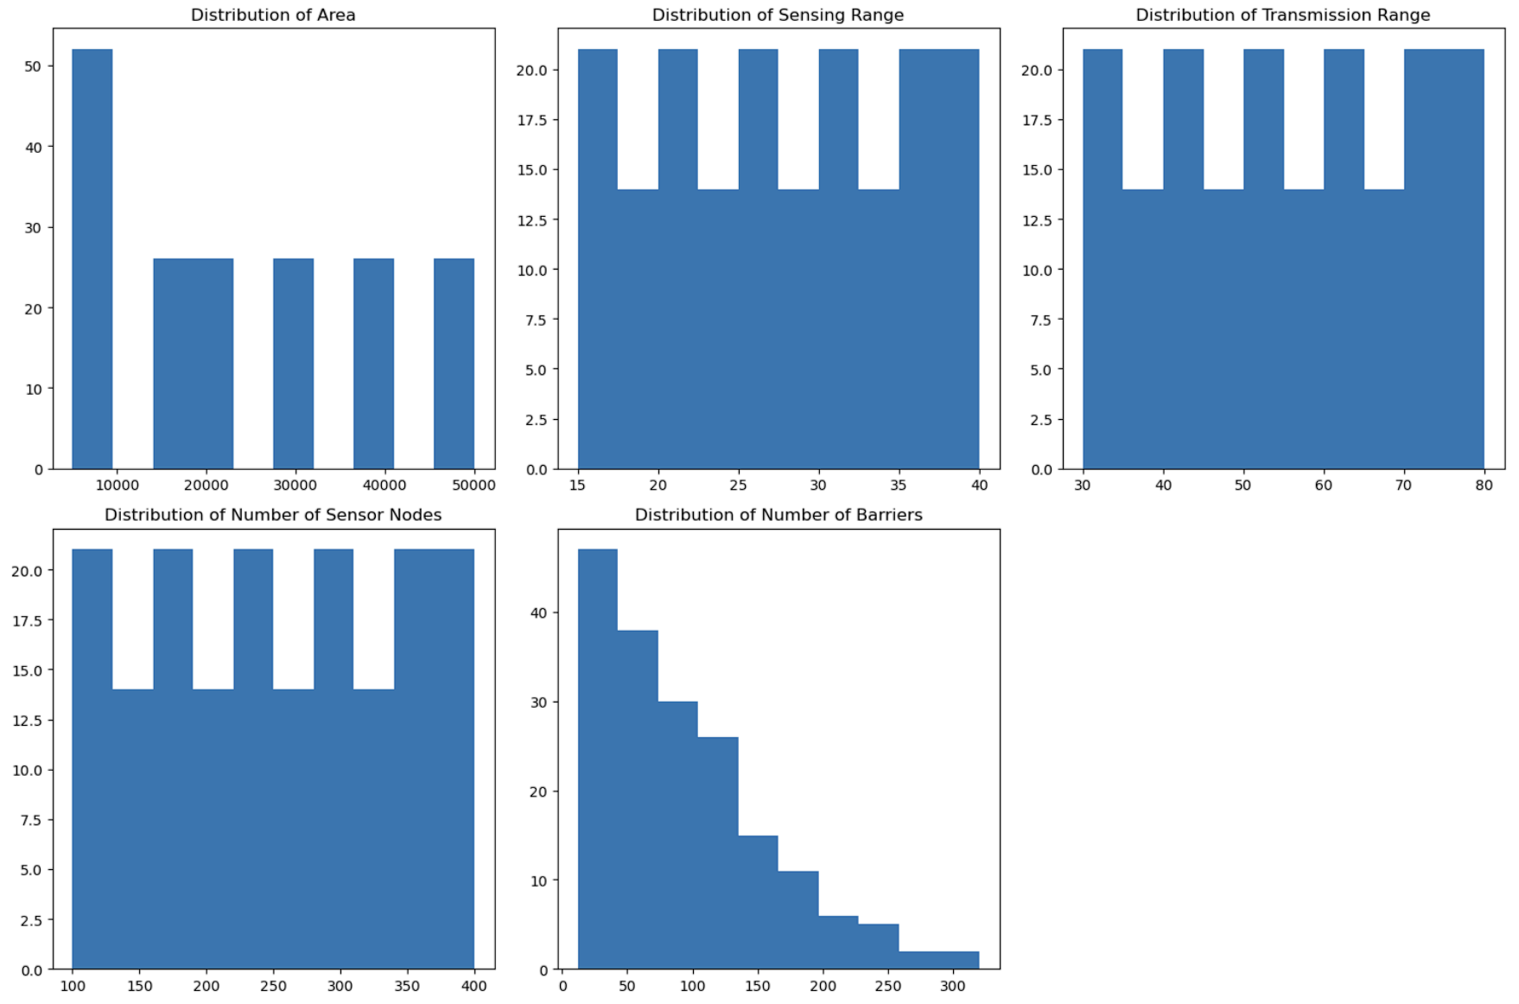
Histograms

Slide 10
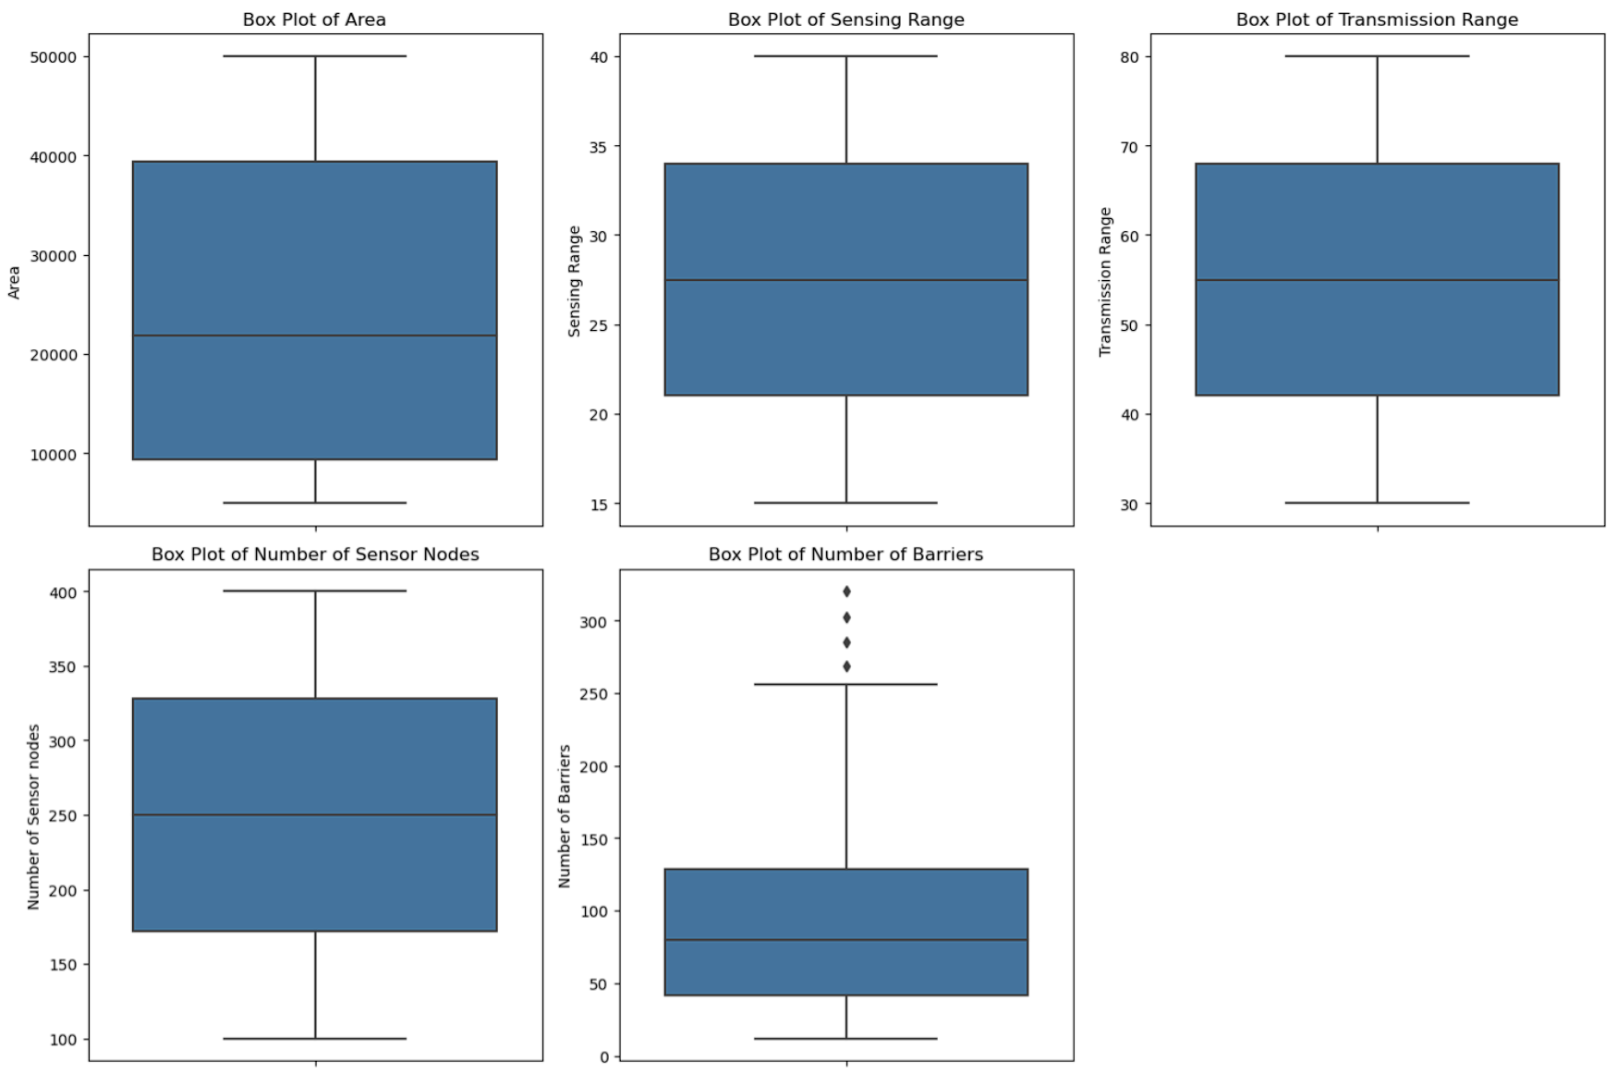
Box Plot

Slide 11
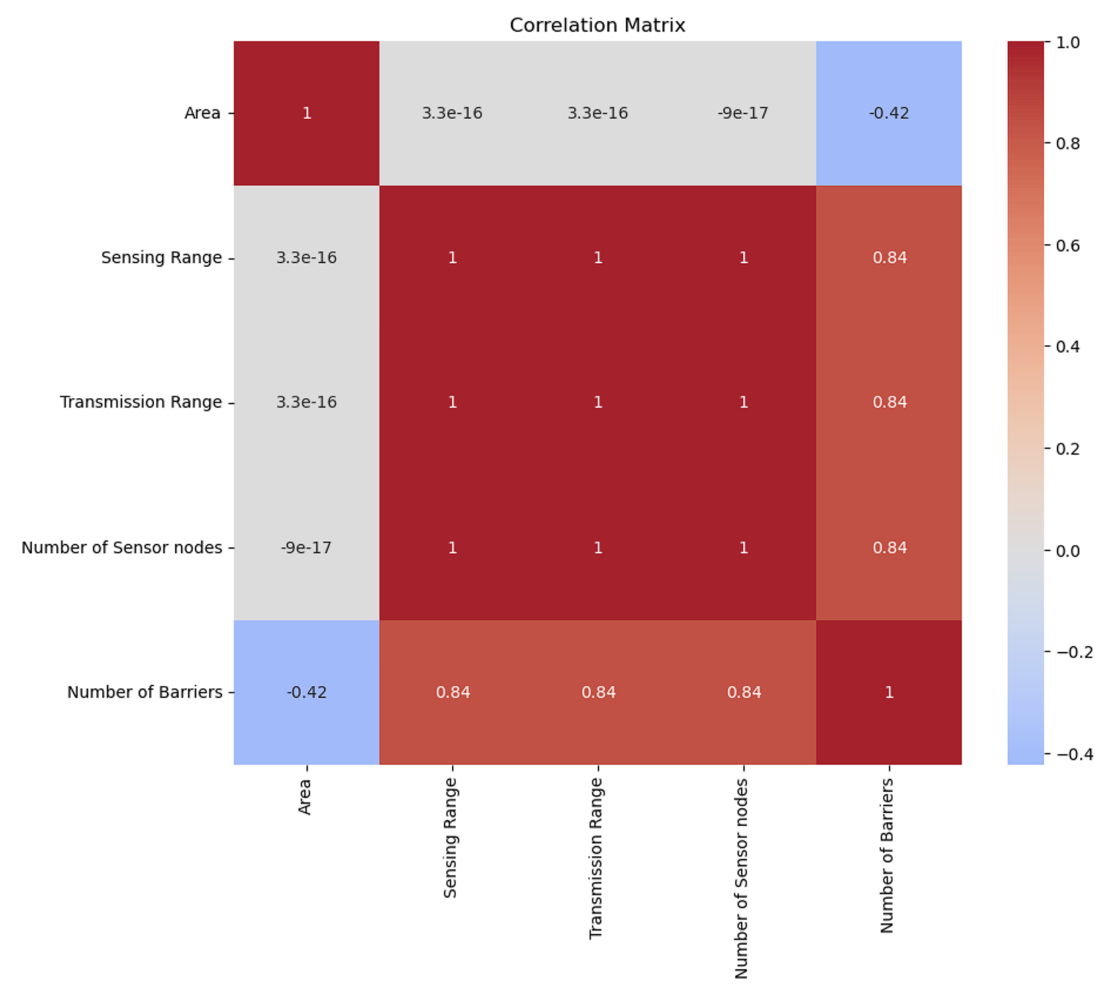
Correlation Heatmap Analysis
Introduction:
The heatmap visualizes the relationships between different features in the dataset.
Correlation values range from -1 to 1, indicating the strength and direction of relationships.
Key Insights:
Area:
Moderate negative correlation with 'Number of Barriers' (-0.42).
Negligible correlation with other features.
Sensing Range, Transmission Range, and Number of Sensor Nodes:
Perfect correlation with each other (1.0).
High positive correlation with 'Number of Barriers' (0.84).

Slide 12
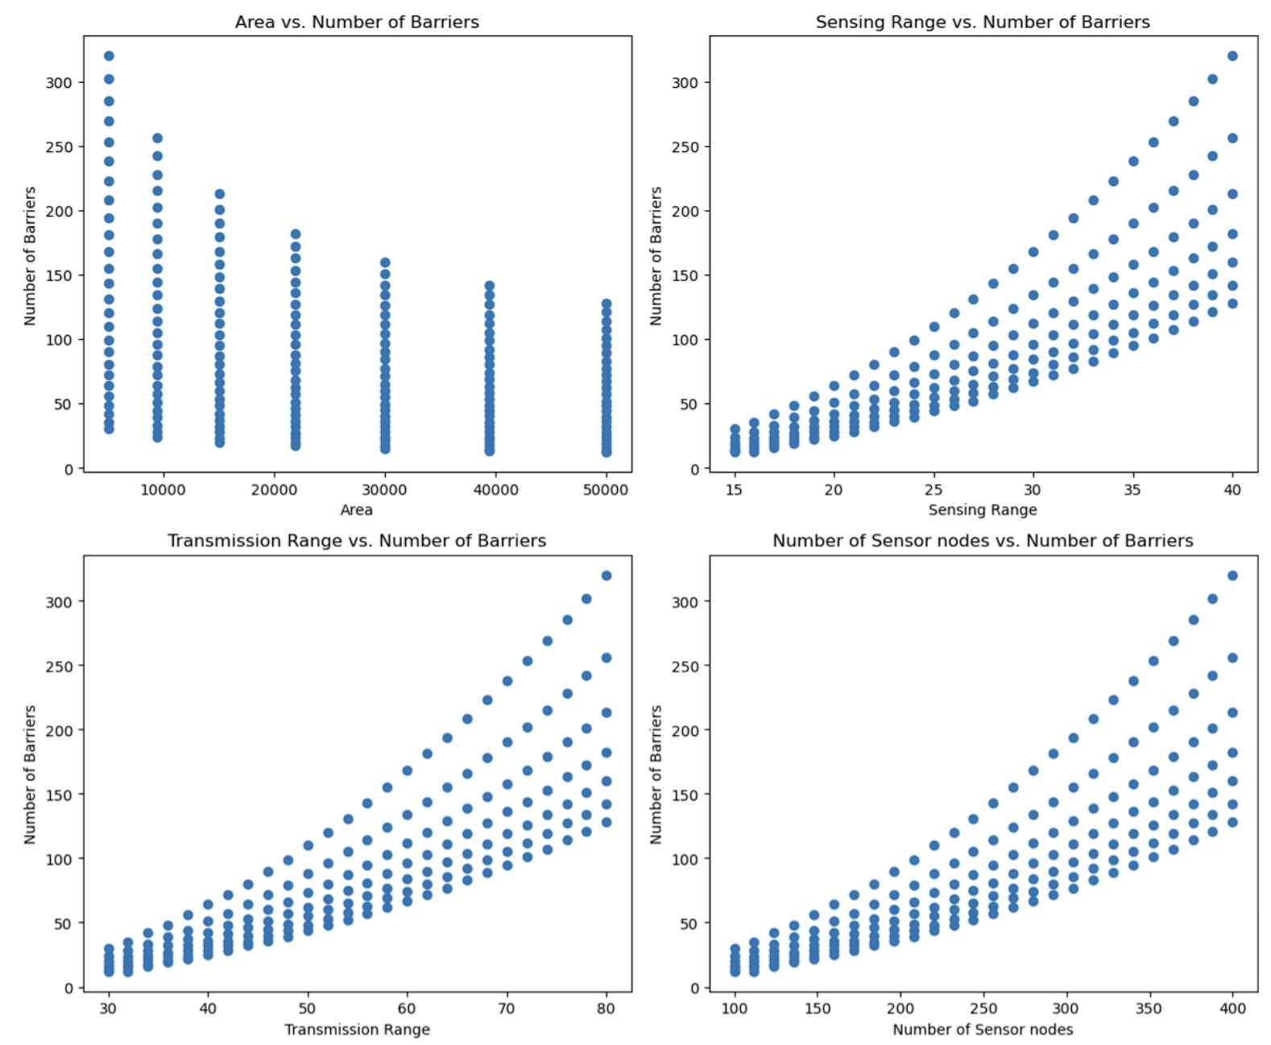
Scatter Plot

Slide 13
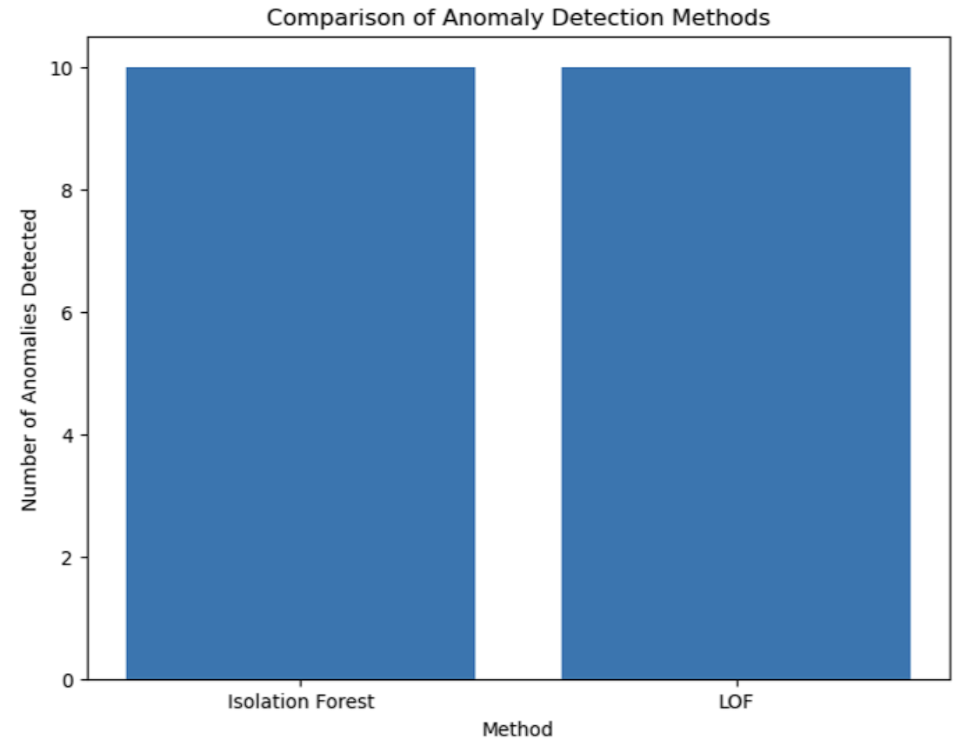
Anomalies
Introduction:
Anomaly detection is crucial for identifying unusual patterns that do not conform to expected behavior in sensor networks.
We used Isolation Forest and Local Outlier Factor (LOF) methods to detect anomalies in our dataset.
Methods and Results:
Isolation Forest and LOF:
Both methods detected 10 anomalies in the dataset.
Highest anomaly value detected: 320
Lowest anomaly value detected: 12

Slide 14
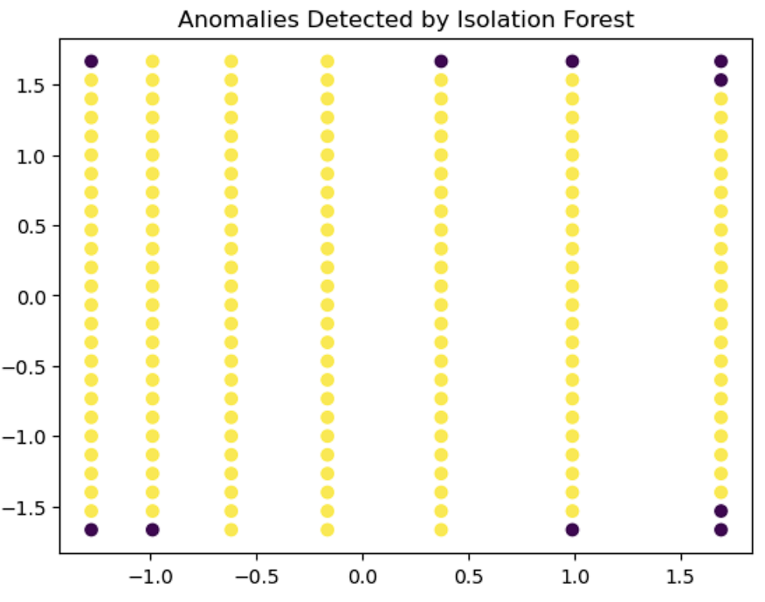
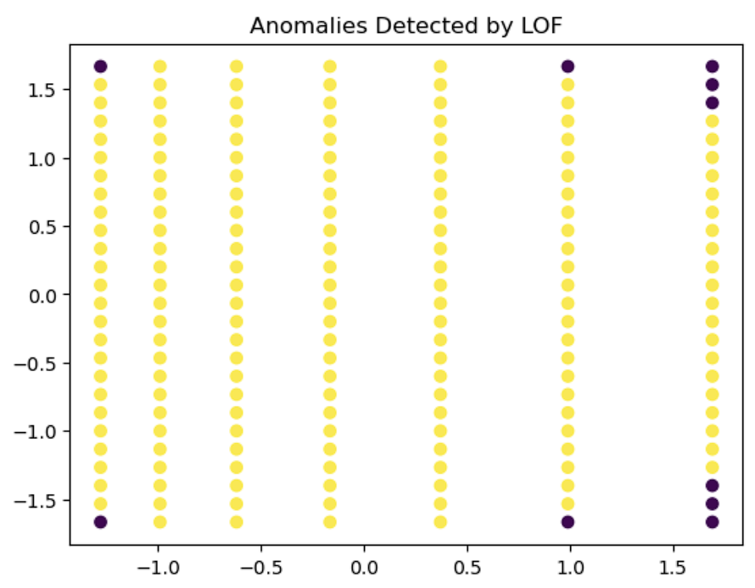
Visualizing Anomaly Detection: Isolation Forest vs. LOF

Slide 15
Model Training and Evaluation
Models Used: Linear Regression, Decision Tree Regressor, Random Forest Regressor, Gradient Boosting Regressor, AdaBoost Regressor, XGBoost.
Training and Testing: Split the data into training (80%) and testing (20%) sets.
Performance Metrics: Evaluated models using Mean Squared Error (MSE) and R-squared (R2) scores.

Slide 16
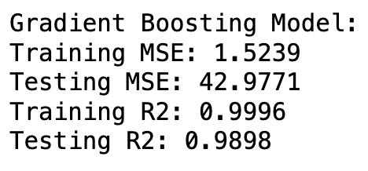
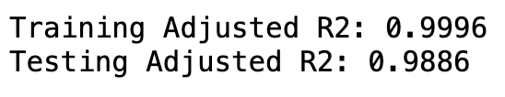
Results and Insights
Best Model: Gradient Boosting Regressor provided the best performance with high accuracy in detecting anomalies and predicting events.
Feature Importance: Analyzed feature importance to understand the contribution of each feature to the model's predictions.

Slide 17
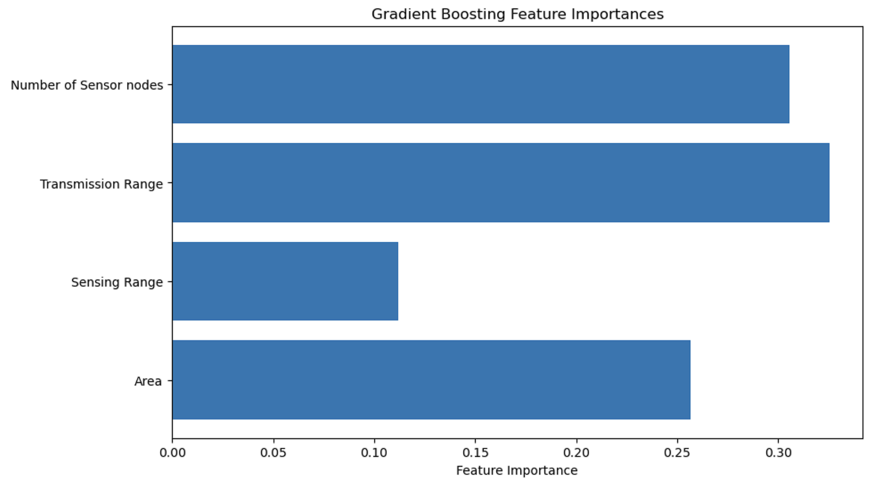
Feature Importance
Number of Sensor Nodes: This feature has the highest importance, indicating that the number of sensor nodes plays a crucial role in detecting anomalies and predicting events.
Transmission Range: This feature is also highly important, suggesting that the range over which sensors can transmit data significantly affects the prediction accuracy.
Sensing Range: Although less important than the other features, the range within which sensors can detect events still contributes to the model's predictions.
Area: The size of the monitored area is another critical factor impacting the model's performance.

Slide 18
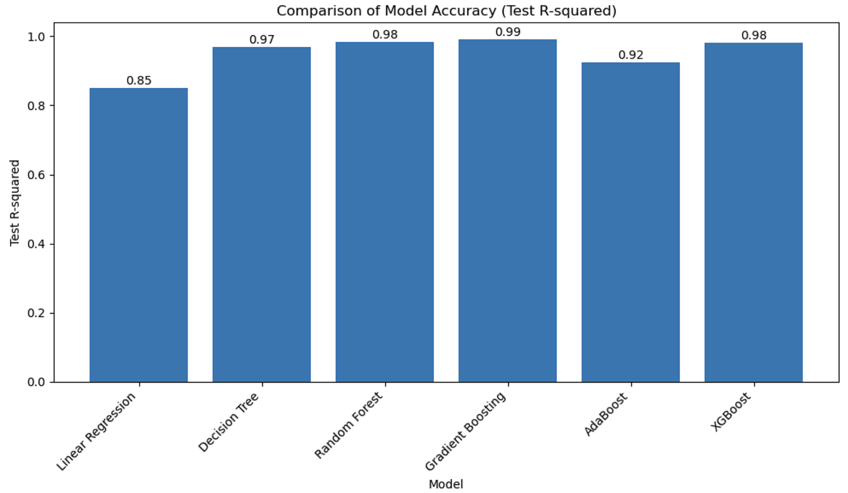
All models performance
Performance Comparison:
We evaluated multiple models to predict anomalies and events in the sensor network. Gradient Boosting achieved the best performance with a testing R2 score of 0.9898 and the lowest testing MSE of 42.9771.
Model Accuracy:
While Decision Tree, Random Forest, and XGBoost models showed high accuracy, Gradient Boosting stood out by providing the most reliable predictions, balancing both training and testing accuracies effectively.
Gradient Boosting Superiority:
Among all models, Gradient Boosting demonstrated the highest consistency and precision in its predictions, indicating its robustness in handling the dataset.

Slide 19

Conclusion
The Gradient Boosting model demonstrated the highest accuracy and performance in detecting anomalies and predicting events within the sensor network. This system provides actionable insights, enabling proactive responses and optimizing resource allocation, thereby significantly enhancing the monitoring capabilities of sensor networks.

Slide 20

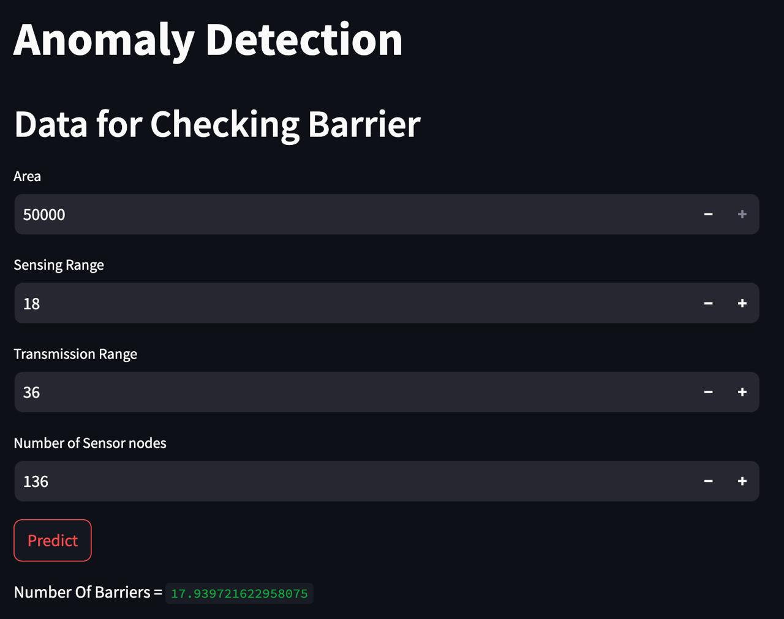
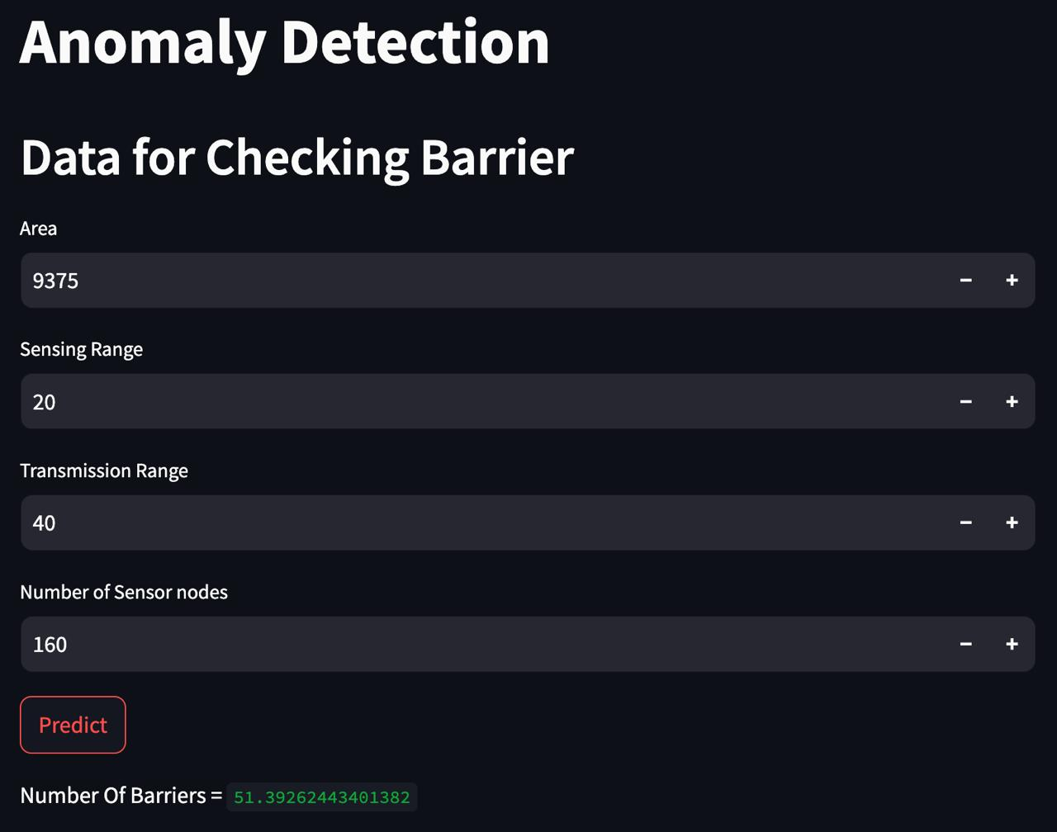
Deployment

Slide 21
Thank You!

