Slide 1
Homework: Drug repositioning for SARS-CoV-2: DTI/CPI prediction
2020.4.28

Slide 2
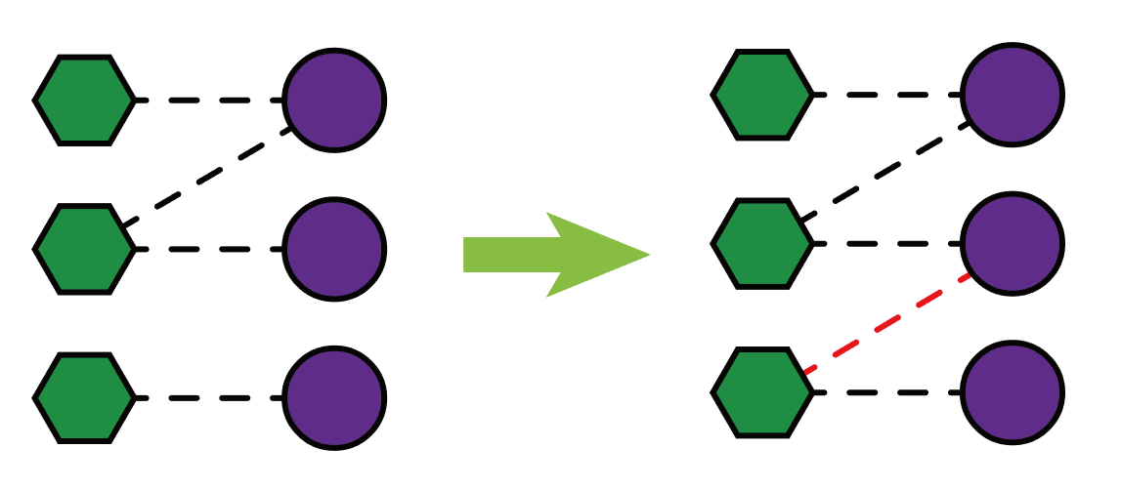
Basic concepts in DTI / CPI prediction
Drugs Targets
Drug-target interaction (DTI) prediction: drug repositioning
Goal: predict new links in the drug-target interaction network
Information: knowledge graphs
Scale: thousands of drugs/targets
Compound-protein interaction (CPI) prediction: drug screening/ repositioning
Goal: classification/regression
Information: molecular compositions of proteins and compounds
Scale: often involves much more compounds
Drugs: a subset of compounds that are approved or in clinical trails
Targets: a subset of proteins that are druggable or disease-related
DTI (binary): chemical interaction
Affinity (scalar): strength of the interaction

Slide 3
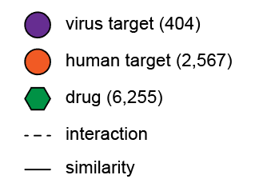
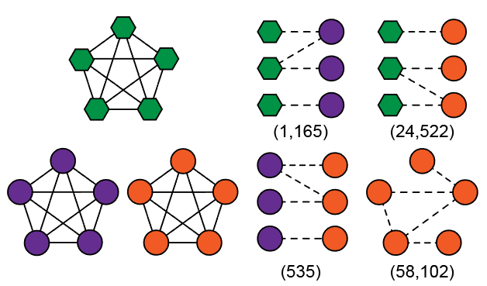
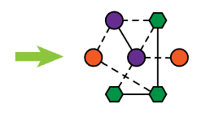

Input of DTI prediction: the heterogeneous network
Types of nodes and edges
Individual networks
Heterogeneous network
Interactions: binary values
Similarities: scalar values

Slide 4
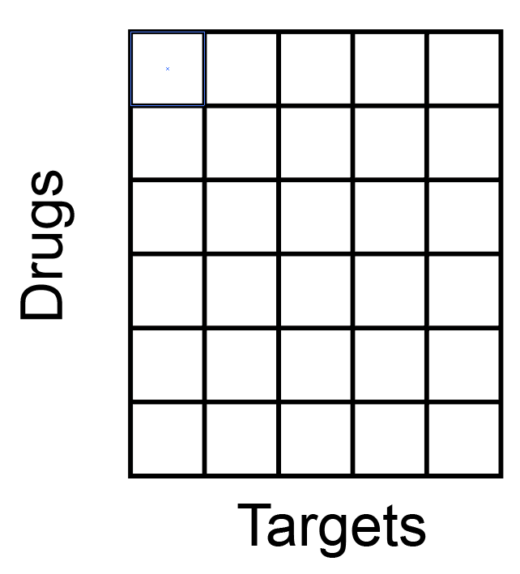
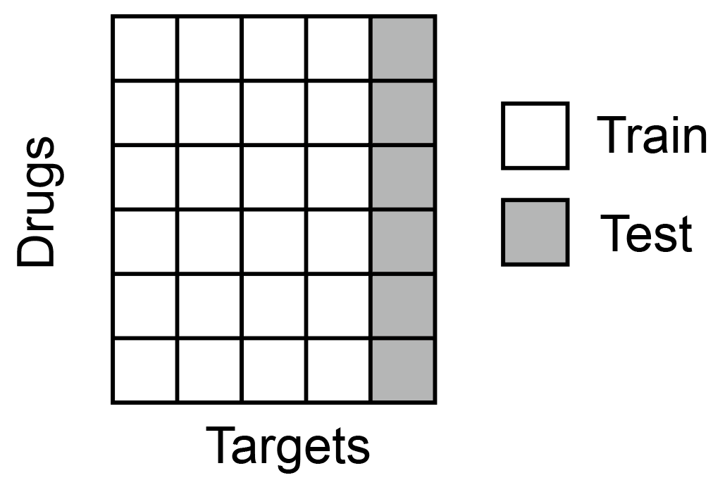
Evaluate DTI model using the virus target-drug network
The individual networks are stored in matrix format, and edges in dictionaries, e.g.,
Perform cross-validations according to the target dimension:

Slide 5
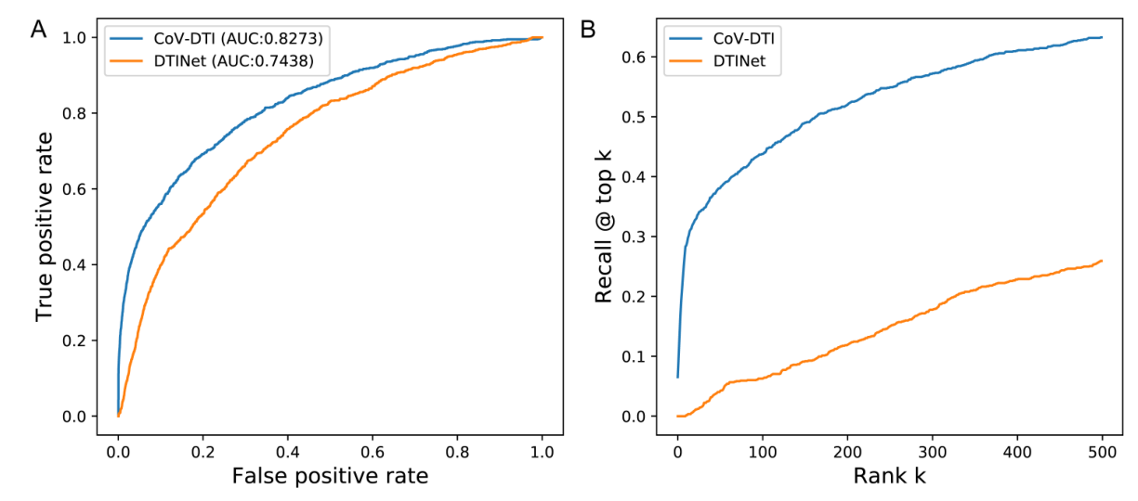
Evaluate DTI model using the virus target-drug network
If all the positive and negative virus DTIs are used, please use AUC and recall@top k (true positives in top k predictions) for evaluation:
If negative DTIs are sampled in a fixed (and relatively balanced) ratio, e.g., 1:1 or 1:10, please use AUC and AUPR for evaluation.

Slide 6
Input of CPI prediction
Classification: list of (proteins, compounds, 0/1 indicating interaction)
Regression: list of (proteins, compounds, scalar value indicating affinity)
Proteins are represented by primary amino-acid sequences
Compounds are represented by InChIs (International Chemical Identifiers)
Protein encoding and feature extraction:
One-hot, word2vec, learnable embeddings, …
CNN, RNN, …

Slide 7
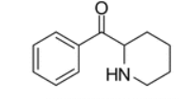
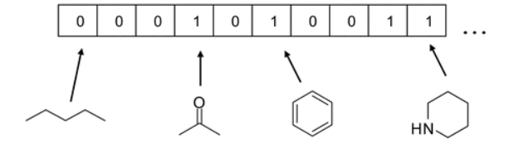
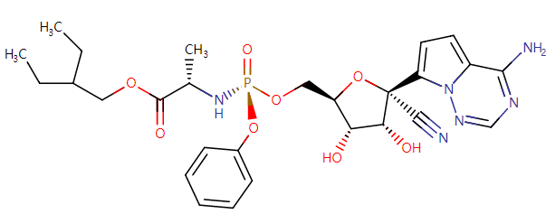
Compound encoding and feature extraction:
Fingerprint: substructures are hashed into bit-vectors (http://www.rdkit.org/docs/source/rdkit.Chem.rdMolDescriptors.html#rdkit.Chem.rdMolDescriptors.GetMorganFingerprintAsBitVect)
SMILES (simplified molecular input line entry specification) string
CCC(CC)COC(=O)[C@H](C)N[P@](=O)(OC[C@H]1O[C@](C#N)([C@H]
(O)[C@@H]1O)C1=CC=C2N1N=CN=C2N)OC1=CC=CC=C1
Graph:
Models: CNN, RNN, graph neural networks, …

Slide 8
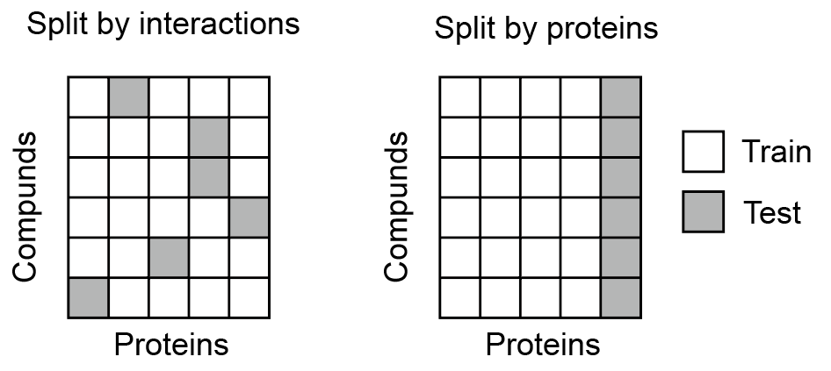
Evaluate CPI model
Perform cross-validations according to pairs or proteins:
Classification metrics: AUC, AUPR
Regression metrics: root mean squared error (RMSE), Pearson’s correlation

Slide 9
Predict drugs for SARS-CoV-2 proteins
Choose one task (DTI or CPI) to build your model
Predict potential active drugs among 6255 candidates, for 2-3 viral proteins
Possible evaluation through recently reported active drugs: remdesivir, chloroquine, nitazoxanide, nafamostat, favipiravir… (https://doi.org/10.1038/s41422-020-0282-0)
Present top 10 drugs, and their drug names, original indications and original targets (All the information can be found at https://www.drugbank.ca/)

