Slide 1
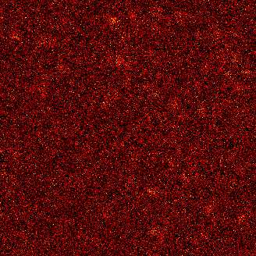
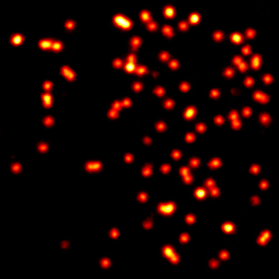













Raw
SRDTrans
GT
Raw
SRDTrans
GT

Slide 2
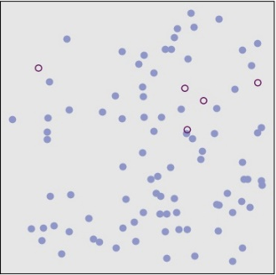
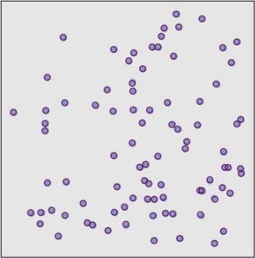
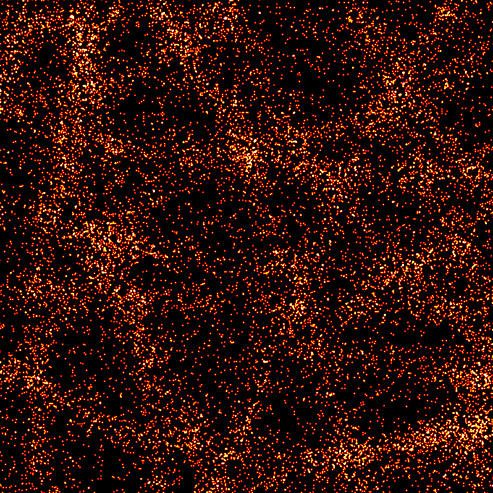
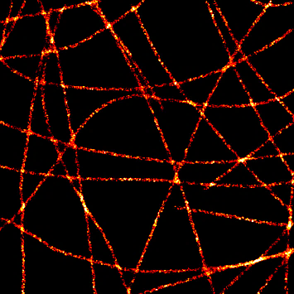
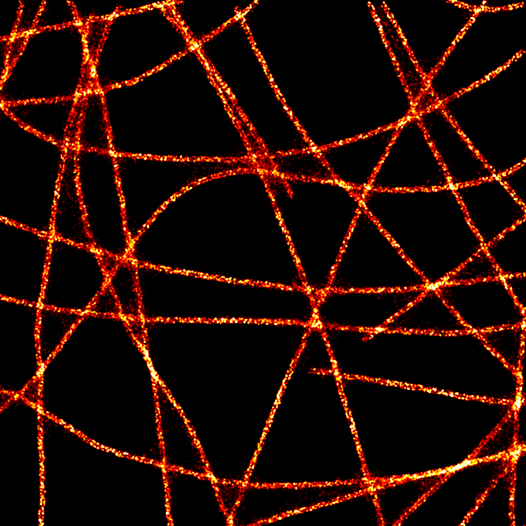
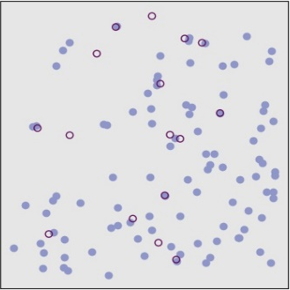
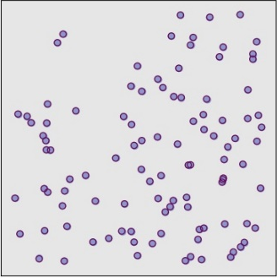




Raw
SRDTrans
Raw STORM
SRDTrans STORM
GT
GT molecules
Detected molecules
Merge
Raw STORM
SRDTrans STORM
GT
localization and reconstruction

Slide 3
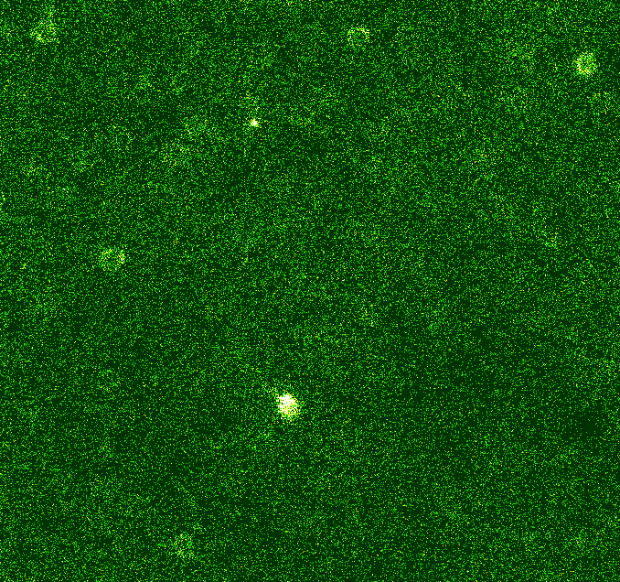
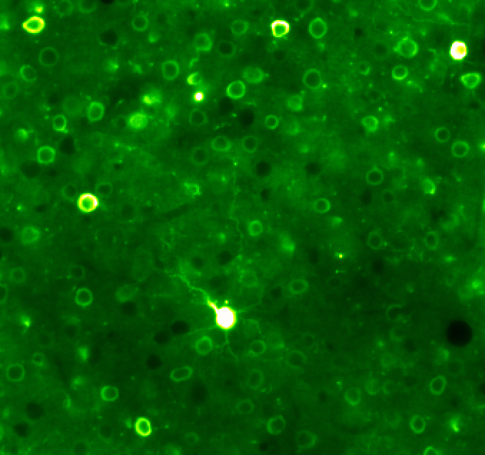
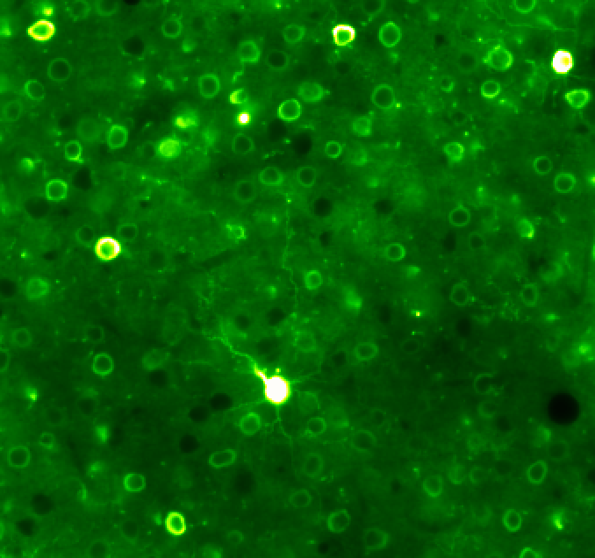
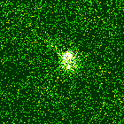
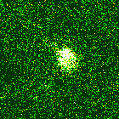
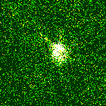
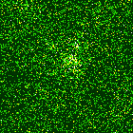
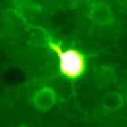
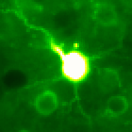
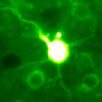
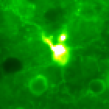

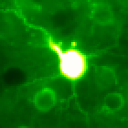
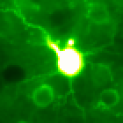

Noisy
SRDTrans
GT
SNR=0.95 dB
SNR=27.86 dB

Slide 4
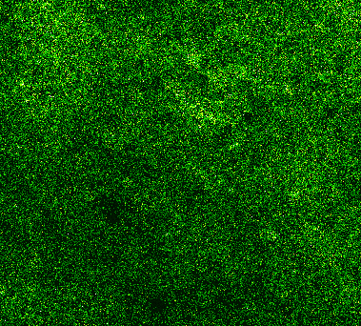
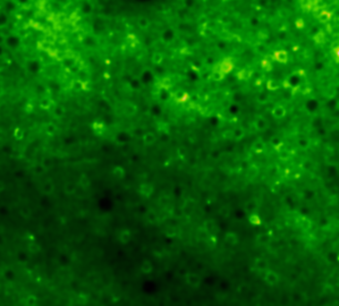
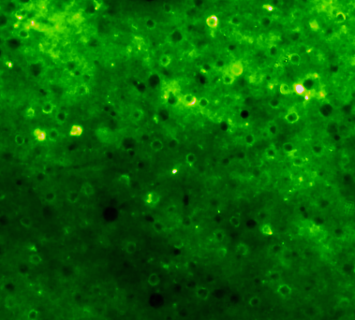
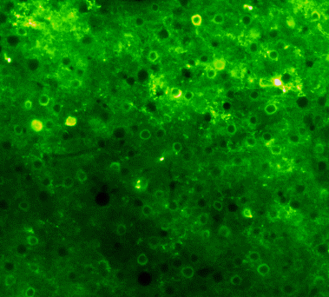













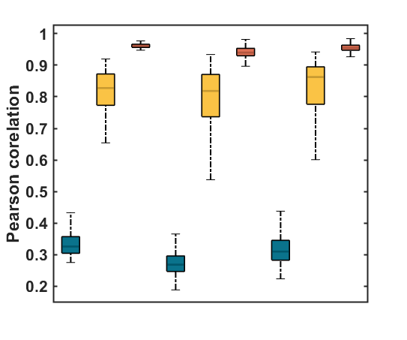


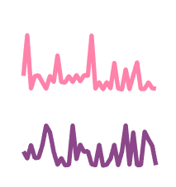


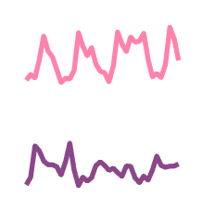


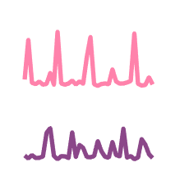


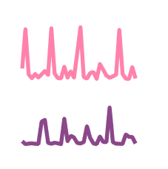
a
Noisy
DeepCAD
SRDTrans
GT
SNR=-0.85 dB
SNR=13.32 dB
SNR=19.88 dB
b
71.47 s
81.47 s
98.14 s
71.47 s
81.47 s
98.14 s
71.47 s
81.47 s
98.14 s
71.47 s
81.47 s
98.14 s
c
0
120
240
360
480
600 (s)
Noisy
DeepCAD
SRDTrans
0
ΔF/F (norm.)
1.0 (norm.)
90 s
R= 0.568
1.0
1.0
Noisy
0.8
R= 0.782
DeepCAD
Pearson correlation
0.6
R= 0.984
SRDTrans
0.4
GT
R= 1.000
0.2
X-Y slice
X-T slice
Y-T slice

