Slide 1
T E A M Z O T N E T I C
B26 · Magnetic gradient navigator in GF180MCU
SSCS Chipathon 2026 · UCI Samueli School of Engineering
Lead: Juan Sánchez · An Bui · Enzo Li · Akam Khinda · Aysha Hussaini
Design, simulation and verification report

Slide 2
01
WHAT THE CHIP DOES
Four sensors read the magnitude of the field. The chip works out which way it grows.

Slide 3
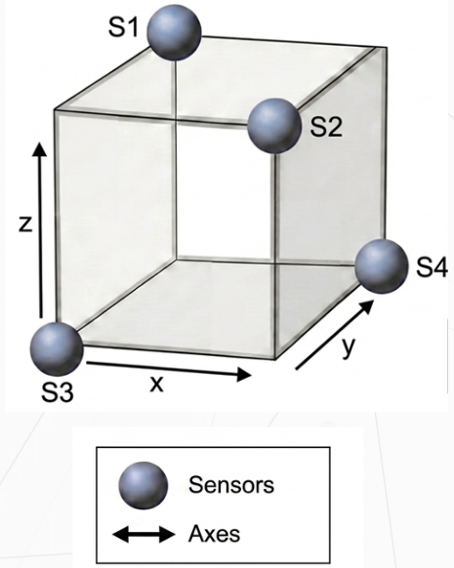
THE PRINCIPLE
The sensors do not measure a vector: they measure magnitude. That distinction is the whole design.
Four magnetoresistive bridges read |B| at the vertices of a tetrahedron.
Each bridge gives a voltage proportional to dR/R, that is to the magnitude of the field at its vertex, not to its direction.
Comparing the four magnitudes reconstructs grad|B|.
The gradient of the magnitude points where the field grows, and the field grows towards the source. That is how the chip can point at a magnet without ever measuring a vector.
The output is one sign per axis: XP/XN, YP/YN, ZP/ZN.
Six digital outputs. It does not say how much, it says which way.
four sensors at the vertices

Slide 4
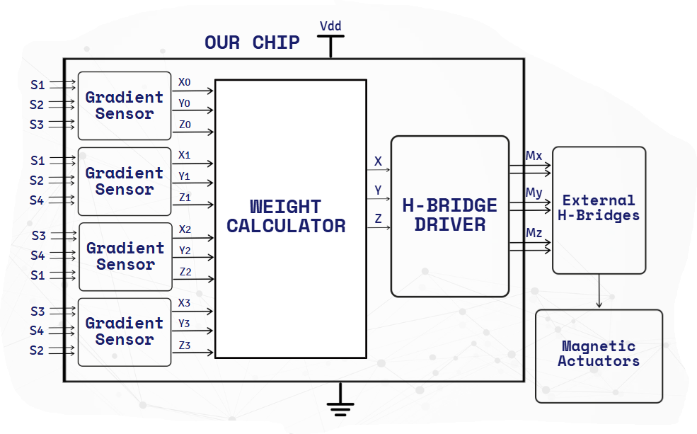
ARCHITECTURE
From sensor to actuator, and which part of that is this chip.
block diagram of the system
Four gradient sensors, a weight calculator, an H-bridge.

Slide 5
SPECIFICATIONS
What goes in, what comes out and what it costs.
Parameter | Value
Technology | GF180MCU-D, 5/6 V devices
Supply | 5.0 V (VDD / VSS), every bench sourced at 5.0 V
Total power | 74.02 mW schematic · 74.03 mW layout (14.81 mA)
Delivered area | 1110 × 1110 µm = 1.232 mm² (B26_A user area)
Navigator area | 460.9 × 387.0 µm = 0.178 mm² (GRADIENT_NAV2)
Analogue inputs | 8 — S1P/S1N … S4P/S4N, four magnetoresistive bridges
Test points | 3 — X, Y, Z, vote counters between 1.814 and 3.035 V
Digital outputs | 6 — XP/XN, YP/YN, ZP/ZN, rail to rail
Pads | 11 analogue + 6 digital + 2 supply = 19
Analogue pad type | analog, with our own secondary ESD (ESD_CDM)
Digital pad type | bidirectional, permanently driving
Secondary ESD | ESD_CDM, 63.2 × 27.9 µm, 8 diodes + 87.5 Ω poly
The 6 V is the device class, not the operating point: everything is simulated and measured at 5.0 V.

Slide 6
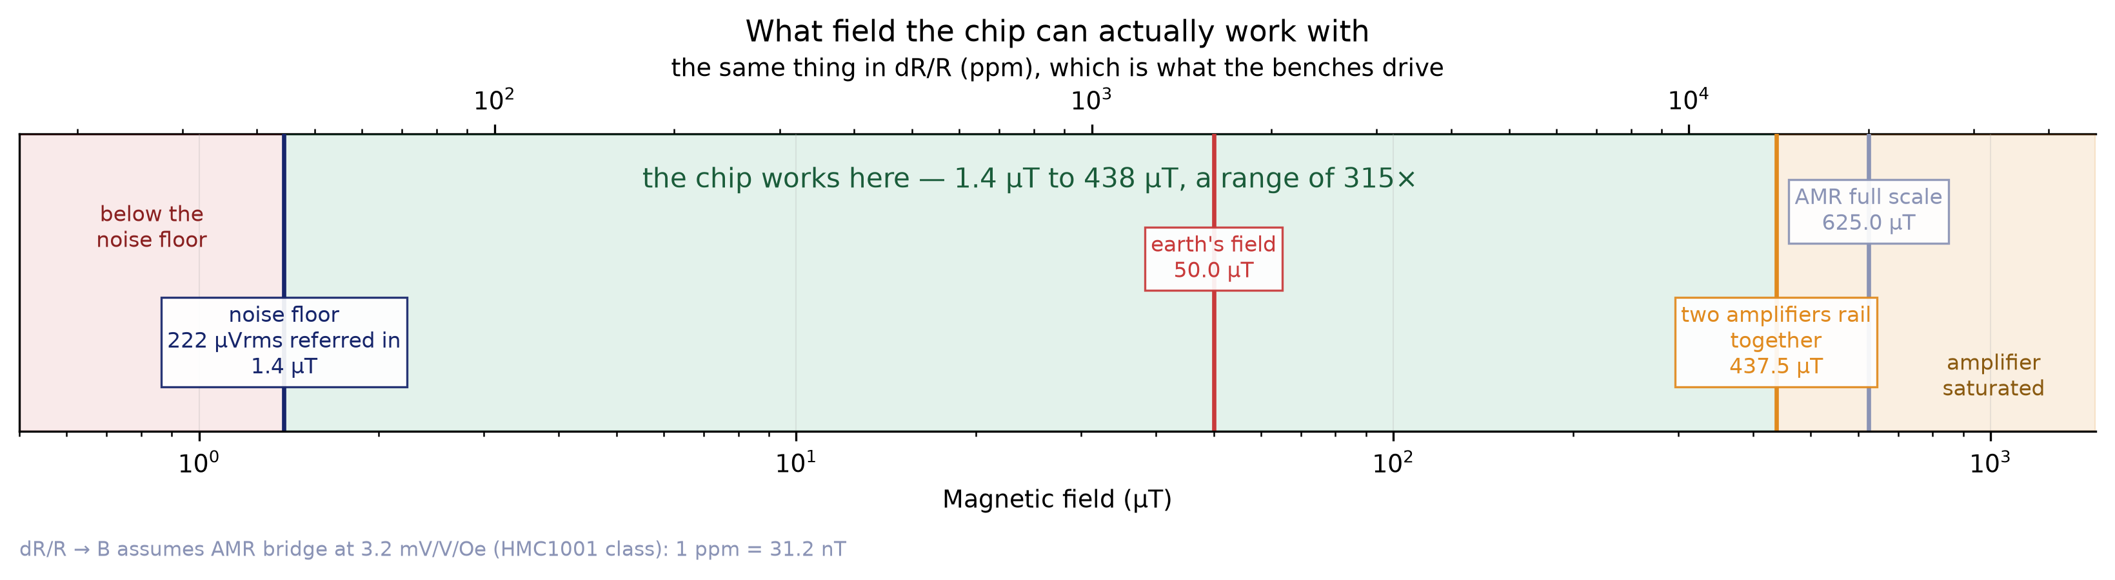
SPECIFICATIONS
The same range in teslas

Slide 7
02
THE THREE BLOCKS
GRADIENT_NAV2 inside: each block with its diagram, its schematic, its layout and its simulations.

Slide 8
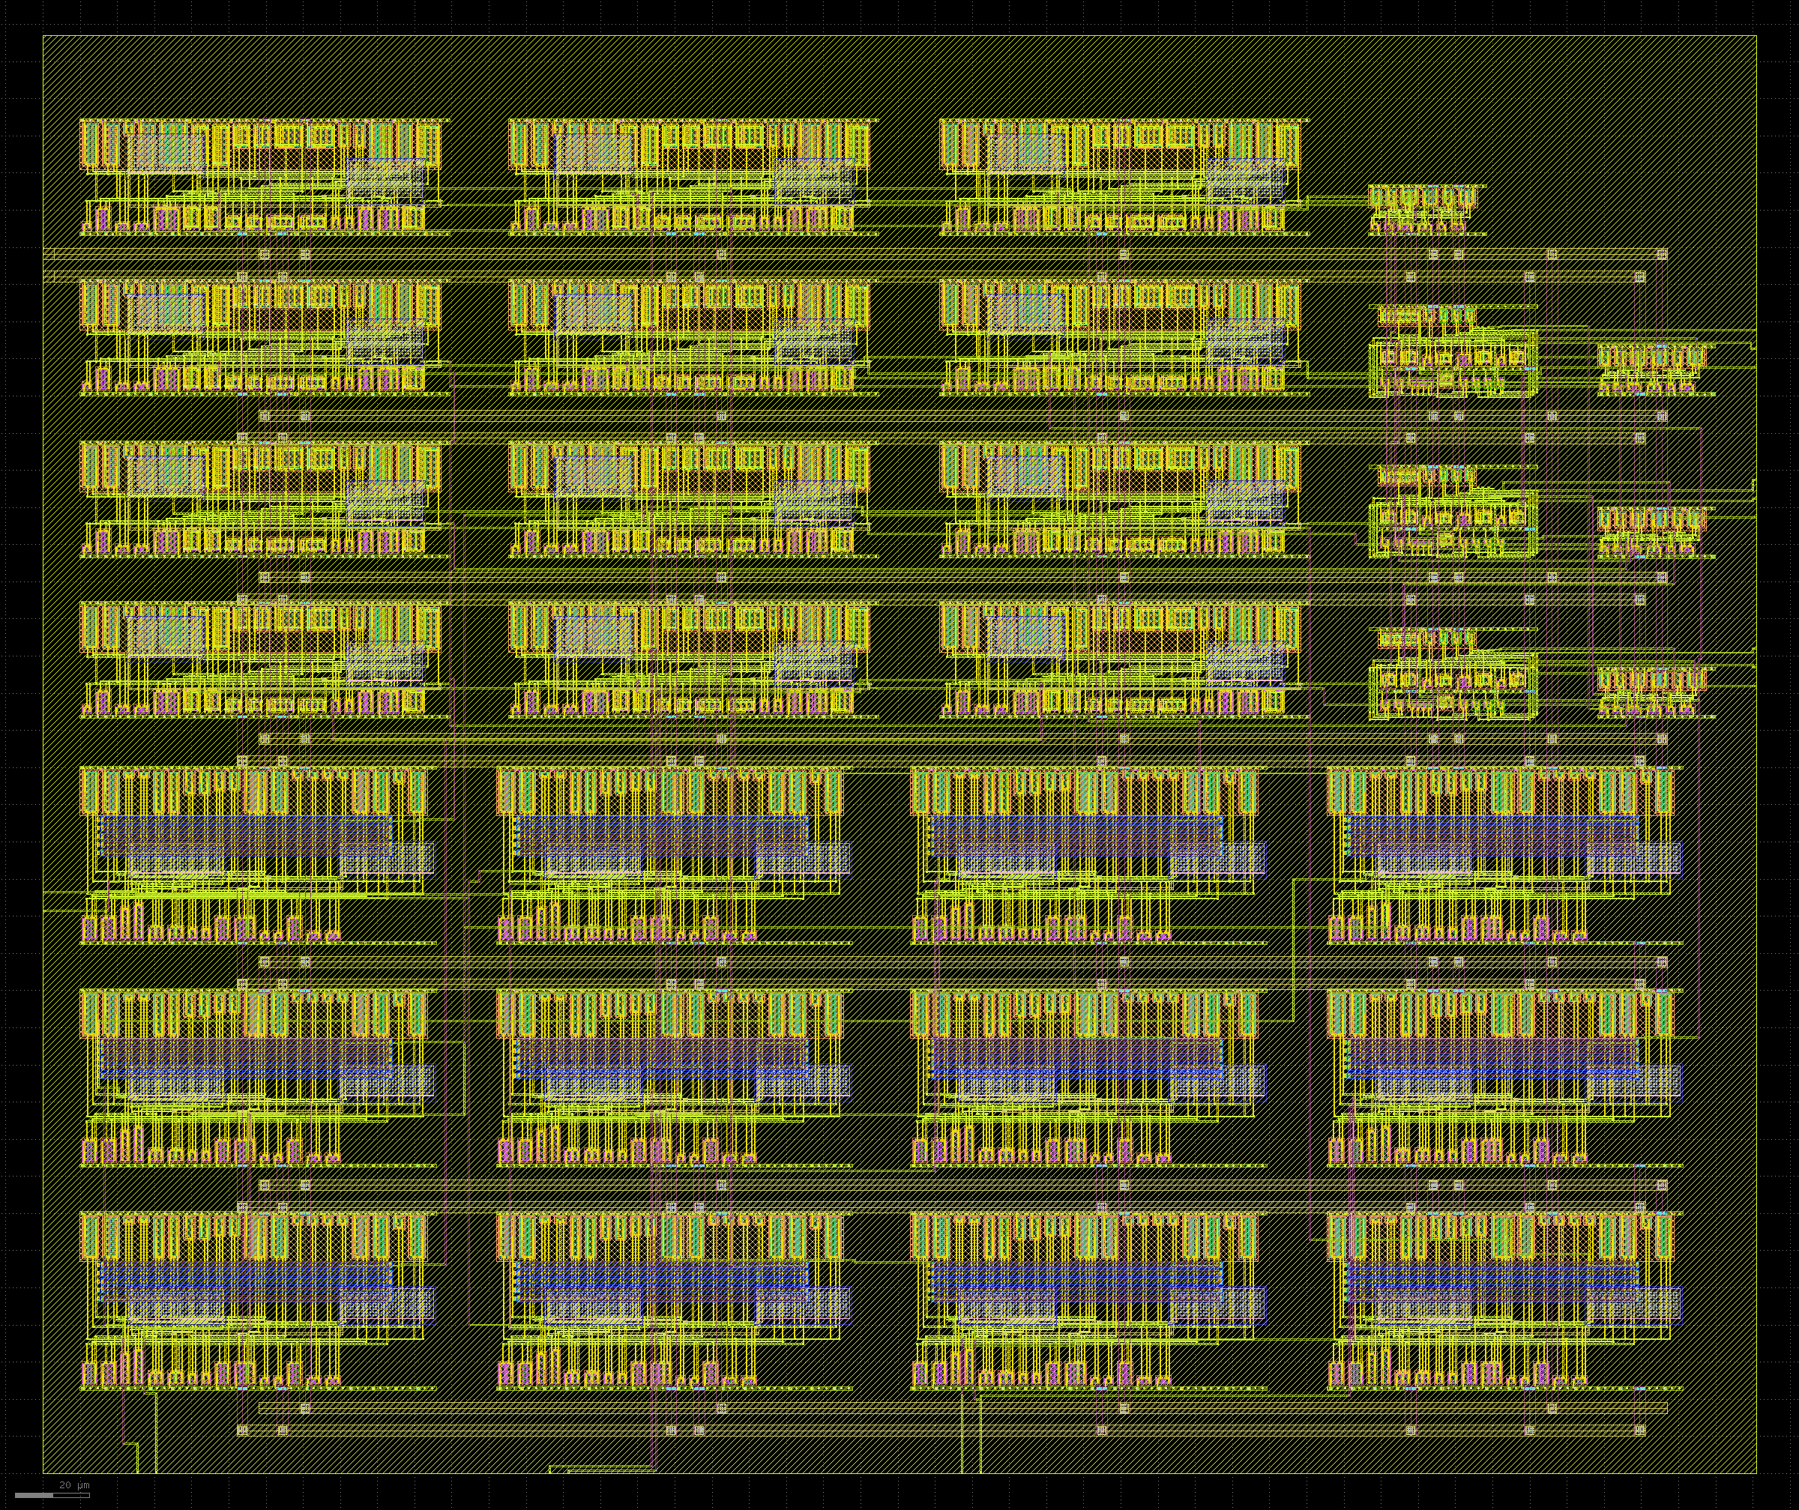
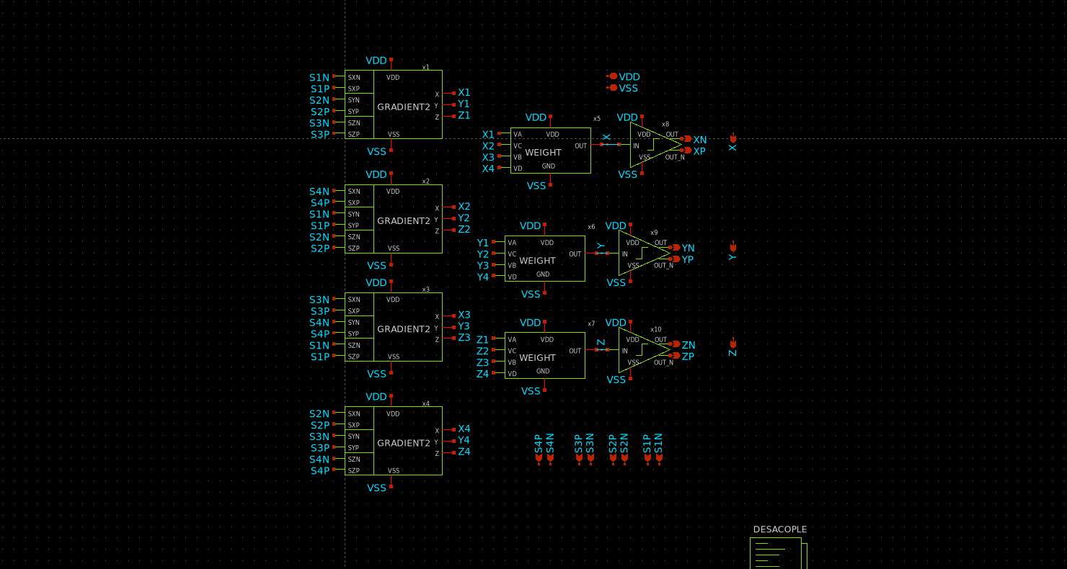
GRADIENT_NAV2
4 × GRADIENT2 → 3 × WEIGHT → 3 × COMP_OUT.
schematic
layout — 460.90 × 386.99 µm

Slide 9
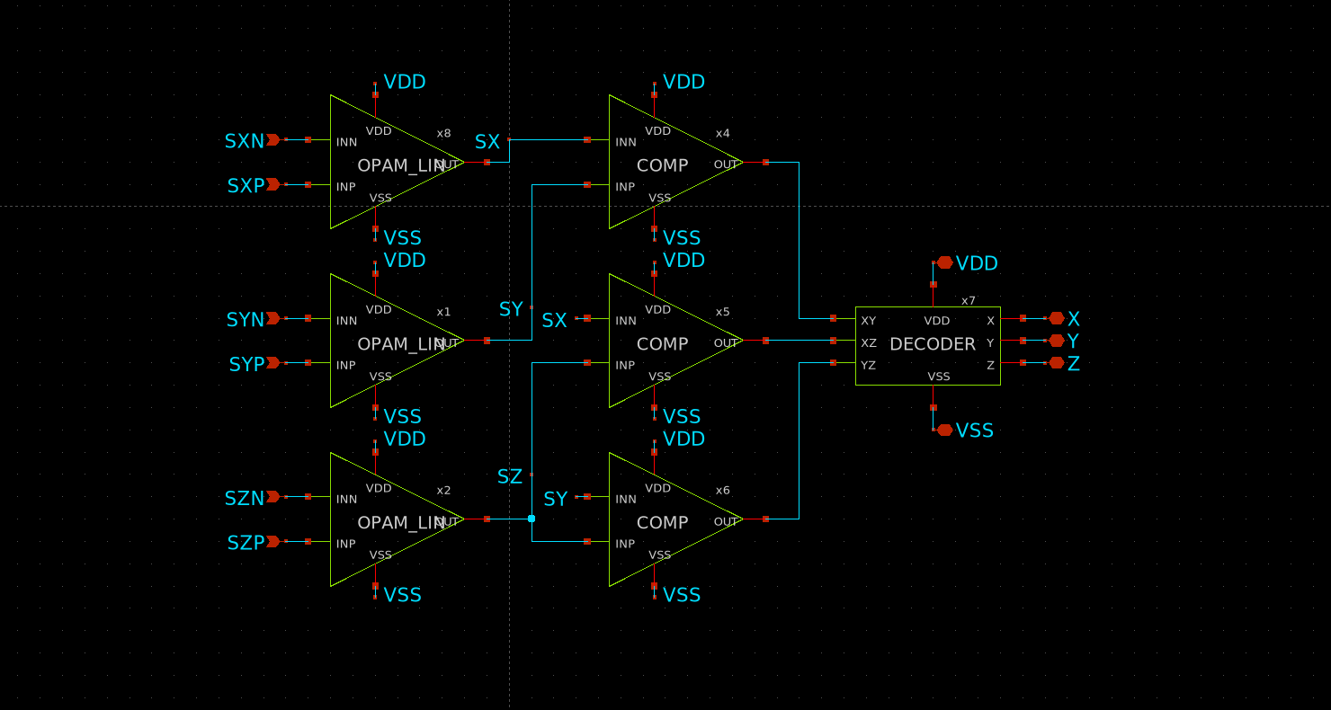
GRADIENT SENSING
GRADIENT2 — three amplifiers, three comparators and a decoder.
One sensing block reads three bridges and decides an axis.
The three OPAM_LIN amplify the three bridge differences. The three COMP compare them PAIRWISE — X with Y, X with Z, Y with Z — and the DECODER turns that order into a winning axis.
Comparing pairwise, rather than against a threshold, is the design decision.
The decoder does not need to know what each axis is worth, only which is larger. That makes the decision immune to absolute gain and to any offset common to the three channels.

Slide 10
OPAM_LIN
40 dB linear amplifier. The first block in the chain.
It amplifies one bridge's difference, and nothing else.
The SkP/SkN pair of a sensor goes in and a single voltage proportional to dR/R comes out. It is the only small-signal block in the chain, so its linearity sets the system's.
Why 40 dB.
The gain was chosen on a measurement, not a taste: it is the one that keeps the cell inside its linear range over the input span the bridges deliver. More gain saturates earlier and loses the crossings, which is all the decision needs.
The common mode does not move with the signal.
The bridge delivering a constant Vcm = VEXC/2 is what makes these curves readable without confusing signal with common-mode sensitivity.
Parameter | Value
Function | amplifies one bridge's difference
Supply | 5.0 V
Power | 2.55 mW schematic / 2.45 mW layout
DC gain | 40.1 dB (103 V/V)
Bandwidth | 338 kHz at −3 dB
Phase margin | 74° (unity gain at 36.9 MHz)
Slew rate | not slew limited: a 2 V step rises at 102 V/µs (schematic) and 562 V/µs (layout) against the 456 V/µs the bandwidth alone allows — the band sets it, not the output current
Linearity | INL 0.10 % over the 1–4 V output
Input-referred noise | 1.95 µV/√Hz at 1 kHz · 222 µVrms over 338 kHz
Area | 95.88 × 48.05 µm = 0.0046 mm²
Instances | 12 (3 per GRADIENT2)

Slide 11
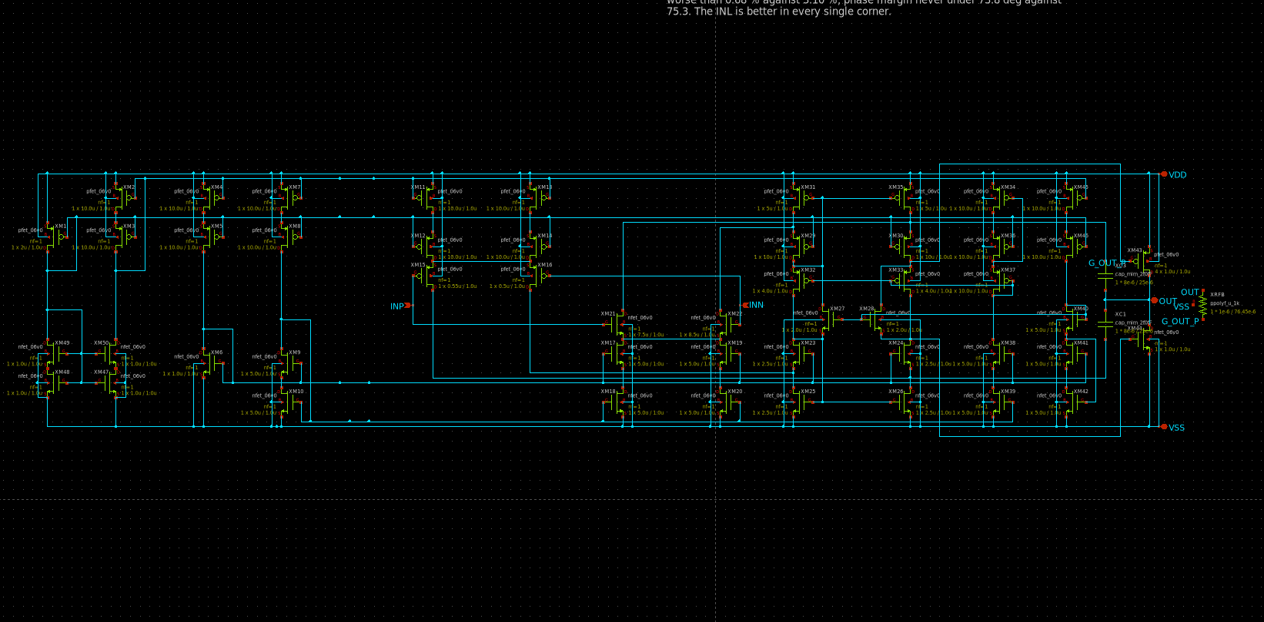
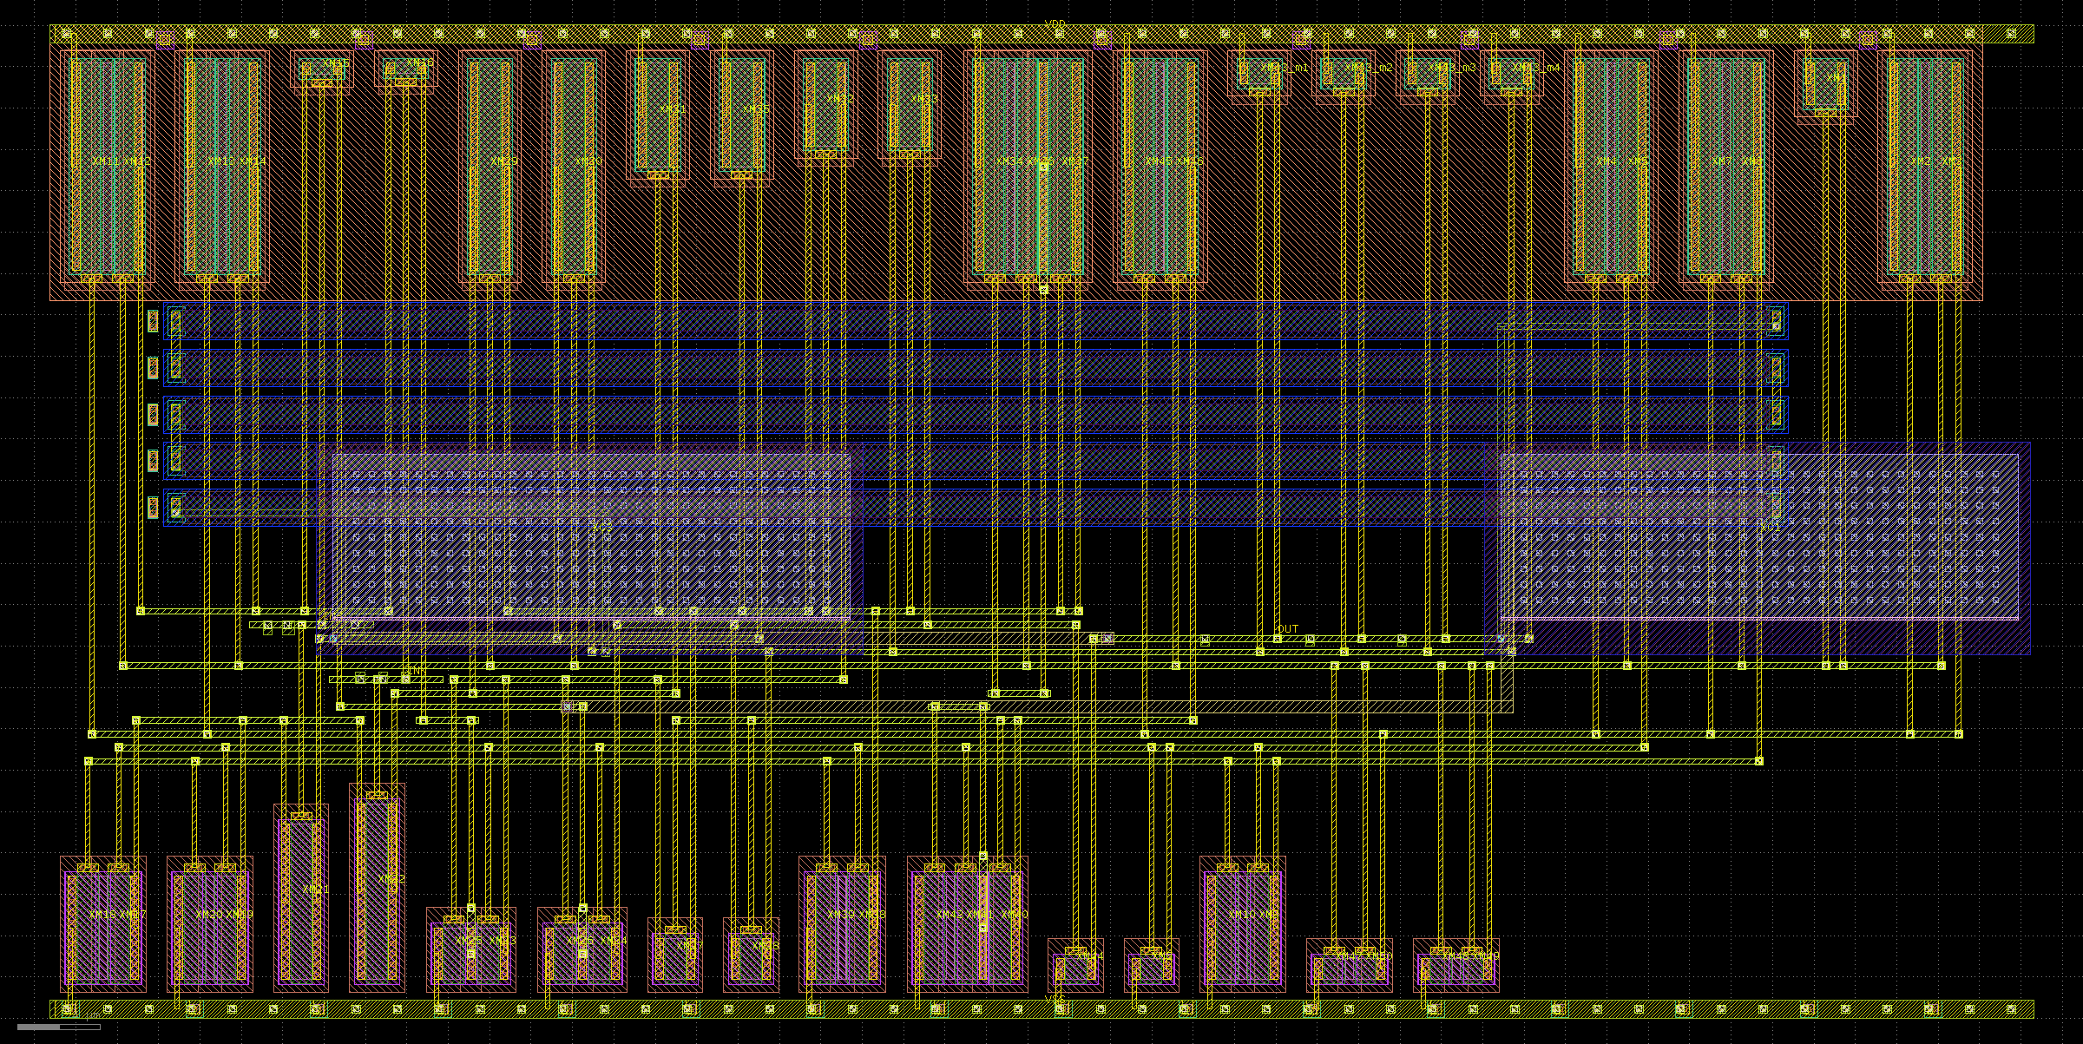
OPAM_LIN
40 dB linear amplifier. The first block in the chain.
schematic
layout — 95.88 × 48.05 µm

Slide 12
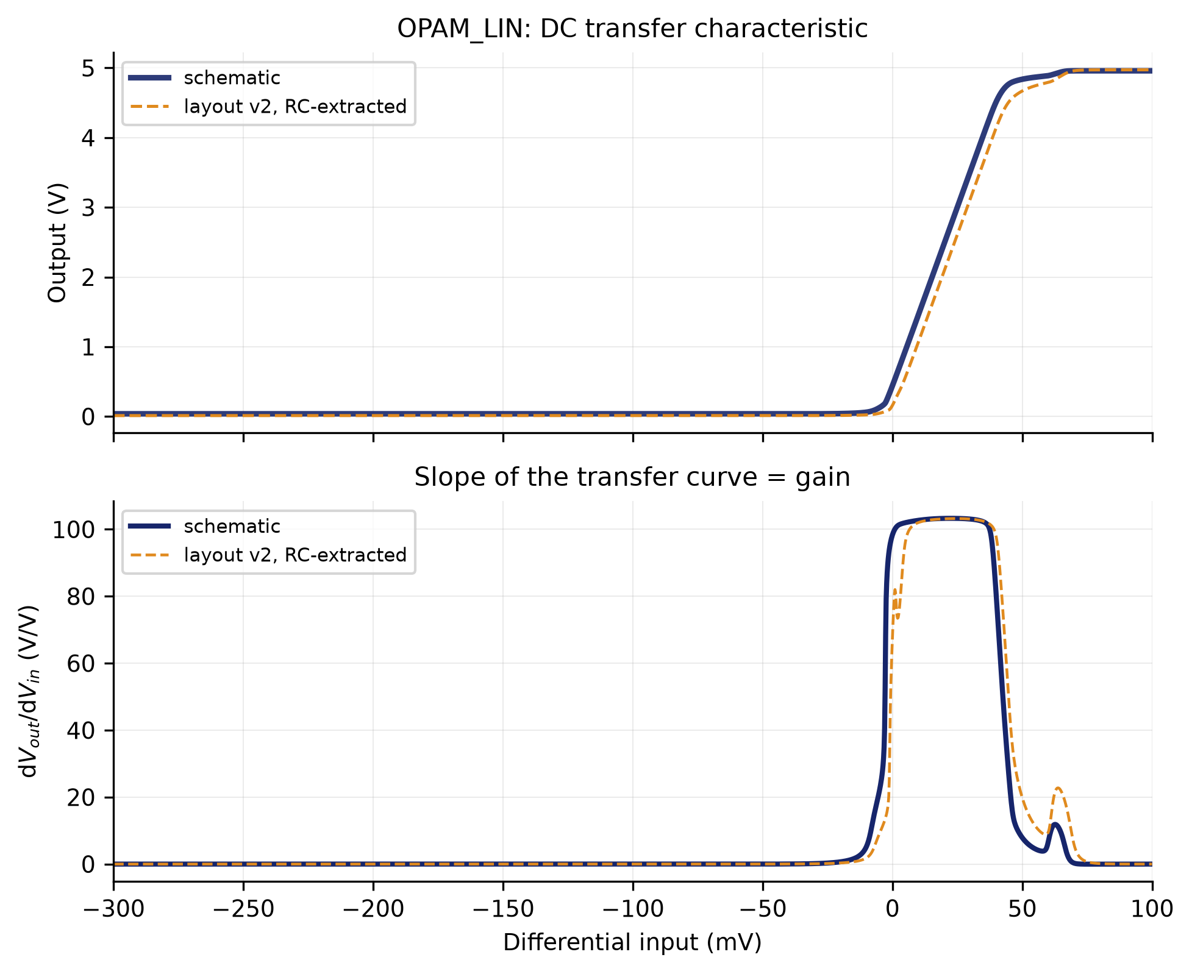
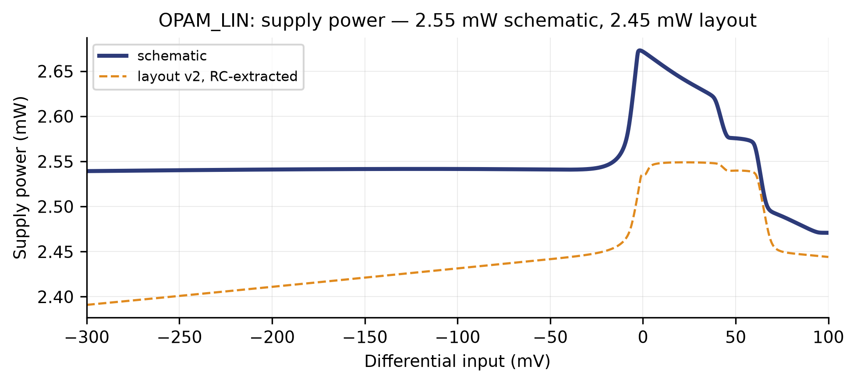
OPAM_LIN
input against output, and the slope that is the gain · supply power
supply power
input against output, and the slope that is the gain

Slide 13
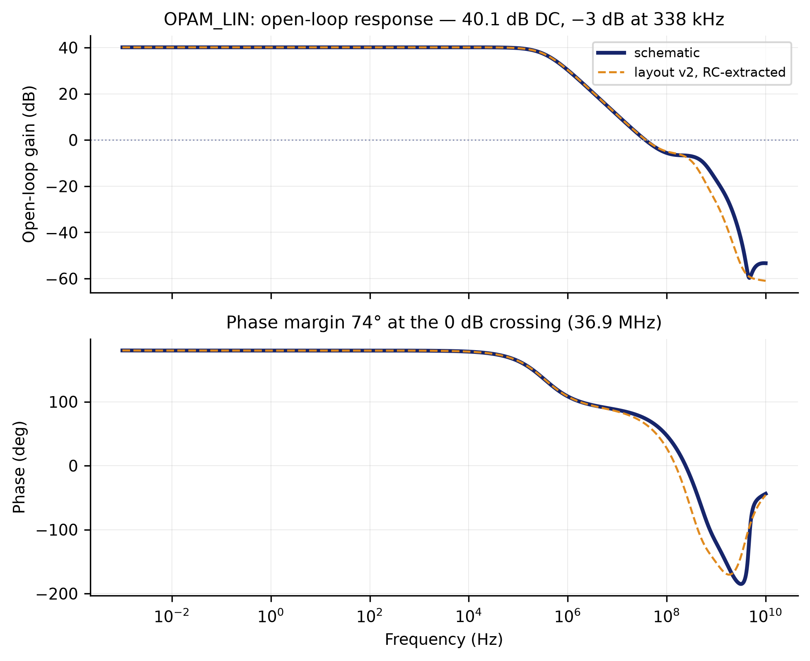
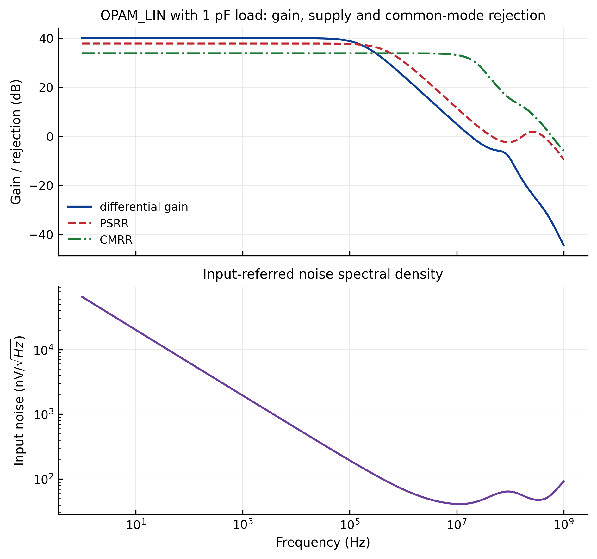
OPAM_LIN
frequency response · rejection and noise
frequency response
rejection and noise

Slide 14
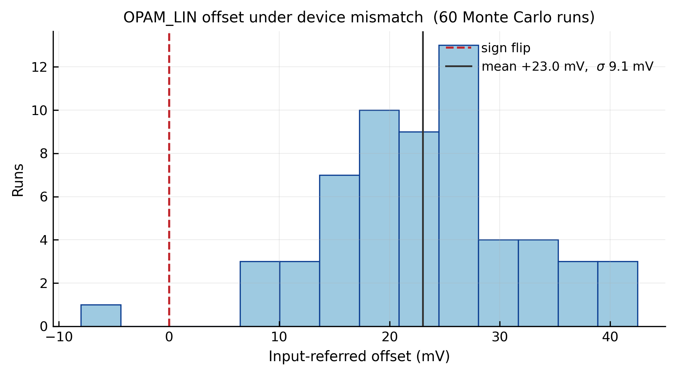
OPAM_LIN
device-mismatch Monte Carlo
XSCHEM/TEST — schematic vs layout v2

Slide 15
COMP
Comparator. Turns the comparison of two axes into a level.
It does not compare against a fixed threshold: it compares two axes against each other.
That is why three comparators serve three axes — X against Y, X against Z, Y against Z. The decoder needs the ORDER of the three, not their values.
This is where the threshold that had to be corrected lives.
The second of the three findings at the end came out of this block: the trip point was not where it was believed to be, and the fine sweep measured it.
Parameter | Value
Function | compares two axes against each other
Supply | 5.0 V
Power | 3.08 mW
Input threshold | +7 µV schematic / +62 µV layout (2.5 V crossing)
Input for a high output | +50 µV schematic / +104 µV layout (>4.5 V)
Decision delay | 399 ns mean, 456 ns worst case
Slew rate | 6.3 V/µs rising and falling (6.2 in layout); a straight ramp over the whole 601 ns edge
Noise | set by the amplifier ahead of it, not by this cell
Area | 99.60 × 31.46 µm = 0.0031 mm²
Instances | 12 (3 per GRADIENT2)

Slide 16
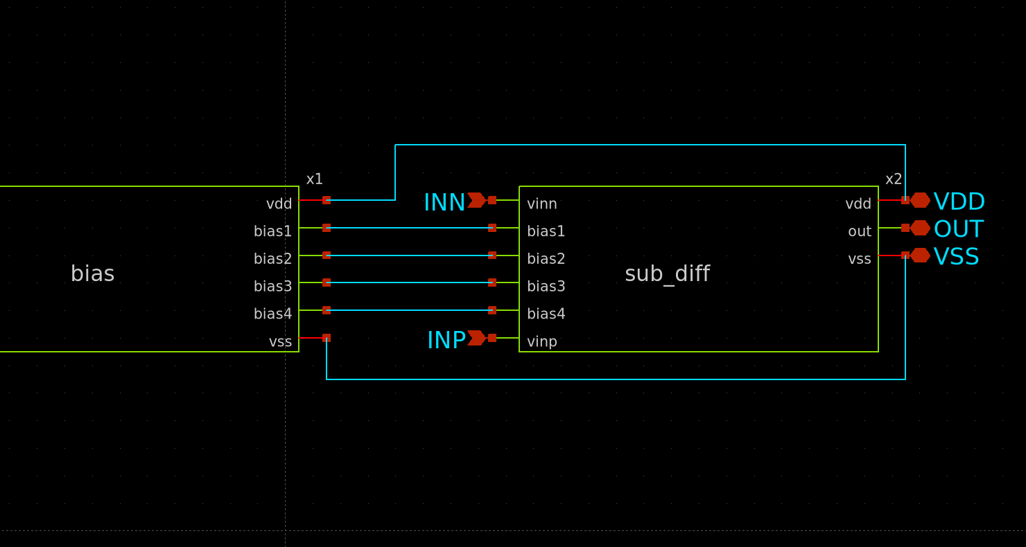
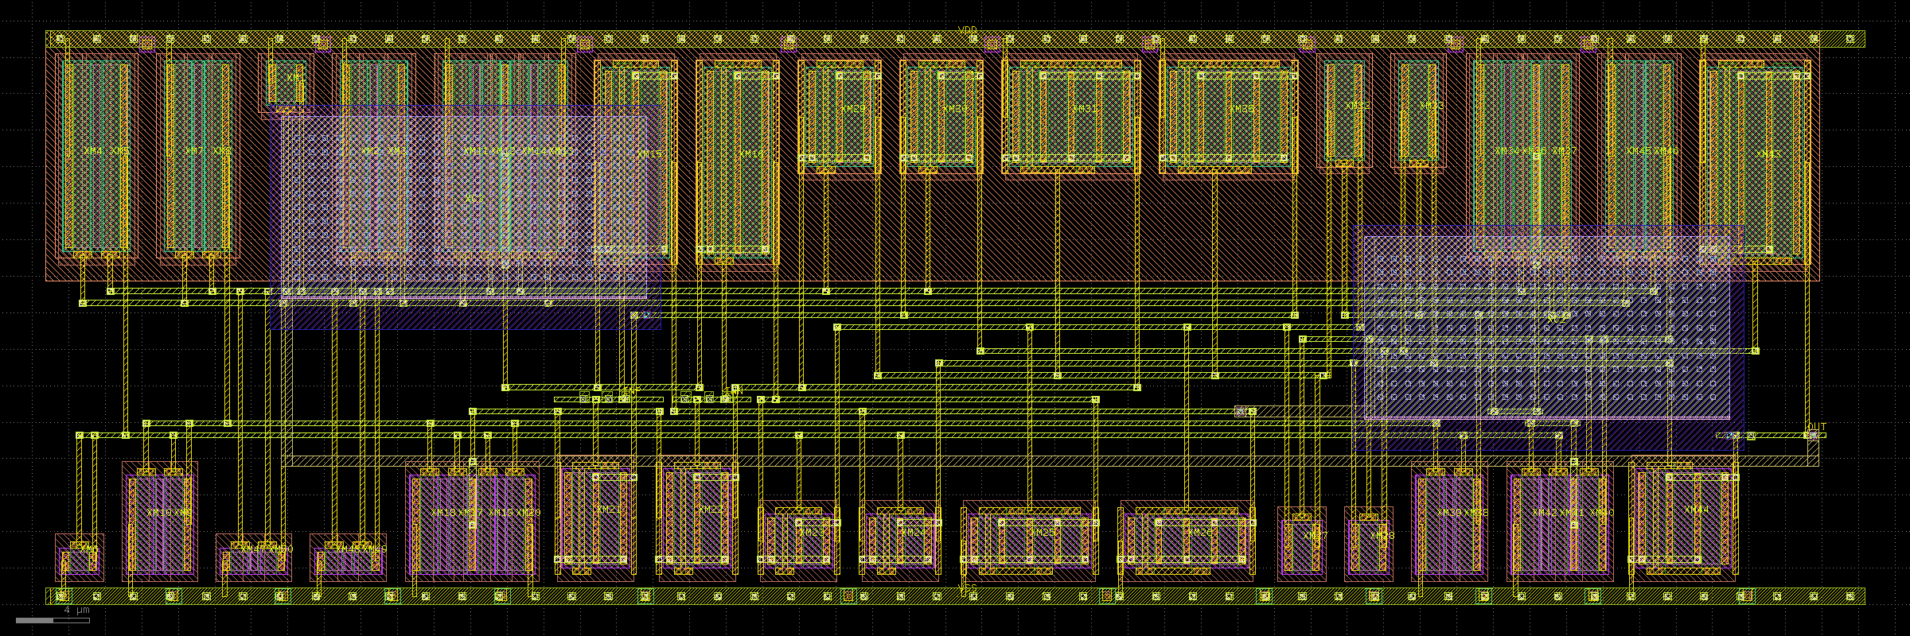
COMP
Comparator. Turns the comparison of two axes into a level.
layout — 99.60 × 31.46 µm
schematic

Slide 17
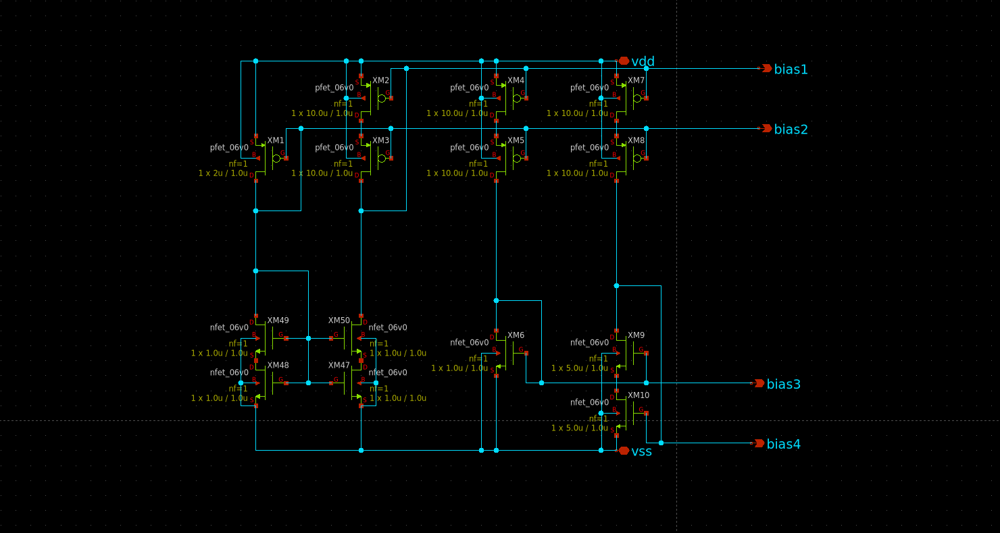
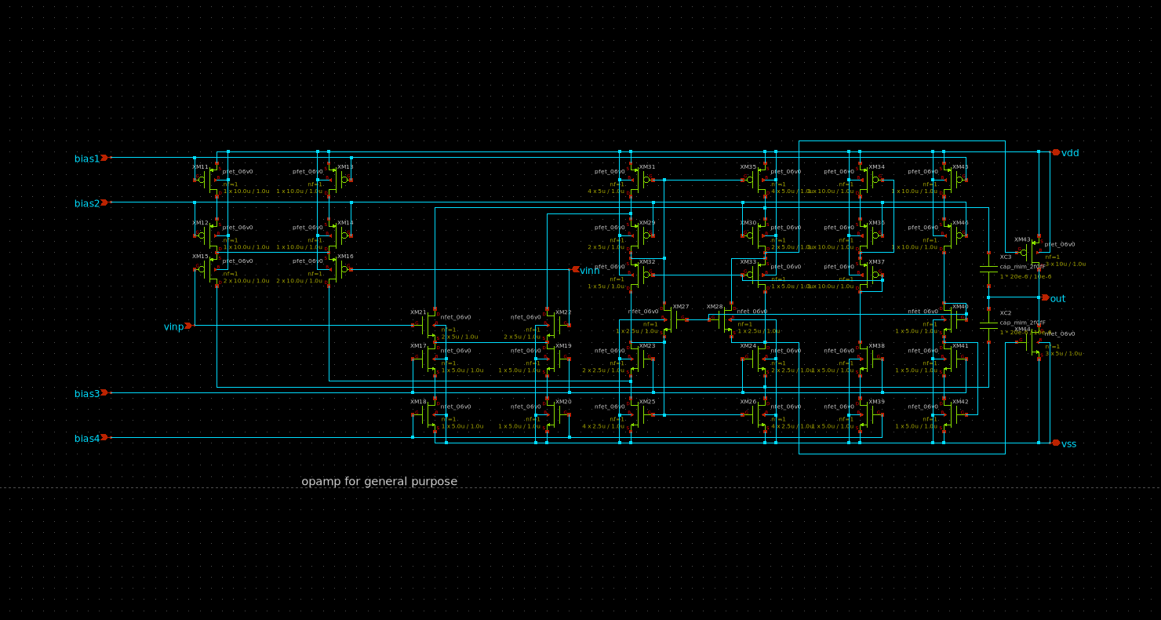
COMP
Inside: the SAME bias generator and its own differential pair.
bias generator (the same cell as OPAM_LIN's)
differential pair (sub_diff)

Slide 18
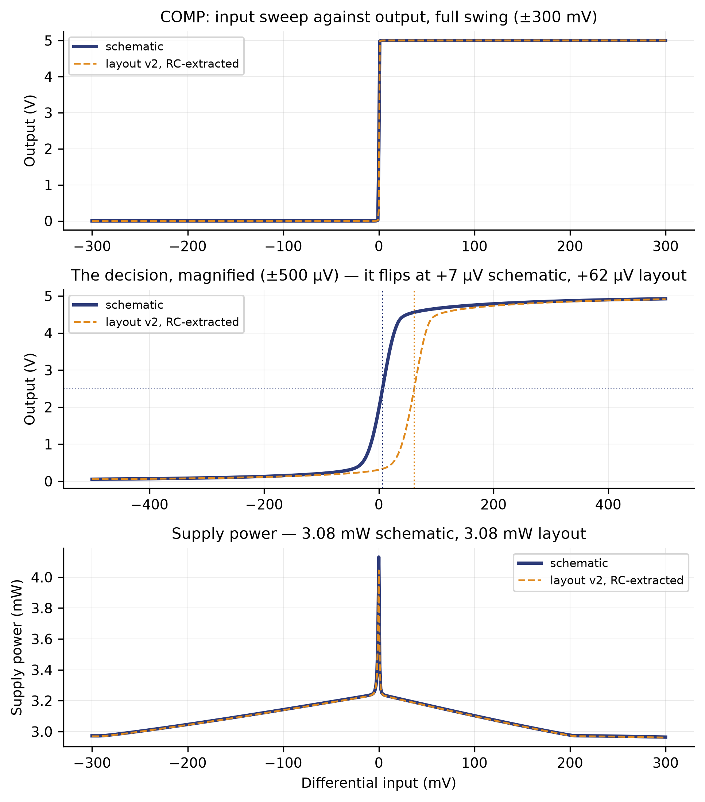
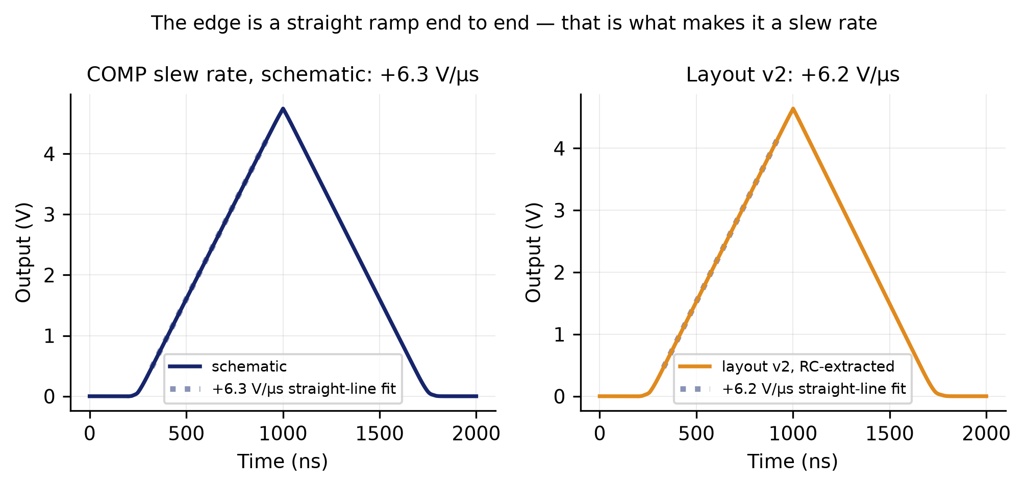
COMP
input sweep against output, and what it costs · slew rate
slew rate
input sweep against output, and what it costs

Slide 19
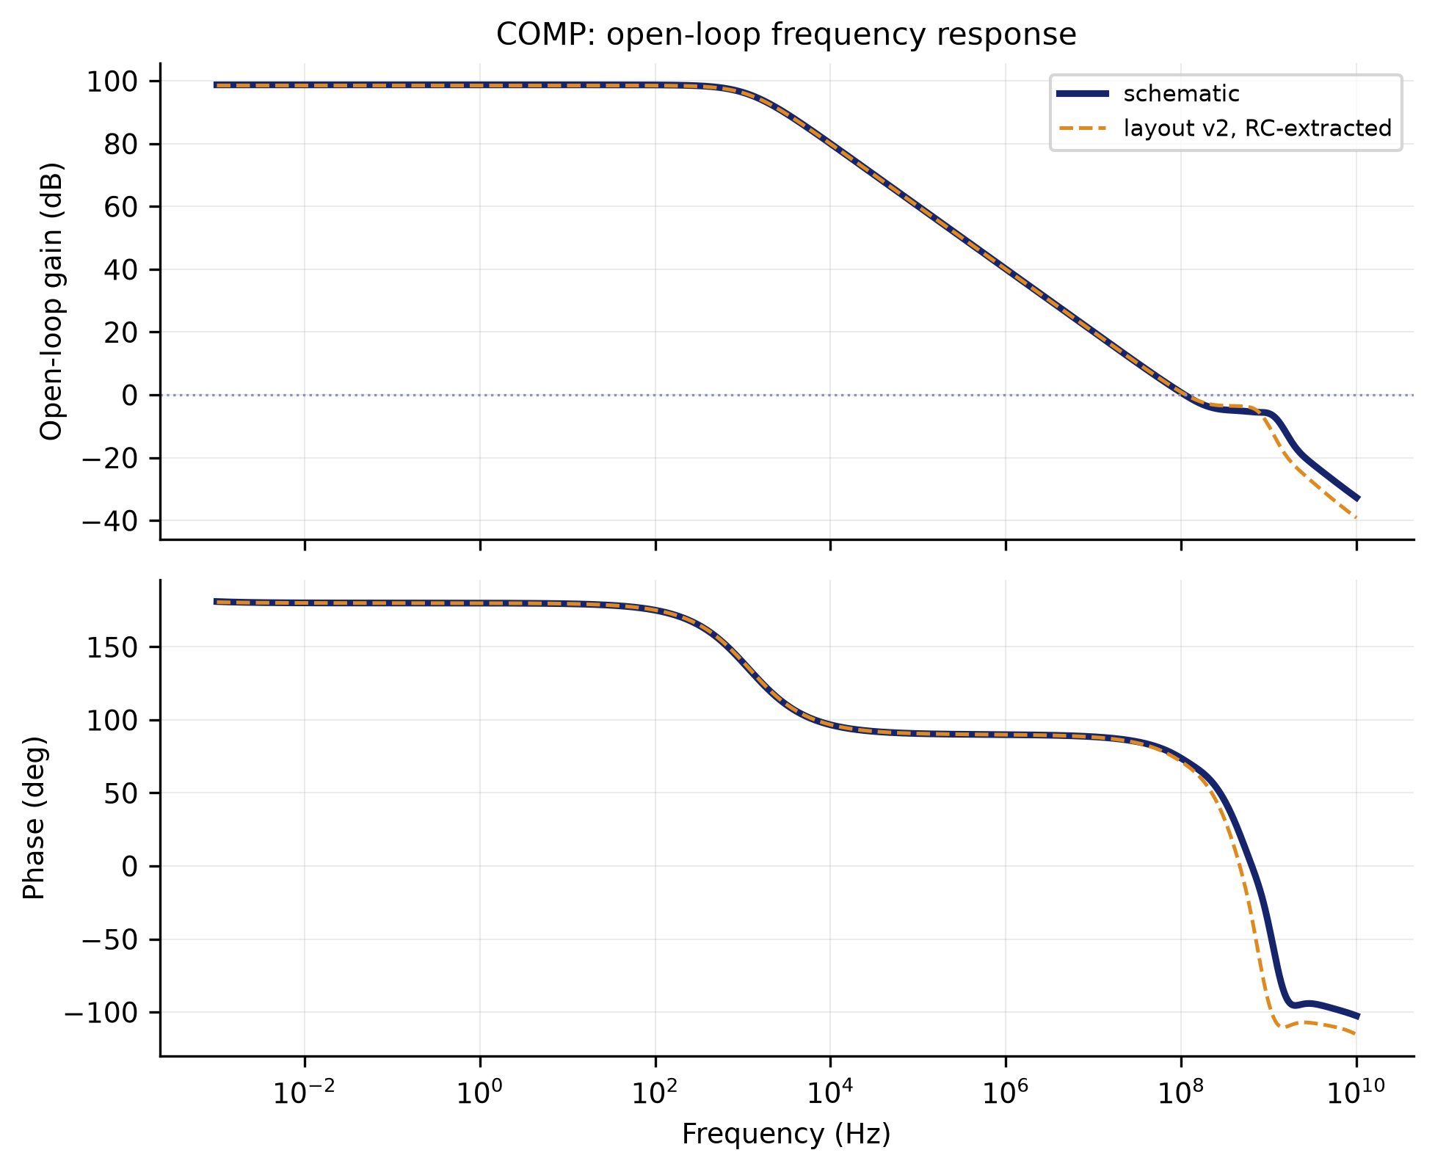
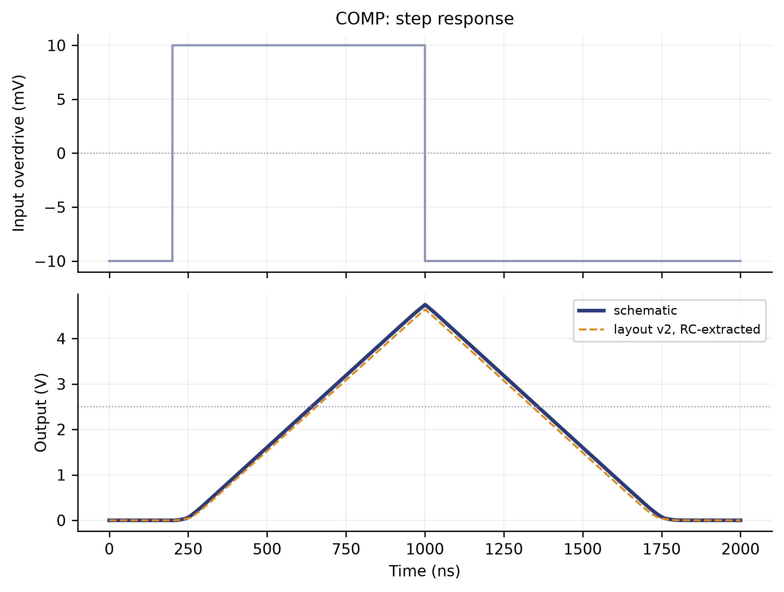
COMP
step response · frequency response
step response
frequency response

Slide 20
DECODER
Decides which axis wins from the three comparisons.
XY, XZ, YZ go in. X, Y or Z comes out.
Pure logic: the three pairwise comparisons determine an order, and the order determines the winner. It is the smallest block in the chain and the lowest-power by three orders of magnitude.
This is where the Z-axis problem showed up.
Z could never win. What fixed it was not raising its weight but changing the order within each triple.
Parameter | Value
Function | three comparisons to one winning axis
Supply | 5.0 V
Power | 1.4 µW
Area | 31.76 × 13.82 µm = 0.0004 mm²
Instances | 4 (one per GRADIENT2)

Slide 21
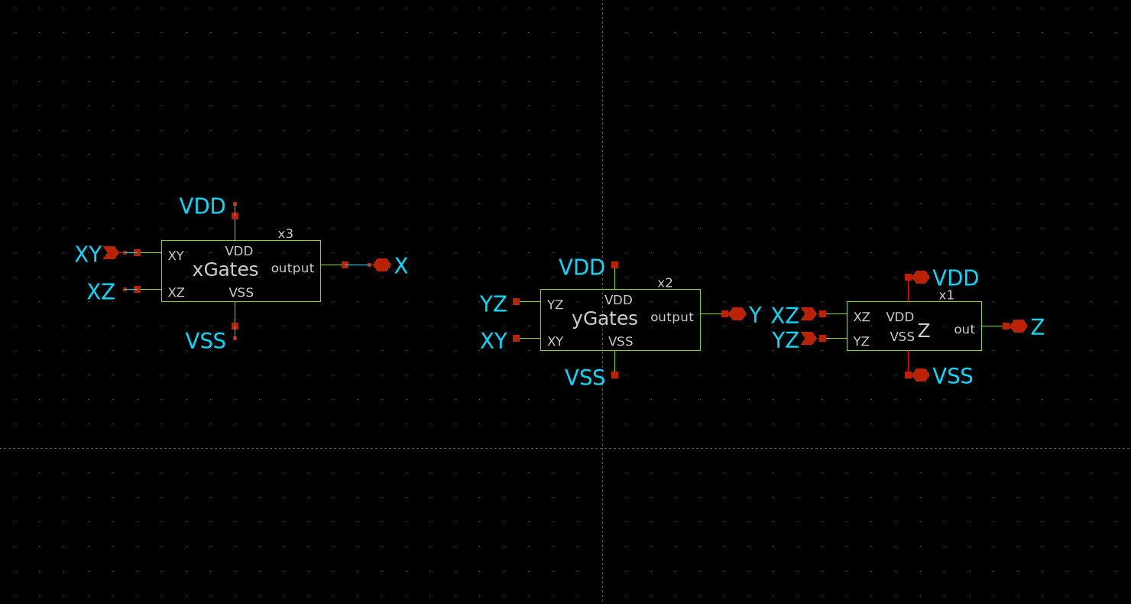
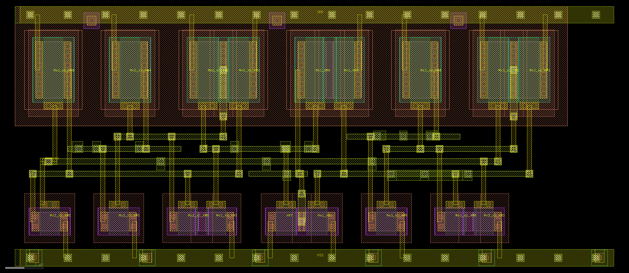
DECODER
Decides which axis wins from the three comparisons.
layout — 31.76 × 13.82 µm
schematic

Slide 22
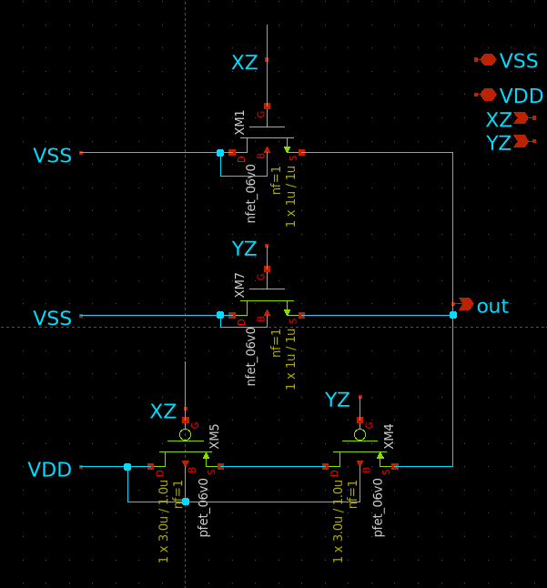
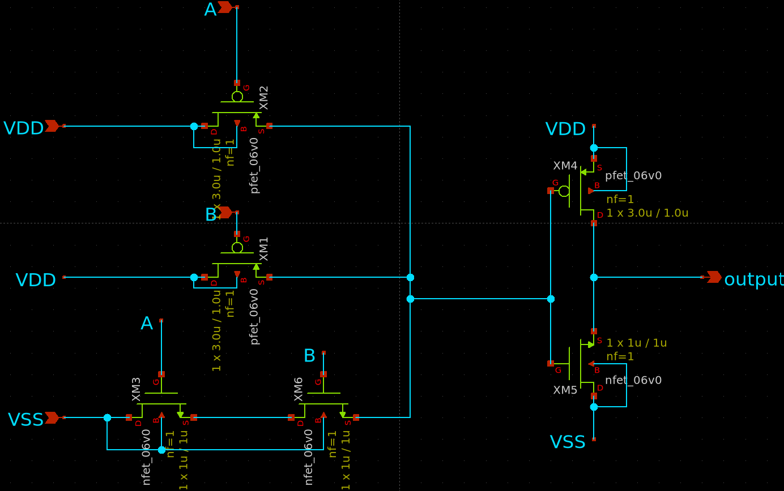
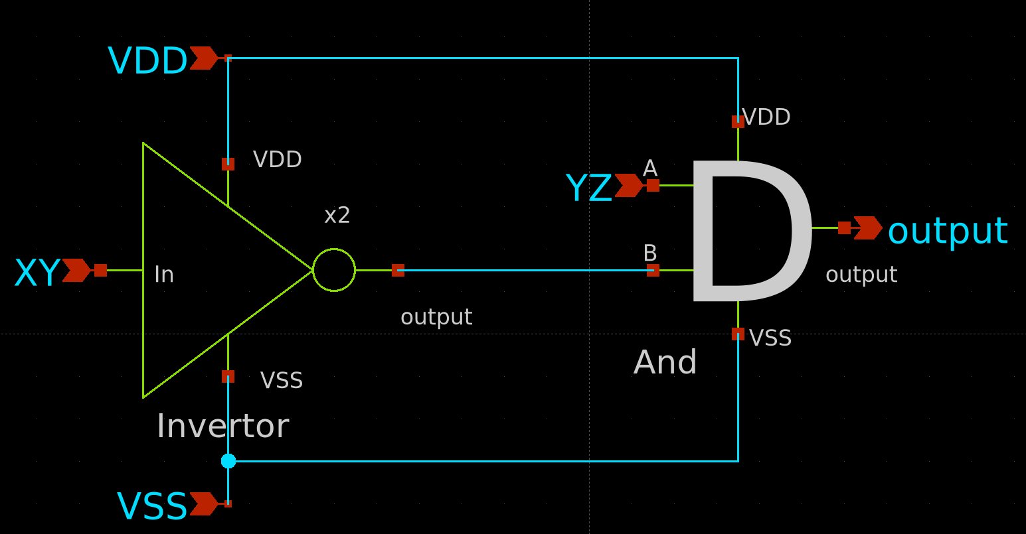
DECODER
Decides which axis wins from the three comparisons.

Slide 23
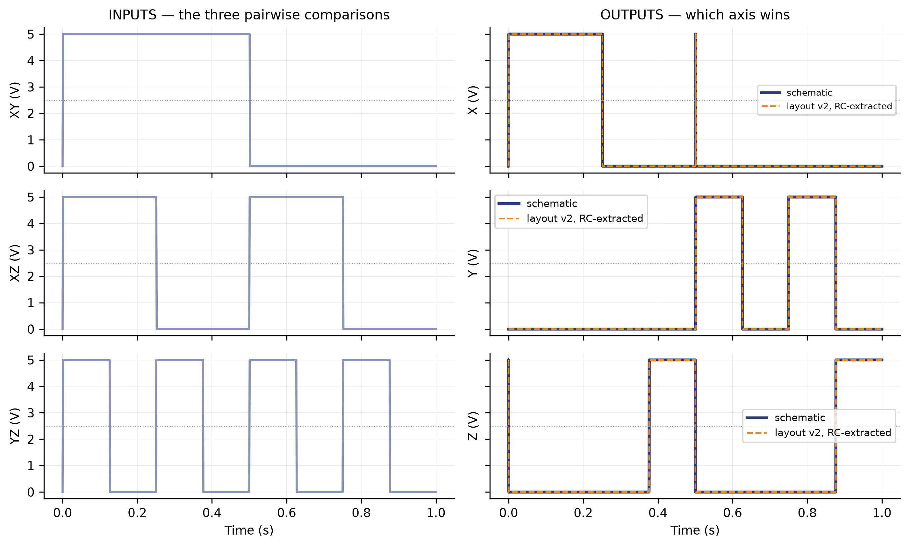
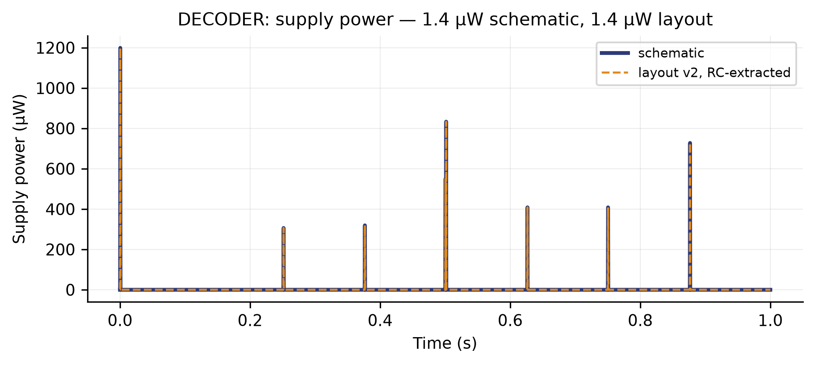
DECODER
logic · supply power
supply power
logic

Slide 24
GRADIENT BENCH · METHOD
run_gradient.sh — three bridges, and only the linear amplifier.
Two chains hung off the SAME six sensor nodes:
G2 — the schematic GRADIENT2, with the 40 dB OPAM_LIN
G4 — the same circuit rebuilt from the v2 layout, with OPAM_LIN_flat and extracted with RC parasitics
It is the same amplifier drawn two ways.
So every comparison in this section is layout against schematic, never one amplifier against another.
What it measures: the three fields are 120° apart, sum to zero, and the vector only changes direction.
Sweeping 0 to 360° each axis should win a sector of exactly 120°. The figures are how far those three boundaries drift and on what percentage of the sweep the decoded axis is the right one.

Slide 25
GRADIENT BENCH · METHOD
run_gradient.sh — three bridges, and only the linear amplifier.
XSCHEM/TEST_TOTAL/test_GRADIENT.sch

Slide 26
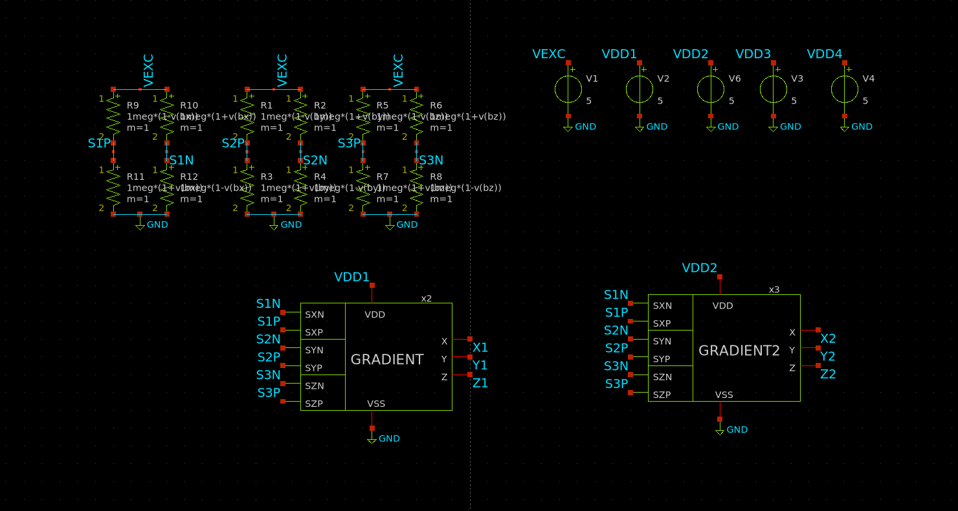
SENSING TRACEABILITY
One signal, four stages: bridge → amplifier → comparator → decoder.
The SAME signal is followed through the sensing block's four stages.
The bench already records every intermediate node, including the ones with no name: the comparator outputs are probed hierarchically.
At each stage, schematic and layout on top of each other.
Only the linear amplifier: G2, the schematic, against G4, the layout.
And at the end, on what percentage of the sweep the decoded axis is the right one.

Slide 27
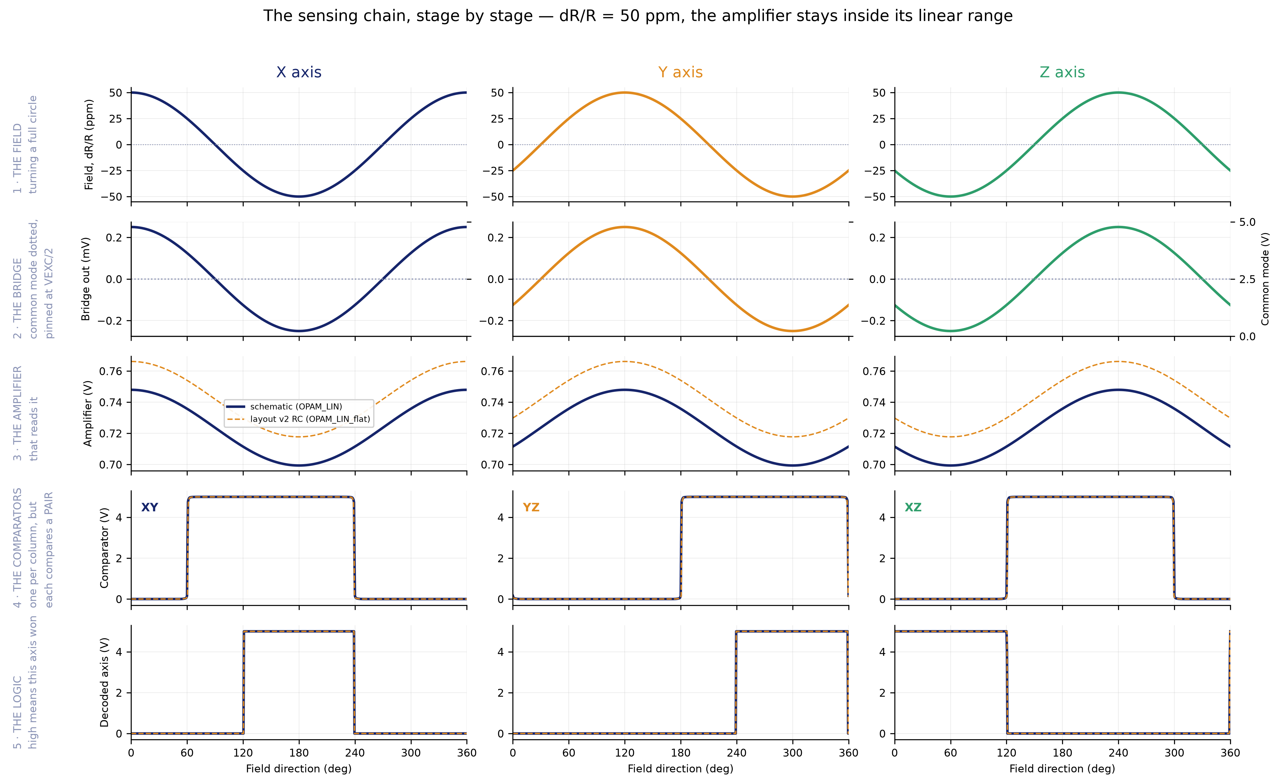
BLOCK RESULT · GRADIENT SENSING
the whole chain on one sheet — amplifier still linear
run_gradient.sh — G2 schematic vs G4 layout

Slide 28
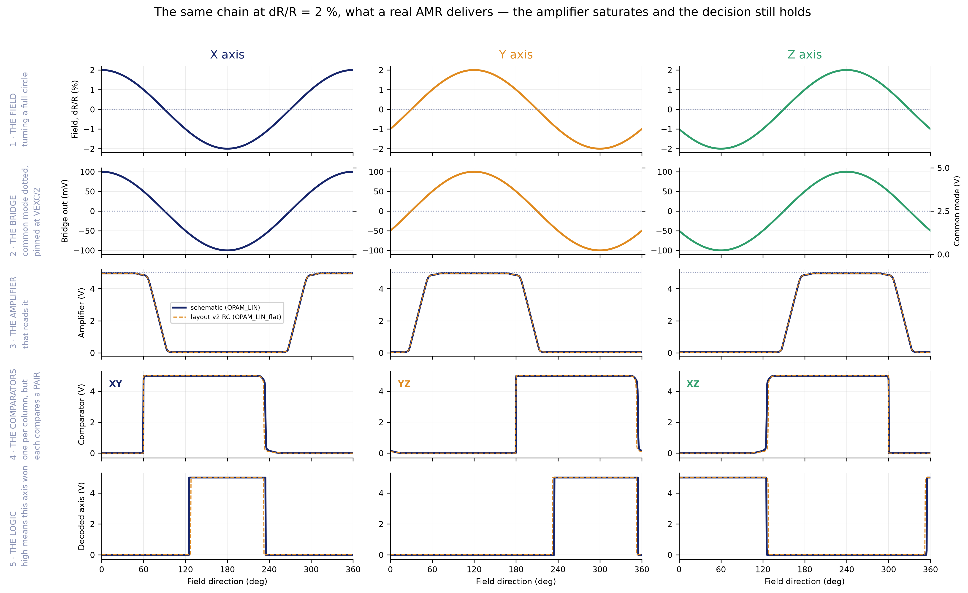
BLOCK RESULT · GRADIENT SENSING
the same chain at dR/R = 2 %, what a real AMR gives
run_gradient.sh — G2 schematic vs G4 layout

Slide 29
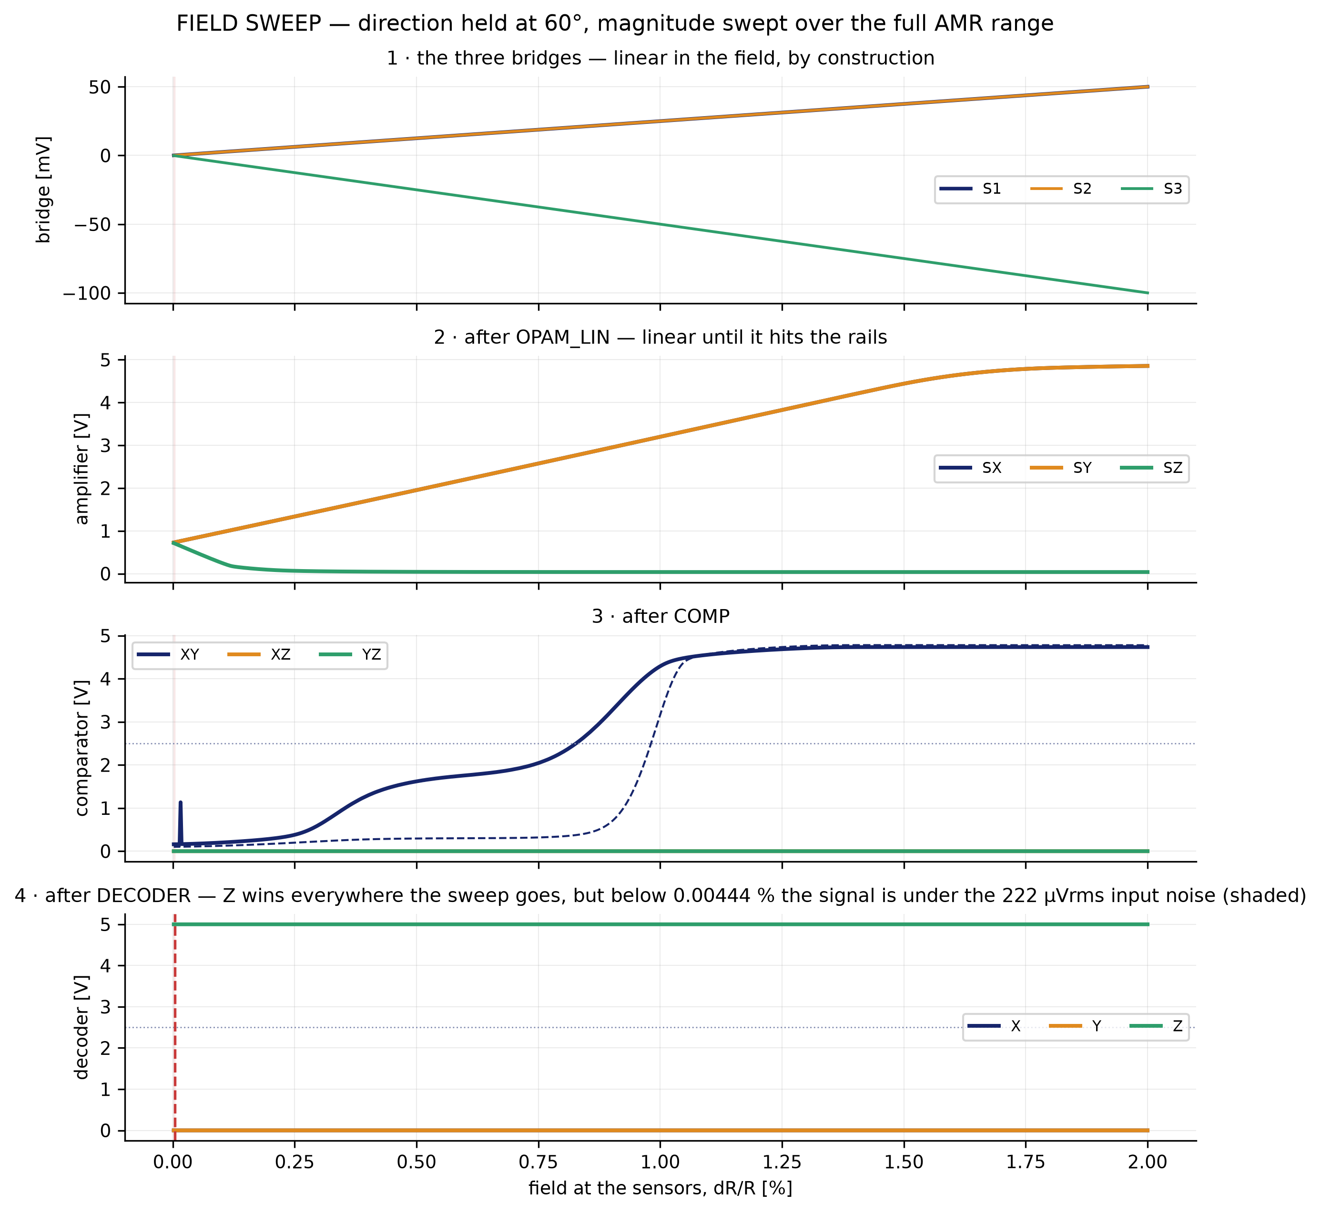
BLOCK RESULT · GRADIENT SENSING
the other experiment: field SIZE swept, direction held
run_gradient.sh — G2 schematic vs G4 layout

Slide 30
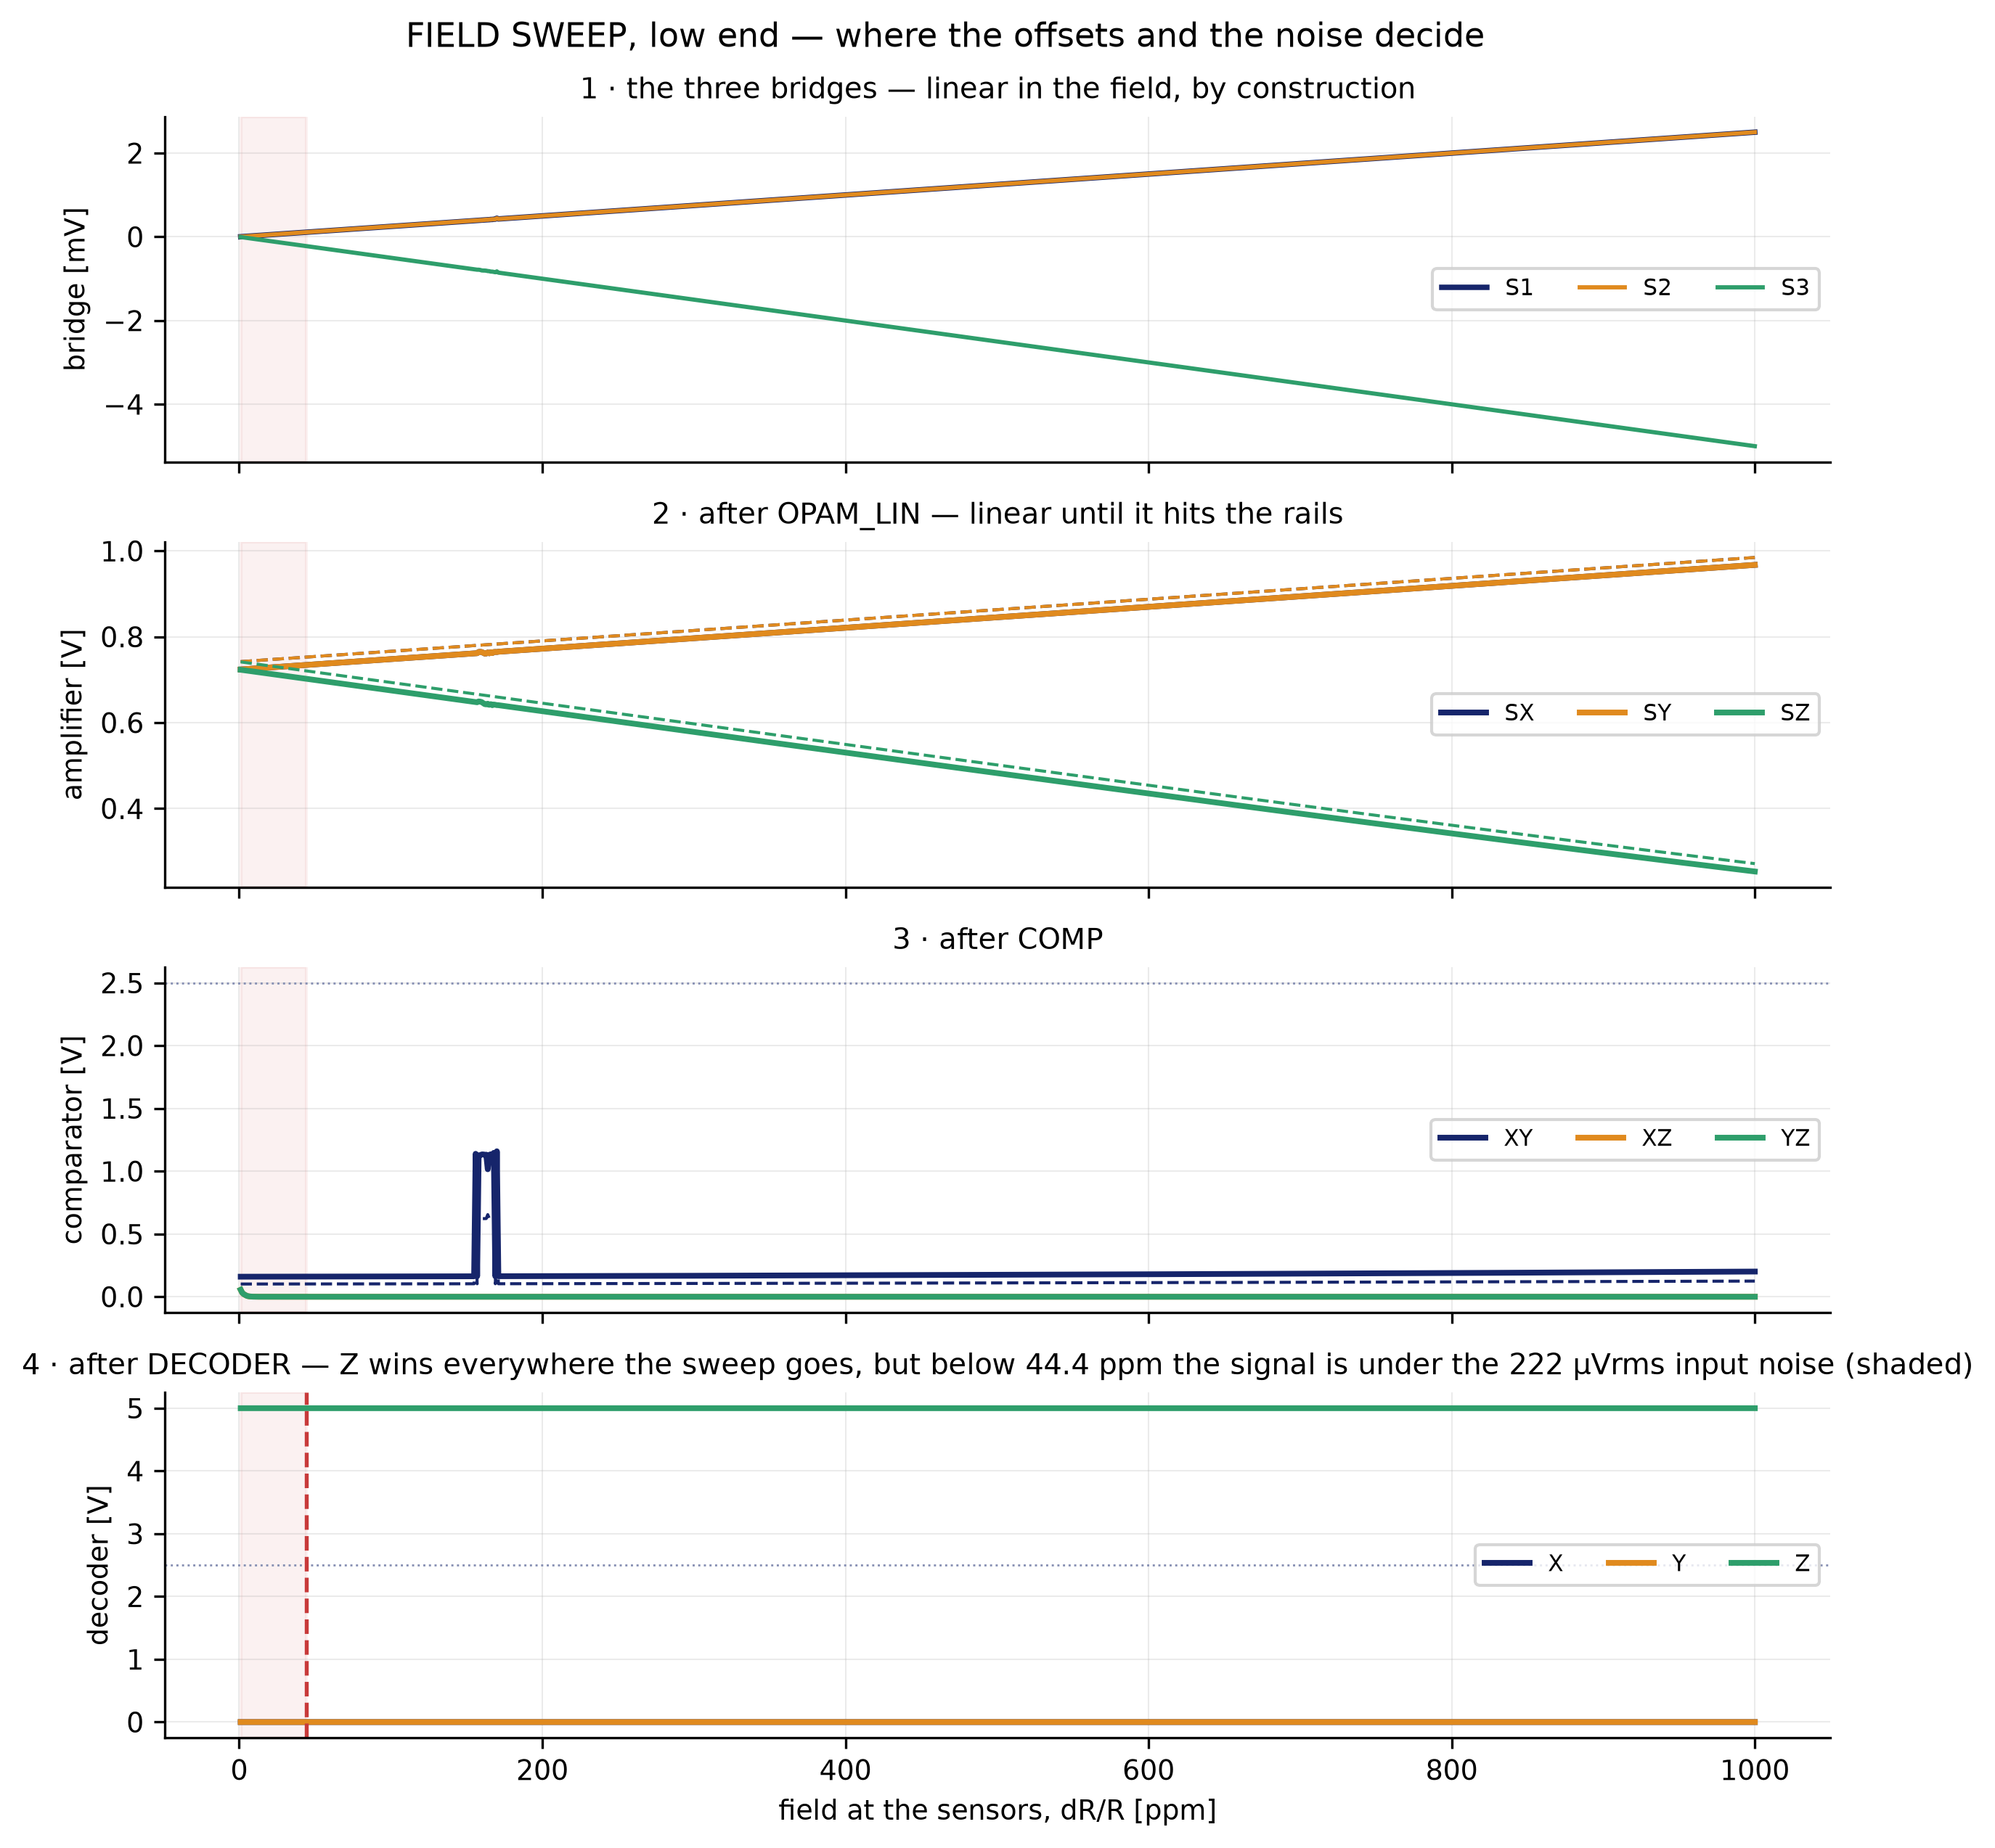
BLOCK RESULT · GRADIENT SENSING
the low end on its own scale: where the chip goes deaf
run_gradient.sh — G2 schematic vs G4 layout

Slide 31
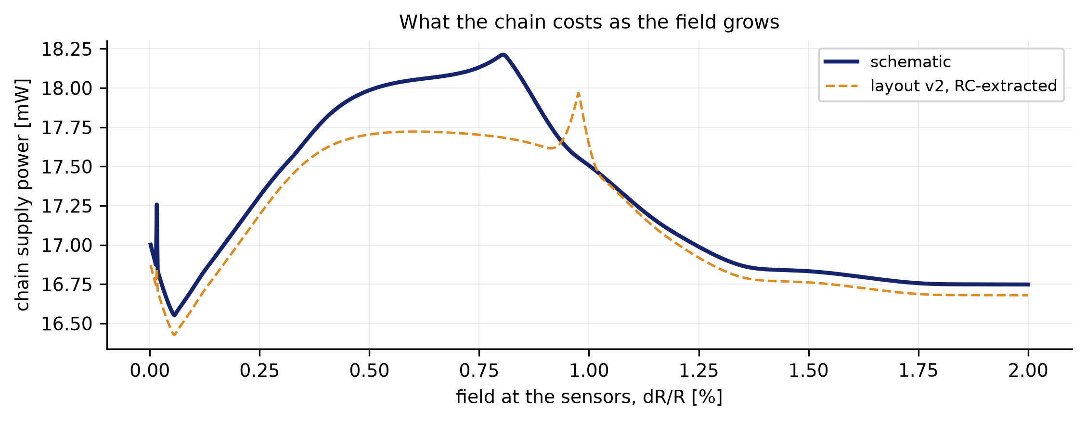
BLOCK RESULT · GRADIENT SENSING
what the chain costs as the field grows
run_gradient.sh — G2 schematic vs G4 layout

Slide 32
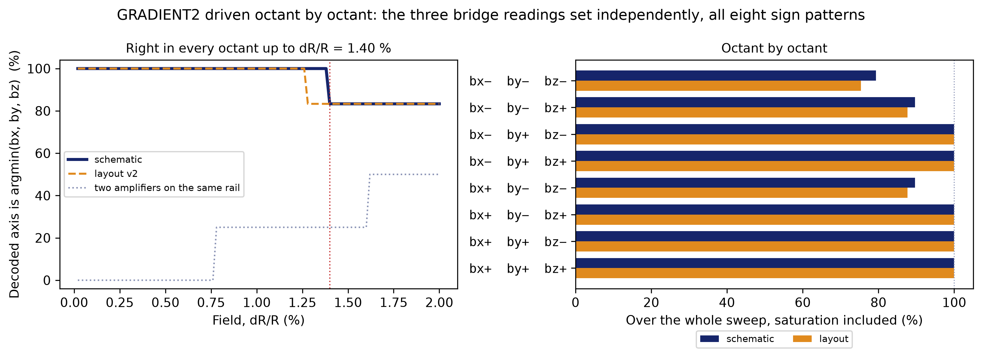
BLOCK RESULT · GRADIENT SENSING
all eight sign combinations of the three bridge readings
run_gradient.sh — G2 schematic vs G4 layout

Slide 33
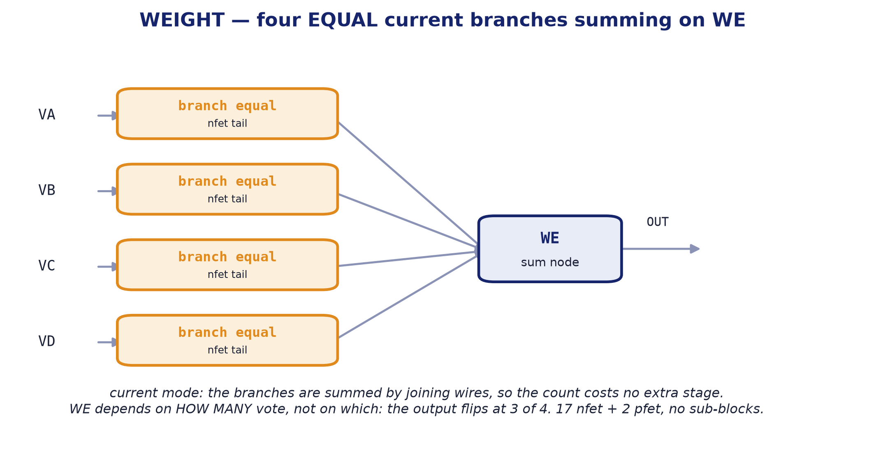
BLOCK 2 · WEIGHT
The vote counter: four chains vote, one axis sums.
internal block diagram

Slide 34
WEIGHT
Current-mode vote counter. One per axis.
Four inputs of EQUAL weight, one output.
Each of the four GRADIENT2 chains votes on this axis, and the block counts the votes in current mode: the branches add by joining wires, so counting costs no extra stage. All four carry the same ~170 µA: what comes out depends on HOW MANY vote, not on which.
The axis is claimed from 2 of 4 votes on.
A FIFTH branch does that: an exact copy of the others with its gate tied to VDD. Always adding one, N real votes read as N+1 and the trip drops from 3 of 4 to 2 of 4, which is the decision the chip has to make with four chains and three axes.
It is a leaf: no sub-blocks.
17 n devices and 2 p, drawn by hand. The WE output is the summing node, and it is what leaves through the X, Y or Z analogue pad.
Parameter | Value
Function | sums the four votes of one axis
Supply | 5.0 V
Power | 3.48 mW
Devices | 17 nfet_06v0 + 2 pfet_06v0 (five branches: four votes and one fixed)
Decision threshold | 2 of 4 votes
Branch current | ~170 µA, igual en las cuatro
Area | 45.34 × 25.00 µm = 0.0011 mm² (WEIGHT_COMP cell, with COMP_OUT)
Instances | 3 (one per axis)

Slide 35
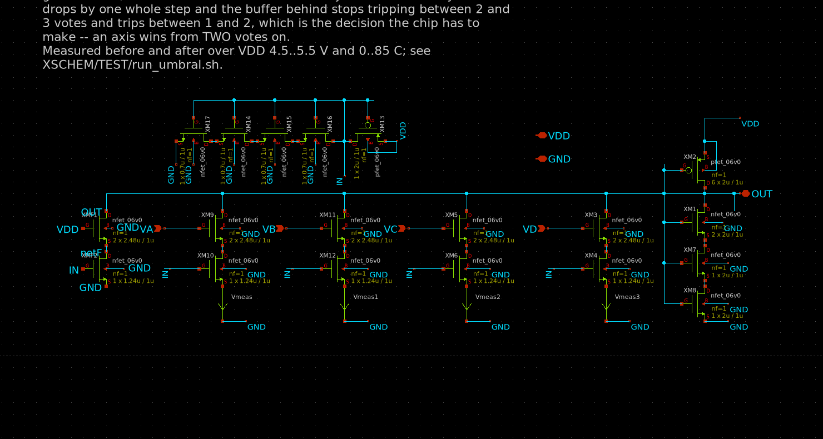
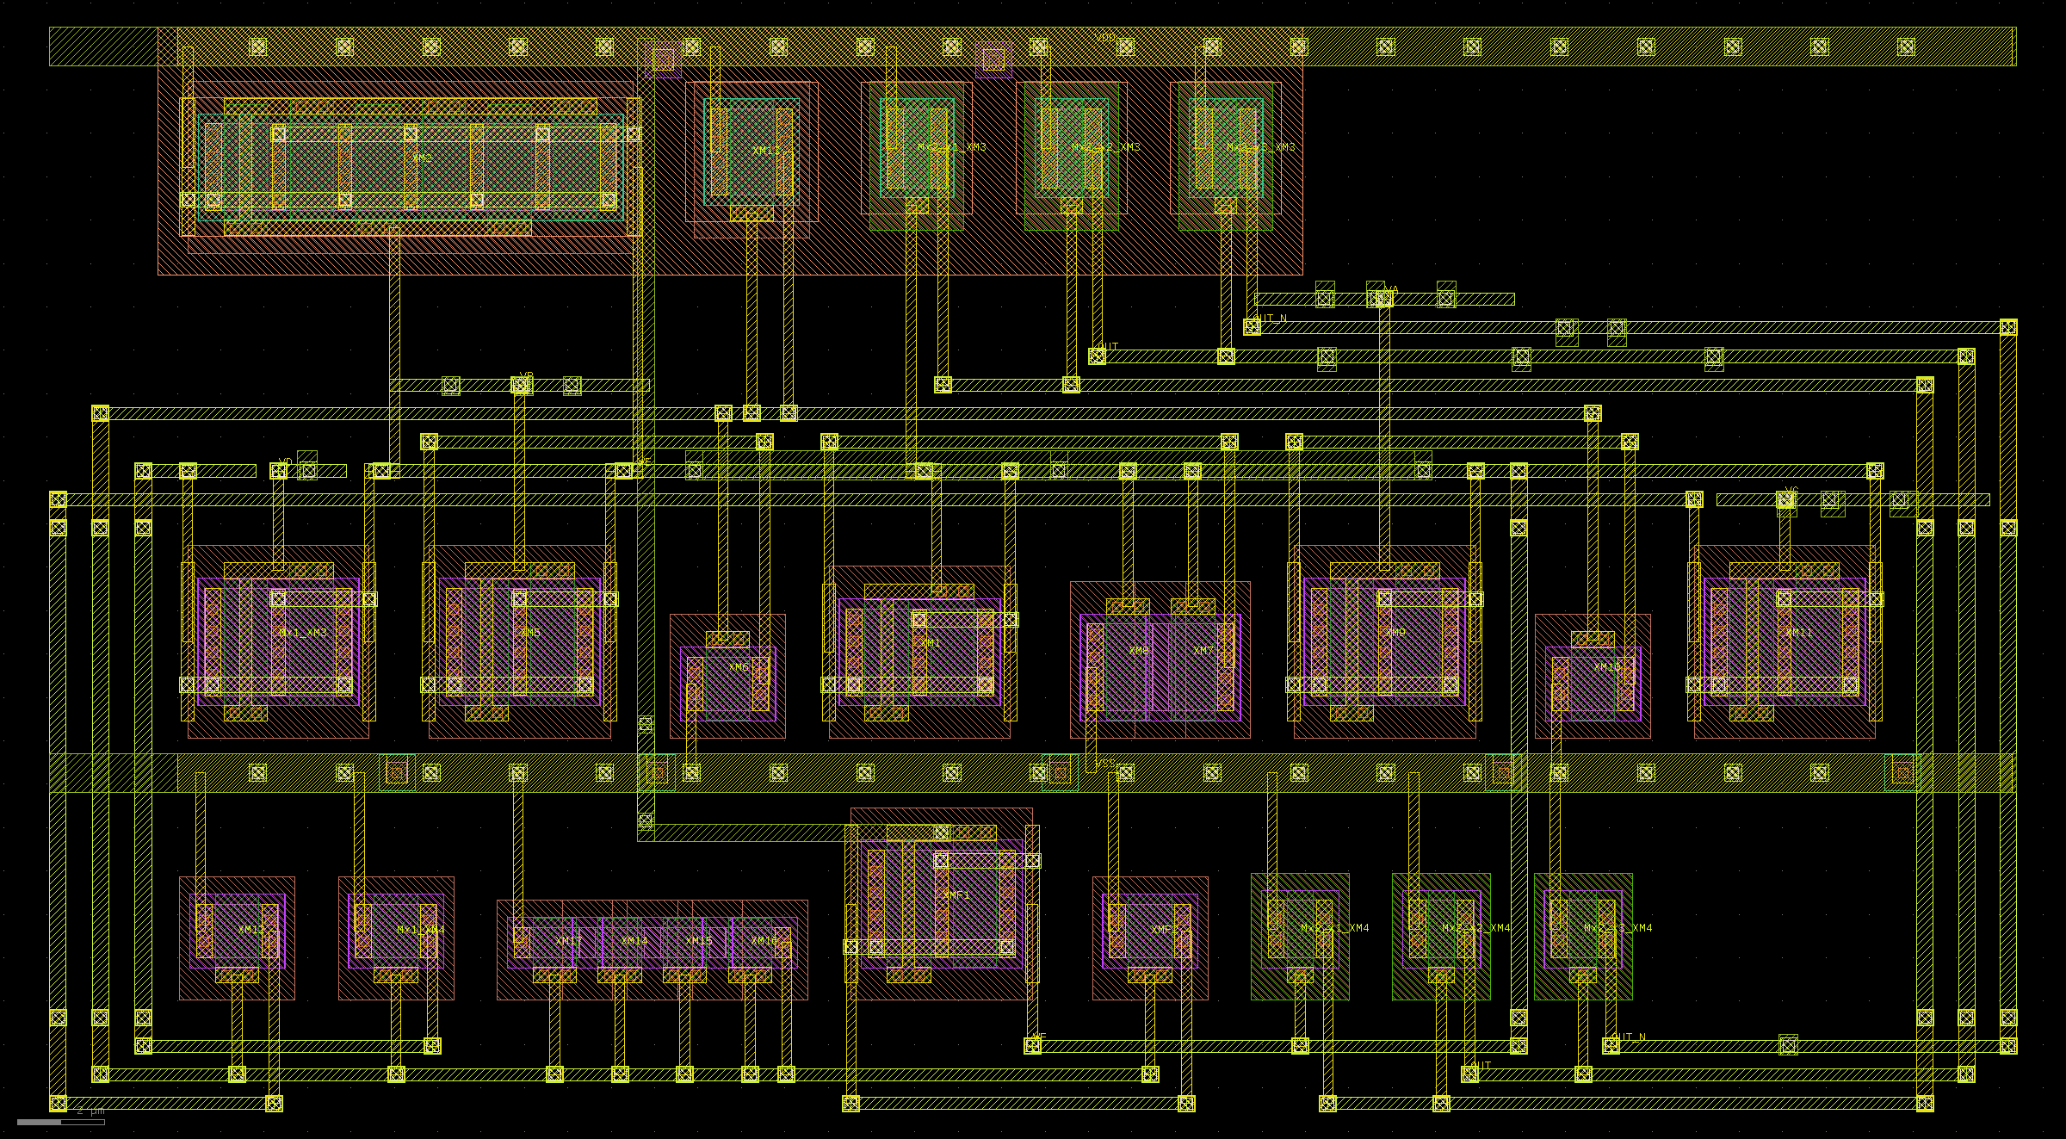
WEIGHT
Current-mode vote counter. One per axis.
schematic
layout — 45.34 × 25.00 µm

Slide 36
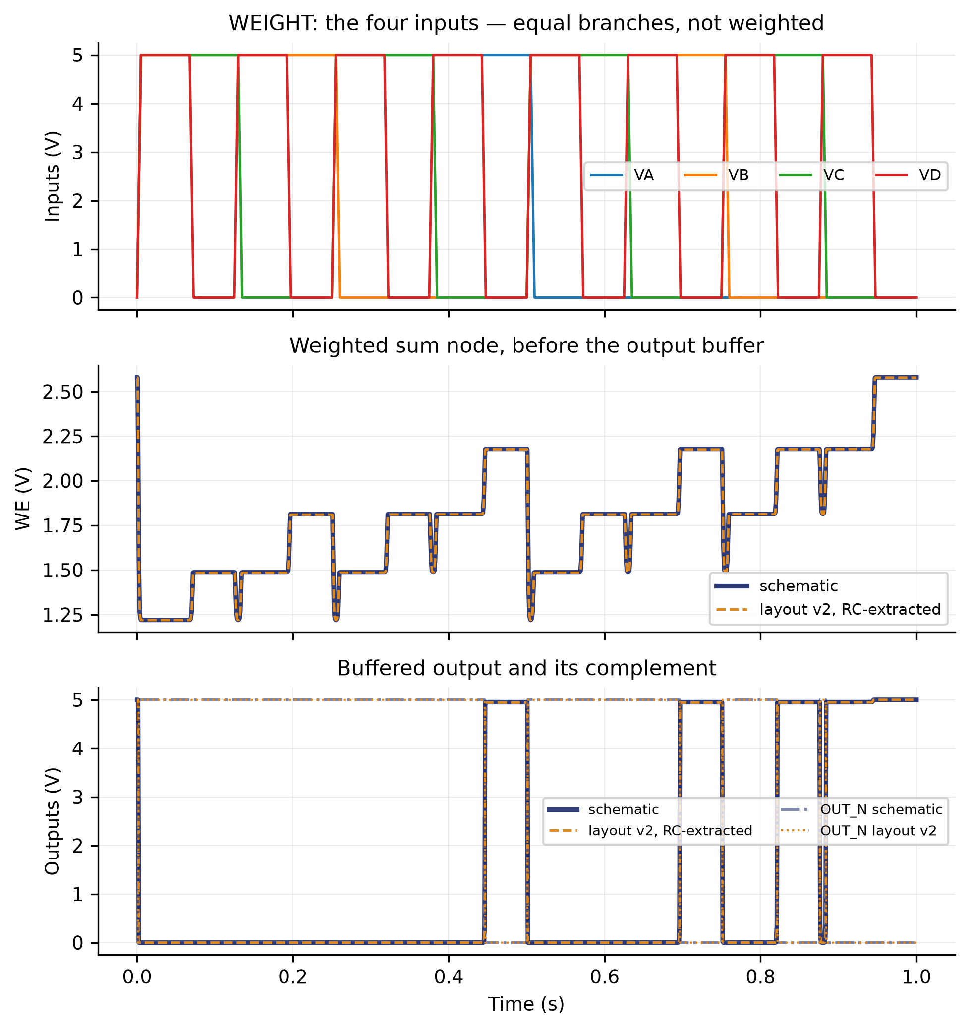
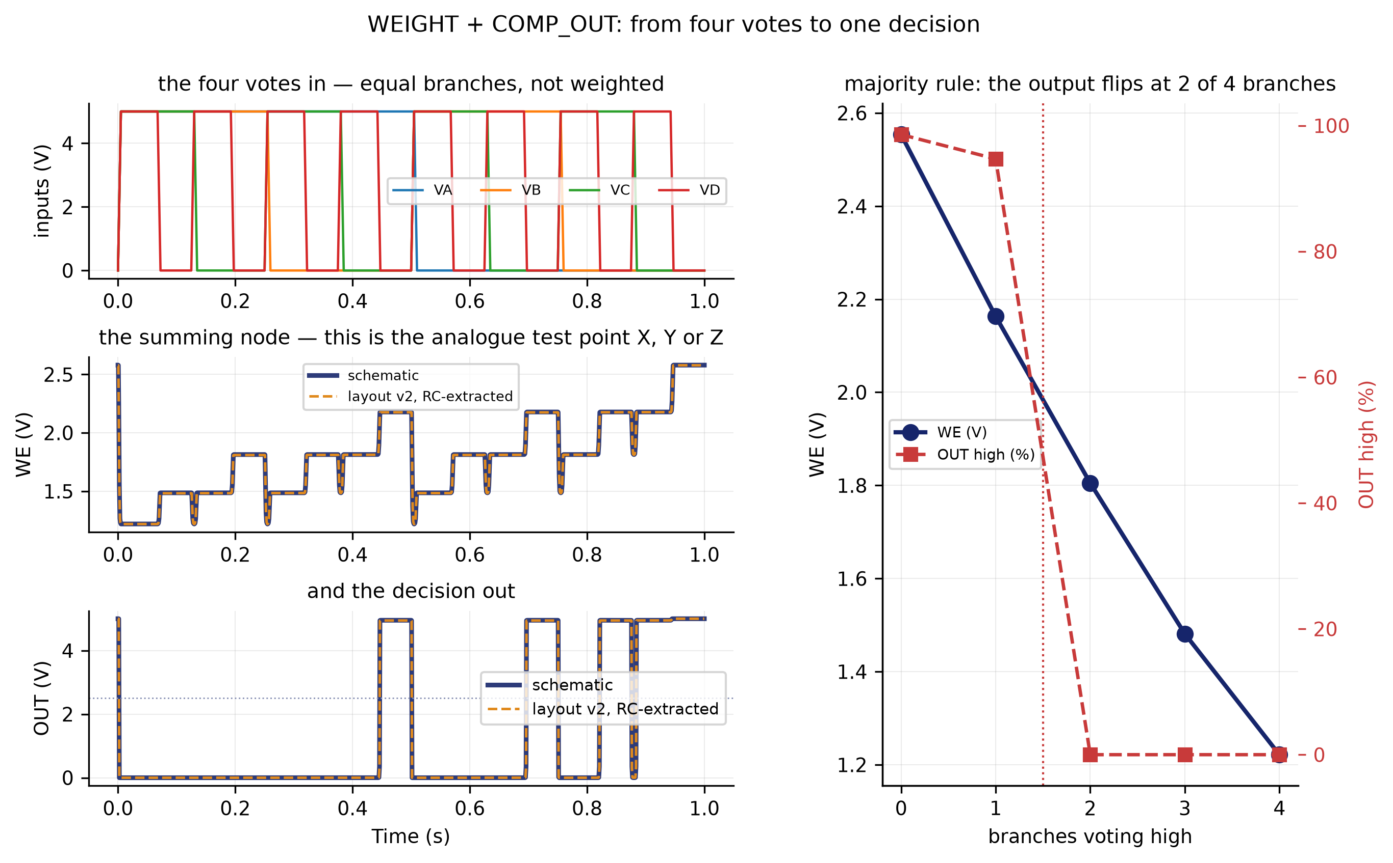
WEIGHT
inputs, sum node and outputs · from four votes to one decision
from four votes to one decision
inputs, sum node and outputs

Slide 37
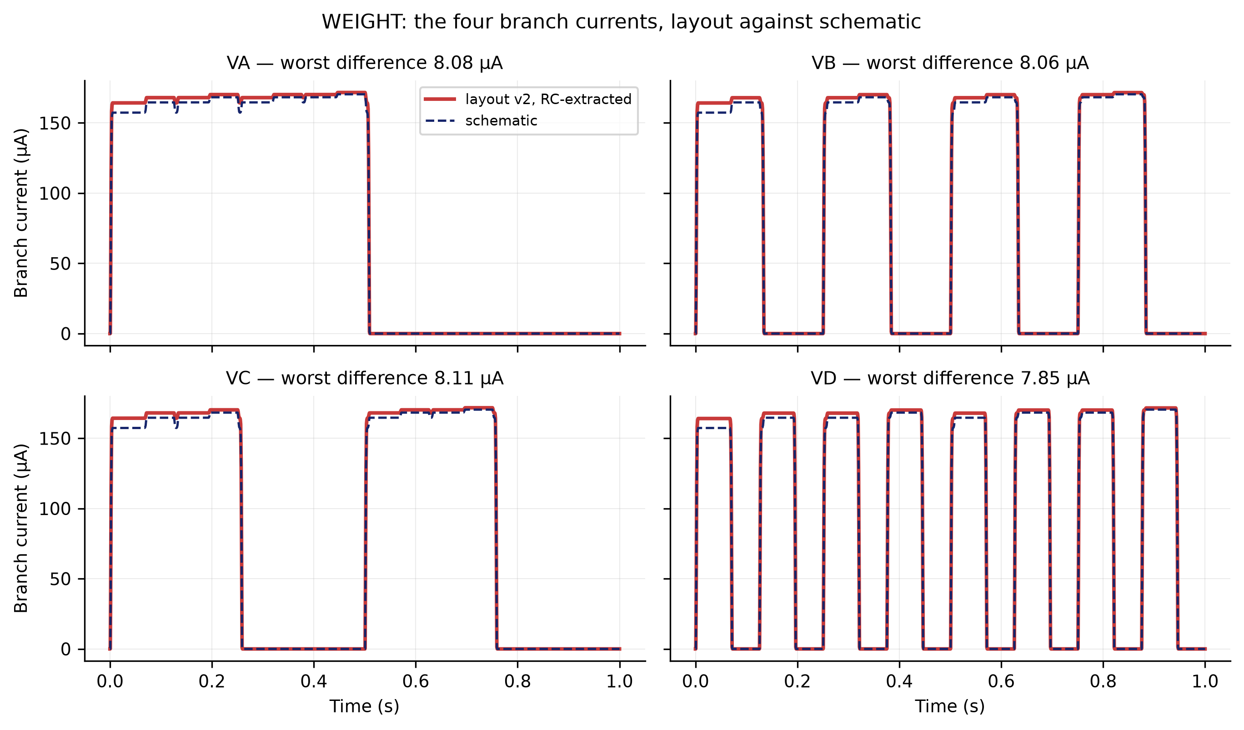
WEIGHT
branch currents
XSCHEM/TEST — schematic vs layout v2

Slide 38
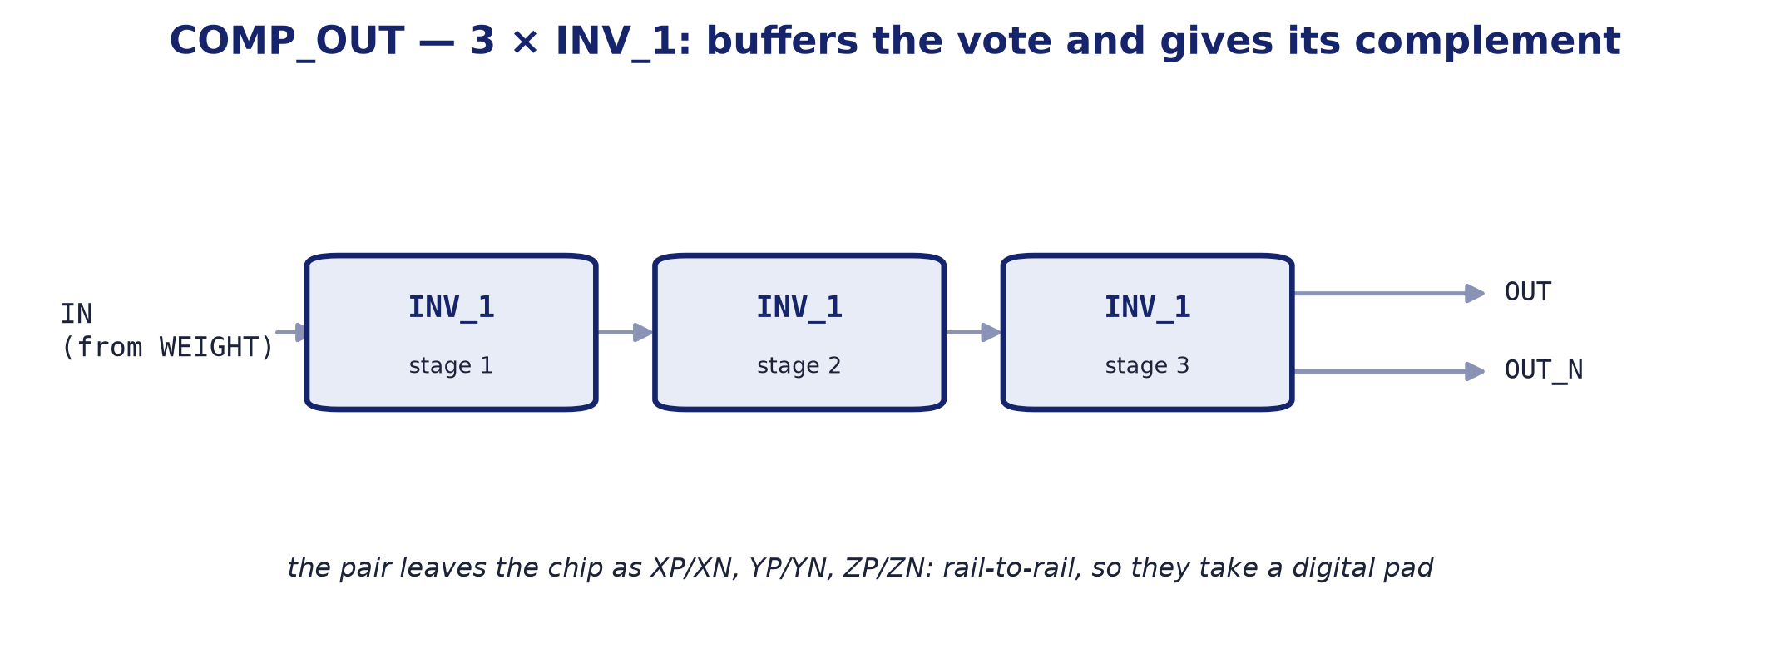
BLOCK 3 · COMP_OUT
The output stage: three inverters and the axis's digital pair.
internal block diagram

Slide 39
COMP_OUT
Output stage: three inverters giving the digital pair.
It takes the summing node up to digital levels.
Three inverters in a chain: the first decides, the rest give edge rate and drive. Out of it come the axis's two signals, the direct one and its complement.
That is why the outputs come in pairs.
XP/XN, YP/YN, ZP/ZN reach the pad rail to rail, which is why they take a digital pad and not an analogue one.
Parameter | Value
Function | buffers the vote and gives its complement
Supply | 5.0 V
Sub-blocks | 3 × INV_1
Area | shared with WEIGHT in the WEIGHT_COMP cell
Instances | 3 (one per axis)

Slide 40
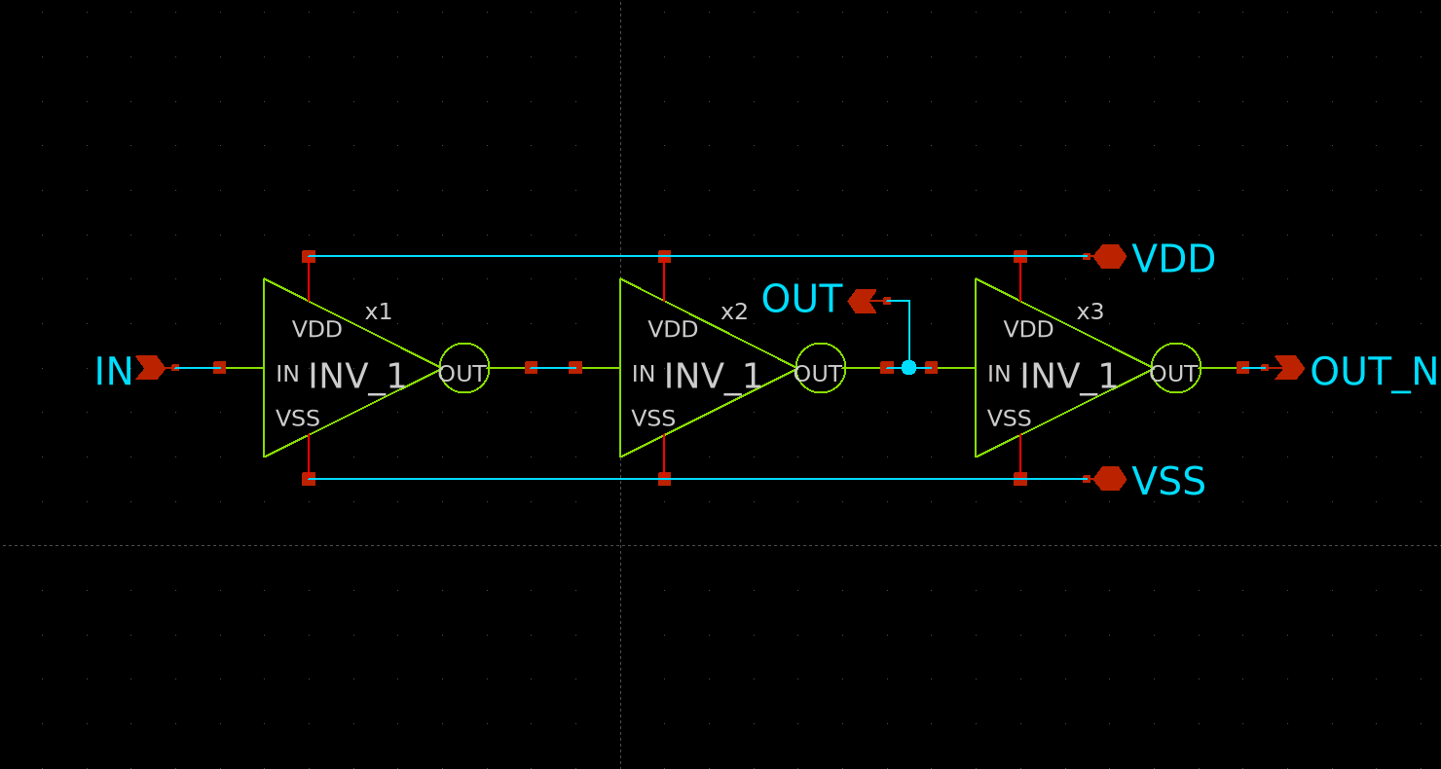
COMP_OUT
Output stage: three inverters giving the digital pair.
schematic
layout — 45.34 × 25.00 µm

Slide 41
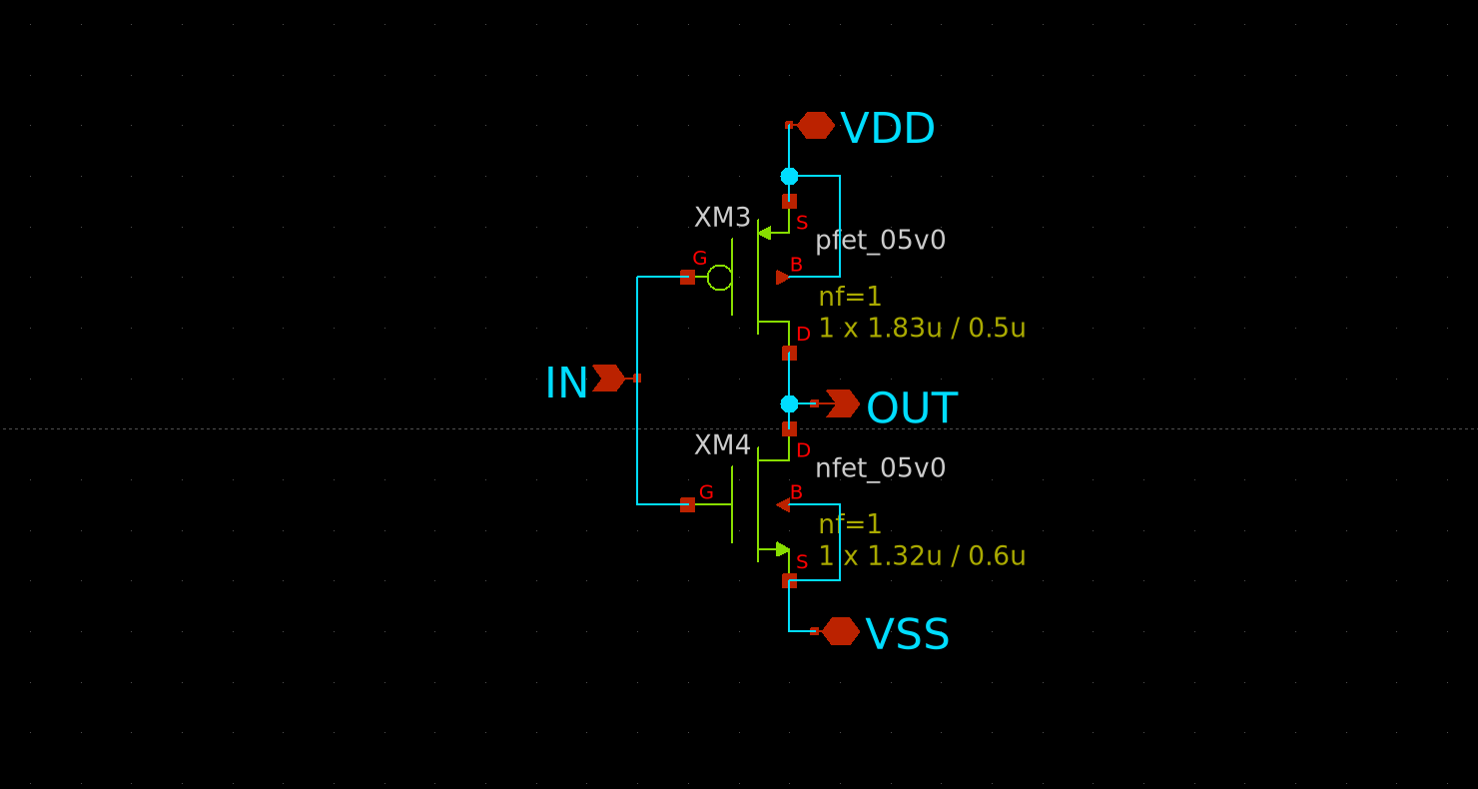
INV_1
COMP_OUT's sub-block: the inverter.
XSCHEM/WEIGTH/INV_1.sch

Slide 42
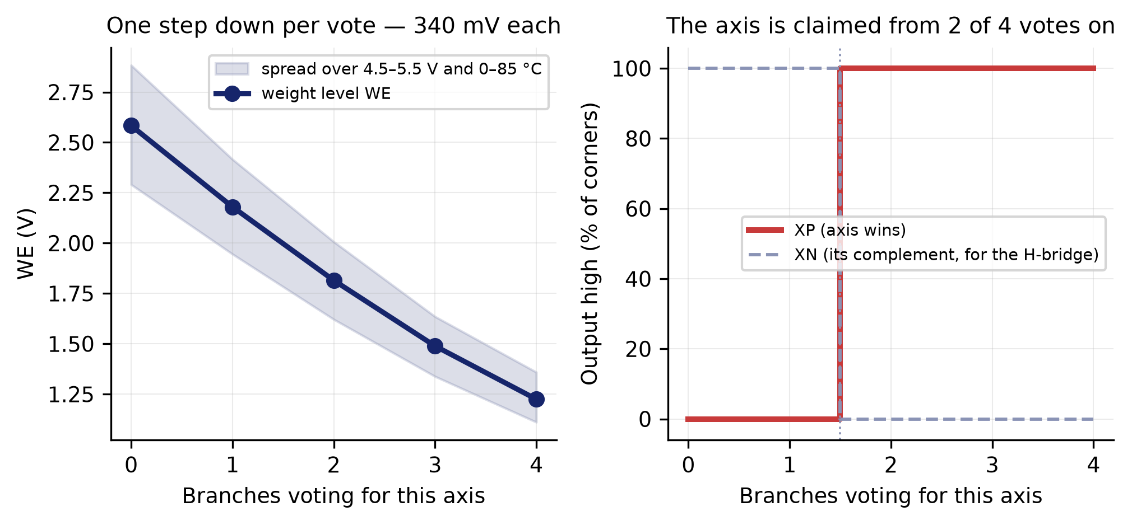
COMP_OUT
output state against the number of branches voting
XSCHEM/TEST — schematic vs layout v2

Slide 43
ESD_CDM · SECONDARY PROTECTION
Outside the signal chain, but inside the user area.
Eleven instances, one per analogue pad.
The PDK's analogue pads carry HBM diodes only, so the CDM network — a series poly resistor plus diodes — is ours to add, and it goes BESIDE the pad: whatever sits between pad and clamp is unprotected.
The circuit is the organisers'; the drawing is ours.
All three of their published cells violate MSLOT.1, and nobody had seen it because the PDK's mslot table crashes before reaching them. Ours is 1762 µm² against 6457: about 52,000 µm² of user area back.
This is where the n-wells were merged.
The four wells sat 1.330 µm apart, which is fine only if the checker knows they are equipotential. They are one well now and it passes in both modes.

Slide 44
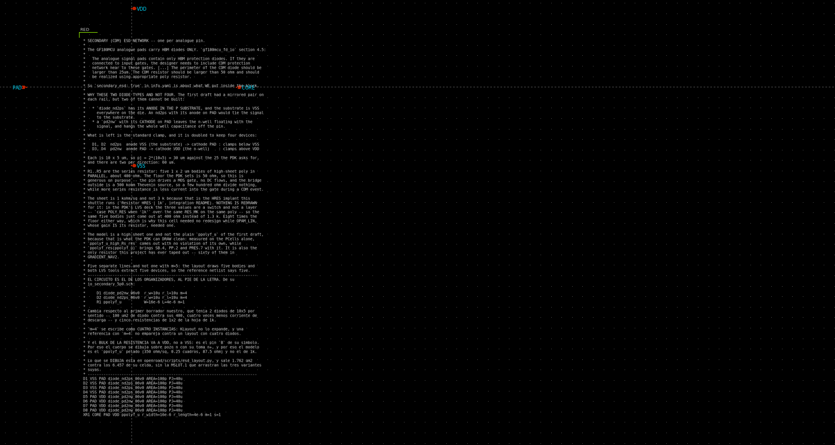
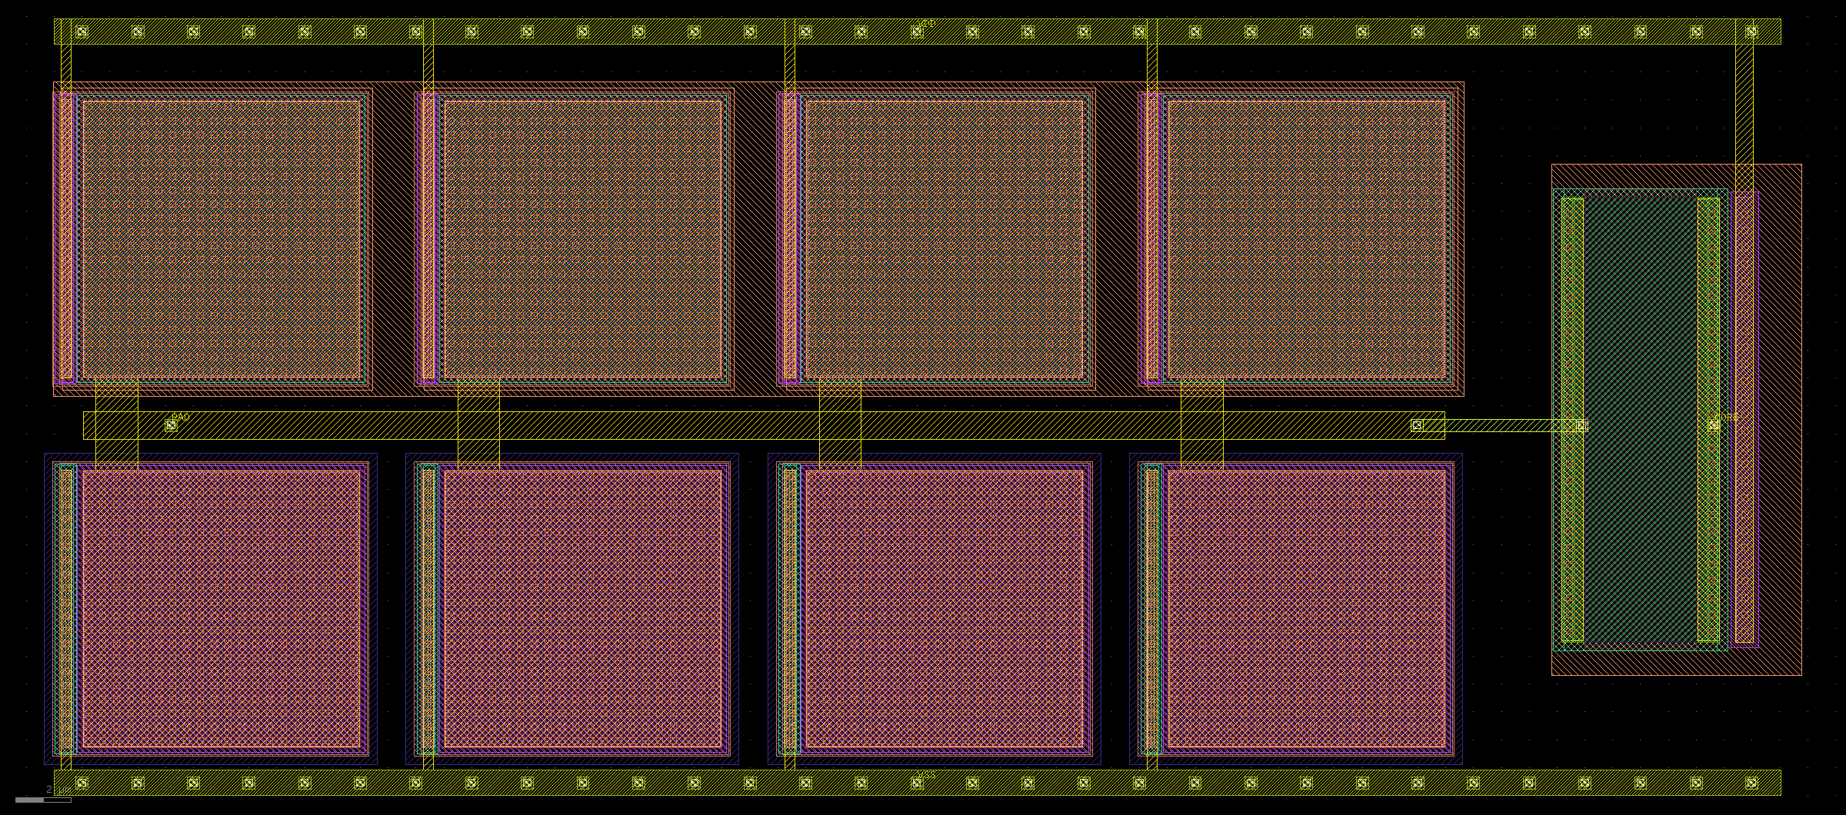
ESD_CDM
Outside the signal chain, but inside the user area.
layout — 63.16 × 27.90 µm
schematic

Slide 45
03
FULL-SYSTEM RESULTS
The whole system, always layout against schematic.

Slide 46
NAVIGATOR BENCH · METHOD
run_nav2.sh — four bridges against two navigators. It is also the layout-vs-schematic comparison.
Two navigators on the same eight sensor nodes:
N_esq — the schematic GRADIENT_NAV2, supply VDDS
N_lay — the same circuit rebuilt from the v2 layout and extracted WITH RC PARASITICS, supply VDDR
Four sensors at 0, 90, 180 and 270°, and the field turning from 0 to 360°.
Each of the four chains reads THREE of the four sensors, in different combinations, and the three weights combine their outputs.
What it measures: on what percentage of the sweep the nine schematic outputs agree with the layout ones, and where they do not, how many degrees wide the disagreement is.

Slide 47
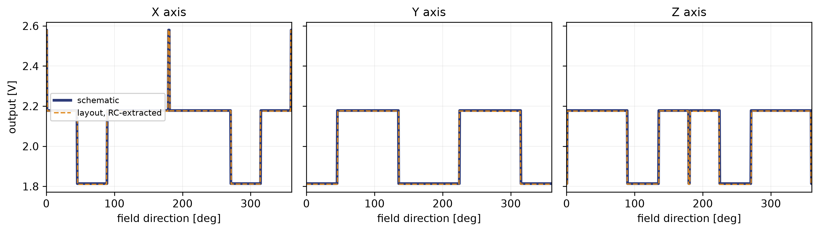
RESULT · LAYOUT AGAINST SCHEMATIC
721 points from 0 to 360°. The dashed orange is the layout extracted with parasitics.
datos_nav2/fino_nav2.csv
The twelve chain outputs agree on 99.7 % of the sweep.

Slide 48
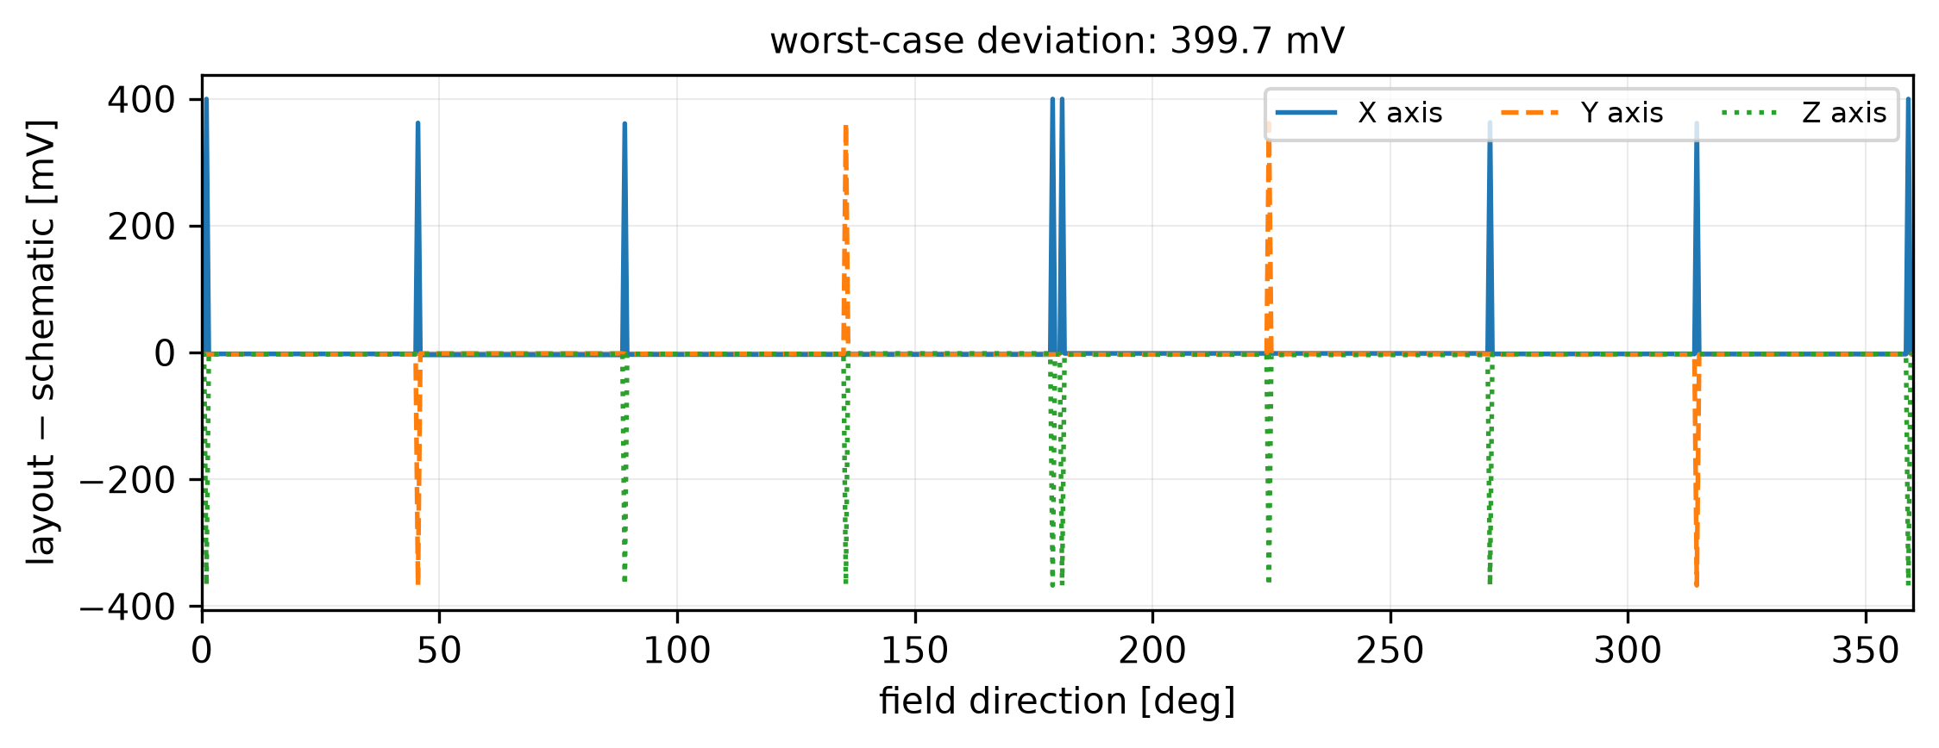
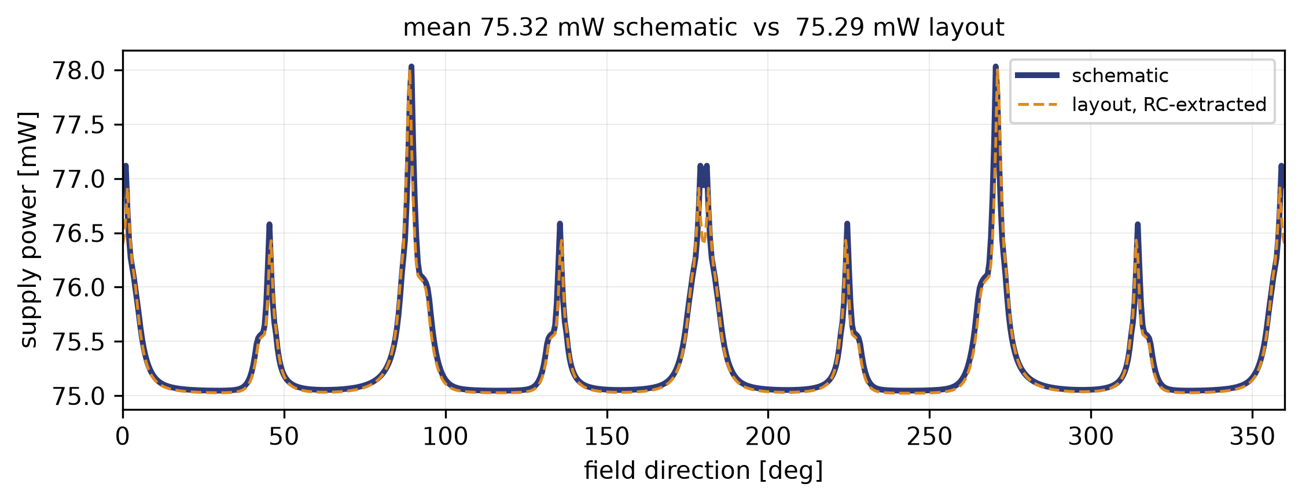
RESULT · LAYOUT AGAINST SCHEMATIC
The twelve chain outputs agree on 99.7 % of the sweep.
The layout's four GRADIENT2 blocks, extracted with RC parasitics, decide what the schematic's do. The whole analogue chain - amplifier, comparator, decoder - reproduces the schematic.
The six digital outputs, on 99.5 % (X and Y) and 98.9 % (Z).
Between 2 and 4 degrees of disagreement out of 360, and they fall where they should: on the sector boundaries, which is exactly where the decision is on a knife edge and the layout's offset settles it.
Deviation at the counter node: 38.8 mV rms.
Power: 75.32 mW schematic, 74.15 mW layout. The RC parasitics do not move the operating point appreciably.

Slide 49

RESULT · LAYOUT AGAINST SCHEMATIC
four chains vote, the counter adds them up
datos_nav2/fino_nav2.csv

Slide 50

RESULT · LAYOUT AGAINST SCHEMATIC
the six pins that leave the die
datos_nav2/fino_nav2.csv

Slide 51
RESULT · LAYOUT AGAINST SCHEMATIC
The six digital pins: three decisions and their complements.
XP high means «this axis wins». XN is its inverse, not «the other sense».
COMP_OUT is OUT = buffer(IN) and OUT_N = NOT(IN), instantiated as x8 VDD XN X XP VSS. The pair is redundant by construction: reading XP is enough, and XN is there to drive the H-bridge directly.
The chip answers WHICH AXIS, not which way along it.
The decoder puts out the axis whose bridge reads LEAST, the vertex upstream of the gradient. That identifies one axis out of three, not one sense out of six.
Telling +X from −X needs one more comparison.
That is what GRADIENT_NAV3 adds, comparing components instead of readings, and it does give the six senses. It is not instantiated on this die.

Slide 52

RESULT · LAYOUT AGAINST SCHEMATIC
all eight sign combinations of the gradient
run_nav2_geo.sh — sphere sweep

Slide 53

RESULT · LAYOUT AGAINST SCHEMATIC
every GRADIENT2, every octant, twice
run_nav2_geo.sh — sphere sweep, schematic tops only

Slide 54
GEOMETRY BENCH · METHOD
run_nav2_geo.sh — how the navigator depends on the box the sensors sit in.
The four sensors sit at the vertices of the tetrahedron inscribed in a box Lxy × Lxy × Lz.
Six combinations: Lxy of 1000, 2000 and 3000 µm, and Lz of 500 and 1000 µm.
1 · Resolution.
For each box and each gradient level the direction is swept 360° and we count on what fraction it gets the axis right. From that curve comes one number: the smallest gradient at which accuracy reaches 95 %. It captures both limits at once — from below the comparator offset, from above the amplifier's saturation — without depending on any borrowed definition.
2 · The same in the X-Y plane, where Lz plays no part.
It separates the x-y resolution from the z one.
3 · Background.
Earth's field is common to all four sensors, so it cancels in the comparison but NOT in the amplifier, which sees all of it. It is swept to find the level at which the measurement is lost.

Slide 55

GEOMETRY BENCH · METHOD
run_nav2_geo.sh — how the navigator depends on the box the sensors sit in.
XSCHEM/TEST_TOTAL/test_NAV2_geo.sch

Slide 56

RESULT · GEOMETRY OF THE BOX
Accuracy on the direction, by box and gradient level.
run_nav2_geo.sh

Slide 57

RESULT · GEOMETRY OF THE BOX
Accuracy on the direction, by box and gradient level.
run_nav2_geo.sh

Slide 58
RESULT · GEOMETRY OF THE BOX
Accuracy on the direction, by box and gradient level.
Box Lxy × Lz [µm] | Low gradient | High gradient
1000 × 1000 | 90.0 % | 97.8 %
1000 × 500 | 87.2 % | 91.7 %
2000 × 1000 | 91.1 % | 92.2 %
2000 × 500 | 92.7 % | 94.4 %
3000 × 1000 | 92.7 % | 93.3 %
3000 × 500 | 92.7 % | 94.4 %
At high gradient the 1000 × 1000 box reaches 97.8 %. Flattening the box (Lz 500) always costs accuracy, because the z axis ends up worse resolved than x-y.

Slide 59
SOURCE BENCH · METHOD
run_fuente.sh — does the chip point at it? This is the question it exists to answer.
Everything so far imposed a uniform gradient in a direction. Here the field comes from a source sitting somewhere and each sensor reads the magnitude at its own vertex.
Two models, and the pair is the method:
SYMMETRIC — |B| depends on distance only, so grad|B| points EXACTLY at the source. Whatever error comes out is the chip's.
REAL DIPOLE — axis along +z. |B| depends on the angle too, and grad|B| does NOT point exactly at the source, not even with a perfect chip.
The difference between the two numbers separates the error of the circuit from the error of the physics.
Which is what you need before believing anything measured with a real magnet.
42 sweeps: three distances, seven azimuths, both models.

Slide 60
RESULT · DOES IT POINT AT THE SOURCE?
Angle the chip gives against the ideal angle, by model and distance.
Accuracy falls with distance, as expected: the gradient weakens and the comparator offset weighs more.
Model | Distance | Chip | Ideal | Accuracy
symmetric | 3000 µm | 14.46° | 14.21° | 90.8 %
symmetric | 6000 µm | 9.02° | 7.56° | 86.9 %
symmetric | 12000 µm | 11.32° | 3.84° | 76.1 %
dipole | 3000 µm | 16.53° | 16.40° | 93.2 %
dipole | 6000 µm | 12.31° | 11.66° | 90.6 %
dipole | 12000 µm | 12.41° | 9.92° | 84.3 %
Read the LAST degrees column, not the first two. «Chip» is the angle out of the four simulated bridge voltages; «Ideal» is the same computation on analytical readings, with no circuit. Neither is zero, and the circuit is not why: the chip does not measure the gradient at a point, it takes a FINITE DIFFERENCE over a 1 mm box, and 3 mm from the source the field curves so sharply across that box that a perfect chip already misses by 14°. What the circuit adds is the difference: +0.25° at 3 mm, +7.48° at 12 mm.

Slide 61

RESULT · DOES IT POINT AT THE SOURCE?
Angle the chip gives against the ideal angle, by model and distance.
run_fuente.sh

Slide 62

RESULT · DOES IT POINT AT THE SOURCE?
Angle the chip gives against the ideal angle, by model and distance.
run_fuente.sh

Slide 63

RESULT · DOES IT POINT AT THE SOURCE?
Angle the chip gives against the ideal angle, by model and distance.
run_fuente.sh

Slide 64

RESULT · DOES IT POINT AT THE SOURCE?
Angle the chip gives against the ideal angle, by model and distance.
run_fuente.sh

Slide 65
04
PHYSICAL VERIFICATION
DRC, LVS, connectivity and current density on the file that ships.

Slide 66


B26_A
On B26_A_filled3.gds, the file that ships.
unfilled — 1110 × 1110 µm
density-filled — 1110 × 1110 µm

Slide 67
PHYSICAL VERIFICATION
On B26_A_filled3.gds, the file that ships.
Check | Result
Sign-off DRC (main/deep, with connectivity) | 660 categories, 0 violations
DRC with --no_connectivity | 0 violations
Split-table DRC, 63 tables | 63 tables, 0 violations
Density fill | all 7 layers pass
LVS netgen | Circuits match uniquely
Connectivity | 17 of 17 signals, 11 through their clamp
Current density at 125 °C | 48.00 µm against 22.10 required
PR_bndry | exactly one
The DRC was run in both connectivity modes. The design no longer depends on how the reviewer runs the check.

Slide 68
05
CONCLUSIONS
Expected against measured, including what did not close.

Slide 69
EXPECTED AGAINST MEASURED
Three things simulation found and the design corrected.
1 · XP and XN were expected to match their names. They did not.
The bench uncovered that they were swapped with respect to the label. Corrected in the schematic.
2 · The decision threshold was expected to be centred. It was misplaced.
The trip sweep measured it and it was readjusted.
3 · The three axes were expected to compete on equal terms. Z could never win.
And its own WEIGHT did not fix it: what fixed it was changing the order within each triple.
All three were found by simulating, not by reviewing. That is the argument for the benches.

Slide 70
WHAT DID NOT CLOSE
Said as plainly as what went right.
The KLayout LVS on the top does not finish the extraction.
Three attempts on a 31 GB machine: 2h33m on the filled GDS, then 1h04m and 30m52 on the unfilled one. None reached the compare stage.
Not a memory problem: each process sat at ~540 MB with 31 GB free.
It is net count, not machine size.
What does match: netgen says Circuits match uniquely on the same 1442 devices, class by class.
It matters for the submission because the chipathon's external LVS runs the KLayout deck, not netgen.

Slide 71

A MEASURED IMPROVEMENT, NOT IN THE DIE
Reordering the sensor ports: 76.2 % to 90.7 %, without touching a single cell.
XSCHEM_v3 — same sphere sweep, both wirings side by side

Slide 72
06
STATUS
The chip is finished and verified. DRC clean in both modes, netgen LVS matching uniquely, 17 of 17 pins conducting, and the supply providing 48.00 µm of section against the 22.10 µm electromigration demands at 125 °C. Deliverable: B26_A_filled3.gds, sha 41bef27a.

