Slide 1
T E A M Z O T N E T I C
B26 · Magnetic gradient navigator in GF180MCU
SSCS Chipathon 2026 · UCI Samueli School of Engineering
Lead: Juan Sánchez · An Bui · Enzo Li · Akam Khinda · Aysha Hussaini
Design, simulation and verification report

Slide 2
01
WHAT THE CHIP DOES
Four sensors read the magnitude of the field. The chip works out which way it grows.

Slide 3
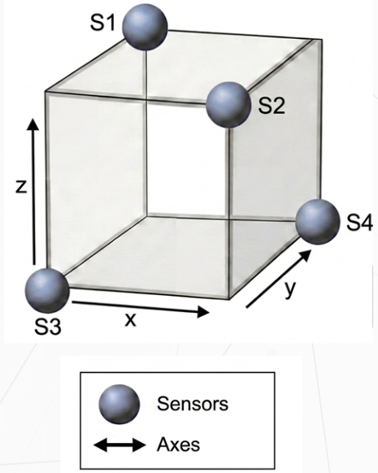
THE PRINCIPLE
The sensors do not measure a vector: they measure magnitude. That distinction is the whole design.
Four magnetoresistive bridges read |B| at the vertices of a tetrahedron.
Each bridge gives a voltage proportional to dR/R, that is to the magnitude of the field at its vertex, not to its direction.
Comparing the four magnitudes reconstructs grad|B|.
The gradient of the magnitude points where the field grows, and the field grows towards the source. That is how the chip can point at a magnet without ever measuring a vector.
The output is one sign per axis: XP/XN, YP/YN, ZP/ZN.
Six digital outputs. It does not say how much, it says which way.
four sensors at the vertices

Slide 4
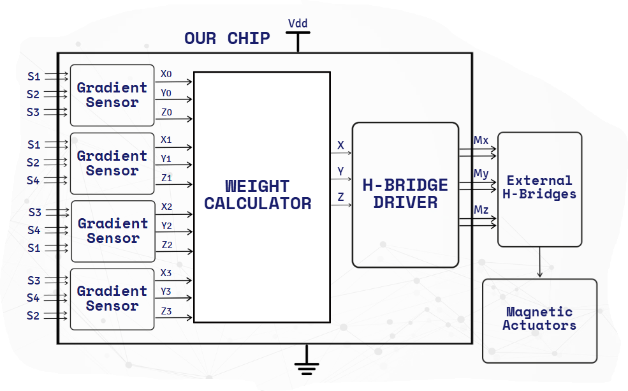
ARCHITECTURE
From sensor to actuator, and which part of that is this chip.
block diagram of the system
Four gradient sensors, a weight calculator, an H-bridge.

Slide 5
SPECIFICATIONS
What goes in, what comes out and what it costs.
Parameter | Value
Technology | GF180MCU-D, 6 V devices
Supply | 5.0 V (VDD / VSS), every bench sourced at 5.0 V
Total power | 74.02 mW schematic · 74.03 mW layout (14.81 mA)
Delivered area | 1110 × 1110 µm = 1.232 mm² (B26_A user area)
Navigator area | 460.9 × 387.0 µm = 0.178 mm² (GRADIENT_NAV2)
Analogue inputs | 8 — S1P/S1N … S4P/S4N, four magnetoresistive bridges
Test points | 3 — X, Y, Z, vote counters between 1.814 and 3.035 V
Digital outputs | 6 — XP/XN, YP/YN, ZP/ZN, rail to rail
Pads | 11 analogue + 6 digital + 2 supply = 19
Analogue pad type | analog, with our own secondary ESD (ESD_CDM)
Digital pad type | bidirectional, permanently driving
Secondary ESD | ESD_CDM, 63.2 × 27.9 µm, 8 diodes + 87.5 Ω poly, 11 instances
The 6 V is the device class, not the operating point: everything is simulated and measured at 5.0 V.

Slide 6
02
THE THREE BLOCKS
GRADIENT_NAV2 inside: each block with its diagram, its schematic, its layout and its simulations.

Slide 7
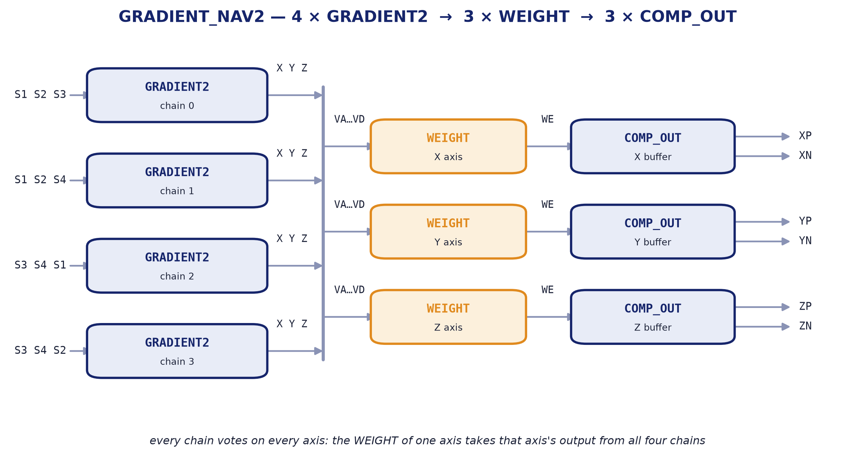
GRADIENT_NAV2 INSIDE
4 × GRADIENT2 → 3 × WEIGHT → 3 × COMP_OUT.
internal block diagram

Slide 8
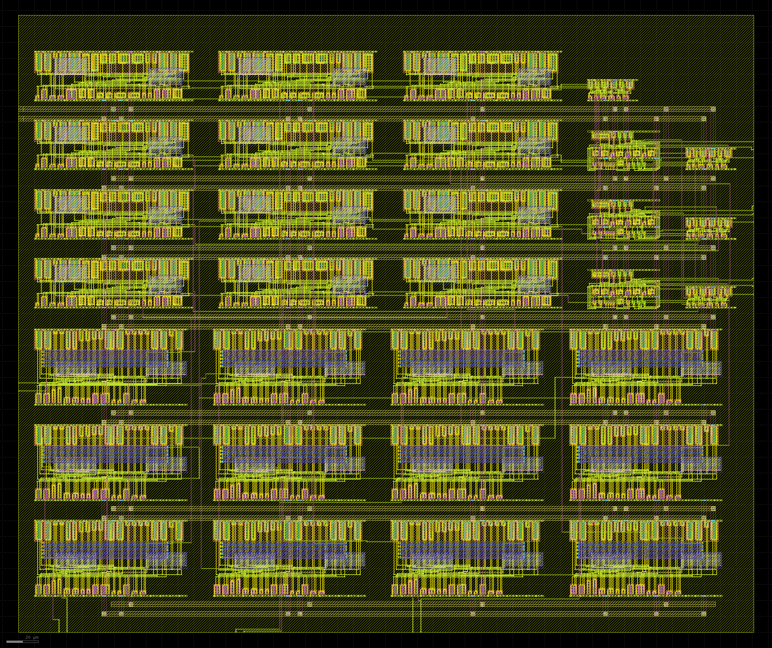
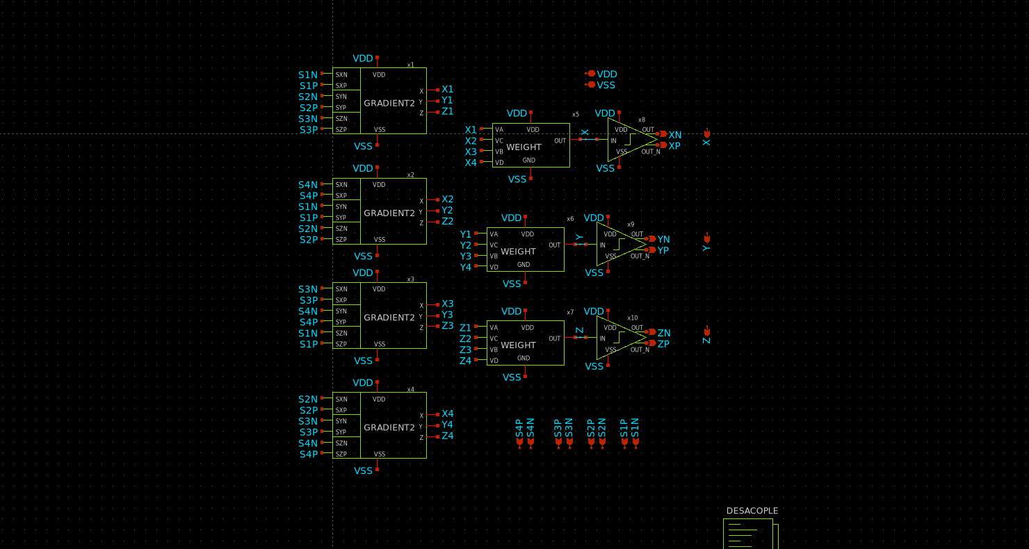
GRADIENT_NAV2
4 × GRADIENT2 → 3 × WEIGHT → 3 × COMP_OUT.
schematic
layout — 460.90 × 386.99 µm

Slide 9
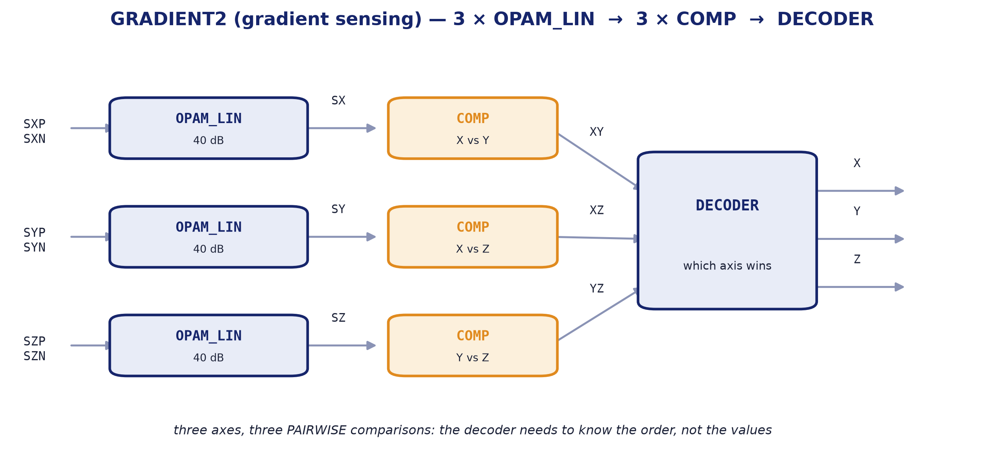
BLOCK 1 · GRADIENT SENSING
GRADIENT2 — three amplifiers, three comparators and a decoder.
internal block diagram
One sensing block reads three bridges and decides an axis.
The three OPAM_LIN amplify the three bridge differences. The three COMP compare them PAIRWISE — X with Y, X with Z, Y with Z — and the DECODER turns that order into a winning axis.
Comparing pairwise, rather than against a threshold, is the design decision.
The decoder does not need to know what each axis is worth, only which is larger. That makes the decision immune to absolute gain and to any offset common to the three channels.

Slide 10
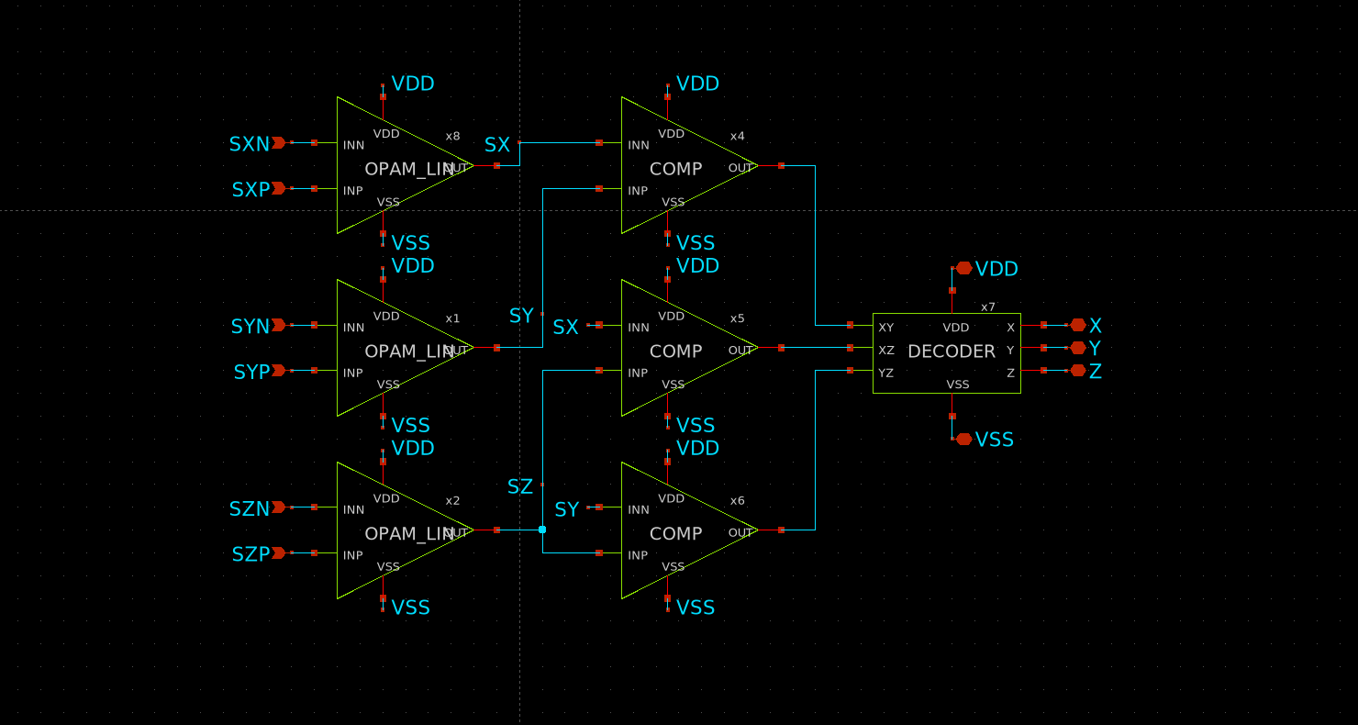
GRADIENT2
GRADIENT2 — three amplifiers, three comparators and a decoder.
XSCHEM/COMBINATION/GRADIENT2.sch

Slide 11
OPAM_LIN
40 dB linear amplifier. The first block in the chain.
It amplifies one bridge's difference, and nothing else.
The SkP/SkN pair of a sensor goes in and a single voltage proportional to dR/R comes out. It is the only small-signal block in the chain, so its linearity sets the system's.
Why 40 dB.
The gain was chosen on a measurement, not a taste: it is the one that keeps the cell inside its linear range over the input span the bridges deliver. More gain saturates earlier and loses the crossings, which is all the decision needs.
The common mode does not move with the signal.
The bridge delivering a constant Vcm = VEXC/2 is what makes these curves readable without confusing signal with common-mode sensitivity.
Parameter | Value
Function | amplifies one bridge's difference
Supply | 5.0 V
Power | 2.55 mW schematic / 2.45 mW layout
DC gain | 40.1 dB (103 V/V)
Bandwidth | 338 kHz at −3 dB
Phase margin | 74° (unity gain at 36.9 MHz)
Linearity | INL 0.10 % over the 1–4 V output
Input-referred noise | 1.95 µV/√Hz at 1 kHz · 222 µVrms over 338 kHz
Area | 95.88 × 48.05 µm = 0.0046 mm²
Instances | 12 (3 per GRADIENT2)

Slide 12
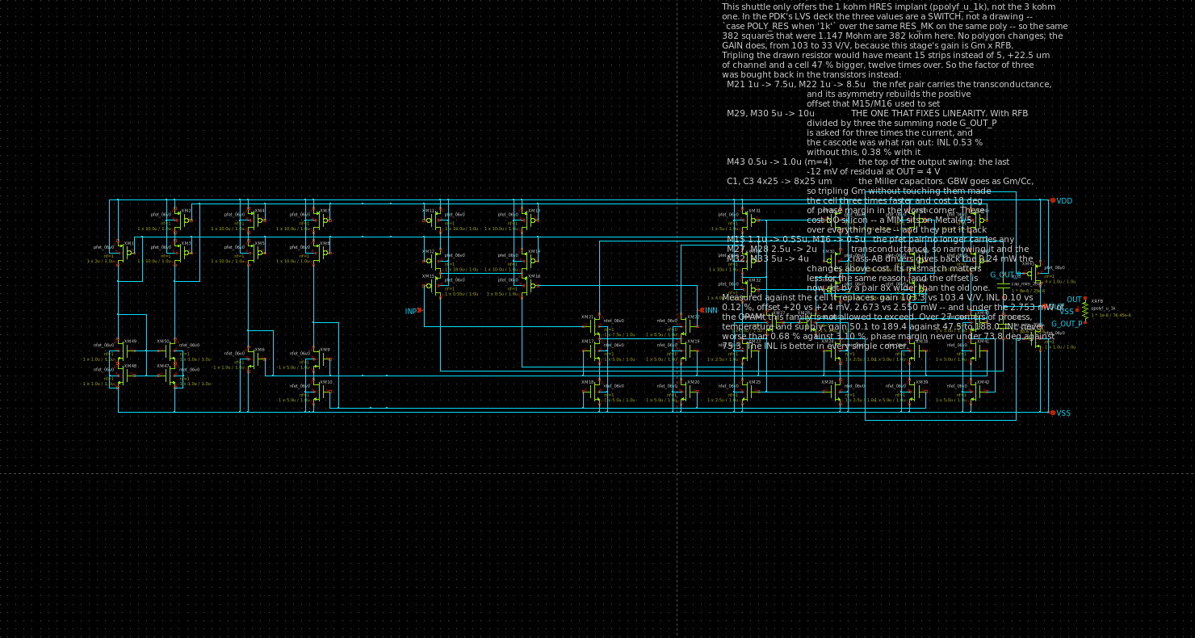
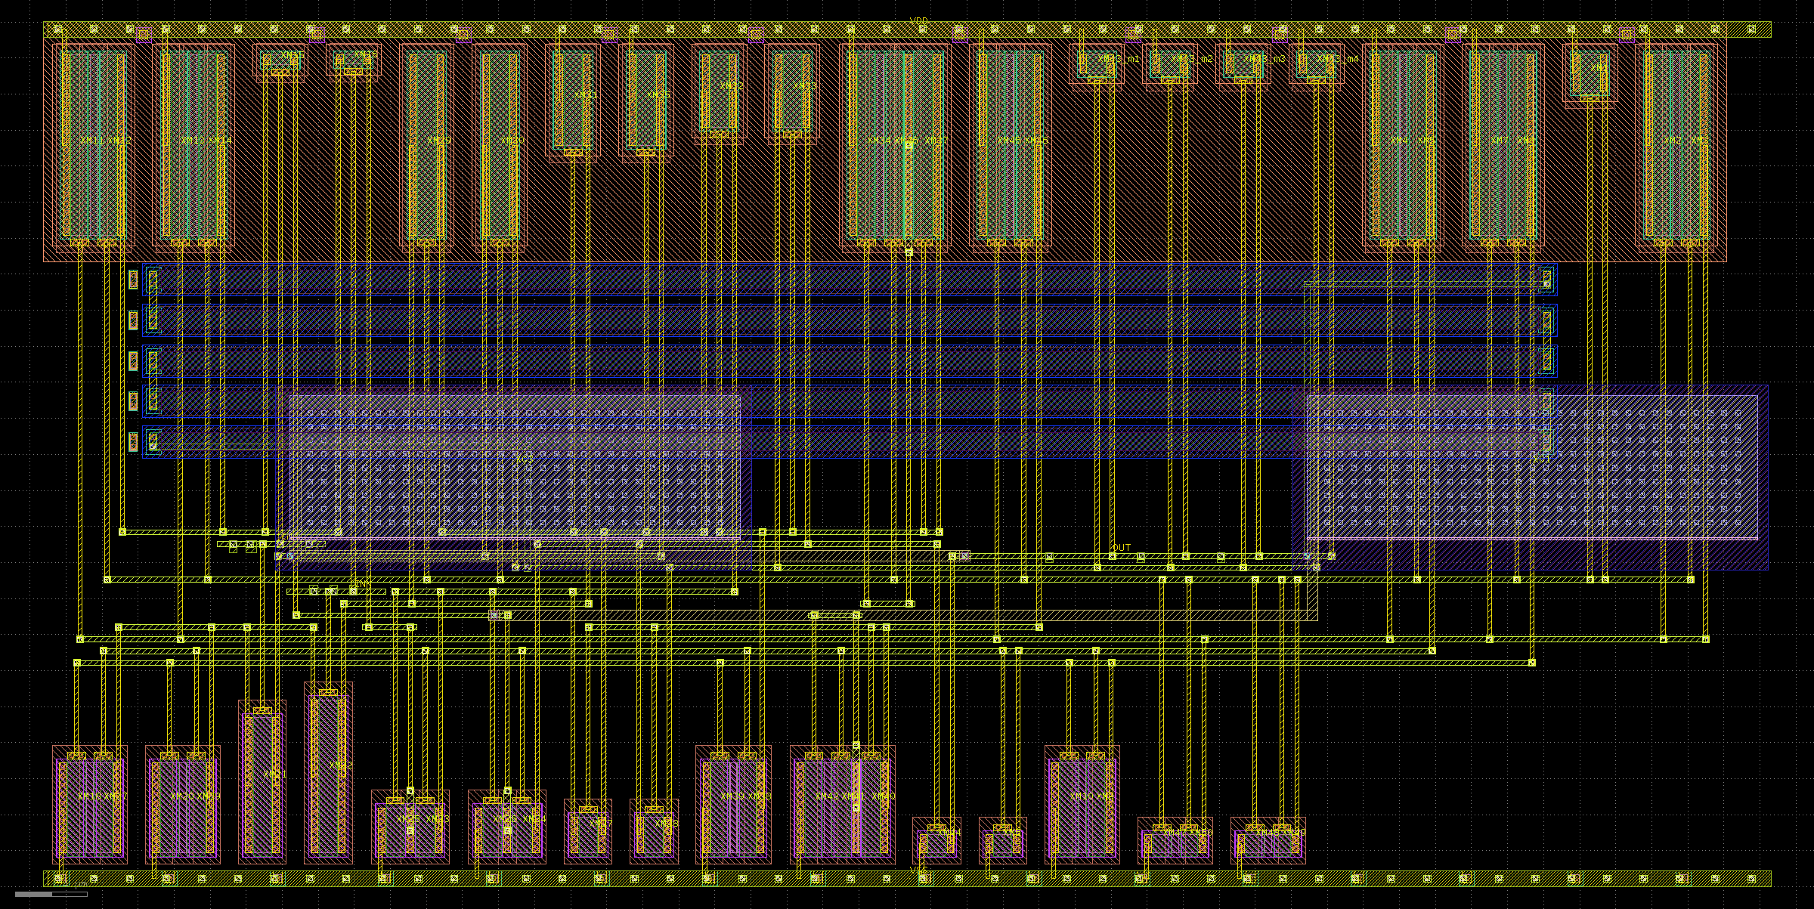
OPAM_LIN
40 dB linear amplifier. The first block in the chain.
schematic
layout — 95.88 × 48.05 µm

Slide 13
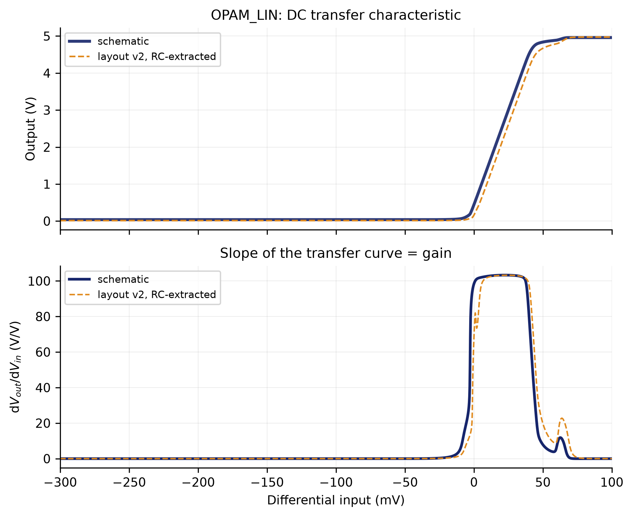
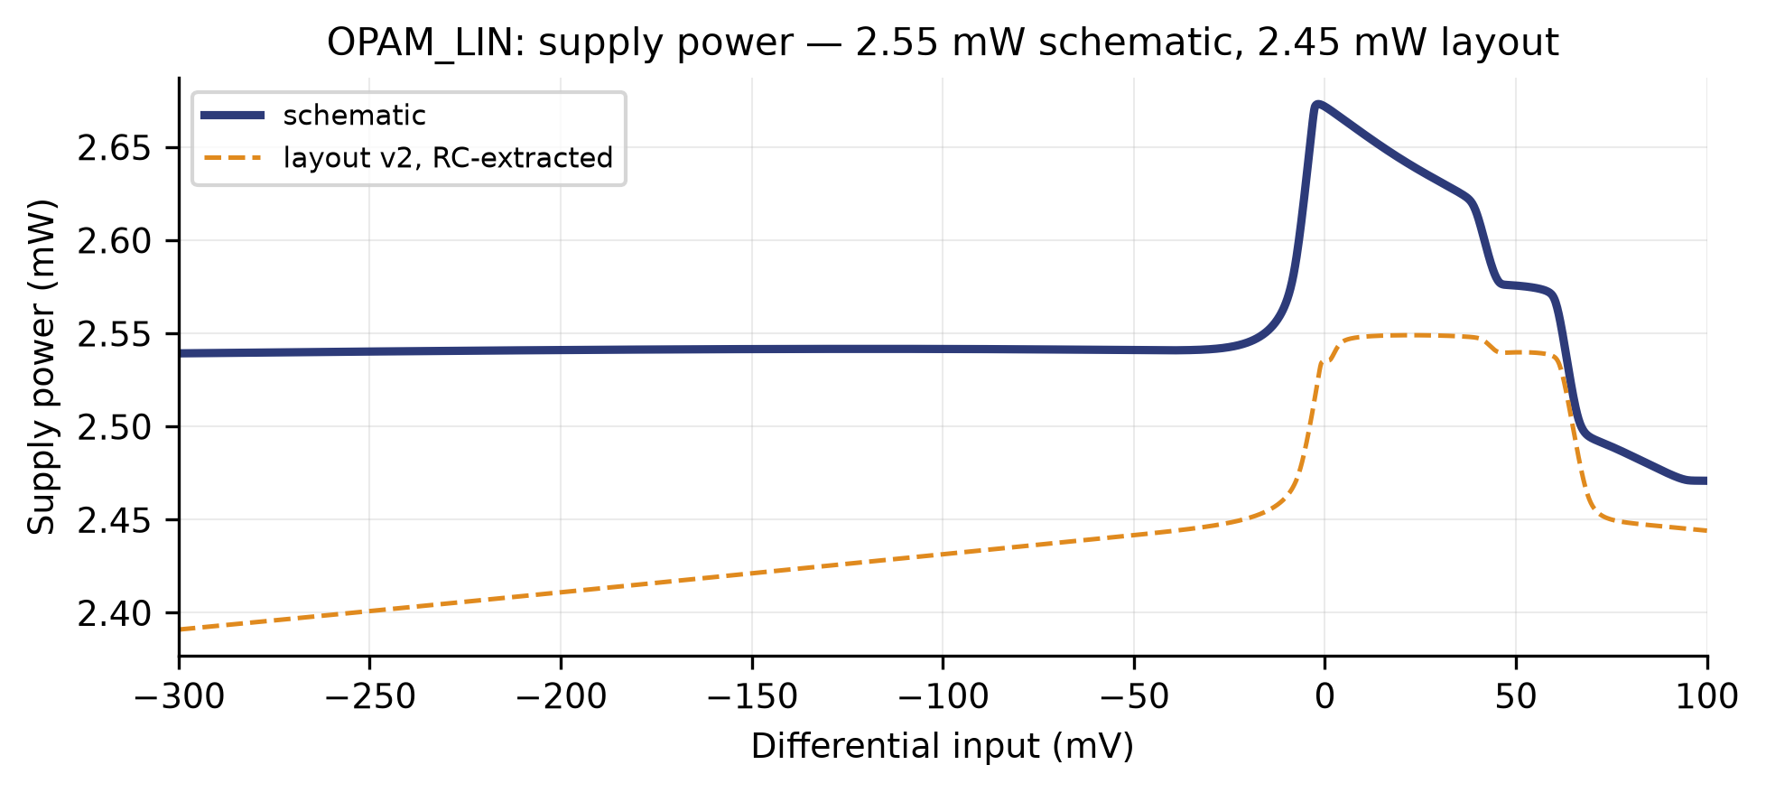
OPAM_LIN
input against output, and the slope that is the gain · supply power
supply power
input against output, and the slope that is the gain

Slide 14
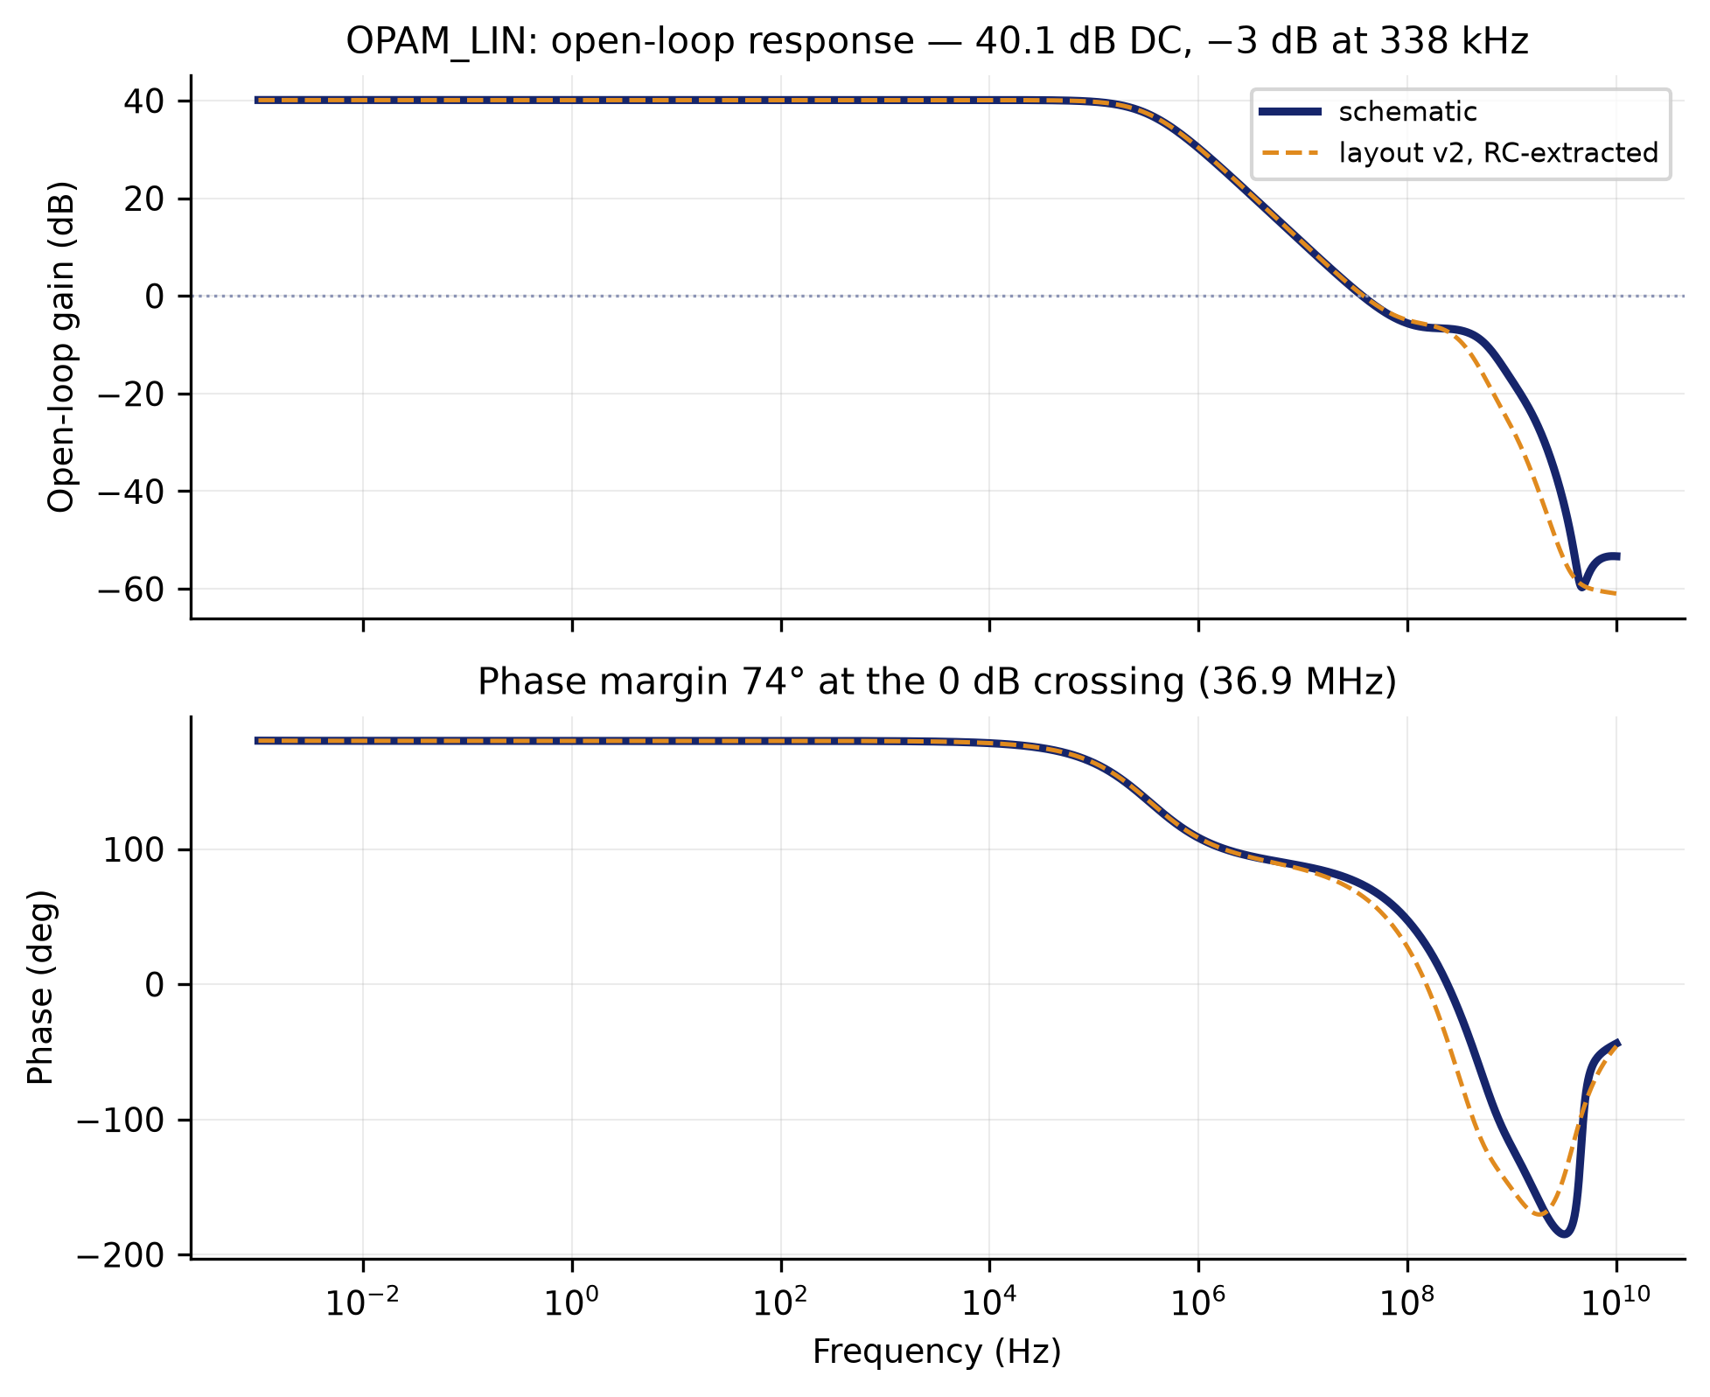
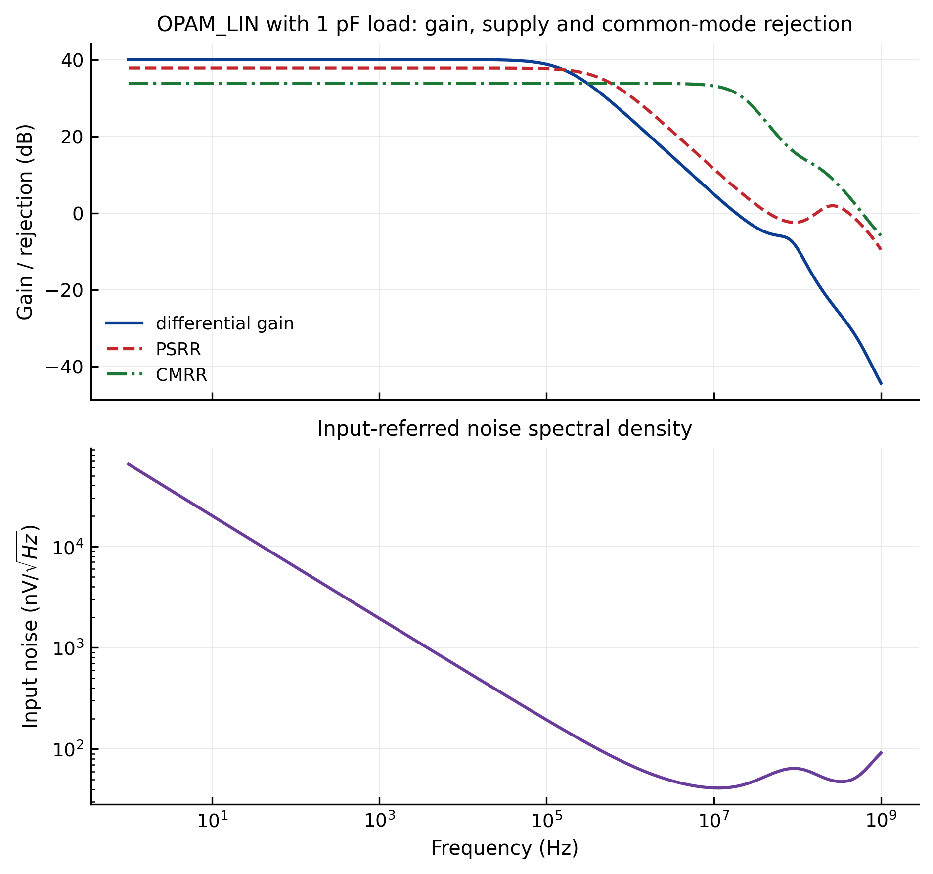
OPAM_LIN
frequency response · rejection and noise
frequency response
rejection and noise

Slide 15
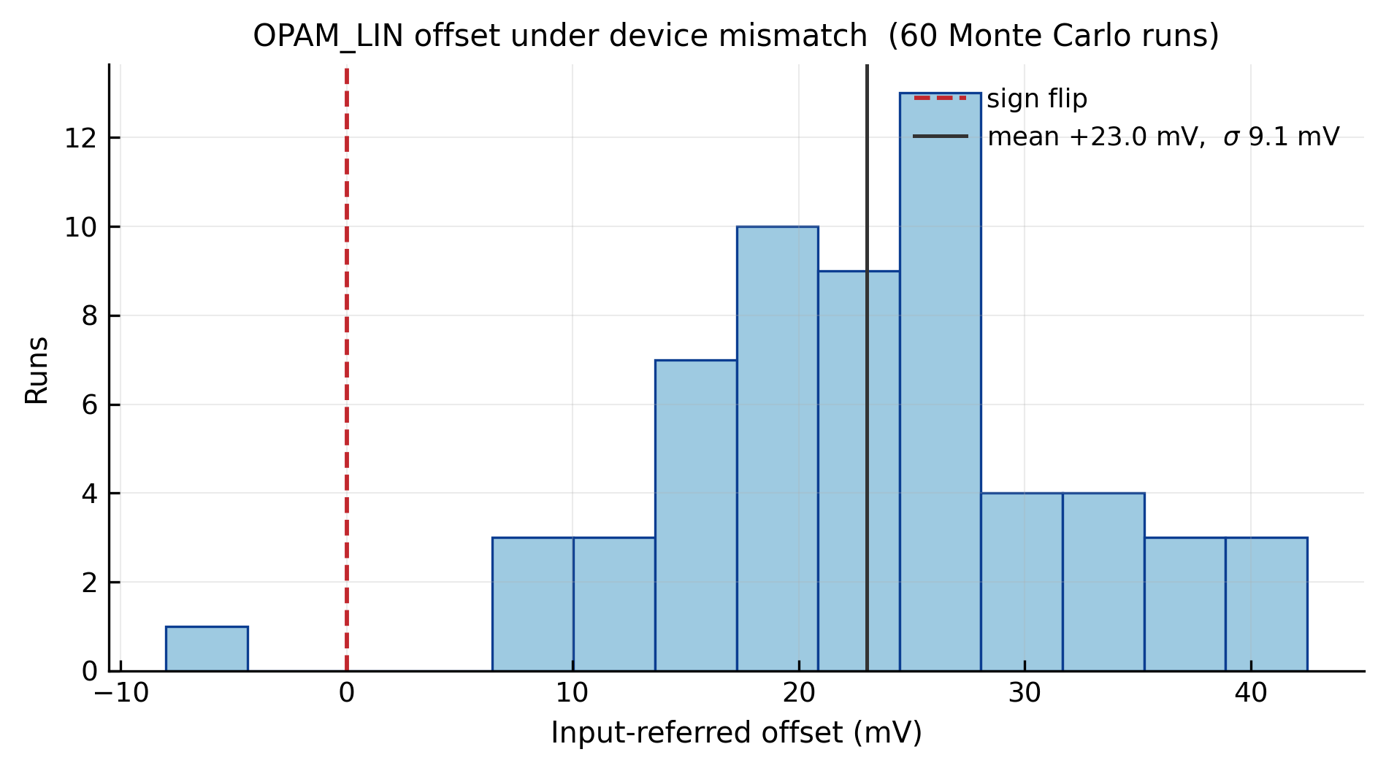
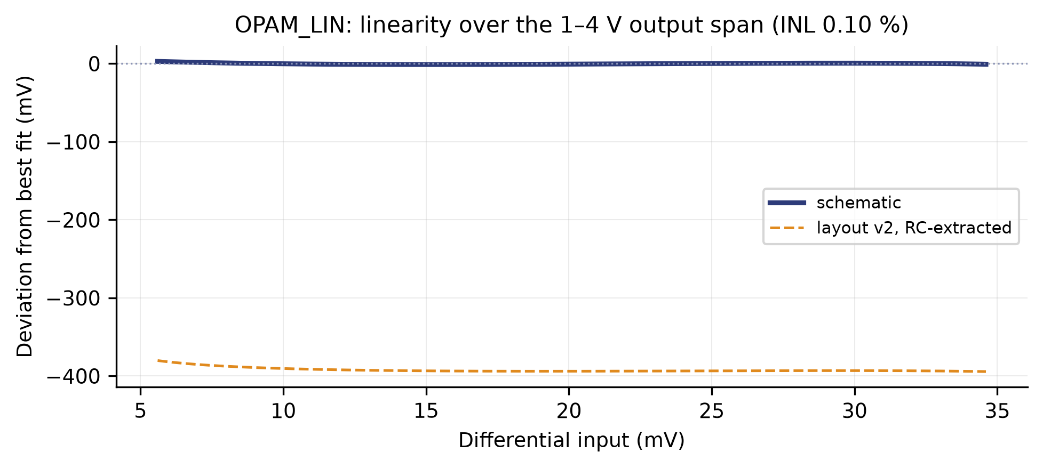
OPAM_LIN
linearity error · device-mismatch Monte Carlo
linearity error
device-mismatch Monte Carlo

Slide 16
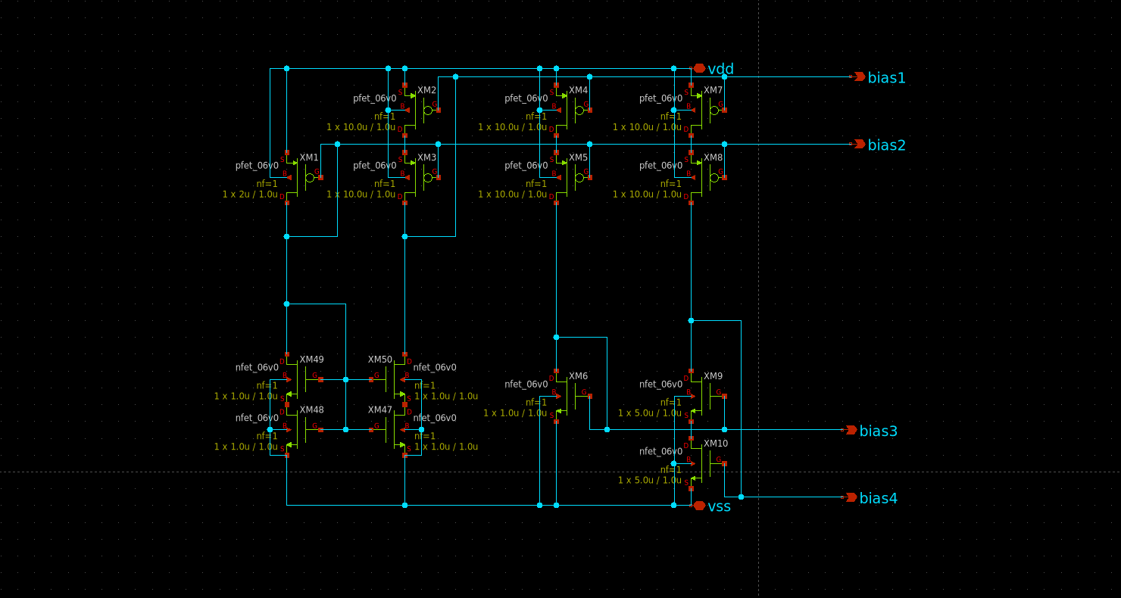
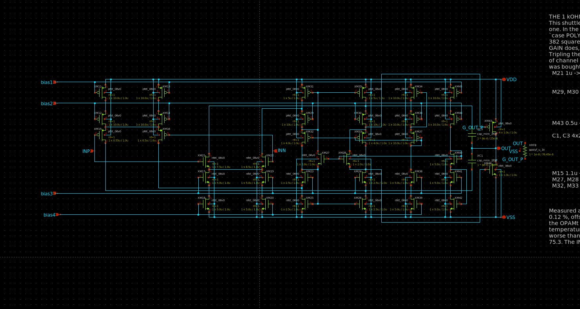
OPAM_LIN
Inside: the bias generator and the differential pair.
bias generator
differential pair (sub_diff_2_LIN)

Slide 17
COMP
Comparator. Turns the comparison of two axes into a level.
It does not compare against a fixed threshold: it compares two axes against each other.
That is why three comparators serve three axes — X against Y, X against Z, Y against Z. The decoder needs the ORDER of the three, not their values.
This is where the threshold that had to be corrected lives.
The second of the three findings at the end came out of this block: the trip point was not where it was believed to be, and the fine sweep measured it.
Parameter | Value
Function | compares two axes against each other
Supply | 5.0 V
Power | 3.08 mW
Input threshold | +7 µV schematic / +62 µV layout (2.5 V crossing)
Input for a high output | +50 µV schematic / +104 µV layout (>4.5 V)
Decision delay | 399 ns mean, 456 ns worst case
Noise | set by the amplifier ahead of it, not by this cell
Area | 99.60 × 31.46 µm = 0.0031 mm²
Instances | 12 (3 per GRADIENT2)

Slide 18
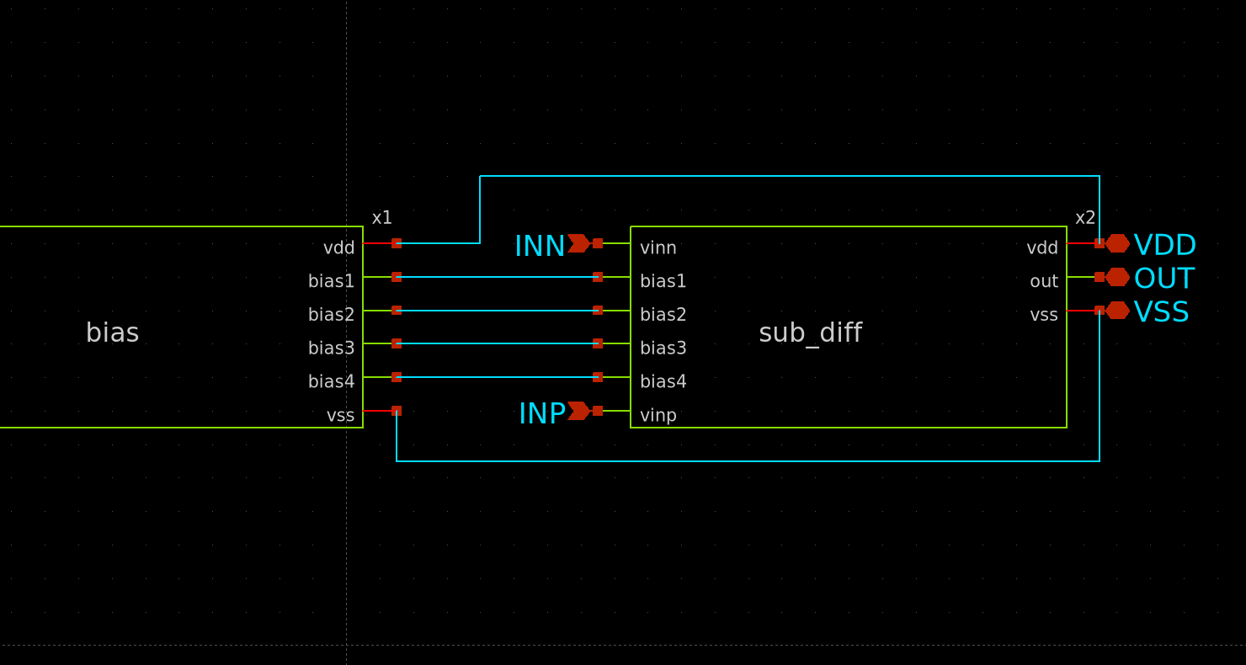
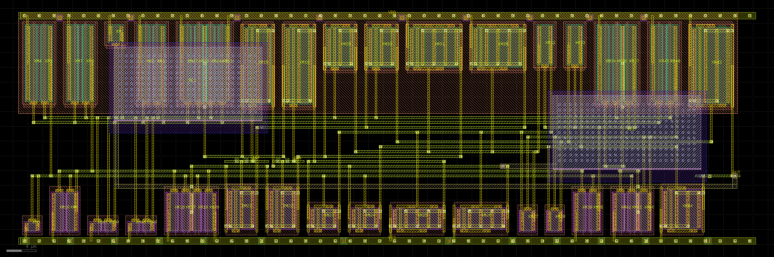
COMP
Comparator. Turns the comparison of two axes into a level.
layout — 99.60 × 31.46 µm
schematic

Slide 19
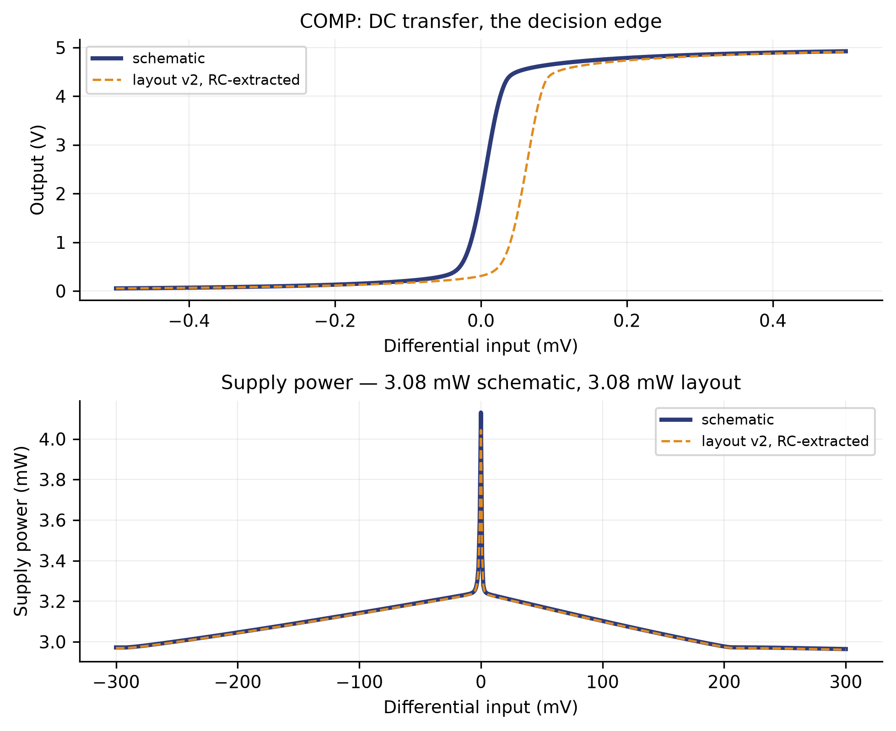
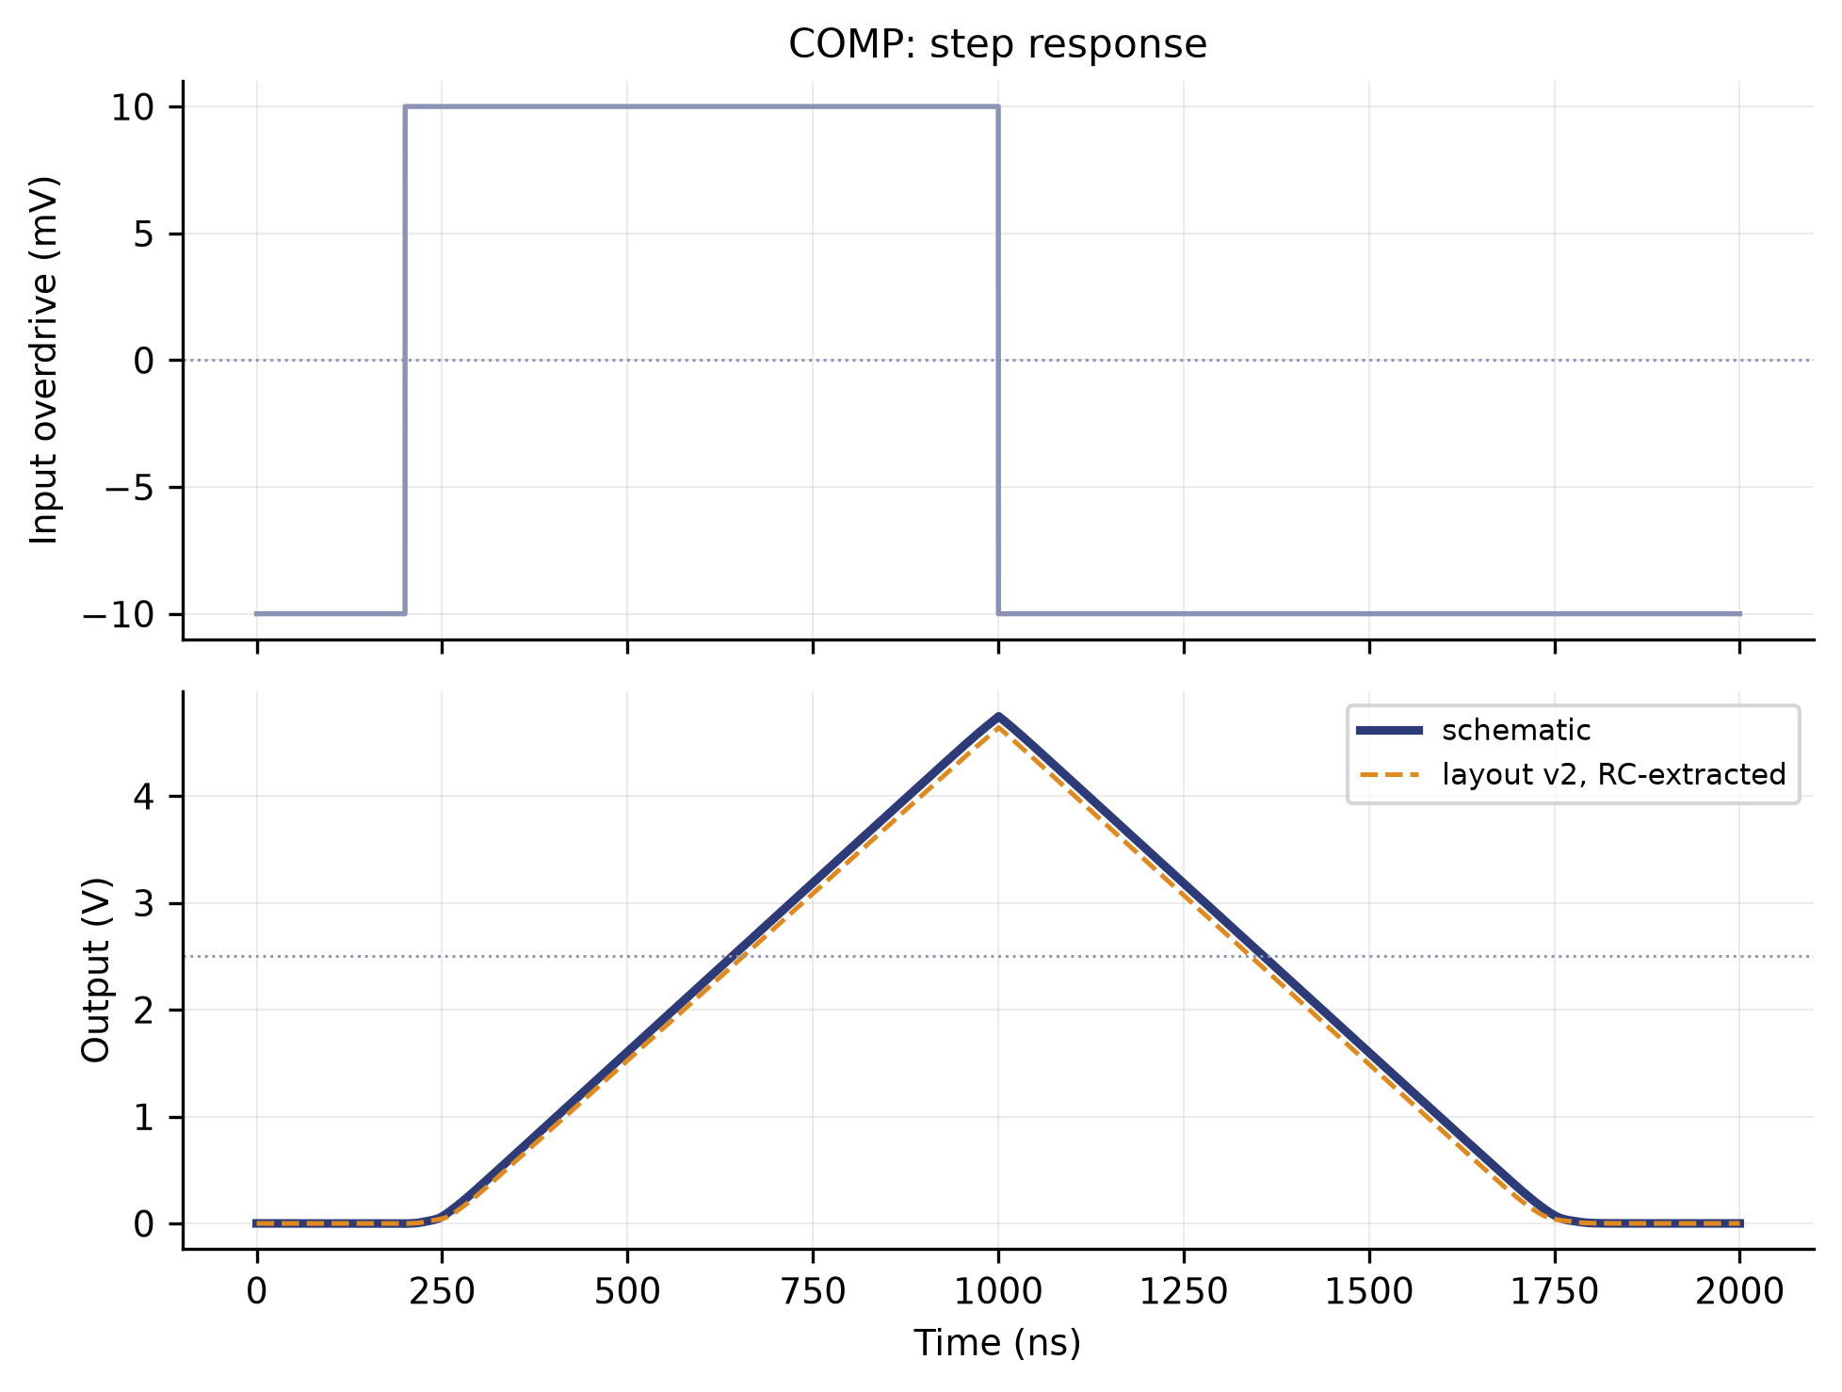
COMP
transfer and power · step response
step response
transfer and power

Slide 20
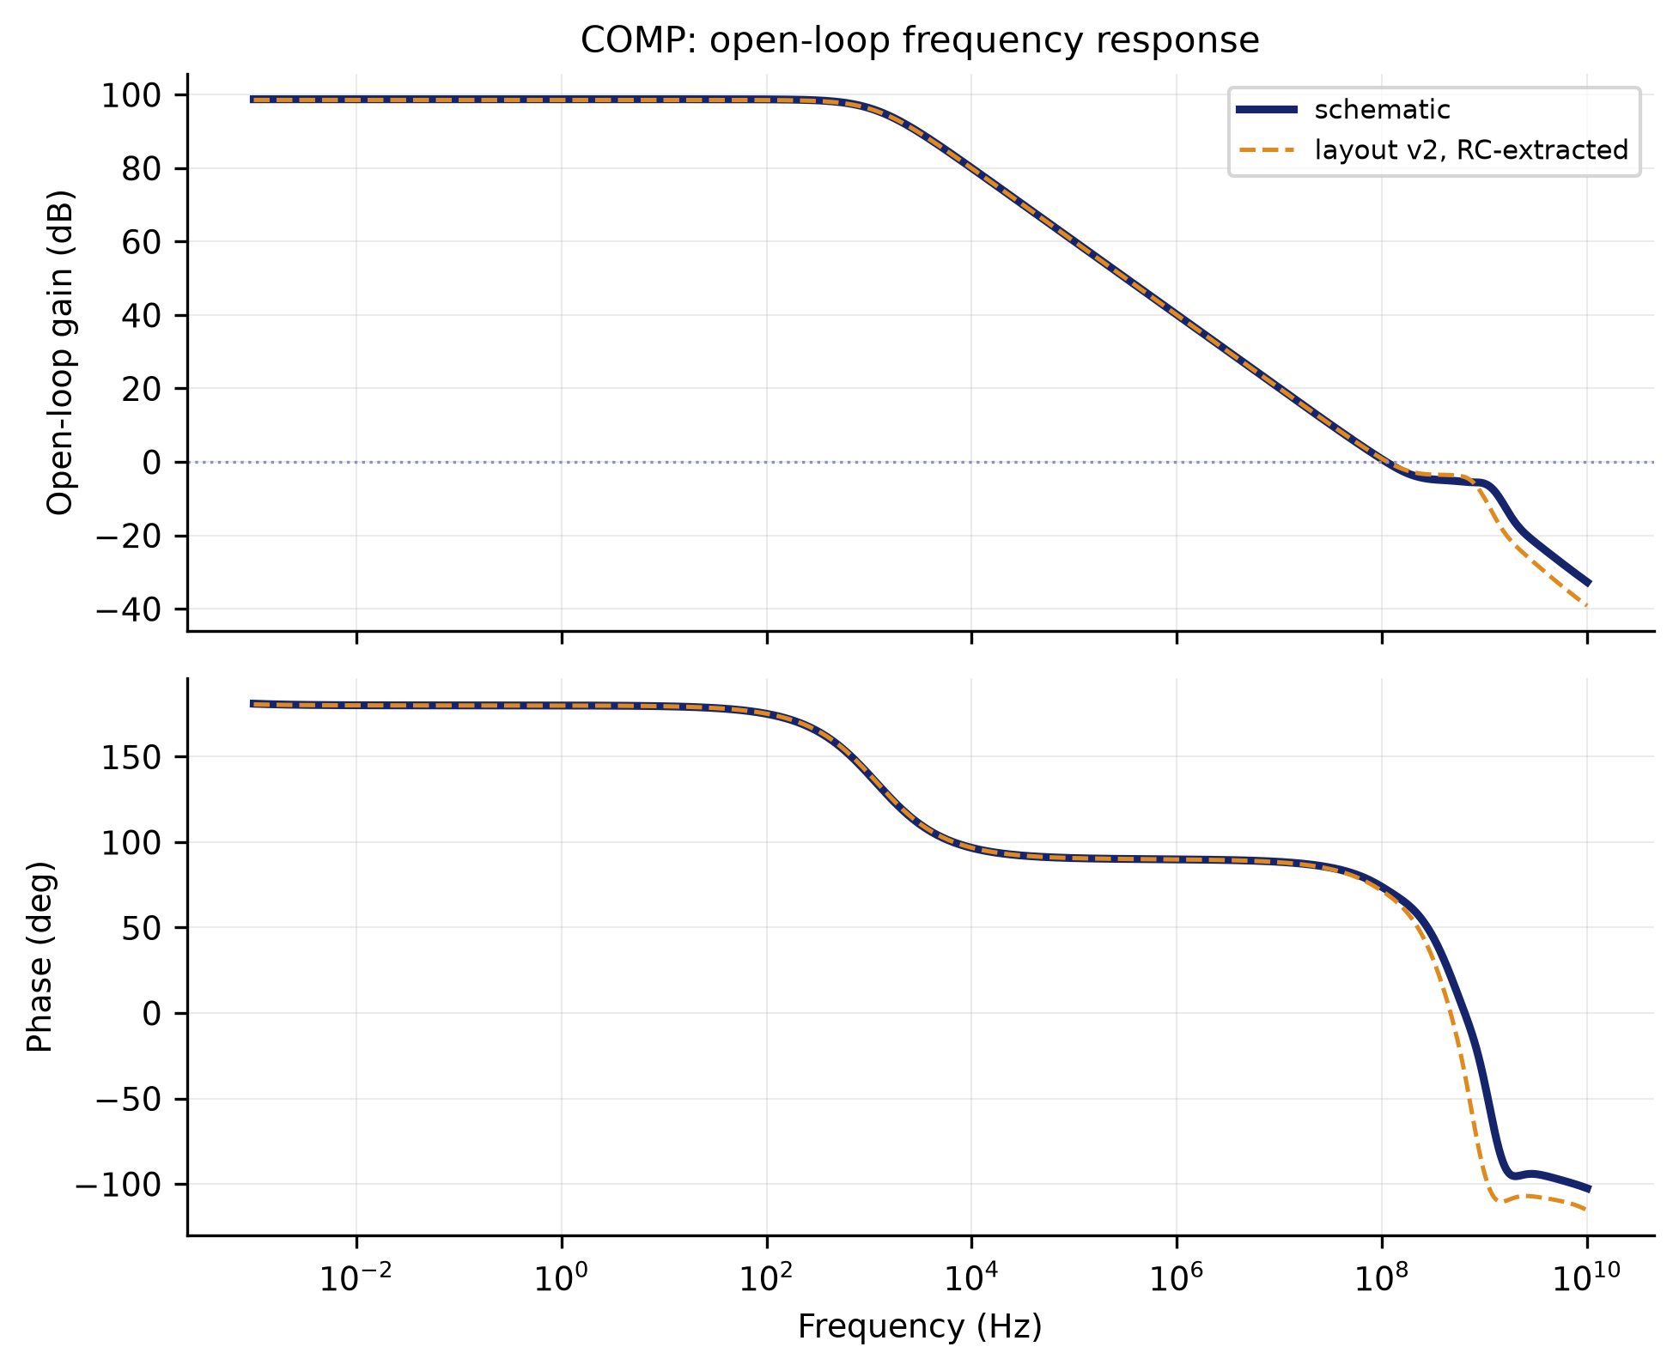
COMP
frequency response
XSCHEM/TEST — schematic vs layout v2

Slide 21
DECODER
Decides which axis wins from the three comparisons.
XY, XZ, YZ go in. X, Y or Z comes out.
Pure logic: the three pairwise comparisons determine an order, and the order determines the winner. It is the smallest block in the chain and the lowest-power by three orders of magnitude.
This is where the Z-axis problem showed up.
Z could never win. What fixed it was not raising its weight but changing the order within each triple.
Parameter | Value
Function | three comparisons to one winning axis
Supply | 5.0 V
Power | 1.4 µW
Area | 31.76 × 13.82 µm = 0.0004 mm²
Instances | 4 (one per GRADIENT2)

Slide 22
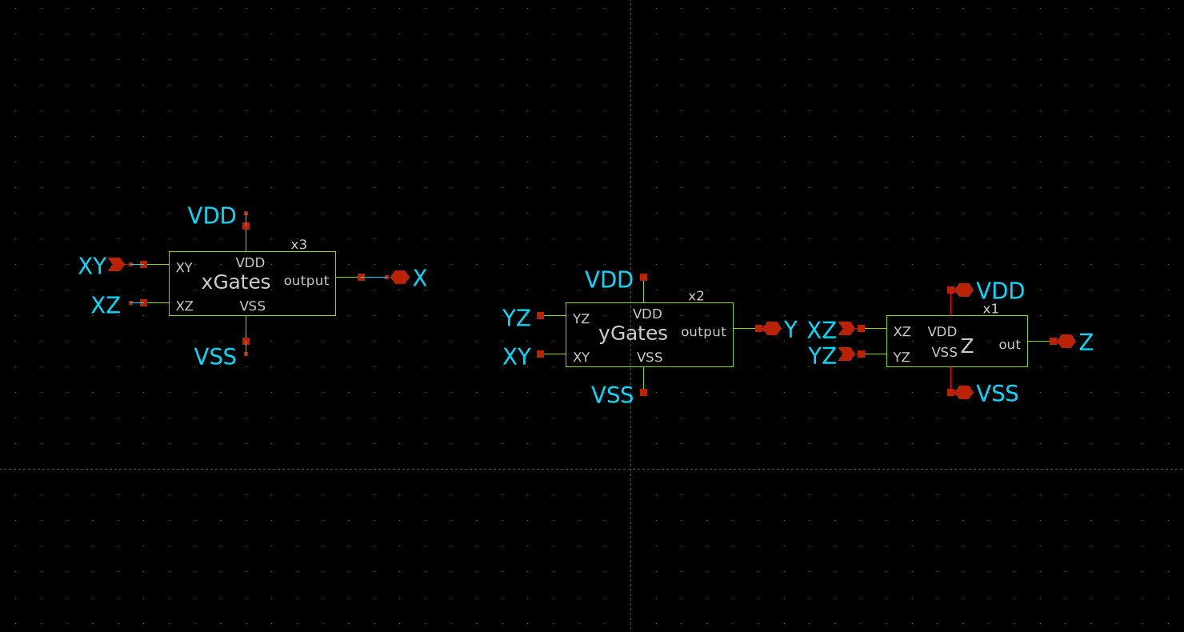
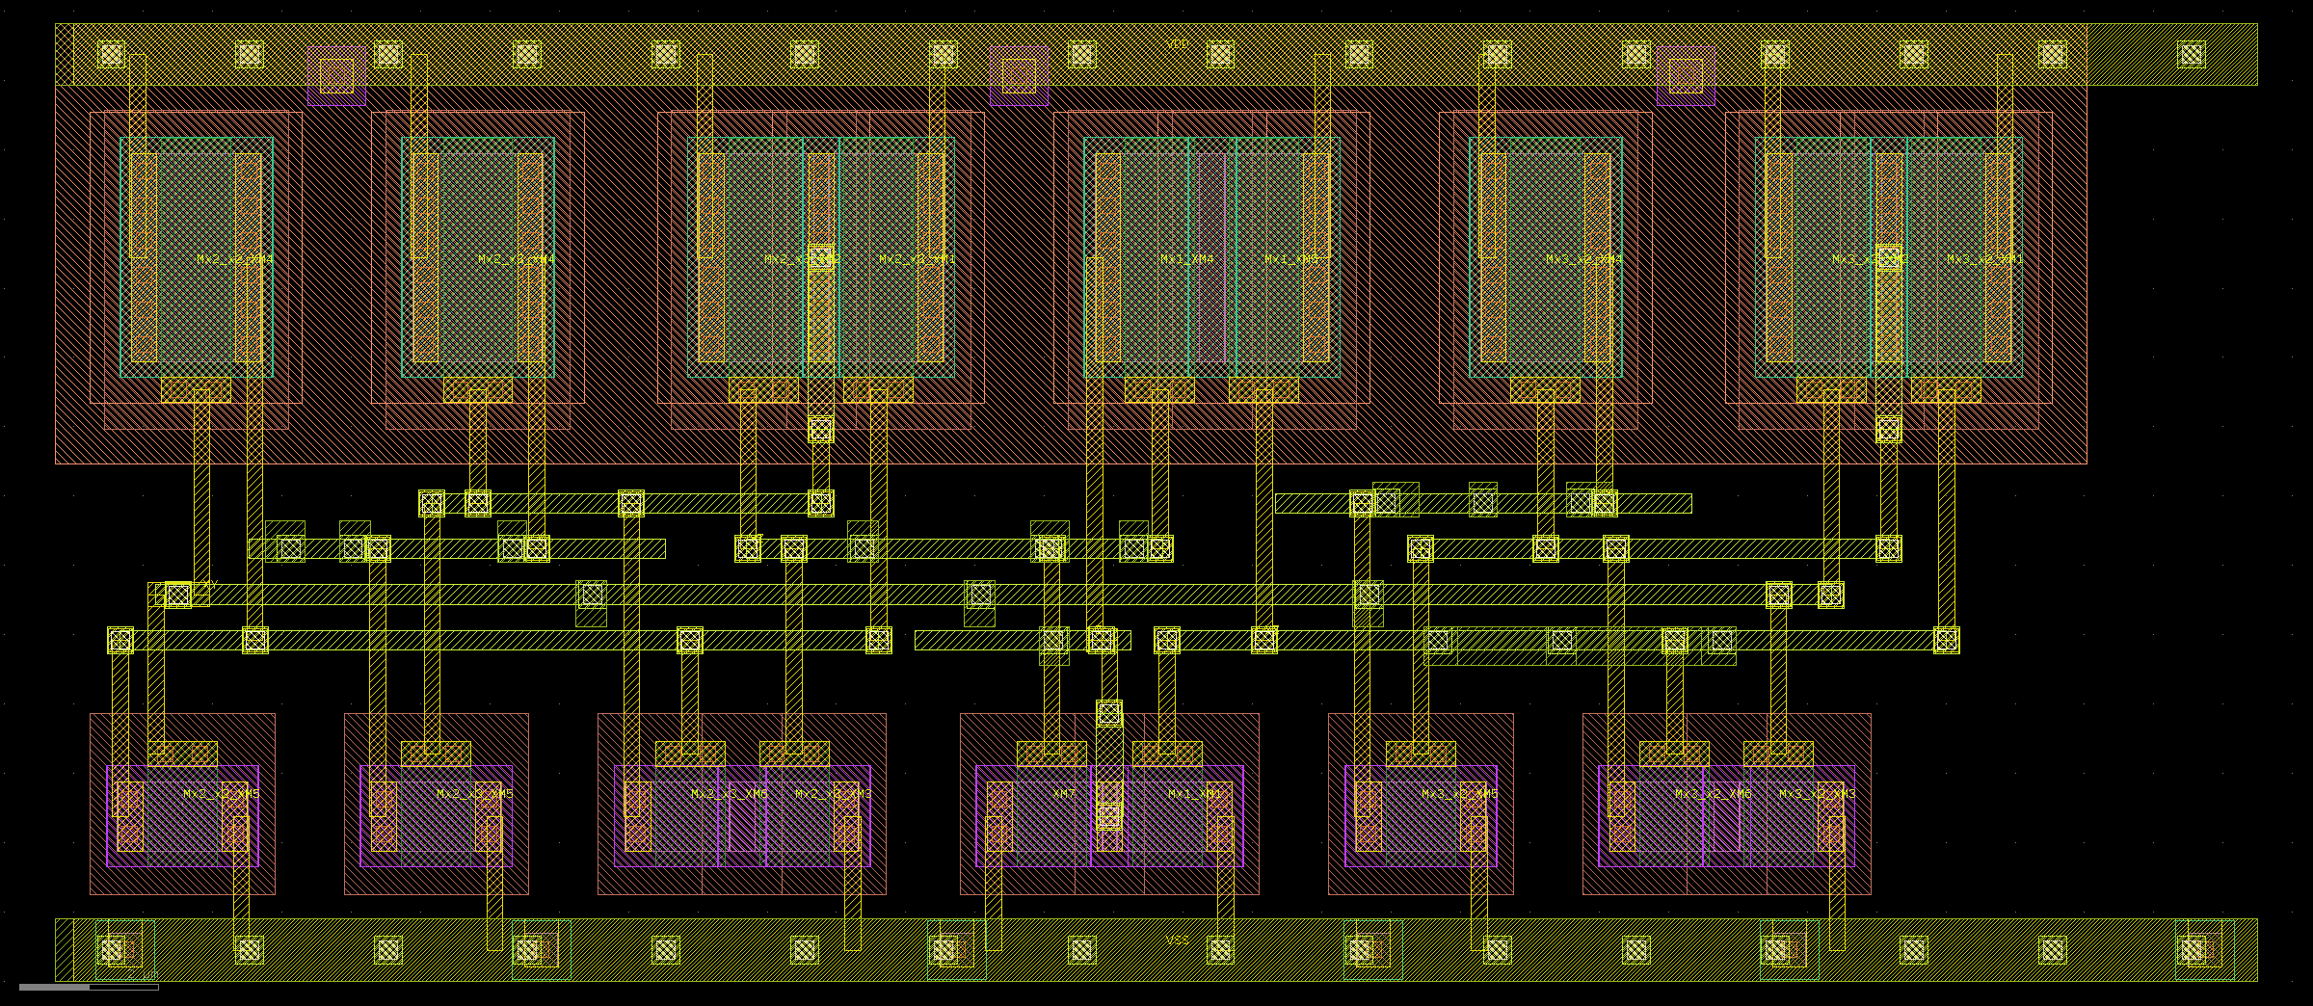
DECODER
Decides which axis wins from the three comparisons.
layout — 31.76 × 13.82 µm
schematic

Slide 23
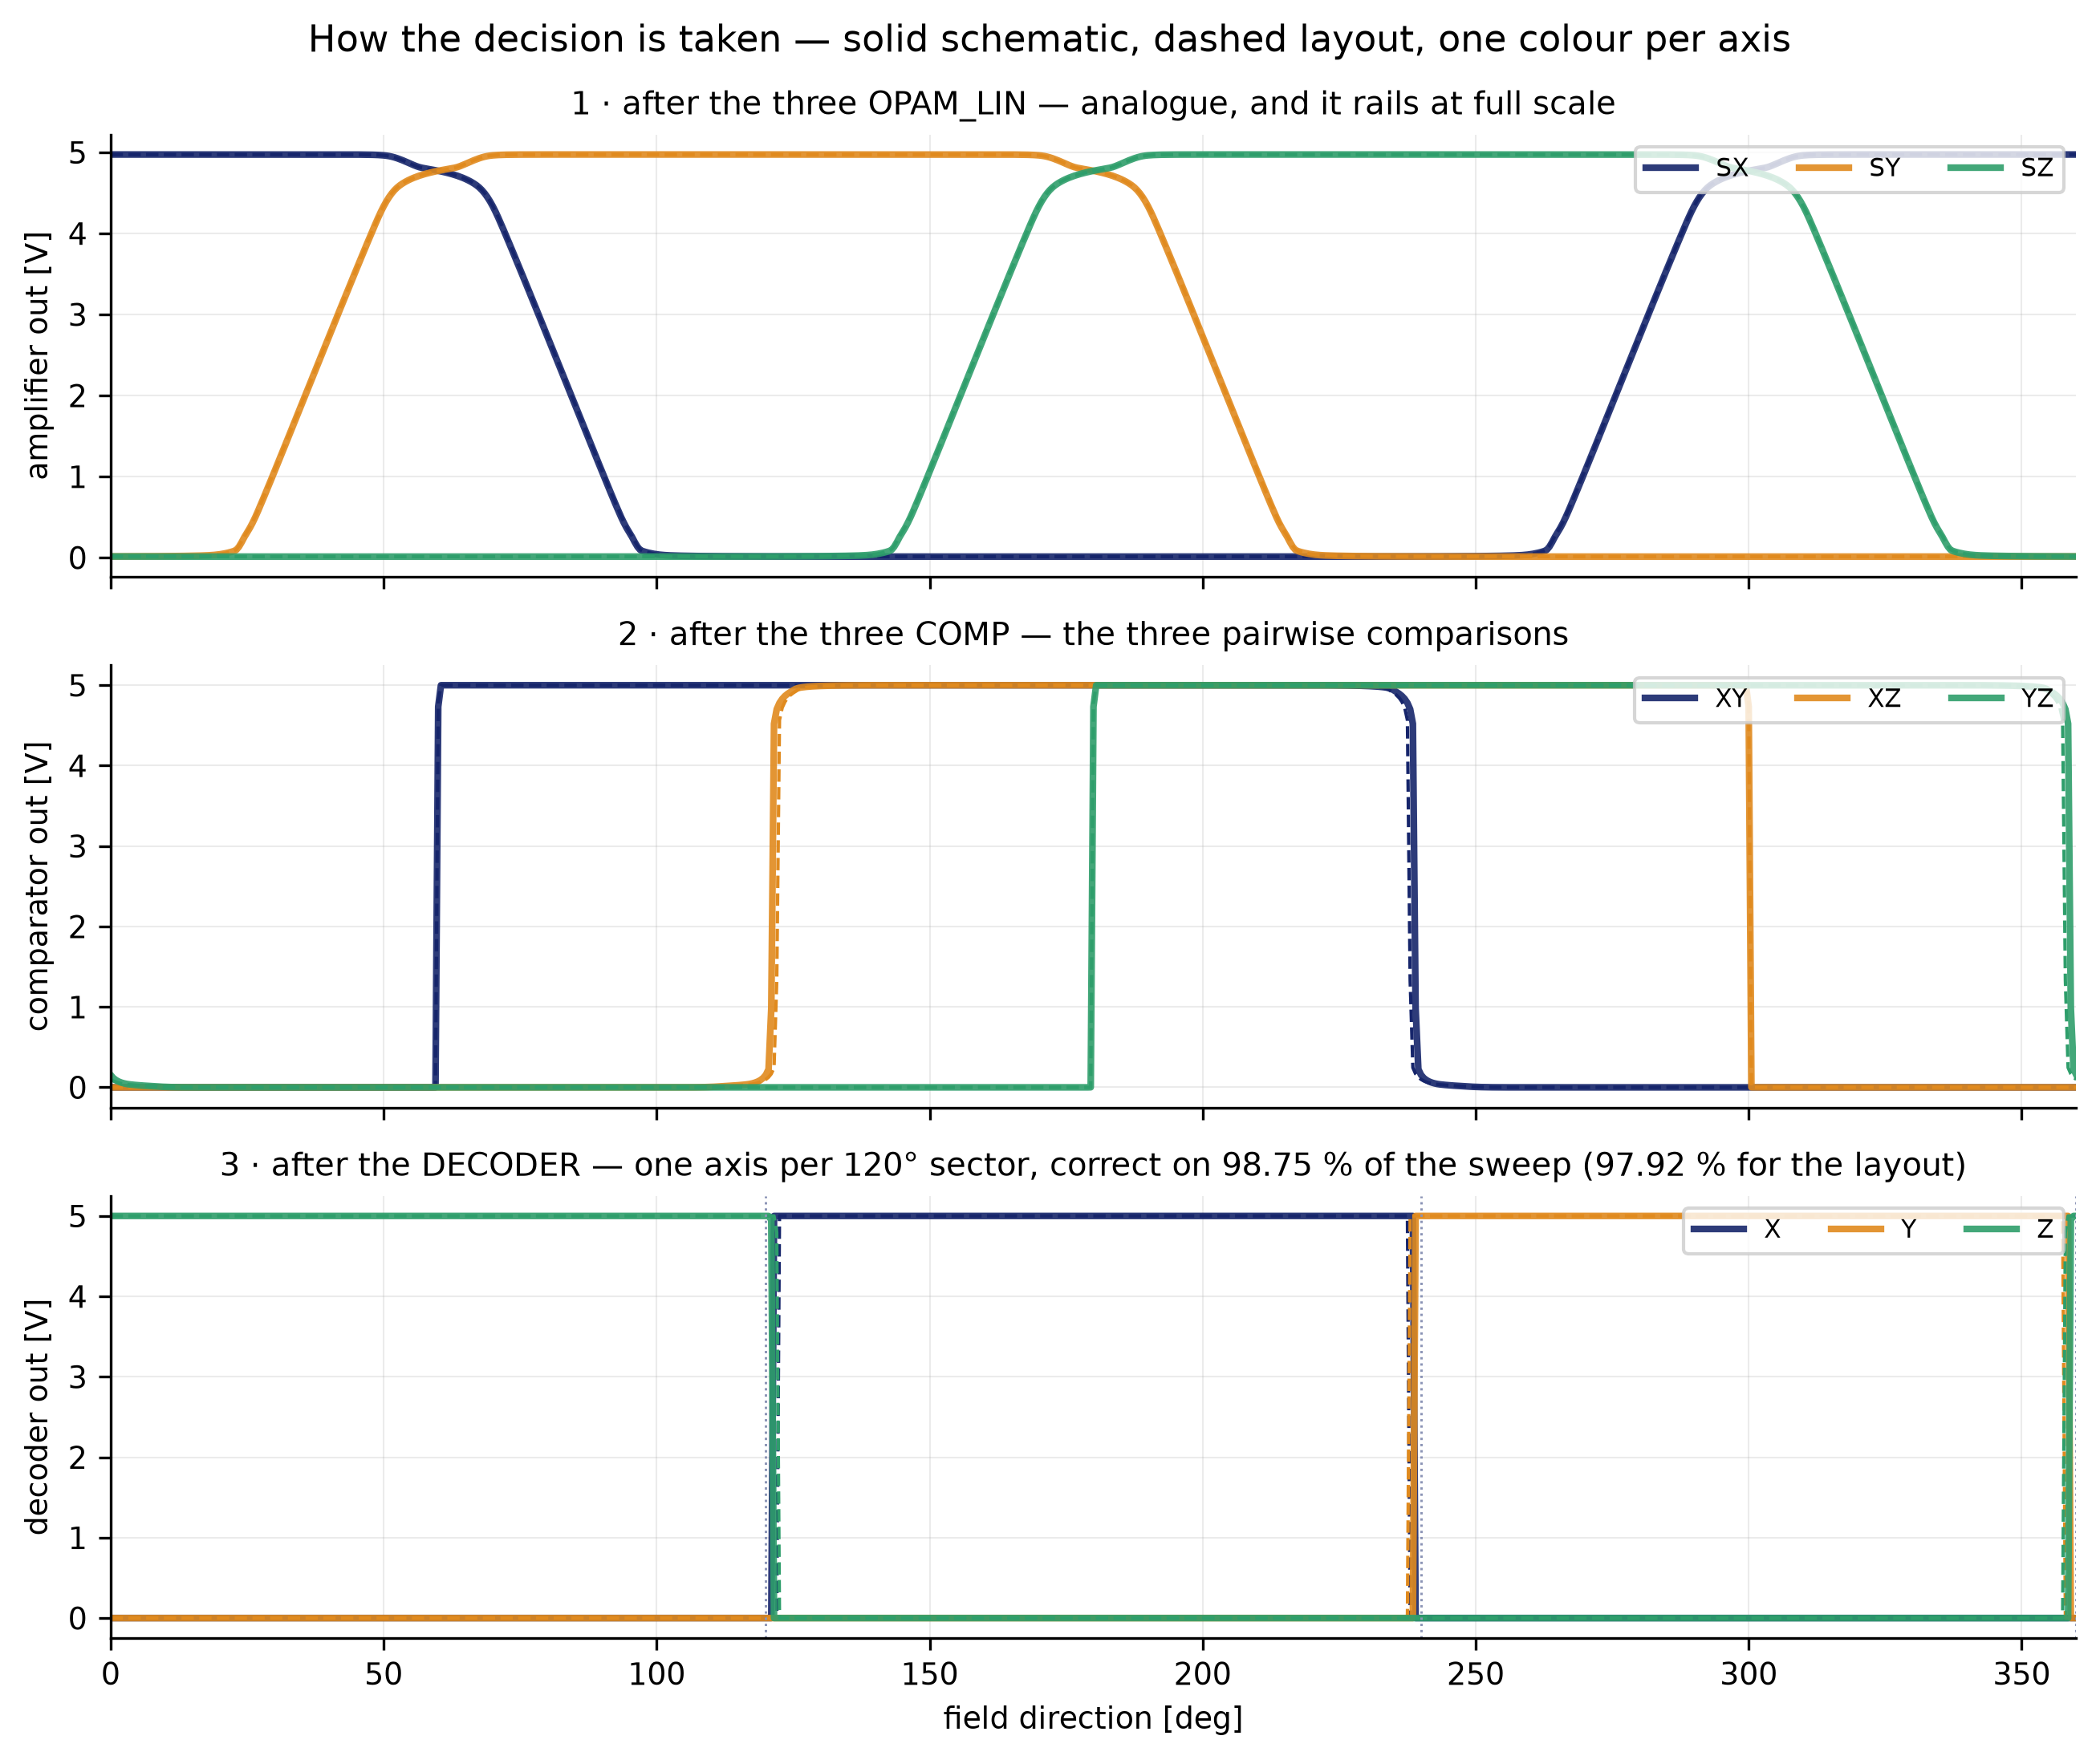
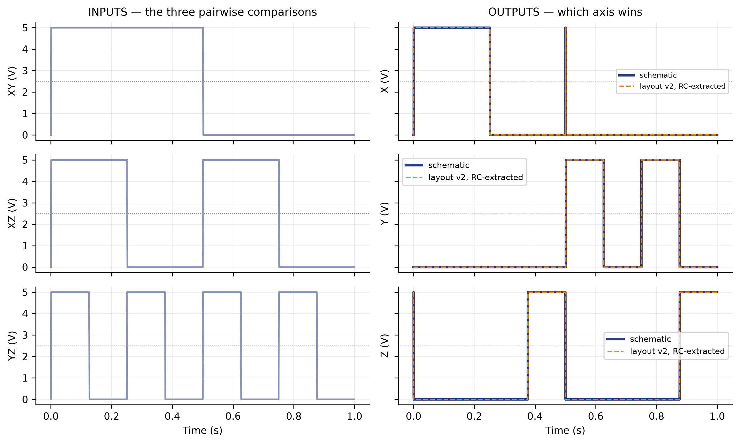
DECODER
logic · how the decision is taken, and how accurate it is
logic
how the decision is taken, and how accurate it is

Slide 24
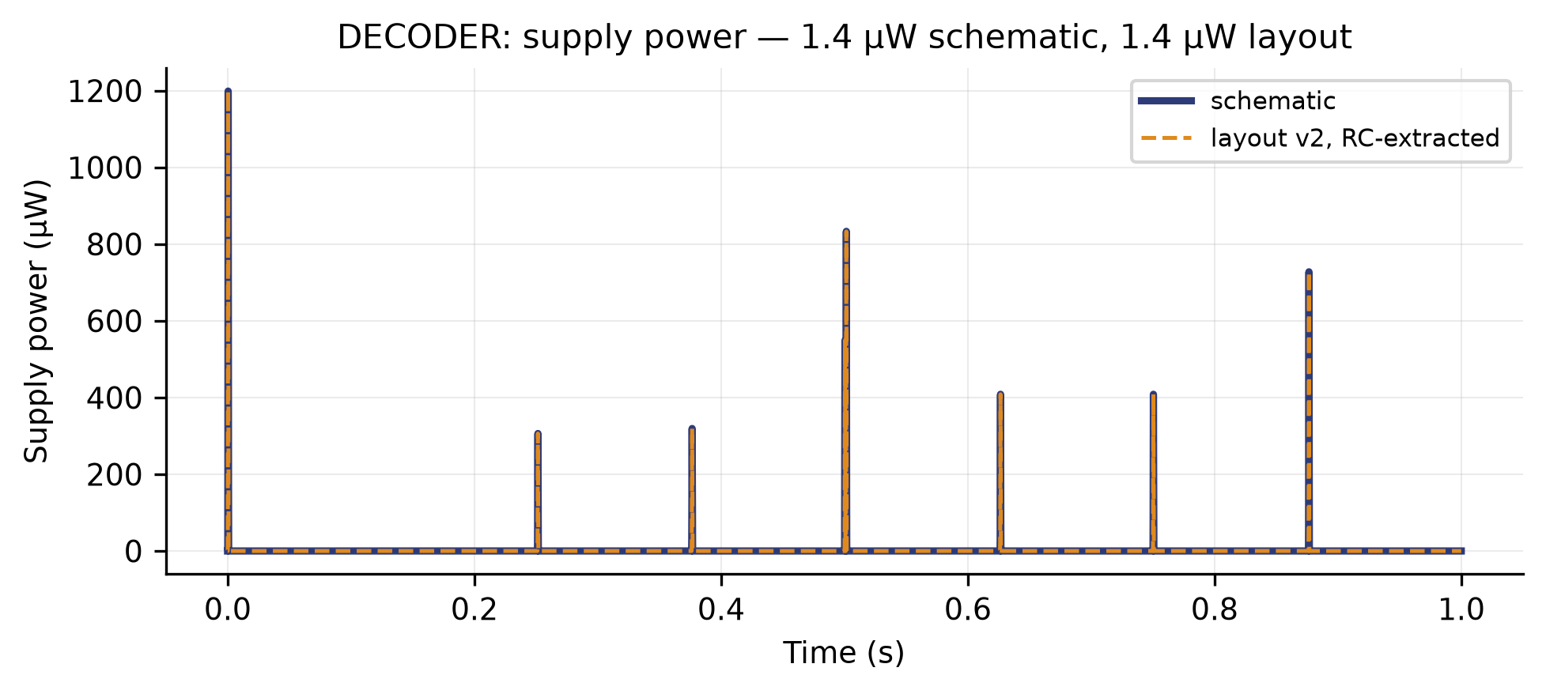
DECODER
supply power
XSCHEM/TEST — schematic vs layout v2

Slide 25
GRADIENT BENCH · METHOD
run_gradient.sh — three bridges, and only the linear amplifier.
Two chains hung off the SAME six sensor nodes:
G2 — the schematic GRADIENT2, with the 40 dB OPAM_LIN
G4 — the same circuit rebuilt from the v2 layout, with OPAM_LIN_flat and extracted with RC parasitics
It is the same amplifier drawn two ways.
So every comparison in this section is layout against schematic, never one amplifier against another.
What it measures: the three fields are 120° apart, sum to zero, and the vector only changes direction.
Sweeping 0 to 360° each axis should win a sector of exactly 120°. The figures are how far those three boundaries drift and on what percentage of the sweep the decoded axis is the right one.

Slide 26
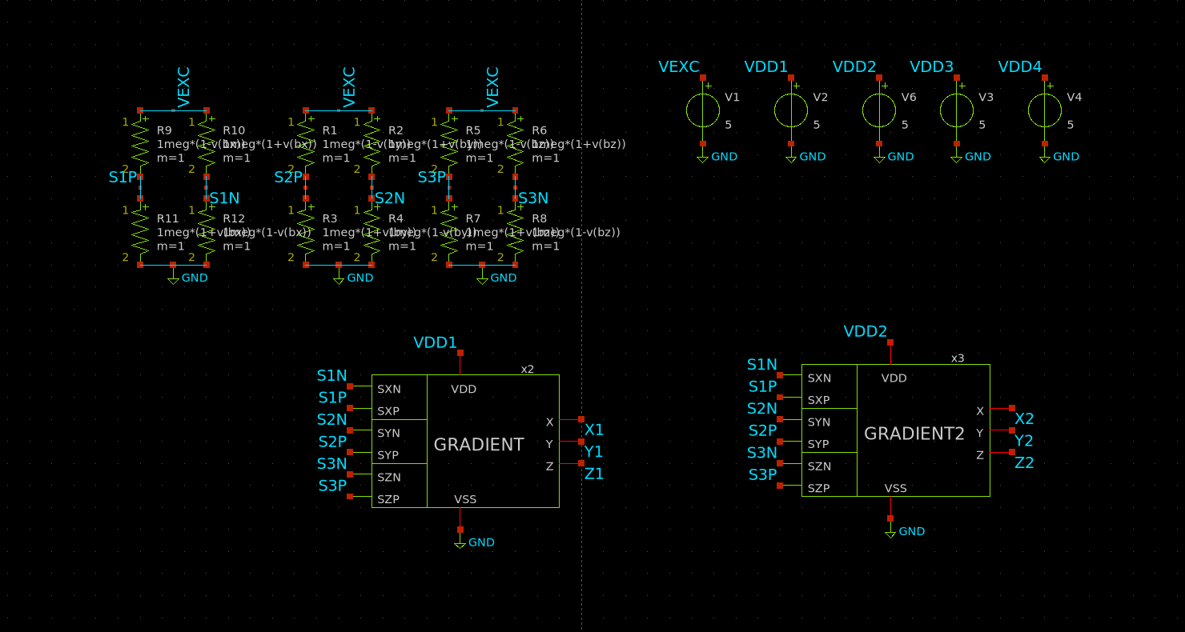
GRADIENT BENCH · METHOD
run_gradient.sh — three bridges, and only the linear amplifier.
XSCHEM/TEST_TOTAL/test_GRADIENT.sch

Slide 27
SENSING TRACEABILITY
One signal, four stages: bridge → amplifier → comparator → decoder.
The SAME signal is followed through the sensing block's four stages.
The bench already records every intermediate node, including the ones with no name: the comparator outputs are probed hierarchically.
At each stage, schematic and layout on top of each other.
Only the linear amplifier: G2, the schematic, against G4, the layout.
And at the end, on what percentage of the sweep the decoded axis is the right one.

Slide 28
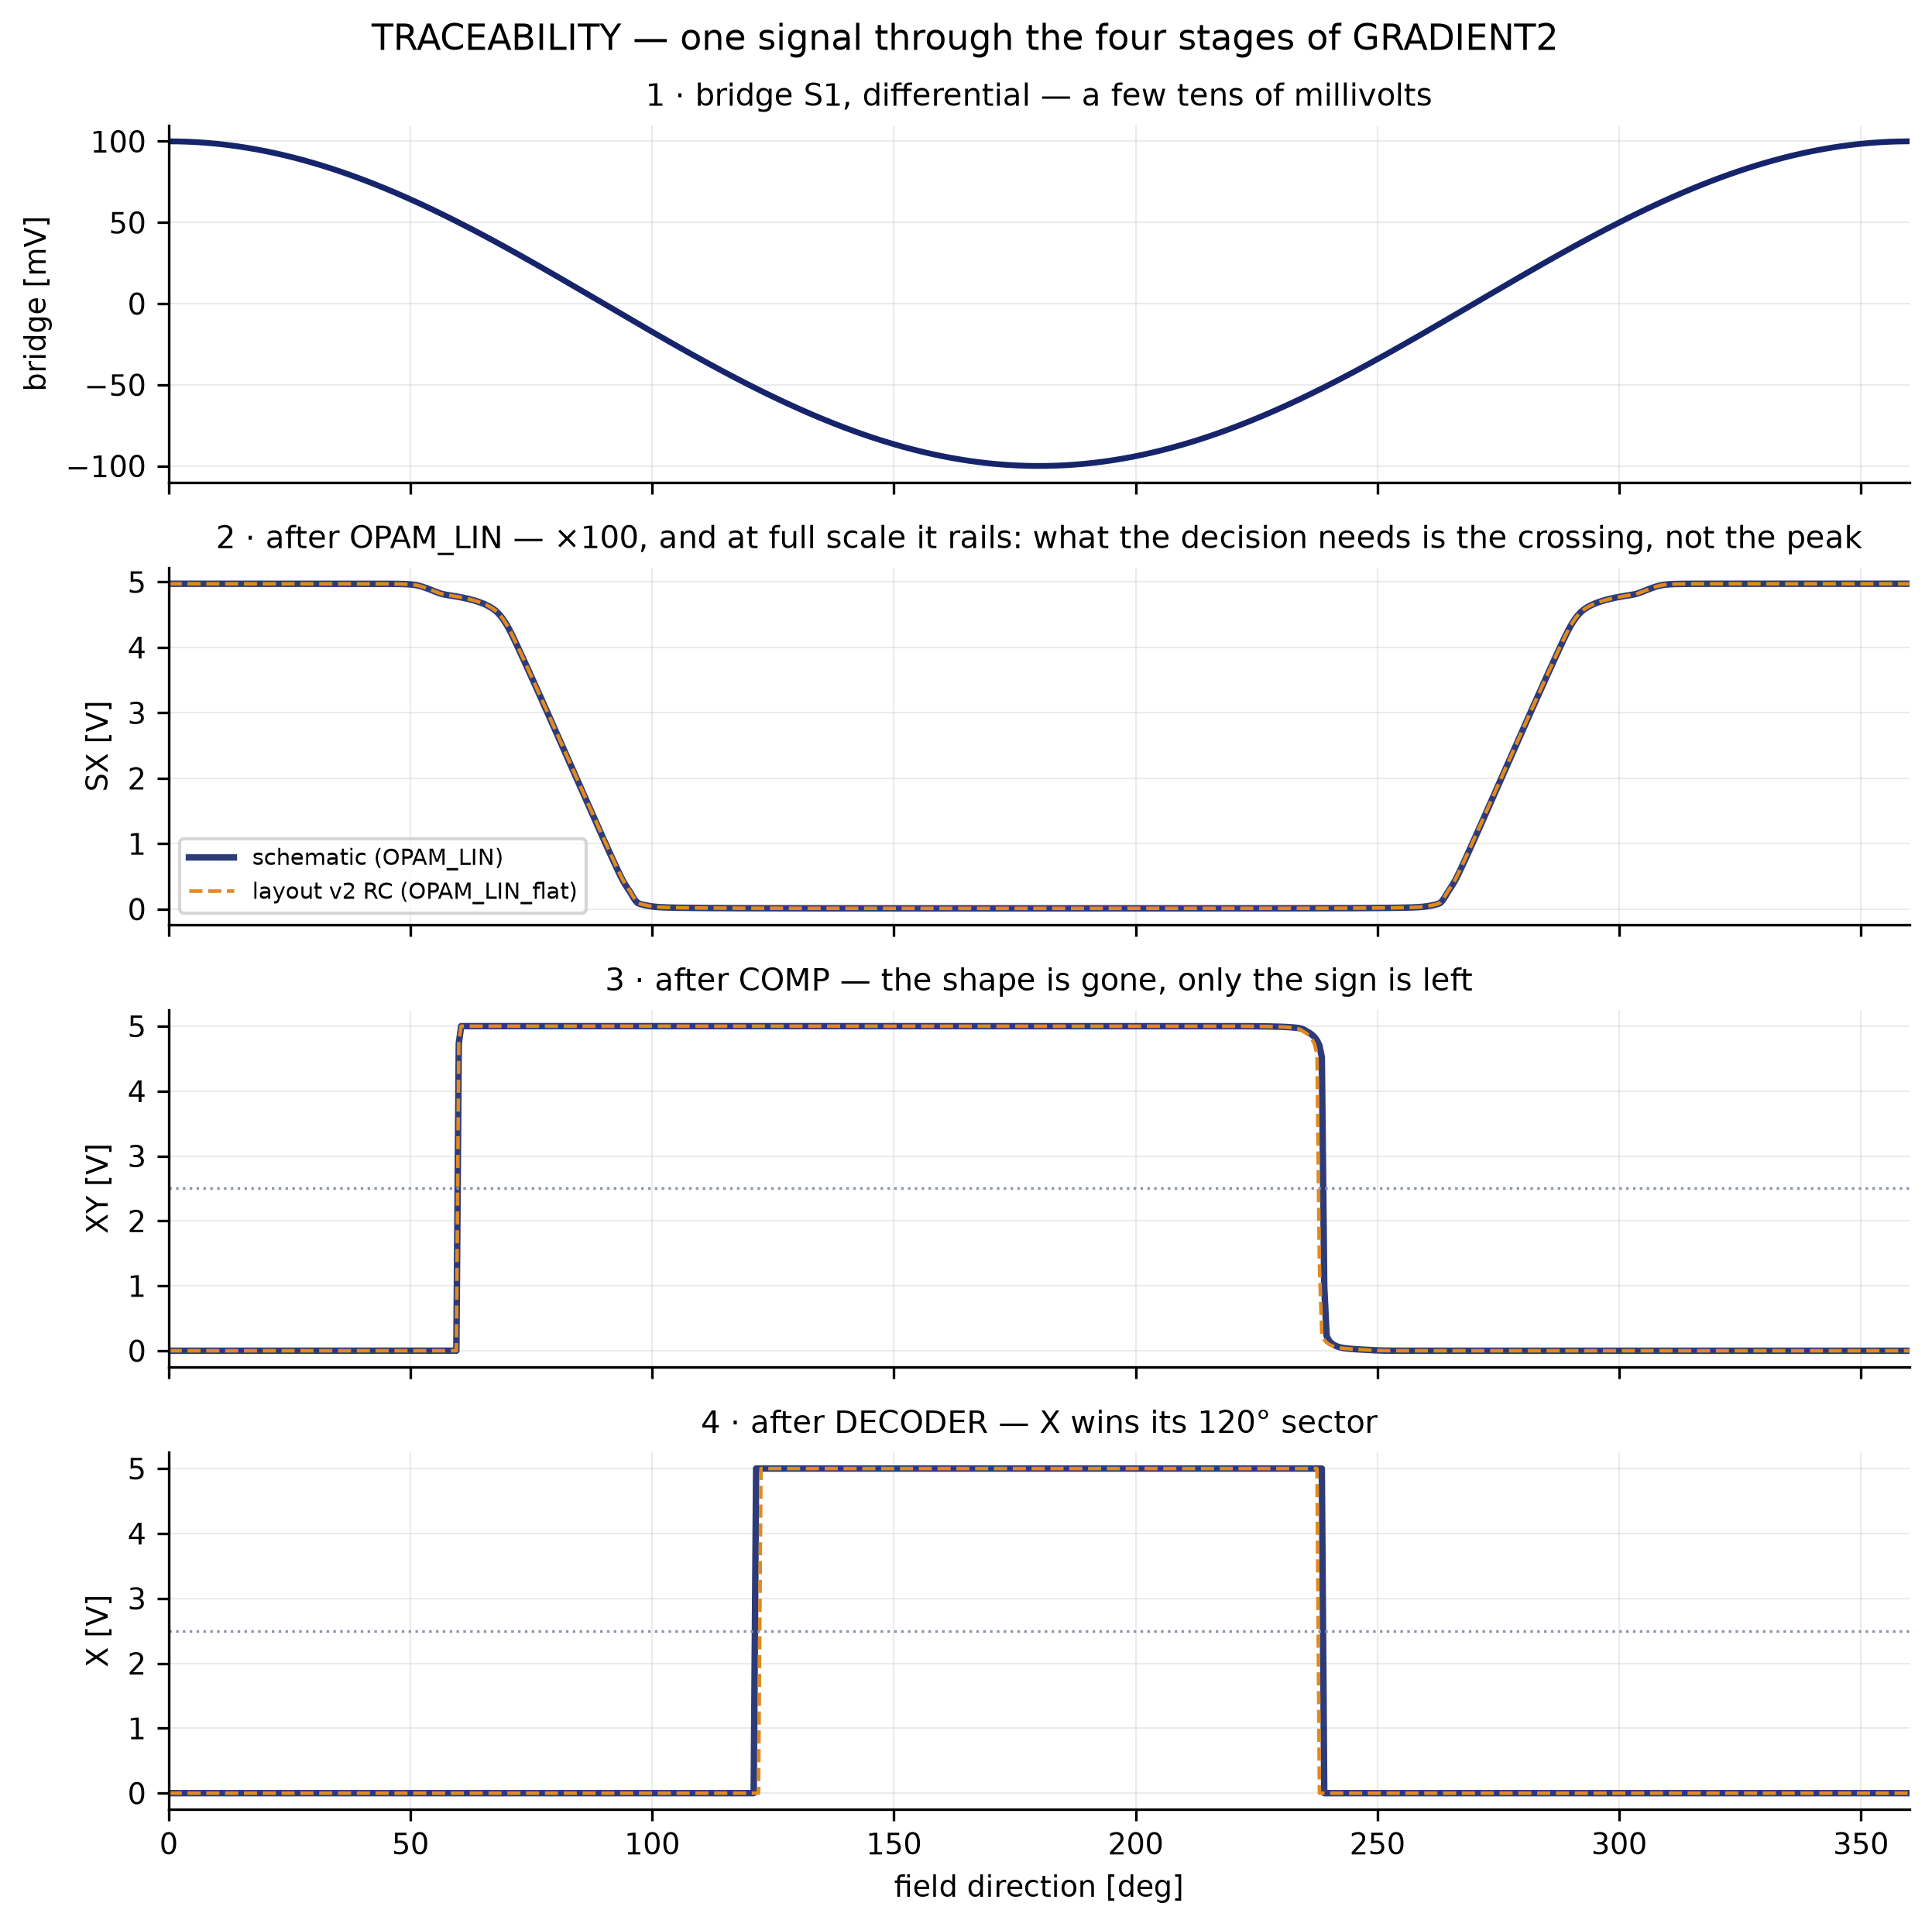
BLOCK RESULT · GRADIENT SENSING
one signal through the four stages
run_gradient.sh — G2 schematic vs G4 layout

Slide 29
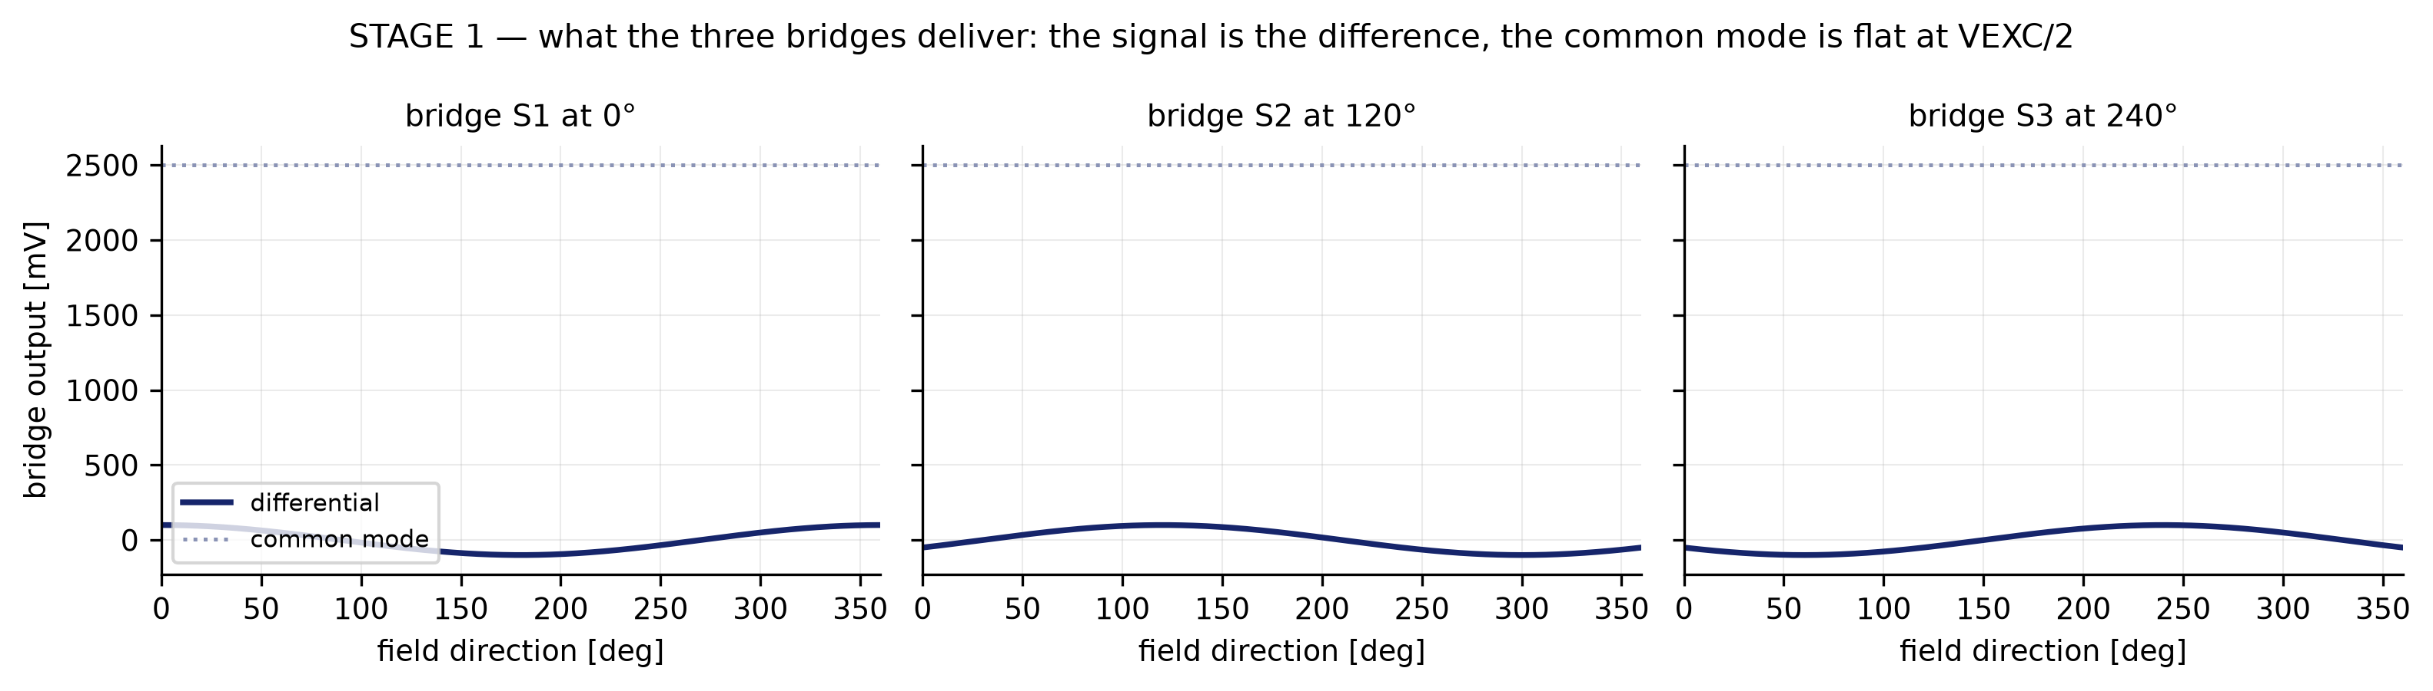
BLOCK RESULT · GRADIENT SENSING
stage 1 — what the three bridges deliver
run_gradient.sh — G2 schematic vs G4 layout

Slide 30
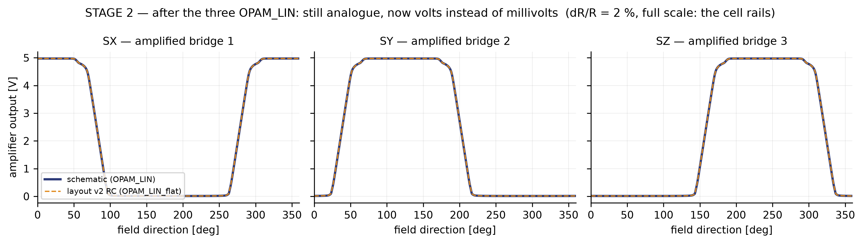
BLOCK RESULT · GRADIENT SENSING
stage 2 — after the three OPAM_LIN, full scale
run_gradient.sh — G2 schematic vs G4 layout

Slide 31
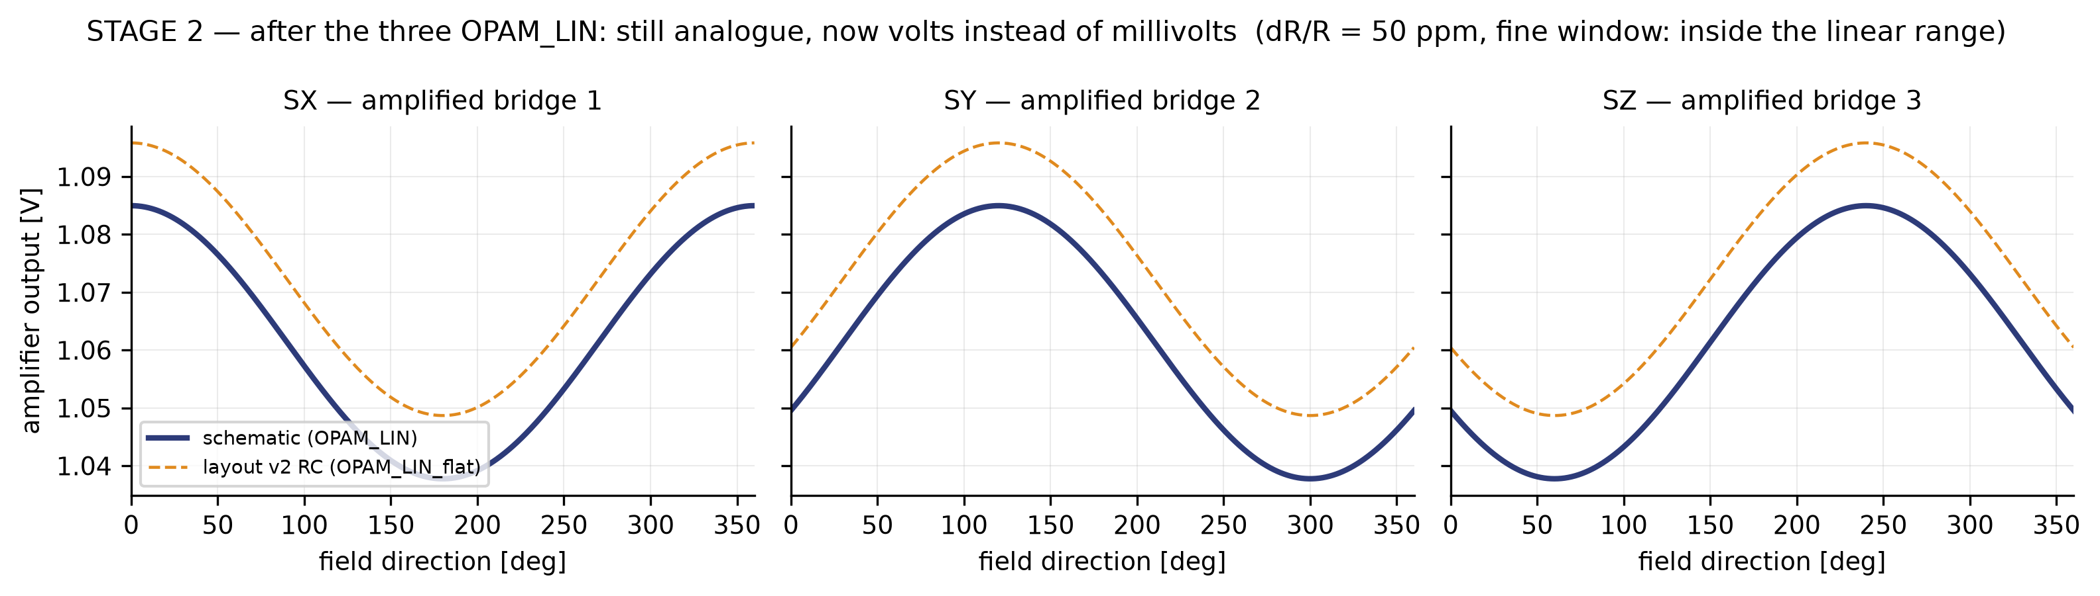
BLOCK RESULT · GRADIENT SENSING
stage 2 — the same, in the fine window
run_gradient.sh — G2 schematic vs G4 layout

Slide 32
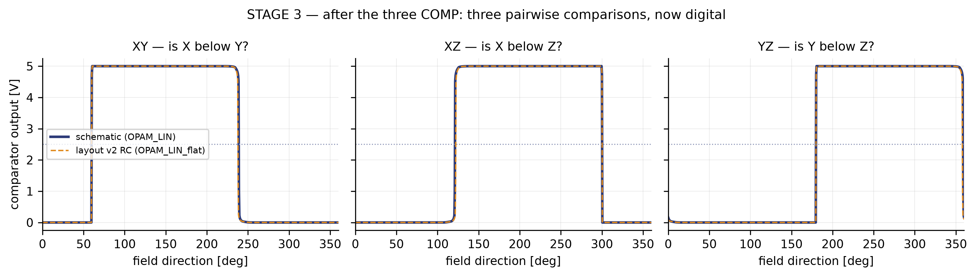
BLOCK RESULT · GRADIENT SENSING
stage 3 — after the three COMP
run_gradient.sh — G2 schematic vs G4 layout

Slide 33
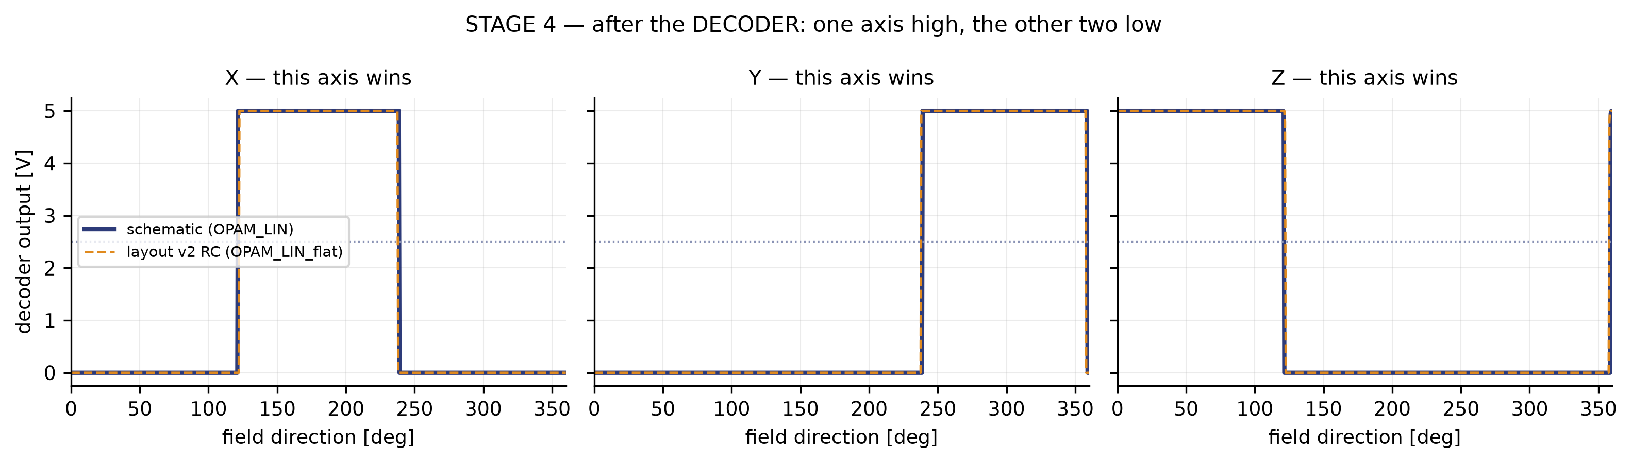
BLOCK RESULT · GRADIENT SENSING
stage 4 — after the DECODER
run_gradient.sh — G2 schematic vs G4 layout

Slide 34
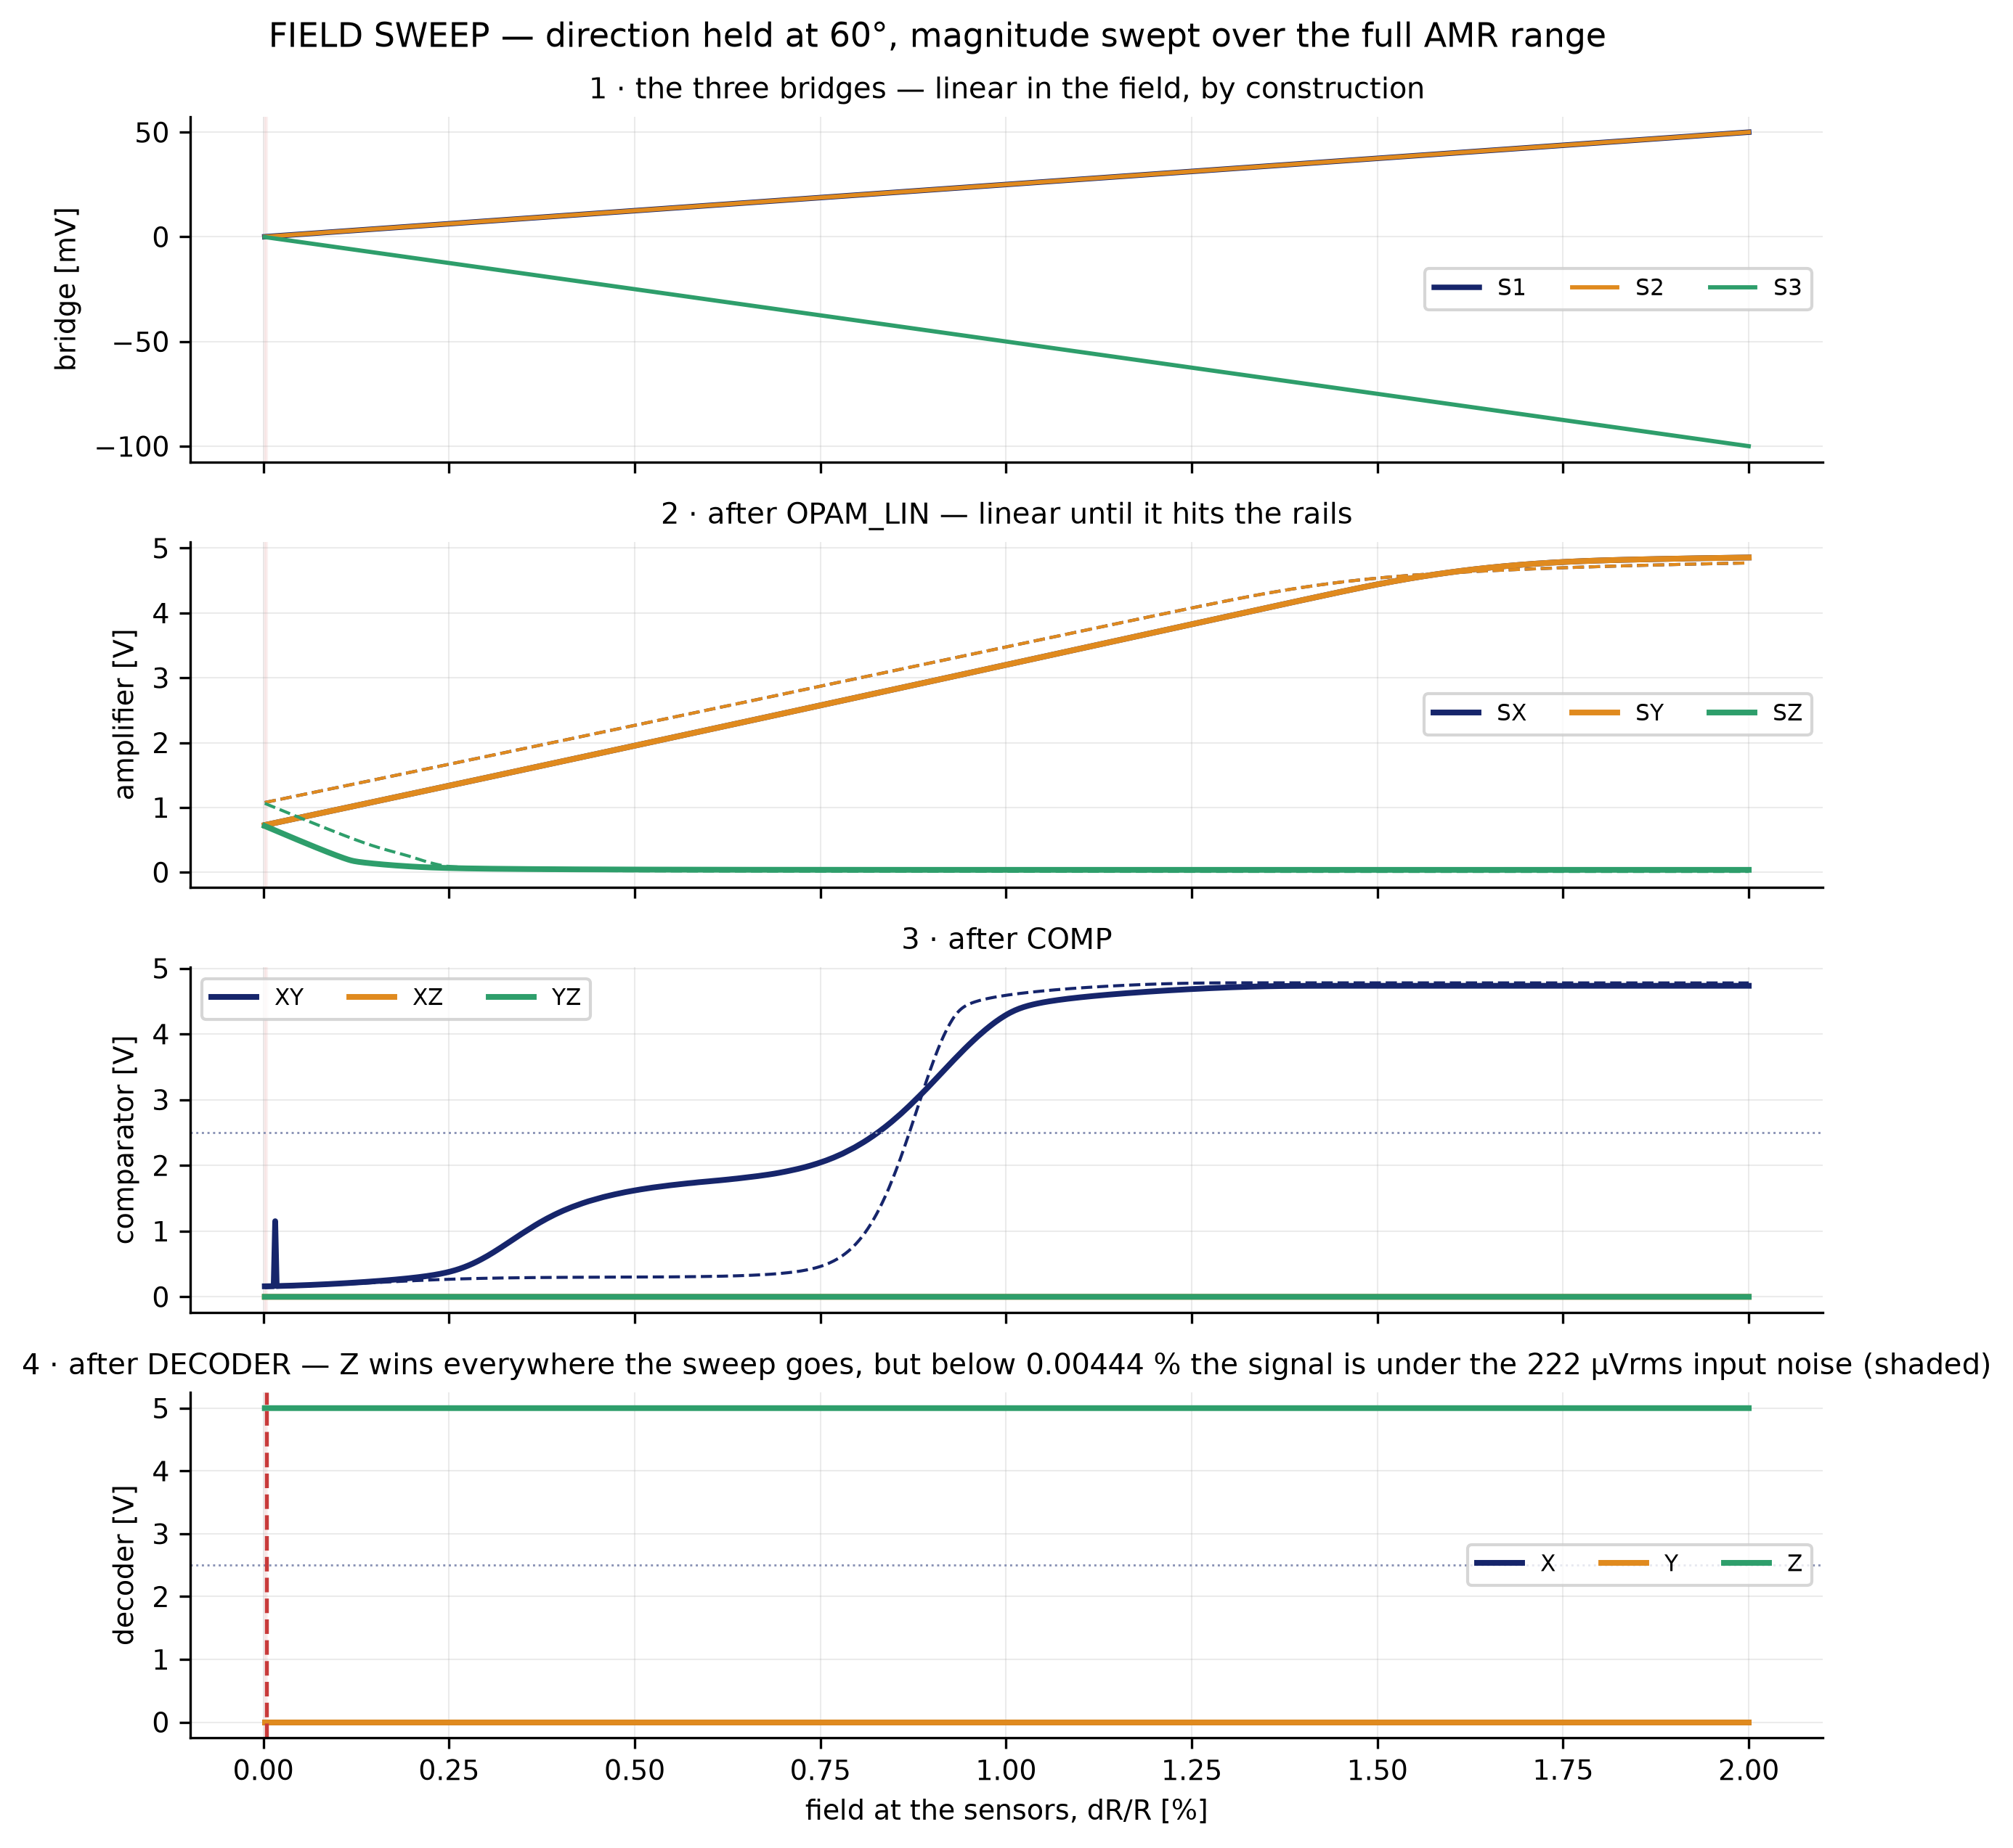
BLOCK RESULT · GRADIENT SENSING
the other axis: field MAGNITUDE swept, direction held
run_gradient.sh — G2 schematic vs G4 layout

Slide 35
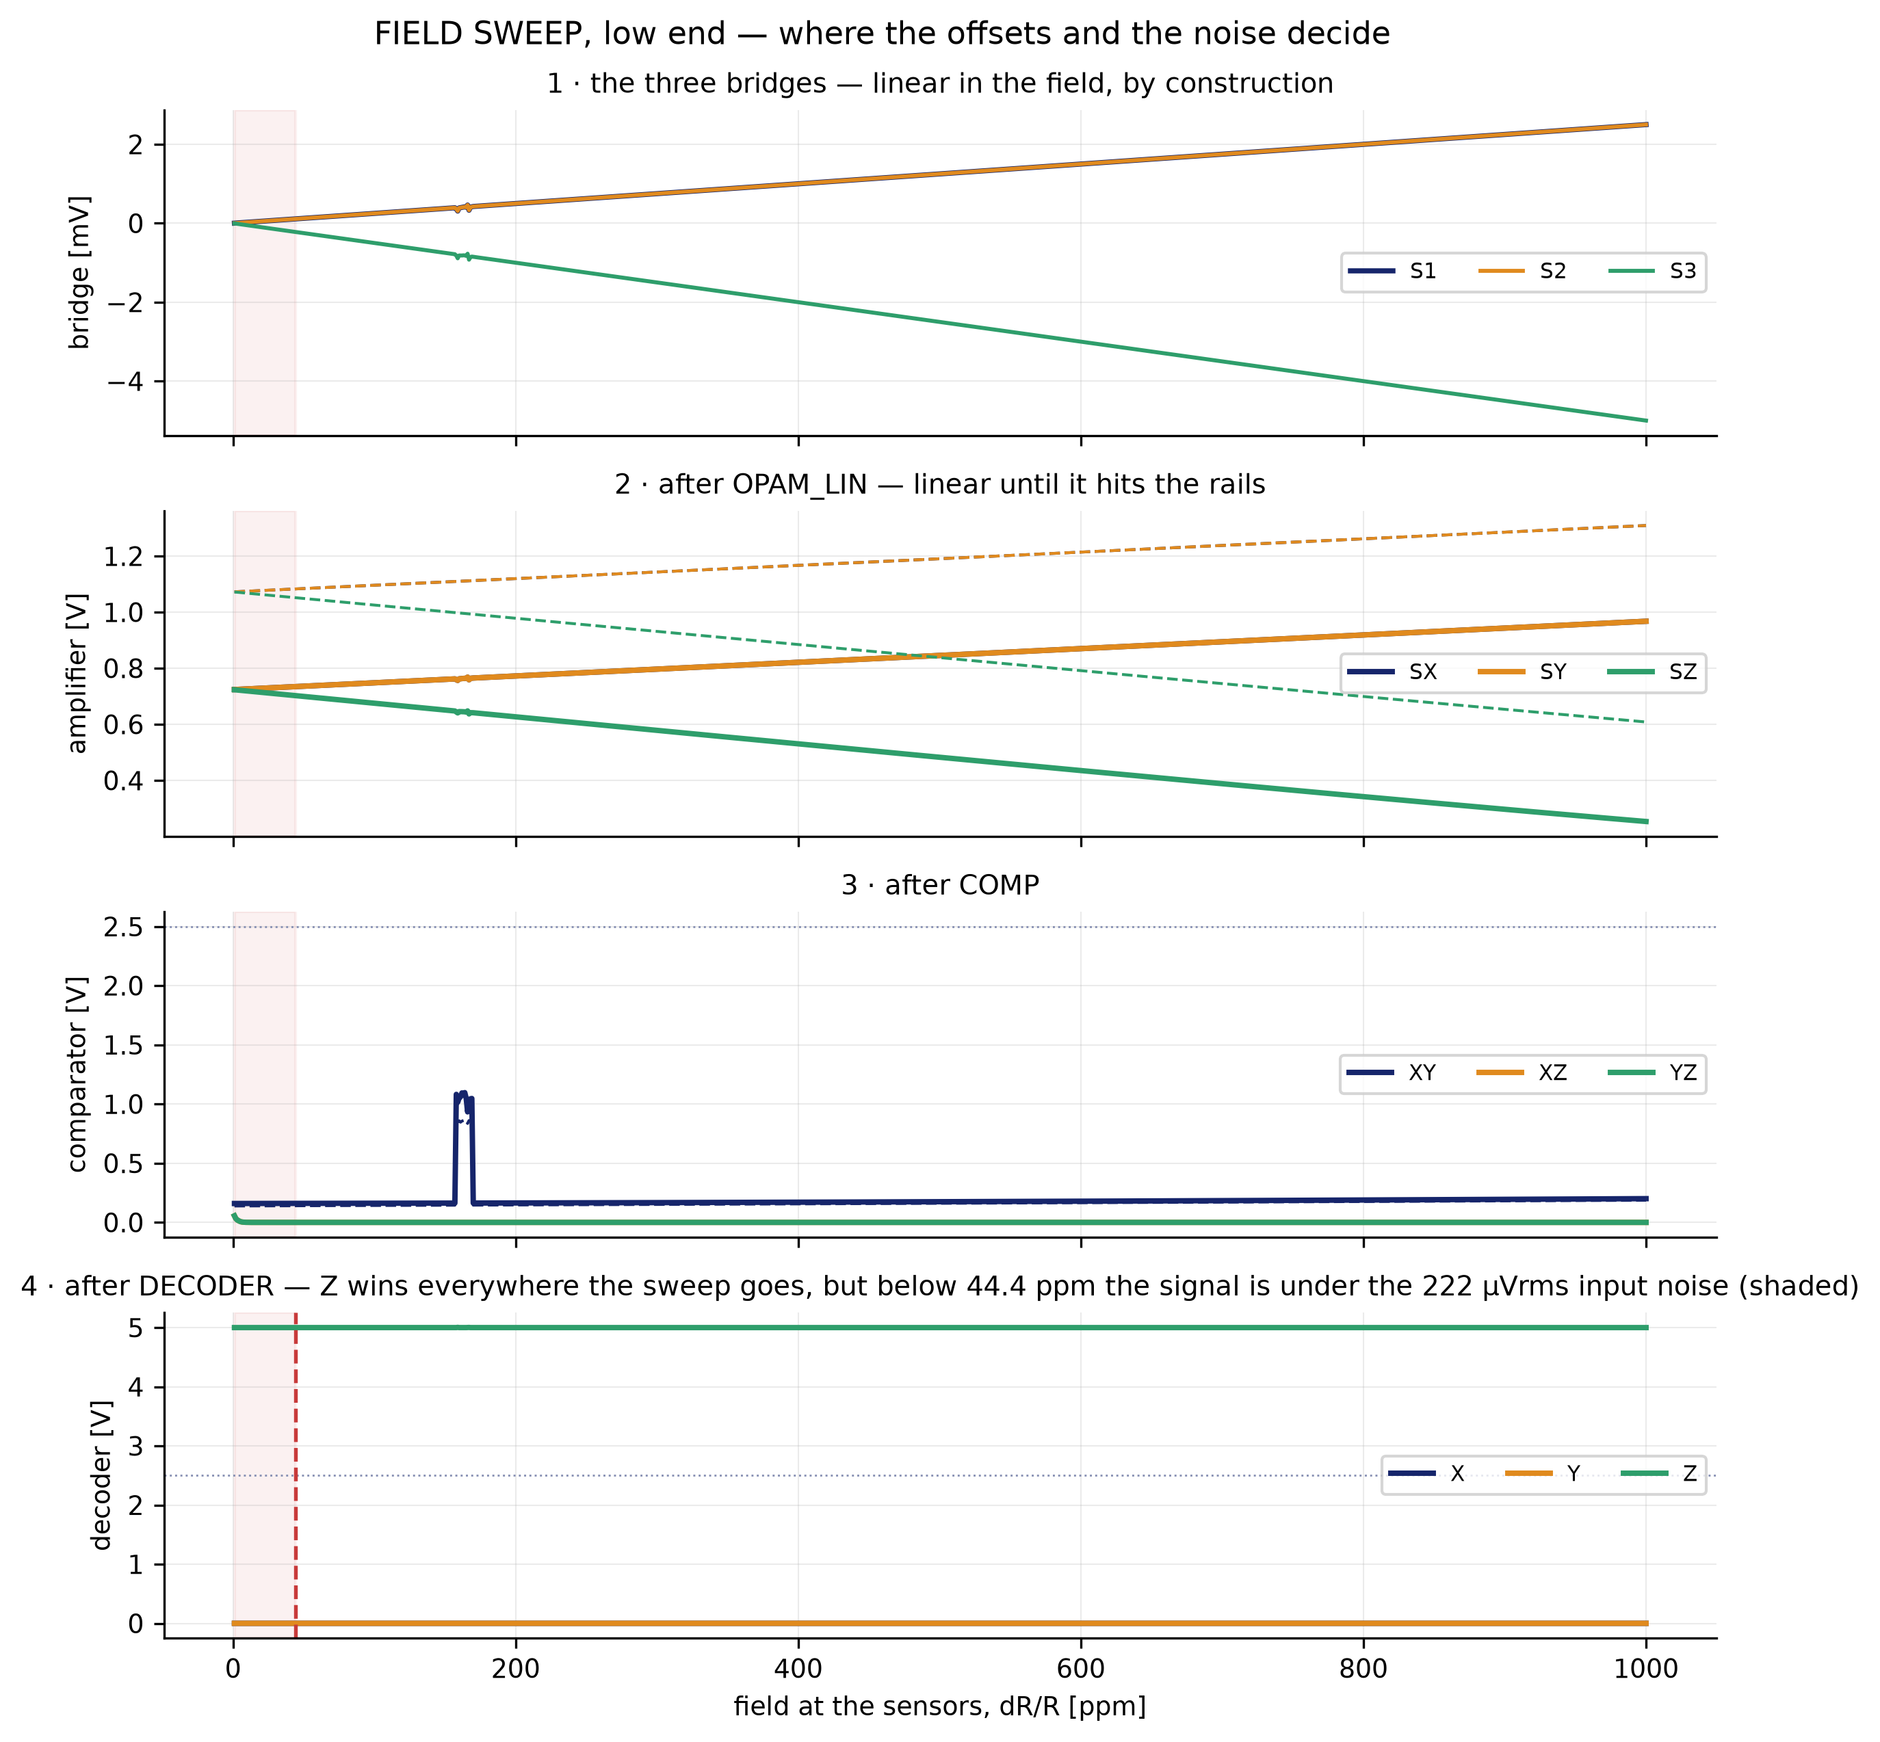
BLOCK RESULT · GRADIENT SENSING
the low end, where the offsets and the noise decide
run_gradient.sh — G2 schematic vs G4 layout

Slide 36
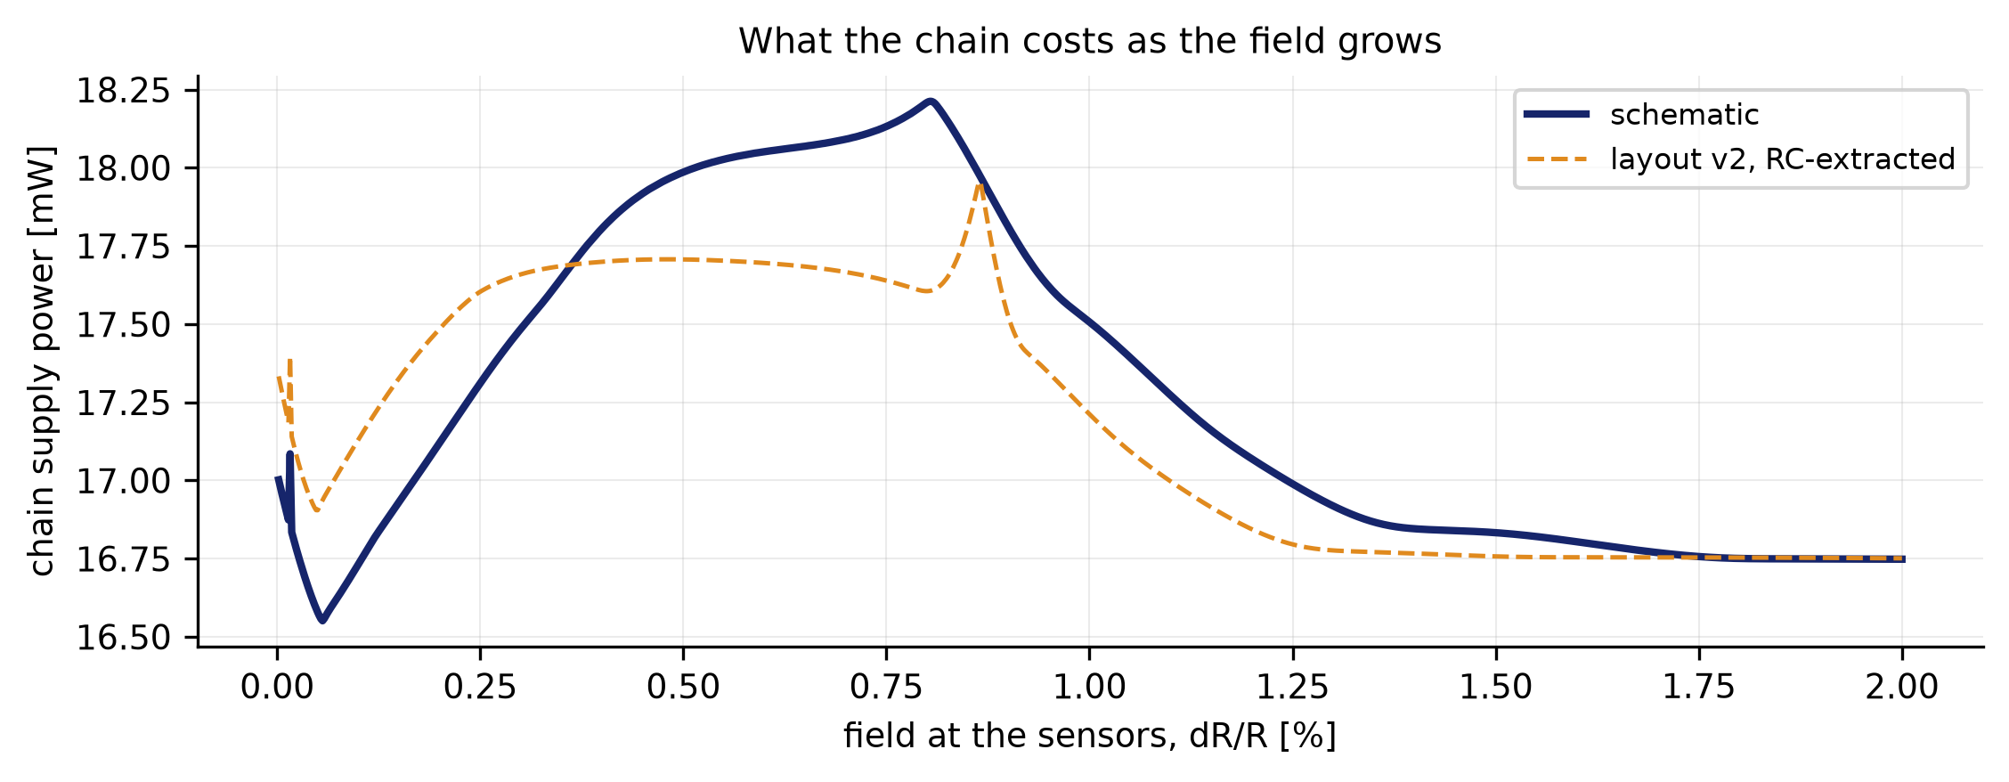
BLOCK RESULT · GRADIENT SENSING
what the chain costs as the field grows
run_gradient.sh — G2 schematic vs G4 layout

Slide 37
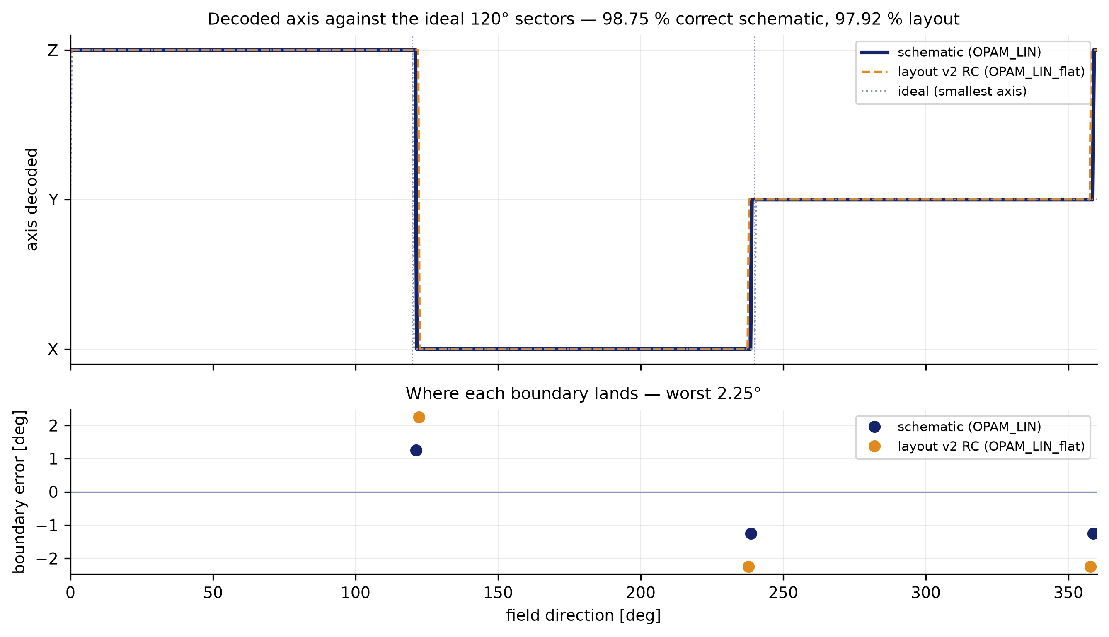
BLOCK RESULT · GRADIENT SENSING
decoded sector against the ideal, and the boundary error
run_gradient.sh — G2 schematic vs G4 layout

Slide 38
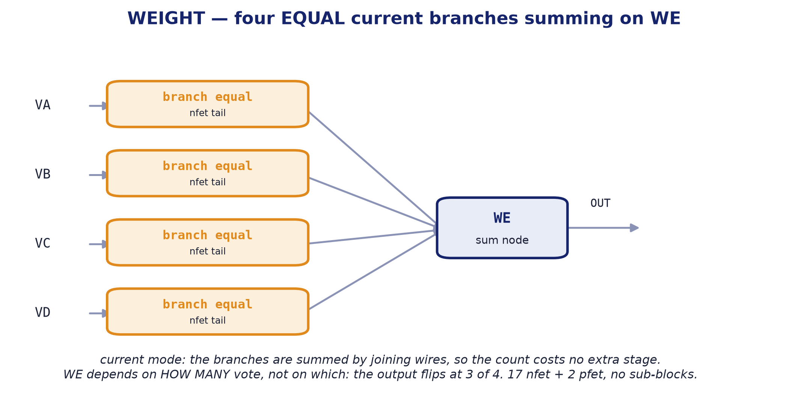
BLOCK 2 · WEIGHT
The vote counter: four chains vote, one axis sums.
internal block diagram

Slide 39
WEIGHT
Current-mode vote counter. One per axis.
Four inputs of EQUAL weight, one output.
Each of the four GRADIENT2 chains votes on this axis, and the block counts the votes in current mode: the branches add by joining wires, so counting costs no extra stage. All four carry the same ~170 µA: what comes out depends on HOW MANY vote, not on which.
The rule is majority: it flips at 3 of 4 branches.
It is a leaf: no sub-blocks.
17 n devices and 2 p, drawn by hand. The WE output is the summing node, and it is what leaves through the X, Y or Z analogue pad.
Parameter | Value
Function | sums the four votes of one axis
Supply | 5.0 V
Power | 2.87 mW
Devices | 17 nfet_06v0 + 2 pfet_06v0
Decision threshold | 3 of 4 branches (majority)
Branch current | ~170 µA, igual en las cuatro
Area | 45.34 × 25.00 µm = 0.0011 mm² (WEIGHT_COMP cell, with COMP_OUT)
Instances | 3 (one per axis)

Slide 40
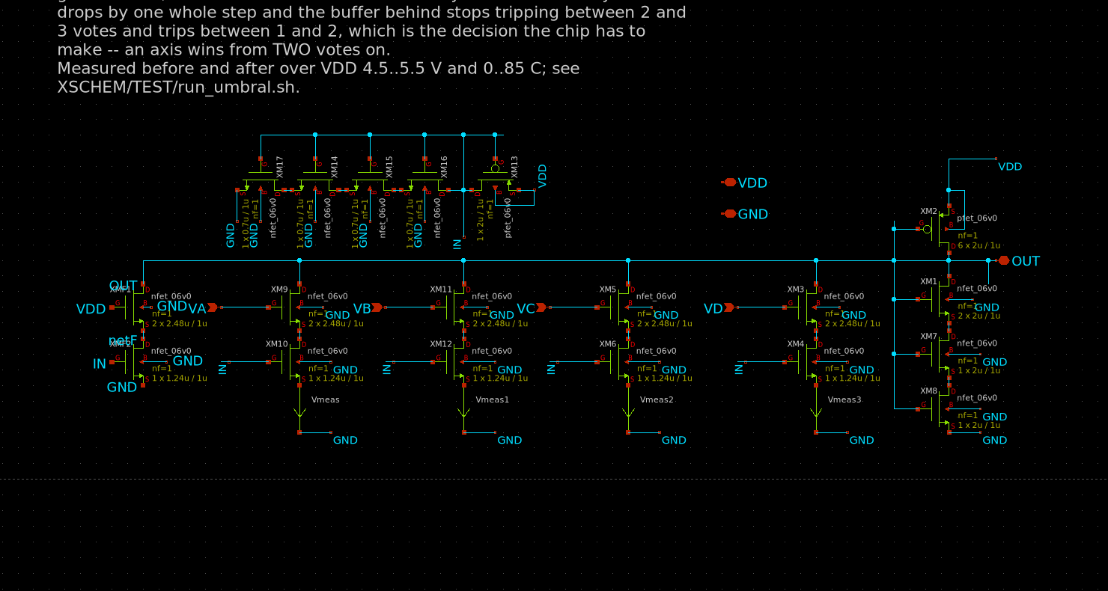
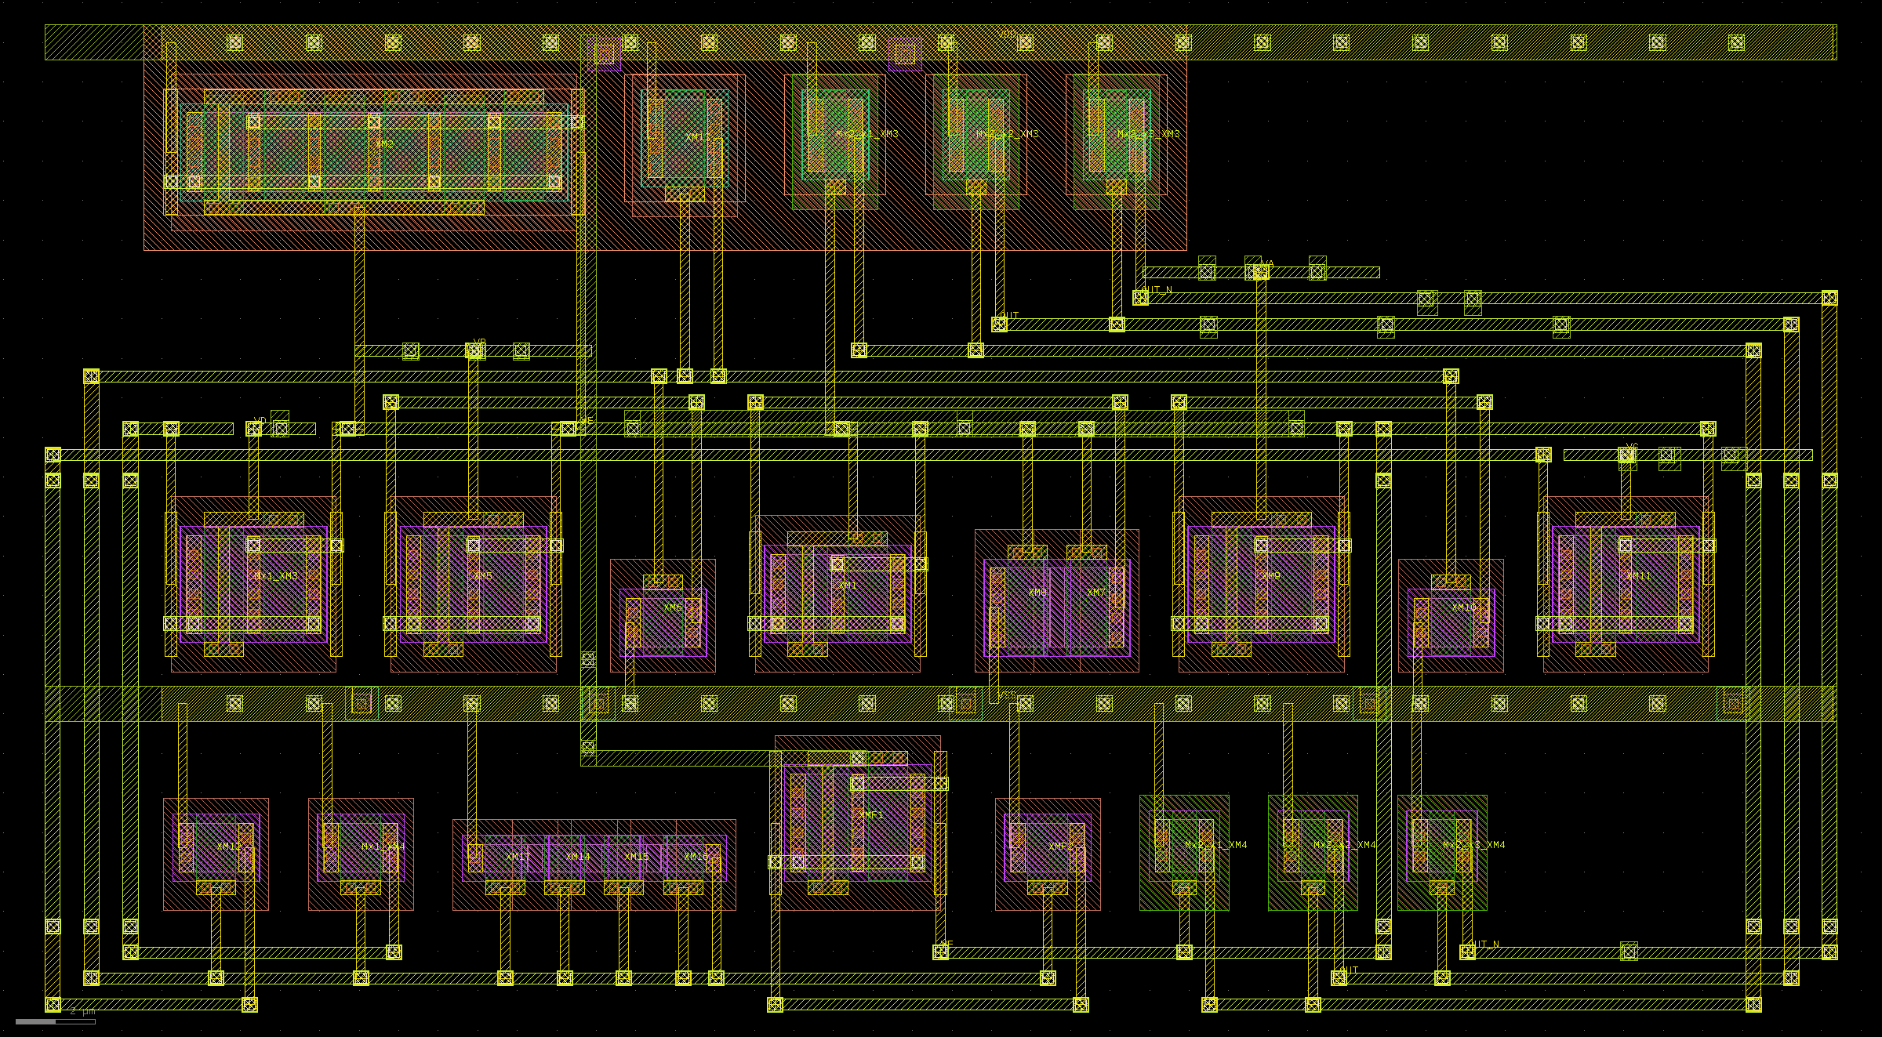
WEIGHT
Current-mode vote counter. One per axis.
schematic
layout — 45.34 × 25.00 µm

Slide 41
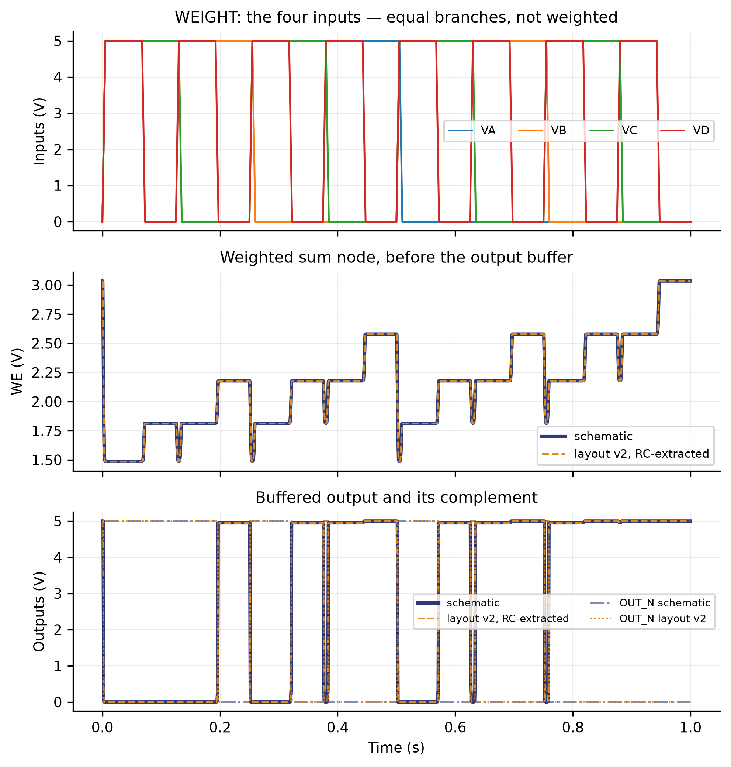
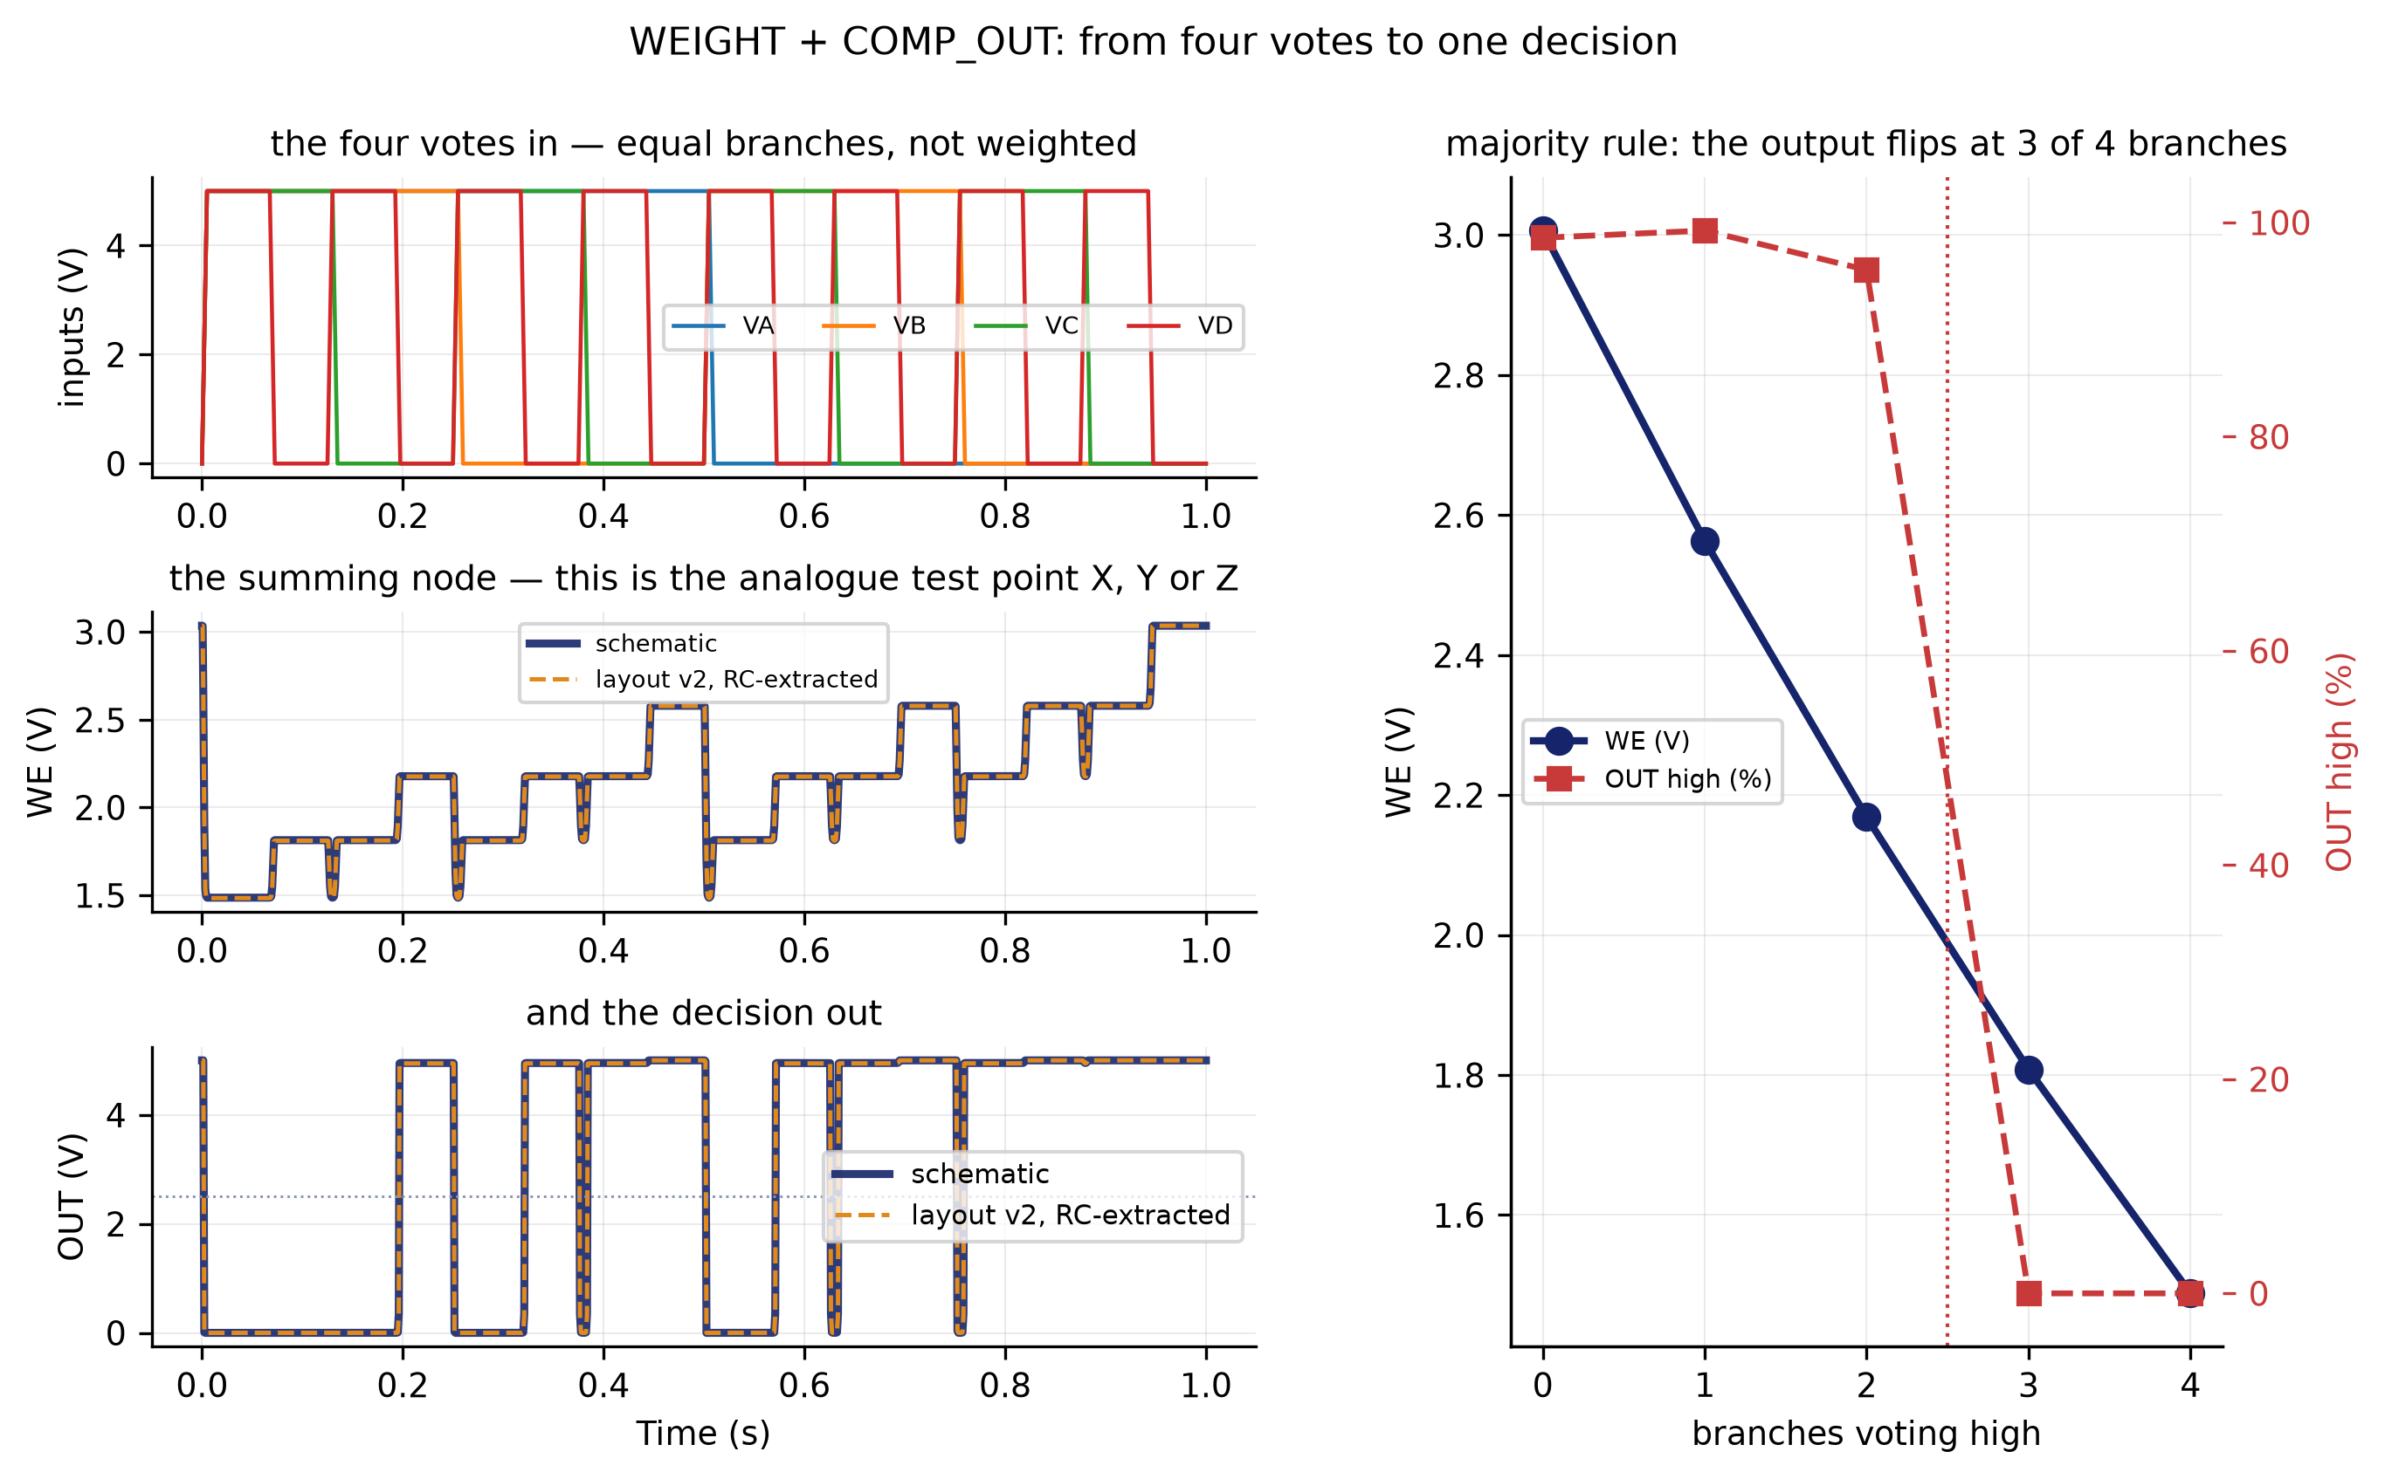
WEIGHT
inputs, sum node and outputs · from four votes to one decision
from four votes to one decision
inputs, sum node and outputs

Slide 42
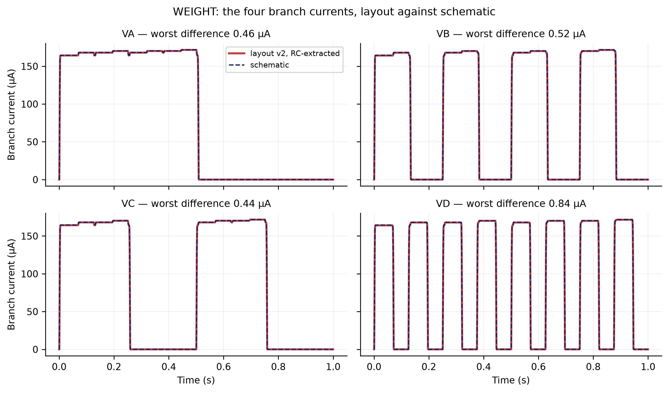
WEIGHT
branch currents
XSCHEM/TEST — schematic vs layout v2

Slide 43
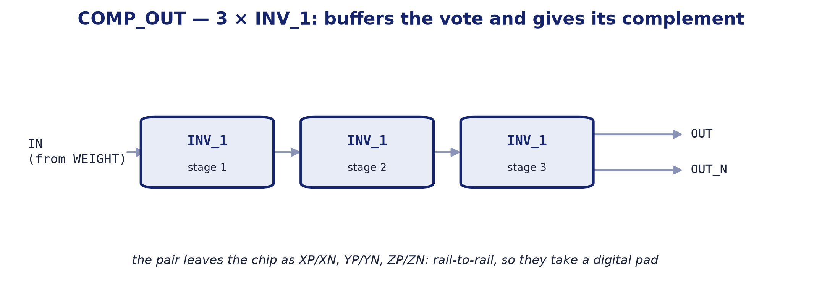
BLOCK 3 · COMP_OUT
The output stage: three inverters and the axis's digital pair.
internal block diagram

Slide 44
COMP_OUT
Output stage: three inverters giving the digital pair.
It takes the summing node up to digital levels.
Three inverters in a chain: the first decides, the rest give edge rate and drive. Out of it come the axis's two signals, the direct one and its complement.
That is why the outputs come in pairs.
XP/XN, YP/YN, ZP/ZN reach the pad rail to rail, which is why they take a digital pad and not an analogue one.
Parameter | Value
Function | buffers the vote and gives its complement
Supply | 5.0 V
Sub-blocks | 3 × INV_1
Area | shared with WEIGHT in the WEIGHT_COMP cell
Instances | 3 (one per axis)

Slide 45
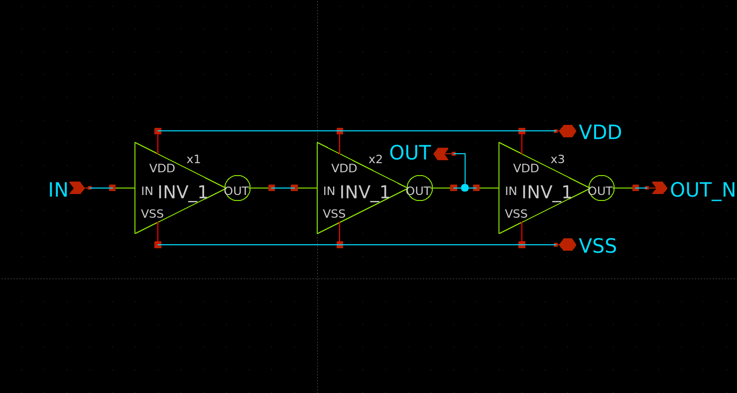
COMP_OUT
Output stage: three inverters giving the digital pair.
schematic
layout — 45.34 × 25.00 µm

Slide 46
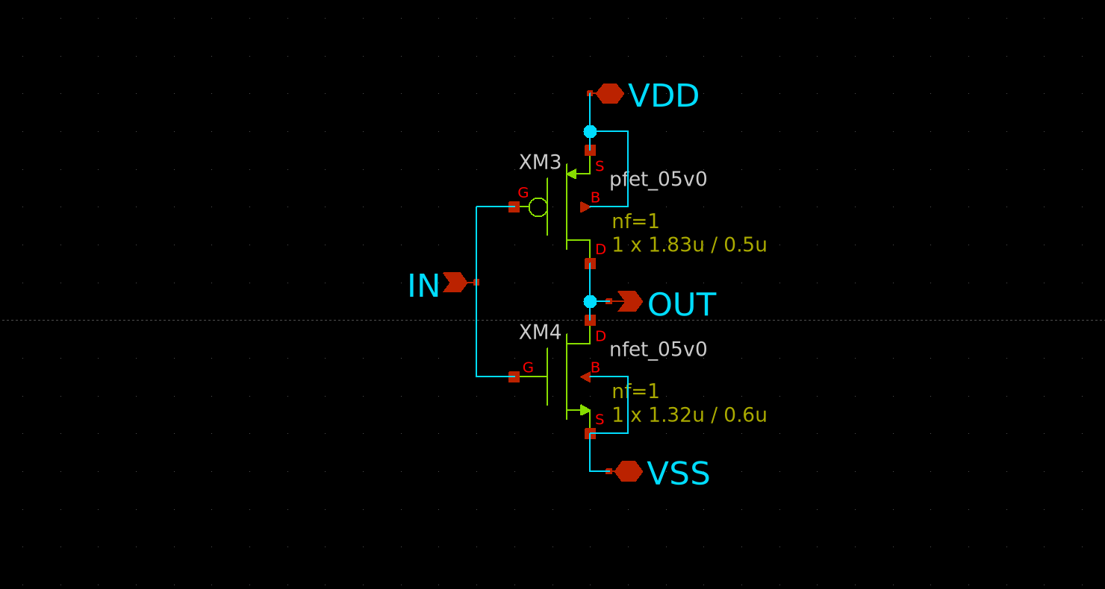
INV_1
COMP_OUT's sub-block: the inverter.
XSCHEM/WEIGTH/INV_1.sch

Slide 47
ESD_CDM · SECONDARY PROTECTION
Outside the signal chain, but inside the user area.
Eleven instances, one per analogue pad.
The PDK's analogue pads carry HBM diodes only, so the CDM network — a series poly resistor plus diodes — is ours to add, and it goes BESIDE the pad: whatever sits between pad and clamp is unprotected.
The circuit is the organisers'; the drawing is ours.
All three of their published cells violate MSLOT.1, and nobody had seen it because the PDK's mslot table crashes before reaching them. Ours is 1762 µm² against 6457: about 52,000 µm² of user area back.
This is where the n-wells were merged.
The four wells sat 1.330 µm apart, which is fine only if the checker knows they are equipotential. They are one well now and it passes in both modes.

Slide 48
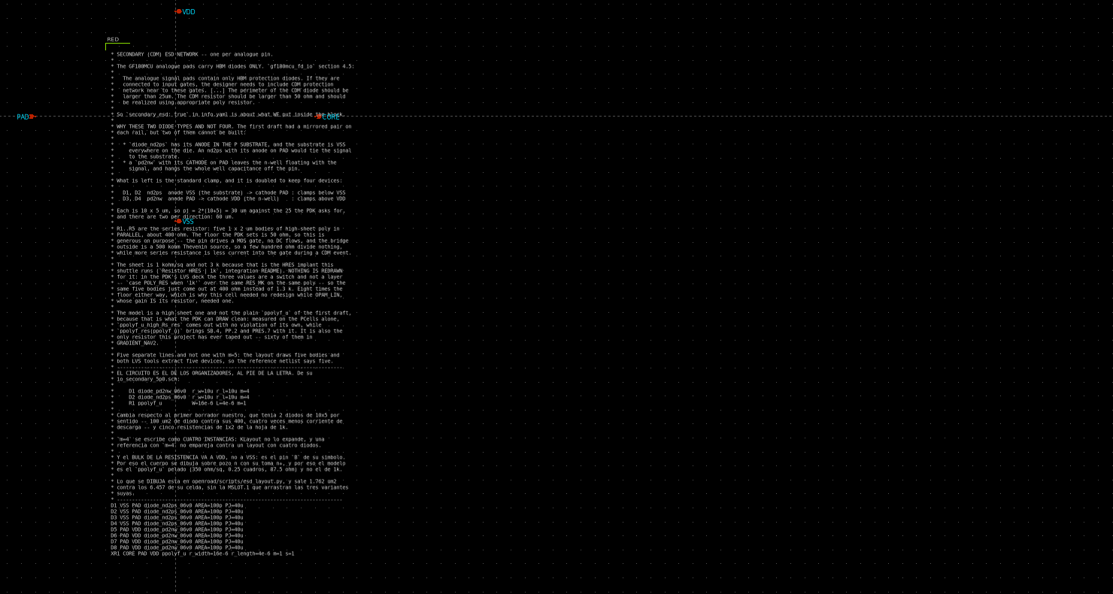
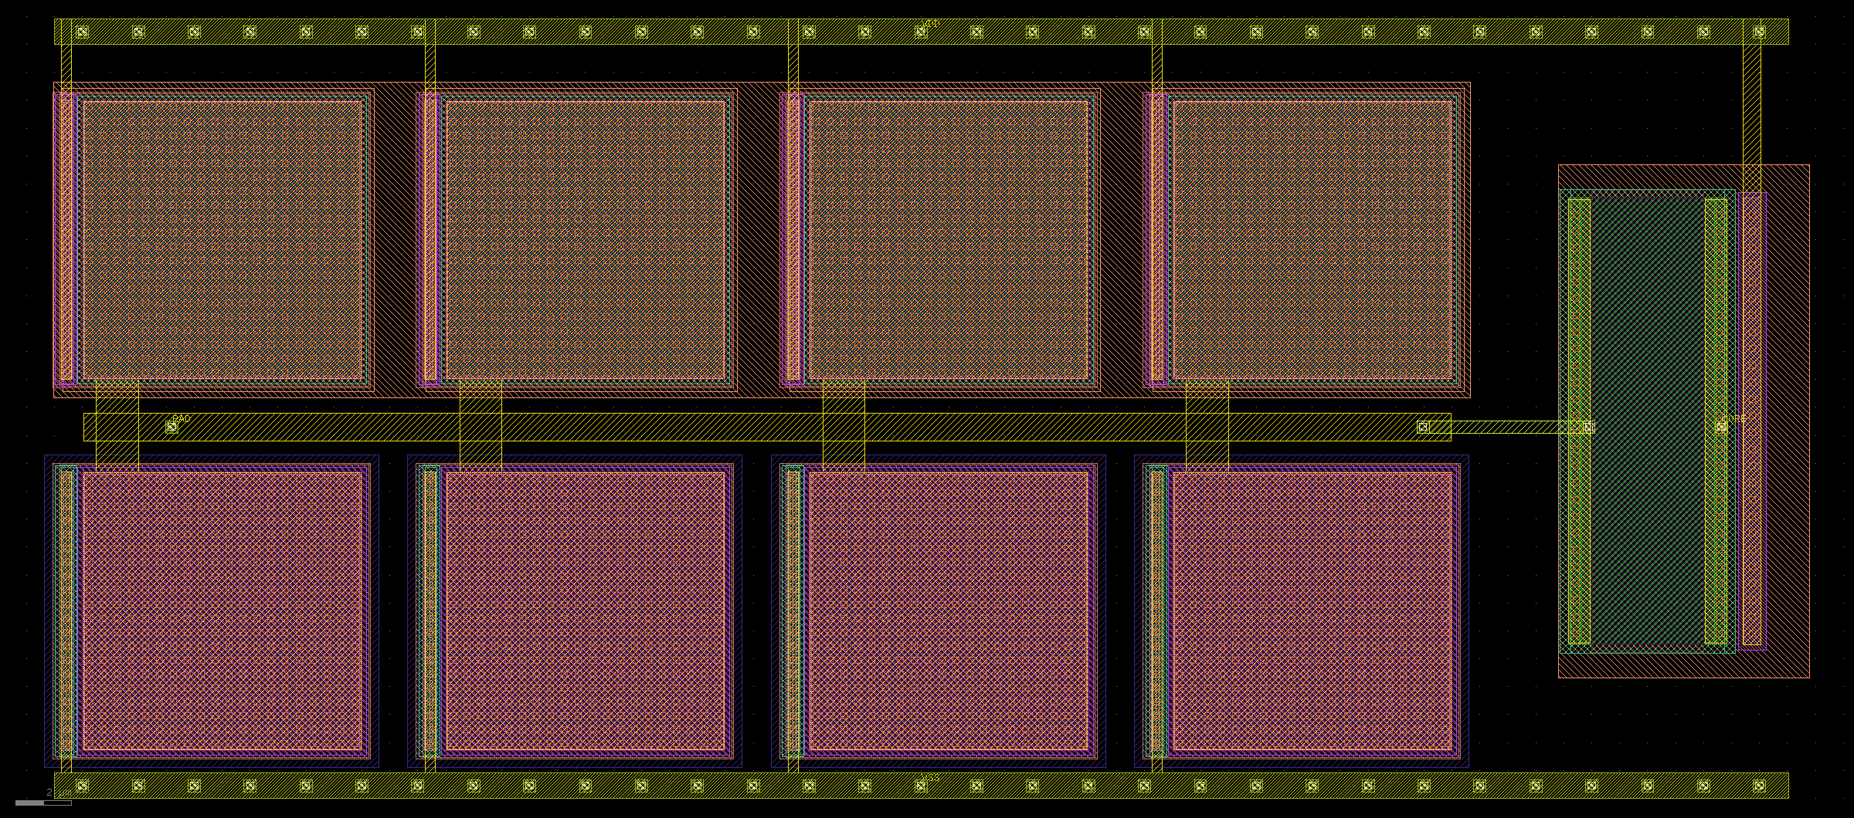
ESD_CDM
Outside the signal chain, but inside the user area.
layout — 63.16 × 27.90 µm
schematic

Slide 49
03
FULL-SYSTEM RESULTS
The whole system, always layout against schematic.

Slide 50
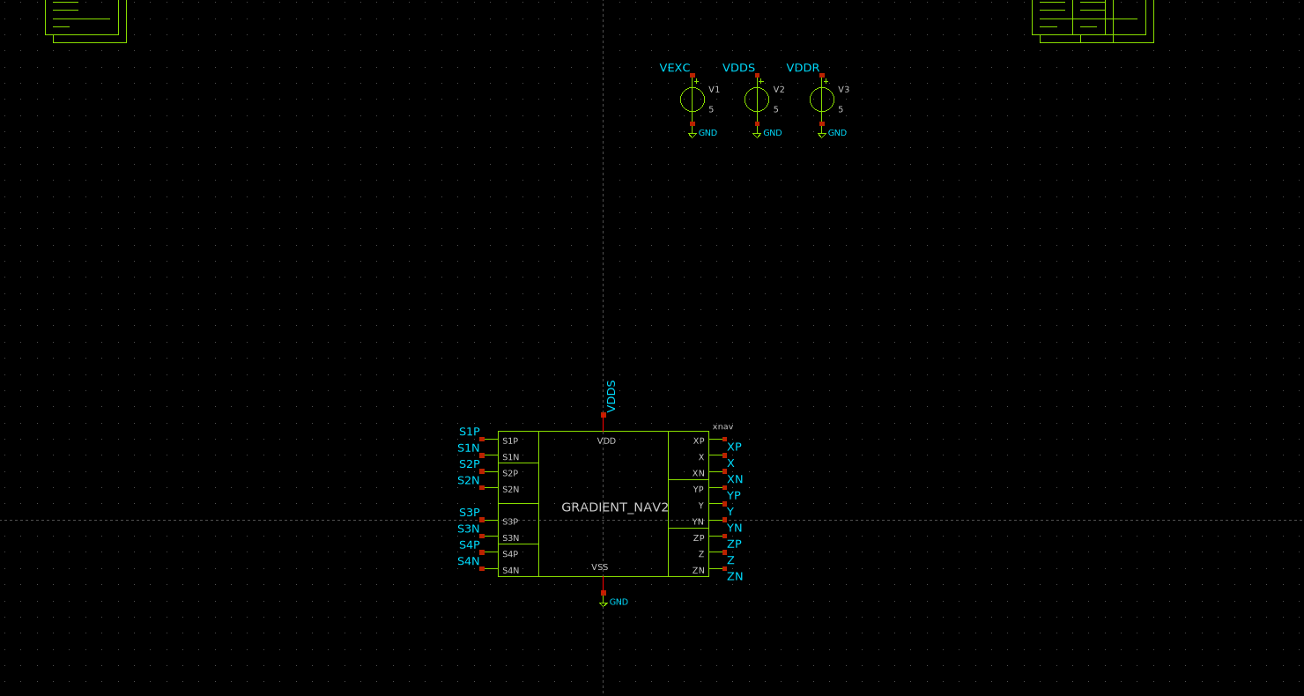
NAVIGATOR BENCH · METHOD
run_nav2.sh — four bridges against two navigators. It is also the layout-vs-schematic comparison.
XSCHEM/TEST_TOTAL/test_NAV2.sch

Slide 51
NAVIGATOR BENCH · METHOD
run_nav2.sh — four bridges against two navigators. It is also the layout-vs-schematic comparison.
Two navigators on the same eight sensor nodes:
N_esq — the schematic GRADIENT_NAV2, supply VDDS
N_lay — the same circuit rebuilt from the v2 layout and extracted WITH RC PARASITICS, supply VDDR
Four sensors at 0, 90, 180 and 270°, and the field turning from 0 to 360°.
Each of the four chains reads THREE of the four sensors, in different combinations, and the three weights combine their outputs.
What it measures: on what percentage of the sweep the nine schematic outputs agree with the layout ones, and where they do not, how many degrees wide the disagreement is.

Slide 52

RESULT · LAYOUT AGAINST SCHEMATIC
721 points from 0 to 360°. The dashed orange is the layout extracted with parasitics.
datos_nav2/fino_nav2.csv
The six digital outputs agree on 100 % of the sweep.

Slide 53


RESULT · LAYOUT AGAINST SCHEMATIC
The six digital outputs agree on 100 % of the sweep.
Zero degrees of disagreement. The layout decides the same as the schematic in every direction tested.
Worst-case deviation on the analogue outputs: 3.1 mV.
Power: 74.02 mW schematic, 74.03 mW layout.
The RC parasitics do not move the operating point appreciably. The 74 mW agree with the 14.81 mA at 5 V measured on the extracted layout.

Slide 54

RESULT · LAYOUT AGAINST SCHEMATIC
four chains vote, the counter adds them up
datos_nav2/fino_nav2.csv

Slide 55

RESULT · LAYOUT AGAINST SCHEMATIC
the six pins that leave the die
datos_nav2/fino_nav2.csv

Slide 56
GEOMETRY BENCH · METHOD
run_nav2_geo.sh — how the navigator depends on the box the sensors sit in.
The four sensors sit at the vertices of the tetrahedron inscribed in a box Lxy × Lxy × Lz.
Six combinations: Lxy of 1000, 2000 and 3000 µm, and Lz of 500 and 1000 µm.
1 · Resolution.
For each box and each gradient level the direction is swept 360° and we count on what fraction it gets the axis right. From that curve comes one number: the smallest gradient at which accuracy reaches 95 %. It captures both limits at once — from below the comparator offset, from above the amplifier's saturation — without depending on any borrowed definition.
2 · The same in the X-Y plane, where Lz plays no part.
It separates the x-y resolution from the z one.
3 · Background.
Earth's field is common to all four sensors, so it cancels in the comparison but NOT in the amplifier, which sees all of it. It is swept to find the level at which the measurement is lost.

Slide 57

GEOMETRY BENCH · METHOD
run_nav2_geo.sh — how the navigator depends on the box the sensors sit in.
XSCHEM/TEST_TOTAL/test_NAV2_geo.sch

Slide 58
RESULT · GEOMETRY OF THE BOX
Accuracy on the direction, by box and gradient level.
Box Lxy × Lz [µm] | Low gradient | High gradient
1000 × 1000 | 90.0 % | 97.8 %
1000 × 500 | 87.2 % | 91.7 %
2000 × 1000 | 91.1 % | 92.2 %
2000 × 500 | 92.7 % | 94.4 %
3000 × 1000 | 92.7 % | 93.3 %
3000 × 500 | 92.7 % | 94.4 %
At high gradient the 1000 × 1000 box reaches 97.8 %. Flattening the box (Lz 500) always costs accuracy, because the z axis ends up worse resolved than x-y.

Slide 59

RESULT · GEOMETRY OF THE BOX
Accuracy on the direction, by box and gradient level.
run_nav2_geo.sh

Slide 60

RESULT · GEOMETRY OF THE BOX
Accuracy on the direction, by box and gradient level.
run_nav2_geo.sh

Slide 61

RESULT · GEOMETRY OF THE BOX
Accuracy on the direction, by box and gradient level.
run_nav2_geo.sh

Slide 62
SOURCE BENCH · METHOD
run_fuente.sh — does the chip point at it? This is the question it exists to answer.
Everything so far imposed a uniform gradient in a direction. Here the field comes from a source sitting somewhere and each sensor reads the magnitude at its own vertex.
Two models, and the pair is the method:
SYMMETRIC — |B| depends on distance only, so grad|B| points EXACTLY at the source. Whatever error comes out is the chip's.
REAL DIPOLE — axis along +z. |B| depends on the angle too, and grad|B| does NOT point exactly at the source, not even with a perfect chip.
The difference between the two numbers separates the error of the circuit from the error of the physics.
Which is what you need before believing anything measured with a real magnet.
42 sweeps: three distances, seven azimuths, both models.

Slide 63
SOURCE BENCH · METHOD
run_fuente.sh — does the chip point at it? This is the question it exists to answer.
XSCHEM/TEST_TOTAL/test_FUENTE.sch

Slide 64
RESULT · DOES IT POINT AT THE SOURCE?
Angle the chip gives against the ideal angle, by model and distance.
Accuracy falls with distance, as expected: the gradient weakens and the comparator offset weighs more.
Model | Distance | Chip | Ideal | Accuracy
symmetric | 3000 µm | 14.46° | 14.21° | 90.8 %
symmetric | 6000 µm | 9.02° | 7.56° | 86.9 %
symmetric | 12000 µm | 11.32° | 3.84° | 76.1 %
dipole | 3000 µm | 16.53° | 16.40° | 93.2 %
dipole | 6000 µm | 12.31° | 11.66° | 90.6 %
dipole | 12000 µm | 12.41° | 9.92° | 84.3 %
At 3000 µm the chip sits 0.25° off the ideal in the symmetric model: the error is the circuit's and it is small. At 12000 µm the gap reaches 7.5° and the measurement is lost.

Slide 65

RESULT · DOES IT POINT AT THE SOURCE?
Angle the chip gives against the ideal angle, by model and distance.
run_fuente.sh

Slide 66

RESULT · DOES IT POINT AT THE SOURCE?
Angle the chip gives against the ideal angle, by model and distance.
run_fuente.sh

Slide 67

RESULT · DOES IT POINT AT THE SOURCE?
Angle the chip gives against the ideal angle, by model and distance.
run_fuente.sh

Slide 68
04
PHYSICAL VERIFICATION
DRC, LVS, connectivity and current density on the file that ships.

Slide 69


B26_A
On B26_A_filled3.gds, the file that ships.
unfilled — 1110 × 1110 µm
density-filled — 1110 × 1110 µm

Slide 70
PHYSICAL VERIFICATION
On B26_A_filled3.gds, the file that ships.
Check | Result
Sign-off DRC (main/deep, with connectivity) | 660 categories, 0 violations
DRC with --no_connectivity | 0 violations
Split-table DRC, 63 tables | 63 tables, 0 violations
Density fill | all 7 layers pass
LVS netgen | Circuits match uniquely
Connectivity | 17 of 17 signals, 11 through their clamp
Current density at 125 °C | 48.00 µm against 22.10 required
PR_bndry | exactly one
The DRC was run in both connectivity modes. The design no longer depends on how the reviewer runs the check.

Slide 71
05
CONCLUSIONS
Expected against measured, including what did not close.

Slide 72
EXPECTED AGAINST MEASURED
Three things simulation found and the design corrected.
1 · XP and XN were expected to match their names. They did not.
The bench uncovered that they were swapped with respect to the label. Corrected in the schematic.
2 · The decision threshold was expected to be centred. It was misplaced.
The trip sweep measured it and it was readjusted.
3 · The three axes were expected to compete on equal terms. Z could never win.
And its own WEIGHT did not fix it: what fixed it was changing the order within each triple.
All three were found by simulating, not by reviewing. That is the argument for the benches.

Slide 73
WHAT DID NOT CLOSE
Said as plainly as what went right.
The KLayout LVS on the top does not finish the extraction.
Three attempts on a 31 GB machine: 2h33m on the filled GDS, then 1h04m and 30m52 on the unfilled one. None reached the compare stage.
Not a memory problem: each process sat at ~540 MB with 31 GB free.
It is net count, not machine size.
What does match: netgen says Circuits match uniquely on the same 1442 devices, class by class.
It matters for the submission because the chipathon's external LVS runs the KLayout deck, not netgen.

Slide 74
06
STATUS
The chip is finished and verified. DRC clean in both modes, netgen LVS matching uniquely, 17 of 17 pins conducting, and the supply providing 48.00 µm of section against the 22.10 µm electromigration demands at 125 °C. Deliverable: B26_A_filled3.gds, sha 41bef27a.

