Slide 1
ME 200 Thermodynamics
Jiahuan CUI, PhD
Lecture 01 – Introductory Concepts
and Definitions

Slide 2
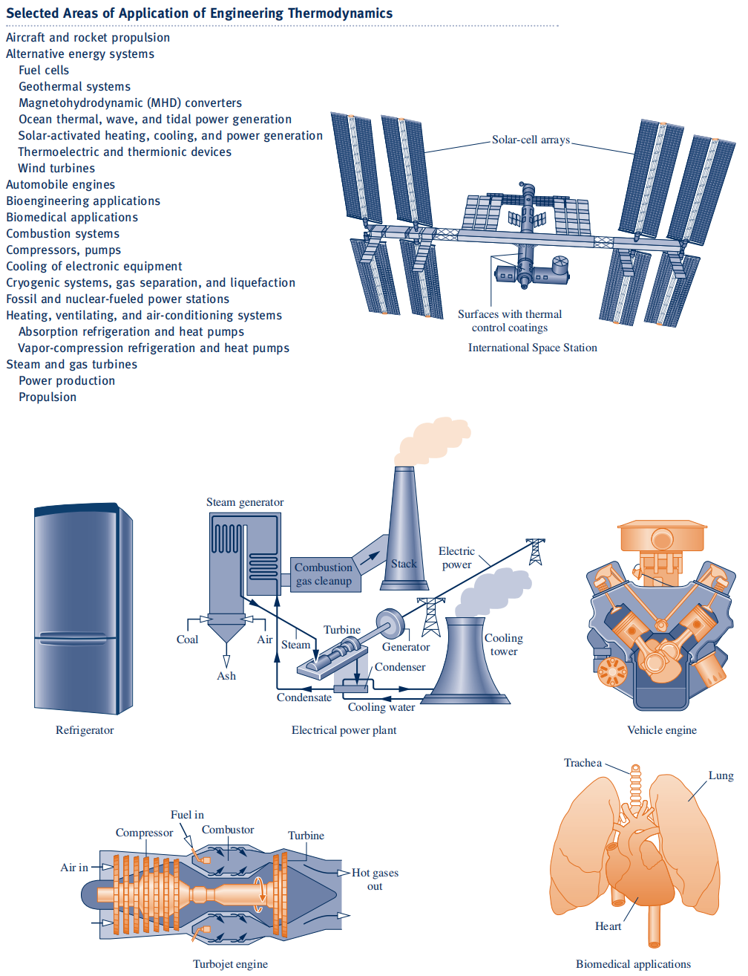
Notes:
Today we are not solving problems.We are learning how thermodynamics thinks

Slide 3
Energy
Power generation
Transportation
Environment
Biomedical systems
Notes:
Thermodynamics is not abstract math—it is everywhere.

Slide 4
What Is Thermodynamics?
Thermo-
dynamics
A synonym for ‘energy’
movement
Study of energy, work, heat
How systems interact with surroundings
Thermodynamics does not care how fast things happen—only where energy goes

Slide 5
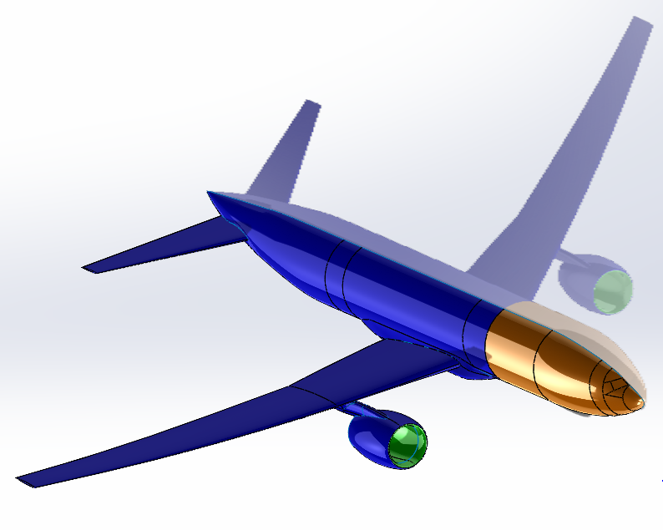
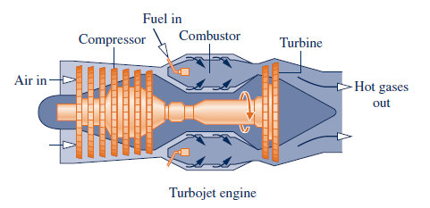
The Concept of a System
SYSTEM = what we choose to study
as simple as a free body or as complex as an entire chemical refinery
The composition of the matter inside the system may be fixed or may be changing through chemical or nuclear reactions
The shape or volume of the system being analyzed is not necessarily constant, as when a gas in a cylinder is compressed by a piston or a balloon is inflated.
Can be anything
Choice depends on question
“The system is NOT given by nature. You define it.”

Slide 6
System, Boundary, Surroundings
SYSTEM = what we choose to study
Surroundings = Everything external to the system
Boundary = an interface which distinguishes the
system from its surroundings
Boundary could be real or imagined, fixed or moving
Boundary choice = modeling decision
Depends on what is known & what is asked
If you draw the boundary wrong, everything after is wrong

Slide 7
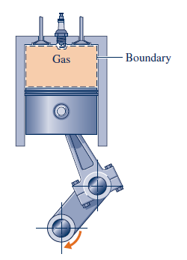
Closed System
Control Mass
It is a particular (unchanging) mass enclosed by a boundary. Heat or work can cross the boundary, but mass cannot.
If Heat or work does not change as well, The system does not interact in any way with its surroundings-an isolated system

Slide 8
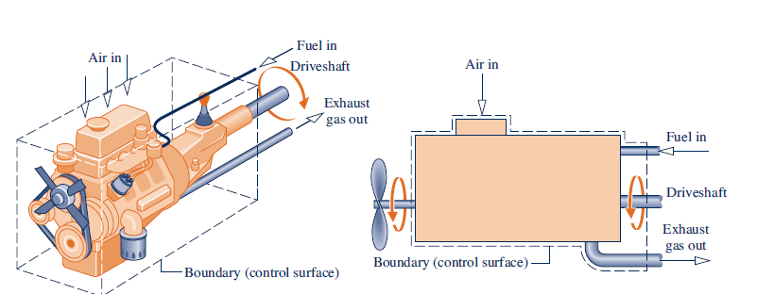
Open System
Control volume
It is a particular volume, enclosed by a boundary (dashed line). Heat, work, and mass can cross the boundary.
Most real machines are control volumes:
Turbine
Pump
Engine
Human lung

Slide 9
System Types
Closed System
(Control Mass)
It is a particular (unchanging) mass enclosed by a boundary. Heat or work can cross the boundary, but mass cannot.
Fixed amount of matter
No mass crosses boundary
Open System
(Control volume)
It is a particular volume, enclosed by a boundary. Heat, work, and mass can cross the boundary.
Specific region in space
Mass can cross boundary
Isolated System
Nothing exchange at all

Slide 10
Conceptual Core - Property
Property : any quantity that describes the state of a system any quantity whose value depends solely on the state of the system under study.
(totally independent of history or future)
Intensive properties – independent on system mass
T, P, density, specific values
Extensive properties – depends on system mass
mass, volume, energy- U, H, S
U: internal energy; H: enthalpy; S: entropy
A
B

Slide 11
State, Process
Usually, with 2 independent intensive properties, we can describe a state
State: condition of system described by properties
ex) state 2, steam at p2, v2, T2, u2, h2, s2, etc
Process: transformation between 2 states
ex) Steam flow through turbine
→ a process from state 1 to state 2
state 1
state 2
p1, v1, T1
p2, v2, T2

Slide 12
Equilibrium
Isolate the system from its surroundings and watch for changes in its observable properties.
If there are no changes, we conclude that the system was in equilibrium at the moment it was isolated.
The system can be said to be at an equilibrium state.
Types:
Thermal
Mechanical
Chemical
Phase
If isolated and nothing changes → equilibrium

Slide 13
Basic Units
SI Units – the foundation of our courses although you are expected to be familiar with English units.
Length – meters
Mass – kilograms
Time – seconds
Temperature - ºC (relative)
- K (absolute)
K = ºC + 273.15
Force – 1 N = 1 kg·m/s²
Energy – 1 J = 1 N·m = 1 kg·m²/s²
Power – 1 W = 1 J/s
Pressure – 1 Pa = 1 N/m² 1 bar =10⁵ Pa = 100 kPa

Slide 14


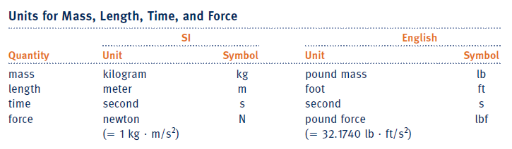
English Units
lbm (or lb), ft, s, lbf, ºF, ºR
1 lbm weight 1 lbf with g = 32.2 ft/s²
→ 1 lbf = 32.2 lbm-ft/s²
or 1 lbm = 1/32.2 lbf·s²/ft
Energy – ft-lbf
Power – ft-lbf/s
Energy/mass -
1 ft·lbf/lbm = 32.2 ft²/s²
lbmol = pound mole
1 lbmol = M lbm
1 Btu = 778.17 ft-lbf
1 hp = 550 ft-lbf/s

Slide 15
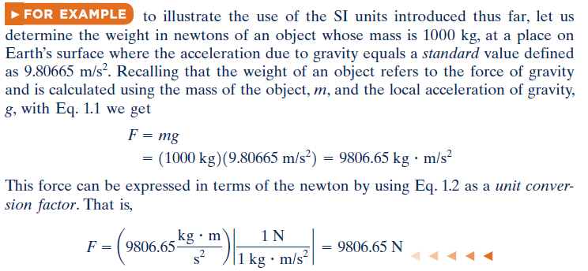
Example

Slide 16

Example

Slide 17

Specific Quantities
Specific volume – v = m³/kg
1 m³/kg = (10² cm)³ / (10³ g) =10³ cm³/g
→ 1 cm³/g = 10⁻³ m³/kg
Specific energy – energy / mass (e.g. u or h) = J/kg = m²/s²
For example:
M = 32 for O₂
M = 28.97 for air
M = 18.02 for water

Slide 18


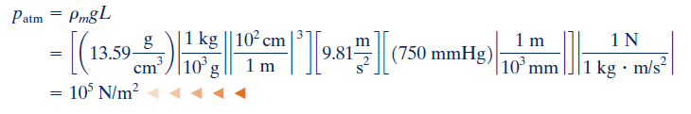

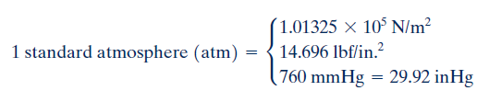
Pressure

Slide 19


Pressure

Slide 20



Temperature
Celsius, Fahrenheit, Rankine scale, Kelvin

