Slide 1
AI Convergence Platform
Stop Wishing, Start Doing and Take command of your life !
Fall, 2022
letsdoit@dankook.ac.kr/letmetry@daum.net
Jaedong LEE, Ph.D

Slide 2
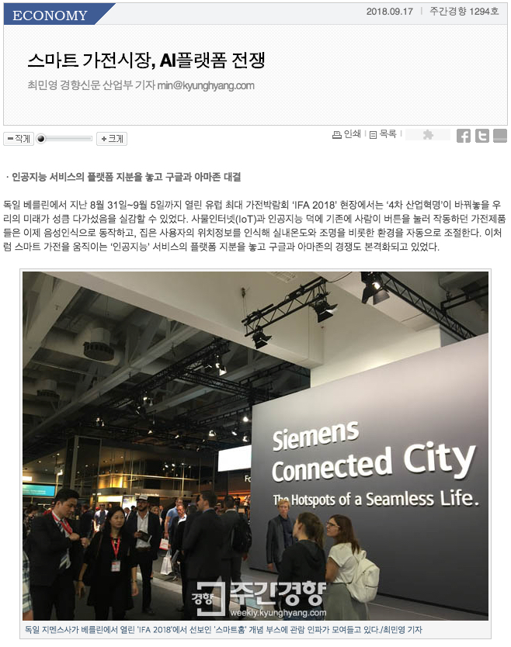
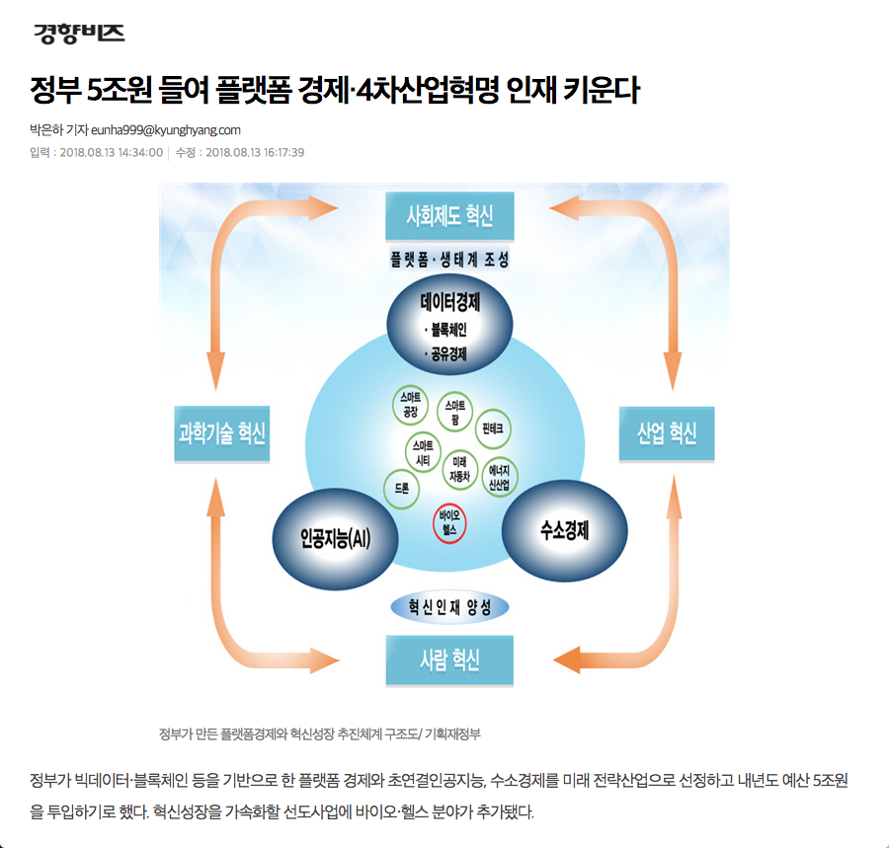
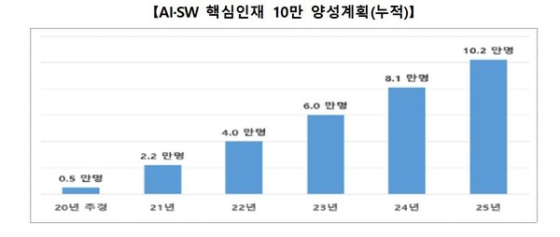

Slide 3

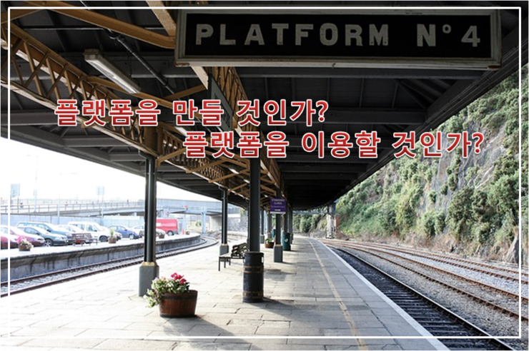
Are you going to build a platform ? Or will you use the platform ?

Slide 4
Why AI Platform ?

Slide 5

AI +AI+AI

Slide 6
Two key criteria by AI for innovation
1. AI technology
Already advanced and will develop rapidly
Currently open source can be easily obtained by anyone
Uber uses the open source such as google map and apple pay etc.
2. Market for Application → Platform
The idea of applying the technology is more important than the technical part in order to preoccupy the market

Slide 7
Platform !!
The platform is already changing the world itself!
플랫폼은 이미 세상 자체를 바꾸고 있다 !
Key Changes of the 4th Industrial Revolution → Platform Revolution
제4차 산업혁명의 핵심적인 변화 → 플랫폼 혁명
At this moment, the market is already dominated by the platform
지금 이순간 시장은 이미 플랫폼이 장악하고 있다
Why are giant companies dominated by the platform ?
왜 거대 기업이 플랫폼에 밀리고 있나 ?

Slide 8







Slide 9
Course Summary
This course examines the many different aspects of the AI convergence platform from various perspectives, namely, necessary technologies, service configurations, business models, and implement environments, and analyzes and learns various types of platforms. For examples, this class investigates and analyzes the platform structure, software architecture of the nations of delivery, Paypal, Airbnb, Amazon, Kakao Talk, and Uber and so on
In addition, students can learn about the necessary technologies for the 4th industrial environment and how to use AI technologies, and designs the future AI platforms that apply this technology. In addition, students will learn how to use the AI convergence platform, which is a future platform, for business & more

Slide 10
Course Goal
Artificial Intelligence Convergence Platform Overview and Definition
Software structure/architecture of AI convergence platform
Core technologies of AI convergence platform (AI, convergence, platform technology, etc.)
Case studies (The nation of Delivery, Uber, Amazon, KakaoTalk, Airbnb, etc.)
Application plan of artificial intelligence convergence platform
Group project

Slide 11
Learning Performance
The learning effect of this course is to acquire knowledge about the structure and utility of the AI convergence platform by analyzing various types of platforms from various perspectives and learning (Case Study) the internal and external aspects of the AI convergence platform.
In addition, by designing a future platform that applies the necessary technologies for the 4th industrial environment (mainly, big data, AI, etc.), students learn how to use the future AI convergence platform for business.

Slide 12
Course Objective Summary
1
The 4th Industrial Revolution and Platform
2
(AI) Platform : Definition, Types, Roles and Case studies
3
Technologies for AI platforms : AI & application
4
Platform Design Method & Strategy (How to Design?)
5
AI Platform Applications, Biz. Model and Start-Up
6
AI Platform Project (Platform Architecture + Biz. Model)

Slide 13
Weekly Lecture Topics (Syllabus)
Introduction of Syllabus (An outline of the subjects in a course)
4th Industrial revolution and required technology
Artificial Intelligence Convergence Platform Overview
Case Study I such as The nations of delivery, Uber and Kakao etc.
Case Study II such as Amazon and Airbnb etc.
Strategy for Future platform design and Characteristics
Success factors and key functions for future platform
Midterm test
Future platform design and implementation plan #1 (modularization and development framework PDLC)
Future platform design and implementation plan #2 (Development framework PDLC: design and implementation)
Subscription Economy and Sharing Economy
AI Convergence Platform 1
AI Convergence Platform 2
Group discussion and presentation
Final Exam

Slide 14
Evaluation
Exams (total 50%)
Midterm exam (30%)
Final test (20%)
Only one Homework Assignments (total 10%)
(Penalty) 20~50% deduction depending on the date submitted
Group project (total 30%)
A proposal + a final document
Any topic related to AI platform
3~4 persons per each team
Members of the same team may have different points depending on the self-evaluation of each team with a total 100%
Class Attendance (10%)
1% deduction per absence, 0.5% deduction per late attendance

Slide 15
Announcement/Notice
Project Based Learning (Future education method)
FAIR
Please follow our class rules and keep common sense
Communication mainly use Kakao Talk and eLearning campus notices
Learning how to design AI Convergence Platform with business model/strategy rather than learning programming/coding techniques
Stay to be fun, be enjoyable and be productive

Slide 16
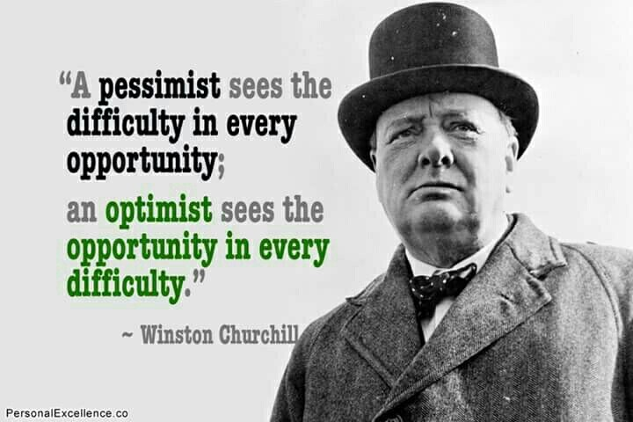
→ Success consists of going from failure to failure without loss of enthusiasm. Never, Never, Never give up !!

Slide 17
Thank you ^^

