Slide 1
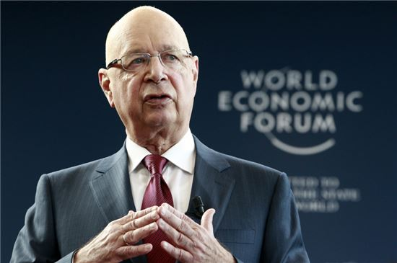
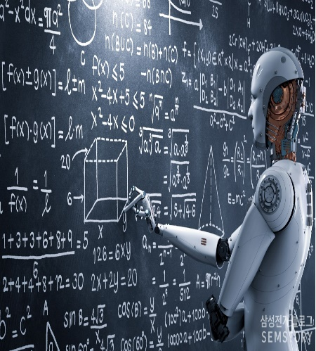
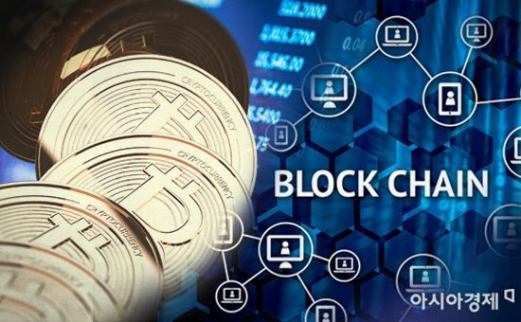
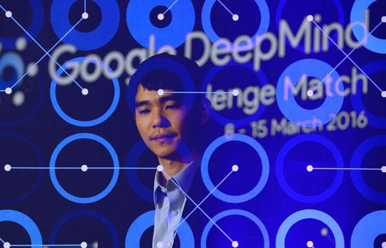
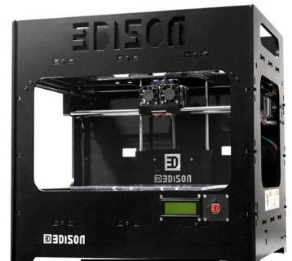
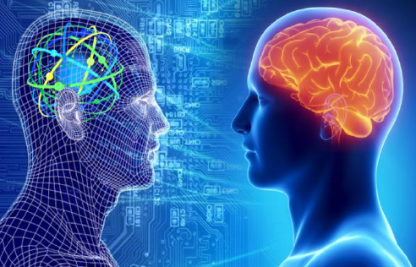
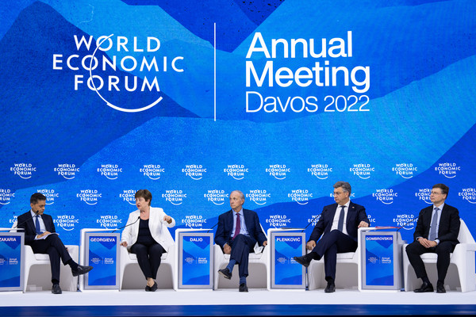

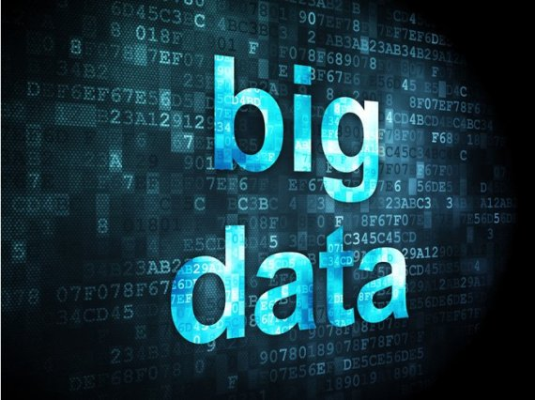
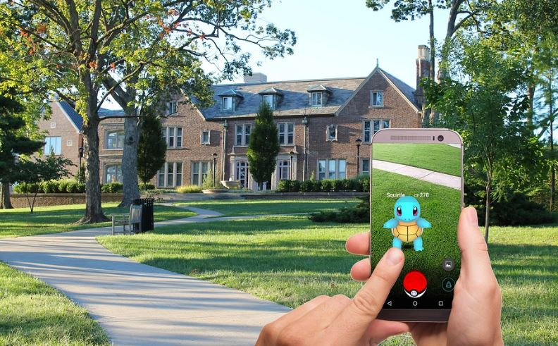
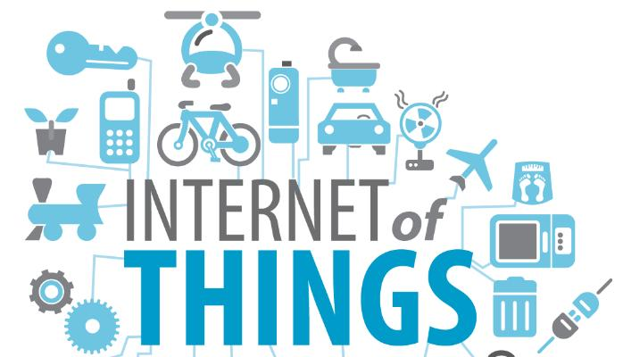

Slide 2
4차 산업 혁명
The 4th Industrial Revolution
Nothing ventured, nothing gained !!
Jaedong LEE, Ph.D

Slide 3
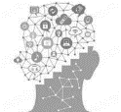





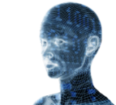





New understanding of the industrial revolution ”The combination of Technology and Desire”
Human’s
New
Desire?
90,000$
Desire of
Survival
700$
Desire of
Stability
2800$
Desire of
Social Connection
20,000$
1st (Machine Revolution)
2nd (Electric Revolution)
3rd (Information Revolution)
4th (Intelligent Revolution)
Supply-oriented → Technology
Demand-oriented → Desire

Slide 4
The 4th Industrial Revolution ?
Hyperconnectivity + Superintelligence
Everything is connected and transformed into a more intelligent society
A revolution in which reality and virtual converge on human beings

Slide 5
The 4th Industry Revolution ?
(참고) 4차 산업혁명 설명 (more details)
4th Industrial Revolution mentioned at the 2016 World Economic Forum(WEF) and representative of the new industrial era based on Information and Communication Technology(ICT). Next-generation industrial revolution, where innovative ICT such as AI, IoT, Bigdata, Mobile converge in the economy and society → A shared revolution in which production and consumption reunite (2016년 세계 경제 포럼(WEF: World Economic Forum)에서 언급되었으며, 정보 통신 기술(ICT) 기반의 새로운 산업 시대를 대표하는 용어. 인공 지능, 사물 인터넷, 빅데이터, 모바일 등 첨단 정보통신기술이 경제·사회 전반에 융합되어 혁신적인 변화가 나타나는 차세대 산업혁명 → 생산과 소비가 재결합하는 공유혁명)
Everything is connected and transformed into a more intelligent society → Super Convergence Social Revolution by ICT such as AI, Big Data, IoT → A revolution in which reality and virtual converge on human beings (모든 것이 연결되고 보다 지능적인 사회로의 변화 → 인공지능, 빅데이터, IoT 등과 같은 ICT 기술에 의한 초융합 사회 혁명 → 현실과 가상이 인간을 중심으로 융합하는 혁명)
“Emerging technology breakthroughs" in fields such as artificial intelligence, robotics, the Internet of Things, autonomous vehicles, 3D printing, quantum computing and nanotechnology. The fourth wave of the industrial revolution is expected to see the heavy implementation of several emerging technologies with a high potential of disruptive effects. (인공 지능, 로봇 공학, 사물 인터넷, 자율 주행 차량, 3D 프린팅, 양자 컴퓨팅 및 나노 기술과 같은 분야의 ＂최신의 기술 혁신". 4차산업혁명은 파괴적인 영향력의 높은 잠재력을 가진 여러 최신 기술들이 강력하게 구현되는 것을 볼 것으로 예상)

Slide 6
New understanding of the industrial revolution
Technology
Innovation
→
Possibility
Human
Desire
→
Necessity
Produc
-tion
Business
Continuity
Consump-tion
Co-evolution of technology and desire
Human desire(Humanities, Sociology) → Humanities (Consumer revolution)
Potential of technology(IT, Science) → Science technology (Production revolution)
Continuity of business (Biz, Economic)→ Economic society (Distribution revolution)
Need Academic Convergence

Slide 7
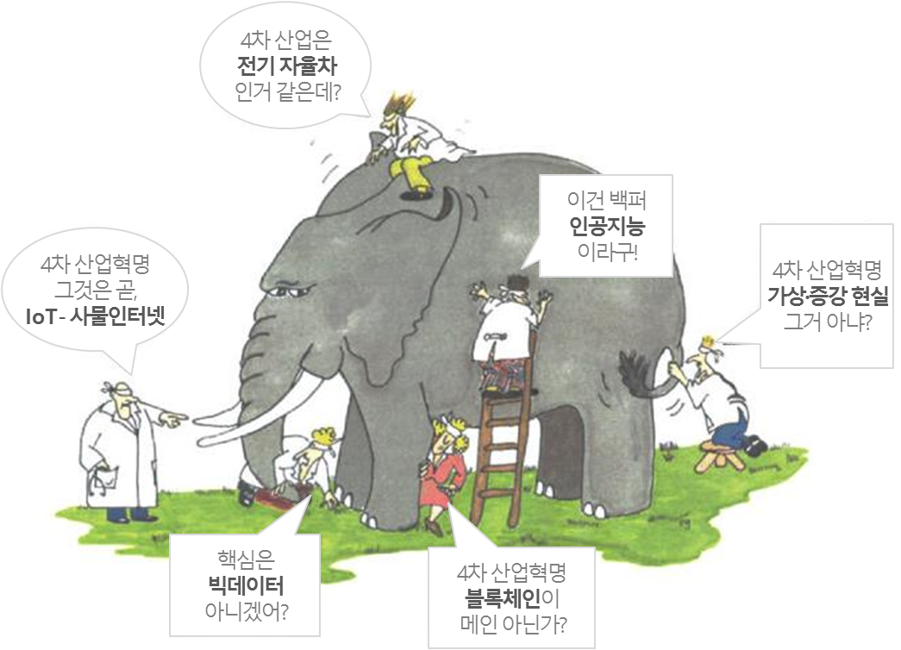
The 4th Industrial revolution, Blind touching elephant?
| Big data | Industrial Internet | AI
Machine Learning | Data Science | Cloud Computing | Virtual Reality
Look at the 4th industrial revolution
In the convergence of the world ^{50 trillion $}

Slide 8

The 4th revolution, Convergence of Real(1st and 2nd) and Virtual(3rd)
Digital Switching
3rd revolution
1st and 2nd revolution
OffLine Real
| Material |
| Possession |
| esource |
OnLine Virtual
| Information |
| Share |
| Relation |
O2O
Analog Switching
4th revolution

Slide 9
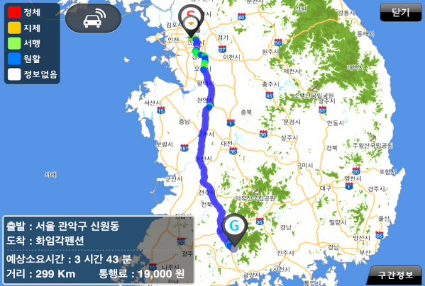
O2O Convergence → By predicting and customizing the virtual world Optimizing Value Creation in the Real World
(ex) Navigation System
Navigator and better traffic
Offline train+vehicle = online map+GPS
Combining dynamic data(traffic data) → Optimal guide
Bigdata-based future directions
Intelligent distributed directions
Customized nearby reservation recommendation
Static data(map) + Dynamic data(traffic)
→ Prediction and Customized service
Factory, Hospital, School, Travel … Every corner of life
Expansion of O2O Convergence

Slide 10
The Fourth Industrial Revolution is the Convergence of reality and virtual for humans

Slide 11
4th Industrial Revolution Model is
4 STEP Convergence

Slide 12

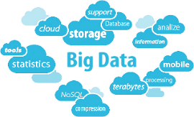
4STEP Convergence & O2O
❷ Save & Analysis
Big data
Online
A.I
❸ Create Value
Prediction
A . I
Customization
Bigdata
Generation
Customization & Prediction
❶ Data Collection
Data
❹ Optimization
Internet of
Everything
IoT+IoB
Offline
into a better world
Internet of
Things
Internet of
Biometry

Slide 13
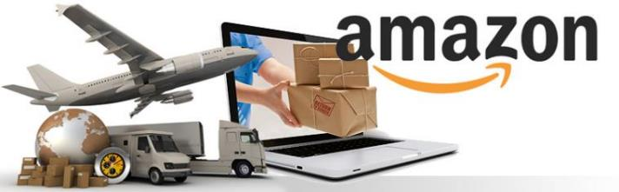
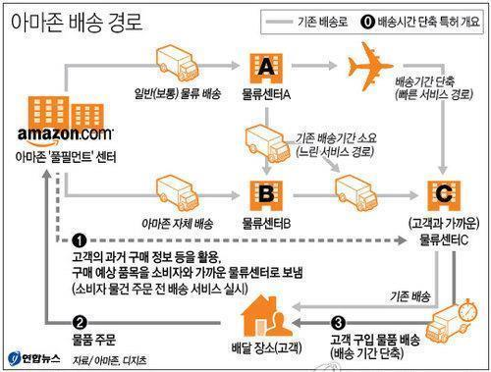
Case : Distribution (Amazon)
❶ Data Collection (IoT)
Collecting customer purchase data
❷ Save & Analysis (CLOUD/BIG DATA)
Buying patterns into Big data
❸ Create Value (A.I.)
Predicting estimated purchase item by AI
❹ Optimization (Technology Convergence)
Pre-order delivery service
Reduced distribution and logistics costs

Slide 14
The 4th Industrial Revolution
6 Tech + 6 Tech + AI

Slide 15
AI + 12 Techs Model
天
6 Digital
Switching
Technologies
Expansion of Time
6 Analog
Switching Technologies
Cloud
Big Data
CPS Design
Blockchain/FinTech
3D Printer/Robot
Prediction
A.I
Customization
AR/VR
Gamification
Wearable IoB
IoT
Platform
Expansion of Space
Expansion of Human
地
LBS
SNS
人

Slide 16
Summary of AI + 12 TECH
6 Digital Switching
6 Analog Switching
IoT
Hyperconnection of objects
LBS
Digitization of spatial information
Cloud
Space of big data
Bigdata
Valuable and huge data
IoB (wearable)
Convergence of humans and smart devices
SNS
Fusion promoting network of humans
CPS Design
Providing services for humans Connecting virtual and physical environments
3D Printer / Robot
Materialize virtual information
AR / VR / MR
Make virtual information a real experience
Block-chain & FinTech
Decentralized trust and trading
Gamification
Motivation of O2O
Platform
Share repeated common competencies
A.I
(Optimization)

Slide 17

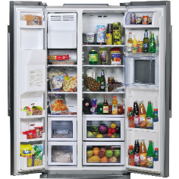


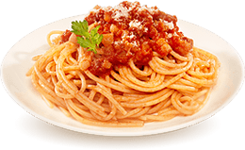

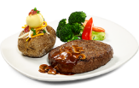



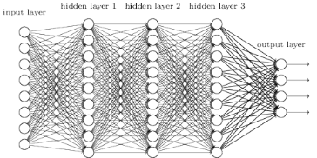
Cooking data to create value
Refrigerator
Ingredients
Chef and Recipe
Delicious dish
Zara’s new model prediction
Netflix’s customized recommendation
Amazon’s order prediction
Robot advisor’s investment
Cloud
Big data
AI algorithm
Prediction / Customization

Slide 18

The fourth industrial revolution is where 12 technologies converge into four stages, with real and virtual being centered on humans

Slide 19
4th Industrial Revolution and
Occupation

Slide 20
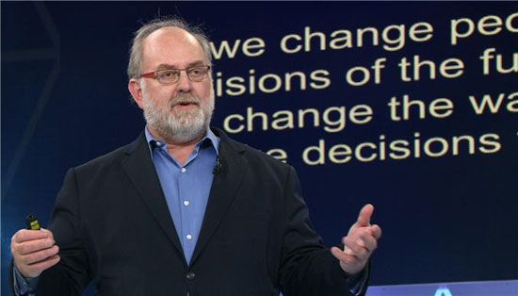
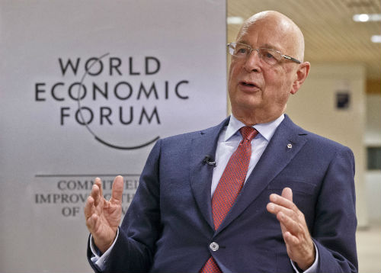
The age of knowledge is gone
&
the age of learning is coming
In the next 15 years, about half of the universities will close.
- Thomas Frey -
Sixty-five percent of the jobs that elementary school students will have today will be completely new jobs that do not exist.
- WEF report -

Slide 21
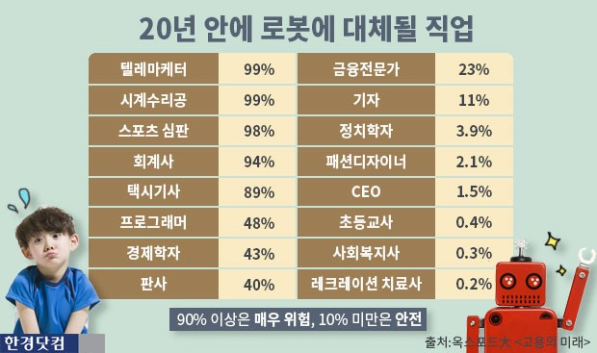

Slide 22
The source of jobs is technological innovation and human needs
Human
+
Technology
Desire
+
Ability
Supply
production
Demand
consumption
Source of Jobs
Human’s desire is source of jobs
Sources of jobs are new technologies and potential desires
Leading supply technology until the 3rd industrial revolution
But, in 4th Industrial Revolution…

Slide 23
→ If Something disappears, Something happens !!
(World Economic Forum, WEF) Two types of occupations that will receive the most attention during the 4th industrial revolution
Data Analyst → Solve technical problems with data
Professional Seller → Someone who can present a characteristic products based on big data
Out of 2 million new jobs, about 20% (400,000) are expected in math/computer field. The advent of the Renaissance in mathematics → Out of pure learning, industrial mathematics uses mathematical theory and analysis methods to solve social problems or create added value
A.I Tutor – Learning artificial intelligence, human communication
Self-driving car engineer – Repairing self-driving car
Robot engineer, Cloning specialist, Biorobot surgeon, Space manager
Cultured meat expert, Quantum computers expert
Body part maker

Slide 24
→ 사라지는 것이 있다면 생겨나는 것도 있다 !!
(세계 경제포럼) 4차 산업혁명 시기에 가장 각광 받을 직종 (2가지)
데이터 분석가 → 기술적 장애가 있는 데이터 문제를 해결
전문 판매자 → 빅데이터를 기반으로 특성있는 상품을 제시할 수 있는 사람
새로 생기는 직업 200만개중 약 20% (40만개)가 수학/컴퓨터 분야로 전망. 수학의 르네상스 시대 도래 → 순수 학문에서 벗어나 산업 수학은 수학적 이론과 분석 방법을 이용해 사회문제를 해결하거나 부가가치를 창출
인공지능 튜터 – 인공지능을 학습시킴. 인간과의 소통
무인자동차 엔지니어 – 무인자동차 수리
로봇기술자, 복제전문가, 생체로봇 외과의사, 우주관리인
배양육전문가, 양자컴퓨터 전문가
신체부위제작자 (Body part maker)

Slide 25
→ If Something disappears, Something happens !!
(Sports field)
A field of a big spotlight in the 4th Industrial Era → Combined with information technology, a new type of product, service, and business model is created.
For examples, a golf robot, a smart bat (swing angle, trajectory, velocity analysis, etc.).
(Media field)
With personalized media and robot journalism, reporters will focus on creative tasks such as investigative reporting and news analysis
(O2O Services)
Omni Channel: All distribution channels → Organically combines offline stores, mobile kiosks, and the Internet that customers use to purchase products to provide customers with a batch of shopping experiences.
Kakao Taxi, Amazon is a human resources broker home service, including plumbing repair and interior design.
Other than that, transportation(car-sharing, proxy driving, parking, etc.) accommodation, property, hospital, pharmacy, beauty care, etc.
(Food Technology)
(Current) Food delivery service and catering business: Evolving from simple brokerage to on-demand real-time delivery
(Future) Customized restaurant, Catering, Virtual restaurant

Slide 26
→ 사라지는 것이 있다면 생겨나는 것도 있다 !!
( 스포츠 분야 )
4차 산업시대에 크게 각광받을 분야 → 정보기술과 결합해 새로운 형태의 제품이나 서비스, 비즈니스 모델이 생김.
예로, 골프로봇, 스마트배트 (스윙각도, 궤적, 속도 분석) 등
(미디어 분야)
개인 맞춤형 미디어, 로봇저널리즘 등장으로 기자들은 탐사보도, 뉴스분석 등 창조적인 업무에 집중할 것
(O2O 서비스)
옴니채널 (Omni Channel: 모든 유통 경로) → 고객이 상품을 구매하기 위해 이용하는 오프라인 매장, 모바일 키오스크, 인터넷 등을 유기적으로 결합해 고객에게 일괄된 쇼핑 경험 제공.
카카오택시, 아마존은 배관수리, 인테리어 등 인력 중개형 홈서비스
그 외, 교통/운수(카셰어링, 대리운전, 주차 등), 숙박, 부동산, 병원, 약국, 뷰티 케어 등
(푸드테크)
(현재) 음식배달서비스와 요식업 : 단순 중개에서 주문형 실시간 배달 진화중
(미래) 맞춤형 식당, 케이터링, 가상 레스토랑

Slide 27
Q & A

