Slide 1
Sharing Economy
and
Subscription Economy

Slide 2

1. Sharing Economy

Slide 3
1. Sharing Economy
It refers to economic activities by recognizing the concept of borrowing and borrowing goods from each other rather than owning them
The sharing economy includes both tangible and intangible types, and can be broadly classified into three categories: 1) sharing, 2) barter, and 3) cooperative community according to the type of transaction. Car-sharing is a typical example of sharing in a way that users can use products or services without owning them. Barter is a method of redistributing goods that are not needed to those who need them.
Finally, collaborative communities deal with both tangible and intangible resources in a way through collaboration between users within a particular community. AirBnB, which provides its own space to travelers, and Wizdom, a knowledge sharing platform, are well-known cooperative community sharing economies.
The sharing economy aims for a win-win structure that benefits users, intermediaries, and society as a whole. For example, while incumbent companies operate separately from the profits earned through product production and sales, and social return, in the sharing economy, not only the parties to the transaction can benefit, but the transaction itself can save resources and solve environmental problems. to contribute to society as a whole.

Slide 4

2. Subscription Economy

Slide 5
2. Subscription Economy
Background
The big axis driving the economy is the rapid shift from ownership to sharing and from sharing to subscription.
Definition and Scope
It refers to a new concept distribution service in which a supplier periodically provides a product or service that a user wants by paying a certain amount. A typical example is a service that allows you to receive and use daily necessities or clothing for a certain amount of money or to use various types of vehicles
In Korea, it started to be introduced around the 2010s, and in the beginning, cosmetics were mainly used, but service items are gradually diversifying into household goods, home shopping, food and beverage, and luxury clothing. Recently, there has even been a service that allows you to choose and change the vehicle you want out of a set number of vehicles by paying a certain amount each month
What is the key to customer-customized subscription service ?

Slide 6
2. Subscription Economy
Model and Type
Unlimited (Netflix model)
Regular delivery type
Rental type (water purifier model)
Effect of Subscription Economy
From the consumer's point of view, a purchasing manager with specialized knowledge selects and delivers excellent products on behalf of consumers, saving time spent choosing products. In addition, from the supplier's point of view, it has the advantage of being able to fully enjoy the effect of promoting its products and understanding the needs of users more easily. For this reason, the subscription economy is in the spotlight as an economic model following the sharing economy.

Slide 7
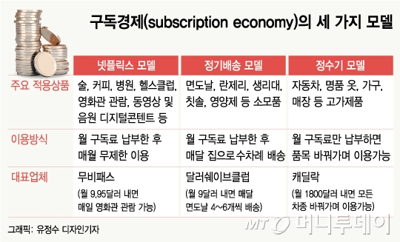
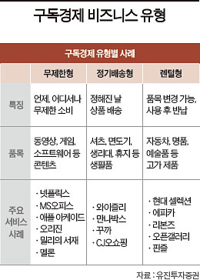
2. Subscription Economy

Slide 8



3. Principles of operation of core IT technologies in the 4th industrial environment
Data Execution
IoT(E)
Internet of Things(Everything)
O2O
Data Connection/Save
E-Commerce
Cloud
Logistics
Thing
Manufacture
Data Collection
인공지능
Optimization
Finance
User
Thing
Connect
Data Analysis
Autonomous vehicles
Big Data
Artificial Intelligent
Thing
User
VR/AR/MR
Data Analysis Application
Deep Learning
Machine Learning
Health Care
Food Tech.
Customization
Platform

Slide 9
Thank you ^^

