Slide 1
Gartner Top 12 Strategic Technology Trends for 2022
2022. 09
단국대학교 정보문화기술연구원/SW학과
원장/교수 이 재 동

Slide 2
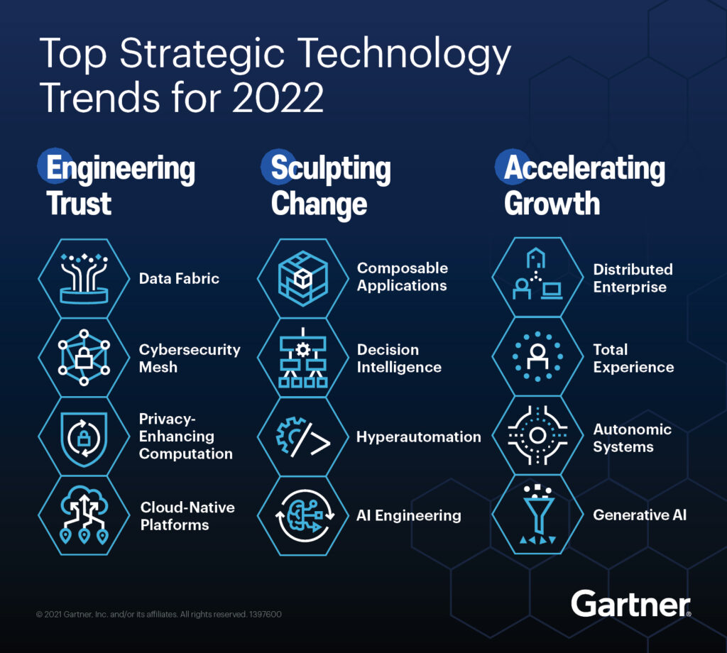

Slide 3
1. Gartner Overview
Gartner is a research company in the IT field that publishes about 9~12 highly reliable strategic technologies every year
Gartner is the world’s leading research and advisory company
Gartner strategic technologies are expected to reach their peak within the next five years with rapid growth as new technologies with innovative potential and showing a wide range of influences and use cases
In 2022, information strategic technology will be presented in accordance with the Accelerating Growth and Sculpting Change and Engineering Trust

Slide 4
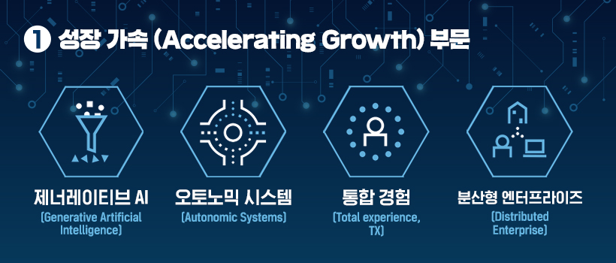
I. Accelerating Growth (성장가속)

Slide 5
I. Accelerating Growth (성장의 가속화)
(2) Generative Artificial Intelligence (생산적 인공지능)
Generative AI refers to artificial intelligence that generates a result according to the request when the user asks the AI to make something
A form of artificial intelligence that can learn even digital representations of artifacts and create completely original and new results
(e.g.) AI DALL.E (Image creation), New Drug Development, Deepfake

Slide 6
I. Accelerating Growth (성장의 가속화)
(2) Autonomic Systems (자치적 독립 시스템)
It refers to a system that manages itself according to the surrounding environment
Without external software update, it can quickly adapt to the changed environment using its own algorithm
(e.g.) The 5G mobile communication base station uses AI to adjust the antenna direction and angle according to the situation

Slide 7
I. Accelerating Growth (성장의 가속화)
(3) Total Experience (TX, 종합적 경험)
Efforts are needed to integrate all experiences, such as customer experience, user experience, employee experience, and multiple experiences, and improve the overall experience of stakeholders
(e.g.) Customers access the service through various devices and channels, and experience the service in various ways. Will customers be able to receive services tailored to their channels and devices each time?

Slide 8
I. Accelerating Growth (성장의 가속화)
(4) Distributed Enterprise (분산형 기업)
Breaking away from the existing centralized corporate operation and business model, independent operation with each distributed system and application, and flexibly connected to each other, must be carried out autonomously
Transformation into a decentralized enterprise that digitizes user contact points but takes a hybrid business approach that can cover both online and offline
(e.g.) Virtual Dressing Room or Virtual Makeup, Metaverse Christmas Market

Slide 9
II. Sculpting Change(기술구현의 변화)
(5) Composable Applications (조합가능 애플리케이션)
Applications that anyone in the organization can easily adapt to and use can make new businesses faster and more flexible
Build each modular component
(e.g.) Using an app development method that can be done “without knowing the code” is called Low Code,
(e.g.) Low-code programming language ‘PowerFX’ that can develop apps with words (Speech)

Slide 10
II. Sculpting Change(기술구현의 변화)
(6) Decision Intelligence (의사 결정 지능)
Decision-making must proceed with more advanced intelligence
It is necessary to model the decision-making process as a set to progressively improve the decision-making process within the organization and to strengthen it to support the majority of human decision-making
(e.g.) Data-Driven Decision Process

Slide 11
II. Sculpting Change(기술구현의 변화)
(7) HyperAutomaion (초 자동화)
Everything that can and should be automated
Hyper-automation is to create a booster for the growth of your business
Automating as many business and IT processes as possible

Slide 12
II. Sculpting Change(기술구현의 변화)
(8) AI Engineering (인공지능 공학)
To maximize the business value of AI, AI models and applications need to be continuously updated and optimized
Simply, it is a continuous update
These areas of AI model update must be formally operationalized and managed to increase business performance

Slide 13
III. Engineering Trust(믿을 수 있는 첨단기술)
(9) Data Fabric (데이터 패브릭)
Design concept in which multiple data management technologies work to support seamless data access and sharing in a distributed network environment
Technology to manage data that will be accumulated in the future along with a lot of data accumulated over the past time
Data fabric, like a tightly woven cotton fabric, means that data sources should be ‘structured’ on the business platform so that data sources can be used flexibly and quickly anywhere, anytime

Slide 14
III. Engineering Trust(믿을 수 있는 첨단기술)
(10) Privacy-Enhancing Computation (PEC, 개인정보보호 강화 컴퓨팅)
Need to realize value by using more diverse data while preserving privacy
The technology was introduced in response to the growing need to share data while maintaining the security of personal information

Slide 15
III. Engineering Trust(믿을 수 있는 첨단기술)
(11) Cybersecurity Mesh (사이버 보안 메시)
It refers to a technology that improves security related to data so that it can be accessed universally and safely even in a distributed and independent computing environment
It means that we have to avoid the risks of traditional business centralization and take both scalability and security
Defines security boundaries based on users or identities, allowing secure access to company-owned data in independent and distributed computing environments

Slide 16
III. Engineering Trust(믿을 수 있는 첨단기술)
(12) Cloud Native Platforms (CNP, 클라우드네이티브 플랫폼)
Beyond simply moving the infrastructure of existing enterprises to the cloud, the need for a cloud-native platform that builds an architecture with wide scalability and agility and elasticity is now emerging
It is a way to minimize the system that has to depend on the infrastructure and maximize the functions of each application
Delivering more scalable and resilient platform services and infrastructure using the core capabilities of cloud computing

Slide 17
Thank you ^^

