Slide 1
Gartner Top 10 Strategic Technology Trends 2021
2021. 09
단국대학교 정보문화기술연구원/SW학과
원장/교수 이 재 동

Slide 2
1. Gartner Overview
Gartner is a research company in the IT field that publishes 10 highly reliable strategic technologies every year
Gartner is the world’s leading research and advisory company
Gartner strategic technologies are expected to reach their peak within the next five years with rapid growth as new technologies with innovative potential and showing a wide range of influences and use cases
In 2021, information strategic technology will be presented in accordance with the flexibility and continuity of business and information technology reflecting the non-face-to-face environment and the COVID-19 environment

Slide 3
1. Gartner Overview
The two core themes in 2020 are People centric and Smart space
People-Centric, Location Independence and Resiliency Delivery as key trends in 2021
People-centric Any technological development is ultimately made for humans. Putting humans at the center of technology strategy emphasizes the most important aspect of technology. In other words, it shows how technology affects consumers, employees, business partners, society, and other members.
Location Independence It refers to new technologies that will allow customers, employees, partners & vendors to overcome physical distances and connect ecosystems. The concept of a company goes beyond offline and also exists online. In other words, it no longer consumes physical time to move
Resiliency Delivery It means that even if business is paralyzed in crisis situations such as economic downturn, natural disasters, or pandemics such as Covid 19, it can be restored/recovered through IT technology.

Slide 4
1. Gartner Overview (참고: 2019 → 2020)
2019년
2020년
Intelligent
NEW
인간중심(People-centric)
Autonomous Things
NEW
초자동화
(Hyperautomation)
Augmented Analytics
인식 및 상호 작용 모델의
다중화(VR/AR/MR)
변경
다중 경험
(Multiexperience)
AI-Driven Development
증강분석 플랫폼으로
AI 분석 전문성의 민주화
변경
전문성의 민주화
(Democratization of Expertise)
Digital
Digital Twins
NEW
인간 증강
(Human Augmentation)
투명성과 추적성은
디지털 윤리와 개인
정보보호 요구를 충족
Empowered Edge
변경
투명성 및 추적성
(Transparency and Traceability)
Immersive Experience
스마트 공간(Smart spaces)
스마트 공간의
중요성 확대
확대
Mesh
유지
자율권을 가진 엣지
(Empowered Edge)
Blockchain
분산형 클라우드
(Distributed Cloud)
Smart Spaces
NEW
유지
자율사물
(Autonomous Things)
All boundary
Digital Ethics and Privacy
변경
실용적 블록체인
(Practical Blockchain)
블록체인 개념을
실용적으로 활용하는 단계로
Quantum Computing
없어짐
NEW
인공지능 보안
(AI Security)

Slide 5
2. Gartner key Strategic Technology (2019 ~ 2021)
2019
Key Trend | Strategic Technologies
Intelligent | (1) Autonomous things
 | (2) Augmented Analytics
 | (3) AI Driven Development
Digital | (4) Digital Twin
 | (5) Empowered Edge
 | (6) Immersive Experience
Mesh | (7) Blockchain
 | (8) Smart Spaces
All Boundary | (9) Digital Ethics and Privacy
 | (10) Quantum Computing
Mesh means a network, and here it refers to a state in which various digital devices are closely connected
2020
Key Trend | Strategic Technologies
People Centric | (1) Hyperautomation
 | (2) Multiexperience
 | (3) Democratization
 | (4) Human Augmentation
 | (5) Transparency and Traceability
Smart Space | (6) The Empowered Edge
 | (7) Distributed Cloud
 | (8) Autonomous Things
 | (9) Practical Blockchain
 | (10) AI Security
The Human-Centered Smart Space is a structure used to shape and evaluate the key impacts of Gartner's strategic technology trends for 2020, highlighting the most important aspect of technology that puts humans at the center of technology strategies
2021
Key Trend | Strategic Technologies
People Centric | (1) IoB : Internet of Behaviors
 | (2) Total Experience Strategy
 | (3) Privacy Enhancing Computing
Location Independence | (4) Distributed Cloud
 | (5) Anywhere Operations
 | (6) Cybersecurity mesh
Resilience Delivery | (7) Intelligent Compasable Business
 | (8) AI Engineering
 | (9) HyperAutomation
Due to COVID-19, many companies have been forced to rapidly transition to digital, and as a result, in recent years, the maturity of technologies such as AI, Big Data, Cloud, and IoT, which can be called digital new technologies, have evolved to the stage of commercialization.

Slide 6
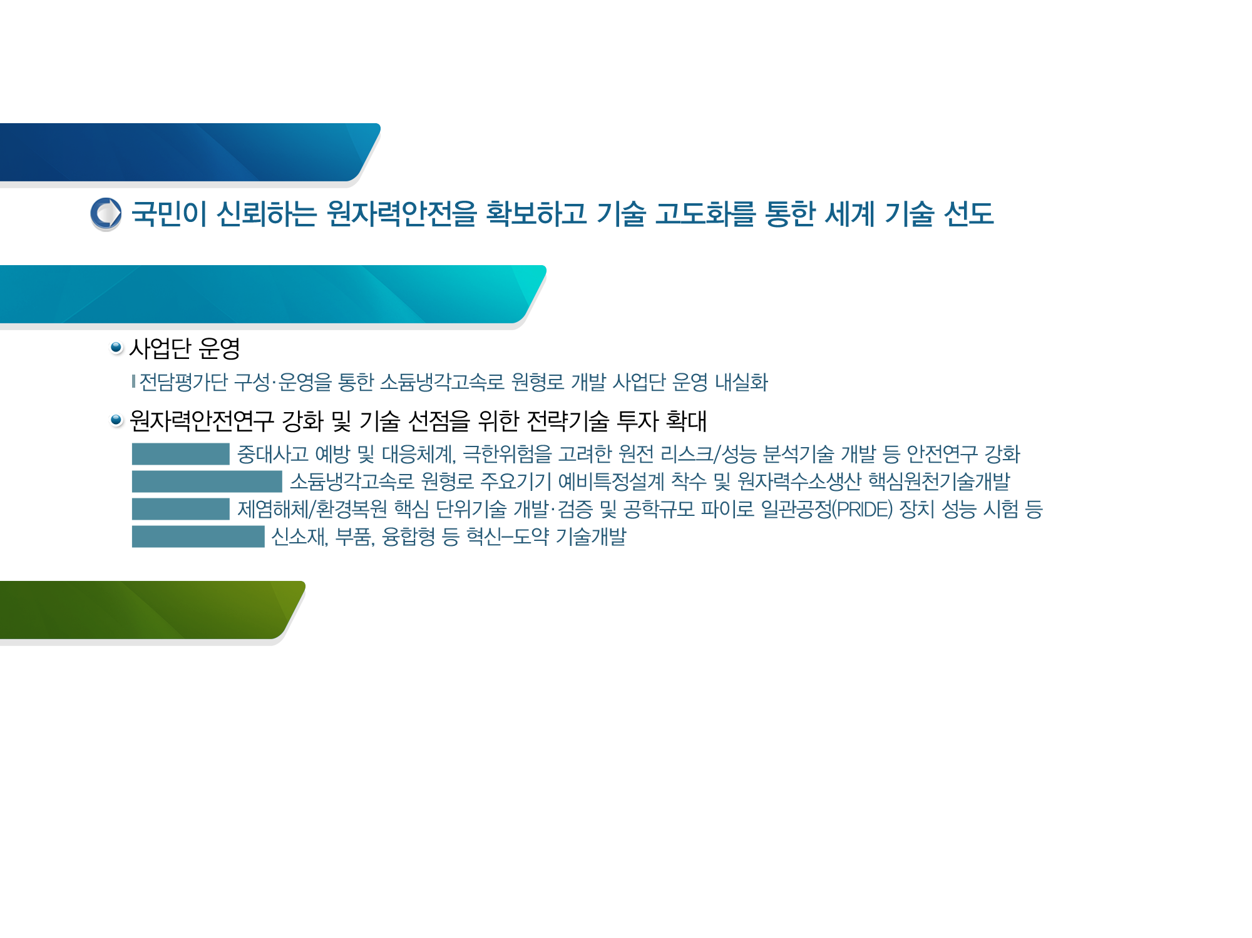
2. Key Strategic Technologies in 2021
(1) 행동 인터넷 (Internet of Behaviors)
Technology that turns people's behavior into big data
Internet that collects, analyzes and predicts human habit or behavior data to induce specific behavior
It is predicted that many actions will become big data in the future and will be used in government policies and corporate strategies
Based on the data, it collects and analyzes behaviors in daily life or online space, i.e., which sites or stores you mainly used, which products you regularly purchase, which posts you liked on social media, and how many videos you watched. It recommends the best option to people. For example, if a user regularly purchases diapers or formula, the information 'parents raising children' is input, and baby products or toys are recommended based on that information
'Healum', which checks users' health information in real time and provides customized medical services and contents, and 'Breinify', which collects consumer data using artificial intelligence and behavioral algorithms to understand the real-time purchase process

Slide 7
2. Key Strategic Technologies in 2021
(2) 총체적 경험 (Total Experience)
An extended version of the multi-experience. A more sophisticated digital world experience will be possible due to technological development, and fields and areas are expected to expand
Strategies for business innovation by combining diverse experiences of customers, employees and users
This is a strategy that aims to achieve a competitive advantage by providing an opportunity to differentiate from competitors by making overall improvements by experiencing all factors in technology

Slide 8
2. Key Strategic Technologies in 2021
(3) 개인정보보호 강화 컴퓨팅 (Privacy Enhancing Computation)
Privacy Enhancing Computation means an environment that observes the following three points
It is predicted that data sharing between institutions and companies will become more active in the future, and encryption methods will be diversified accordingly
Reliable data storage
Distributed work for data analysis
Automatic data encryption

Slide 9
2. Key Strategic Technologies in 2021
(4) 분산 클라우드 (Distributed Cloud)
Technology for distributing cloud servers in each region. This is expected to reduce server management costs and increase the use of low-latency areas
Distributed management of data prevents service delays and enables rapid provision of existing services. Decentralization of data increases the flexibility of physical data expansion and management, and reduces the burden of environmental support and service operation

Slide 10
2. Key Strategic Technologies in 2021
(5) 어디서나 운영 (Anywhere Operation)
To ensure the continuity of business in the non-face-to-face era, it means to achieve digital transformation of information technology infrastructure so that businesses can be operated regardless of location.
A business and operating model designed to deliver business and services anywhere by applying digital technologies. In other words, the era of digital processing beyond the physical space is coming.
Examples currently applied include Internet-only banks, remote collaboration frameworks such as Slack and Zoom, and text messages to inform the situation remotely and ask for cooperation.
e.g., Bank account opening and management services provided non-face-to-face and/or contactless

Slide 11
2. Key Strategic Technologies in 2021
(6) 사이버 보안 메시 (Cybersecurity Mesh)
The new security in the non-face-to-face era means that a security network must be constructed and guaranteed within the connection between individuals and objects
Technology that provides a thorough security system based on the ID of people and things regardless of location
By composing security based on the identity of objects or people, and enabling rapid management/control of such access with modularized responses, a flexible and dense cybersecurity environment can be created
In the past, security was achieved by blocking access from outside the system because digital assets such as data were in the security system. How digital assets, wherever they are located, can identify and access the identity of a 'person' or thing

Slide 12
2. Key Strategic Technologies in 2021
(7) 지능형 컴포저블 비즈니스 (Intelligent Composable Business)
Artificial intelligence technology that helps people make decisions. It is expected that there will be more cases of business operation and new product conception using this technology
The technology works in a way that contributes to decision-making based on big data built on a wealth of data. It is predicted that this technology will be able to plan new business models, entrust autonomous operations, or build the foundation for new products, services, and channels
In the future, companies will need to make quick data-based decisions to achieve digital innovation and good business results, so using intelligent composable business processes will make it easier to access information, understand the meaning of this information, and Add your own insight and be able to respond quickly
Developing new business services in consideration of the bank's customer behavior trends

Slide 13
2. Key Strategic Technologies in 2021
(8) 인공지능 공학 (AI Engineering)
A technology that makes the product envisioned by AI capable of actual production. Through the development of this technology, we will be able to meet more advanced AI systems
AI engineering focuses on managing the overall operation of artificial intelligence models, such as machine learning for AI development or knowledge graph for data management and operation.

Slide 14
2. Key Strategic Technologies in 2021
(9) 초자동화 (Hyperautomation)
Hyperautomation is the combination of multiple machine learning (ML), packaged software, and automation tools to perform tasks
It will develop into a core industry in the future
Hyperautomation is not only a wide range of tools, but also a concept that encompasses all phases of the automation itself (including detection, analysis, design, automation, measurement, monitoring, reevaluation, etc.)
Mainly focused on understanding the scope of automation mechanisms, the relationships between them, and how mechanisms are combined and organized
RPA(Robotic Process Automation), iBPMS(intelligent Business Process Management), Digital Twin etc.

Slide 15
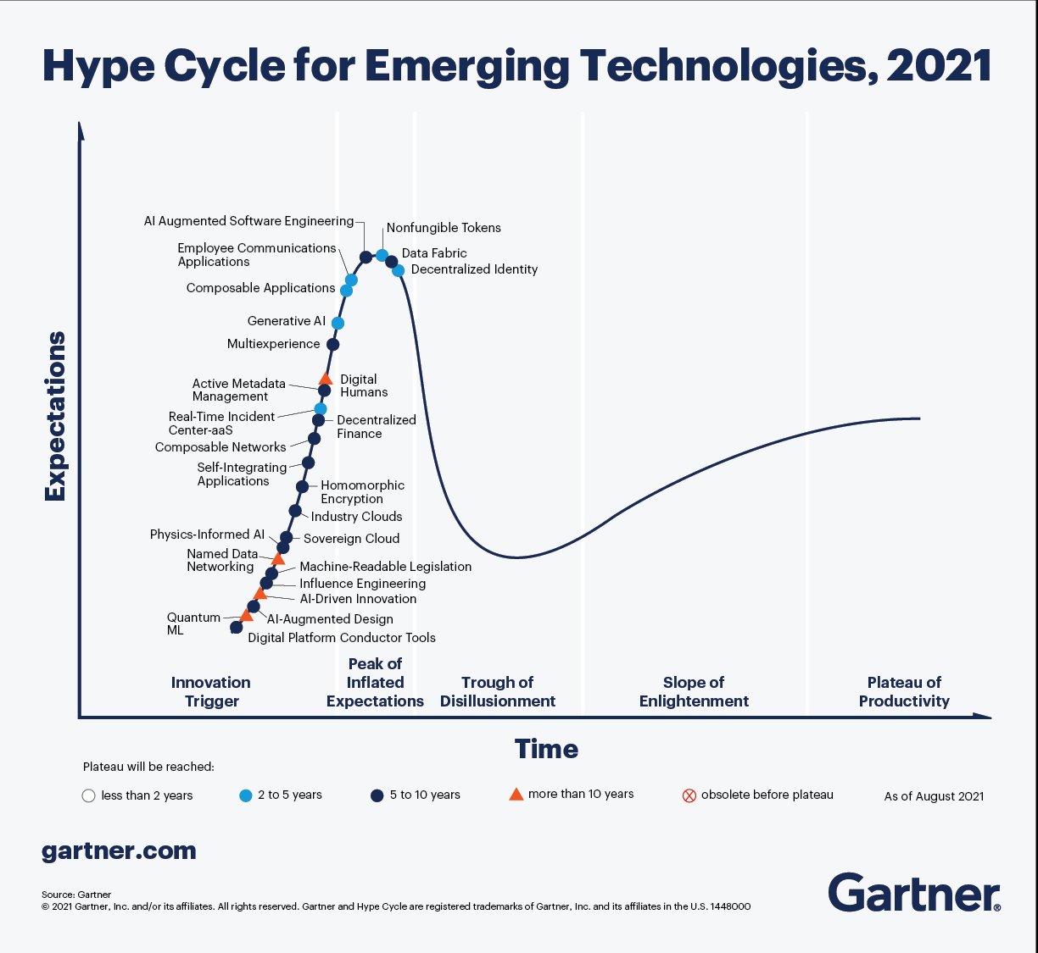
3. Gartner Hype Cycle

Slide 16
4. Gartner Trends Analysis (2016 ~ 2021)
2016
2017
2018
2019
2020
2021
고급 머신러닝
AI와 고급 머신러닝
AI 강화 시스템
AI 기반의 개발
분산 클라우드
분산 클라우드
디바이스 메시
VR/AR
몰입 경험
몰입 경험
다중 경험
총체적 경험
메시 앱과 서비스 아키텍쳐
메시 앱과 서비스 아키텍쳐
Digital Twins
Digital Twins
인간 증강
AI engineering
앰비언트 사용자 경험
Blockchain과 분산 장부
Blockchain
Blockchain
실용적 Blockchain
행동인터넷
3D 프린팅 재료
Digital Twins
엣지 클라우드
강화된 엣지 컴퓨팅
투명성 및 추적성
Anywhere operations
자율 에이전트와 기기
지능형 앱
지능형 앱과 분석
증강 분석
강화된 엣지 컴퓨팅
사이버보안 메시
IoT 아키텍쳐 및 플랫폼
지능형 사물
지능형 사물
사물 자동화
초자동화
초자동화
만물정보
대화형 시스템
대화형 플랫폼
스마트 공간
기술의 대중화
개인정보보호 강화 컴퓨팅
고급 시스템 아키텍쳐
디지털 기술 플랫폼
이벤트 기반 모델
디지털 윤리 및 개인정보보호
자율 사물
지능형 구성 가능한 비즈니스
반응형 보안 아키텍쳐
능동형 보안 아키텍쳐
CARTA
양자 컴퓨팅
AI 보안

Slide 17
4. Gartner Trends Analysis (2016 ~ 2021)
2020년까지 디지털 비즈니스 기회를 구체화하게 될 것으로 예상하며 알고리즘 비즈니스에서 사람이 직접 개입하지 않아도 많은 업무 처리가 가능할 것으로 예측함
지능형 디지털 메시와 관련되어 있고, 지능형 디지털 메시는 미래 디지털 비즈니스와 생태계를 위한 기초임
People-Centric과 Smart Spaces, 두 가지 키워드를 중심으로 특정 기술 한 가지가 아닌 전략기술의 융합을 통한 비즈니스가 이루어진 기술 형태의 구성을 제안하였음
2016
2018
2020
지능형 디지털 메쉬를 위한 기초를 준비하는 것으로 디지털 세계와 물리적인 세계가 좀 더 긴밀하게 연결되고 있는 상황에 초점을 맞춤
지능, 디지털, 메시는 지난 2년간 지속적으로 주목받았던 주제로 2019년에도 주요한 성장 요인으로 꼽히며, 이 세 가지는 지속적인 혁신 프로세스를 추진하는 핵심요소임
2017
2019
2021

Slide 18
4. Gartner Trends Analysis (2016 ~ 2021)
AI
AI를 실제 개발 도구로 사용,
머신러닝을 이용하는 증강 분석 개념 추가
AI 유지보수 및 확장성을 위한 AI engineering 개념 추가
AI 개념 추가
AI 능력 향상
2016
2017
2018
2019
2021
고급 머신러닝
AI와 고급 머신러닝
AI 강화 시스템
AI 기반의 개발,
증강 분석
AI engineering
연결 & IoT
IoT 기술을 기반으로 한 IoB 기술의 등장,
연결 기술의 발달로 어디서나 서비스 제공이 가능해짐
메시 개념이 확장되어 스마트 공간으로 제시
웨어러블 디바이스의 발달로 물리적 증강이 이뤄짐
메시 개념들과 IoT개념이 하나로 통합
2016
2017
2019
2020
2021
메시 앱과 서비스 아키텍쳐
스마트 공간
인간 증강
(물리적 증강)
행동 인터넷,
Anywhere operations

Slide 19
4. Gartner Trends Analysis (2016 ~ 2021)
Cloud
센서, 스토리지, AI 기능들을 엣지에 탑재할 예측이 추가됨
거리 감소 및 스마트 공간 형성 및 증가 방법 주목,
분산 클라우드 개념 추가
COVID-19로 인한 분산 클라우드의 중요성 대두
2018
2019
2020
2021
엣지 클라우드
강화된 엣지 컴퓨팅
강화된 엣지 컴퓨팅,
분산 클라우드
분산 클라우드
Automation, Digitalization
지능형 앱 개념은 AI로 통합,
지능형 사물을 통한 자동화 개념 추가,
Digital Twins 향후 전망 예측 추가
COVID-19로 인해 Digital First의 요구가 높아져 초자동화의 필요성이 더욱 대두됨
자율 에이전트와 기기가 각각 지능형 앱과 사물로 개념이 나눠짐,
Digital Twins 개념 추가
자동화 개념이 초자동화로 확장,
지능형 사물의 확장 개념인 자율 사물 등장
지능형 앱과 Digital Twins의 개념이 구체화 됨
2016
2017
2018
2019
2020
2021
자율 에이전트와 기기
지능형 앱,
지능형 사물,
Digital Twins
지능형 앱과 분석,
지능형 사물,
Digital Twins
사물 자동화,
Digital Twins
초자동화,
자율 사물
초자동화

Slide 20
4. Gartner Trends Analysis (2016 ~ 2021)
Experience
대화형 시스템 개념이 플랫폼으로 확장,
VR/AR 기술의 통합 및 가치 하락
몰입 경험 개념 확장 및 제공된 경험을 통해 인지적 증강이 이뤄짐
대화형 플랫폼과 기존 몰입 경험이 통합
다중 경험 개념의 확장
2017
2018
2019
2020
2021
VR/AR,
대화형 시스템
대화형 플랫폼,
몰입 경험
몰입 경험
다중 경험,
인간 증강(인지적)
총체적 경험
Digital Business
고급 시스템 아키텍쳐는 디지털 기술 플랫폼의 구성 요소로 통합
구체적인 모델의 제시
2016
2017
2018
2021
고급 시스템 아키텍쳐
디지털 기술 플랫폼
이벤트 기반 모델
지능형 구성 가능한 비즈니스

Slide 21
5. Review
First of all, it is possible to confirm the continuous interest and development of AI technology, and although AI technology and machine learning technology were only partially applied to real life in 2021, it was revealed that they have been lit up based on predictions in 2017. As the platform and mesh technology develop, you can check the keywords of AI technology that are increasingly combined with other elements
In addition, security technology keywords tend to materialize as time goes by. If the structure of a dynamically applied security system has been studied in the past, as AI technology and big data utilization platforms develop, security that can be dynamically applied to more diverse and specific situations Tendency to focus on technology
Among the keywords that existed and were merged with other technologies, there were keywords that had high potential before, such as IoT and 3D printer, which were previously illuminated. As printers are commercialized to some extent and applied to everyday life, technologies with lower potential naturally tend to deviate from keywords.

Slide 22
Thank you ^^

