Slide 1
플랫폼 비즈니스 모델 그리고 사례

Slide 2
Open Market (Online Shopping Website)
Online Direct Marketplace
An e-commerce site → Mediated platform that allows you to sell products directly to buyers through stores opened by individuals or small businesses online. Individuals and small retailers can freely trade products online.
The open market is Korean style expression → Online Shopping Website
Unlike general internet shopping malls operated by home shopping, department stores, or large marts, open markets can sell products directly to buyers without any intermediate distribution margin between product producers and sellers.
11th Avenue, eBay (acquired Auction + G Market → eBay Korea)
Amazon sells both direct purchase and open market
Japan's Rakuten & China's Taobao (by Alibaba)

Slide 3
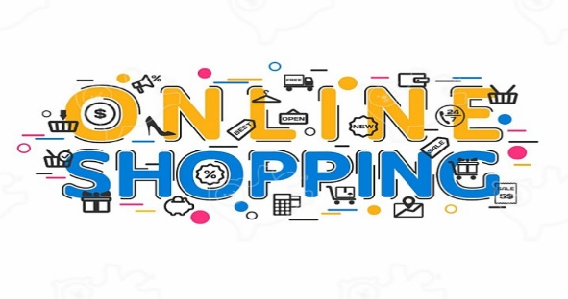

Open Market
(Virtuous cycle structure for Open market platform)
Relatively inexpensive product sales (low fees/commission)
Inexpensive(cheap), so attracting many buyers
Many buyers → margin can be further reduced (quick sales at small profits)
Get cheaper, More buyers
Open Market collects more buyers through media ads., events, coupons, and more

Slide 4
SNS (Social Media)
Online service that builds a network of people who share certain interests or activities
Services that mediate and facilitate social relationships and interactions among users
(Wikipedia) An online service or platform that builds and shows an exchange or exchange between people who share their interests or activities.
Social media in English. Person-Centered Relationships and Services
(e.g.) Instagram, YouTube, Facebook, Twitter, TikTok, LinkedIn etc.

Slide 5
SNS (Social Media)
(Types)
General-purpose SNS: Establish all kinds of social relationships without being limited to a specific field
YouTube, Facebook, Kakao Story, etc.
Vertical SNS: Establish social relations limited to specific fields such as shopping game and alumni etc.
LinkedIn: social relationships between business and technology professionals
Between: forming social relationships between couples
In Vertical SNS, there are always room/gaps to open (cultural and regional characteristics)

Slide 6
SNS
(Characteristics)
SNS is viewed as a marketing tool
It is often observed in the tradition of communication research from the perspective of SNS as computer mediated communication
It is a view of SNS from a social network, there is a primary interest in showing the network structure itself and its structural features
It is a perspective of politics, political communication research, etc. from the perspective of viewing SNS as a place where power relations or influences are revealed or exercised
It is a perspective that considers SNS as the subject of computer application research

Slide 7
SNS
(Issues)
One of the biggest controversies continues to be privacy concerns/protection
It is a matter of potential abuse of private information
It's an online attack problem called "cyber-bullying."
(Revenue Model)
Advertising revenue (more than 90%)
Income from payment fees through mediation such as commerce and games
Building a successful ecosystem is a big factor for survival → Providing various applications → Increasing activity
Facebook vs MySpace/Cyworld

Slide 8
1. MicroSoft
Why does Microsoft struggle with new businesses despite having a lot of cash and talented people ?
(Summary)
Multinational Corporation founded by Bill Gates with Paul Allen in 1975
It is the world's largest software company, and is the creator of the software “Industry”
Main income: Windows, MS Office (killer app), enterprise (Enterprise SW & Service)
Acquisition failure cases: Nokia ($72 billion, 2014), aQuantive ($62 billion/about 7jo, 2007)

Slide 9
Forgetting their duty as an infrastructure platform company → The success of the platform is achieved through developers devoted to the platform with passion → Increasing users (building a virtuous cycle ecosystem)
Continued fail of developer ecosystem based on MS technology → developer strategy failed
Windows 95 (Visual Basic, Visual C ++) → Visual Studio 97
Launch of .NET brand to compete with Java → Destroy existing ecosystem → Leave developers
Organizational culture is bureaucratized
Absence of Leadership: Bill Gates → Steve Ballmer (2001~2013) → Satya Nadella

Slide 10
(Future prospect ?)
New business success will not be easy due to fundamental problems → Innovative approach required
To abandoning the Windows monopoly strategy, such as releasing Microsoft Office to macOS, iOS and Android, the strategy of embracing the Linux environment under the name of WSL and investing aggressively in Cloud Computing has been very successful, and since in 2018, it is in a perfect recovery. It has been successful and is called MAGA along with Apple, Google, and Amazon, and is said to have re-entered the heart of Silicon Valley

