Slide 1
Software Engineering
Chapter 2
Software Life Cycle &
Software Process

Slide 2
Table of Contents
Software Process
Process Models
  - Waterfall Model
  - Prototype Model
  - Spiral Model
  - RAD
  - Formal Methods
  - Component Based Development ➔ next
  - Agile Process Model (XP, Agile) ➔ next
  - Unified Process Model (UP) ➔ next

Slide 3
I. What is Process?

Slide 4
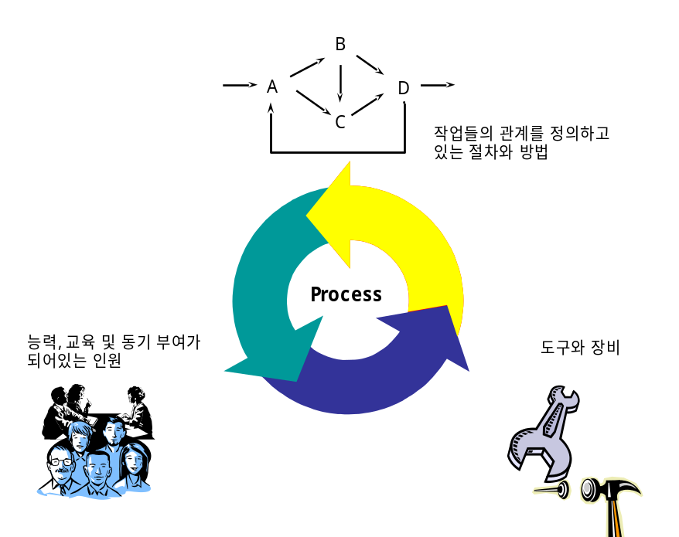
Process?
의미
  주어진 목적을 위해 수행되는 일련의 절차
역할
  절차, 인력, 기술을 통합
  각 순서와 활동이 명확하게 정의
    조직원들의 행동 양식을
    지정해주는 역할
Example?
Process vs. System
프로세스

Slide 5
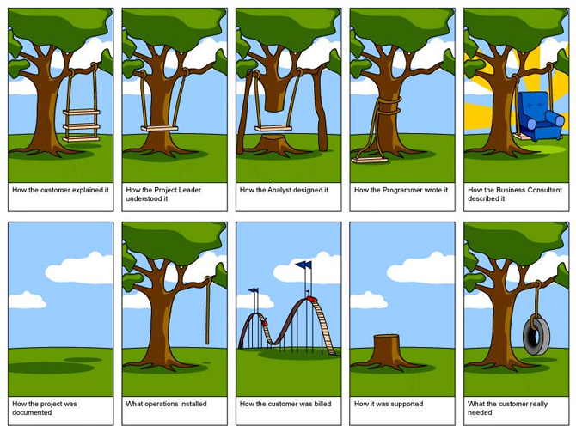

Slide 6
1.Definition of Process
The set of steps and activities and associated results which produce a software product
소프트웨어제품을 생산하기 위해 적용되는 과정과 활동 그리고 산출물들
=> the way we produce software
Definition:
  The Software Process is a description of the process which becomes the guideline for software engineers as they work by identifying their roles and tasks.

Slide 7
2. Five Basic Steps (Activity) of SW Process
  Analysis : defining what the system should do
  Design : defining the structure of the system (How)
  Implementation : implementing the system
  Validation : checking that it does what the customer wants
  Maintenance : changing the system in response to changing customer needs
  These steps and activities can be refined into more sub-activities according to the process models

Slide 8
Process may include:
  Products : the outcomes of a process activity
  Roles : reflects the responsibilities of the people involved in the process;
  Pre- and post-conditions : statements that are true before and after a process activity has been enacted or a product produced.

Slide 9
3. Plan-driven and Agile processes
Plan-driven processes
all of the process activities are planned in advance and progress is measured against this plan
In agile processes
planning is incremental and it is easier to change the process to reflect changing customer requirements.
In practice, most practical processes include elements of both plan-driven and agile approaches.
There are no right or wrong software process

Slide 10
Classification of S/W processes
The waterfall model
  Plan-driven model. Separate and distinct phases of
  specification and development.
Incremental development
  Specification, development and validation are interleaved.
  May be plan-driven or agile.
Reuse-oriented software development
  The system is assembled from existing components.
  May be plan-driven or agile.
In practice, most large systems are developed using a process that incorporates elements from all of these models.

Slide 11
Part Two
Software Process Models

Slide 12
Generic Software Process Models
(Life Cycle Models)
Code-and-Fix Model
The waterfall mode
The Prototype model
The RAD model
Evolutionary development
  Spiral Model
Formal systems development
  A mathematical system model is formally transformed to an implementation
Component (Reuse) based development
  The system is assembled from existing components
XP, Scrum Model
Unified Process Model

Slide 13
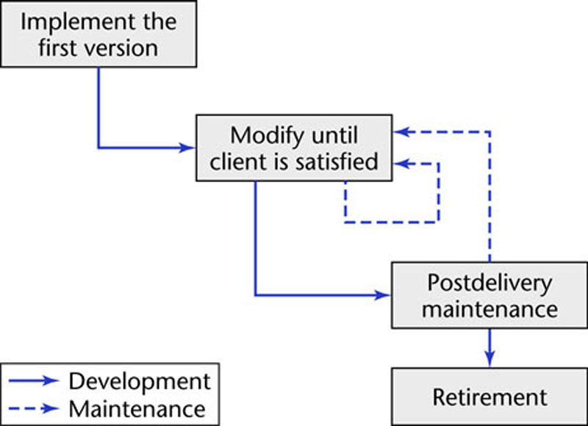
1. Code-and-Fix Model
(코딩-수정 모델)
No design
No specifications
Maintenance nightmare
The easiest way to
develop software
The most expensive way

Slide 14
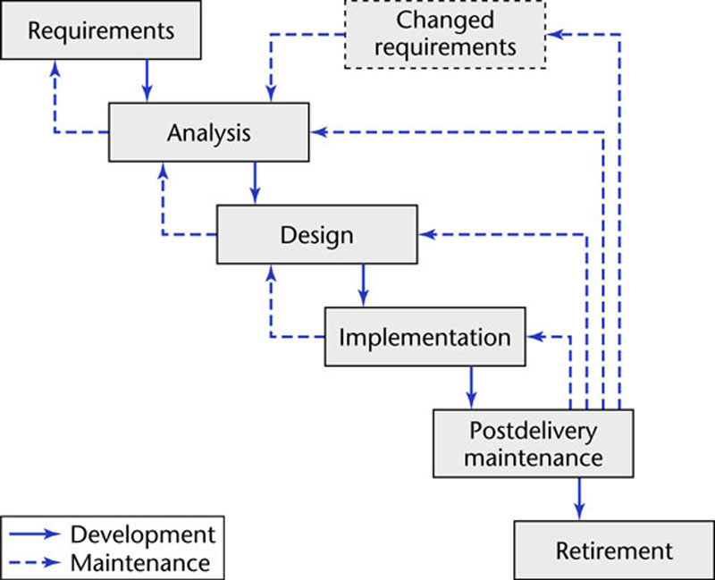
2. Waterfall Model (Linear Model)

Slide 15
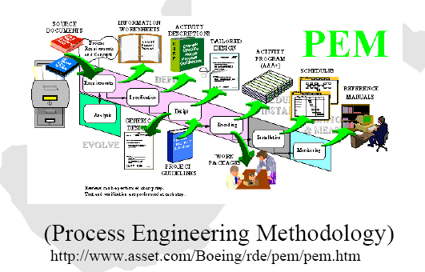
Waterfall and its results

Slide 16
Characteristics of Waterfall model
Classic Life Cycle (plan-driven process)
Useful for problems that are well understood
Real problems are more complex than that; changes = confusion
Customer must state all requirements upfront but it is almost impossible
Customer must have patience until code is ready
Lack of feedback to the customer makes blunders disastrous

Slide 17
3. Prototype Model
Throw-away (Rapid) prototyping
  Objective is to understand the system requirements. Should start with poorly understood requirements
    Develop “quick and dirty” system quickly;
    Expose to user comments;
    Refine;
  After catching requirements, develop the real system
  Particularly suitable where:
    detailed requirements not possible;
    powerful development tools (e.g. GUI) available
Evolutionary prototyping is another approach

Slide 18
Process model
Build Prototype
Requirements
Gathering
Customer Evaluation of Prototype
Customer satisfied
Quick Design
Design
Refine Requirements
Implement
Test
Maintain

Slide 19
A prototype is
a toy implementation of a system:
  limited functional capabilities
  low reliability
  inefficient performance
  Graphical user interface is widely used
  Illustrate to the customer: input data formats, messages, reports, or interactive dialogs.

Slide 20
A prototype is
an initial version of a system used to demonstrate concepts and try out design options.
A prototype can be used in:
  The requirements engineering process to help with requirements elicitation and validation;
  In design processes to explore options and develop a UI design;
  In the testing process to run back-to-back tests.

Slide 21
Benefits of prototyping
Improved system usability.
A closer match to users’ real needs.
Improved design quality.
Improved maintainability.
Reduced development effort.

Slide 22
4. Spiral model
Process is represented as a spiral rather than as a sequence of activities with backtracking => evolutionary approach
Each loop in the spiral represents a phase in the process.
No fixed phases such as specification or design - loops in the spiral are chosen depending on what is required
Risks are explicitly assessed and resolved throughout the process

Slide 23
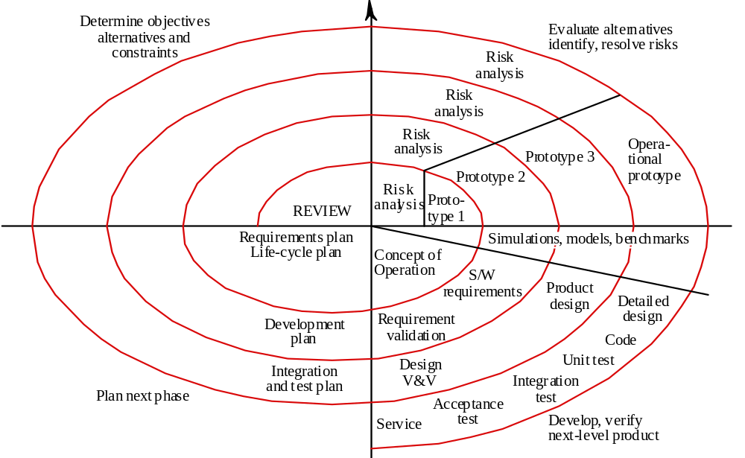
Diagram of Spiral Model

Slide 24
Risk?
People problems
Expected H/W is not supported due to the bankrupt
Too much time for testing
Competitor announces the better similar product
Integration becomes failure
➔ construct the prototype and test it fully
(proof-of-concept prototype)
if it is impossible to eliminate significant risks
=>

Slide 25
Characteristics of Spiral Model
Combines iterative prototyping with systematic aspects of the waterfall model
Can be used throughout the S/W life cycle:
from conceptualization to maintenance
Anchor point milestones:
  Work products
  Required conditions to be attained
Realistic to the development of large-scale systems
  Iteratively reduces risk
  Allows repeated use of the prototyping approach
PROBLEM: Customers may not like it, fearing lack of control
S/W is still developed in discrete phases
➔ Need another approach ( Iterative-and-incremental model)

Slide 26
5. RAD 긴급 응용 개발 모델
(Rapid Application Development
Emphasizes short development cycle
If requirements are well understood and project scope is constrained, it may allow rapid creation of S/W systems
For large projects may require vast human resources (for many RAD teams)
Developers and customers must be able to cope with fast action
For systems that are not highly modularized, the RAD approach may not work
If systems require mutual tuning of various components, the RAD approach may not work
RAD may not be appropriate with technical risks high (new technology)

Slide 27
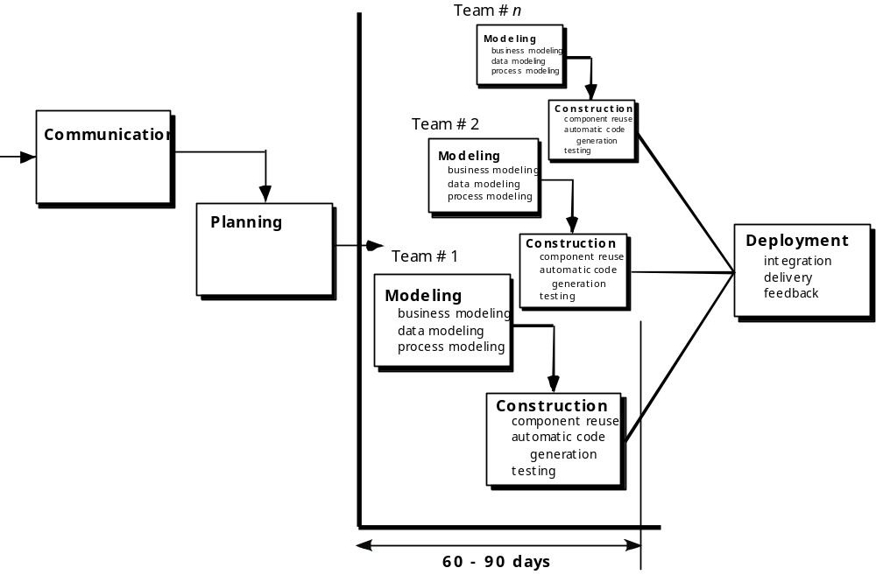
RAD Model

Slide 28
6. Formal Methods
Based on the transformation of a mathematical specification through different representations to an executable program
Embodied in the ‘CleanRoom’ approach (which was originally developed by IBM) to software development

Slide 29
Characteristics of Formal Methods
Use of mathematical techniques to specify the requirements of the system e.g the B method, Z, VDM, Object-Z, Larch
Mainly used in safety or mission-critical applications, e.g heart pacemakers, NASA
Can get a very high quality software
Problems
  Time-consuming and expensive
  Few developers have necessary skills, so extensive training required
  Difficult to use as a tool to communicate with users

Slide 30
Examples
Their principal benefits are in reducing the number of errors in systems so their main area of applicability is critical systems:
  Air traffic control information systems,
  Railway signalling systems
  Spacecraft systems
  Medical control systems
In this area, the use of formal methods is most likely to be cost-effective
개발 비용이 많이 든다. 하지만 확실한 소프트웨어 개발 가능
Formal methods have limited practical applicability

Slide 31
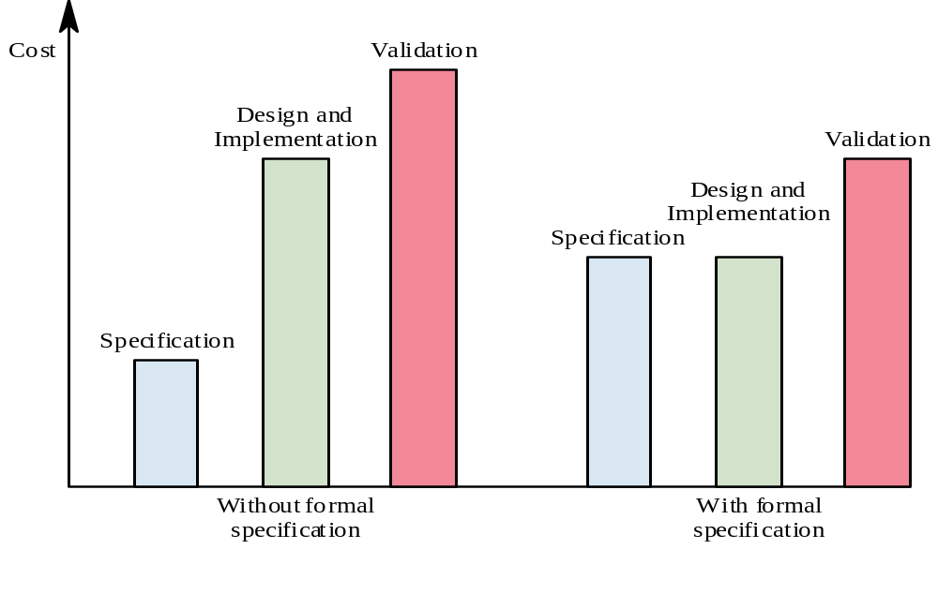

Slide 32
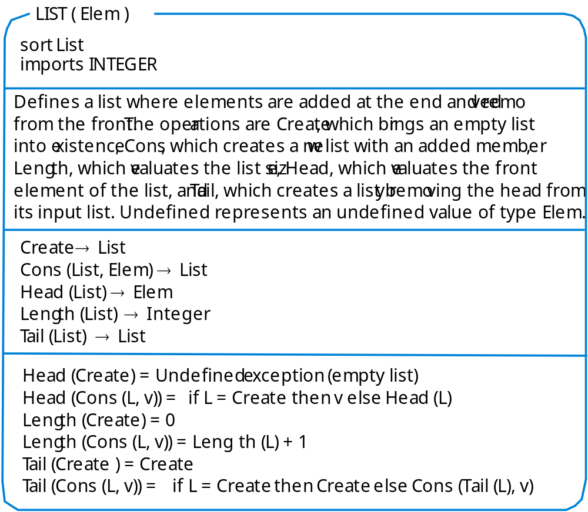

Slide 33
홈페이지 과제
Wix 또는 wordpress 등 홈페이지 저작도구를 사용하여 강의 수업 내용 및 수업시간에 특별히 과제로 언급된 내용을 홈페이지로 개발함
중간고사 이후, 기말 고사 이후 평가
평가 기준 : 디자인, 컨텐츠 등등

Slide 34
1차 팀 프로젝트
주어진 주제를 요구사항정의, 분석을 진행 (주제 변경 가능)
UML을 이용한 모델링 및 문서화
  Use case diagram : package 사용, 통합된 다이어그램
  Use case documents : package 단위로 2개씩
  개념 클래스 다이어그램 : package 단위 또는 통합
  분석 클래스 다이어그램 : package 단위 또는 통합
추진 일정
  10/21 : 중간고사
  10/30 : 온라인 제출 (이러닝에 pdf로)
  11/4 : 발표 (발표자료 출력된 paper로 수업 전 제출)
  11/11 : 최종 제출 (수정된 내용을 paper로 제출함)

Slide 35
발표자료 구성안
팀 주제 소개 : 기존 참고 시스템 개요
팀원 소개
Use case diagrams + documents (2개정도)
개념 클래스 다이어그램
분석 클래스 다이어그램
다이어그램은 UML 저작 도구를 사용
  StarUML, visio, powerpoint, etc

