Slide 1
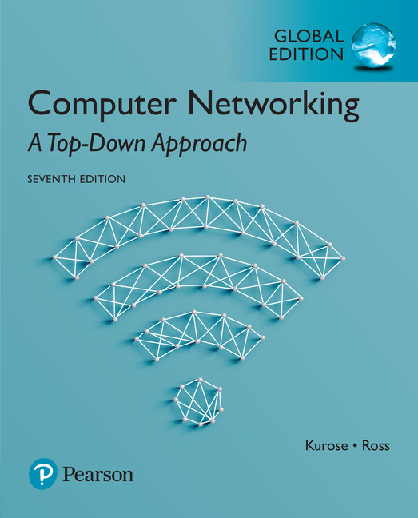
Chapter 5 Network Layer:
The Control Plane
Computer Networking: A Top Down Approach
7th Edition, Global Edition Jim Kurose, Keith Ross Pearson April 2016

Slide 2
Chapter 5: network layer control plane
chapter goals: understand principles behind network control plane
traditional routing algorithms
SDN controlllers
Internet Control Message Protocol
network management
and their instantiation, implementation in the Internet:
OSPF, BGP, OpenFlow, ODL and ONOS controllers, ICMP, SNMP

Slide 3
Chapter 5: outline
5.1 introduction
5.2 routing protocols
link state
distance vector
5.3 intra-AS routing in the Internet: OSPF
5.4 routing among the ISPs: BGP
5.5 The SDN control plane
5.6 ICMP: The Internet Control Message Protocol
5.7 Network management and SNMP

Slide 4
Network-layer functions
Recall: two network-layer functions:
forwarding: move packets from router’s input to appropriate router output
data plane
routing: determine route taken by packets from source to destination
control plane
Two approaches to structuring network control plane:
per-router control (traditional)
logically centralized control (software defined networking)

Slide 5
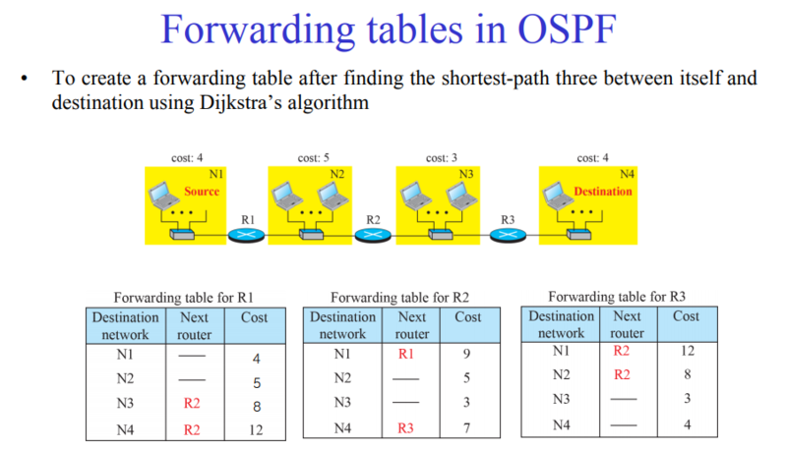
라우팅(routing)이란?
라우터에 저장될 라우팅 테이블을 만드는 과정
라우팅 (forwarding) 테이블의 구조

Slide 6
Per-router control plane (기존 방식)
Individual routing algorithm components in each and every router interact with each other in control plane to compute forwarding tables
Routing
Algorithm
control
plane
data
plane

Slide 7
Logically centralized control plane (최근)
A distinct (typically remote) controller interacts with local control agents (CAs) in routers to compute forwarding tables
Remote Controller
control
plane
data
plane
CA
CA
CA
CA
CA

Slide 8
Chapter 5: outline
5.1 introduction
5.2 routing protocols (기존)
link state
distance vector
5.3 intra-AS routing in the Internet: OSPF
5.4 routing among the ISPs: BGP
5.5 The SDN control plane
5.6 ICMP: The Internet Control Message Protocol
5.7 Network management and SNMP

Slide 9
Routing protocols
Routing protocol goal: determine “good” paths (equivalently, routes), from sending hosts to receiving host, through network of routers
path: sequence of routers packets will traverse in going from given initial source host to given final destination host
“good”: least “cost”, “fastest”, “least congested” (네비 선택 기능)
routing: a “top-10” networking challenge!

Slide 10
Graph abstraction of the network
5
v
3
w
2
5
u
2
1
z
3
1
2
x
y
1
graph: G = (N,E) : 노드, 엣지
N = set of routers = { u, v, w, x, y, z }
E = set of links ={ (u,v), (u,x), (v,x), (v,w), (x,w), (x,y), (w,y), (w,z), (y,z) }
aside: graph abstraction is useful in other network contexts, e.g.,
P2P, where N is set of peers and E is set of TCP connections

Slide 11
Graph abstraction: costs
c(x,x’) = cost of link (x,x’)
e.g., c(w,z) = 5
cost could always be 1, or
inversely related to bandwidth,
or inversely related to
Congestion
일반적으로 비용은 동일하게 간주할 때는 => 최단(hop의 수) 경로
혼잡, 라우터 큐 지연
5
v
3
w
2
5
u
2
1
z
3
1
2
x
y
1
cost of path (x₁, x₂, x₃,…, x_{p}) = c(x₁,x₂) + c(x₂,x₃) + … + c(x_{p-1},x_{p})
key question: what is the least-cost path between u and z ?
routing algorithm: algorithm that finds that least cost path

Slide 12
Routing algorithm classification

Slide 13
Static or dynamic
static: (수동) 라우팅
routes are changed by 관리자 => slow
복잡한 소프트웨어 구현이 불필요
소규모, 변화가 거의 없는 네트워크 환경
라우팅 트래픽에 의한 대역폭 소모가 불필요
인터넷에서는 불가능
왜?
dynamic: (동적, 자동)
routes change more quickly
자동적으로 periodic update
in response to link cost changes
초기에는 관리자가 라우터 테이블을 초기화
현재 대부분 프로토콜은 동적

Slide 14
Dynamic 라우팅의 두 종류
global:
all routers have complete topology, link cost info. 라우터는 전체 네트워크 구조와 연결 비용을 알고 있음
“link state” algorithms
라우터가 자신이 속해 있는 네트워크 전체 라우터의 정보를 공유
decentralized:
router knows physically-connected neighbors, link costs to neighbors
자신과 직접 연결된 라우터의 정보와 최종 목적지를 가기 위한 경로 비용과 다음 라우터의 정보만 알고 있음
iterative process of computation, exchange of info with neighbors
“distance vector” algorithms

Slide 15
Chapter 5: outline
5.1 introduction
5.2 routing protocols
link state
distance vector
5.3 intra-AS routing in the Internet: OSPF
5.4 routing among the ISPs: BGP
5.5 The SDN control plane
5.6 ICMP: The Internet Control Message Protocol
5.7 Network management and SNMP

Slide 16
링크 상태 라우팅 알고리즘
각 라우터는 전체 네트워크의 구성(topology)과 링크 상태 정보를 유지
각 라우터는 전체 네트워크 상태 정보를 이용하여 모든 목적지 네트워크까지의 최적 경로 계산
최적 경로를 기반으로 각 네트워크에 대한 라우팅 테이블을 구성
Notes:
Topology (외우기)

Slide 17
A link-state routing algorithm
Link state advertisement(LSA) message
나와 직접 연결된 이웃 라우터의 정보
내 이웃의 링크 정보(연결, 비용, 상황 등)
-> 이웃에서 다른 것까지
실행 방법
라우터는 LSA를 만들어 내는 경우
이웃 라우터의 정보가 변했을 때
링크 상태 등을 주기적으로 체크함
라우터는 LSA를 자신과 같은 네트워크 내(AS)의 모든 라우터에게 전한다. 맨 처음에는 바로 이웃에게만
각 라우터는 받은 LSA를 기초로, 전체 네트워크 토폴로지를 설정
두 노드 간의 최소 경로 비용을 계산 : Dijkstra’s algorithm

Slide 18
A link-state routing algorithm
Dijkstra’s algorithm
computes least cost paths from one node (‘source”) to all other nodes
gives forwarding table for that node
iterative: after k iterations, know least cost path to k dest.’s
노드 (라우터) 개수 만큼의 반복이 필요
notation:
c(x,y): link cost from node x to y; = ∞ if not direct neighbors
D(v): current value of cost of path from source to dest. v
p(v): predecessor node along path from source to v
N': set of nodes whose least cost path definitively known
Notes:
D(v) : v까지 오는데 걸리는 전체 cost
N’ 경로를 설정할 때 경로안에 포함된 모든 노드들의 집합

Slide 19
Dijsktra’s algorithm
1 Initialization:
2 N' = {u}
3 for all nodes v
4 if v adjacent to u
5 then D(v) = c(u,v)
6 else D(v) = ∞
7
8 Loop
9 find w not in N' such that D(w) is a minimum
10 add w to N'
11 update D(v) for all v adjacent to w and not in N' :
12 D(v) = min( D(v), D(w) + c(w,v) )
13 /* new cost to v is either old cost to v or known
14 shortest path cost to w plus cost from w to v */
15 until all nodes in N'

Slide 20
Dijkstra’s algorithm: example
D(v)
p(v)
D(w)
p(w)
D(x)
p(x)
D(y)
p(y)
D(z)
p(z)
Step
N'
0
u
7,u
3,u
5,u
∞
∞
1
uw
6,w
5,u
11,w
∞
2
uwx
6,w
11,w
14,x
3
uwxv
10,v
14,x
4
uwxvy
12,y
5
uwxvyz
x
9
notes:
construct shortest path tree by tracing predecessor nodes
ties can exist (can be broken arbitrarily)
5
7
4
8
u
3
w
y
z
2
3
7
4
v

Slide 21
Dijkstra’s algorithm: another example
Step
0
1
2
3
4
5
N'
u
ux
uxy
uxyv
uxyvw
uxyvwz
D(v),p(v)
2,u
2,u
2,u
D(w),p(w)
5,u
4,x
3,y
3,y
D(x),p(x)
1,u
D(y),p(y)
∞
2,x
D(z),p(z)
∞
∞
4,y
4,y
4,y
5
v
3
w
2
5
u
2
1
z
3
1
2
x
y
1
* Check out the online interactive exercises for more examples: http://gaia.cs.umass.edu/kurose_ross/interactive/

Slide 22
Dijkstra’s algorithm: example (2)
resulting shortest-path tree from u:
v
w
u
z
x
y
resulting forwarding table in u:
destination
link
v
(u,v)
x
(u,x)
y
(u,x)
w
(u,x)
z
(u,x)

Slide 23
Dijkstra’s algorithm, discussion
algorithm complexity: n nodes
each iteration: need to check all nodes, w, not in N
n(n+1)/2 comparisons: O(n²)
more efficient implementations possible: O(nlogn)
oscillations possible:
e.g., link cost equals amount of carried traffic (트래픽 양)
따라서 링크 비용 결정을 잘 해야 한다.
A
A
A
A
1
1+e
2+e
0
0
2+e
2+e
0
D
B
D
B
D
B
D
B
0
0
1+e
1
0
0
1+e
1
0
C
e
0
0
1
0
0
1
C
C
1+e
C
1
e
initially
given these costs,
find new routing….
resulting in new costs
given these costs,
find new routing….
resulting in new costs
given these costs,
find new routing….
resulting in new costs

Slide 24
Chapter 5: outline
5.1 introduction
5.2 routing protocols
link state
distance vector
5.3 intra-AS routing in the Internet: OSPF
5.4 routing among the ISPs: BGP
5.5 The SDN control plane
5.6 ICMP: The Internet Control Message Protocol
5.7 Network management and SNMP

Slide 25
Distance vector algorithm
Bellman-Ford equation (dynamic programming)
let
d_{x}(y) := cost of least-cost path from x to y
then
d_{x}(y) = min {c(x,v) + d_{v}(y) }
v
cost from neighbor v to destination y
cost to neighbor v
min taken over all neighbors v of x

Slide 26
Bellman-Ford example
5
clearly, d_{v}(z) = 5, d_{x}(z) = 3, d_{w}(z) = 3
v
3
w
2
5
u
z
B-F equation says:
2
1
3
1
2
d_{u}(z) = min { c(u,v) + d_{v}(z),
c(u,x) + d_{x}(z),
c(u,w) + d_{w}(z) }
= min {2 + 5,
1 + 3,
5 + 3} = 4
x
y
1
node achieving minimum is next
hop in shortest path, used in forwarding table

Slide 27
Distance vector algorithm
key idea:
each node sends its own distance vector estimate to neighbors, when x receives new DV estimate from neighbor, it updates its own DV using B-F equation:
각 라우터는 DV를 이웃에만 공유
각 라우터는 이웃으로 받은 DV를 근거로 자신의 DV를 갱신
D_{x}(y) ← min_{v}{c(x,v) + D_{v}(y)} for each node y ∊ N
Notes:
Node -> router와 동의어 (여기선)

Slide 28
거리 벡터 라우팅 알고리즘
각 라우터는 자신이 속한 네트워크(AS) 상태 정보로 각 네트워크에 대한 거리 경로 정보를 갱신
거리 경로 정보를 이웃 라우터와 공유함
이웃 라우터들의 거리 경로 정보를 사용하여 각 네트워크에 대한 최적 거리 경로 정보 갱신
최적 거리 경로 정보가 갱신되면 라우팅 테이블을 갱신함
누구를 통해 가는 것이 가장 효율적인 것도 알려줌 (방향과 거리 경로 정보)

Slide 29
Distance vector algorithm
iterative, asynchronous: each local iteration caused by:
local link cost change
DV update message from neighbor
distributed:
each node notifies neighbors only when its DV changes
neighbors then notify their neighbors if necessary
each node:
wait for (change in local link cost or msg from neighbor)
recompute estimates
if DV to any dest has changed, notify neighbors

Slide 30
D_{x}(z) = min{c(x,y) + D_{y}(z), c(x,z) + D_{z}(z)}
= min{2+1 , 7+0} = 3
D_{x}(y) = min{c(x,y) + D_{y}(y), c(x,z) + D_{z}(y)} = min{2+0 , 7+1} = 2
node x
table
cost to
cost to
x y z
x y z
x
0 2 7
x
0
2
3
y
y
2 0 1
from
∞
∞
∞
from
z
∞
∞
∞
z
7 1 0
node y
table
cost to
x y z
y
2
1
x
∞
∞
z
∞
2 0 1
x
from
y
7
z
∞
∞
∞
node z
table
cost to
x y z
x
∞ ∞ ∞
from
y
∞
∞
∞
z
7
1
0
time

Slide 31
D_{x}(z) = min{c(x,y) + D_{y}(z), c(x,z) + D_{z}(z)}
= min{2+1 , 7+0} = 3
D_{x}(y) = min{c(x,y) + D_{y}(y), c(x,z) + D_{z}(y)} = min{2+0 , 7+1} = 2
node x
table
cost to
cost to
cost to
x y z
x y z
x y z
x
0 2 7
x
0
2
3
x
0 2 3
y
y
2 0 1
from
∞
∞
∞
from
y
2 0 1
z
z
from
∞
∞
∞
7 1 0
z
3 1 0
node y
table
cost to
cost to
cost to
x y z
x y z
x y z
y
2
1
x
∞
∞
x
0 2 7
∞
2 0 1
x
0 2 3
x
z
from
y
y
2 0 1
y
7
from
from
2 0 1
z
∞
∞
∞
z
7 1 0
z
3 1 0
node z
table
cost to
cost to
cost to
x y z
x y z
x y z
x
∞ ∞ ∞
x
0 2 7
x
0 2 3
y
y
2 0 1
from
y
∞
∞
from
2 0 1
from
∞
z
z
3 1 0
z
3 1 0
7
1
0
time
time

Slide 32
https://devgraphy.tistory.com/entry/08-%ED%8C%A8%ED%82%B7-%EC%A0%84%EB%8B%AC%EA%B3%BC-%EB%9D%BC%EC%9A%B0%ED%8C%85-%ED%94%84%EB%A1%9C%ED%86%A0%EC%BD%9C
https://velog.io/@anjaekk/%EB%84%A4%ED%8A%B8%EC%9B%8C%ED%81%AC-%EB%9D%BC%EC%9A%B0%ED%8C%85-%ED%94%84%EB%A1%9C%ED%86%A0%EC%BD%9C

Slide 33
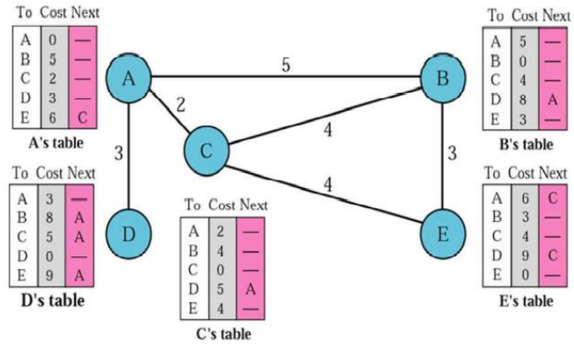

Slide 34
Distance vector: link cost changes
link cost changes:
node detects local link cost change
updates routing info, recalculates distance vector
if DV changes, notify neighbors
1
y
4
1
x
z
50
“good
news
travels
fast”
t₀ : y detects link-cost change, updates its DV, informs its neighbors.
t₁ : z receives update from y, updates its table, computes new least cost to x , sends its neighbors its DV.
t₂ : y receives z’s update, updates its distance table. y’s least costs do not change, so y does not send a message to z.
* Check out the online interactive exercises for more examples: http://gaia.cs.umass.edu/kurose_ross/interactive/

Slide 35
Distance vector: link cost changes
link cost changes:
bad news travels slow - “count to infinity” problem!
44 iterations before algorithm stabilizes:
Y가 X로 보낼 때 Z가 5로 X로 보낼 수 있다고 하니 자신의 테이블을 6으로 갱신
Z는 Y가 변경된 정보를 보고 다시 7로 갱신
Z가 바뀌니 Y도 또 8로 바꾸고 통보
이렇게 50이 될 때까지 지속적으로 반복
➔ 정보 교환이 일반적으로 30초 ➔ 테이블 44번 갱신한다면?
60
y
4
1
x
z
50
poisoned reverse: (위 문제 해결 방법, 완벽하지 않음)
If Z routes through Y to get to X :
Z tells Y its (Z’s) distance to X is infinite (so Y won’t route to X via Z)
will this completely solve count to infinity problem?

Slide 36
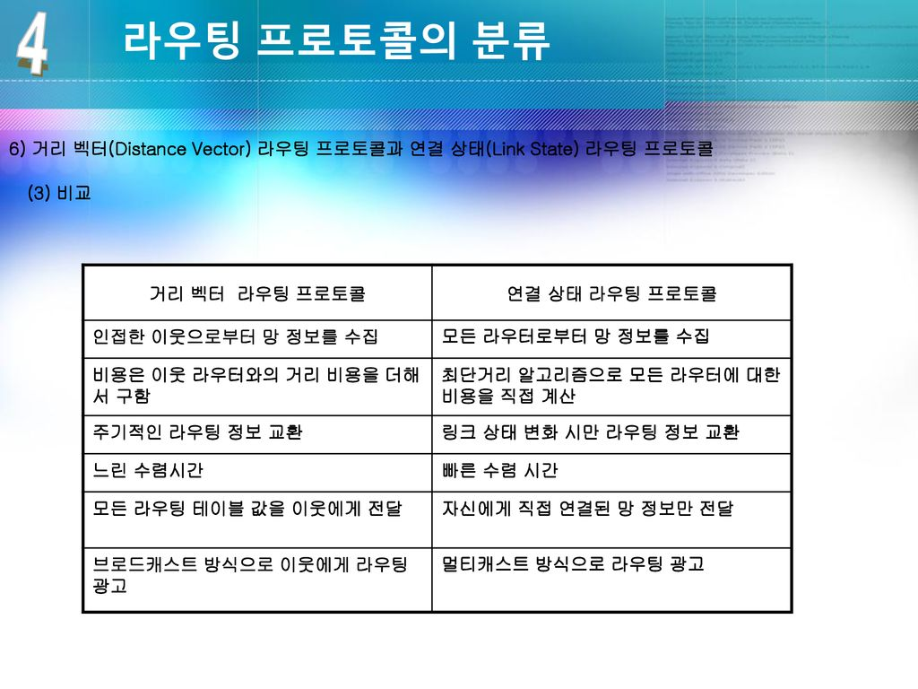

Slide 37
라우팅 프로토콜 정리
자율 시스템 (AS : Autonomous System = domain)
한 기관의 내부 네트워크 (동일한 통제안에 있음)
AS 내부 vs. AS 외부로 나누어짐
AS 내부 라우팅 프로토콜 (Intra-domain)
OSPF, IGRP, EIGRP, RIP
표준이 없음, AS 마다 각각 다른 프로토콜 사용가능
AS 외부 라우팅 프로토콜 (Inter-domain)
BGP (국제 표준)
Unicast와 Multicast 라우팅 테이블과 프로토콜이 다르다.

Slide 38
경로 상태 라우팅 (Link state) [1]
AS 내 모든 라우터(노드)는 각각 네트워크 구성도를 만듦
내가 가진 정보(이웃과의 관계)를 다른 라우터와 공유
각 라우터는 AS내의 다른 모든 라우터와의 최단 경로를 구함
네트워크의 상태변화(장애, 혼잡 등)가 생기면 토폴로지를 다시 구성

Slide 39
경로 상태 라우팅 (Link state) [2]
처음에는 바로 이웃 노드와 연결 -> 서로 공유 -> 전체 토폴로지를 구성 (거리 백터 방식과 유사)
변화가 생기면 새로운 토폴로지 구성을 위해 전체 네트워크에게 자신의 상태 변화를 통보
일시적으로 트래픽이 증가할 수 있음
Flooding : 전체 노드에게 정보를 뿌림
링크 상태 데이터베이스를 구성 (토폴로지 구성을 위해)
OSPF (Open Shortest Path First), ISIS
현재 OSPF가 가장 많이 사용 중

Slide 40
거리 벡터 라우팅 (Distance Vector Routing)
두 이웃 노드 사이의 최소 비용 경로는 최소 거리로 간주
Bellman-Ford 알고리즘 사용
RIP v1, v2 IGRP, EIGRP (cisco 제품)
BGP (유사한 방법을 사용)
각 라우터는 자신의 정보를 이웃하고만 공유
주기적으로 정보를 업데이트
노드간 cost : 속도, 혼잡, 장애 등

Slide 41
Distance Vector Algorithms
RIP 초기 버전은 cost를 라우터의 개수로 최적 경로 설정
빠른 속도, 혼잡 등을 고려하지 않음
주기적으로 DV 교환 : RIP (30초), IGRP (90초)
장점
설정이 간단
작은 규모의 NW에 적합 (15개 이내의 라우터들)

Slide 42
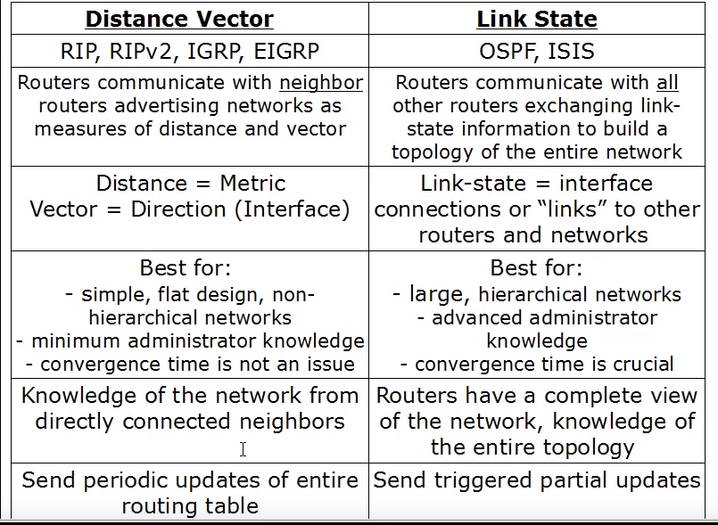
두 알고리즘 비교 테이블

Slide 43
Chapter 5: outline
5.1 introduction
5.2 routing protocols
link state
distance vector
5.3 intra-AS routing in the Internet: OSPF
5.4 routing among the ISPs: BGP
5.5 The SDN control plane
5.6 ICMP: The Internet Control Message Protocol
5.7 Network management and SNMP

Slide 44
Making routing scalable (확장성 문제)
our routing study thus far - idealized
all routers identical ➔ 실제로는 다양한 종류의 라우터가 존재
network “flat” ➔ 실제는 계층 구조
scale: with billions of destinations:
can’t store all destinations in routing tables!
routing table exchange would swamp links!
administrative autonomy
internet = network of networks
each network admin may want to control routing in its own network

Slide 45
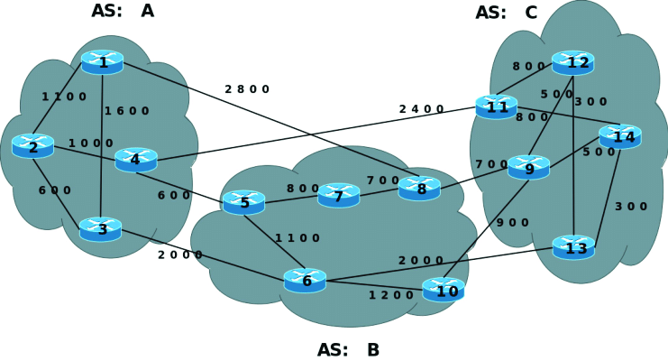
Internet approach to scalable routing
aggregate routers into regions known as “autonomous systems” (AS)
한 기관에서 관리하는 네트워크
동일한 네트워크 ID를 가진 라우터의 집합

Slide 46
Internet approach to scalable routing
aggregate routers into regions known as “autonomous systems” (AS) (a.k.a. “domains”)
intra-AS routing [내부]
routing among hosts, routers in same AS (“network”)
all routers in AS must run same intra-domain protocol
routers in different AS can run different intra-domain routing protocol
gateway router: at “edge” of its own AS, has link(s) to router(s) in other AS’es
inter-AS routing [외부]
routing among AS’es
gateways perform inter-domain routing (as well as intra-domain routing)

Slide 47
Interconnected ASes
3c
3a
2c
3b
AS3
2a
1c
2b
AS2
1a
1b
1d
AS1
forwarding table configured by both intra- and inter-AS routing algorithm
intra-AS routing determine entries for destinations within AS
inter-AS & intra-AS determine entries for external destinations
Intra-AS
Routing
algorithm
Inter-AS
Routing
algorithm
Forwarding
table

Slide 48
라우팅 알고리즘의 종류
적용되는 범위에 따라 사용되는 라우팅 알고리즘이 다르다.
IGP (Interior Gateway Protocol) : Intra-AS
독립적인 네트워크 관리 조직(AS)내에서 사용
RIP (Distance vector 방식)
OSPF (Link state 방식)
EGP (Exterior Gateway Protocol) : Inter-AS
AS 상호간에서 사용되는 라우팅 프로토콜
BGP (Path vector)

Slide 49
Intra-AS Routing [AS 내부 네트워크]
also known as interior gateway protocols (IGP)
most common intra-AS routing protocols:
RIP: Routing Information Protocol
OSPF: Open Shortest Path First (IS-IS protocol essentially same as OSPF)
IGRP: Interior Gateway Routing Protocol (Cisco proprietary for decades, until 2016)

Slide 50
RIP (Routing Information Protocol)
단순화된 거리 벡터 라우팅 알고리즘 적용
모든 링크 비용을 1로 동일시 (초기 버전)
이웃 라우터에 주기적으로 거리 벡터 정보 공유 [예, 30초]
초창기 인터넷에서 사용 ➔ 지금은 거의 사용하지 않음
보안문제 취약

Slide 51
RIP (추가)
연결된 라우터의 개수로 최적의 경로를 설정
최대 15개 라우터를 가진 네트워크에서만
설정이 간단한 표준 라우팅 프로토콜
Convergence(수렴) time
네트워크 상의 변화가 생겼을 때 그 정보들을
서로 인식하고 수정하는 시간

Slide 52
OSPF (Open Shortest Path First)
“open”: publicly available (개방형) : 라우터 제조회사가 달라도 사용 가능하다
Uses link-state algorithm
Topology map at each node
Route computation using Dijkstra’s algorithm
Router floods OSPF link-state advertisements(LSAs) to all other routers in entire AS
Carried in OSPF messages directly over IP (rather than TCP or UDP :
security: all OSPF messages authenticated (to prevent malicious intrusion) ➔ 네트워크 공격을 방지
거짓 정보로 인한 네트워크 문제를 차단

Slide 53
OSPF
링크의 상태 변화가 있을 때만 AS내 모든 라우터에게 알려줌
Convergence time이 상대적으로 빠름
라우팅 정보 갱신 회수가 적어 성능 저하 방지
Broadcasting 방식으로 갱신 정보를 빨리 전파 = flooding
링크 유형에 따라 경로 비용을 다르게 설정
따라서 RIP에 비해 설정이 복잡함
경로 설정을 하기 위한 연산이 필요하기 때문에 라우터의 성능이 중요
RIP 보다 효능이 뛰어남

Slide 54
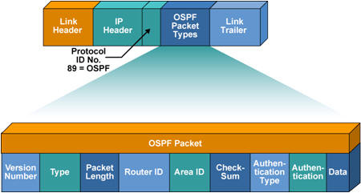
OSPF 프로토콜 헤더 정보

Slide 55
Hierarchical OSPF
boundary router
backbone router
backbone
area
border
routers
area 3
internal
routers
area 1
area 2

Slide 56
계층적 OSPF
AS가 큰 경우 하나의 OSPF로 운행하면 트래픽 부담. 이를 해결하기 위해 지역화 (subnet 개념)
two-level hierarchy: local area, backbone.
LSA는 지역 AS만
each nodes has detailed area topology; only know direction (shortest path) to nets in other areas.
area border routers: “summarize” distances to nets in own area, advertise to other Area Border routers.
backbone routers: run OSPF routing limited to backbone.
boundary routers: connect to other AS’es.

Slide 57
Chapter 5: outline
5.1 introduction
5.2 routing protocols
link state
distance vector
5.3 intra-AS routing in the Internet: OSPF
5.4 routing among the ISPs: BGP
5.5 The SDN control plane
5.6 ICMP: The Internet Control Message Protocol
5.7 Network management and SNMP

Slide 58
Inter-AS tasks
suppose router in AS1 receives datagram destined outside of AS1:
router should forward packet to gateway router, but which one?
AS1 must:
learn which dests are reachable through AS2, which through AS3
propagate this reachability info to all routers in AS1
job of inter-AS routing!
3c
3a
3b
AS3
2c
other
networks
1c
2a
other
networks
1a
2b
1b
AS2
AS1
1d

Slide 59
Internet inter-AS routing: BGP
BGP (Border Gateway Protocol): the de facto inter-domain routing protocol [표준 프로토콜]
“glue that holds the Internet together”
BGP provides each AS a means to:
eBGP: obtain subnet reachability information from neighboring AS’es (게이트웨이 끼리)
iBGP: propagate reachability information to all AS-internal routers. (게이트웨이가 내부 라우터에게 전달)
determine “good” routes(경로) to other networks based on reachability information and policy
allows subnet to advertise its existence to rest of Internet: “I am here”

Slide 60
eBGP, iBGP connections
2b
∂
2a
2c
1b
3b
2d
∂
1a
1c
3a
3c
AS 2
1d
3d
AS 1
eBGP connectivity
AS 3
iBGP connectivity
1c
gateway routers run both eBGP and iBGP protocols

Slide 61
BGP basics
BGP session: two BGP routers exchange BGP messages over semi-permanent TCP connection: (항상 연결됨, 중요)
advertising paths to different destination network prefixes (BGP is a “path vector” protocol)
when AS3 gateway router 3a advertises path AS3,X to AS2 gateway router 2c:
AS3 promises to AS2 it will forward datagrams towards X
AS 3
3b
AS 1
1b
3a
3c
1a
1c
AS 2
2b
3d
X
1d
2a
2c
BGP advertisement:
AS3, X
2d

Slide 62
Path attributes and BGP routes
advertised prefix includes BGP attributes
Prefix(NW id) + attributes = “route” (경로 정보)
two attributes:
AS-PATH: list of ASes through which prefix advertisement has passed [예, AS3.X]
NEXT-HOP: indicates specific internal-AS router to next-hop AS [예, 2c]
Policy-based routing:
gateway receiving route advertisement uses import policy to accept/decline path (e.g., never route through AS Y).
AS policy also determines whether to advertise path to other other neighboring ASes
관리자의 정책에 따라 라우팅을 제어할 수 있음

Slide 63
BGP: achieving policy via advertisements
legend:
provider
B
network
X
W
A
customer
C
network:
Y
Suppose an ISP only wants to route traffic to/from its customer networks (does not want to carry transit traffic between other ISPs)
A advertises path Aw to B and to C
B chooses not to advertise BAw to C: [B와 C는 경쟁관계]
B gets no “revenue” for routing CBAw, since none of C, A, w are B’s customers
C does not learn about CBAw path
C will route CAw (not using B) to get to w

Slide 64
BGP path advertisement
AS3
3b
AS1
1b
AS3,X
3a
3c
1a
1c
AS2
2b
3d
X
1d
AS3,X
AS2,AS3,X
2a
2c
2d
gateway router may learn about multiple paths to destination:
AS1 gateway router 1c learns path AS2,AS3,X from 2a
AS1 gateway router 1c learns path AS3,X from 3a
Based on policy, AS1 gateway router 1c chooses path AS3,X, and advertises path within AS1 via iBGP

Slide 65
BGP messages
BGP messages exchanged between peers over TCP connection
BGP messages:
OPEN: opens TCP connection to remote BGP peer and authenticates sending BGP peer
UPDATE: advertises new path (or withdraws old)
KEEPALIVE: keeps connection alive in absence of UPDATES; also ACKs OPEN request
NOTIFICATION: reports errors in previous msg; also used to close connection

Slide 66
BGP, OSPF, forwarding table entries
Q: how does router set forwarding table entry to distant prefix?
AS3
3b
AS1
1b
AS3,X
1
AS3,X
3a
3c
1a
2
1c
local link interfaces
at 1a, 1d
AS2
2b
3d
X
2
1d
1
AS3,X
AS2,AS3,X
2a
2c
physical link
2d
dest
interface
recall: 1a, 1b, 1c learn about dest X via iBGP from 1c: “path to X goes through 1c”
…
…
…
…
X
1
1d: OSPF intra-domain routing: to get to 1c, forward over outgoing local interface 1

Slide 67
BGP, OSPF, forwarding table entries
Q: how does router set forwarding table entry to distant prefix?
AS3
3b
AS1
1b
1
3a
3c
1a
2
1c
AS2
2b
3d
X
1d
2a
2c
2d
dest
interface
recall: 1a, 1b, 1c learn about dest X via iBGP from 1c: “path to X goes through 1c”
…
…
…
…
X
2
1d: OSPF intra-domain routing: to get to 1c, forward over outgoing local interface 1
1a: OSPF intra-domain routing: to get to 1c, forward over outgoing local interface 2

Slide 68
Hot Potato Routing
AS3
3b
AS1
1b
3a
3c
1a
1c
AS2
2b
3d
X
1d
112
152
AS3,X
AS1,AS3,X
2a
263
2c
201
OSPF link weights
2d
2d learns (via iBGP) it can route to X via 2a or 2c
hot potato routing: choose local gateway that has least intra-domain cost (e.g., 2d chooses 2a, even though more AS hops to X): don’t worry about inter-domain cost!
전체 경로를 고려하는 것이 아니라 자기 AS내에서 가장 비용이 적게 되는 게이트웨이를 통해 빨리 내 보냄 (이기적)

Slide 69
BGP Route Selection 기준
관리자의 판단 : policy 우선
Shortest AS-PATH
Closest NEXT_HOP route : 뜨거운 감자
기타 기준에 의해 경로 선택

Slide 70
Why different Intra-, Inter-AS routing ?
policy: [정책 중시]
inter-AS: admin wants control over how its traffic routed, who routes through its net.
intra-AS: single admin, so no policy decisions needed
scale: [확장성이 가장 중요]
hierarchical routing saves table size, reduced update traffic
performance:
intra-AS: can focus on performance 와 관리가 중요
inter-AS: policy may dominate over performance

