Slide 1
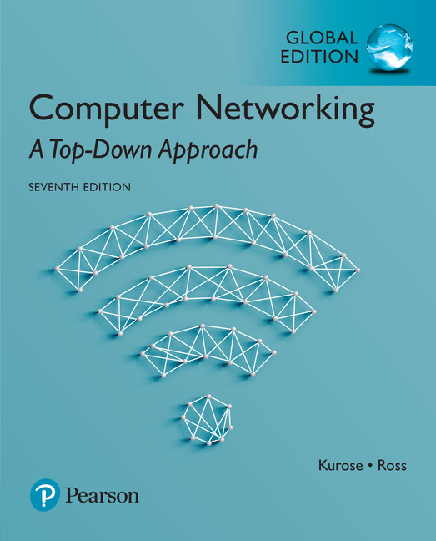
Chapter 5 Network Layer:
The Control Plane
Computer Networking: A Top Down Approach
7th Edition, Global Edition Jim Kurose, Keith Ross Pearson April 2016

Slide 2
Chapter 5: outline
5.1 introduction
5.2 routing protocols
link state
distance vector
5.3 intra-AS routing in the Internet: OSPF
5.4 routing among the ISPs: BGP
5.5 The SDN control plane
5.6 ICMP: The Internet Control Message Protocol
5.7 Network management and SNMP

Slide 3

Traffic engineering: difficult traditional routing
5
3
v
w
5
2
u
2
1
z
3
1
2
x
y
1
Q: what if network operator wants u-to-z traffic to flow along uvwz, x-to-z traffic to flow xwyz?
A: need to define link weights so traffic routing algorithm computes routes accordingly (or need a new routing algorithm)!
Link weights are only control “knobs”: wrong!
Notes:
Note: implicit assumption here: destination based forwarding

Slide 4
Traffic engineering: difficult
5
3
v
w
5
2
u
2
1
z
3
1
2
x
y
1
Q: what if network operator wants to split u-to-z traffic along uvwz and uxyz (load balancing)?
A: can’t do it (or need a new routing algorithm)
Notes:
Note: implicit assumption here: destination based forwarding

Slide 5

Traffic engineering: difficult
Networking 401
5
v
3
w
2
v
w
5
u
2
1
z
3
z
1
2
x
y
x
1
y
Q: what if w wants to route blue and red traffic differently?
A: can’t do it (with destination based forwarding, and LS, DV routing)
Notes:
Note: implicit assumption here: destination based forwarding

Slide 6
Recall: per-router control plane
Individual routing algorithm components in each and every router interact with each other in control plane to compute forwarding tables
[기존 방식] : control 과 data plane이 분리 안됨
Routing
Algorithm
control
plane
data
plane

Slide 7
Software defined networking (SDN)
Internet network layer: historically has been implemented via distributed, per-router approach
monolithic router contains switching hardware, runs proprietary implementation of Internet standard protocols (IP, RIP, IS-IS, OSPF, BGP) in proprietary router OS (e.g., Cisco IOS)
different “middleboxes” for different network layer functions: firewalls, load balancers, NAT boxes, ..
~2005: 그 이전에는 개별 라우터에 맡김. 네트워크 자원의 효율적인 사용을 하고자 함
현재는 네트워크 관리자가 패킷의 흐름을 제어할 수 있도록 관여 ➔ 소프트웨어를 통해

Slide 8
Recall: logically centralized control plane
A distinct (typically remote) controller interacts with local control agents (CAs) in routers to compute forwarding tables
Remote Controller
control
plane
data
plane
CA
CA
CA
CA
CA

Slide 9
Software defined networking (SDN)
Why a logically centralized control plane?
easier network management: avoid router misconfigurations, greater flexibility of traffic flows
“programming” routers (recall OpenFlow API)
centralized “programming” easier: compute tables centrally and distribute (SDN)
distributed “programming: more difficult: compute tables as result of distributed algorithm (protocol) implemented in each and every router (기존방식)
open (non-proprietary) control plane : 사용자가 사용 가능, 기존은 라우터 제조 회사에서 모든 것을 관리

Slide 10
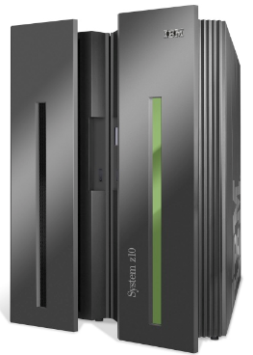

Analogy: mainframe to PC evolution*
App
App
App
App
App
App
App
App
App
App
App
Specialized
Applications
Open Interface
Specialized
Operating
System
Windows
(OS)
Linux
Mac
OS
or
or
Specialized
Hardware
Open Interface
Microprocessor
Vertically integrated
Closed, proprietary
Slow innovation
Small industry
Horizontal
Open interfaces
Rapid innovation
Huge industry
* Slide courtesy: N. McKeown

Slide 11
Software defined networking (SDN)
4. programmable control applications
…
3. control plane functions external to data-plane switches
routing
access control
load
balance
Remote Controller
control
plane
data
plane
CA
2. control, data plane separation
CA
CA
CA
CA
1: generalized“ flow-based” forwarding (e.g., OpenFlow)

Slide 12
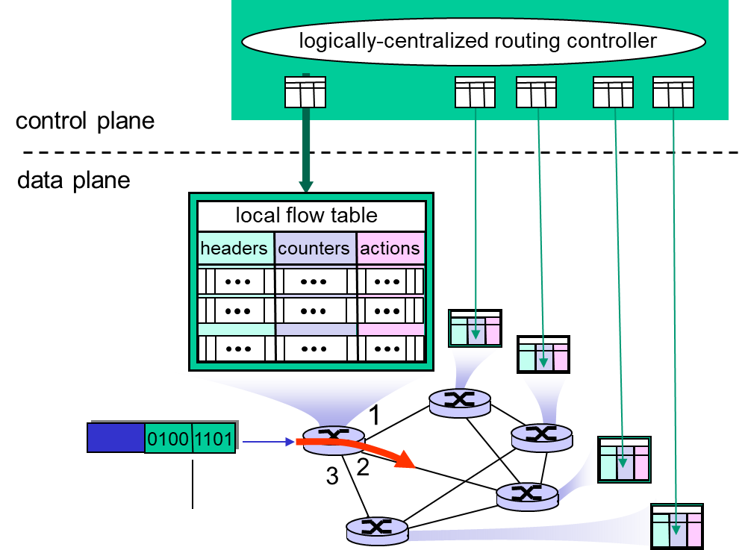
Generalized Forwarding
기존방식
목적지 기반 포워딩 (오직 IP 주소만 보고 결정함
Generalized forwarding
헤더의 여러 정보를 검토해서 포워딩
각각의 라우터들은 SDN에 의해 계산된 flow table을 갖고 있다.
Forwarding table vs. Flow table

Slide 13
SDN perspective: control applications
network-control apps:
“brains” of control: implement control functions using lower-level services, API provided by SND controller
unbundled: can be provided by 3rd party: distinct from routing vendor, or SDN controller
라우터 회사에서 결정하는 것이 네트워크 운영자가 개발할 수도 있고 상업 sw 사용도 가능
보안, 부담 분산, 경로 설정 등을 sw로 제어가 가능
정책이 가장 중요
network-control applications
…
routing
access
control
load
balance
control
plane
northbound API
SDN Controller
(network operating system)
southbound API
data
plane
SDN-controlled switches

Slide 14
SDN perspective: SDN controller
SDN controller (network OS):
maintain network state information
interacts with network control applications “above” via northbound API
interacts with network switches “below” via southbound API
implemented as distributed system for performance, scalability, fault-tolerance, robustness ➔ logically centralized (실제는 분리, 논리적으로는 통합)
network-control applications
…
routing
access
control
load
balance
control
plane
northbound API
SDN Controller
(network operating system)
southbound API
data
plane
SDN-controlled switches

Slide 15
SDN perspective: data plane switches
Data plane switches
fast, simple, commodity switches implementing generalized data-plane forwarding (Section 4.4) in hardware
switch flow table computed, installed by controller
API for table-based switch control (e.g., OpenFlow)
defines what is controllable and what is not
protocol for communicating with controller (e.g., OpenFlow)
network-control applications
…
routing
access
control
load
balance
control
plane
northbound API
SDN Controller
(network operating system)
southbound API
data
plane
SDN-controlled switches

Slide 16
Components of SDN controller
routing
access
control
load
balance
Interface layer to network control apps: abstractions API
Interface, abstractions for network control apps
…
network graph
RESTful
API
intent
Network-wide state management layer: state of networks links, switches, services: a distributed database
…
statistics
flow tables
SDN
controller
Network-wide distributed, robust state management
…
Link-state info
host info
switch info
…
communication layer: communicate between SDN controller and controlled switches
OpenFlow
SNMP
Communication to/from controlled devices

Slide 17

OpenFlow protocol
operates between controller, switch
TCP used to exchange messages
optional encryption
TSL or TCP
three classes of OpenFlow messages:
controller-to-switch(sync)
switch to controller(async)
symmetric (misc)
OpenFlow Controller

Slide 18

OpenFlow: controller-to-switch messages
Key controller-to-switch messages
features: controller queries switch features, switch replies
configure: controller queries/sets switch configuration parameters
modify-state: add, delete, modify flow entries in the OpenFlow tables
packet-out: controller can send this packet out of specific switch port
OpenFlow Controller

Slide 19
OpenFlow: switch-to-controller messages
Key switch-to-controller messages
packet-in: transfer packet (and its control) to controller. See packet-out message from controller
flow-removed: flow table entry deleted at switch
port status: inform controller of a change on a port.
OpenFlow Controller
Fortunately, network operators don’t “program” switches by creating/sending OpenFlow messages directly. Instead use higher-level abstraction at controller

Slide 20
SDN: control/data plane interaction example
Dijkstra’s link-state
Routing
1
S1, experiencing link failure using OpenFlow port status message to notify controller
4
5
…
network graph
RESTful
API
intent
2
SDN controller receives OpenFlow message, updates link status info
3
…
statistics
flow tables
…
3
Dijkstra’s routing algorithm application has previously registered to be called when ever link status changes. It is called.
Link-state info
host info
switch info
2
…
OpenFlow
SNMP
6
4
Dijkstra’s routing algorithm access network graph info, link state info in controller, computes new routes
1
s2
s1
s4
s3

Slide 21
SDN: control/data plane interaction example
Dijkstra’s link-state
Routing
4
5
…
network graph
RESTful
API
intent
5
link state routing app interacts with flow-table-computation component in SDN controller, which computes new flow tables needed
3
…
statistics
flow tables
…
Link-state info
host info
switch info
2
…
6
Controller uses OpenFlow to install new tables in switches that need updating
OpenFlow
SNMP
6
1
s2
s1
s4
s3

Slide 22
OpenDaylight (ODL) controller
…
Traffic
Engineering
ODL Lithium controller
network apps may be contained within, or be external to SDN controller
Service Abstraction Layer: interconnects internal, external applications and services
REST API
Network service apps
Basic Network Service Functions
topology
manager
switch
manager
stats
manager
Access
Control
forwarding
manager
host
manager
Service Abstraction Layer (SAL)
…
OpenFlow 1.0
SNMP
OVSDB

Slide 23
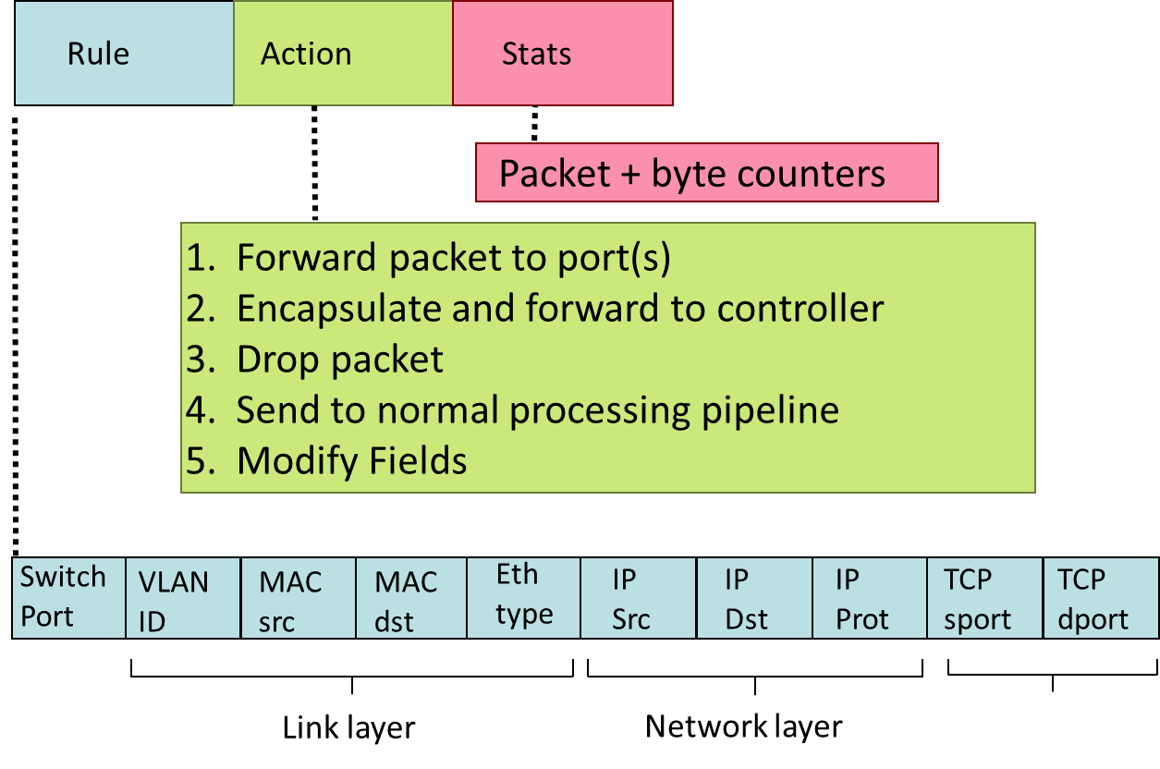
OpenFlow: Flow Table Entries

Slide 24
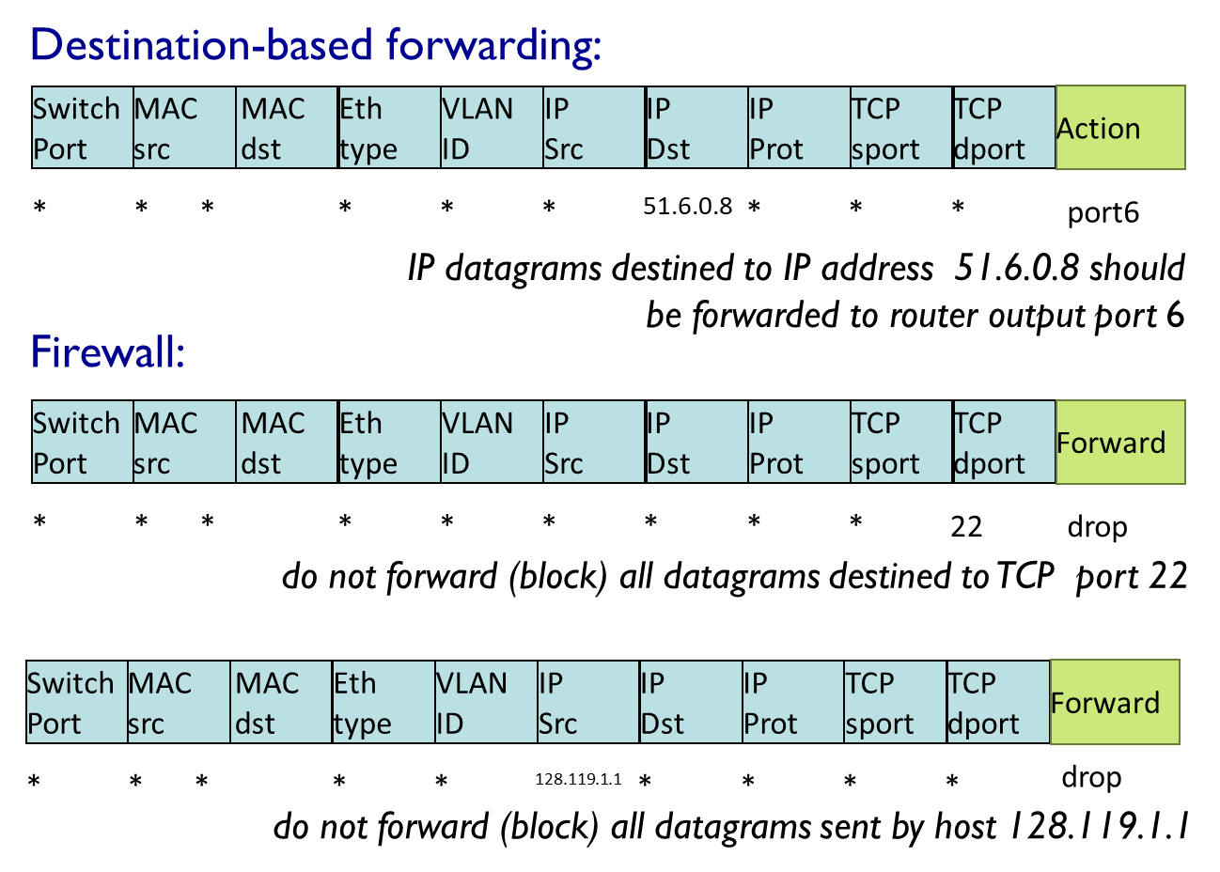
Examples

Slide 25
OpenFlow abstraction
match+action: unifies different kinds of devices
Firewall
match: IP addresses and TCP/UDP port numbers
action: permit or deny
NAT
match: IP address and port
action: rewrite address and port
Router
match: longest destination IP prefix
action: forward out a link
Switch
match: destination MAC address
action: forward or flood

Slide 26
Chapter 5: outline
5.1 introduction
5.2 routing protocols
link state
distance vector
5.3 intra-AS routing in the Internet: OSPF
5.4 routing among the ISPs: BGP
5.5 The SDN control plane
5.6 ICMP: The Internet Control Message Protocol
5.7 Network management and SNMP

Slide 27
ICMP: internet control message protocol
used by hosts & routers to communicate network-level information
error reporting: unreachable host, network, port, protocol
echo request/reply (used by ping)
network-layer “above” IP:
ICMP msgs carried in IP datagrams
ICMP message: type, code plus first 8 bytes of IP datagram causing error
[big datagram]
Type Code description
0 0 echo reply (ping)
3 0 dest. network unreachable
3 1 dest host unreachable
3 2 dest protocol unreachable
3 3 dest port unreachable
3 6 dest network unknown
3 7 dest host unknown
4 0 source quench (congestion
control - not used)
8 0 echo request (ping)
9 0 route advertisement
10 0 router discovery
11 0 TTL expired
12 0 bad IP header

Slide 28


Traceroute and ICMP
source sends series of UDP segments to destination
first set has TTL =1
second set has TTL=2, etc.
unlikely port number
when datagram in nth set arrives to nth router:
router discards datagram and sends source ICMP message (type 11, code 0)
ICMP message include name of router & IP address
when ICMP message arrives, source records RTTs
stopping criteria:
UDP segment eventually arrives at destination host
destination returns ICMP “port unreachable” message (type 3, code 3)
source stops
3 probes
3 probes
3 probes

Slide 29
Chapter 5: outline
5.1 introduction
5.2 routing protocols
link state
distance vector
5.3 intra-AS routing in the Internet: OSPF
5.4 routing among the ISPs: BGP
5.5 The SDN control plane
5.6 ICMP: The Internet Control Message Protocol
5.7 Network management and SNMP

Slide 30
What is network management?
autonomous systems (aka “network”): 1000s of interacting hardware/software components
other complex systems requiring monitoring, control:
jet airplane
nuclear power plant
others?
"Network management includes the deployment, integration
and coordination of the hardware, software, and human
elements to monitor, test, poll, configure, analyze, evaluate,
and control the network and element resources to meet the
real-time, operational performance, and Quality of Service
requirements at a reasonable cost."

Slide 31


Infrastructure for network management
definitions:
managing entity
agent
data
managing
entity
managed devices contain managed objects whose data is gathered into a Management Information Base (MIB)
data
managed device
network
management
protocol
agent
data
managed device
agent
data
managed device
agent
data
agent
data
managed device
managed device

Slide 32


SNMP protocol
Two ways to convey MIB info, commands:
managing
entity
managing
entity
request
trap msg
response
agent
data
agent
data
managed device
managed device
request/response mode
trap mode

Slide 33
SNMP protocol: message types
Message type
Function
GetRequest
GetNextRequest
GetBulkRequest
manager-to-agent: “get me data”
(data instance, next data in list, block of data)
InformRequest
manager-to-manager: here’s MIB value
SetRequest
manager-to-agent: set MIB value
Response
Agent-to-manager: value, response to
Request
Trap
Agent-to-manager: inform manager
of exceptional event

Slide 34
SNMP protocol: message formats
Get/set header
Variables to get/set
PDU
type
(0-3)
Error
Status
(0-5)
Request
ID
Error
Index
Name
Value
Name
Value
….
PDU
type
4
Trap
Type
(0-7)
Enterprise
Agent
Addr
Specific
code
Time
stamp
Name
Value
….
Trap header
Trap info
SNMP PDU
More on network management: see earlier editions of text!

Slide 35
Chapter 5: summary
we’ve learned a lot!
approaches to network control plane
per-router control (traditional)
logically centralized control (software defined networking)
traditional routing algorithms
implementation in Internet: OSPF, BGP
SDN controllers
implementation in practice: ODL, ONOS
Internet Control Message Protocol
network management
next stop: link layer!

