Slide 1
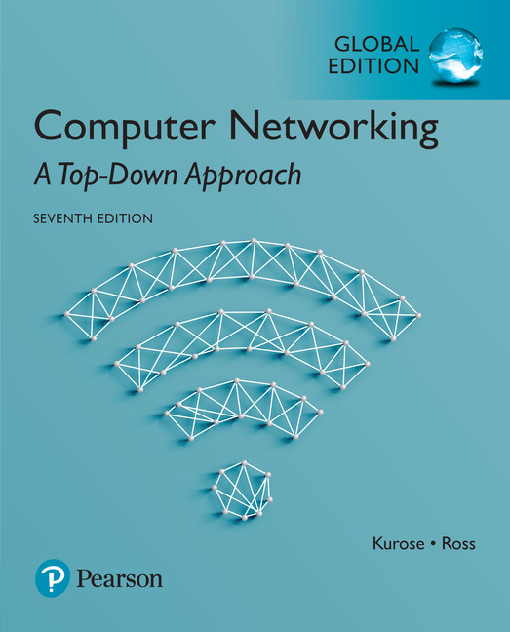
Chapter 6 The Link Layer
and LANs
Computer Networking: A Top Down Approach
7th Edition, Global Edition Jim Kurose, Keith Ross Pearson April 2016

Slide 2
네트워크 장비 (1)
Repeaters : L1 계층
물리계층에서 네트워크를 구성하는데 사용
약해진 신호를 재생성 (강하게 또는 복원)
통신 선을 연장하는 효과
Hub : L1 계층
연결된 모든 호스트에게 전달 [주소 인식 불가]
Bridge : L2계층
리피터 기능과 Filtering 기능을 가짐
목적지 주소(Mac주소)를 검사해서 프레임을 전달할 포터(h/w)를 결정
포트와 주소를 연결할 테이블 존재
네트워크와 네트워크를 연결 (LAN 연장)
네트워크를 분리

Slide 3
네트워크 장비(2)
Switching Hub : L2 계층
목적지 주소를 인식, 해당 목적지 포터로만 전달
LAN에 많이 사용
라우터 : L3 계층
IP 주소로 목적지에 패킷 전달
L3 스위치도 같은 기능
Backbone 장치
여러 네트워크(LAN)를 연결해 주는 장치
백본 스위치

Slide 4
Link layer, LANs: outline
6.1 introduction, services
6.2 error detection, correction
6.3 multiple access protocols
6.4 LANs
addressing, ARP
Ethernet
switches
VLANS
6.5 link virtualization: MPLS
6.6 data center networking
6.7 a day in the life of a web request

Slide 5








Link layer: 링크 계층 (L2)
terminology: 주요용어
hosts and routers: nodes
communication channels that connect adjacent nodes along communication path: links (링크)
인접한 두 노드를 물리적인 매체로 연결해줌, 연결 상태를 점검하는 계층
Wired
Wireless links
Layer-2 packet: frame
data-link layer has responsibility of
transferring datagram from one node
to physically adjacent node over a link

Slide 6
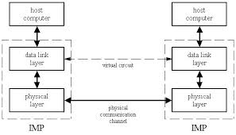
Link layer: context
datagram transferred by different link protocols over different links:
e.g., Ethernet on first link, frame relay on intermediate links, 802.11 on last link
transportation analogy:
trip from Princeton to Lausanne
limo: Princeton to JFK
plane: JFK to Geneva
train: Geneva to Lausanne
tourist = datagram
transport segment = communication link
transportation mode = link layer protocol
travel agent = routing algorithm

Slide 7
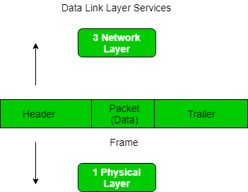
Link layer services [1]
framing, link access:
encapsulate datagram into frame, adding header, trailer
channel access if shared medium [공유함]
“MAC” addresses used in frame headers to identify source, destination
reliable delivery between adjacent nodes

Slide 8
Link layer services [2]
flow control:
pacing between adjacent sending and receiving nodes
인접한 두 노드 사이의 데이터 흐름을 조절
error detection: 에러 발견
errors caused by signal attenuation, noise.
receiver detects presence of errors:
signals sender for retransmission or drops frame
error correction: 에러 수정 (option)
receiver identifies and corrects bit error(s) without resorting to retransmission
half-duplex and full-duplex [단방향, 양방향]
with half duplex, nodes at both ends of link can transmit, but not at same time

Slide 9
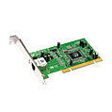
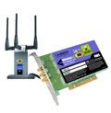

Where is the link layer implemented?
in each and every host
link layer implemented in “adaptor” (aka network interface card NIC) or on a chip
Ethernet card, 802.11 card; Ethernet chipset
implements link, physical layer
attaches into host’s system buses
combination of hardware, software, firmware
각 네트워크 계층 프로토콜의 구현 방식은?
application
transport
network
link
cpu
memory
link
physical
host
bus
(e.g., PCI)
controller
physical
transmission
network adapter
card

Slide 10
Adaptors communicating
datagram
datagram
controller
controller
sending host
receiving host
datagram
frame
sending side: 송신자
encapsulates datagram in frame
adds error checking bits, flow control, etc.
receiving side : 수신자
looks for errors, flow control, etc.
extracts datagram, passes to upper layer at receiving side

Slide 11
Link layer, LANs: outline
6.1 introduction, services
6.2 error detection, correction
6.3 multiple access protocols
6.4 LANs
addressing, ARP
Ethernet
switches
VLANS
6.5 link virtualization: MPLS
6.6 data center networking
6.7 a day in the life of a web request

Slide 12
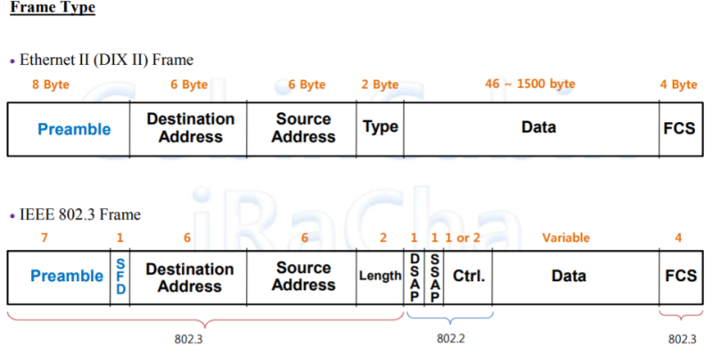
Frame 구조
Preamble : 데이터 동기화를 위한 제어 신호. 프레임의 속도를 맞추고 실제 데이터의 시작을 알려 제대로 인식할 수 있도록 도와 줌.
SFD : 데이터의 시작을 알림
Destination Address : 목적지의 MAC Address라고 하는 주소
Source Address : 출발지 주소 필드, MAC Address
Type : 상위계층의 프로토콜 정보, Next Header의 프로토콜을 나타내는 필드.
Length : 0x0600보다 작으면 IEEE 802.3 Frame. 크면 Ether Type.
DSAP : 목적지 3계층 프로토콜 주소
SSAP : 출발지 3계층 프로토콜 주소
FCS : 오류 검출을 위한 필드,G(x)함수를 이용한 데이터를 체크하는 값이 들어가 있어서 오류 검출을 할 수 있다. Frame의 시작인 Destination Address 부분부터 데이터 필드 까지를 포함.

Slide 13
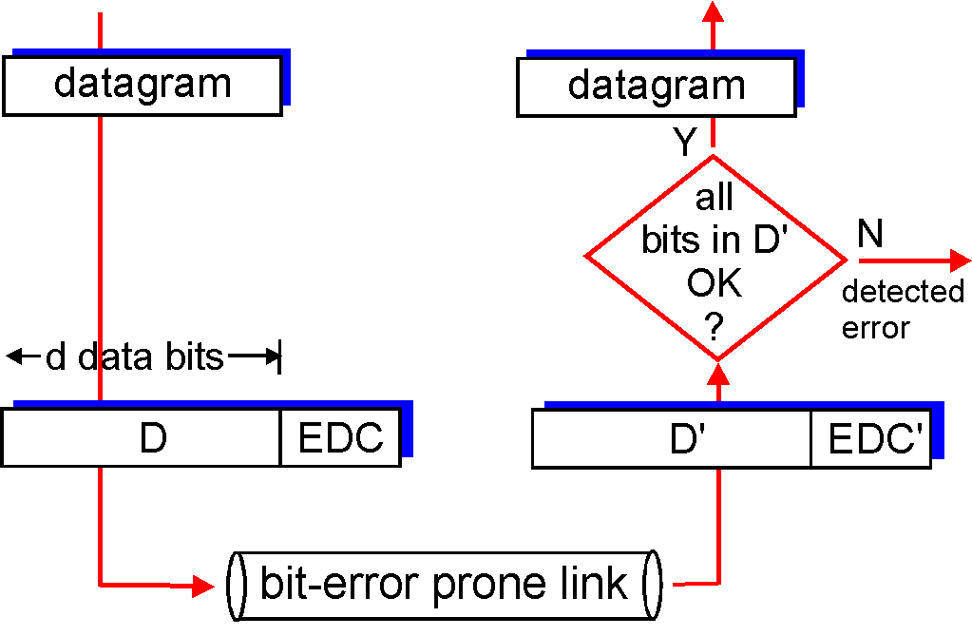
Error detection & Correction
에러가 있는 프레임을 보낸다면 비효율적 ➔ 링크에서 처리
EDC= Error Detection and Correction bits (redundancy)
D = Data protected by error checking, may include header fields
에러 발견과 수정을 위해 추가적인 데이터를 추가함.
Error detection not 100% reliable!
protocol may miss some errors, but rarely
larger EDC field yields better detection and correction ➔ tradeoff
otherwise

Slide 14
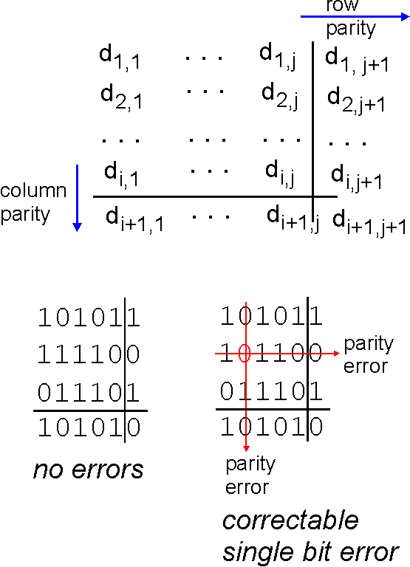
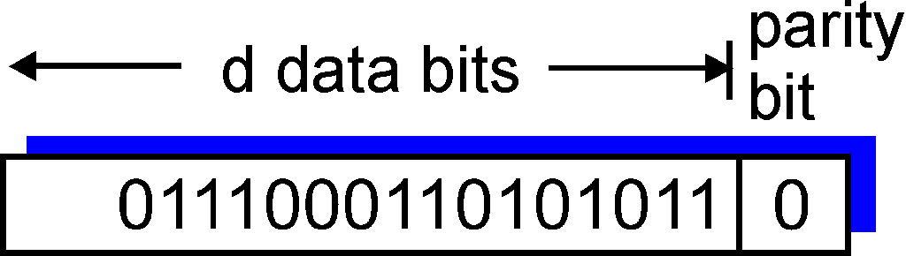
Parity checking (간단/비효율)
single bit parity:
detect single bit errors
two-dimensional bit parity:
detect and correct single bit errors
0
0
* Check out the online interactive exercises for more examples: http://gaia.cs.umass.edu/kurose_ross/interactive/

Slide 15
Internet checksum (review)
goal: detect “errors” (e.g., flipped bits) in transmitted packet (note: used at transport layer only)
sender:
treat segment contents as sequence of 16-bit integers
checksum: addition (1’s complement sum) of segment contents
sender puts checksum value into UDP checksum field
receiver:
compute checksum of received segment
check if computed checksum equals checksum field value:
NO - error detected
YES - no error detected. But maybe errors nonetheless?

Slide 16
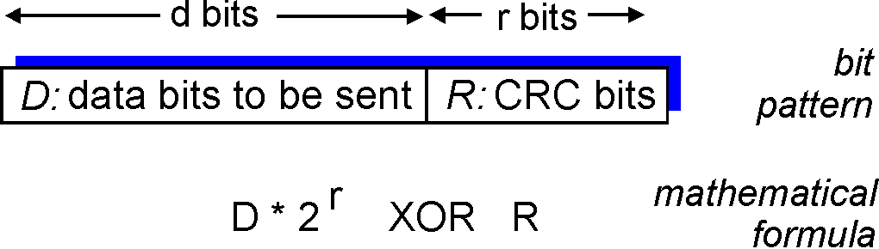
Cyclic redundancy check (CRC)
more powerful error-detection coding : 더 강력한 에러 검사
view data bits, D, as a binary number
choose r+1 bit pattern (generator), G
goal: choose r CRC bits, R, such that
<D,R> exactly divisible by G (modulo 2)
receiver knows G, divides <D,R> by G. If non-zero remainder: error detected!
can detect all burst errors less than r+1 bits
widely used in practice (Ethernet, 802.11 WiFi, ATM)

Slide 17
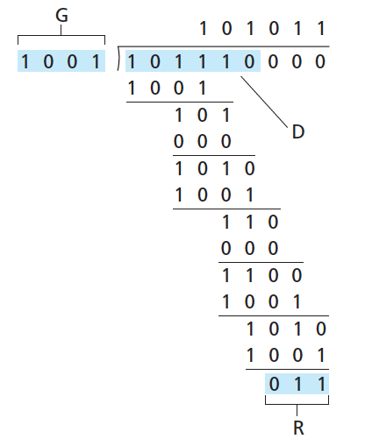
CRC example
want:
D.2^{r} XOR R = nG
equivalently:
D.2^{r} = nG XOR R
equivalently:
if we divide D.2^{r} by G, want remainder R to satisfy:
D.2^{r}
G
R = remainder[ ]
* Check out the online interactive exercises for more examples: http://gaia.cs.umass.edu/kurose_ross/interactive/

Slide 18
CRC (more)
[D,R]을 보냄
송신자를 [D,R]/G로 나누면 0이면 전송 오케이
else면 에러가 발생한 것으로 판단함
Error이면 버리거나 재전송 요구

Slide 19
Error Correction (에러 수정)
Forward error correction (FEC) or channel coding
Hamming code (예)
다른 자료 참고

Slide 20
Link layer, LANs: outline
6.1 introduction, services
6.2 error detection, correction
6.3 multiple access protocols
6.4 LANs
addressing, ARP
Ethernet
switches
VLANS
6.5 link virtualization: MPLS
6.6 data center networking
6.7 a day in the life of a web request

Slide 21



Multiple access links, protocols
two types of “links”:
point-to-point ➔ 독점함, 문제가 적음
PPP for dial-up access
point-to-point link between Ethernet switch, host
broadcast (shared wire or medium) ➔ 공유
old-fashioned Ethernet
upstream HFC
802.11 wireless LAN
shared wire (e.g.,
cabled Ethernet)
shared RF
(e.g., 802.11 WiFi)
shared RF
(satellite)
humans at a
cocktail party
(shared air, acoustical)

Slide 22
Multiple access (MAC) protocols
single shared broadcast channel (하나의 채널을 공유)
two or more simultaneous transmissions by nodes: interference
collision if node receives two or more signals at the same time ➔ 두개 이상의 시그널이 보내질 때는 충돌발생
multiple access protocol (MAC)
distributed algorithm that determines how nodes share channel, i.e., determine when node can transmit
채널을 공유하게끔 도와주는 알고리즘
여러 사람이 서로 대화할 때 서로 방해되는 현상

Slide 23
An ideal multiple access protocol
given: broadcast channel of rate R bps
desiderata: (해결 기준/원칙)
1. when one node wants to transmit, it can send at rate R.(하나의 노드가 전송을 독점할 수도 있음)
2. When M nodes want to transmit, each can send at average rate R/M (다수의 노드가 균등하게 전송)
3. fully decentralized: (조정없이 개별적/분산적으로 처리)
no special node to coordinate transmissions
no synchronization of clocks, slots
4. simple

Slide 24
MAC protocols: taxonomy
three broad classes:
channel partitioning (채널을 분배) : 충돌 없음
divide channel into smaller “pieces” (time slots, frequency, code)
allocate piece to node for exclusive use
random access (서로 알아서) ➔ 충돌/복구 문제
channel not divided, allow collisions
“recover” from collisions
“taking turns” (순서를 배정) : 충돌 없음
nodes take turns, but nodes with more to send can take longer turns
충돌 없는 경우 vs. 충돌 발생 경우

Slide 25
채널을 분할하는 방법
TDMA (시간 분할)
FDMA (주파수 분할)
CMDA (코드 분할)

Slide 26
Channel partitioning MAC protocols: TDMA
TDMA: time division multiple access
access to channel in "rounds" (노드가 돌아가며)
each station gets fixed length slot (length = packet transmission time) in each round
unused slots go idle (1,3,4 have packets to send, slots 2,5,6 idle )
전화 회선
6-slot
frame
6-slot
frame
1
3
4
1
3
4

Slide 27
Channel partitioning MAC protocols: FDMA
FDMA: frequency division multiple access
channel spectrum divided into frequency bands
each station assigned fixed frequency band
unused transmission time in frequency bands go idle (비효율)
1,3,4 have packet to send, frequency bands 2,5,6 idle
오케스트라 합주
라디오 방송
time
frequency bands
FDM cable

Slide 28
Channel Partition :CDMA
CDMA : code division multiple access
각 휴대폰의 신호를 각각 암호화 하여 보내고 수신 측에서는 암호된 것을 해독
FDMA + TDMA를 믹스한 경우
이동 통신에서 (chapter 7)

Slide 29

“Taking turns” MAC protocols
polling:
master node “invites” slave nodes to transmit in turn
typically used with “dumb” slave devices
concerns:
polling overhead
Latency (지연)
single point of failure (master)
마스터 노드가 순서를 결정
data
poll
master
data
slaves

Slide 30
“Taking turns” MAC protocols
token passing:
control token passed from one node to next sequentially.
token message
concerns:
token overhead
latency
single point of failure (token)
FDDI (Fiber Distributed Dual Interface) ➔ dual token ring (노드간 두개의 링크를 가짐)
T
(nothing
to send)
T
data

Slide 31
램덤 방식 (Random Access Protocols)
노드들이 자율적으로 알아서 눈치껏 보내기
충돌을 최소화 하기 위해서는?
충돌시에 재 전송
충돌 감지 방법은?

Slide 32
Random access protocols
when node has packet to send
transmit at full channel data rate R. (각 노드가 독점하고자 함)
no a priori coordination among nodes (노드간의 조정이 없음)
two or more transmitting nodes ➜ “collision”,
random access MAC protocol specifies:
how to detect collisions
how to recover from collisions (e.g., via delayed retransmissions)
examples of random access MAC protocols:
slotted ALOHA
ALOHA
CSMA, CSMA/CD, CSMA/CA

Slide 33
ALOHAnet
하와이 대학에서 1971년도 개발
Additive Links Online Hawaii Area의 약자

Slide 34
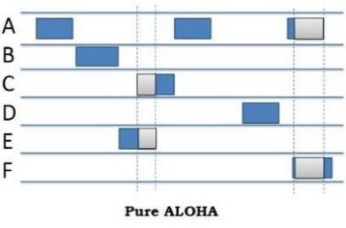
ALOHA protocol
All frames have the same length → 전송 시간도 동일
각 노드는 프레임이 생성되면, 랜덤하게 각자 알아서 전송시작
충돌이 발생하면 재 전송함.
충돌 감지는 일정시간까지 에코가 오지 않을 때.

Slide 35
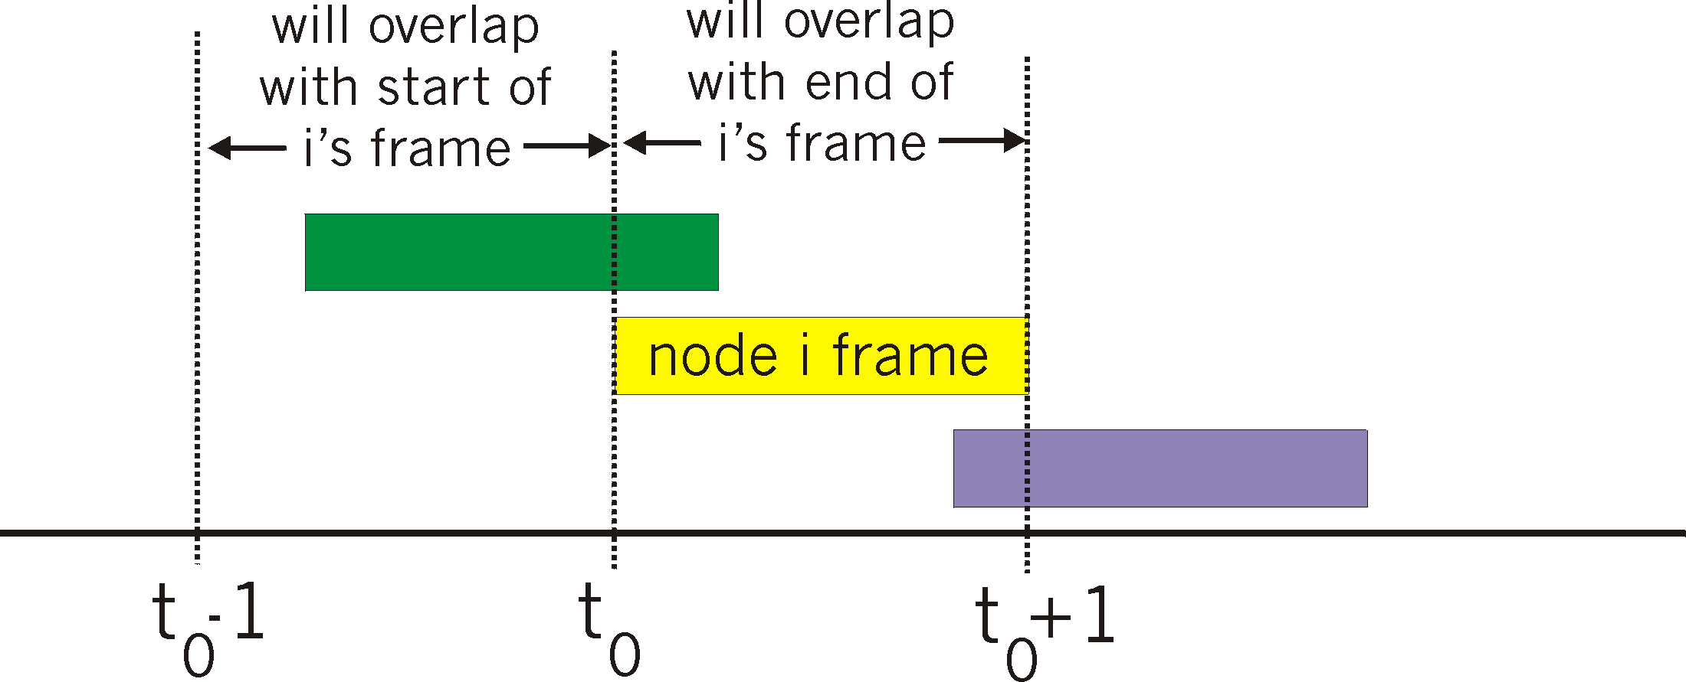
Pure (unslotted) ALOHA
unslotted Aloha: simpler, no synchronization
collision probability increases:
frame sent at t₀ collides with other frames sent in [t₀-1,t₀+1] : 프레임 i가 보내진 t0 전후에 보내진 다른 프레임이 있다면 충돌 발생하여 문제가 발생

Slide 36
Pure ALOHA efficiency
P(success by given node) = P(node transmits) .
P(no other node transmits in [t₀-1,t₀] .
P(no other node transmits in [t₀-1,t₀]
= p . (1-p)^{N-1 .} (1-p)^{N-1}
= p . (1-p)^{2(N-1)}
… choosing optimum p and then letting n
= 1/(2e) = .18 ^{(18%) : 전송이 비효율}
포이송 확률 분포
even worse than slotted Aloha!

Slide 37
Slotted ALOHA
assumptions:
all frames same size
time divided into equal size slots (time to transmit
1 frame)
nodes start to transmit only slot beginning
nodes are synchronized
if 2 or more nodes transmit in slot, all nodes detect collision
operation:
when node obtains fresh frame, transmits in next slot
if no collision: node can send new frame in next slot
if collision: node retransmits frame in each subsequent slot with prob. p until success

Slide 38
Slotted ALOHA
node 1
1
1
1
1
node 2
2
2
2
node 3
3
3
3
C
E
C
S
E
C
E
S
S
Pros:
single active node can continuously transmit at full rate of channel
highly decentralized: only slots in nodes need to be in sync
simple
Cons:
collisions, wasting slots
idle slots
nodes may be able to detect collision in less than time to transmit packet
clock synchronization

Slide 39
Slotted ALOHA: efficiency
efficiency: long-run fraction of successful slots (many nodes, all with many frames to send)
max efficiency: find p* that maximizes Np(1-p)^{N-1}
for many nodes, take limit of Np*(1-p*)^{N-1} as N goes to infinity, gives:
max efficiency = 1/e = .37
^{충돌의 확률이 ½로 줄어듬}
suppose: N nodes with many frames to send, each transmits in slot with probability p
prob that given node has success in a slot = p(1-p)^{N-1}
prob that any node has a success = Np(1-p)^{N-1}
!
at best: channel
used for useful
transmissions 37%
of time!

Slide 40
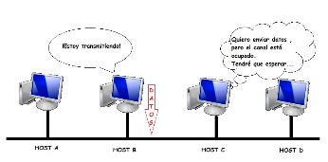
CSMA (carrier sense multiple access)
ALOHA는 노드들끼리 간섭하지 않기 때문에 효율성이 떨어짐.
CSMA: listen before transmit:
if channel sensed idle: transmit entire frame
if channel sensed busy, defer transmission
human analogy: don’t interrupt others!
(다른 사람이 얘기하면 말하지 않는다)
충돌을 완전히 해결할 수 있는가? No. why?

Slide 41
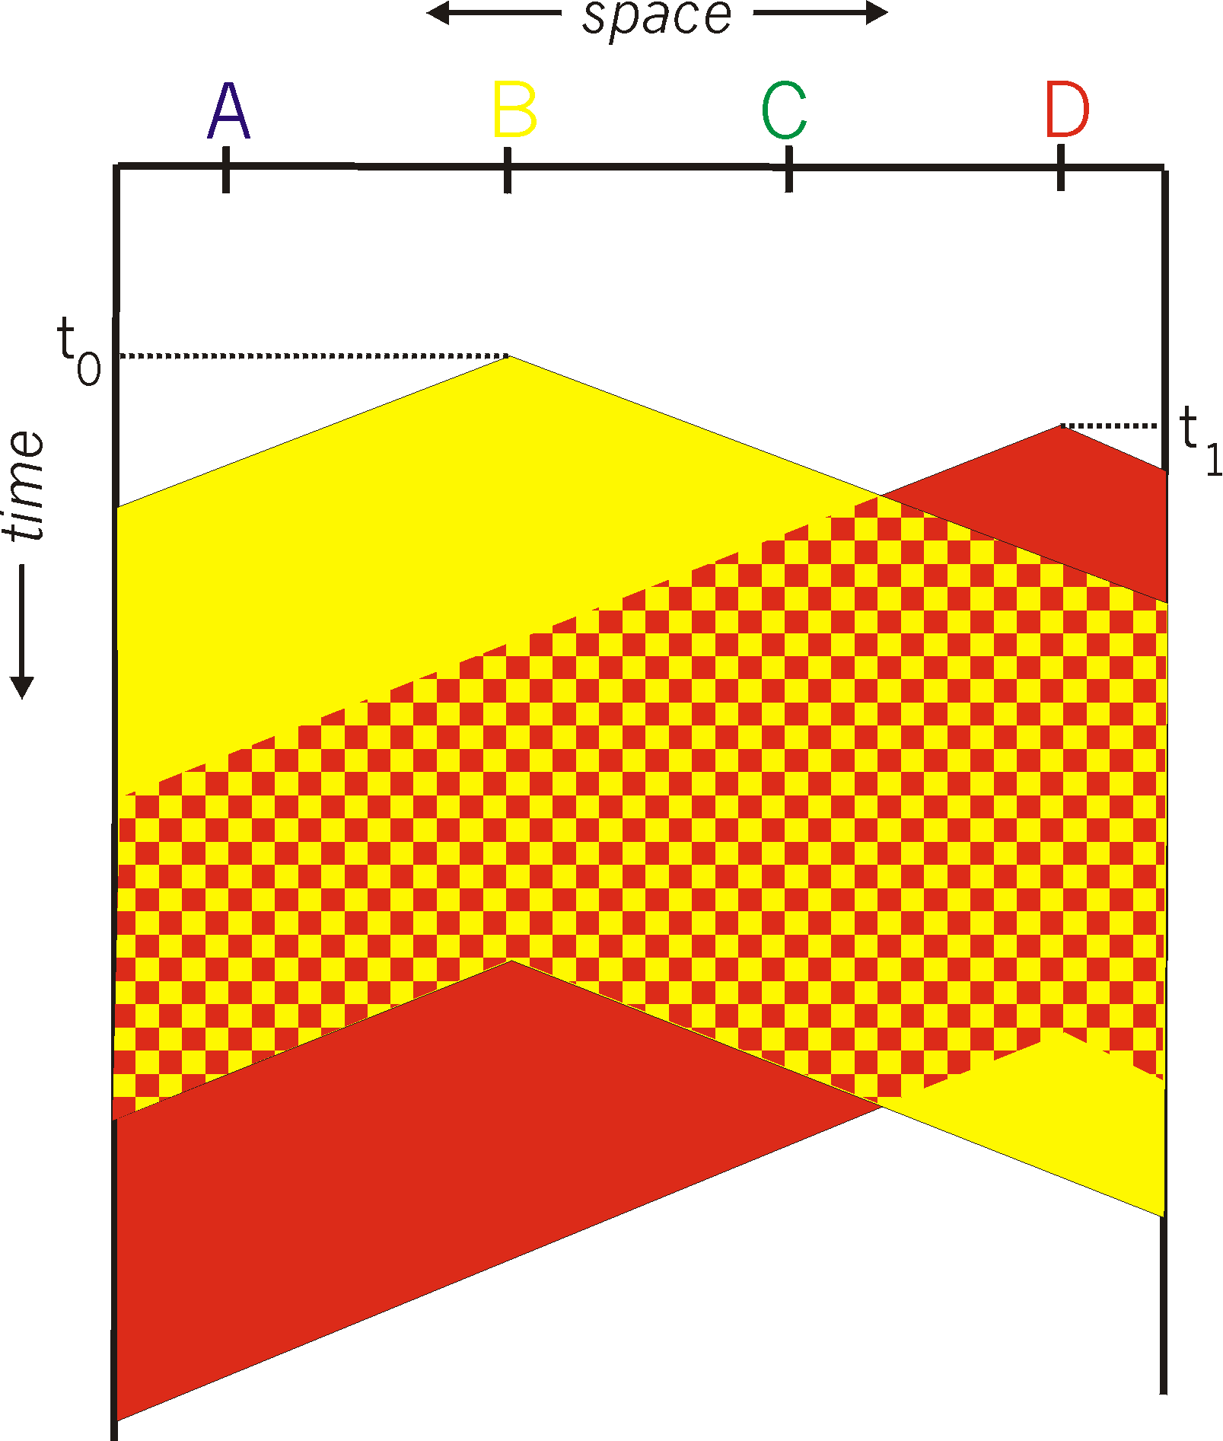
CSMA collisions
spatial layout of nodes
collisions can still occur: propagation delay means two nodes may not hear each other’s transmission
전송속도로 인한 문제
collision: entire packet transmission time wasted
distance & propagation delay play role in in determining collision probability

Slide 42
CSMA/CD (collision detection)
CSMA/CD: carrier sensing, deferral as in CSMA
collisions detected within short time
colliding transmissions aborted, reducing channel wastage
collision detection:
easy in wired LANs: measure signal strengths, compare transmitted, received signals (유선은 가능)
전송 시그널의 강도를 감지해서 충돌 여부를 판단
충돌이 감지되면 전송을 취소하고 jam 시그널을 광고해서 다른 노드도 보내지 않기를 통보
difficult in wireless LANs: received signal strength overwhelmed by local transmission strength
human analogy: the polite conversationalist
Ethernet에서 사용

Slide 43
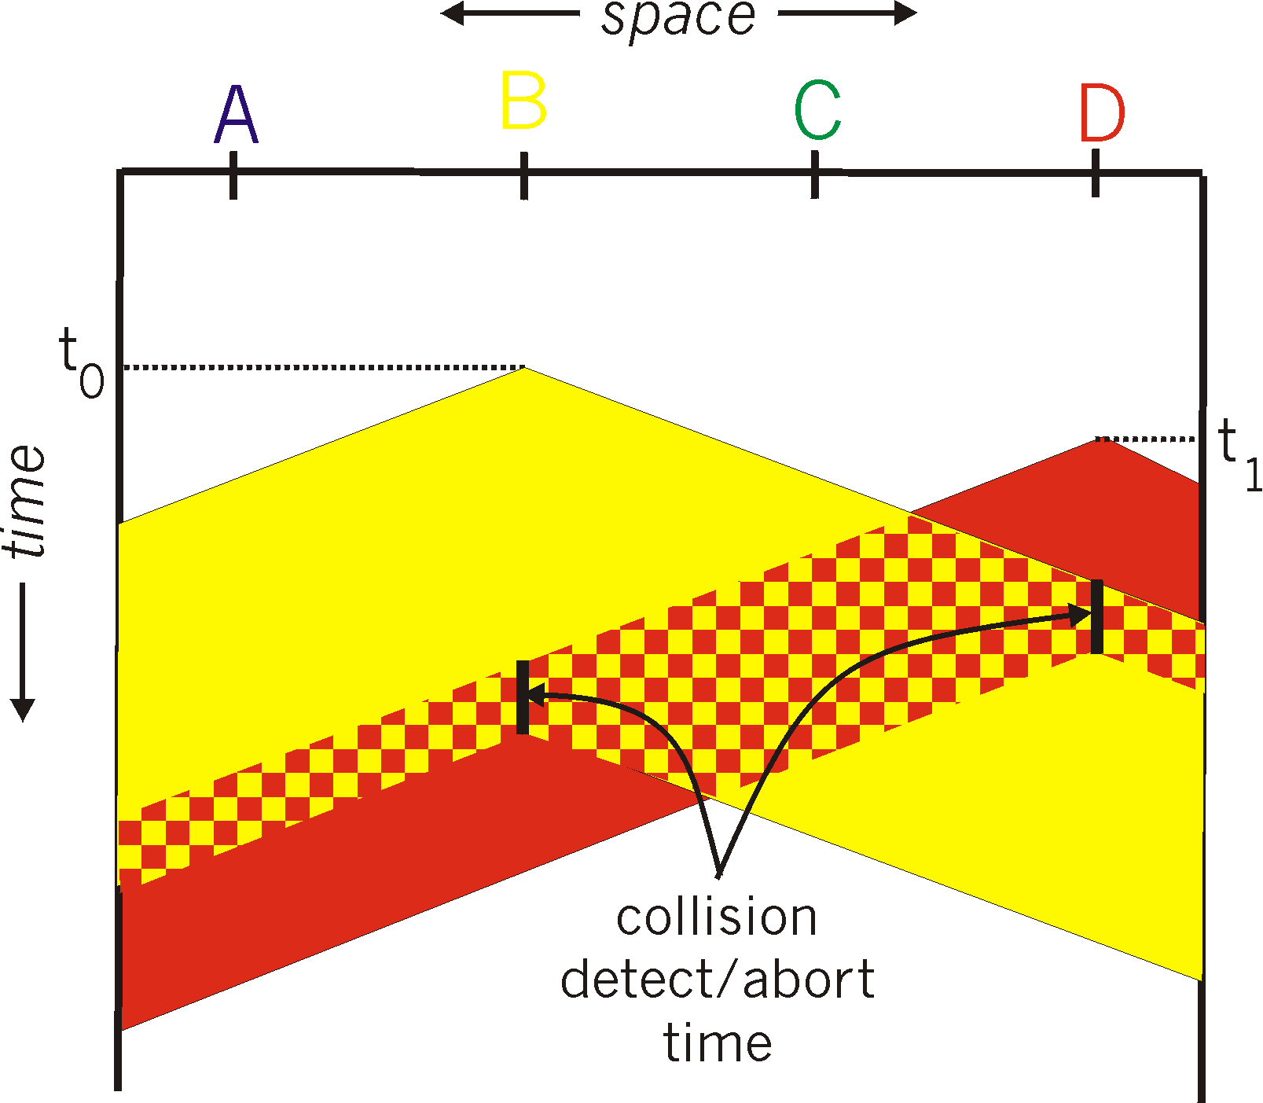
CSMA/CD (collision detection)
spatial layout of nodes

Slide 44
Ethernet CSMA/CD algorithm
1. NIC receives datagram from network layer, creates frame
2. If NIC senses channel idle, starts frame transmission. If NIC senses channel busy, waits until channel idle, then transmits.
3. If NIC transmits entire frame without detecting another transmission, NIC is done with frame !
4. If NIC detects another transmission while transmitting, aborts and sends jam signal
5. After aborting, NIC enters binary (exponential) backoff:
after mth collision, NIC chooses K at random from {0,1,2, …, 2^{m}-1}. NIC waits K·512 bit times, returns to Step 2
longer backoff interval with more collisions

Slide 45
CSMA/CD efficiency
T_{prop} = max prop delay between 2 nodes in LAN
t_{trans} = time to transmit max-size frame
efficiency goes to 1
as t_{prop} goes to 0
as t_{trans} goes to infinity
better performance than ALOHA: and simple, cheap, decentralized!

Slide 46
“Taking turns” MAC protocols
channel partitioning MAC protocols:
share channel efficiently and fairly at high load
inefficient at low load: delay in channel access, 1/N bandwidth allocated even if only 1 active node!
random access MAC protocols
efficient at low load: single node can fully utilize channel
high load: collision overhead
“taking turns” protocols
look for best of both worlds!
Control overhead, 링크가 끊어졌을 때 문제

Slide 47
Summary of MAC protocols
channel partitioning, by time, frequency or code
Time Division, Frequency Division
random access (dynamic),
ALOHA, S-ALOHA, CSMA, CSMA/CD
carrier sensing: easy in some technologies (wire), hard in others (wireless)
CSMA/CD used in Ethernet
CSMA/CA used in 802.11
taking turns
polling from central site, token passing
Bluetooth, FDDI, token ring

Slide 48
Link layer, LANs: outline
6.1 introduction, services
6.2 error detection, correction
6.3 multiple access protocols
6.4 LANs
addressing, ARP
Ethernet
switches
VLANS
6.5 link virtualization: MPLS
6.6 data center networking
6.7 a day in the life of a web request

Slide 49
MAC addresses and ARP
IP address (32 or 128 bits) : 집주소
Logical network-layer address
used for layer 3 (network layer) forwarding
MAC address (48 bits)
LAN or physical or Ethernet address:
전세계적으로 고유함 (주민번호, 여권번호)
burned in NIC ROM, also sometimes software settable
e.g.: 1A-2F-BB-76-09-AD 6bytes
[앞 3바이트는 제조사 고유번호 + 3바이트는 제품의 시리얼 번호] : 기기에 종속

Slide 50

LAN addresses and ARP
each adapter on LAN has unique LAN address
function: used ‘locally” to get frame from one interface to another physically-connected interface
1A-2F-BB-76-09-AD
LAN
(wired or
wireless)
adapter
71-65-F7-2B-08-53
58-23-D7-FA-20-B0
0C-C4-11-6F-E3-98

Slide 51
LAN addresses (more)
MAC address allocation administered by IEEE
manufacturer buys portion of MAC address space (to assure uniqueness)
analogy:
MAC address: like Social Security Number
IP address: like postal address
MAC flat address ➜ portability : 실제 주소
can move LAN card from one LAN to another
IP hierarchical address not portable : 가상 주소
address depends on IP subnet to which node is attached
IP 주소는 목적지 네트워크를 찾는데 중점, MAC 주소는 최종 호스트를 도달하는데 목적

Slide 52
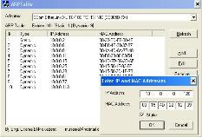




ARP: address resolution proto
Question: how to determine
interface’s MAC address, knowing its IP address?
ARP table: each IP node (host, router) on LAN has table
IP/MAC address mappings for some LAN nodes:
< IP address; MAC address; TTL>
TTL (Time To Live): time after which address mapping will be forgotten (typically 20 min)
137.196.7.78
1A-2F-BB-76-09-AD
137.196.7.23
137.196.7.14
LAN
71-65-F7-2B-08-53
58-23-D7-FA-20-B0
0C-C4-11-6F-E3-98
137.196.7.88

Slide 53
ARP : same LAN (동일 N/W 내)
A wants to send datagram to B
B’s MAC address not in A’s ARP table.
A broadcasts ARP query packet, containing B's IP address
destination MAC address = FF-FF-FF-FF-FF-FF
all nodes on LAN receive ARP query
B receives ARP packet, replies to A with its (B's) MAC address
frame sent to A’s MAC address (unicast)
A caches (saves) IP-to-MAC address pair in its ARP table until information becomes old (times out)
TTL 동안 정보 유지
ARP is “plug-and-play”:
nodes create their ARP tables without intervention from net administrator

Slide 54




ARP: 다른 네트워크 LAN
walkthrough: send datagram from A to B via R (라우터)
focus on addressing – at IP (datagram) and MAC layer (frame)
assume A knows B’s IP address
assume A knows IP address of first hop router, R (how?)
assume A knows R’s MAC address (how?)
A
B
R
111.111.111.111
222.222.222.222
74-29-9C-E8-FF-55
49-BD-D2-C7-56-2A
222.222.222.220
1A-23-F9-CD-06-9B
111.111.111.112
111.111.111.110
222.222.222.221
CC-49-DE-D0-AB-7D
E6-E9-00-17-BB-4B
88-B2-2F-54-1A-0F

Slide 55
Addressing: routing to another LAN
A creates IP datagram with IP source A, destination B
A creates link-layer frame with R's MAC address as destination address, frame contains A-to-B IP datagram
MAC src: 74-29-9C-E8-FF-55
MAC dest: E6-E9-00-17-BB-4B
IP
Eth
Phy
IP src: 111.111.111.111
IP dest: 222.222.222.222
A
B
R
111.111.111.111
222.222.222.222
74-29-9C-E8-FF-55
49-BD-D2-C7-56-2A
222.222.222.220
1A-23-F9-CD-06-9B
111.111.111.112
111.111.111.110
222.222.222.221
CC-49-DE-D0-AB-7D
E6-E9-00-17-BB-4B
88-B2-2F-54-1A-0F

Slide 56
Addressing: routing to another LAN
frame sent from A to R
frame received at R, datagram removed, passed up to IP
MAC src: 74-29-9C-E8-FF-55
MAC dest: E6-E9-00-17-BB-4B
IP src: 111.111.111.111
IP dest: 222.222.222.222
IP
Eth
Phy
IP src: 111.111.111.111
IP dest: 222.222.222.222
IP
Eth
Phy
A
B
R
111.111.111.111
222.222.222.222
74-29-9C-E8-FF-55
49-BD-D2-C7-56-2A
222.222.222.220
1A-23-F9-CD-06-9B
111.111.111.112
111.111.111.110
222.222.222.221
CC-49-DE-D0-AB-7D
E6-E9-00-17-BB-4B
88-B2-2F-54-1A-0F

Slide 57
Addressing: routing to another LAN
R forwards datagram with IP source A, destination B
R creates link-layer frame with B's MAC address as destination address, frame contains A-to-B IP datagram
MAC src: 1A-23-F9-CD-06-9B
MAC dest: 49-BD-D2-C7-56-2A
IP
Eth
Phy
IP
Eth
Phy
IP src: 111.111.111.111
IP dest: 222.222.222.222
A
B
R
111.111.111.111
222.222.222.222
74-29-9C-E8-FF-55
49-BD-D2-C7-56-2A
222.222.222.220
1A-23-F9-CD-06-9B
111.111.111.112
111.111.111.110
222.222.222.221
CC-49-DE-D0-AB-7D
E6-E9-00-17-BB-4B
88-B2-2F-54-1A-0F

Slide 58
Addressing: routing to another LAN
R forwards datagram with IP source A, destination B
R creates link-layer frame with B's MAC address as destination address, frame contains A-to-B IP datagram
MAC src: 1A-23-F9-CD-06-9B
MAC dest: 49-BD-D2-C7-56-2A
IP
Eth
Phy
IP
Eth
Phy
IP src: 111.111.111.111
IP dest: 222.222.222.222
A
B
R
111.111.111.111
222.222.222.222
74-29-9C-E8-FF-55
49-BD-D2-C7-56-2A
222.222.222.220
1A-23-F9-CD-06-9B
111.111.111.112
111.111.111.110
222.222.222.221
CC-49-DE-D0-AB-7D
E6-E9-00-17-BB-4B
88-B2-2F-54-1A-0F

Slide 59
Addressing: routing to another LAN
R forwards datagram with IP source A, destination B
R creates link-layer frame with B's MAC address as dest, frame contains A-to-B IP datagram
MAC src: 1A-23-F9-CD-06-9B
MAC dest: 49-BD-D2-C7-56-2A
IP src: 111.111.111.111
IP dest: 222.222.222.222
IP
Eth
Phy
A
B
R
111.111.111.111
222.222.222.222
74-29-9C-E8-FF-55
49-BD-D2-C7-56-2A
222.222.222.220
1A-23-F9-CD-06-9B
111.111.111.112
111.111.111.110
222.222.222.221
CC-49-DE-D0-AB-7D
E6-E9-00-17-BB-4B
88-B2-2F-54-1A-0F
* Check out the online interactive exercises for more examples: http://gaia.cs.umass.edu/kurose_ross/interactive/

Slide 60
Link layer, LANs: outline
6.1 introduction, services
6.2 error detection, correction
6.3 multiple access protocols
6.4 LANs
addressing, ARP
Ethernet
switches
VLANS
6.5 link virtualization: MPLS
6.6 data center networking
6.7 a day in the life of a web request

Slide 61
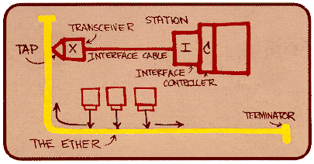
Ethernet
“dominant” wired LAN technology:
74년에 개발 (Metcalfe), ALOHAnet에 적용됨
83년도에 표준화됨
single chip, multiple speeds (e.g., Broadcom BCM5761)
first widely used LAN technology
simpler, cheap
kept up with speed race: 10 Mbps – 10 Gbps
Metcalfe’s Ethernet sketch

Slide 62
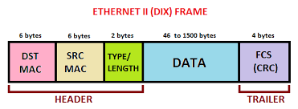
Ethernet frame 구조
sending adapter encapsulates IP datagram (or other network layer protocol packet) in Ethernet frame
preamble: (송수신자 사이에 동기화를 위해)
7 bytes with pattern 10101010 followed by one byte with pattern 10101011
used to synchronize receiver, sender clock rates
최소 64, 최대 1518 바이트
type
preamble
dest.
address
source
address
data (payload)
CRC

Slide 63
Ethernet frame structure (more)
addresses: 6 byte source, destination MAC addresses
if adapter receives frame with matching destination address, or with broadcast address (e.g. ARP packet), it passes data in frame to network layer protocol
otherwise, adapter discards frame
type: indicates higher layer protocol (mostly IP but others possible, e.g., Novell IPX, AppleTalk)
CRC: cyclic redundancy check at receiver
error detected: frame is dropped
ACK를 사용하지 않음 ➔ 신뢰성이 없는 전송
type
preamble
dest.
address
source
address
data (payload)
CRC

Slide 64



Ethernet: physical topology
bus: popular through mid 90s (초창기)
All nodes in same collision domain (can collide with each other)
Star: prevails today 충돌이 없음
active switch in center
each “spoke” runs a (separate) Ethernet protocol (nodes do not collide with each other)
switch
star
bus: coaxial cable

Slide 65
Ethernet: unreliable, connectionless
connectionless: no handshaking between sending and receiving NICs
unreliable: receiving NIC doesn't send acks or nacks to sending NIC
data in dropped frames recovered only if initial sender uses higher layer rdt (e.g., TCP), otherwise dropped data lost
Ethernet’s MAC protocol: unslotted CSMA/CD with binary backoff

Slide 66
802.3 Ethernet standards: link & physical layers
many different Ethernet standards
common MAC protocol and frame format
different speeds: 2 Mbps, 10 Mbps, 100 Mbps, 1Gbps, 10 Gbps, 40 Gbps
different physical layer media: fiber, cable
application
transport
network
link
physical
MAC protocol
and frame format
100BASE-TX
100BASE-T2
100BASE-FX
100BASE-T4
100BASE-SX
100BASE-BX
copper (twister
pair) physical layer
fiber physical layer

Slide 67
Link layer, LANs: outline
6.1 introduction, services
6.2 error detection, correction
6.3 multiple access protocols
6.4 LANs
addressing, ARP
Ethernet
switches
VLANS
6.5 link virtualization: MPLS
6.6 data center networking
6.7 a day in the life of a web request

Slide 68
Switch: multiple simultaneous transmissions
Hosts have dedicated, direct connection to switch
Switch의 역할
Buffering packets (in/out)
입력 프레임의 mac주소를 검사하고 목적 mac주소를 보고 전송
Ethernet protocol used on each incoming link, but no collisions; full duplex
each link is its own collision domain
switching: A-to-A’ and B-to-B’ can transmit simultaneously, without collisions (충돌이 없음)
A
C’
B
6
1
2
5
4
3
B’
C
A’
switch with six interfaces
(1,2,3,4,5,6)

Slide 69
Ethernet switch (통신장비)
link-layer device: takes an active role
store, forward Ethernet frames
examine incoming frame’s MAC address, selectively forward frame to one-or-more outgoing links when frame is to be forwarded on segment, uses CSMA/CD to access segment
transparent
hosts are unaware of presence of switches
plug-and-play, self-learning
switches do not need to be configured

Slide 70
Switch: switch table
Source: A
Dest: A’
switch learns which hosts can be reached through which interfaces
when frame received, switch “learns” location of sender: incoming LAN segment
records sender/location pair in switch table
A
A A’
C’
B
6
1
2
5
4
3
B’
C
A’
MAC addr interface TTL
A
1
60
Switch table
(initially empty)

Slide 71
Switch forwarding table
Q: how does switch know A’ reachable via interface 4, B’ reachable via interface 5?
A
C’
B
A: each switch has a switch table, each entry:
(MAC address of host, interface to reach host, time stamp)
looks like a routing table!
6
1
2
5
4
3
B’
C
A’
Q: how are entries created, maintained in switch table?
something like a routing protocol?
switch with six interfaces
(1,2,3,4,5,6)

Slide 72
Self-learning, forwarding: example
Source: A
Dest: A’
A
A A’
frame destination, A’, location unknown:
flood
C’
B
destination A location known:
6
1
2
A A’
A A’
A A’
A A’
selectively send
on just one link
A A’
5
4
3
B’
C
A’ A
A’
MAC addr interface TTL
A
1
60
switch table
(initially empty)
A’
4
60

Slide 73




Institutional network
mail server
to external
network
router
web server
IP subnet

Slide 74
Self-learning multi-switch example
Suppose C sends frame to I, I responds to C
S₄
S₁
S₃
A
S₂
F
I
B
C
D
E
G
H
Q: show switch tables and packet forwarding in S₁, S₂, S₃, S₄

Slide 75


Switches vs. routers
application
transport
network
link
physical
both are store-and-forward:
routers: network-layer devices (examine network-layer headers)
switches: link-layer devices (examine link-layer headers)
both have forwarding tables:
routers: compute tables using routing algorithms, IP addresses
switches: learn forwarding table using flooding, learning, MAC addresses
datagram
frame
link
physical
frame
switch
network
link
physical
datagram
frame
application
transport
network
link
physical

Slide 76
Link layer, LANs: outline
6.1 introduction, services
6.2 error detection, correction
6.3 multiple access protocols
6.4 LANs
addressing, ARP
Ethernet
switches
VLANS
6.5 link virtualization: MPLS (생략)
6.6 data center networking
6.7 a day in the life of a web request

Slide 77
Link layer, LANs: outline
6.1 introduction, services
6.2 error detection, correction
6.3 multiple access protocols
6.4 LANs
addressing, ARP
Ethernet
switches
VLANS
6.5 link virtualization: MPLS
6.6 data center networking (생략)
6.7 a day in the life of a web request

Slide 78
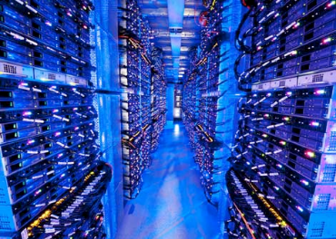
Data center networks
10’s to 100’s of thousands of hosts, often closely coupled, in close proximity:
e-business (e.g. Amazon)
content-servers (e.g., YouTube, Akamai, Apple, Microsoft)
search engines, data mining (e.g., Google)
challenges:
multiple applications, each serving massive numbers of clients
managing/balancing load, avoiding processing, networking, data bottlenecks
Inside a 40-ft Microsoft container,
Chicago data center

Slide 79
Data center networks
load balancer: application-layer routing
receives external client requests
directs workload within data center
returns results to external client (hiding data center internals from client)
Internet
Border router
Load
balancer
Load
balancer
Access router
B
Tier-1 switches
A
C
Tier-2 switches
TOR switches
Server racks
1
2
3
4
5
6
7
8

Slide 80
Data center networks
rich interconnection among switches, racks:
increased throughput between racks (multiple routing paths possible)
increased reliability via redundancy
Tier-1 switches
Tier-2 switches
TOR switches
Server racks
1
2
3
4
5
6
7
8

Slide 81
Link layer, LANs: outline
6.1 introduction, services
6.2 error detection, correction
6.3 multiple access protocols
64 LANs
addressing, ARP
Ethernet
switches
VLANS
6.5 link virtualization: MPLS
6.6 data center networking
6.7 a day in the life of a web request

Slide 82
Synthesis: a day in the life of a web request
journey down protocol stack complete!
application, transport, network, link
putting-it-all-together: synthesis!
goal: identify, review, understand protocols (at all layers) involved in seemingly simple scenario: requesting www page
scenario: student attaches laptop to campus network, requests/receives www.google.com

Slide 83





A day in the life: scenario
browser
DNS server
Comcast network
68.80.0.0/13
school network
68.80.2.0/24
web page
web server
Google’s network
64.233.160.0/19
64.233.169.105

Slide 84

A day in the life… connecting to the Internet
DHCP
DHCP
UDP
IP
Eth
Phy
connecting laptop needs to get its own IP address, addr of first-hop router, addr of DNS server: use DHCP
DHCP
DHCP
DHCP
DHCP
DHCP request encapsulated in UDP, encapsulated in IP, encapsulated in 802.3 Ethernet
DHCP
DHCP
UDP
IP
Eth
Phy
DHCP
DHCP
DHCP
DHCP
router
(runs DHCP)
Ethernet frame broadcast (dest: FFFFFFFFFFFF) on LAN, received at router running DHCP server
Ethernet demuxed to IP demuxed, UDP demuxed to DHCP

Slide 85
A day in the life… connecting to the Internet
DHCP
DHCP
UDP
IP
Eth
Phy
DHCP server formulates DHCP ACK containing client’s IP address, IP address of first-hop router for client, name & IP address of DNS server
DHCP
DHCP
DHCP
encapsulation at DHCP server, frame forwarded (switch learning) through LAN, demultiplexing at client
DHCP
DHCP
UDP
IP
Eth
Phy
DHCP
DHCP
DHCP
router
(runs DHCP)
DHCP
DHCP client receives DHCP ACK reply
Client now has IP address, knows name & addr of DNS
server, IP address of its first-hop router

Slide 86
A day in the life… ARP (before DNS, before HTTP)
DNS
UDP
IP
Eth
Phy
before sending HTTP request, need IP address of www.google.com: DNS
DNS
DNS
DNS
ARP
ARP query
DNS query created, encapsulated in UDP, encapsulated in IP, encapsulated in Eth. To send frame to router, need MAC address of router interface: ARP
ARP
ARP reply
Eth
Phy
ARP query broadcast, received by router, which replies with ARP reply giving MAC address of router interface [라우터의 MAC주소 응답]
router
(runs DHCP)
client now knows MAC address of first hop router, so can now send frame containing DNS query

Slide 87
A day in the life… using DNS
DNS
UDP
IP
Eth
Phy
DNS
DNS server
DNS
UDP
IP
Eth
Phy
DNS
DNS
DNS
DNS
DNS
DNS
DNS
DNS
Comcast network
68.80.0.0/13
IP datagram forwarded from campus network into Comcast network, routed (tables created by RIP, OSPF, IS-IS and/or BGP routing protocols) to DNS server
router
(runs DHCP)
IP datagram containing DNS query forwarded via LAN switch from client to 1st hop router
demuxed to DNS server
DNS server replies to client with IP address of www.google.com

Slide 88
A day in the life…TCP connection carrying HTTP
HTTP
HTTP
TCP
IP
Eth
Phy
SYNACK
SYN
SYNACK
SYN
SYNACK
SYN
SYN
to send HTTP request, client first opens TCP socket to web server
router
(runs DHCP)
TCP
IP
Eth
Phy
TCP SYN segment (step 1 in 3-way handshake) inter-domain routed to google web server
SYNACK
SYN
SYNACK
SYN
SYNACK
SYNACK
SYN
web server responds with TCP SYNACK (step 2 in 3-way handshake)
web server
64.233.169.105
TCP connection established!

Slide 89
A day in the life… HTTP request/reply
HTTP
HTTP
TCP
IP
Eth
Phy
web page finally (!!!) displayed
HTTP
HTTP
HTTP
HTTP
HTTP
HTTP
HTTP
HTTP
HTTP request sent into TCP socket
router
(runs DHCP)
IP datagram containing HTTP request routed to www.google.com
HTTP
HTTP
TCP
IP
Eth
Phy
HTTP
HTTP
HTTP
web server responds with HTTP reply (containing web page)
HTTP
web server
64.233.169.105
IP datagram containing HTTP reply routed back to client

Slide 90
Chapter 6: Summary
principles behind data link layer services:
error detection, correction
sharing a broadcast channel: multiple access
link layer addressing
instantiation and implementation of various link layer technologies
Ethernet
switched LANS, VLANs
virtualized networks as a link layer: MPLS
synthesis: a day in the life of a web request

Slide 91
Chapter 6: let’s take a breath
journey down protocol stack complete (except PHY)
solid understanding of networking principles, practice
….. could stop here …. but lots of interesting topics!
wireless
multimedia
security

