Slide 1
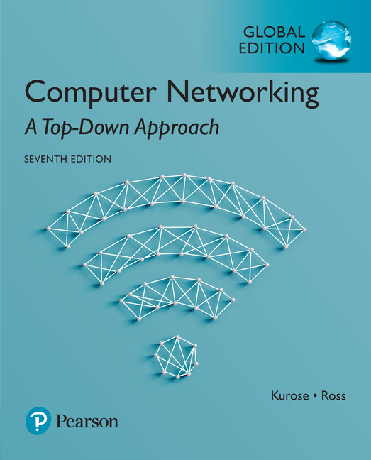
Chapter 7 Wireless and
Mobile Networks
Computer Networking: A Top Down Approach
7th Edition, Global Edition Jim Kurose, Keith Ross Pearson April 2016

Slide 2
Characteristics of selected wireless links
1300
802.11 ac
450
802.11n
54
802.11a,g
802.11a,g point-to-point
5-11
802.11b
4G: LTWE WIMAX
4
3G: UMTS/WCDMA-HSPDA, CDMA2000-1xEVDO
Data rate (Mbps)
1
802.15
.384
2.5G: UMTS/WCDMA, CDMA2000
.056
2G: IS-95, CDMA, GSM
Indoor
10-30m
Outdoor
50-200m
Mid-range
outdoor
200m – 4 Km
Long-range
outdoor
5Km – 20 Km

Slide 3
Chapter 7 outline
7.1 Introduction
Wireless
7.2 Wireless links, characteristics
CDMA
7.3 IEEE 802.11 wireless LANs (“Wi-Fi”)
7.4 Cellular Internet access
architecture
standards (e.g., 3G, LTE)
Mobility
7.5 Principles: addressing and routing to mobile users
7.6 Mobile IP
7.7 Handling mobility in cellular networks
7.8 Mobility and higher-layer protocols

Slide 4
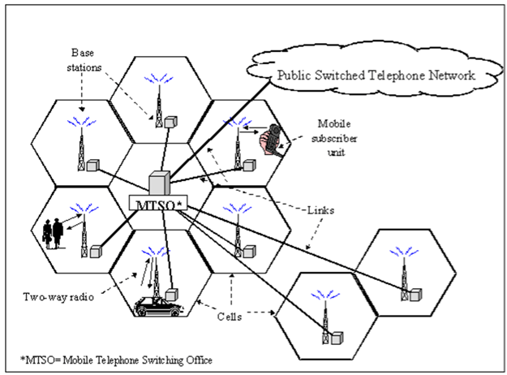
Cellular Network Topology
Goal of cell : increase the available capacity for mobile service
Cell size can be determined according to the trade-off relation between deployment cost and frequency reusability
Cell을 구성하는데 많은 비용이 필요
(장비, 토지, 임대료,
관리 유지비)
도시는 조밀하게, 시골은 느슨하게

Slide 5
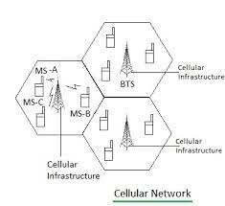
Cellular Geometry
In the hexagonal pattern, distances between all pairs of antennas are equivalent
4각형, 원 구조 보다 육각형 구조가 가장 효율성이 높다

Slide 6

Components of cellular network architecture
MSC
connects cells to wired tel. net.
manages call setup (more later!)
handles mobility (more later!)
cell
covers geographical region
base station (BS) analogous to 802.11 AP
mobile users attach to network through BS
air-interface: physical and link layer protocol between mobile and BS
Mobile
Switching
Center
Public telephone
network
Mobile
Switching
Center
wired network

Slide 7
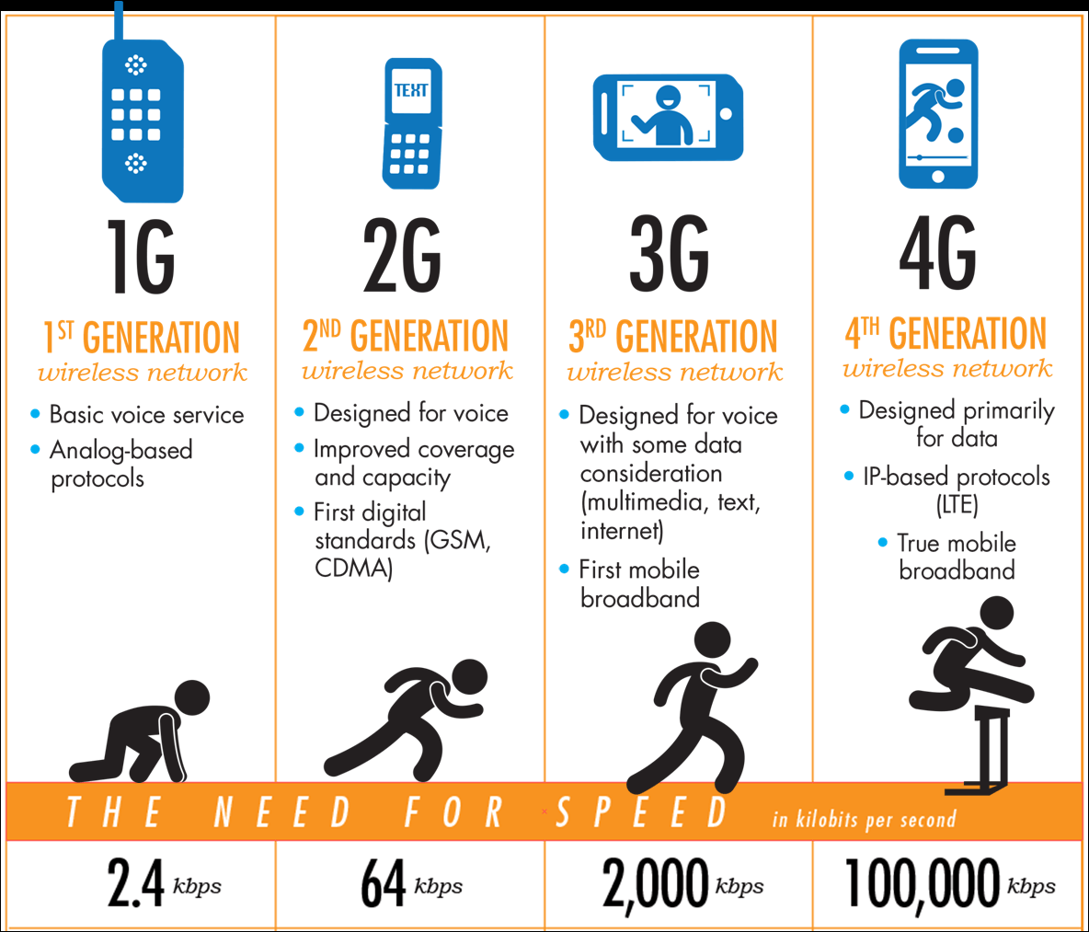
Cellular Network 역사

Slide 8
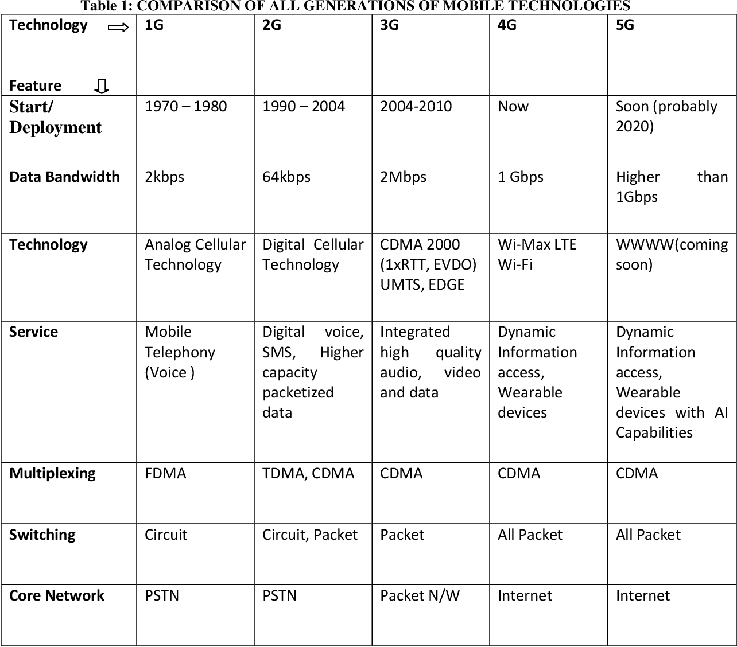

Slide 9
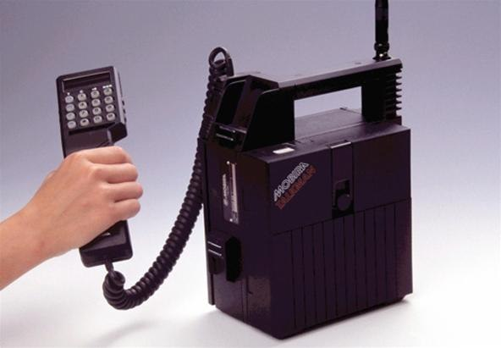
1G 이동통신
아날로그 방식
음성 통신만 가능
FDMA 방식만 적용
2.4 kbps

Slide 10
2G (voice) network architecture
Base station system (BSS)
MSC
BTS
BSC
G
Public
telephone
network
Gateway
MSC
Legend
Base transceiver station (BTS)
Digital Standards
GSM = FDMA + TDMA
CDMA
Base station controller (BSC)
Mobile Switching Center (MSC)
Mobile subscribers

Slide 11
BTS(기지국), BSC(제어국), MSC(교환기)
기지국(BTS: Base station Transceiver Subsystem)은 이동전화와 무선 구간으로 연결되어 이동전화를 제어하고 통화채널을 연결시켜줌
제어국(BSC: Base Station Controller)은 여러 대의 기지국들을 관리하면서, 이동교환기(MSC)와 연동한다. 일부 제어국에서는 2.5세대/3세대 데이터서비스를 위하여 PDSN(라우터)과 연동 기능을 제공
교환기(MSC: Mobile Switching Center)는 이동통신망의 핵심 망요소로서, 음성통화 및 각종 부가서비스를 제어하고, 통화로를 설정하며, 여러 다른 장비들 및 외부망과의 연결기능을 제공한다.

Slide 12

Cellular networks : GSM
Two techniques for sharing mobile-to-BS radio spectrum
combined FDMA/TDMA: divide spectrum in frequency channels, divide each channel into time slots : GSM
CDMA: code division multiple access
time slots
frequency
bands

Slide 13
Code Division Multiple Access (CDMA)
unique “code” assigned to each user; i.e., code set partitioning
all users share same frequency, but each user has own “chipping” sequence (i.e., code) to encode data
allows multiple users to “coexist” and transmit simultaneously with minimal interference (if codes are “orthogonal”)
encoded signal = (original data) X (chipping sequence)
decoding: inner-product of encoded signal and chipping sequence

Slide 14
CDMA encode/decode
channel output Z_{i,m}
Z_{i,m}= d_{i}.c_{m}
data
bits
d₀ = 1
1
1
1
1
1
d₁ = -1
1
1
1
-
-
-
-
1
-
-
-
1
-
1
1
1
1
1
sender
1
1
slot 1
channel
output
slot 0
channel
output
1
1
1
1
1
code
1
1
-
-
-
1
-
1
1
1
-
-
-
1
-
1
1
1
slot 1
slot 0
M
D_{i} = Σ Z_{i,m}.c_{m}
m=1
M
received
input
1
1
1
1
1
1
1
1
d₀ = 1
-
-
-
-
1
-
-
-
1
-
1
1
1
1
1
1
d₁ = -1
1
slot 1
channel
output
slot 0
channel
output
1
1
1
1
1
code
1
1
-
-
-
1
-
1
1
1
-
-
-
1
-
1
1
1
receiver
slot 1
slot 0

Slide 15
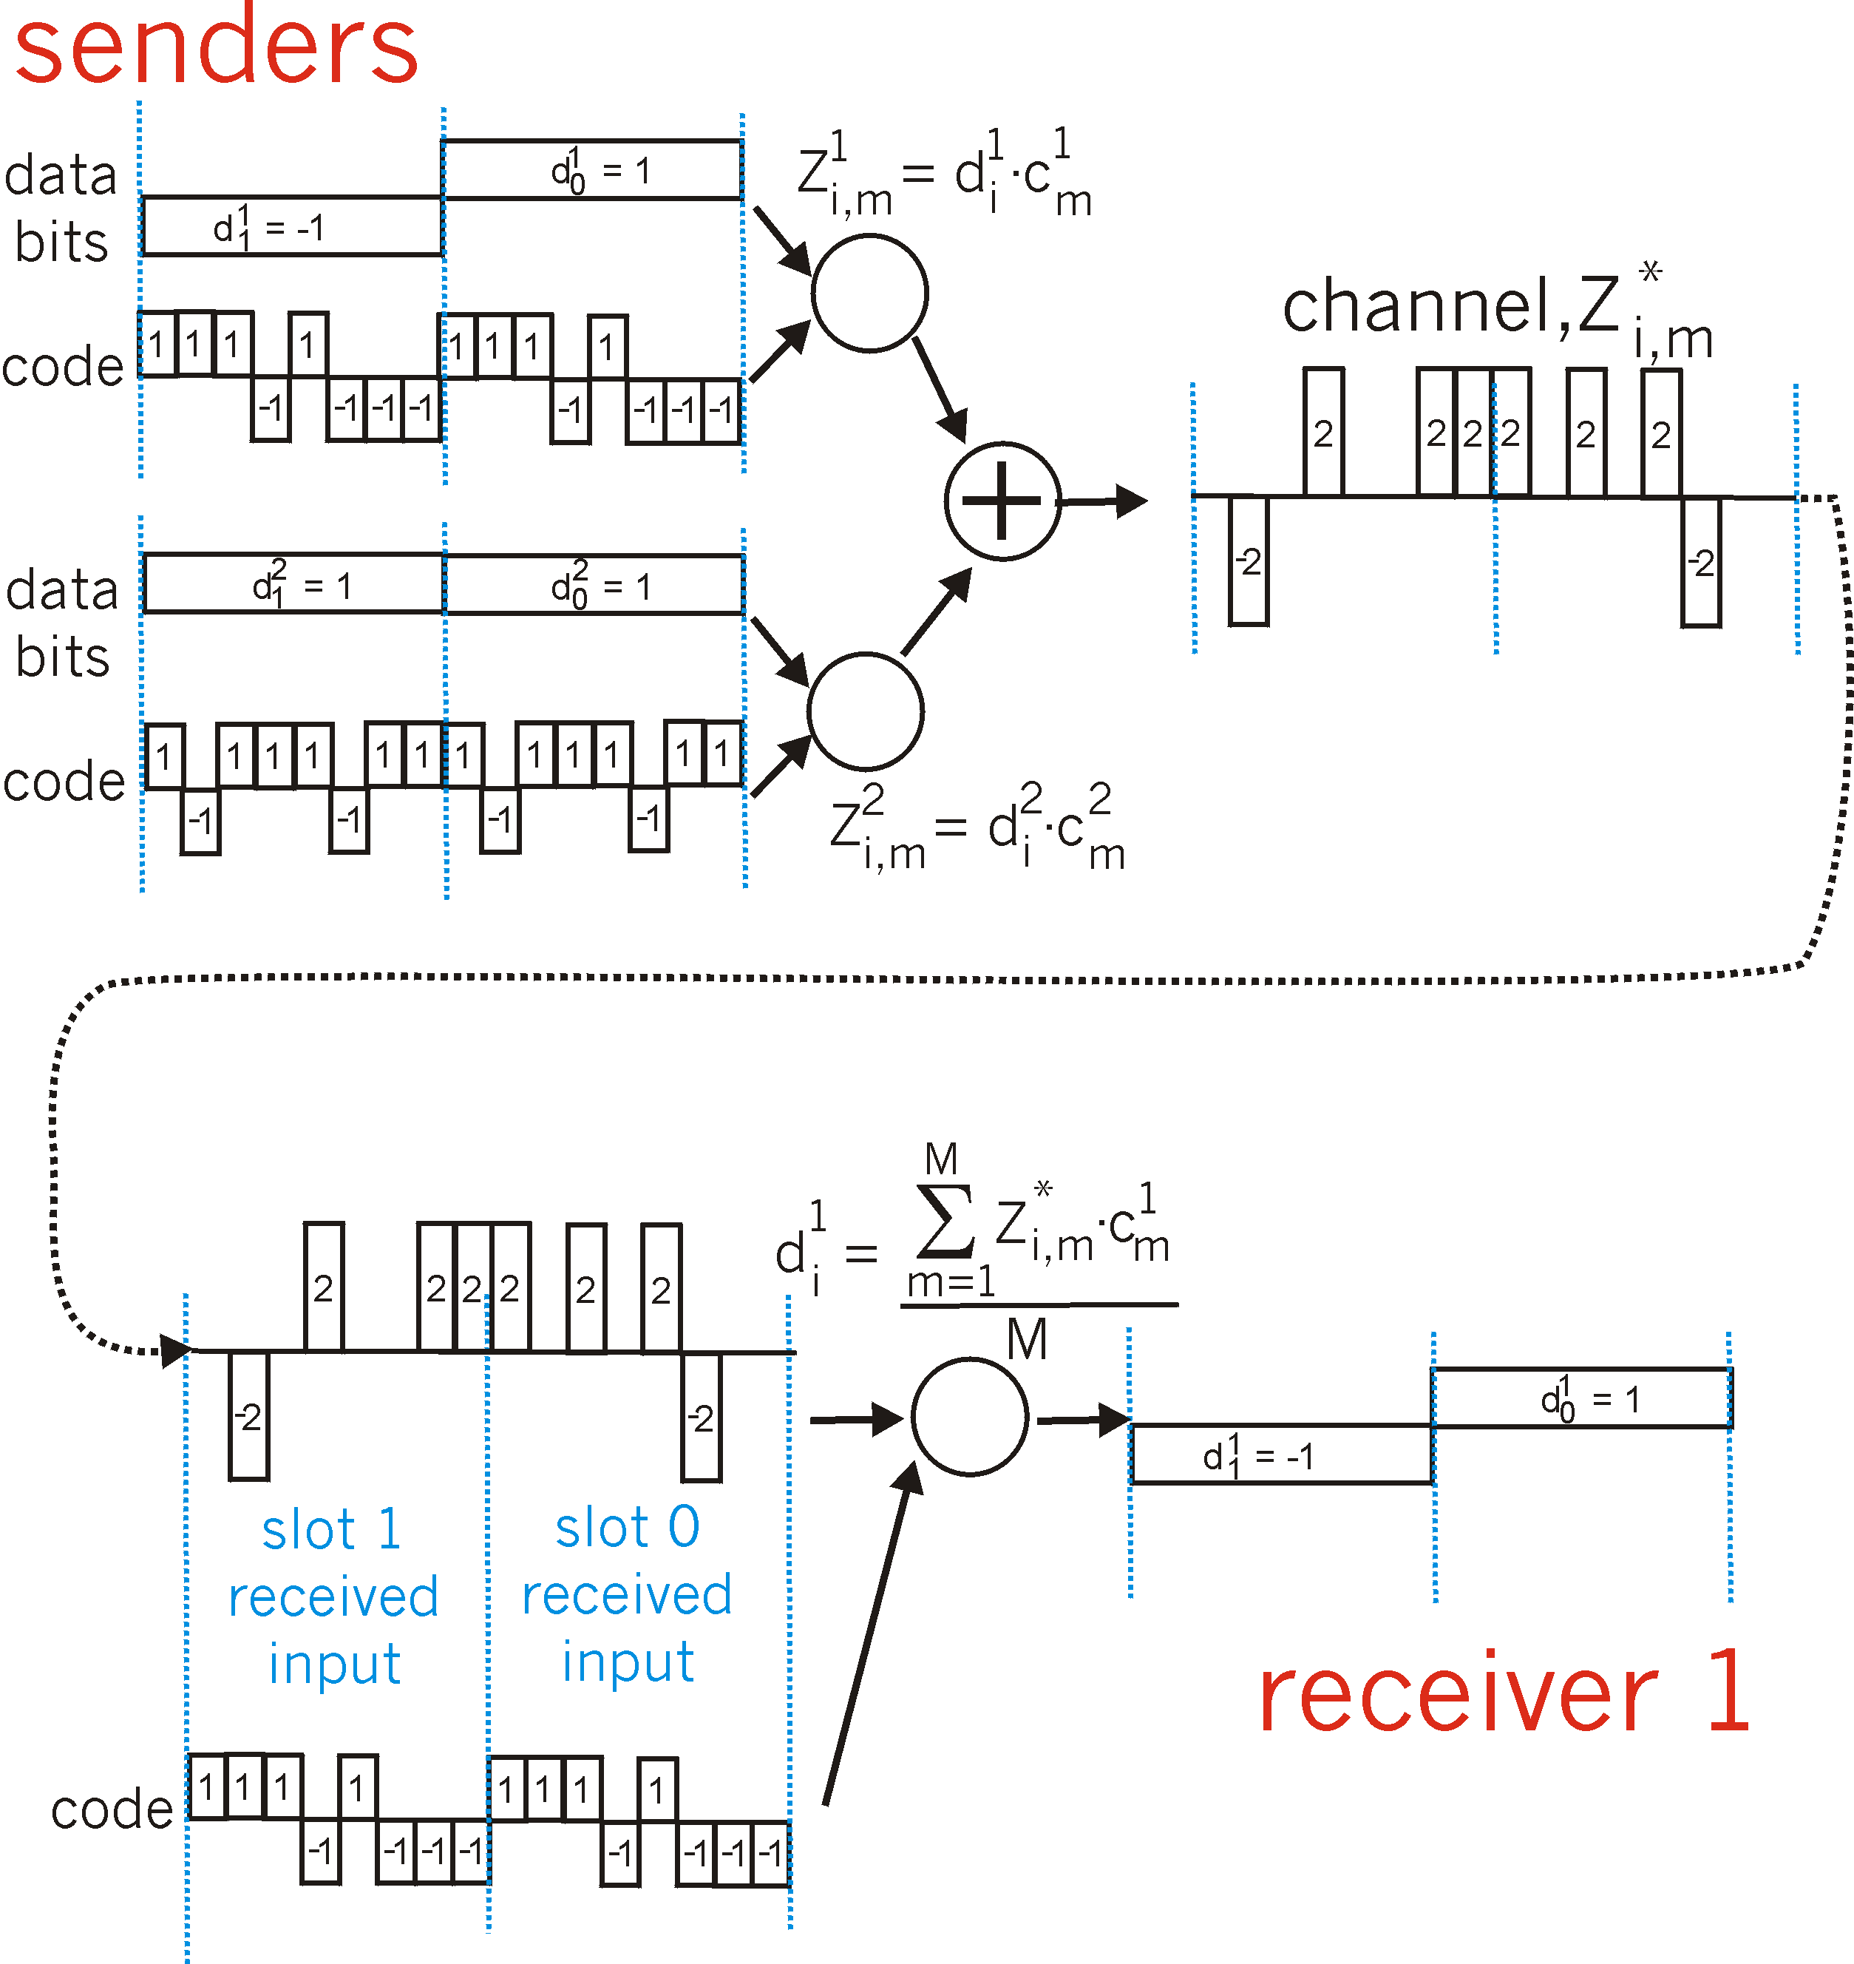
CDMA: two-sender interference
channel sums together transmissions by sender 1 and 2
Sender 1
Sender 2
using same code as sender 1, receiver recovers sender 1’s original data from summed channel data!

Slide 16
3G (voice+data) network architecture
MSC
G
Public
telephone
network
radio
network
controller
Gateway
MSC
G
Public
Internet
SGSN
Key insight: new cellular data
network operates in parallel
(except at edge) with existing
cellular voice network
voice network unchanged in core
data network operates in parallel
GGSN
Serving GPRS Support Node (SGSN)
Gateway GPRS Support Node (GGSN)

Slide 17
3G versus 4G LTE network architecture
MSC
G
Public
telephone
network
3G
radio
network
controller
Gateway
MSC
G
Public
Internet
SGSN
GGSN
4G-LTE
HSS
MME
G
G
Public
Internet
S-GW
P-GW
radio access network
Universal Terrestrial Radio
Access Network (UTRAN)
Evolved Packet Core
(EPC)

Slide 18
4G: differences from 3G
두 종류 : LTE(Long Term Evolution) or WiMAX
LTE는 기존 3G망 사용, WiMAX는 백본도 무선으로
All IP core: IP packets tunneled (through core IP network) from base station to gateway
no separation between voice and data – all traffic carried over IP core to gateway 음성 (VoIP) 과 데이터망의 통합
Mobility
Management
Entity (MME)
Home Subscriber
Server(HSS)
(like HLR+VLR)
Serving
Gateway
(S-GW)
Packet data
network
Gateway
(P-GW)
UE
(user element)
eNodeB
(base station)
HSS
MME
control
G
G
Public
Internet
data
S-GW
P-GW
radio access network
Universal Terrestrial Radio
Access Network (UTRAN)
Evolved Packet Core
(EPC)

Slide 19

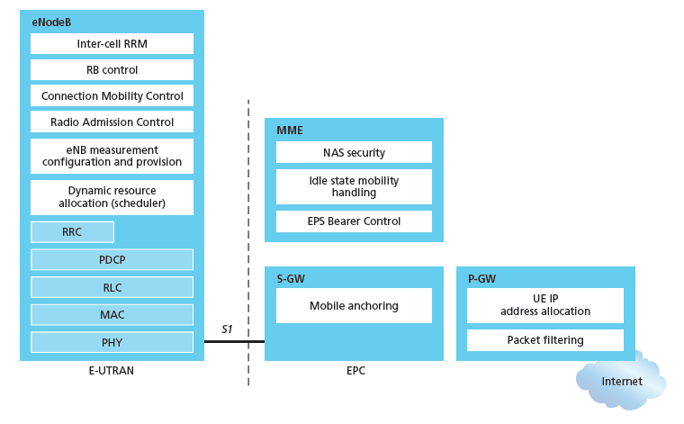
Functional split of major LTE components
handles idle/active UE transitions
pages UE
sets up eNodeB-PGW tunnel (aka bearer)
holds idle UE info
QoS enforcement

Slide 20

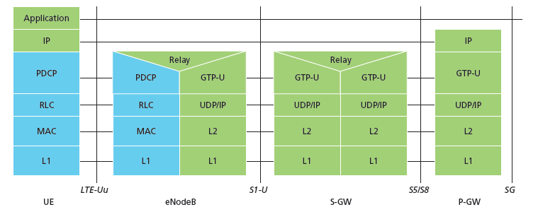
Radio+Tunneling: UE – eNodeB – PGW
IP packet from UE encapsulated in GPRS Tunneling Protocol (GTP) message at ENodeB
GTP message encapsulated in UDP, then encapsulated in IP. large IP packet addressed to SGW
G
G
UE
eNodeB
S-GW
P-GW
tunnel
link-layer radio net

Slide 21
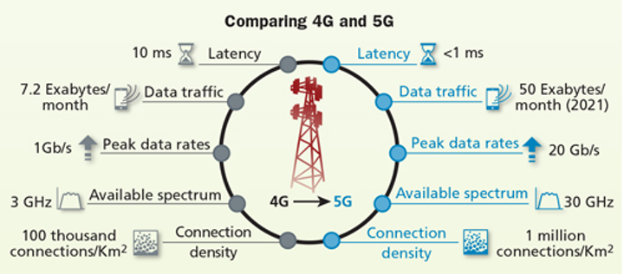
5G
Requirements for 5G network (4G에 대해 성능 향상)
Area traffic capacity (1000배)
Peak data rate (10 Gbps) (100배)
User experienced data rate (100 Mbps)
5% user spectral efficiency
Transmission latency ( < 1ms)
Energy efficiency
Mobility (up to 500 km/h)
Handover interruption time ( < 10ms)

Slide 22
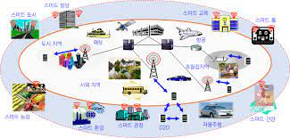
5G 응용분야
자율 주행 자동차
군사용

Slide 23
5G 동영상
주파수 개념
https://www.youtube.com/watch?v=L0uO6t_lowM
https://www.youtube.com/watch?v=tiA-fgRCMGw
https://www.youtube.com/watch?v=0d_4LKWDIAg&t=1054s
6G
https://www.youtube.com/watch?v=YtyhfrUpdLM

Slide 24
Chapter 7 outline
7.1 Introduction
Wireless
7.2 Wireless links, characteristics
CDMA
7.3 IEEE 802.11 wireless LANs (“Wi-Fi”)
7.4 Cellular Internet Access
architecture
standards (e.g., 3G, LTE)
Mobility
7.5 Principles: addressing and routing to mobile users
7.6 Mobile IP
7.7 Handling mobility in cellular networks
7.8 Mobility and higher-layer protocols

Slide 25
What is mobility?
spectrum of mobility, from the network perspective:
no mobility
high mobility
mobile wireless user,
using same access
point
mobile user, connecting/ disconnecting from network using DHCP.
mobile user, passing through multiple access point while maintaining ongoing connections (like cell phone)

Slide 26



Mobility: vocabulary
home network: permanent “home” of mobile
(e.g., 128.119.40/24)
home agent: entity that will perform mobility functions on behalf of mobile, when mobile is remote
wide area network
permanent address: address in home network, can always be used to reach mobile
e.g., 128.119.40.186

Slide 27
Mobility: more vocabulary
permanent address: remains constant (e.g., 128.119.40.186)
visited network: network in which mobile currently resides (e.g., 79.129.13/24)
care-of-address: address in visited network.
(e.g., 79,129.13.2)
wide area network
foreign agent: entity in visited network that performs mobility functions on behalf of mobile.
correspondent: wants to communicate with mobile

Slide 28

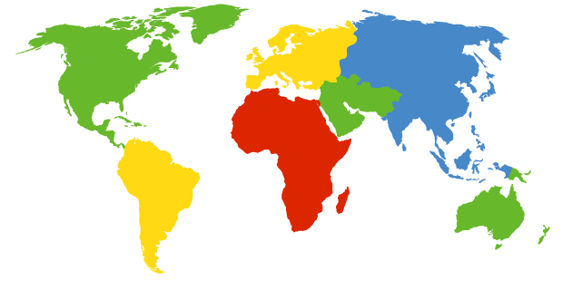

How do you contact a mobile friend:
Consider friend frequently changing addresses, how do you find her?
I wonder where Alice moved to?
search all phone books?
call her parents?
expect her to let you know where he/she is?
Facebook!

Slide 29
Mobility: approaches
let routing handle it: routers advertise permanent address of mobile-nodes-in-residence via usual routing table exchange.
routing tables indicate where each mobile located
no changes to end-systems
라우터가 직접 이동된 디바이스의 주소를 직접 관리한다면 문제가 심각
현실적으로 라우터는 서브넷 단위로 관리
포워드 테이블의 한계
확장성 문제 (scalability)

Slide 30
Mobility: approaches
let routing handle it: routers advertise permanent address of mobile-nodes-in-residence via usual routing table exchange.
routing tables indicate where each mobile located
no changes to end-systems
let end-systems handle it:
(호스트가 Agent 도움을 받아 해결함)
indirect routing: (간접 라우팅)
direct routing: (직접 라우팅)
not
scalable
to millions of
mobiles

Slide 31
Mobility: approaches
let end-systems handle it:
indirect routing: communication from correspondent to mobile goes through home agent, then forwarded to remote
간접 라우팅 방식
direct routing: correspondent gets foreign address of mobile, sends directly to mobile

Slide 32
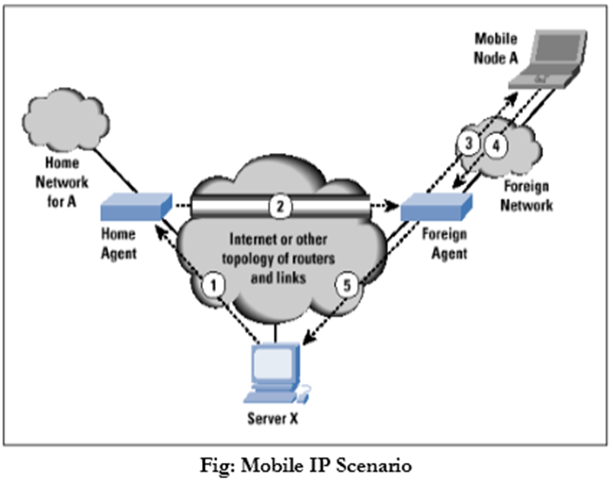
Mobile IP
RFC 3344
간접 라우팅 방식
has many features we’ve seen:
home agents, foreign agents, foreign-agent registration, care-of-addresses, encapsulation (packet-within-a-packet)
three components to standard: (3 단계)
1) agent discovery (HA 와 FA를 서로 확인함)
2) registration with home agent
3) indirect routing of datagrams

Slide 33
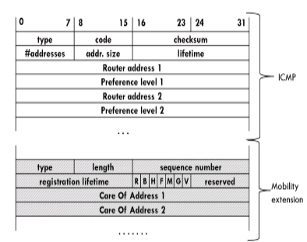
Mobile IP : 1) Agent Discovery
Agent advertisement : foreign/home agents advertise service by broadcasting ICMP messages
(typefield = 9)
Care-of-address (COA)
Foreign agent가 외부
디바이스에게
할당하고자 하는 여분의
IP 주소

Slide 34
Mobile IP: agent discovery
agent advertisement: foreign/home agents advertise service by broadcasting ICMP messages (typefield = 9)
H,F bits: home and/or foreign agent
R bit: registration required

Slide 35
Agent Discovery
permanent address: remains constant (e.g., 128.119.40.186)
visited network: network in which mobile currently resides (e.g., 79.129.13/24)
care-of-address: address in visited network.
(e.g., 79,129.13.2)
wide area network
foreign agent: entity in visited network that performs mobility functions on behalf of mobile.
correspondent: wants to communicate with mobile

Slide 36
Mobility: registration
visited network
home network
1
2
wide area network
mobile contacts foreign agent on entering visited network
foreign agent contacts home agent home: “this mobile is resident in my network”
end result:
foreign agent knows about mobile device
home agent knows location of mobile
이동 장치는 새로운 COA를 하나 할당됨
HA는 이동 장치의 위치를 알게 됨

Slide 37


Mobile IP: registration example
visited network: 79.129.13/24
home agent
HA: 128.119.40.7
foreign agent
COA: 79.129.13.2
mobile agent
MA: 128.119.40.186
ICMP agent adv.
COA: 79.129.13.2
….
registration req.
registration req.
COA: 79.129.13.2
HA: 128.119.40.7
MA: 128.119.40.186
Lifetime: 9999
identification: 714
encapsulation format
….
COA: 79.129.13.2
HA: 128.119.40.7
MA: 128.119.40.186
Lifetime: 9999
identification:714
….
registration reply
HA: 128.119.40.7
MA: 128.119.40.186
Lifetime: 4999
Identification: 714
encapsulation format
….
registration reply
HA: 128.119.40.7
MA: 128.119.40.186
Lifetime: 4999
Identification: 714
….
time

Slide 38

Mobility via indirect routing
foreign agent receives packets, forwards to mobile
home agent intercepts packets, forwards to foreign agent
visited
network
home
network
3
wide area network
2
1
correspondent addresses packets using home address of mobile
4
mobile replies directly to correspondent

Slide 39

Mobile IP: indirect routing
foreign-agent-to-mobile packet
packet sent by home agent to foreign agent: a packet within a packet
dest: 128.119.40.186
dest: 79.129.13.2
dest: 128.119.40.186
Permanent address: 128.119.40.186
Care-of address: 79.129.13.2
dest: 128.119.40.186
packet sent by correspondent

Slide 40
Co-located COA
모바일 디바이스에게 직접 새로운 IP 주소를 할당할 수 있다.

Slide 41
Indirect Routing: comments
mobile uses two addresses:
permanent address: used by correspondent (hence mobile location is transparent to correspondent)
care-of-address: used by home agent to forward datagrams to mobile
비효율적일 수 있다.

Slide 42
Indirect routing: moving between networks
suppose mobile user moves to another network
registers with new foreign agent
new foreign agent registers with home agent
home agent update care-of-address for mobile
packets continue to be forwarded to mobile (but with new care-of-address)
mobility, changing foreign networks transparent: on going connections can be maintained!

Slide 43

Mobility via direct routing: comments
overcome triangle routing problem
non-transparent to correspondent: correspondent must get care-of-address from home agent
what if mobile changes visited network?
송신자가 수신자의 변동된 IP (COA)을 H.A을 통해 알아서 직접 FA를 거쳐서 수신자를 찿아감
3
1
2
4

Slide 44



Mobility via direct routing
foreign agent receives packets, forwards to mobile
correspondent forwards to foreign agent
visited
network
home
network
3
1
2
4
correspondent requests, receives foreign address of mobile
mobile replies directly to correspondent

Slide 45
Chapter 7 outline
7.1 Introduction
Wireless
7.2 Wireless links, characteristics
CDMA
7.3 IEEE 802.11 wireless LANs (“Wi-Fi”)
7.4 Cellular Internet Access
architecture
standards (e.g., 3G, LTE)
Mobility
7.5 Principles: addressing and routing to mobile users
7.6 Mobile IP
7.7 Handling mobility in cellular networks
7.8 Mobility and higher-layer protocols

Slide 46
Components of cellular network architecture
recall:
correspondent
wired public telephone
network
MSC
MSC
MSC
MSC
MSC
different cellular networks,
operated by different providers

Slide 47
GSM: handoff with common MSC
handoff goal: route call via new base station (without interruption)
수신되는 BSS가 바뀜 : 에너지 절약, 로더 밸린싱
reasons for handoff (handover):
stronger signal to/from new BSS (continuing connectivity, less battery drain)
load balance: free up channel in current BSS
handoff initiated by old BSS
VLR
Mobile
Switching
Center
old
routing
new
routing
old BSS
new BSS

Slide 48
GSM: handoff with common MSC
old BSS informs MSC of impending handoff, provides list of 1⁺ new BSSs
시그널 강도가 약함을 먼저 감지
2. MSC sets up path (allocates resources) to new BSS
3. new BSS allocates radio channel for use by mobile
4. new BSS signals MSC, old BSS: ready
5. old BSS tells mobile: perform handoff to new BSS
6. mobile, new BSS signal to activate new channel
7. mobile signals via new BSS to MSC: handoff complete. MSC reroutes call
8 MSC-old-BSS resources released
VLR
Mobile
Switching
Center
4
2
1
8
7
3
old BSS
5
6
new BSS

Slide 49
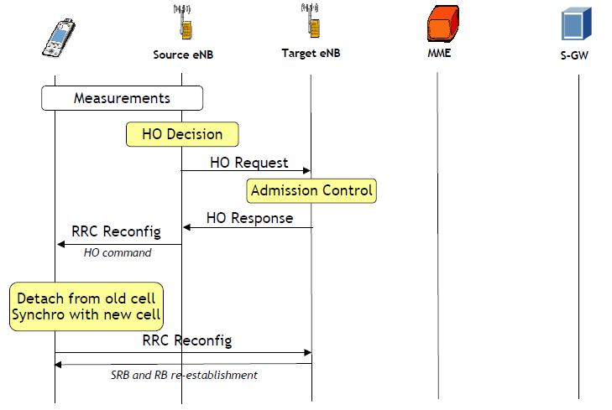

Slide 50

Handling Mobility in LTE
Paging: idle UE may move from cell to cell: network does not know where the idle UE is resident
paging message from MME broadcast by all eNodeB to locate UE
handoff: similar to 3G:
preparation phase
execution phase
completion phase
source
MME
P-GW
target
MME
old
routing
new
routing
old
eNodeB
new
eNodeB

Slide 51
Mobility: cellular versus Mobile IP
cellular element |  | Comment on cellular element | Mobile IP element
Home system | Network to which mobile user’s permanent phone number belongs |  |  | Home network
Gateway Mobile Switching Center, or “home MSC”. Home Location Register (HLR) | Home MSC: point of contact to obtain routable address of mobile user. HLR: database in home system containing permanent phone number, profile information, current location of mobile user, subscription information |  |  | Home agent
Visited System | Network other than home system where mobile user is currently residing |  |  | Visited network
Visited Mobile services Switching Center. Visitor Location Record (VLR) | Visited MSC: responsible for setting up calls to/from mobile nodes in cells associated with MSC. VLR: temporary database entry in visited system, containing subscription information for each visiting mobile user |  |  | Foreign agent
Mobile Station Roaming Number (MSRN), or “roaming number” | Routable address for telephone call segment between home MSC and visited MSC, visible to neither the mobile nor the correspondent. |  |  | Care-of-address

Slide 52
Wireless, mobility: impact on higher layer protocols
logically, impact should be minimal …
best effort service model remains unchanged
TCP and UDP can (and do) run over wireless, mobile
… but performance-wise:
packet loss/delay due to bit-errors (discarded packets, delays for link-layer retransmissions), and handoff
TCP interprets loss as congestion, will decrease congestion window un-necessarily
delay impairments for real-time traffic
limited bandwidth of wireless links

Slide 53
Chapter 7 summary
Wireless
wireless links:
capacity, distance
channel impairments
CDMA
IEEE 802.11 (“Wi-Fi”)
CSMA/CA reflects wireless channel characteristics
cellular access
architecture
standards (e.g., 3G, 4G LTE)
Mobility
principles: addressing, routing to mobile users
home, visited networks
direct, indirect routing
care-of-addresses
case studies
mobile IP
mobility in GSM, LTE
impact on higher-layer protocols

