Slide 1

Chapter 7 Wireless and
Mobile Networks
Computer Networking: A Top Down Approach
7th Edition, Global Edition Jim Kurose, Keith Ross Pearson April 2016

Slide 2
Ch. 6: Wireless and Mobile Networks
Background:
현재 모바일 폰과 무선 인터넷에 연결된 장치의 수가 기존 유선 방식을 능가하고 있음
# wireless (mobile) phone subscribers now exceeds # wired phone subscribers (5-to-1)!
# wireless Internet-connected devices =
# wireline Internet-connected devices
laptops, Internet-enabled phones promise anytime untethered Internet access
two important (but different) challenges
wireless: communication over wireless link
mobility: handling the mobile user who changes point of attachment to network

Slide 3
Chapter 7 outline
7.1 Introduction
Wireless
7.2 Wireless links, characteristics
CDMA
6.73 IEEE 802.11 wireless LANs (“Wi-Fi”)
67.4 Cellular Internet Access
architecture
standards (e.g., 3G, LTE)
Mobility
7.5 Principles: addressing and routing to mobile users
7.6 Mobile IP
7.7 Handling mobility in cellular networks
7.8 Mobility and higher-layer protocols

Slide 4






Elements of a wireless network
wireless hosts
laptop, smartphone
run applications
may be stationary (non-mobile) or mobile
wireless does not always mean mobility
network
infrastructure

Slide 5

Elements of a wireless network
base station
typically connected to wired network
relay - responsible for sending packets between wired network and wireless host(s) in its “area”
e.g., cell towers, 802.11 access points
network
infrastructure

Slide 6
Elements of a wireless network
wireless link
typically used to connect mobile(s) to base station
also used as backbone link
multiple access protocol coordinates link access
various data rates, transmission distance
network
infrastructure

Slide 7
Elements of a wireless 기반구조
infrastructure mode
base station connects mobiles into wired network
handoff: mobile changes base station providing connection into wired network (handover)
Wi-Fi, cellular, WiMax (Wibro), etc
network
infrastructure

Slide 8
Elements of a wireless network
ad hoc mode
no base stations
nodes can only transmit to other nodes within link coverage
nodes organize themselves into a network: route among themselves
Multi-hop comm.
Wi-Fi Direct, Bluetooth, etc

Slide 9
Wireless network taxonomy
single hop
multiple hops
host connects to
base station (WiFi,
WiMAX, cellular)
which connects to
larger Internet
host may have to
relay through several
wireless nodes to
connect to larger
Internet: mesh net
infrastructure
(e.g., APs)
no base station, no
connection to larger
Internet. May have to
relay to reach other
a given wireless node
MANET 이동 애드 혹 넷
VANET: 차량 에드 혹 넷
no
infrastructure
no base station, no
connection to larger
Internet (Bluetooth,
ad hoc nets)

Slide 10
Chapter 7 outline
7.1 Introduction
Wireless
7.2 Wireless links, characteristics
CDMA
7.3 IEEE 802.11 wireless LANs (“Wi-Fi”)
7.4 Cellular Internet Access
architecture
standards (e.g., 3G, LTE)
Mobility
7.5 Principles: addressing and routing to mobile users
7.6 Mobile IP
7.7 Handling mobility in cellular networks
7.8 Mobility and higher-layer protocols

Slide 11
Wireless Link Characteristics (1)
important differences from wired link ….
decreased signal strength: 시그널 강도가 물체 또는 거리에 따라 약해짐 (path loss)
interference from other sources: standardized wireless network frequencies (e.g., 2.4 GHz) shared by other devices (e.g., phone); devices (motors) interfere as well
표준 무선 주파수 대역은 많은 기기가 공유로 무선 신호 간섭이 심함
multipath propagation: radio signal reflects off objects ground, arriving ad destination at slightly different times
무선신호가 건물, 산, 장애물로 신호의 도착 시간이 다름
(지연, 방해)
…. make communication across (even a point to point) wireless link much more “difficult”
비트 오류가 심함 ➔ 강력한 CRC 오류 검출, 프레임 재 전송이 필요

Slide 12
Wireless 특징 :신호대비 잡음 비율 (SNR)
SNR: signal-to-noise ratio
larger SNR – easier to extract signal from noise (a “good thing”)
SNR vs. BER tradeoffs [반비례]
Given physical layer: increase power -> increase SNR->decrease BER
Given SNR: choose physical layer that meets BER requirement, giving highest thruput
SNR may change with mobility: dynamically adapt physical layer (modulation technique, rate)
10⁻¹
10⁻²
10⁻³
BER
10⁻⁴
10⁻⁵
10⁻⁶
10⁻⁷
10
20
30
40
SNR(dB)
QAM256 (8 Mbps) : 좋은 환경
QAM16 (4 Mbps)
BPSK (1 Mbps) : 소음이 큰 환경

Slide 13
Chapter 7 outline
7.1 Introduction
Wireless
7.2 Wireless links, characteristics
CDMA
7.3 IEEE 802.11 wireless LANs (“Wi-Fi”)
7.4 Cellular Internet Access
architecture
standards (e.g., 3G, LTE)
Mobility
7.5 Principles: addressing and routing to mobile users
7.6 Mobile IP
7.7 Handling mobility in cellular networks
7.8 Mobility and higher-layer protocols

Slide 14
무선통신의 대역폭 :wifi, wpan, celluar
1300
802.11 ac
450
802.11n
54
802.11a,g
802.11a,g point-to-point
5-11
802.11b
4G: LTWE WIMAX
4
3G: UMTS/WCDMA-HSPDA, CDMA2000-1xEVDO
Data rate (Mbps)
1
802.15
.384
2.5G: UMTS/WCDMA, CDMA2000
.056
2G: IS-95, CDMA, GSM
Indoor
10-30m
Outdoor
50-200m
Mid-range
outdoor
200m – 4 Km
Long-range
outdoor
5Km – 20 Km

Slide 15
IEEE 802.11 Wireless LAN
802.11b (1999)
2.4 GHz unlicensed spectrum
up to 11 Mbps
802.11a (1999)
5 GHz range
up to 54 Mbps
802.11g (2003)
2.4-5 GHz range
up to 54 Mbps
802.11n: multiple antennae 2009
2.4-5 GHz range
up to 200 Mbps (SU-MIMO)
802.11ac (14,16)
5GHz range
up to 866.7 Mbps(SU-MIMO), 1.73Gbps)MU-MIMO)
all use CSMA/CA for multiple access
all have base-station and ad-hoc network versions
SU-MIMO : 안테나당 하나의 유저 할당
MU-MIMO : 안테나를 여러 유저가 공유

Slide 16




802.11 LAN architecture
wireless host communicates with base station
base station = access point (AP) 공유기
Basic Service Set (BSS) (aka “cell”) in infrastructure mode contains:
wireless hosts
access point (AP): base station
ad hoc mode: hosts only
Internet
hub, switch
or router
BSS 1
BSS 2

Slide 17
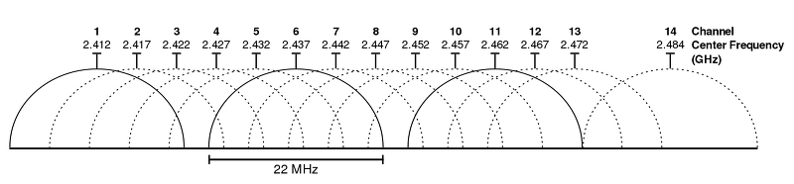
802.11: Channels, association
802.11b: 2.4GHz-2.485GHz spectrum divided into 11 channels at different frequencies
AP admin chooses frequency for AP
interference possible: channel can be same as that chosen by neighboring AP!
총 80Mhz, 1채널당 20Mhz
11개 채널이 주파수 대역을 공유 (1,6,11 주로 사용)

Slide 18
802.11: Channels, association
host: must associate with an AP
AP가 먼저 자신의 존재를 알림
scans channels, listening for beacon frames containing AP’s name (SSID) and MAC address
selects AP to associate with
may perform authentication [Chapter 8]
will typically run DHCP to get IP address in AP’s subnet
Beacon : 안전운행을 위한 불빛, 위치 확인을 위한 무선 송신소

Slide 19


802.11: passive/active scanning
BBS 1
BBS 2
BBS 1
BBS 2
1
AP 2
AP 1
1
1
AP 2
AP 1
2
2
2
3
3
4
H1
H1
passive scanning:
beacon frames sent from APs
association Request frame sent: H1 to selected AP
association Response frame sent from selected AP to H1
active scanning:
Probe Request frame broadcast from H1
Probe Response frames sent from APs
Association Request frame sent: H1 to selected AP
Association Response frame sent from selected AP to H1

Slide 20
802.11 frame: more
frame seq #
(for RDT)
duration of reserved
transmission time (RTS/CTS)
2
2
6
6
6
2
6
0 - 2312
4
frame
control
duration
address
1
address
2
address
3
seq
control
address
4
payload
CRC
2
2
4
1
1
1
1
1
1
1
1
Protocol
version
Type
Subtype
To
AP
From
AP
More
frag
Retry
Power
mgt
More
data
WEP
Rsvd
frame type
(RTS, CTS, ACK, data)

Slide 21



802.11 frame: addressing
Internet
H1
R1
router
R1 MAC addr H1 MAC addr
dest. address
source address
802.3 frame
AP MAC addr H1 MAC addr R1 MAC addr
address 1
address 2
address 3
802.11 frame

Slide 22
802.11: advanced capabilities
Rate adaptation
base station, mobile dynamically change transmission rate (physical layer modulation technique) as mobile moves, SNR varies
802.11g supports various data rates : 6, 9,12,18,24,36,48 & 54 Mbps
10⁻¹
10⁻²
10⁻³
BER
10⁻⁴
10⁻⁵
10⁻⁶
10⁻⁷
10
20
30
40
SNR(dB)
1. SNR decreases, BER increase as node moves away from base station
QAM256 (8 Mbps)
QAM16 (4 Mbps)
2. When BER becomes too high, switch to lower transmission rate but with lower BER
BPSK (1 Mbps)
operating point

Slide 23
CSMA, CSMA/CD in Wireless
신호를 전송하기 전에 다른 사용 여부를 감지함
충돌이 일어나면 재 전송
문제점
만약 송신자가 시그널을 감지 못한다면?
만약 송신자가 충돌을 감지하지 못한다면?

Slide 24


Wireless network characteristics
Multiple wireless senders and receivers create additional problems (beyond multiple access):
A
B
C
C
A’s signal
strength
C’s signal
strength
B
A
Hidden terminal problem
B, A hear each other
B, C hear each other
A, C can not hear each other means A, C unaware of their interference at B
space
Signal attenuation:
B, A hear each other
B, C hear each other
A, C can not hear each other interfering at B

Slide 25



IEEE 802.11: multiple access
avoid collisions: 2⁺ nodes transmitting at same time
802.11: CSMA - sense before transmitting
don’t collide with ongoing transmission by other node
802.11: no collision detection!
difficult to receive (sense collisions) when transmitting due to weak received signals (fading)
can’t sense all collisions in any case: hidden terminal, fading
goal: avoid collisions: CSMA/C(ollision)A(voidance)
A
B
C
C
B
A’s signal
strength
C’s signal
strength
A
space

Slide 26
IEEE 802.11 MAC Protocol: CSMA/CA
802.11 sender
1 if sense channel idle for DIFS then
transmit entire frame (no CD)
2 if sense channel busy then
start random backoff time
timer counts down while channel idle
transmit when timer expires
if no ACK, increase random backoff interval, repeat 2
802.11 receiver
- if frame received OK
return ACK after SIFS (ACK needed due to hidden terminal problem)
DIFS > SIFS (Ack 메시지를 방해 하지 않음)
Distributed Inter-Frame Space (신호없음을 감지하는 시간)
Short Inter-Frame Space
sender
receiver
DIFS
data
SIFS
ACK

Slide 27
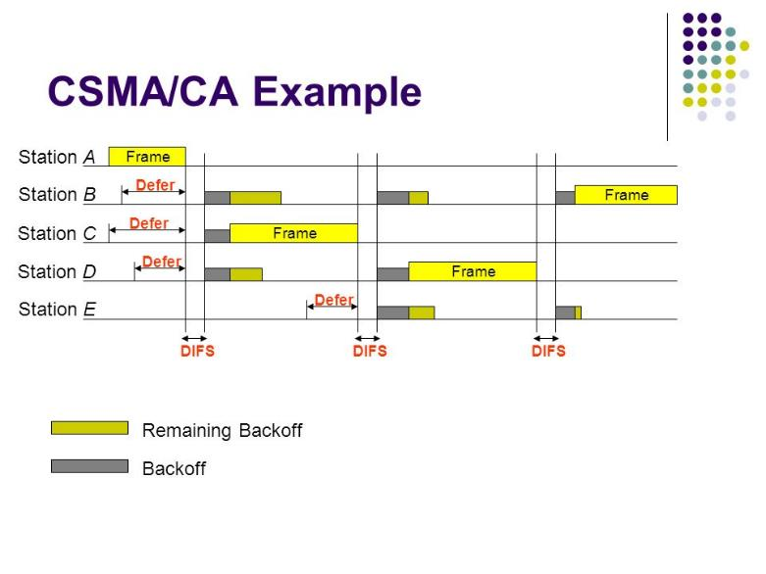

Slide 28
Avoiding collisions (more)
Hidden Terminal Problem의 해결책
idea: allow sender to “reserve(예약)” channel rather than random access of data frames: avoid collisions of long data frames
sender first transmits small request-to-send (RTS) packets to BS using CSMA
RTSs may still collide with each other (but they’re short)
BS broadcasts clear-to-send CTS in response to RTS
CTS heard by all nodes
sender transmits data frame
other stations defer transmissions
avoid data frame collisions completely
using small reservation packets!

Slide 29
Collision Avoidance: RTS-CTS exchange
A
B
AP
RTS(B)
RTS(A)
reservation collision
RTS(A)
CTS(A)
CTS(A)
DATA (A)
defer
time
ACK(A)
ACK(A)

Slide 30
802.11 frame: more
frame seq #
(for RDT)
duration of reserved
transmission time (RTS/CTS)
2
2
6
6
6
2
6
0 - 2312
4
frame
control
duration
address
1
address
2
address
3
seq
control
address
4
payload
CRC
2
2
4
1
1
1
1
1
1
1
1
Protocol
version
Type
Subtype
To
AP
From
AP
More
frag
Retry
Power
mgt
More
data
WEP
Rsvd
frame type
(RTS, CTS, ACK, data)

Slide 31

802.11: mobility within same subnet
H1 remains in same IP subnet: IP address can remain same
switch: which AP is associated with H1?
self-learning (Ch. 5): switch will see frame from H1 and “remember” which switch port can be used to reach H1
BBS 1
H1
BBS 2

Slide 32
802.15: personal area network
less than 10 m diameter
replacement for cables (mouse, keyboard, headphones)
ad hoc: no infrastructure
master/slaves:
slaves request permission to send (to master)
master grants requests
802.15: evolved from Bluetooth specification
2.4-2.5 GHz radio band
up to 721 kbps
8개 디바이스 연결
S
P
P
radius of
coverage
M
S
S
P
P
M
Master device
Slave device
Parked device (inactive)
S
P

Slide 33
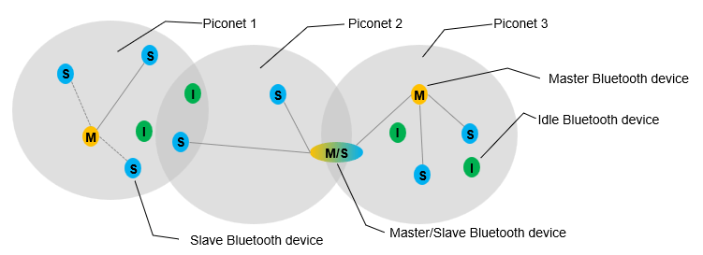

Slide 34
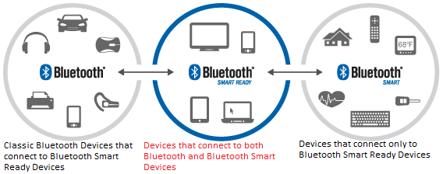
Bluetooth 4.0 : Bluetooth Smart
B. Smart : 기존 것과는 호환 불가
B. Smart Ready : 기존 것과 호환 가능
슬래브가 항상 대기 상태가 아님
전력 손실이 적음

Slide 35

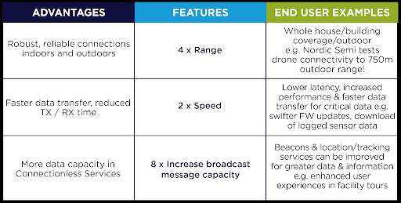
Bluetooth 5
신뢰성, 속도 등이 향상
거리, 데이터 양이 증가

Slide 36
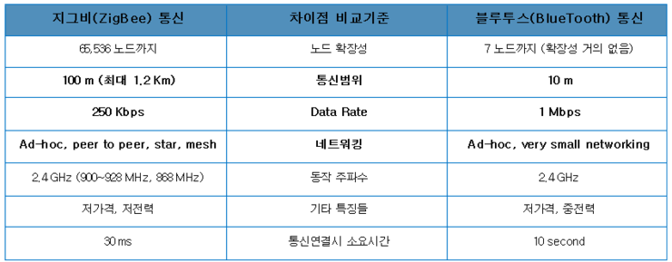
Zigbee
2001년도 MIT에서 개발
소형, 저전력 디지털 라디오 주파수를 이용하여 개인 통신망을 구축하기 위한 표준
긴 베터리 수명과 보안성이 요구되는 분야에서

Slide 37
Zigbee 활용도
스마트 에너지분야
홈 엔터테인먼트와 제어 (온도 조절, 영화/음악)
홈 인식 시스템 (수온센서, 화재 및 도난 센서)
모바일 서비스 (모바일 결제, 모니터링, 헬스케어)
상업빌딩 (에너지 감시, 공기정화시설, 조명,출입)
산업용 공장 (자재관리, 환경관리, 에너지 관리)

Slide 38
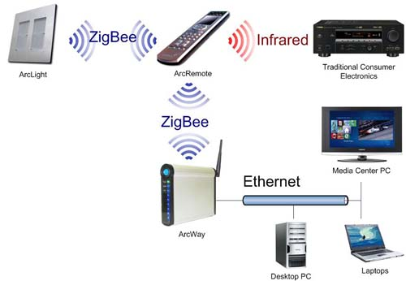

Slide 39
Chapter 7 outline
7.1 Introduction
Wireless
7.2 Wireless links, characteristics
CDMA
7.3 IEEE 802.11 wireless LANs (“Wi-Fi”)
7.4 Cellular Internet access
architecture
standards (e.g., 3G, LTE)
Mobility
7.5 Principles: addressing and routing to mobile users
7.6 Mobile IP
7.7 Handling mobility in cellular networks
7.8 Mobility and higher-layer protocols

Slide 40
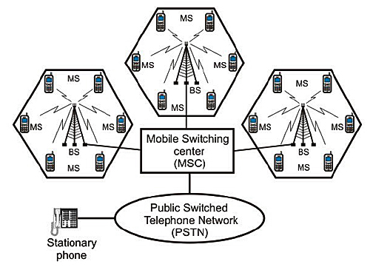
Background
Wireless (무선) 네트워크
무선을 통해서 통신이 가능
모바일
사용자가 접속하는 네트워크의 범위를 바꿀 수 있도록 지원

Slide 41
What is mobility?
spectrum of mobility, from the network perspective:
no mobility
high mobility
mobile wireless user,
using same access
Point (Bluetooth)
mobile user, connecting/ disconnecting from network using DHCP.
Wifi
mobile user, passing through multiple access point while maintaining ongoing connections
(like cell phone)

Slide 42
Code Division Multiple Access (CDMA)
unique “code” assigned to each user; i.e., code set partitioning
all users share same frequency, but each user has own “chipping” sequence (i.e., code) to encode data
allows multiple users to “coexist” and transmit simultaneously with minimal interference (if codes are “orthogonal”)
encoded signal = (original data) X (chipping sequence)
decoding: inner-product of encoded signal and chipping sequence

Slide 43
CDMA encode/decode
channel output Z_{i,m}
Z_{i,m}= d_{i}.c_{m}
data
bits
d₀ = 1
1
1
1
1
1
d₁ = -1
1
1
1
-
-
-
-
1
-
-
-
1
-
1
1
1
1
1
sender
1
1
slot 1
channel
output
slot 0
channel
output
1
1
1
1
1
code
1
1
-
-
-
1
-
1
1
1
-
-
-
1
-
1
1
1
slot 1
slot 0
M
D_{i} = Σ Z_{i,m}.c_{m}
m=1
M
received
input
1
1
1
1
1
1
1
1
d₀ = 1
-
-
-
-
1
-
-
-
1
-
1
1
1
1
1
1
d₁ = -1
1
slot 1
channel
output
slot 0
channel
output
1
1
1
1
1
code
1
1
-
-
-
1
-
1
1
1
-
-
-
1
-
1
1
1
receiver
slot 1
slot 0

Slide 44
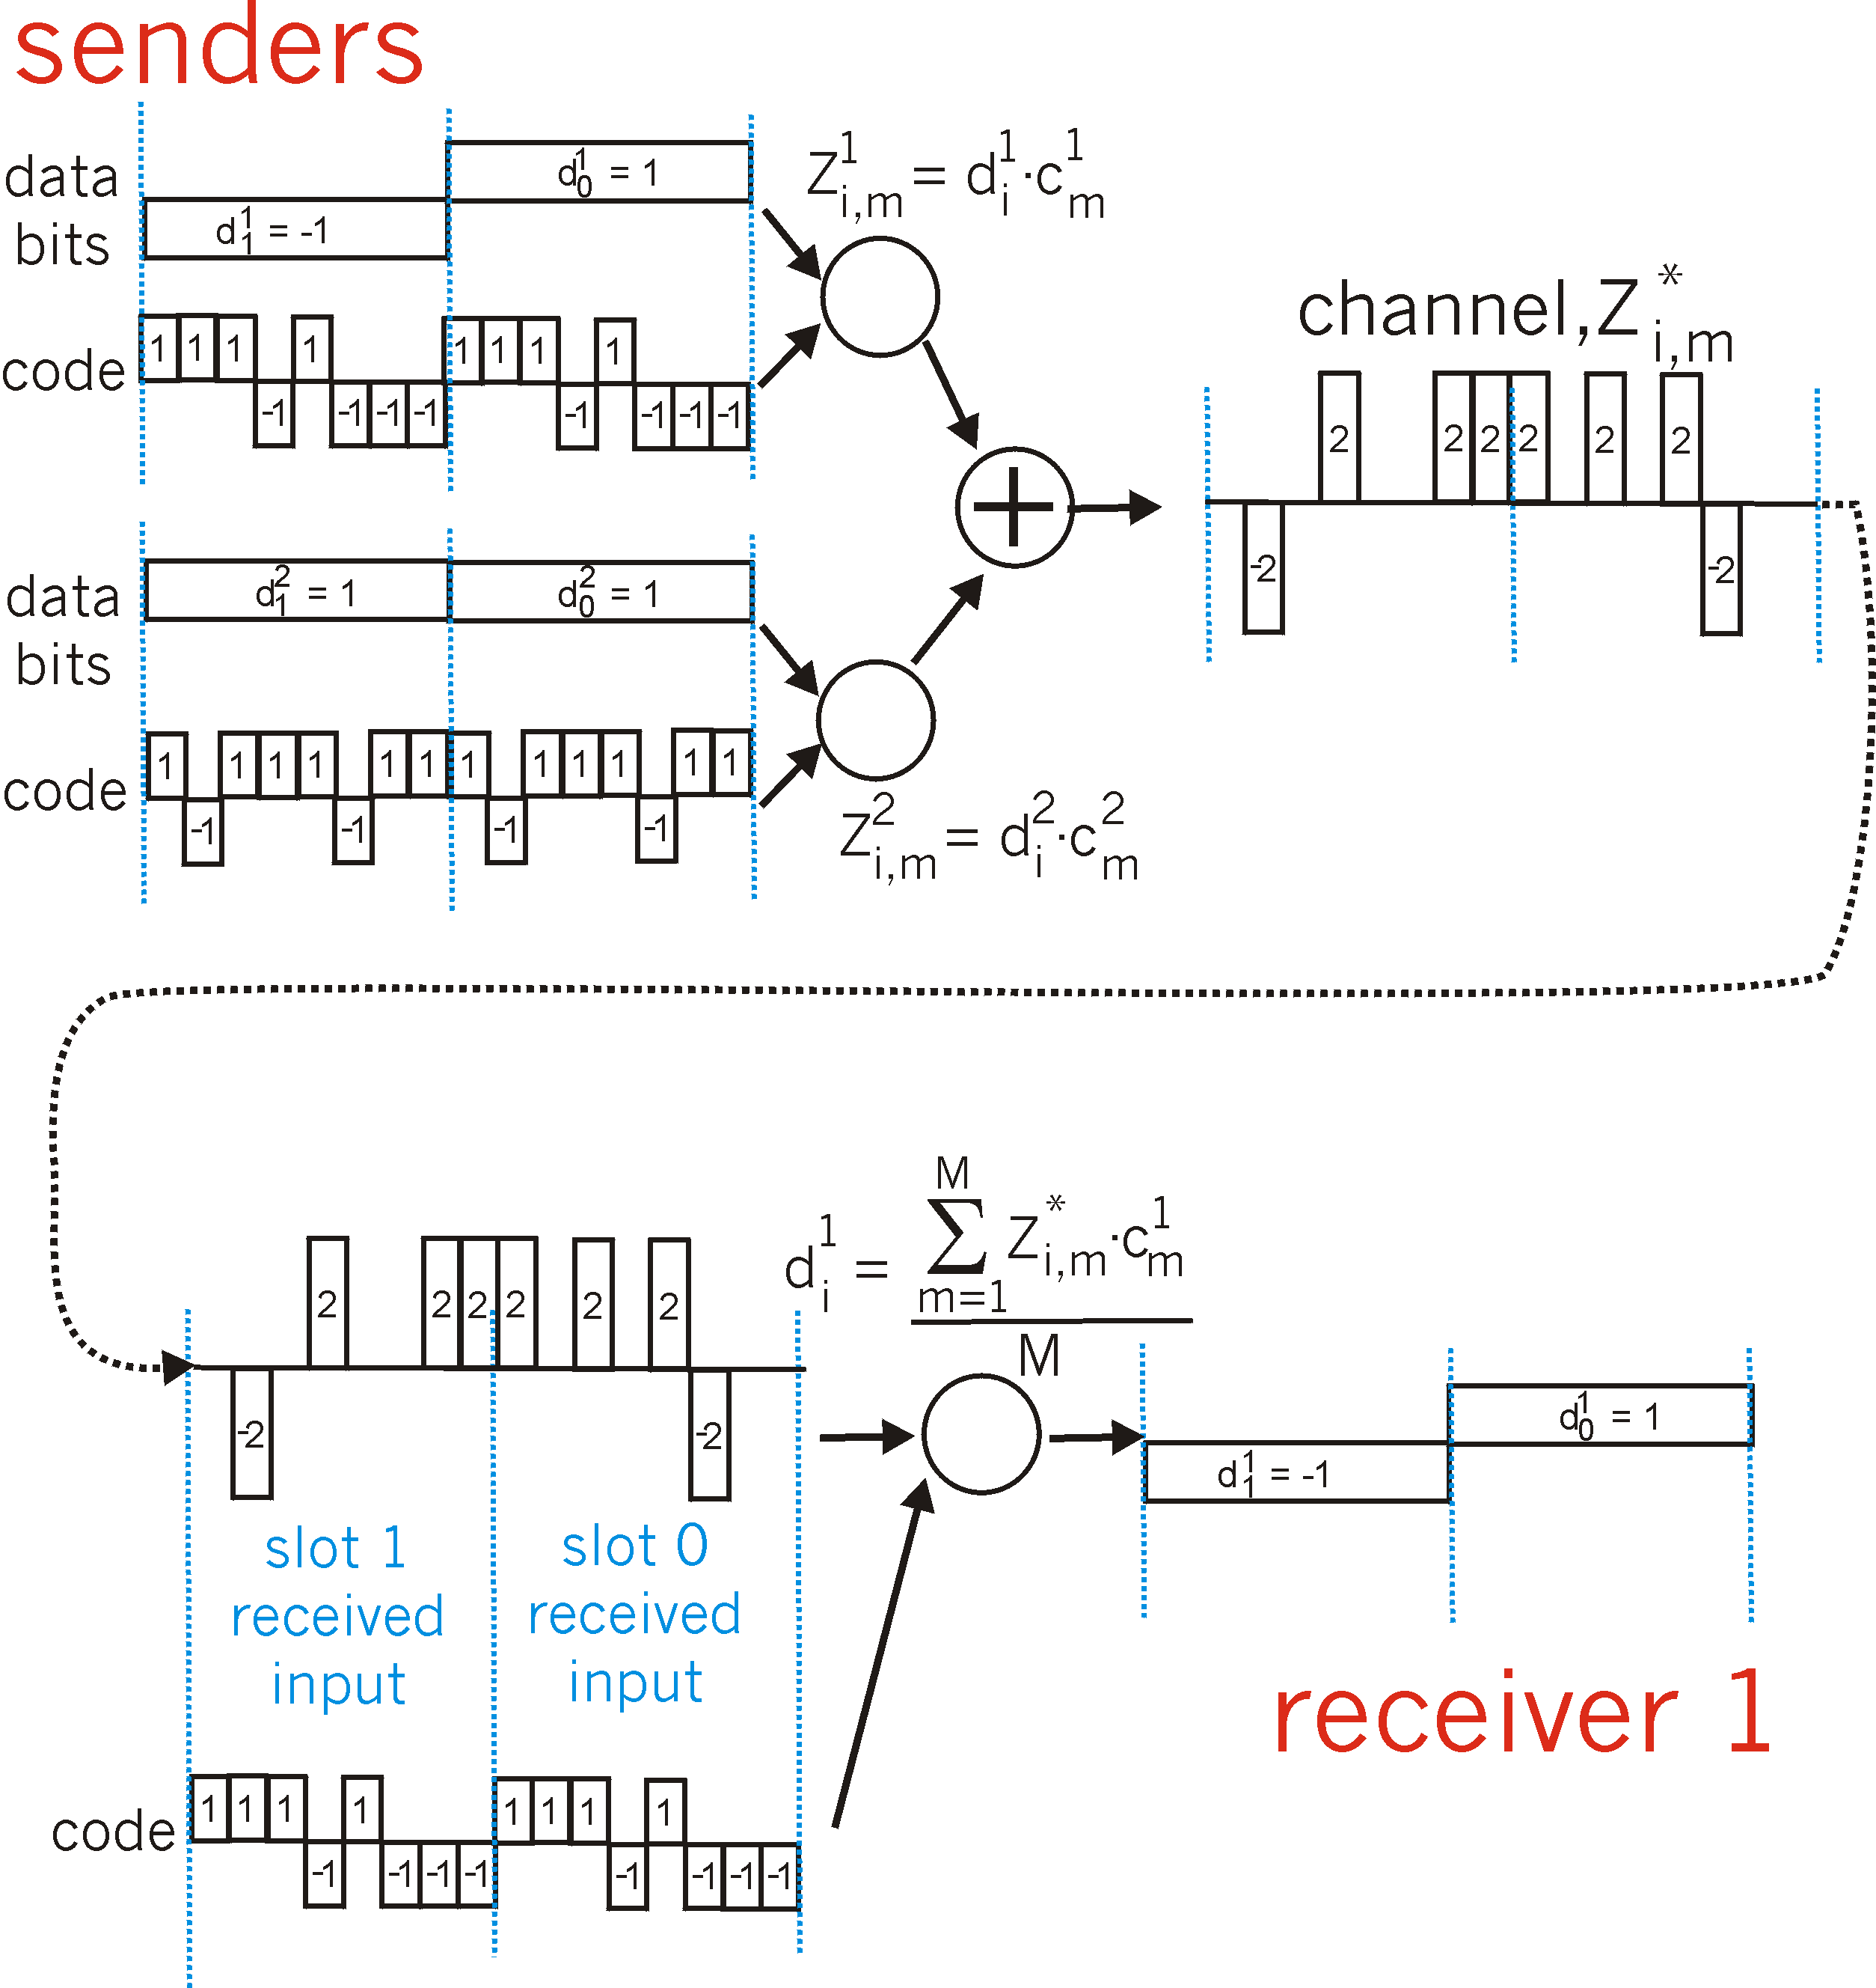
CDMA: two-sender interference
channel sums together transmissions by sender 1 and 2
Sender 1
Sender 2
using same code as sender 1, receiver recovers sender 1’s original data from summed channel data!

