Slide 1
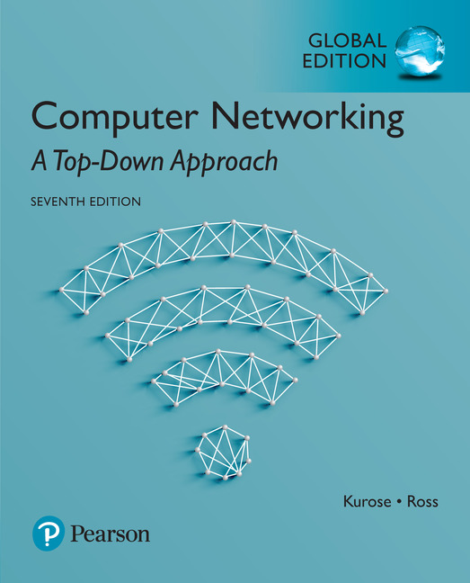

Chapter 2
Application Layer
어플리케이션 계층
Computer Networking: A Top Down Approach
7th Edition, Global Edition
Jim Kurose, Keith Ross
Pearson
April 2016
Application Layer
2-<number>

Slide 2
Chapter 2: outline
2.1 principles of network applications
2.2 Web and HTTP
2.3 electronic mail
  SMTP, POP3, IMAP
2.4 DNS
2.5 P2P applications
2.6 video streaming and content distribution networks
2.7 socket programming with UDP and TCP
Application Layer
2-<number>

Slide 3
Chapter 2: application layer
our goals:
conceptual, implementation aspects of network application protocols
  transport-layer service models
  client-server paradigm
  peer-to-peer paradigm
  content distribution networks
learn about protocols by examining popular application-level protocols
  HTTP
  FTP
  SMTP / POP3 / IMAP
  DNS
creating network applications
  socket API
Application Layer
2-<number>

Slide 4
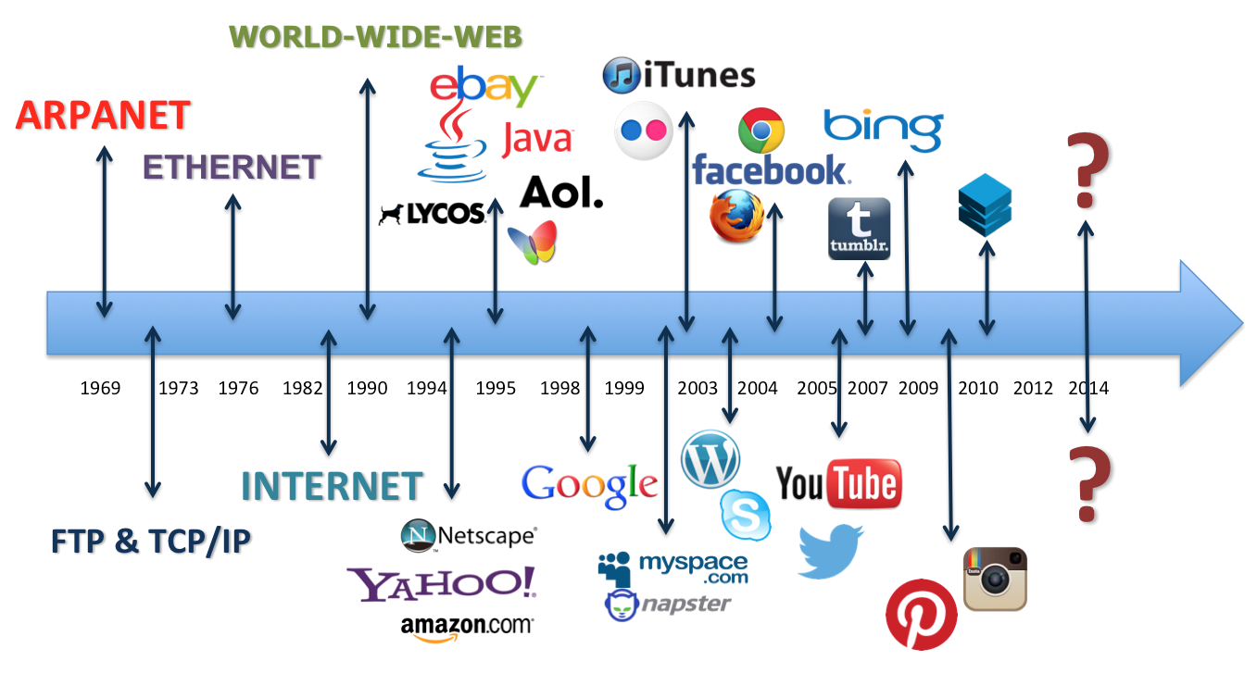

Internet Applications (1992~2010)
Application Layer
2-<number>

Slide 5

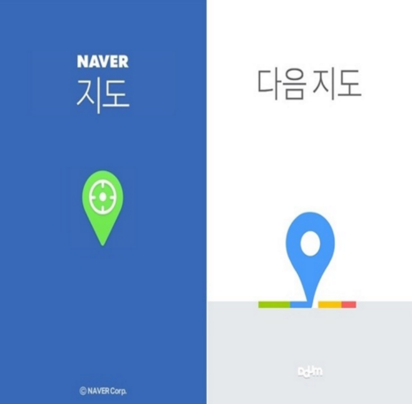






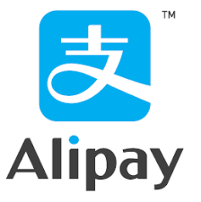
Internet Applications (2010~present) Internet Applications (2010~present)
Application Layer
2-<number>

Slide 6
Some network apps
e-mail
ftp : file 공유
web
text messaging (카톡)
remote login
P2P file sharing
multi-user network games
streaming stored video (YouTube, Hulu, Netflix)
Skype : voice over IP
Zoom : real-time video conferencing
social networking
Searching engine
그 외 Application?
Application Layer
2-<number>
Notes:
OTT: Over the Top 인터넷으로 다양한 플랫폼으로 사용자가 원할 때 방송을 보여주는 VOD 서비스이다

Slide 7
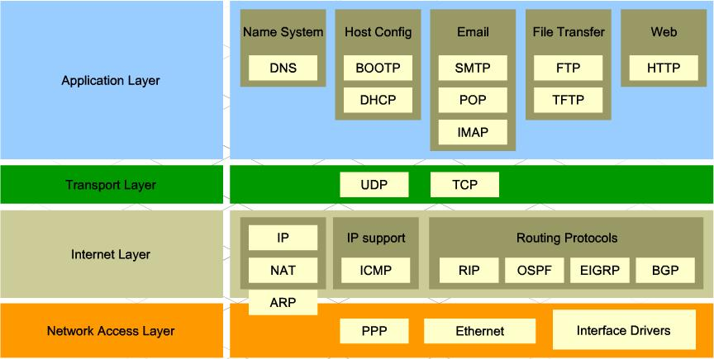
TCP/IP protocol layers
(Application Protocols)
Application Layer
2-<number>

Slide 8

















Creating a network app
application
transport
network
data link
physical
write programs that:
run on (different) end systems
communicate over network
e.g., web server software communicates with browser software (client)
no need to write software for network-core devices
network-core devices do not run user applications
applications on end systems allows for rapid app development
application
transport
network
data link
physical
application
transport
network
data link
physical
Application Layer
2-<number>

Slide 9
Application S/W 개발 기술
Client 쪽 개발 언어
HTML
CSS
JavaScript
Server 단 개발 언어
ASP
Jsp
Php
웹 개발 언어 및 플랫폼
Ruby
Spring
Application Layer
2-<number>
Notes:
SGML : 문서용 마크업 언어를 정의하기 위한 메타 언어이다.
(Standard Generalized Markup Language)

Slide 10
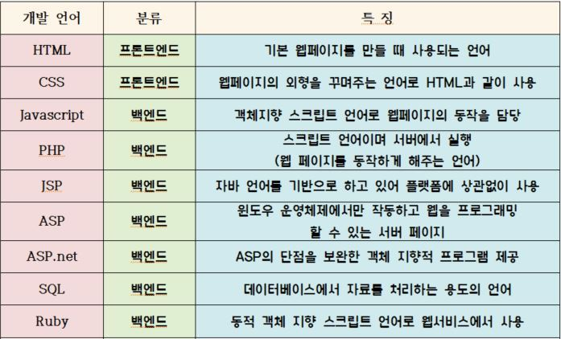
Appl. SW 개발 언어들
Application Layer
2-<number>

Slide 11
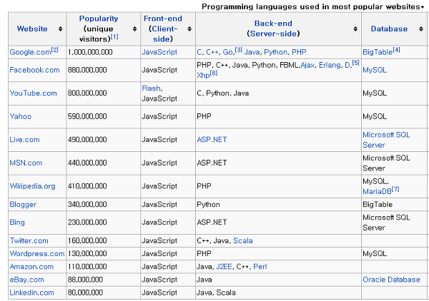
Application Layer
2-<number>

Slide 12
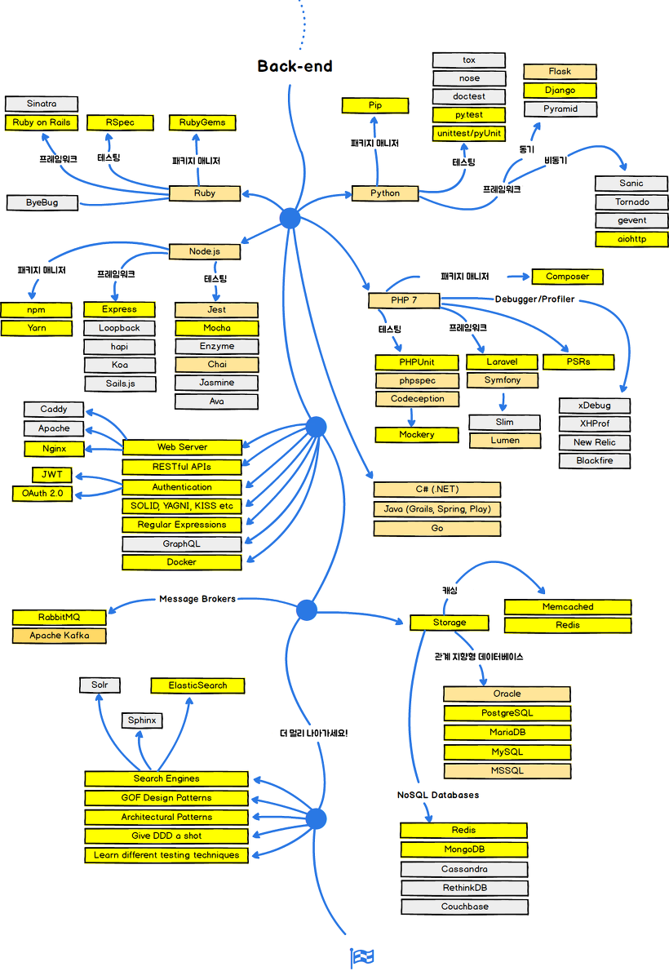
Application Layer
2-<number>

Slide 13
Application architectures
possible structure of applications:
client-server : 예전부터 널리 사용됨(전통적)
peer-to-peer (P2P) : pc 와 n/w 성능이 향상
두 모델의 Hybrid 형태
Application Layer
2-<number>

Slide 14
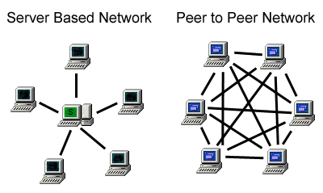
C/S vs. P2P 구조
Application Layer
2-<number>

Slide 15
Client-server architecture
server:
always-on host
permanent IP address
data centers for scaling
Cloud computer
Data Center
clients:
communicate with server
may be intermittently connected
may have dynamic IP addresses
do not communicate directly with each other
client/server
Application Layer
2-<number>

Slide 16
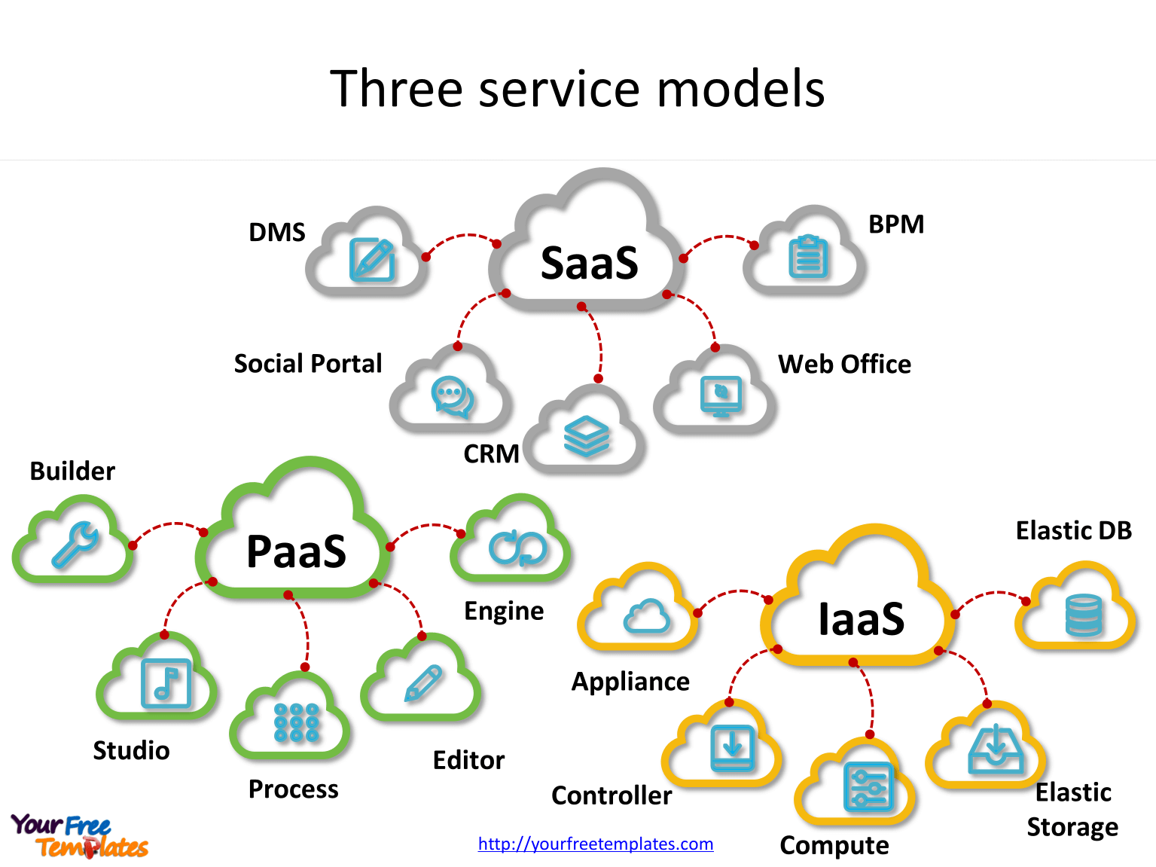
Cloud computing
IaaS(Infrastructure as a Service)
컴퓨터 및 데이터 스토리지 제공
PaaS(Platform as a Service)
애플리케이션 개발과 관리 환경을 제공
SaaS (Software as a Service)
특정 소프트웨어 제공 (예. 웹 메일)
Application Layer
2-<number>

Slide 17
P2P architecture
no always-on server
arbitrary end systems directly communicate
peers request service from other peers, provide service in return to other peers
  self scalability – new peers bring new service capacity, as well as new service demands
peers are intermittently connected and change IP addresses
  complex management
예제: 음악, 영화 다운로더 사이트
peer-peer
Application Layer
2-<number>
Notes:
Scalability: 확장성

Slide 18
Processes communicating
process: program running within a host
within same host, two processes communicate using inter-process communication (defined by OS)
processes in different hosts communicate by exchanging messages
clients, servers
client process: process that initiates communication
server process: process that waits to be contacted
aside: applications with P2P architectures have client processes & server processes
Application Layer
2-<number>
Notes:
Process: 컴퓨터에서 연속적으로 실행되고 있는 컴퓨터 프로그램을 말한다
Thread: 가벼운 프로세스
프로세스가 떨어져있을 때는 message를 통해서 주고 받는다.

Slide 19
IPC (inter process communications)
OS가 제공하고 있음
https://www.youtube.com/results?search_query=%ED%94%84%EB%A1%9C%EC%84%B8%EC%8A%A4+%ED%86%B5%EC%8B%A0
https://www.youtube.com/watch?v=Bgdii8FppOU
https://www.youtube.com/watch?v=BW3Cr0-MFxE
Application Layer
2-<number>
Notes:
IPC: 프로세스들 사이에 서로 데이터를 주고 받는 행위

Slide 20

Sockets : (later on)
process sends/receives messages to/from its socket
socket analogous to door
  sending process shoves message out door
  sending process relies on transport infrastructure on other side of door to deliver message to socket at receiving process
application
socket
application
controlled by
app developer
process
process
transport
transport
network
network
controlled
by OS
link
Internet
link
physical
physical
Application Layer
2-<number>
Notes:
노드: 대형 네트워크에서는 장치나 데이터 지점(data point)을 의미한다. 개인용 컴퓨터, 휴대전화, 프린터와 같은 정보처리 장치들이 노드이다.

Slide 21
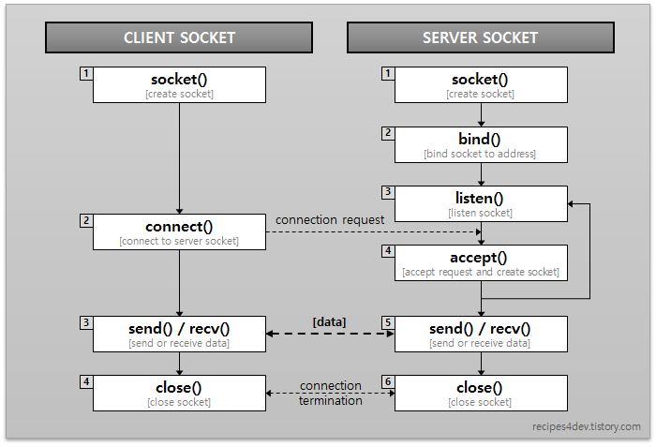
Socket program 구조
Application Layer
2-<number>

Slide 22
Addressing processes (IP : later on)
to receive messages, process must have identifier
host device has unique 32-bit IP address
Q: does IP address of host on which process runs suffice for identifying the process?
identifier includes both IP address and port numbers associated with process on host.
example port numbers:
  HTTP server: 80
  mail server: 25
to send HTTP message to gaia.cs.umass.edu web server:
  IP address: 128.119.245.12
  port number: 80
more shortly…
  A: no, many processes can be running on same host
Application Layer
2-<number>
Notes:
Port: process 주소에 해당하는 것

Slide 23
App-layer protocol defines
types of messages exchanged,
  e.g., request, response
message syntax:
  what fields in messages & how fields are delineated
message semantics
  meaning of information in fields
rules for when and how processes send & respond to messages
open protocols:
defined in RFCs
allows for interoperability
e.g., HTTP, SMTP
proprietary protocols:
e.g., Skype
Application Layer
2-<number>
Notes:
Semantics: 문법은 같은데 뜻이 다른 것

Slide 24
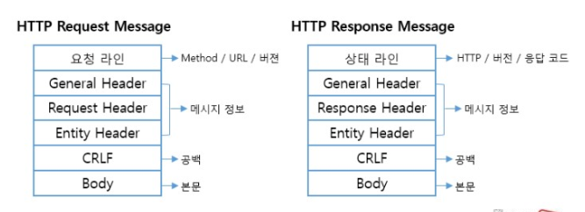
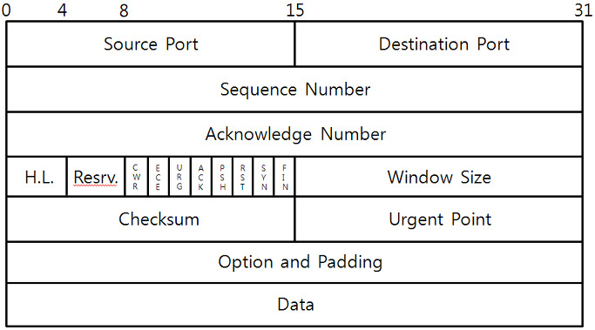
HTTP / TCP protocol 구조
Application Layer
2-<number>

Slide 25
What transport service does an app need?
Data integrity (신뢰성)
some apps (e.g., file transfer, web transactions) require 100% reliable data transfer
other apps (e.g., audio) can tolerate some loss
Throughput (전송률)
some apps (e.g., multimedia) require minimum amount of throughput to be “effective”
other apps (“elastic apps”) make use of whatever throughput they get
Timing (시간)
some apps (e.g., Internet telephony, interactive games) require low delay to be “effective”
Security (암호화)
encryption, data integrity, …
신용카드 전송
Application Layer
2-<number>

Slide 26
Transport service requirements: common apps
application
file transfer
e-mail
Web documents
real-time audio/video
stored audio/video
interactive games
text messaging
data loss
no loss
no loss
no loss
loss-tolerant
loss-tolerant
loss-tolerant
no loss
throughput
elastic
elastic
elastic
audio: 5kbps-1Mbps
video:10kbps-5Mbps
same as above
few kbps up
elastic
time sensitive
no
no
no
yes, 100’s msec
yes, few secs
yes, 100’s msec
yes and no
Application Layer
2-<number>

Slide 27
Internet transport protocols services
TCP service:
reliable transport between sending and receiving process
flow control: sender won’t overwhelm receiver
congestion control: throttle sender when network overloaded (혼잡제어)
does not provide: timing, minimum throughput guarantee, security
connection-oriented: setup required between client and server processes
(hand-shake)
UDP service:
unreliable data transfer between sending and receiving process
does not provide: reliability, flow control, congestion control, timing, throughput guarantee, security, or connection setup,
Q: why bother? Why is there a UDP?
Application Layer
2-<number>

Slide 28
Internet apps: application, transport protocols
application
layer protocol
SMTP [RFC 2821]
Telnet [RFC 854]
HTTP [RFC 2616]
FTP [RFC 959]
HTTP (e.g., YouTube),
RTP [RFC 1889]
SIP, RTP, proprietary
(e.g., Skype)
underlying
transport protocol
TCP
TCP
TCP
TCP
TCP or UDP
TCP or UDP
application
e-mail
remote terminal access
Web
file transfer
streaming multimedia
Internet telephony
Application Layer
2-<number>

Slide 29
Securing TCP
TCP & UDP
no encryption
cleartext passwds sent into socket traverse Internet in cleartext
SSL (Secure Socket Layer)
provides encrypted TCP connection
data integrity
end-point authentication
Https://
SSL is at app layer
apps use SSL libraries, that “talk” to TCP
SSL socket API
  cleartext passwords sent into socket traverse Internet encrypted
  see Chapter 8
Application Layer
2-<number>

Slide 30
과제
Web Application 개발 언어 조사
  HTML, HTML5, CSS, JavaScript
  Jsp, Ruby, 기타 등등
C/S architecture P2P의 장단점
Cloud computing
IPC
제출 방법 ?
  홈페이지, 블로그
Application Layer
2-<number>
Notes:
1장 2장 내용 및 자기소개 -> wix로 과제

Slide 31
Application Layer
2-<number>

Slide 32
Chapter 2: outline
2.1 principles of network applications
2.2 Web and HTTP
2.3 electronic mail
  SMTP, POP3, IMAP
2.4 DNS
2.5 P2P applications
2.6 video streaming and content distribution networks
2.7 socket programming with UDP and TCP
Application Layer
2-<number>

