Slide 1


Chapter 2 (part II)
Application Layer
Computer Networking: A Top Down Approach
7th Edition, Global Edition
Jim Kurose, Keith Ross
Pearson
April 2016
Application Layer
2-<number>

Slide 2
Some network apps
e-mail
web
text messaging
remote login
P2P file sharing
multi-user network games
streaming stored video (YouTube, Hulu, Netflix)
voice over IP (e.g., Skype)
real-time video conferencing
social networking
Search
그 외 Application?
Application Layer
2-<number>

Slide 3
Chapter 2: outline
2.1 principles of network applications
2.2 Web and HTTP
2.3 electronic mail
  SMTP, POP3, IMAP
2.4 DNS
2.5 P2P applications
2.6 video streaming and content distribution networks
2.7 socket programming with UDP and TCP
Application Layer
2-<number>

Slide 4
Web and HTTP
First, a review…
web page consists of objects
object can be HTML file, JPEG image, Java applet?, audio file,…
web page consists of base HTML-file which includes several referenced objects
each object is addressable by a URL, e.g.,
Domain Name vs. URL
www.someschool.edu/someDept/pic.gif
host name
path name
Application Layer
2-<number>
Notes:
Web: 거미줄, WWW

Slide 5
웹 문서
HTML
CSS
HTML5 = HTML + CSS + Javascript
SGML, XML
Application Layer
2-<number>

Slide 6
APM(Apache, php, MySql)
Apache
  리눅스OS에서 작동되는 웹 서버 프로그램
  MS의 IIS (Internet Information Services)
PHP
  유닉스/리눅스에서 지원되는 스크립트 언어
  HTML문서 내장된
  MS의 ASP, JSP
MySql
  데이터베이스 관리 시스템
  Oracle, SQL server, etc
Application Layer
2-<number>

Slide 7
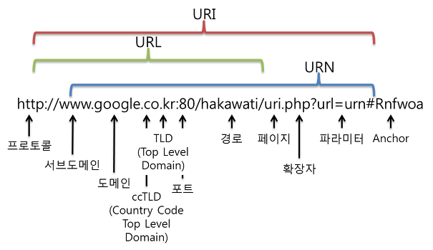
질문 (알아보기)
Java Applet vs. Java Script
URI : URL URN
URL (Uniform Resource Locator)
  서버에 있는 resource을 지칭
  일반적으로 프로토콜, 호스트이름, 파일경로명
  https://www.donga.com/news/Society/article/all/20230310/118264056/2?ref=main
Application Layer
2-<number>

Slide 8


HTTP overview
HTTP: hypertext transfer protocol
Web’s application layer protocol
client/server model
  client: browser that requests, receives, (using HTTP protocol) and “displays” Web objects
  server: Web server sends (using HTTP protocol) objects in response to requests
HTTP request
PC running
Firefox browser
HTTP response
HTTP request
server
running
Apache Web
server
HTTP response
iPhone running
Safari browser
Application Layer
2-<number>

Slide 9
HTTP overview (continued)
uses TCP: 왜?
client initiates TCP connection (creates socket) to server, port 80
server accepts TCP connection from client
HTTP messages (application-layer protocol messages) exchanged between browser (HTTP client) and Web server (HTTP server)
TCP connection closed
HTTP is “stateless”
server maintains no information about past client requests
Http는 비상태 프로토콜
aside
protocols that maintain “state” are complex!
past history (state) must be maintained
if server/client crashes, their views of “state” may be inconsistent, must be reconciled (정보 일치 문제)
Application Layer
2-<number>

Slide 10
웹 서버의 포터 번호
기본 포터 번호 : 80
보안을 위해 8000, 8080도 사용
https (http over TSL/SSL)의 경우 443 사용
Application Layer
2-<number>

Slide 11
HTTP connections
non-persistent HTTP
(비지속)
at most one object sent over TCP connection
  connection then closed
downloading multiple objects required multiple connections
HTTP 1.0
단점 : TCP 변수, 시간
persistent HTTP (지속)
multiple objects can be sent over single TCP connection between client, server
HTTP 1.1
Application Layer
2-<number>

Slide 12
Non-persistent HTTP
suppose user enters URL:
(contains text,
references to 10
jpeg images)
www.someSchool.edu/someDepartment/home.index
1a. HTTP client initiates TCP connection to HTTP server (process) at www.someSchool.edu on port 80
1b. HTTP server at host www.someSchool.edu waiting for TCP connection at port 80. “accepts” connection, notifying client
2. HTTP client sends HTTP request message (containing URL) into TCP connection socket. Message indicates that client wants object someDepartment/home.index
3. HTTP server receives request message, forms response message containing requested object, and sends message into its socket
time
Application Layer
2-<number>

Slide 13
Non-persistent HTTP (cont.)
4. HTTP server closes TCP connection.
5. HTTP client receives response message containing html file, displays html. Parsing html file, finds 10 referenced jpeg objects
time
6. Steps 1-5 repeated for each of 10 jpeg objects
Application Layer
2-<number>

Slide 14
Non-persistent HTTP: response time
RTT (round-trip time): time for a small packet to travel from client to server and back
HTTP response time:
one RTT to initiate TCP connection
one RTT for HTTP request and first few bytes of HTTP response to return
file transmission time
non-persistent HTTP response time =
  2RTT+ file transmission time
initiate TCP
connection
RTT
request
file
RTT
time to
transmit
file
file
received
time
time
Application Layer
2-<number>

Slide 15
Persistent HTTP
non-persistent HTTP issues:
requires 2 RTTs per object
OS overhead for each TCP connection
browsers often open parallel TCP connections to fetch referenced objects
(동시에 여러 TCP 연결을 유지할 수 있음)
persistent HTTP:
server leaves connection open after sending response
subsequent HTTP messages between same client/server sent over open connection
client sends requests as soon as it encounters a referenced object
as little as one RTT for all the referenced objects
Application Layer
2-<number>

Slide 16
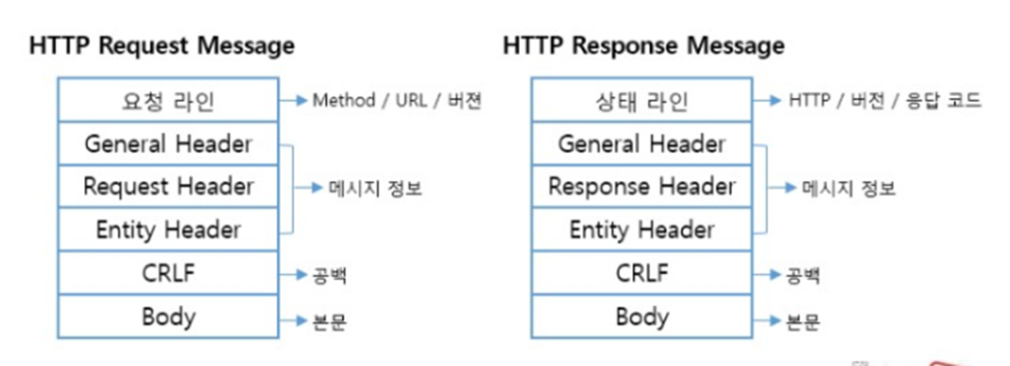
Http 프로토콜 구조
Application Layer
2-<number>

Slide 17
HTTP request(요청) message
two types of HTTP messages: request, response
클라이언트측에서 서버쪽으로 보내는 메시지
HTTP request message:
  ASCII (human-readable format)
carriage return character
request line
(GET, POST,
HEAD commands)
line-feed character
GET /index.html HTTP/1.1\r\n
Host: www-net.cs.umass.edu\r\n
User-Agent: Firefox/3.6.10\r\n
Accept: text/html,application/xhtml+xml\r\n
Accept-Language: en-us,en;q=0.5\r\n
Accept-Encoding: gzip,deflate\r\n
Accept-Charset: ISO-8859-1,utf-8;q=0.7\r\n
Keep-Alive: 115\r\n
Connection: keep-alive\r\n
\r\n [공백라인]
Body : 비거나 채워짐
header
lines
carriage return,
line feed at start
of line indicates
end of header lines
* Check out the online interactive exercises for more examples: http://gaia.cs.umass.edu/kurose_ross/interactive/
Application Layer
2-<number>

Slide 18
HTTP request message: general format
method
sp
URL
sp
version
cr
request
line
lf
header field name
value
cr
lf
~
~
header
lines
~
~
header field name
value
cr
lf
cr
lf
~
entity body
~
body
~
~
Application Layer
2-<number>

Slide 19
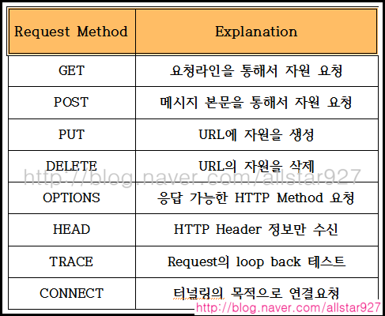
Method types (요청 메시지)
HTTP/1.0:
GET : 서버에게 URL의 웹 문서 전송을 요청
HEAD : 문서 내용보다 특정 문서(헤더)에 대한 정보 요청
POST : 클라이언트가 서버에 정보(사용자 입력)을 전송
Application Layer
2-<number>

Slide 20
Method types
HTTP/1.1:
GET, POST, HEAD
PUT [위험]
  uploads file in entity body to path specified in URL field
DELETE
  deletes file specified in the URL field
PATCH, MOVE, DELETE, LINK, OPTION
Application Layer
2-<number>
Notes:
PUT: PUT을 많이 쓰는 사이트 -> 위키피디아

Slide 21
Uploading form input 클라이언트가 서버에 정보를
보내는 방법
POST method:
web page often includes form input
input is uploaded to server in entity body [데이터로]
URL method: (요청하면서 정보를 보냄)
uses GET method
input is uploaded in URL field of request line: [헤더에 붙어서]
www.somesite.com/animalsearch?monkeys&banana
Application Layer
2-<number>

Slide 22
HTTP response message (응답 메시지)
status line
(protocol
status code
status phrase)
HTTP/1.1 200 OK\r\n
Date: Sun, 26 Sep 2010 20:09:20 GMT\r\n
Server: Apache/2.0.52 (CentOS)\r\n
Last-Modified: Tue, 30 Oct 2007 17:00:02 GMT\r\n
ETag: "17dc6-a5c-bf716880"\r\n
Accept-Ranges: bytes\r\n
Content-Length: 2652\r\n
Keep-Alive: timeout=10, max=100\r\n
Connection: Keep-Alive\r\n
Content-Type: text/html; charset=ISO-8859-1\r\n
\r\n
data data data data data ...
header
lines
data, e.g.,
requested
HTML file
* Check out the online interactive exercises for more examples: http://gaia.cs.umass.edu/kurose_ross/interactive/
Application Layer
2-<number>
Notes:
중간고사: Protol을 정의하기, html protocol 특수한 목적으로 정의 (ex: email)

Slide 23
HTTP response status codes
status code appears in 1st line in server-to-client response message.
some sample codes:
200 OK
  request succeeded, requested object later in this msg
301 Moved Permanently
  requested object moved, new location specified later in this msg (Location:)
400 Bad Request
  request msg not understood by server
404 Not Found
  requested document not found on this server
505 HTTP Version Not Supported
Application Layer
2-<number>

Slide 24
실습 [명령 프롬프트]
nc.exe www.nate.com 80
GET /HTTP/1.1
Telnet 프로그램으로 텍스트로 시뮬레이션 가능
Application Layer
2-<number>

Slide 25
Trying out HTTP (client side) for yourself
1. Telnet to your favorite Web server:
telnet gaia.cs.umass.edu 80
opens TCP connection to port 80
(default HTTP server port)
at gaia.cs.umass. edu.
anything typed in will be sent
to port 80 at gaia.cs.umass.edu
2. type in a GET HTTP request:
GET /kurose_ross/interactive/index.php HTTP/1.1
Host: gaia.cs.umass.edu
by typing this in (hit carriage
return twice), you send
this minimal (but complete)
GET request to HTTP server
3. look at response message sent by HTTP server!
(or use Wireshark to look at captured HTTP request/response)
Application Layer
2-<number>

Slide 26
User-server state: cookies
example:
Susan always access Internet from PC
visits specific e-commerce site for first time
when initial HTTP requests arrives at site, site creates:
  unique ID
  entry in backend database for ID
many Web sites use cookies
four components:
  1) cookie header line of HTTP response message
  2) cookie header line in next HTTP request message
  3) cookie file kept on user’s host, managed by user’s browser
  4) back-end database at Web site
Application Layer
2-<number>

Slide 27
Cookies: keeping “state” (cont.)
client
server
ebay 8734
usual http request msg
Amazon server
creates ID
1678 for user
cookie file
usual http response
set-cookie: 1678
backend
database
create
entry
ebay 8734
amazon 1678
usual http request msg
cookie: 1678
cookie-
specific
action
access
usual http response msg
one week later:
access
ebay 8734
amazon 1678
usual http request msg
cookie: 1678
cookie-
specific
action
usual http response msg
Application Layer
2-<number>

Slide 28
Cookies (continued)
aside
what cookies can be used for:
authorization
shopping carts
recommendations
user session state (Web e-mail)
cookies and privacy:
cookies permit sites to learn a lot about you
you may supply name and e-mail to sites
how to keep “state”:
protocol endpoints: maintain state at sender/receiver over multiple transactions
cookies: http messages carry state
Application Layer
2-<number>

Slide 29

Web caches (proxy server)
goal: satisfy client request without involving origin server
user sets browser: Web accesses via cache
browser sends all HTTP requests to cache
  object in cache: cache returns object
  else cache requests object from origin server, then returns object to client
proxy
server
HTTP request
HTTP request
client
origin
server
HTTP response
HTTP response
HTTP request
HTTP response
client
origin
server
Application Layer
2-<number>
Notes:
Proxsy server:

Slide 30
More about Web caching
cache acts as both client and server
  server for original requesting client
  client to origin server
typically cache is installed by ISP (university, company, residential ISP)
why Web caching?
reduce response time for client request
reduce traffic on an institution’s access link
Internet dense with caches: enables “poor” content providers to effectively deliver content (so too does P2P file sharing)
Application Layer
2-<number>

Slide 31

Caching example:
assumptions:
avg object size: 100K bits
avg request rate from browsers to origin servers:15/sec
avg data rate to browsers: 1.50 Mbps
RTT from institutional router to any origin server: 2 sec
access link rate: 1.54 Mbps
consequences:
LAN utilization: 15%
access link utilization = 99%
total delay = Internet delay + access delay + LAN delay
= 2 sec + minutes + usecs
origin
servers
public
Internet
1.54 Mbps
access link
problem!
institutional
network
1 Gbps LAN
Application Layer
2-<number>

Slide 32
Caching example: fatter access link
assumptions:
avg object size: 100K bits
avg request rate from browsers to origin servers:15/sec
avg data rate to browsers: 1.50 Mbps
RTT from institutional router to any origin server: 2 sec
access link rate: 1.54 Mbps
consequences:
LAN utilization: 15%
access link utilization = 99%
total delay = Internet delay + access delay + LAN delay
= 2 sec + minutes + usecs
origin
servers
public
Internet
154 Mbps
1.54 Mbps
access link
154 Mbps
institutional
network
9.9%
1 Gbps LAN
msecs
Cost: increased access link speed (not cheap!)
Application Layer
2-<number>

Slide 33
Caching example: install local cache
assumptions:
avg object size: 100K bits
avg request rate from browsers to origin servers:15/sec
avg data rate to browsers: 1.50 Mbps
RTT from institutional router to any origin server: 2 sec
access link rate: 1.54 Mbps
consequences:
LAN utilization: 15%
access link utilization = 100%
total delay = Internet delay + access delay + LAN delay
= 2 sec + minutes + usecs
origin
servers
public
Internet
1.54 Mbps
access link
institutional
network
?
1 Gbps LAN
?
local web
cache
How to compute link
utilization, delay?
Cost: web cache (cheap!)
Application Layer
2-<number>

Slide 34
Caching example: install local cache
Calculating access link utilization, delay with cache:
suppose cache hit rate is 0.4
  40% requests satisfied at cache, 60% requests satisfied at origin
origin
servers
public
Internet
access link utilization:
  60% of requests use access link
data rate to browsers over access link
= 0.6*1.50 Mbps = .9 Mbps
  utilization = 0.9/1.54 = .58
1.54 Mbps
access link
institutional
network
total delay
  = 0.6 * (delay from origin servers) +0.4 * (delay when satisfied at cache)
  = 0.6 (2.01) + 0.4 (~msecs) = ~ 1.2 secs
  less than with 154 Mbps link (and cheaper too!)
1 Gbps LAN
local web
cache
Application Layer
2-<number>

Slide 35
Conditional GET
client
server
Goal: don’t send object if cache has up-to-date cached version
  no object transmission delay
  lower link utilization
cache: specify date of cached copy in HTTP request
  If-modified-since: <date>
server: response contains no object if cached copy is up-to-date:
  HTTP/1.0 304 Not Modified
HTTP request msg
If-modified-since: <date>
object
not
modified
before
<date>
HTTP response
HTTP/1.0
304 Not Modified
HTTP request msg
If-modified-since: <date>
object
modified
after
<date>
HTTP response
HTTP/1.0 200 OK
<data>
Application Layer
2-<number>

Slide 36
Chapter 2: outline
2.1 principles of network applications
2.2 Web and HTTP
2.3 electronic mail
  SMTP, POP3, IMAP
2.4 DNS
2.5 P2P applications
2.6 video streaming and content distribution networks
2.7 socket programming with UDP and TCP
Application Layer
2-<number>

Slide 37
Electronic mail
outgoing
message queue
user mailbox
Three major components:
user agents
mail servers
simple mail transfer protocol: SMTP
User Agent [요즘은?]
a.k.a. “mail reader”
composing, editing, reading mail messages
e.g., Outlook, Thunderbird, iPhone mail client
outgoing, incoming messages stored on server
user
agent
mail
server
user
agent
SMTP
mail
server
user
agent
SMTP
SMTP
user
agent
mail
server
user
agent
user
agent
Application Layer
2-<number>

Slide 38
Electronic mail: mail servers
mail servers:
mailbox contains incoming messages for user
message queue of outgoing (to be sent) mail messages
SMTP protocol between mail servers to send email messages
  client: sending mail server
  “server”: receiving mail server
user
agent
mail
server
user
agent
SMTP
mail
server
user
agent
SMTP
SMTP
user
agent
mail
server
user
agent
user
agent
Application Layer
2-<number>

Slide 39
Electronic Mail: SMTP [RFC 2821]
uses TCP to reliably transfer email message from client to server, port 25
direct transfer: sending server to receiving server
three phases of transfer
  handshaking (greeting)
  transfer of messages
  closure
command/response interaction (like HTTP)
  commands: ASCII text
  response: status code and phrase
messages must be in 7-bit ASCI
Application Layer
2-<number>
Notes:
SMTP 프로토콜은 아스키코드만 보내는 프로토콜
ASCII : 컴퓨터에서 문자를 나타내기 위한 표준 코드 체계, 7비트(128개)로 구성되어 있으며, 각 문자에는 0부터 127까지의 숫자가 할당되어 있다.

Slide 40


Scenario: Alice sends message to Bob
1) Alice uses UA to compose message “to” bob@someschool.edu
2) Alice’s UA sends message to her mail server; message placed in message queue
3) client side of SMTP opens TCP connection with Bob’s mail server
4) SMTP client sends Alice’s message over the TCP connection
5) Bob’s mail server places the message in Bob’s mailbox
6) Bob invokes his user agent to read message
user
agent
mail
server
user
agent
1
mail
server
2
3
6
4
Alice’s mail server
5
Bob’s mail server
Application Layer
2-<number>

Slide 41
Sample SMTP interaction
S: 220 hamburger.edu
C: HELO crepes.fr
S: 250 Hello crepes.fr, pleased to meet you
C: MAIL FROM: <alice@crepes.fr>
S: 250 alice@crepes.fr... Sender ok
C: RCPT TO: <bob@hamburger.edu>
S: 250 bob@hamburger.edu ... Recipient ok
C: DATA
S: 354 Enter mail, end with "." on a line by itself
C: Do you like ketchup?
C: How about pickles?
C: .
S: 250 Message accepted for delivery
C: QUIT
S: 221 hamburger.edu closing connection
Application Layer
2-<number>

Slide 42
Try SMTP interaction for yourself:
telnet servername 25
see 220 reply from server
enter HELO, MAIL FROM, RCPT TO, DATA, QUIT commands
above lets you send email without using email client (reader)
Application Layer
2-<number>

Slide 43
SMTP: final words
SMTP uses persistent connections
SMTP requires message (header & body) to be in 7-bit ASCII
SMTP server uses CRLF.CRLF to determine end of message
comparison with HTTP:
HTTP: pull
SMTP: push
both have ASCII command/response interaction, status codes
HTTP: each object encapsulated in its own response message
SMTP: multiple objects sent in multipart message
Application Layer
2-<number>

Slide 44
Mail message format
SMTP: protocol for exchanging email messages
RFC 822: standard for text message format:
header lines, e.g.,
  To:
  From:
  Subject:
  different from SMTP MAIL FROM, RCPT TO: commands!
Body: the “message”
  ASCII characters only
header
blank
line
body
Application Layer
2-<number>

Slide 45
Mail access protocols
user
agent
mail access
protocol
user
agent
SMTP
SMTP
(e.g., POP,
IMAP)
sender’s mail
server
receiver’s mail
server
SMTP: delivery/storage to receiver’s server
mail access protocol: retrieval from server
  POP: Post Office Protocol [RFC 1939]: authorization, download
  IMAP: Internet Mail Access Protocol [RFC 1730]: more features, including manipulation of stored messages on server
  HTTP: gmail, Hotmail, Yahoo! Mail, etc.
Application Layer
2-<number>

Slide 46
POP3 protocol
S: +OK POP3 server ready
C: user bob
S: +OK
C: pass hungry
S: +OK user successfully logged on
authorization phase
client commands:
  user: declare username
  pass: password
server responses
  +OK
  -ERR
transaction phase, client:
list: list message numbers
retr: retrieve message by number
dele: delete
quit
C: list
S: 1 498
S: 2 912
S: .
C: retr 1
S: <message 1 contents>
S: .
C: dele 1
C: retr 2
S: <message 1 contents>
S: .
C: dele 2
C: quit
S: +OK POP3 server signing off
Application Layer
2-<number>

Slide 47
POP3 (more) and IMAP
more about POP3
previous example uses POP3 “download and delete” mode
  Bob cannot re-read e-mail if he changes client
POP3 “download-and-keep”: copies of messages on different clients
POP3 is stateless across sessions
IMAP
keeps all messages in one place: at server
allows user to organize messages in folders
keeps user state across sessions:
  names of folders and mappings between message IDs and folder name
Application Layer
2-<number>

Slide 48
Chapter 2: outline
2.1 principles of network applications
2.2 Web and HTTP
2.3 electronic mail
  SMTP, POP3, IMAP
2.4 DNS
2.5 P2P applications
2.6 video streaming and content distribution networks
2.7 socket programming with UDP and TCP
Application Layer
2-<number>

Slide 49
DNS: domain name system
people: many identifiers:
  SSN, name, passport #
Internet hosts, routers:
  IP address (32 bit) - used for addressing datagrams
  “name”, e.g., www.yahoo.com - used by humans
Q: how to map between IP address and name, and vice versa ?
Domain Name System:
distributed database implemented in hierarchy of many name servers
application-layer protocol: hosts, name servers communicate to resolve names (address/name translation)
  note: core Internet function, implemented as application-layer protocol
  전송계층 : UDP 사용
Application Layer
2-<number>

Slide 50
DNS: services, structure
DNS services
hostname to IP address translation
host aliasing
  canonical, alias names
mail server aliasing
load distribution
  replicated Web servers: many IP addresses correspond to one name
why not centralize DNS?
single point of failure
traffic volume
distant centralized database
maintenance
A: doesn‘t scale!
Application Layer
2-<number>

Slide 51
DNS
가장 초기 방식
  직접 IP 주소 입력
  10여대 이내
  기억해야 함
좀 더 발전된 형태
  Client 컴퓨터에 파일 형태로
  C:/Windows/System32/drivers/etc/hosts
  수첩
Host 엄청나게 증가
  DNS 서버 (전화교환수)
> nslookup
Application Layer
2-<number>

Slide 52
DNS에 자신의 IP 등록 및
DNA 서버 접근방식
https://www.youtube.com/watch?v=hfj0IGgKAgU
https://www.youtube.com/watch?v=cue7j43PxhE&t=520s
https://www.youtube.com/watch?v=0XUuzx172jY
Application Layer
2-<number>

Slide 53
DNS: a distributed, hierarchical database
Root DNS Servers
…
…
com DNS servers
org DNS servers
edu DNS servers
yahoo.com
DNS servers
pbs.org
DNS servers
poly.edu
DNS servers
umass.edu
DNS servers
amazon.com
DNS servers
client wants IP for www.amazon.com; 1st approximation:
client queries root server to find com DNS server
client queries .com DNS server to get amazon.com DNS server
client queries amazon.com DNS server to get IP address for www.amazon.com
Application Layer
2-<number>

Slide 54

DNS: root name servers
contacted by local name server that can not resolve name
ICANN 관리 (a.root-ervers.net, b.root …. m.root-servers.net)
root name server:
  contacts authoritative name server if name mapping not known
  gets mapping
  returns mapping to local name server
c. Cogent, Herndon, VA (5 other sites)
d. U Maryland College Park, MD
h. ARL Aberdeen, MD
j. Verisign, Dulles VA (69 other sites )
k. RIPE London (17 other sites)
i. Netnod, Stockholm (37 other sites)
e. NASA Mt View, CA
f. Internet Software C.
Palo Alto, CA (and 48 other sites)
m. WIDE Tokyo
(5 other sites)
13 logical root name “servers” worldwide
each “server” replicated many times
a. Verisign, Los Angeles CA
(5 other sites)
b. USC-ISI Marina del Rey, CA
l. ICANN Los Angeles, CA
(41 other sites)
g. US DoD Columbus, OH (5 other sites)
Application Layer
2-<number>

Slide 55
TLD, authoritative servers
top-level domain (TLD) servers:
  responsible for com, org, net, edu, aero, jobs, museums, and all top-level country domains, e.g.: uk, fr, ca, jp
  Network Solutions maintains servers for .com TLD
  Educause for .edu TLD
authoritative DNS servers:
  organization’s own DNS server(s), providing authoritative hostname to IP mappings for organization’s named hosts
  can be maintained by organization or service provider
Application Layer
2-<number>

Slide 56
Local DNS name server
does not strictly belong to hierarchy
each ISP (residential ISP, company, university) has one
  also called “default name server”
when host makes DNS query, query is sent to its local DNS server
  has local cache of recent name-to-address translation pairs (but may be out of date!)
  acts as proxy, forwards query into hierarchy
Application Layer
2-<number>
Notes:
프록시 서버는 클라이언트와 다른 서버(일반적으로 인터넷) 간의 게이트웨이 역할을 하는 중간 서버입니다. 클라이언트(예: 웹 브라우저)가 리소스(예: 웹 페이지)를 요청하면 요청이 먼저 프록시 서버로 전송된 다음 적절한 서버로 요청을 전달합니다. 그런 다음 서버의 응답은 프록시 서버로 다시 전송되고 클라이언트로 다시 전송됩니다.

Slide 57
DNS name resolution example
root DNS server
2
host at cis.poly.edu wants IP address for gaia.cs.umass.edu
3
TLD DNS server
4
5
iterated query:
contacted server replies with name of server to contact
“I don’t know this name, but ask this server”
local DNS server
dns.poly.edu
7
6
1
8
authoritative DNS server
dns.cs.umass.edu
requesting host
cis.poly.edu
gaia.cs.umass.edu
Application Layer
2-<number>

Slide 58
DNS name
resolution example
root DNS server
2
3
recursive query:
puts burden of name resolution on contacted name server
heavy load at upper levels of hierarchy?
7
6
TLD DNS
server
local DNS server
dns.poly.edu
5
4
1
8
authoritative DNS server
dns.cs.umass.edu
requesting host
cis.poly.edu
gaia.cs.umass.edu
Application Layer
2-<number>

Slide 59
DNS: caching, updating records
once (any) name server learns mapping, it caches mapping
  cache entries timeout (disappear) after some time (TTL)
  TLD servers typically cached in local name servers
    thus root name servers not often visited
cached entries may be out-of-date (best effort name-to-address translation!)
  if name host changes IP address, may not be known Internet-wide until all TTLs expire
update/notify mechanisms proposed IETF standard
  RFC 2136
Application Layer
2-<number>

Slide 60
DNS records
DNS: distributed database storing resource records (RR)
RR format: (name, value, type, ttl)
type=A
  name is hostname
  value is IP address
type=CNAME
  name is alias name for some “canonical” (the real) name
  www.ibm.com is really
  servereast.backup2.ibm.com
  value is canonical name
type=NS
  name is domain (e.g., foo.com)
  value is hostname of authoritative name server for this domain
type=MX
  value is name of mailserver associated with name
Application Layer
2-<number>

Slide 61
DNS protocol, messages
query and reply messages, both with same message format
2 bytes
2 bytes
message header
identification: 16 bit # for query, reply to query uses same #
flags:
  query or reply
  recursion desired
  recursion available
  reply is authoritative
identification
flags
# questions
# answer RRs
# authority RRs
# additional RRs
questions (variable # of questions)
answers (variable # of RRs)
authority (variable # of RRs)
additional info (variable # of RRs)
Application Layer
2-<number>

Slide 62
DNS protocol, messages
2 bytes
2 bytes
identification
flags
# questions
# answer RRs
# authority RRs
# additional RRs
name, type fields
for a query
questions (variable # of questions)
RRs in response
to query
answers (variable # of RRs)
records for
authoritative servers
authority (variable # of RRs)
additional “helpful”
info that may be used
additional info (variable # of RRs)
Application Layer
2-<number>

Slide 63
Inserting records into DNS
example: new startup “Network Utopia”
register name networkuptopia.com at DNS registrar (e.g., Network Solutions)
  provide names, IP addresses of authoritative name server (primary and secondary)
  registrar inserts two RRs into .com TLD server:
  (networkutopia.com, dns1.networkutopia.com, NS)
  (dns1.networkutopia.com, 212.212.212.1, A)
create authoritative server type A record for www.networkuptopia.com; type MX record for networkutopia.com
Application Layer
2-<number>
Notes:
과제

Slide 64
Attacking DNS
DDoS attacks
bombard root servers with traffic
  not successful to date
  traffic filtering
  local DNS servers cache IPs of TLD servers, allowing root server bypass
bombard TLD servers
  potentially more dangerous
redirect attacks
man-in-middle
  Intercept queries
DNS poisoning
  Send bogus relies to DNS server, which caches
exploit DNS for DDoS
send queries with spoofed source address: target IP
requires amplification
Application Layer
2-<number>

Slide 65

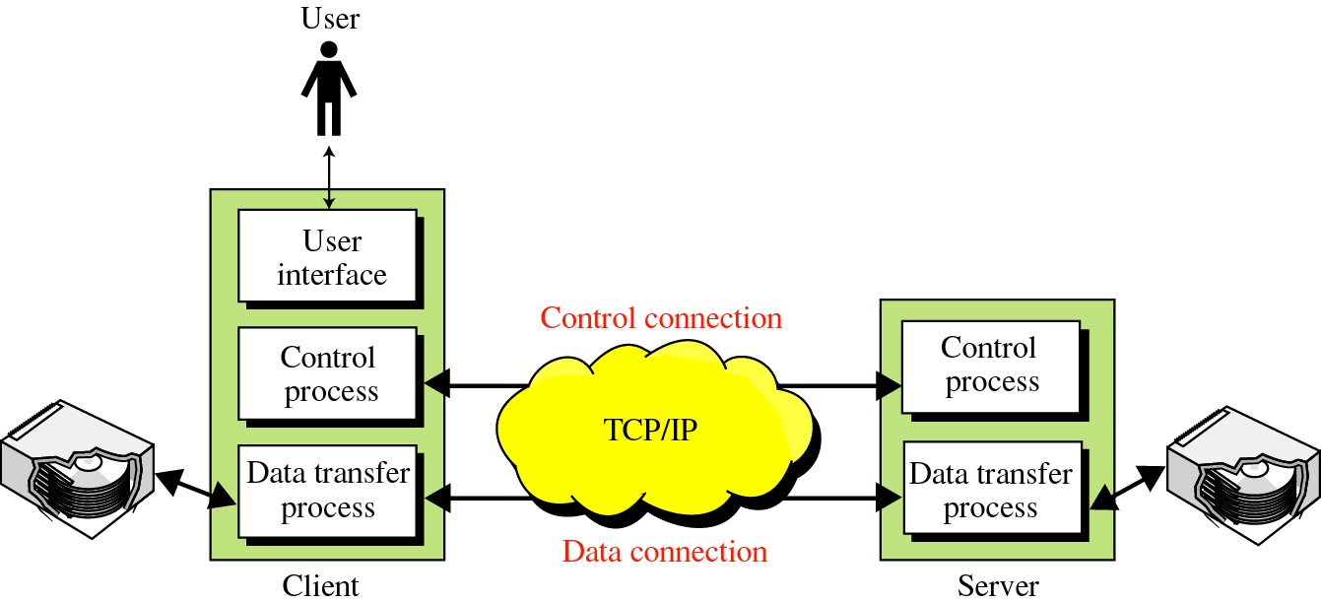
FTP 프로토콜 (파일 전송)
Application Layer
2-<number>

Slide 66
ftp 구조
https://filezilla-project.org/
Application Layer
2-<number>

