Slide 1
Chapter 2
File Transfer
Protocol
(FTP)

Slide 2
CONTENTS
CONNECTIONS
COMMUNICATION
COMMAND PROCESSING
FILE TRANSFER
USER INTERFACE
ANONYMOUS FTP

Slide 3
FTP uses the services of TCP.
It needs two TCP connections.
The well-known port 21 is used
for the control connection
and the well-known
port 20 for the data connection.

Slide 4
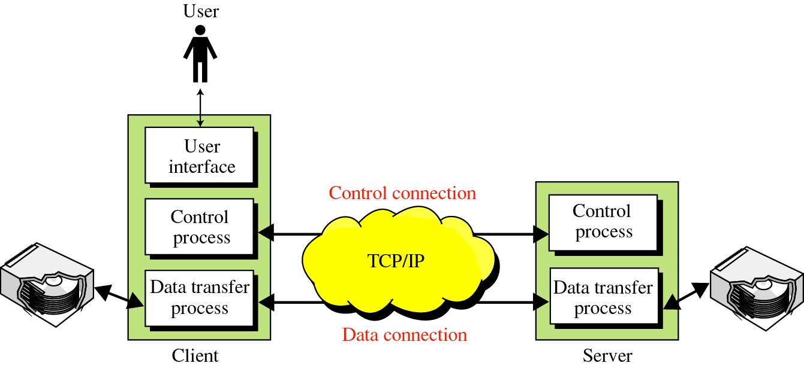
Figure 20-1
FTP

Slide 5
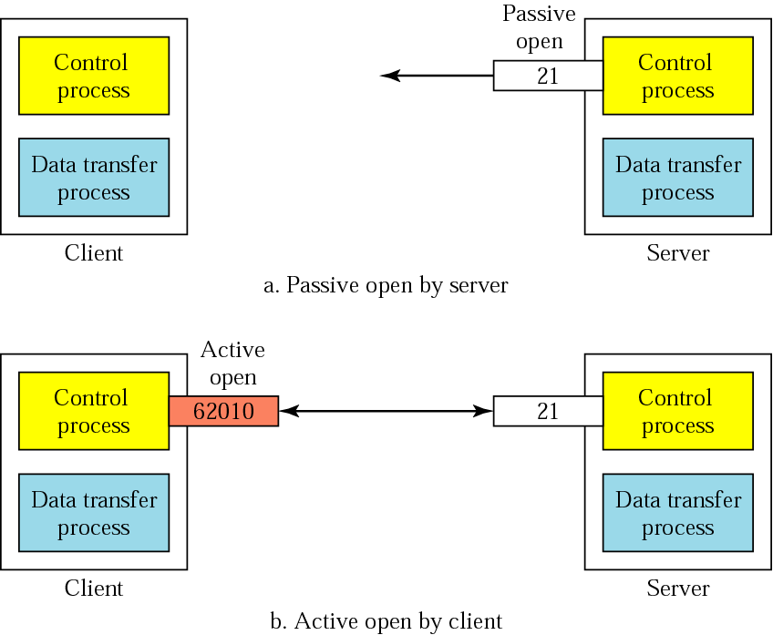
20.1 Connections: The control connection

Slide 6
The Data Connection
Uses Server’s well-known port 20
Client issues a passive open on an ephemeral port, say x.
Client uses PORT command to tell the server about the port number x.
Server issues an active open from port 20 to port x.
Server creates a child server/ephemeral port number to serve the client

Slide 7
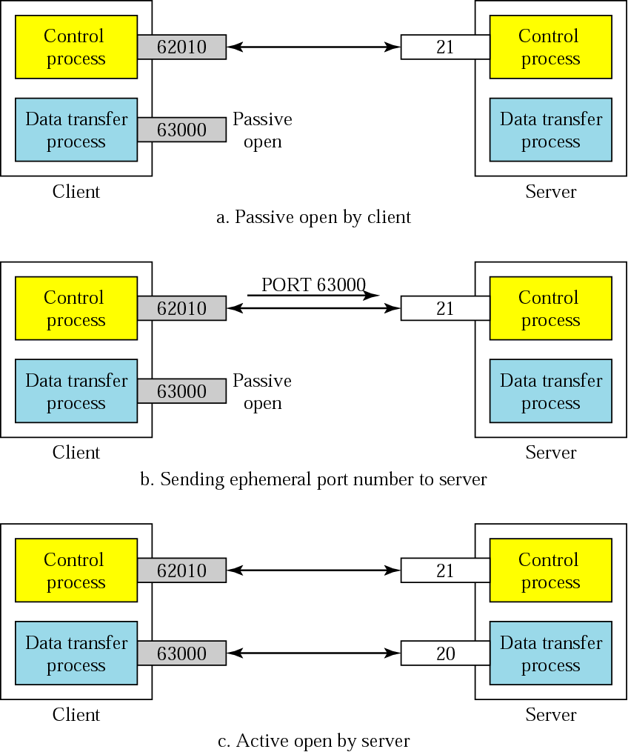
Creating
the data
connection

Slide 8
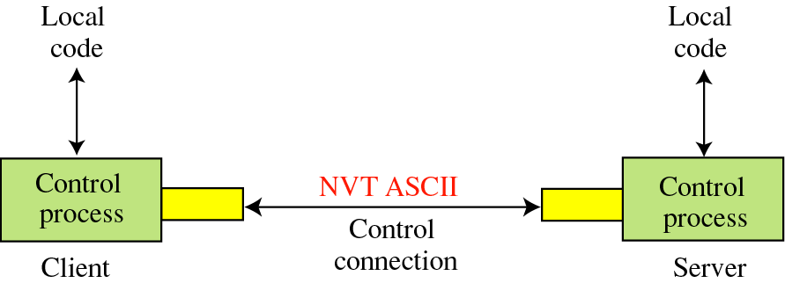
Figure 20-4
20.2 Communication
Using the control connection

Slide 9
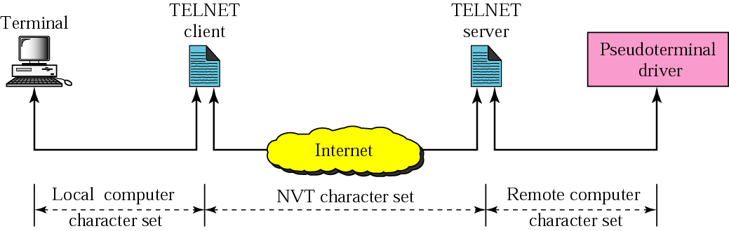
NVT
FTP
FTP

Slide 10

Format of NVT ASCII characters
일반 문자인 경우

Slide 11

Format of NVT control characters
컨트롤 제어 문자인 경우

Slide 12
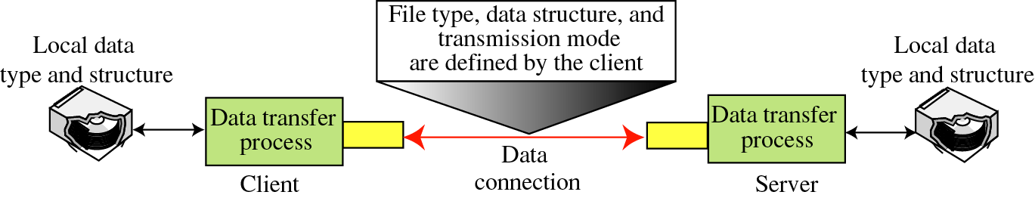
Figure 20-5
Using the data connection

Slide 13
File Type
ASCII or EBCDIC
  Nonprint
  TELNET
Image

Slide 14
Data Structure
File Structure
Record Structure
Page Structure

Slide 15
Transmission Mode
Stream mode
Block mode
Compressed mode

Slide 16
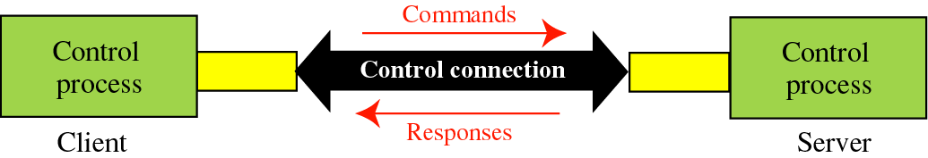
20.3 Command processing
Access Commands
File Management
Data Formatting
Port defining
File transfer
Miscellaneous

Slide 17
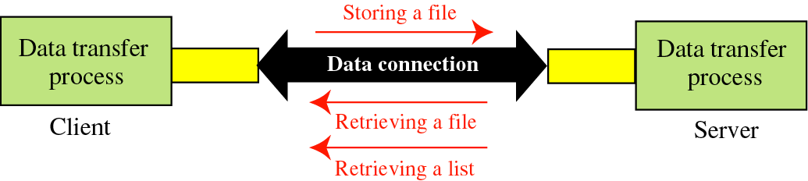
20.4 File transfer

Slide 18
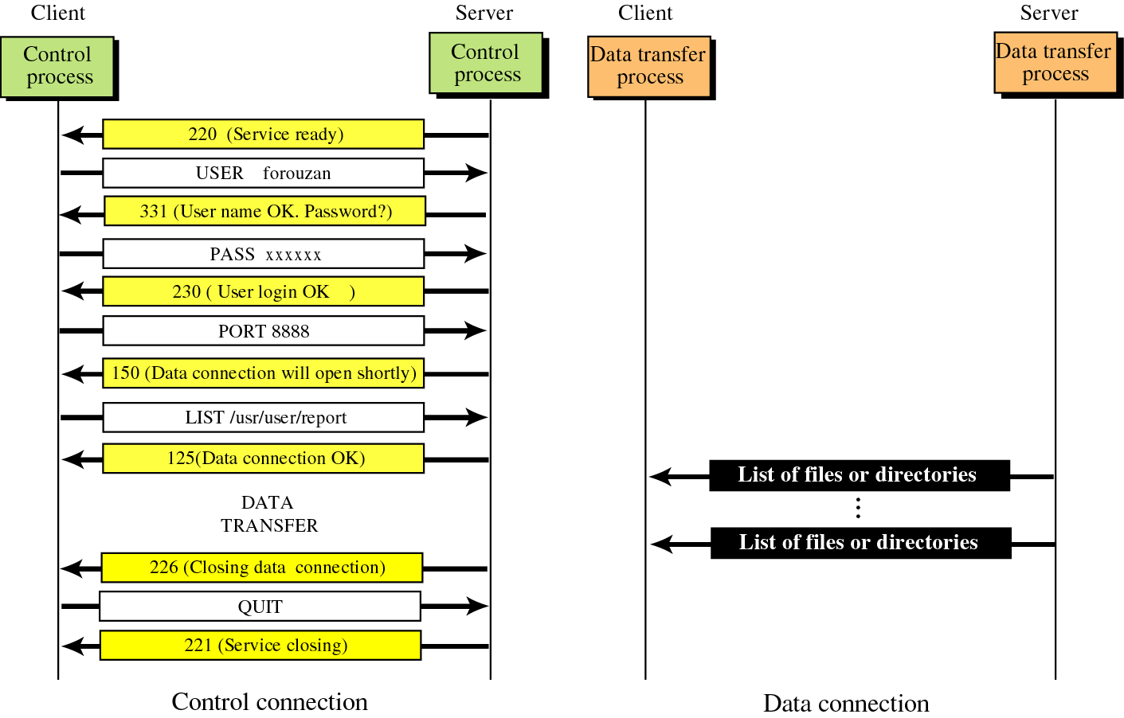
Figure 20-8
Example 1

Slide 19
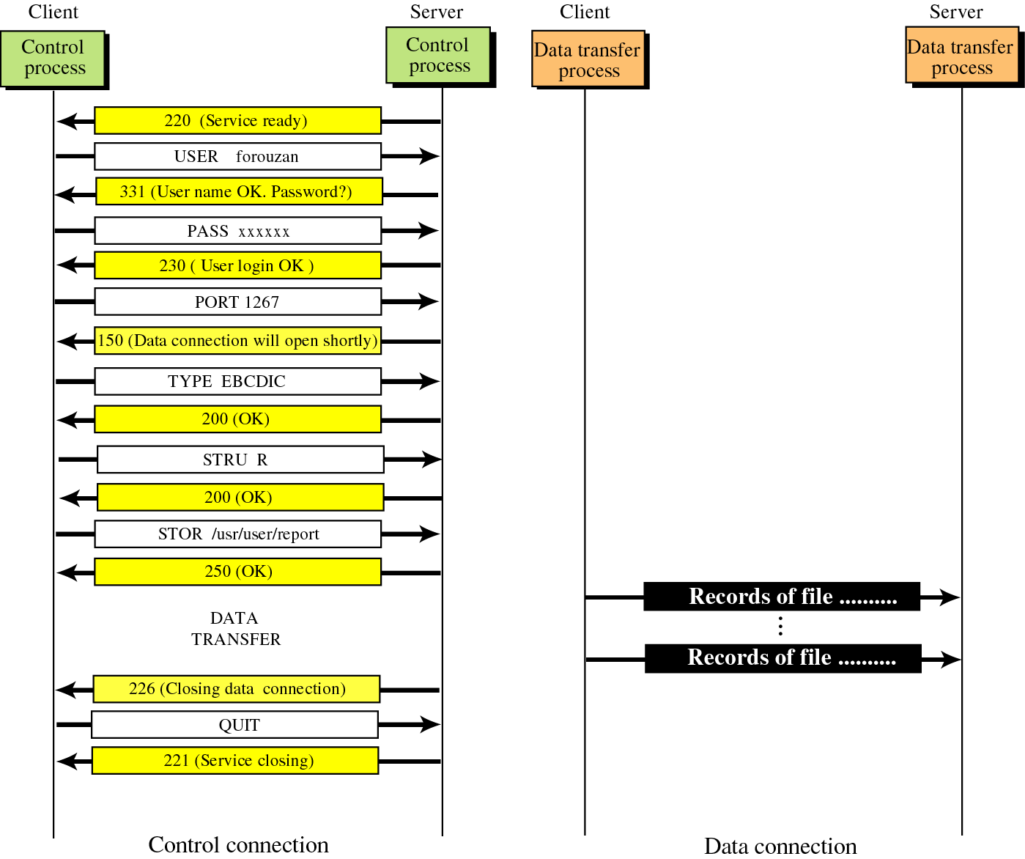
Figure 20-9
Example 2

Slide 20
20.5
USER
INTERFACE

Slide 21
Solution
% ftp challenger.atc.fhda.edu
Connected to challenger.atc.fhda.edu
220 Server ready
Name: forouzan
Password: xxxxxxx
ftp > ls /usr/user/report
200 OK

Slide 22
Solution
150 Opening ASCII mode
...........
226 transfer complete
ftp > close
221 Goodbye
ftp > quit

Slide 23
20.6
ANONYMOUS
FTP

Slide 24
Solution
% ftp internic.net
Connected to internic.net
220 Server ready
Name: anonymous
331 Guest login OK, send “guest” as password
Password: guest
ftp > pwd
257 ’/’ is current directory

Slide 25
Solution
ftp > ls
200 OK
150 Opening ASCII mode
bin
…
ftp> close
221 Goodbye
ftp> quit

Slide 26
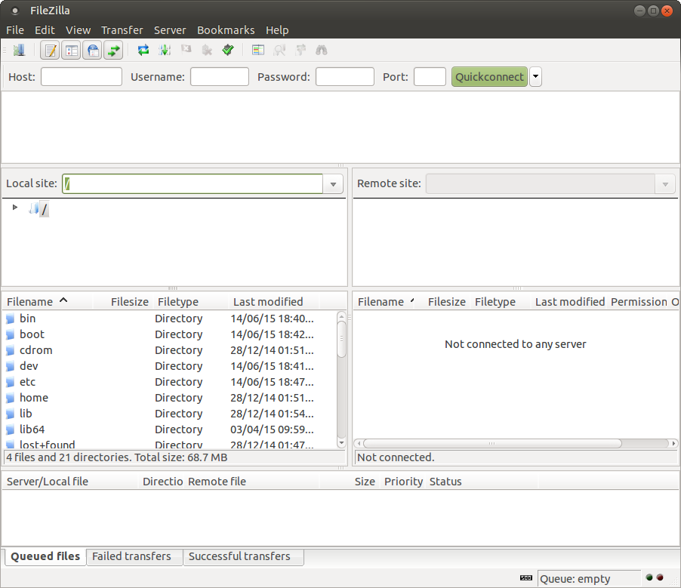
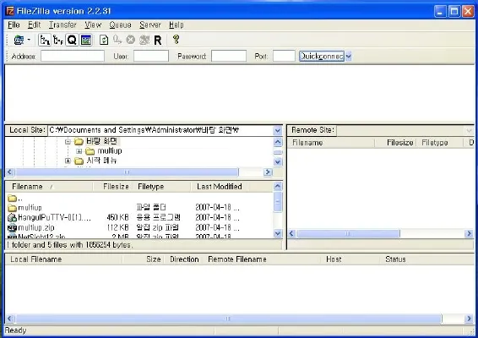
https://filezilla-project.org/

