Slide 1


Chapter 3
Transport Layer
전송계층
Computer Networking: A Top Down Approach
7th Edition, Global Edition
Jim Kurose, Keith Ross
Pearson
April 2016
Transport Layer
2-<number>

Slide 2
Chapter 3: Transport Layer (전송계층)
our goals:
understand principles behind transport layer services:
  multiplexing, demultiplexing
  reliable data transfer
  flow control
  congestion control
learn about Internet transport layer protocols:
  UDP: connectionless transport
  TCP: connection-oriented reliable transport
  TCP congestion control
Transport Layer
3-<number>

Slide 3
Chapter 3 outline
3.1 transport-layer services
3.2 multiplexing and demultiplexing
3.3 connectionless transport: UDP
3.4 principles of reliable data transfer
3.5 connection-oriented transport: TCP
  segment structure
  reliable data transfer
  flow control
  connection management
3.6 principles of congestion control
3.7 TCP congestion control
Transport Layer
3-<number>

Slide 4

















Transport services and protocols
application
transport
network
data link
physical
provide logical communication between app processes running on different hosts
transport protocols run in end systems (종단 시스템에서만 작동하는 프로토콜)
  send side: breaks app messages into segments, passes to network layer
  rcv side: reassembles segments into messages, passes to app layer
Internet: TCP and UDP
logical end-end transport
application
transport
network
data link
physical
Transport Layer
3-<number>

Slide 5
Transport vs. network layer 비유
network layer: logical communication between hosts
transport layer: logical communication between processes
  relies on, enhances, network layer
  네트워크계층 의존
Program, Process, Thread
household analogy:
12 kids in Ann’s house sending letters to 12 kids in Bill’s house:
hosts = houses
processes = kids
app messages = letters in envelopes
transport protocol = Ann and Bill who demux to in-house siblings
network-layer protocol = postal service (우체부)
Link, Physical layer (버스, 기차, 비행기 등 운반차량)
Transport Layer
3-<number>

Slide 6
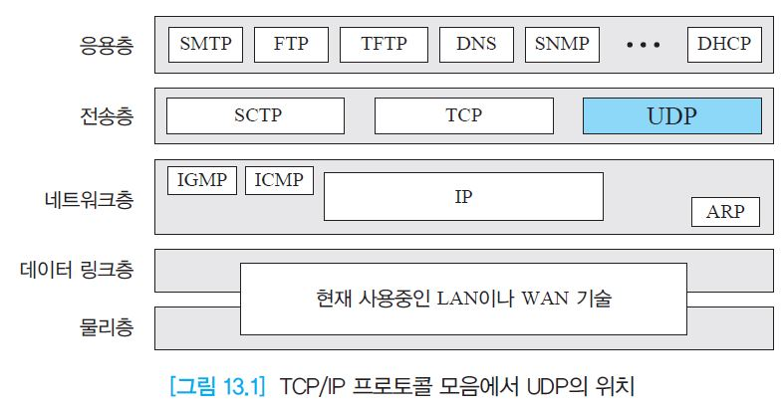
TCP/IP 프로토콜 모음들

Slide 7
Internet transport-layer protocols
reliable, in-order delivery (TCP)
  congestion control (혼잡제어)
  flow control (흐름제어)
  connection setup
unreliable, unordered delivery: UDP
  no-frills(기본, 장식없음) extension of “best-effort” IP
하위계층인 IP layer
  어떤 것도 보장하지 않음 (순서, 데이터 무결성). 최소한 작업
application
transport
network
data link
physical
network
data link
physical
network
data link
physical
network
data link
physical
logical end-end transport
network
data link
physical
network
data link
physical
network
data link
physical
network
data link
physical
application
transport
network
data link
physical
Transport Layer
3-<number>

Slide 8
Chapter 3 outline
3.1 transport-layer services
3.2 multiplexing and demultiplexing
3.3 connectionless transport: UDP
3.4 principles of reliable data transfer
3.5 connection-oriented transport: TCP
  segment structure
  reliable data transfer
  flow control
  connection management
3.6 principles of congestion control
3.7 TCP congestion control
Transport Layer
3-<number>

Slide 9

Multiplexing(다중화)/ demultiplexing (역다중화) : 여러 프로세스 처리
multiplexing at sender:
demultiplexing at receiver:
handle data from multiple
sockets, add transport header (later used for demultiplexing)
use header info to deliver
received segments to correct
socket
application
application
P1
P2
application
socket
P3
transport
P4
process
transport
network
transport
network
link
network
link
physical
link
physical
physical
Transport Layer
3-<number>

Slide 10
How demultiplexing works (주소 필요)
host receives IP datagrams
  each datagram has source IP address, destination IP address
  each datagram carries one transport-layer segment
  each segment has source, destination port number
host uses IP addresses & port numbers to direct segment to appropriate socket
Payload : 상위계층에서 보내진 데이터 (상위헤드+데이터)
32 bits
source port #
dest port #
other header fields
application
data
(payload)
TCP/UDP segment format
Transport Layer
3-<number>

Slide 11
Connectionless demux: example
DatagramSocket serverSocket = new DatagramSocket
(6428);
DatagramSocket mySocket2 = new DatagramSocket
(9157);
DatagramSocket mySocket1 = new DatagramSocket (5775);
application
application
P1
application
P3
P4
transport
transport
network
transport
network
link
network
link
physical
link
physical
physical
source port: 6428
dest port: 9157
source port: ?
dest port: ?
source port: 9157
dest port: 6428
source port: ?
dest port: ?
Transport Layer
3-<number>

Slide 12
Connection-oriented demux
TCP socket identified by 4-tuple:
  source IP address
  source port number
  dest IP address
  dest port number
demux: receiver uses all four values to direct segment to appropriate socket
server host may support many simultaneous TCP sockets:
  each socket identified by its own 4-tuple
web servers have different sockets for each connecting client
  non-persistent HTTP will have different socket for each request
Transport Layer
3-<number>

Slide 13
Connection-oriented demux: example
application
application
P4
P5
P6
application
P3
P2
P3
transport
transport
network
transport
network
link
network
link
physical
link
physical
server: IP address B
physical
host: IP address A
source IP,port: B,80
dest IP,port: A,9157
host: IP address C
source IP,port: C,5775
dest IP,port: B,80
source IP,port: A,9157
dest IP, port: B,80
source IP,port: C,9157
dest IP,port: B,80
three segments, all destined to IP address: B,
dest port: 80 are demultiplexed to different sockets
Transport Layer
3-<number>

Slide 14
Connection-oriented demux: example
threaded server
application
application
application
P4
P3
P3
P2
transport
transport
network
transport
network
link
network
link
physical
link
physical
server: IP address B
physical
host: IP address A
source IP,port: B,80
dest IP,port: A,9157
host: IP address C
source IP,port: C,5775
dest IP,port: B,80
source IP,port: A,9157
dest IP, port: B,80
source IP,port: C,9157
dest IP,port: B,80
Transport Layer
3-<number>

Slide 15
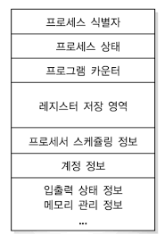
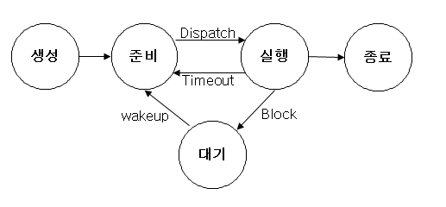
Process vs. thread
실행중인 프로그램
PCB (process control block)
Multiprogramming
Transport Layer
3-<number>

Slide 16
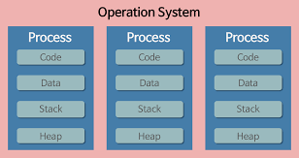
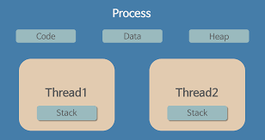
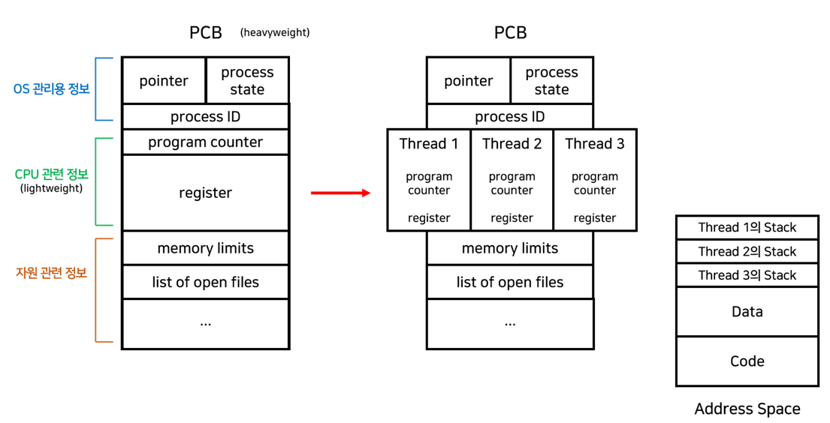
Process vs. thread
Transport Layer
3-<number>

Slide 17
Chapter 3 outline
3.1 transport-layer services
3.2 multiplexing and demultiplexing
3.3 connectionless transport: UDP
3.4 principles of reliable data transfer
3.5 connection-oriented transport: TCP
  segment structure
  reliable data transfer
  flow control
  connection management
3.6 principles of congestion control
3.7 TCP congestion control
Transport Layer
3-<number>

Slide 18
UDP 전송 프로토콜 임무
프로세스-대-프로세스 통신 생성 : 포트번호 이용
최소한의 오류 제어 메커니즘 수행
프로세스로부터 데이터 단위를 받아 신뢰성 없는 전달 제공
비 연결형, 신뢰성이 없는 전송 프로토콜
최소한의 오버헤드만 사용하는 간단한 프로토콜

Slide 19
UDP: User Datagram Protocol [RFC 768]
“no frills,” “bare bones” Internet transport protocol (기본만 제공)
“best effort” service, UDP segments may be:
  lost
  delivered out-of-order to app.
connectionless:
  no handshaking between UDP sender, receiver
  each UDP segment handled independently of others
UDP use:
  streaming multimedia apps (loss tolerant, rate sensitive)
  DNS
  SNMP
reliable transfer over UDP: (단점 해결책은?)
  Add reliability at application layer
  Application-specific error recovery!
  응용 프로그램에서 필요하면 알아서 처리
Transport Layer
3-<number>

Slide 20
UDP 특징
비연결형(Connectionless)
  VS. TCP는 데이터를 전송하기 전에 연결을 설정
비상태정보(Non-state)
  VS. TCP 종단 시스템에서는 각각의 연결에 대한 상태정보를 유지
비정규적인 송신률(Unregulated Send Rate)
  일부 패킷 손실이 발생하더라도 지속적인 최소 전송률을 요구하는 실시간 영상서비스에 적합
최선형 서비스(Best Effort service)
  수신확인 및 재전송 기능 無

Slide 21
UDP: segment header
length, in bytes of UDP segment, including header
32 bits
source port #
dest port #
length
checksum
why is there a UDP?
no connection establishment (which can add delay)
simple: no connection state at sender, receiver
small header size (8바이트)
no congestion control: UDP can blast away as fast as desired
application
data
(payload)
UDP segment format
Transport Layer
3-<number>

Slide 22
UDP checksum
Goal: detect “errors” (e.g., flipped bits) in transmitted segment [전송과정에 발생하는 에러]
sender:
treat segment contents, including header fields, as sequence of 16-bit integers
checksum: addition (one’s complement sum) of segment contents
sender puts checksum value into UDP checksum field
receiver:
compute checksum of received segment
check if computed checksum equals checksum field value:
  NO - error detected
  YES - no error detected. But maybe errors nonetheless? More later ….
Transport Layer
3-<number>

Slide 23
Internet checksum: example
example: add two 16-bit integers
1 1 1 1 0 0 1 1 0 0 1 1 0 0 1 1 0
1 1 1 0 1 0 1 0 1 0 1 0 1 0 1 0 1
1 1 0 1 1 1 0 1 1 1 0 1 1 1 0 1 1
1 1 0 1 1 1 0 1 1 1 0 1 1 1 1 0 0
1 0 1 0 0 0 1 0 0 0 1 0 0 0 0 1 1
wraparound
sum
checksum
Note: when adding numbers, a carryout from the most significant bit needs to be added to the result
* Check out the online interactive exercises for more examples: http://gaia.cs.umass.edu/kurose_ross/interactive/
Transport Layer
3-<number>
Notes:
Kurose and Ross forgot to say anything about wrapping the carry and adding it to low order bit

Slide 24
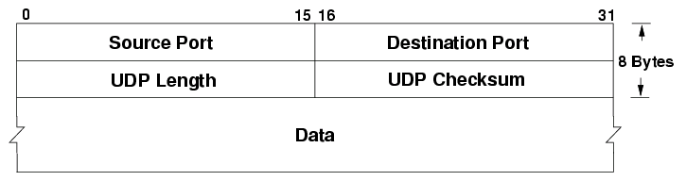
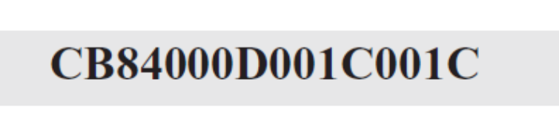
UDP 헤터 예제
다음은 16진수의 형식으로 UDP 헤더를 덤프한 것이다.
a. 발신지 포트 번호는 얼마인가?
b. 목적지 포트 번호는 얼마인가?
c. 사용자 데이터그램의 총 길이는 얼마인가?
d. 데이터의 길이는 얼마인가?
e. 데이터의 전송 방향이 클라이언트에서 서버쪽으로 인가? 아니면 반대의 방향인가?
f. 클라이언트 프로세스는 무엇인가?

Slide 25
예제 13.1 해답
a. 발신지 포트 번호는 처음 네 자리 16진수(CB84₁₆)이며, 10진수로 표현하면 52,100이다.
b. 목적지 포트 번호는 두 번째 네 자리 16진수(000D₁₆)이며, 10진수로 표현하면 13이다.
c. 세 번째 네 자리 16진수(001C₁₆)은 UDP 패킷의 전체 길이를 나타내며, 28바이트이다.
d. 데이터의 길이는 패킷의 전체 길이에서 헤더의 길이를 뺀 것으로, 28 − 8 = 20바이트이다.
e. 목적지 포트 번호가 13(잘 알려진 포트)이므로, 클라이언트로부터 서버로 패킷이 전송되었다.
f. 서버 프로세스는 Daytime(표 13.1 참조)이다.

Slide 26
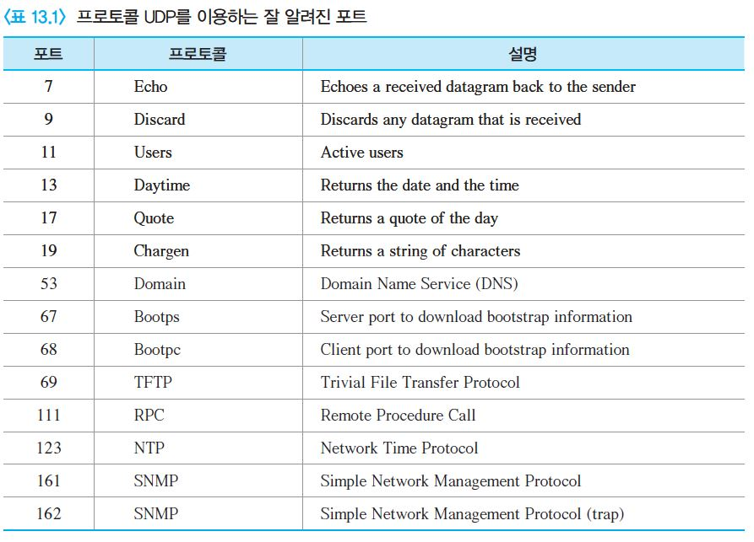
UDP를 이용하는 잘 알려진 포트

Slide 27
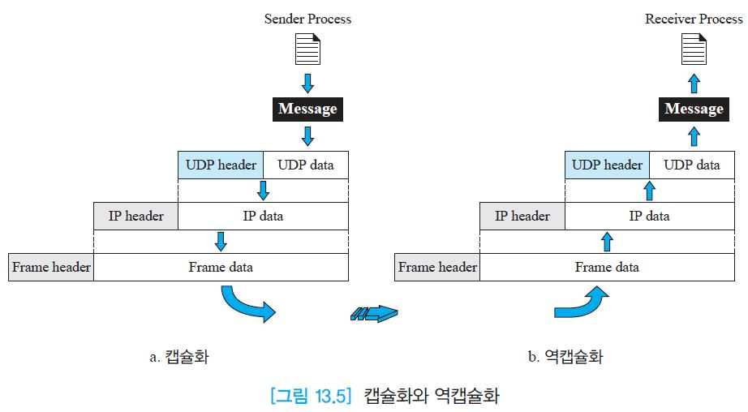
캡슐화와 역캡슐화

Slide 28
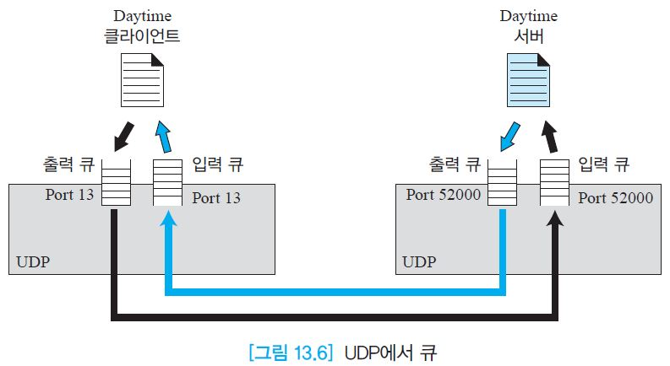




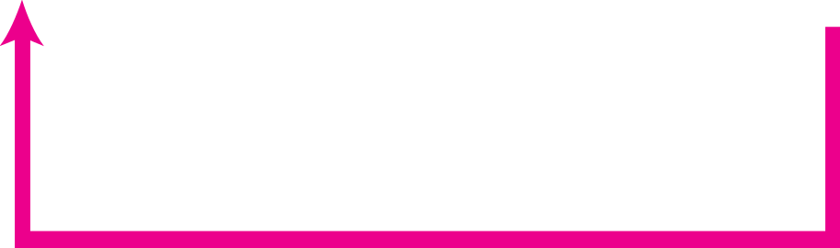
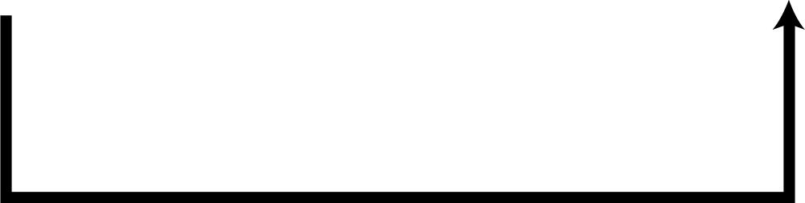
UDP에서 큐(Queue)

Slide 29
UDP 대표적인 응용
단순 요청-응답 통신이 필요하고 흐름과 오류 제어가 필요 없는 프로세스에 적합
내부에 흐름 및 오류제어가 있는 프로세스에 적합(예: TFTP)
멀티캐스팅에 적합한 전송 프로토콜
SNMP와 같은 관리 프로세스에 사용
RIP와 같은 경로 갱신 프로토콜에 사용
수신된 메시지 단편간 지연이 동일한 실시간 응용에 사용

Slide 30
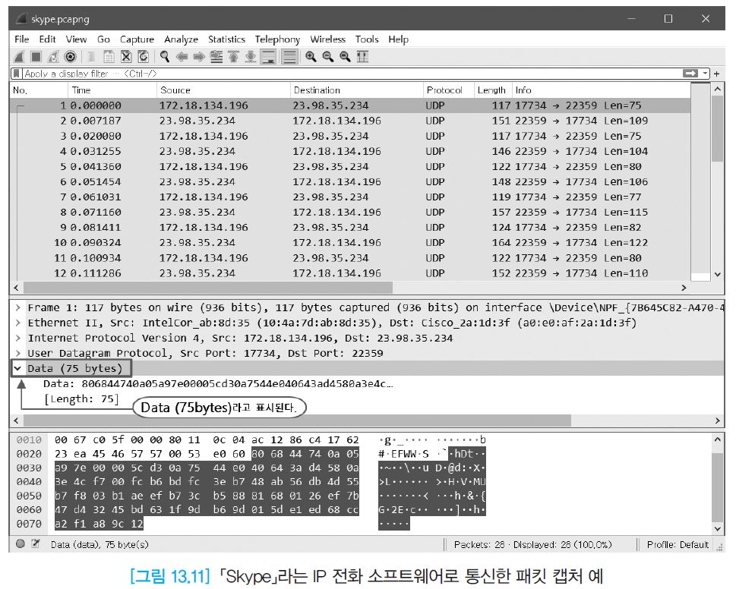
「Skype」라는 IP 전화 소프트웨어로 통신의 패킷 캡처 예
그림 1112 VoIP 소프트웨어인 Skype를 이용한 통신 패킷 캡처 화면

