Slide 1


Chapter 3
Transport Layer
전송계층
Computer Networking: A Top Down Approach
7th Edition, Global Edition
Jim Kurose, Keith Ross
Pearson
April 2016
Transport Layer
2-<number>

Slide 2
Chapter 3 outline (TCP 소개)
3.1 transport-layer services
3.2 multiplexing and demultiplexing
3.3 connectionless transport: UDP
3.4 principles of reliable data transfer
(신뢰성 전송 원리)
3.5 connection-oriented transport: TCP
  segment structure
  reliable data transfer
  flow control
  connection management
3.6 principles of congestion control
3.7 TCP congestion control
Transport Layer
3-<number>

Slide 3
TCP 서비스
TCP 특징
  연결형(Connection-Oriented)
    IP 계층 위에 가상의 회선을 설정 : 실제 연결 방식은?
    호스트간 데이터 송수신 서비스 제공
  신뢰성(Reliability)
    확인을 통한 신뢰성 있는 통신서비스 제공
  흐름제어(Flow Control)
    상대방이 처리할 수 있는 범위 내의 데이터를 보내도록 제어
  혼잡제어(Congestion Control)
    네트워크 혼잡 현상을 방지하거나 제어하는 기능
  스트림 통신
    데이터를 바이트 단위로 나눠서 전송

Slide 4
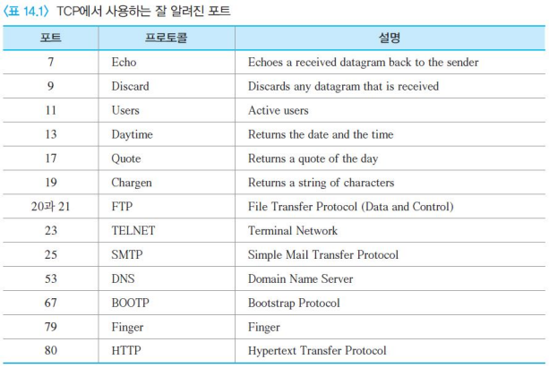
TCP을 이용하는 응용들
포트 번호를 이용한 프로세스간 통신 제공

Slide 5
스트림 배달 서비스
TCP는 스트림 기반 프로토콜
바이트 스트림 형태로 데이터 송수신
두 개의 프로세스가 가상의 채널로 연결
송신 프로세스는 바이트 스트림 생성(쓰기)
수신 프로세스는 바이트 스트림 소비(읽기)

Slide 6
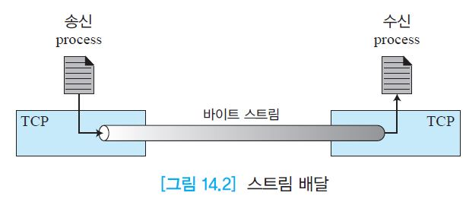
스트림 배달 서비스

Slide 7
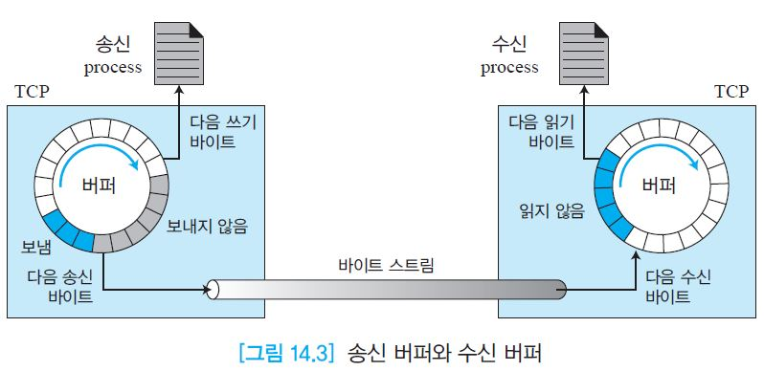
스트림 배달 서비스
송신 버퍼와 수신 버퍼
  송/수신이 동일한 속도로 이루어지지 않을 때
  버퍼가 필요

Slide 8
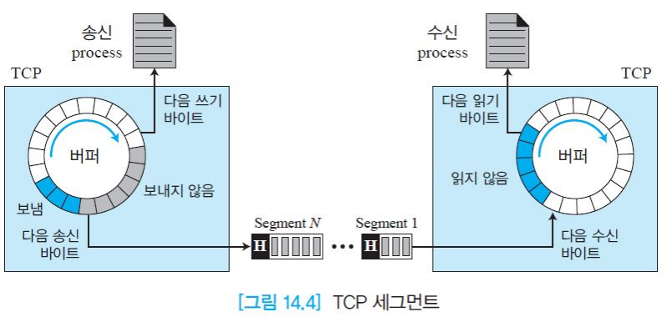
스트림 배달 서비스
세그먼트
  일련의 바이트를 세그먼트(segment)라는 패킷으로 그룹화해서 IP계층에 전달

Slide 9
TCP 서비스
전이중 통신
  동시에 양방향 전송과 송수신 데이터 대한 확인응답을 함께 보내는 피기배킹(piggybacking)
다중화와 역다중화
  송신측은 다중화, 수신측은 역다중화 수행
연결형 서비스
  TCP는 연결형 프로토콜
  물리적인 연결이 아닌 가상 연결
  연결 설정 → 데이터 교환 → 해제 순으로 진행
신뢰성 서비스
  확인응답 메커니즘 이용

Slide 10
TCP 특징
번호화 시스템 (Numbering System)
흐름 제어 (Flow Control)
오류 제어 (Error Control)
혼잡 제어 (Congestion Control)

Slide 11
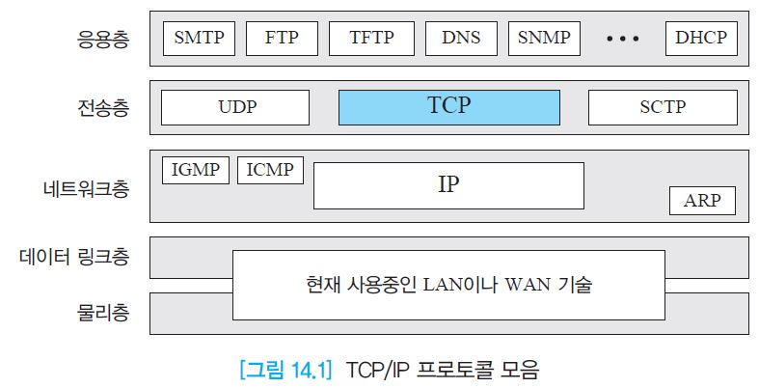
14.1 TCP 서비스
TCP/IP 프로토콜 모음

Slide 12

Principles of reliable data transfer
important in application, transport, link layers
  top-10 list of important networking topics!
characteristics of unreliable channel will determine complexity of reliable data transfer protocol (rdt)
Transport Layer
3-<number>

Slide 13
Principles of reliable data transfer
important in application, transport, link layers
  top-10 list of important networking topics!
characteristics of unreliable channel will determine complexity of reliable data transfer protocol (rdt)
Transport Layer
3-<number>

Slide 14
Principles of reliable data transfer
important in application, transport, link layers
  top-10 list of important networking topics!
characteristics of unreliable channel will determine complexity of reliable data transfer protocol (rdt)
Transport Layer
3-<number>

Slide 15

Reliable data transfer: getting started
rdt_send(): called from by app. Passed data to
deliver to receiver by the upper layer
deliver_data(): called by rdt to deliver data to upper
send
side
receive
side
udt_send(): called by rdt,
to transfer packet over
unreliable channel to receiver
rdt_rcv(): called when packet arrives on rcv-side of channel
Transport Layer
3-<number>

Slide 16
Reliable data transfer: getting started
we’ll:
신뢰성 있는 데이터 전송을 위한 프로토콜의 진화를 상태전이도를 이용하여 설명
use finite state machines (FSM) to specify sender, receiver
State (상태), event(외부 사건),
actions(내부 처리/행위)
event causing state transition
actions taken on state transition
state: when in this “state” next state uniquely determined by next event
state
1
state
2
event
actions
Transport Layer
3-<number>

Slide 17
rdt1.0: reliable transfer over a reliable channel
하위 네트워크 계층이 신뢰성이 있을 때 가능
  no bit errors, no loss of packets
separate FSMs for sender, receiver:
  sender sends data into underlying channel
  receiver reads data from underlying channel
Wait for call from above
rdt_send(data)
Wait for call from below
rdt_rcv(packet)
extract (packet,data)
deliver_data(data)
packet = make_pkt(data)
udt_send(packet)
sender
receiver
Transport Layer
3-<number>

Slide 18
rdt2.0: channel with bit errors
underlying channel may flip bits in packet
하위 계층에서 오류가 발생할 수 있을 때
  checksum to detect bit errors
the question: how to recover from errors:
  acknowledgements (ACKs): receiver explicitly tells sender that pkt received OK
  negative acknowledgements (NAKs): receiver explicitly tells sender that pkt had errors
  sender retransmits pkt on receipt of NAK
  수신자는 OK 또는 Error 메시지를 송신자에게 보냄
  송신자는 Error(NAK) 메시지는 재전송함
new mechanisms in rdt2.0 (beyond rdt1.0):
  error detection
  receiver feedback: control msgs (ACK,NAK) to sender
Transport Layer
3-<number>
Notes:
ACKS: 에러없음 NAKS: 에러있음

Slide 19
rdt2.0: FSM specification
rdt_send(data)
sndpkt = make_pkt(data, checksum)
udt_send(sndpkt)
receiver
rdt_rcv(rcvpkt) &&
isNAK(rcvpkt)
Wait for call from above
Wait for ACK or NAK
rdt_rcv(rcvpkt) &&
corrupt(rcvpkt)
udt_send(sndpkt)
udt_send(NAK)
rdt_rcv(rcvpkt) && isACK(rcvpkt)
Λ
Wait for call from below
sender
rdt_rcv(rcvpkt) &&
notcorrupt(rcvpkt)
extract(rcvpkt,data)
deliver_data(data)
udt_send(ACK)
Transport Layer
3-<number>

Slide 20
rdt2.0: operation with no errors
rdt_send(data)
snkpkt = make_pkt(data, checksum)
udt_send(sndpkt)
rdt_rcv(rcvpkt) &&
isNAK(rcvpkt)
Wait for call from above
Wait for ACK or NAK
rdt_rcv(rcvpkt) &&
corrupt(rcvpkt)
udt_send(sndpkt)
udt_send(NAK)
rdt_rcv(rcvpkt) && isACK(rcvpkt)
Wait for call from below
Λ
rdt_rcv(rcvpkt) &&
notcorrupt(rcvpkt)
extract(rcvpkt,data)
deliver_data(data)
udt_send(ACK)
Transport Layer
3-<number>

Slide 21
rdt2.0: error scenario
rdt_send(data)
snkpkt = make_pkt(data, checksum)
udt_send(sndpkt)
rdt_rcv(rcvpkt) &&
isNAK(rcvpkt)
Wait for call from above
Wait for ACK or NAK
rdt_rcv(rcvpkt) &&
corrupt(rcvpkt)
udt_send(sndpkt)
udt_send(NAK)
rdt_rcv(rcvpkt) && isACK(rcvpkt)
Wait for call from below
Λ
rdt_rcv(rcvpkt) &&
notcorrupt(rcvpkt)
extract(rcvpkt,data)
deliver_data(data)
udt_send(ACK)
Transport Layer
3-<number>

Slide 22
rdt2.0 has a fatal flaw!
handling duplicates:
sender retransmits current pkt if ACK/NAK corrupted
sender adds sequence number to each pkt
receiver discards (doesn’t deliver up) duplicate pkt
패켓에 순차번호 부여 (중요)
what happens if ACK/NAK corrupted?
ack/nak에 오류발생시?
sender doesn’t know what happened at receiver!
can’t just retransmit: possible duplicate
재전송은
중복문제
stop and wait
sender sends one packet,
then waits for receiver
response
Transport Layer
3-<number>

Slide 23
rdt2.1: sender, handles 왜곡된 ACK/NAKs
rdt_send(data)
sndpkt = make_pkt(0, data, checksum)
udt_send(sndpkt)
rdt_rcv(rcvpkt) &&
( corrupt(rcvpkt) ||
isNAK(rcvpkt) )
Wait for call 0 from above
Wait for ACK or NAK 0
udt_send(sndpkt) :재전송
rdt_rcv(rcvpkt)
&& notcorrupt(rcvpkt)
&& isACK(rcvpkt)
rdt_rcv(rcvpkt)
&& notcorrupt(rcvpkt)
&& isACK(rcvpkt)
Λ
Λ 아무 일도 하지 않고 상태 전환
Wait for ACK or NAK 1
Wait for
call 1 from above
rdt_rcv(rcvpkt) &&
( corrupt(rcvpkt) ||
isNAK(rcvpkt) )
rdt_send(data)
udt_send(sndpkt)
sndpkt = make_pkt(1, data, checksum)
udt_send(sndpkt)
Transport Layer
3-<number>

Slide 24
rdt2.1: receiver, handles garbled ACK/NAKs
rdt_rcv(rcvpkt) && notcorrupt(rcvpkt)
&& has_seq0(rcvpkt)
extract(rcvpkt,data)
deliver_data(data)
sndpkt = make_pkt(ACK, chksum)
udt_send(sndpkt)
rdt_rcv(rcvpkt) && (corrupt(rcvpkt)
rdt_rcv(rcvpkt) && (corrupt(rcvpkt)
sndpkt = make_pkt(NAK, chksum)
udt_send(sndpkt)
sndpkt = make_pkt(NAK, chksum)
udt_send(sndpkt)
Wait for
0 from below
Wait for
1 from below
rdt_rcv(rcvpkt) &&
not corrupt(rcvpkt) &&
has_seq1(rcvpkt)
rdt_rcv(rcvpkt) &&
not corrupt(rcvpkt) &&
has_seq0(rcvpkt)
sndpkt = make_pkt(ACK, chksum)
udt_send(sndpkt)
sndpkt = make_pkt(ACK, chksum)
udt_send(sndpkt)
rdt_rcv(rcvpkt) && notcorrupt(rcvpkt)
&& has_seq1(rcvpkt)
extract(rcvpkt,data)
deliver_data(data)
sndpkt = make_pkt(ACK, chksum)
udt_send(sndpkt)
Transport Layer
3-<number>

Slide 25
rdt2.1: discussion
sender: 송신측
seq # added to pkt
two seq. #’s (0,1) will suffice. Why?
must check if received ACK/NAK corrupted
twice as many states
  state must “remember” whether “expected” pkt should have seq # of 0 or 1
receiver: 수신측
must check if received packet is duplicate
  state indicates whether 0 or 1 is expected pkt seq #
note: receiver can not know if its last ACK/NAK received OK at sender
Transport Layer
3-<number>

Slide 26
rdt2.2: a NAK-free protocol
same functionality as rdt2.1, using ACKs only
instead of NAK, receiver sends ACK for last pkt received OK
  receiver must explicitly include seq # of pkt being ACKed
duplicate ACK at sender results in same action as NAK: retransmit current pkt
Transport Layer
3-<number>

Slide 27
rdt2.2: sender, receiver fragments
rdt_send(data)
sndpkt = make_pkt(0, data, checksum)
udt_send(sndpkt)
rdt_rcv(rcvpkt) &&
( corrupt(rcvpkt) ||
isACK(rcvpkt,1) )
Wait for call 0 from above
Wait for ACK
0
udt_send(sndpkt)
sender FSM
fragment
rdt_rcv(rcvpkt)
&& notcorrupt(rcvpkt)
&& isACK(rcvpkt,0)
rdt_rcv(rcvpkt) &&
(corrupt(rcvpkt) ||
has_seq1(rcvpkt))
Λ
Wait for
0 from below
receiver FSM
fragment
udt_send(sndpkt)
rdt_rcv(rcvpkt) && notcorrupt(rcvpkt)
&& has_seq1(rcvpkt)
extract(rcvpkt,data)
deliver_data(data)
sndpkt = make_pkt(ACK1, chksum)
udt_send(sndpkt)
Transport Layer
3-<number>

Slide 28
rdt3.0: channels with errors and loss
new assumption: underlying channel can also lose packets (data, ACKs)
  checksum, seq. #, ACKs, retransmissions will be of help … but not enough
approach: sender waits “reasonable” amount of time for ACK
retransmits if no ACK received in this time
if pkt (or ACK) just delayed (not lost):
  retransmission will be duplicate, but seq. #’s already handles this
  receiver must specify seq # of pkt being ACKed
requires countdown timer
Transport Layer
3-<number>

Slide 29
rdt3.0 sender
rdt_send(data)
rdt_rcv(rcvpkt) &&
( corrupt(rcvpkt) ||
isACK(rcvpkt,1) )
sndpkt = make_pkt(0, data, checksum)
udt_send(sndpkt)
start_timer
rdt_rcv(rcvpkt)
Λ
Λ
Wait for
call 0from above
Wait for ACK0
timeout
udt_send(sndpkt)
start_timer
rdt_rcv(rcvpkt)
&& notcorrupt(rcvpkt)
&& isACK(rcvpkt,1)
rdt_rcv(rcvpkt)
&& notcorrupt(rcvpkt)
&& isACK(rcvpkt,0)
stop_timer
stop_timer
Wait for ACK1
Wait for
call 1 from above
timeout
udt_send(sndpkt)
start_timer
rdt_rcv(rcvpkt)
rdt_send(data)
Λ
rdt_rcv(rcvpkt) &&
( corrupt(rcvpkt) ||
isACK(rcvpkt,0) )
sndpkt = make_pkt(1, data, checksum)
udt_send(sndpkt)
start_timer
Λ
Transport Layer
3-<number>

Slide 30
TCP에서 에러 문제 해결책
전송 시 매체의 불량으로 데이터의 왜곡 (Bit errors) 점검 및 해결 방법
  Checksum : 수신자(서버)가 오류 검사를 검사한 후에 송신자에게 Ack(OK)/Nak(Error)을 보냄
패킷 손실 (Data & Ack) 문제 해결
  Timer 설정 (Time out)
  Sequence number 설정 => 순서 및 중복 전송 해결
흐름/혼잡 제어 : 버퍼(buffer) 또한 필요
  Buffer vs. window
Transport Layer
3-<number>

Slide 31
Packet 재 전송을 위한 방법
Stop-and-wait : 비효율
Pipelining method
  Go-back-N (GNB) 방식 : 오류 패킷 이후 모두
  Selective repeat 방식 : 오류 패킷만 재전송
실제 TCP에서는 어떻게 적용되는지? => 뒤에서
Transport Layer
3-<number>

Slide 32

rdt3.0 in action : timer의 역할
sender
receiver
sender
receiver
send pkt0
pkt0
send pkt0
pkt0
rcv pkt0
rcv pkt0
ack0
send ack0
ack0
send ack0
rcv ack0
rcv ack0
send pkt1
pkt1
send pkt1
pkt1
rcv pkt1
X
ack1
send ack1
loss
rcv ack1
send pkt0
pkt0
rcv pkt0
timeout
resend pkt1
ack0
send ack0
pkt1
rcv pkt1
ack1
send ack1
rcv ack1
send pkt0
pkt0
(a) no loss
rcv pkt0
ack0
send ack0
(b) packet loss
Transport Layer
3-<number>

Slide 33
rdt3.0 in action : timer 중요성
sender
receiver
sender
receiver
send pkt0
pkt0
send pkt0
pkt0
rcv pkt0
rcv pkt0
ack0
send ack0
send ack0
rcv ack0
ack0
send pkt1
pkt1
rcv ack0
rcv pkt1
send pkt1
pkt1
send ack1
rcv pkt1
ack1
send ack1
ack1
X
loss
timeout
resend pkt1
pkt1
rcv pkt1
timeout
resend pkt1
rcv ack1
pkt1
rcv pkt1
pkt0
(detect duplicate)
send pkt0
send ack1
ack1
(detect duplicate)
ack1
rcv pkt0
rcv ack1
send ack1
rcv ack1
ack0
send ack0
pkt0
send pkt0
pkt0
send pkt0
rcv pkt0
rcv pkt0
ack0
(detect duplicate)
ack0
send ack0
send ack0
(c) ACK loss
(d) premature timeout/ delayed ACK
Transport Layer
3-<number>

Slide 34

Performance of rdt3.0
rdt3.0 is correct, but performance stinks
e.g.: 1 Gbps link, 15 ms prop. delay, 8000 bit packet:
L
8000 bits
D_{trans} =
=
=
8 microsecs
R
10⁹ bits/sec
  U _{sender}: utilization – fraction of time sender busy sending
  if RTT=30 msec, 1KB pkt every 30 msec: 33kB/sec thruput over 1 Gbps link
network protocol limits use of physical resources!
Transport Layer
3-<number>

Slide 35

rdt3.0: stop-and-wait operation : 비효율
sender
receiver
first packet bit transmitted, t = 0
last packet bit transmitted, t = L / R
first packet bit arrives
RTT
last packet bit arrives, send ACK
ACK arrives, send next
packet, t = RTT + L / R
Transport Layer
3-<number>

Slide 36


Pipelined protocols : 지속적인 전송
pipelining: sender allows multiple, “in-flight”, yet-to-be-acknowledged pkts
  range of sequence numbers must be increased
  buffering at sender and/or receiver
two generic forms of pipelined protocols: go-Back-N, selective repeat
Transport Layer
3-<number>

Slide 37

Pipelining: increased utilization (효율)
sender
receiver
first packet bit transmitted, t = 0
last bit transmitted, t = L / R
first packet bit arrives
RTT
last packet bit arrives, send ACK
last bit of 2nd packet arrives, send ACK
last bit of 3rd packet arrives, send ACK
ACK arrives, send next
packet, t = RTT + L / R
3-packet pipelining increases
utilization by a factor of 3!
Transport Layer
3-<number>

Slide 38
스트림 배달 서비스
세그먼트
  일련의 바이트를 세그먼트(segment)라는 패킷으로 그룹화해서 IP계층에 전달

Slide 39
Pipelined protocols: overview
방법1: Go-back-N:
sender can have up to N unacked packets in pipeline
receiver only sends cumulative ack (누적 확인)
sender has timer for oldest unacked packet
  when timer expires, retransmit all unacked packets
하나의 타이머로 체크
장단점?
방법2: Selective Repeat:
sender can have up to N unacked packets in pipeline
수신자 sends individual ack for each packet (개별)
sender maintains timer for each unacked packet
  when timer expires, retransmit only that unacked packet
개별 타이머로 체크
장단점?
Transport Layer
3-<number>

Slide 40
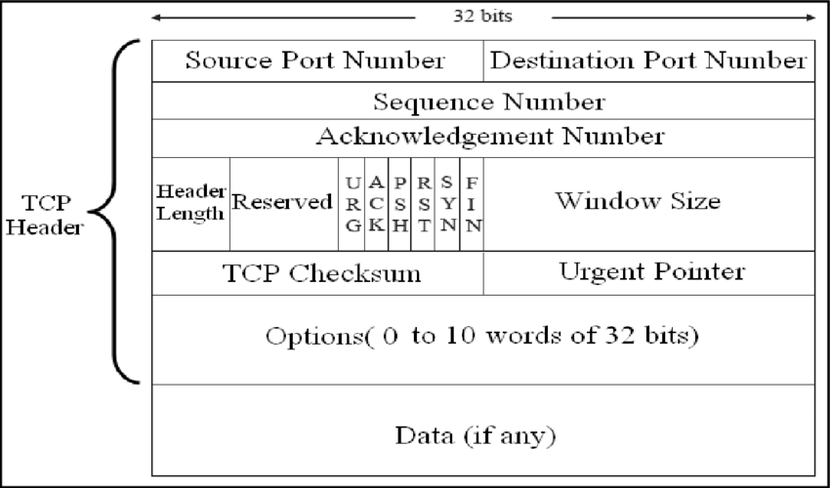

방법1)Go-Back-N: sender
k-bit seq # in pkt header
“window” of up to N, consecutive unacked pkts allowed
ACK(n): ACKs all pkts up to “cumulative ACK”
  may receive duplicate ACKs (see receiver)
timer for oldest in-flight pkt (하나의 타이머로)
송신자는 보냈으나 ack를 받지 못한 pkt들 중 가장 오래전에 보낸 것의 타이머를 그 그룹의 타이머로 간주
timeout(n): retransmit packet n and all higher seq # pkts in window
Transport Layer
3-<number>

Slide 41
윈도우 사이즈(N)
변동이 가능
송신자와 수신자의 윈도우 사이즈는 다를 수 있음
크기의 문제
  작을 때 문제
  클 때의 문제
  처리율에 영향을 미침
Transport Layer
3-<number>

Slide 42
GBN in action
sender window (N=4)
sender
receiver
0 1 2 3 4 5 6 7 8
send pkt0
send pkt1
send pkt2
send pkt3
(wait)
0 1 2 3 4 5 6 7 8
receive pkt0, send ack0
receive pkt1, send ack1
receive pkt3, discard,
(re)send ack1
0 1 2 3 4 5 6 7 8
X
0 1 2 3 4 5 6 7 8
loss
0 1 2 3 4 5 6 7 8
rcv ack0, send pkt4
rcv ack1, send pkt5
0 1 2 3 4 5 6 7 8
receive pkt4, discard,
(re)send ack1
ignore duplicate ACK
receive pkt5, discard,
(re)send ack1
pkt 2 timeout
0 1 2 3 4 5 6 7 8
send pkt2
send pkt3
send pkt4
send pkt5
0 1 2 3 4 5 6 7 8
0 1 2 3 4 5 6 7 8
rcv pkt2, deliver, send ack2
rcv pkt3, deliver, send ack3
rcv pkt4, deliver, send ack4
rcv pkt5, deliver, send ack5
0 1 2 3 4 5 6 7 8
Transport Layer
3-<number>

Slide 43
방법2) Selective repeat 선택적 반복전송
receiver individually acknowledges all correctly received pkts
  buffers pkts, as needed, for eventual in-order delivery to upper layer
sender only resends pkts for which ACK not received
  sender timer for each unACKed pkt
sender window
  N consecutive seq #’s
  limits seq #s of sent, unACKed pkts
Transport Layer
3-<number>

Slide 44

Selective repeat: sender, receiver windows
Transport Layer
3-<number>

Slide 45
Selective repeat
sender
receiver
data from above:
if next available seq # in window, send pkt
timeout(n):
Re-send pkt n, restart timer
ACK(n) in [sendbase,sendbase+N]:
mark pkt n as received
if n smallest unACKed pkt, advance window base to next unACKed seq #
pkt n in [rcvbase, rcvbase+N-1]
send ACK(n)
out-of-order: buffer
in-order: deliver (also deliver buffered, in-order pkts), advance window to next not-yet-received pkt
pkt n in [rcvbase-N,rcvbase-1]
ACK(n)
otherwise:
ignore
Transport Layer
3-<number>

Slide 46
Selective repeat in action
sender window (N=4)
sender
receiver
0 1 2 3 4 5 6 7 8
send pkt0
send pkt1
send pkt2
send pkt3
(wait)
0 1 2 3 4 5 6 7 8
receive pkt0, send ack0
receive pkt1, send ack1
receive pkt3, buffer,
send ack3
0 1 2 3 4 5 6 7 8
X
0 1 2 3 4 5 6 7 8
loss
0 1 2 3 4 5 6 7 8
rcv ack0, send pkt4
rcv ack1, send pkt5
0 1 2 3 4 5 6 7 8
receive pkt4, buffer,
send ack4
record ack3 arrived
receive pkt5, buffer,
send ack5
pkt 2 timeout
0 1 2 3 4 5 6 7 8
send pkt2
0 1 2 3 4 5 6 7 8
record ack4 arrived
0 1 2 3 4 5 6 7 8
rcv pkt2; deliver pkt2,
pkt3, pkt4, pkt5; send ack2
record ack5 arrived
0 1 2 3 4 5 6 7 8
Q: what happens when ack2 arrives?
Transport Layer
3-<number>

Slide 47

Selective repeat: dilemma
sender window
(after receipt)
receiver window
(after receipt)
0 1 2 3 0 1 2
pkt0
0 1 2 3 0 1 2
pkt1
0 1 2 3 0 1 2
example:
seq #’s: 0, 1, 2, 3
window size=3
0 1 2 3 0 1 2
pkt2
0 1 2 3 0 1 2
0 1 2 3 0 1 2
0 1 2 3 0 1 2
pkt3
X
0 1 2 3 0 1 2
pkt0
will accept packet
with seq number 0
receiver sees no difference in two scenarios!
duplicate data accepted as new in (b)
Q: 윈도우 사이즈는 시퀀스 넘버의 ½ 이하가 좋음
(a) no problem
receiver can’t see sender side.
receiver behavior identical in both cases!
something’s (very) wrong!
0 1 2 3 0 1 2
pkt0
0 1 2 3 0 1 2
pkt1
0 1 2 3 0 1 2
0 1 2 3 0 1 2
pkt2
0 1 2 3 0 1 2
X
0 1 2 3 0 1 2
X
timeout
retransmit pkt0
X
0 1 2 3 0 1 2
pkt0
will accept packet
with seq number 0
(b) oops!
Transport Layer
3-<number>

Slide 48
Chapter 3 outline
3.1 transport-layer services
3.2 multiplexing and demultiplexing
3.3 connectionless transport: UDP
3.4 principles of reliable data transfer
3.5 connection-oriented transport: TCP
  segment structure
  reliable data transfer
  flow control
  connection management
3.6 principles of congestion control
3.7 TCP congestion control
Transport Layer
3-<number>

