Slide 1

ORCHESTRATION ENGINE
FlowForge
AI-Powered Distributed Workflow Orchestration
Deterministic execution, Kahn validation cycle defense, and automated AI self-healing workflows at enterprise scale.
CYCLE GUARANTEE
DISPATCH ISOLATION
AI INTEGRATION

Slide 2

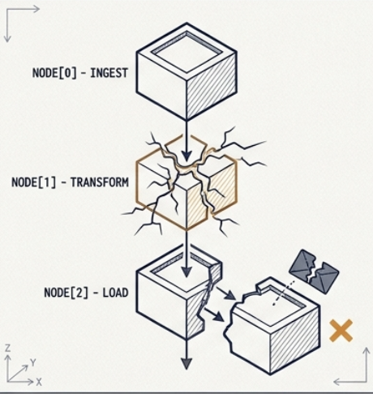
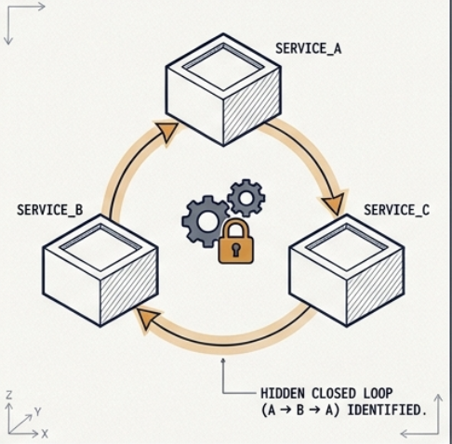
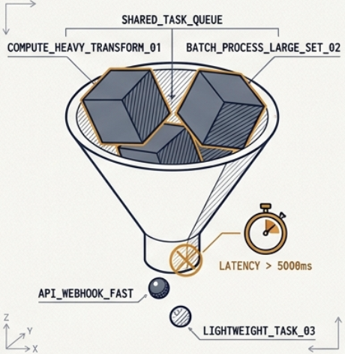
DIAGNOSTIC MODEL: SYSTEMIC FAILURE MODES
The Microservices Orchestration Crisis
Cascading Failures
Circular Deadlocks
Queue Contention
Single node breakdown cascades across downstream workflows, creating fragmented orphan data without automated rollback.
Distributed services inadvertently form mutual dependencies (A → B → A), freezing system threads permanently without telemetry alert.
Heavy analytical ETL transforms hog shared queues, starving fast transactional webhooks and escalating overall p99 latency beyond 5000ms.
[STATUS: CRITICAL DATA_LOSS]
[STATUS: RESOURCE_UTIL = 100%]
[STATUS: THROUGHPUT_COLLAPSE]

Slide 3
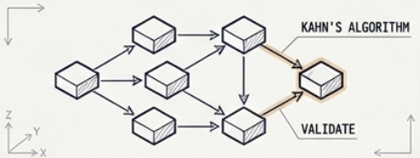
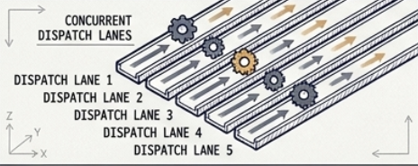
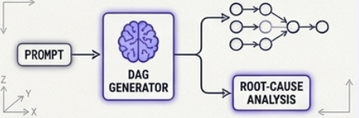
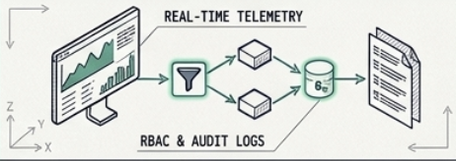
ARCHITECTURAL SOLUTION: ORCHESTRATION & RESILIENCE
The FlowForge Core Paradigm
Mathematical Certainty
5-Lane Queue Isolation
Kahn's Topological Sort validates workflows at submission, ensuring zero-cycle pipeline execution.
Dedicated execution lanes eliminate compute hogging and protect high-speed I/O threads.
AI Engine
FLOWFORGE
ORCHESTRATOR
Total Observability & RBAC
Automated natural language Prompt-to-DAG generation coupled with active root-cause diagnostics.
Granular role control, step-level telemetry, and immutable cryptographic audit logging.

Slide 4
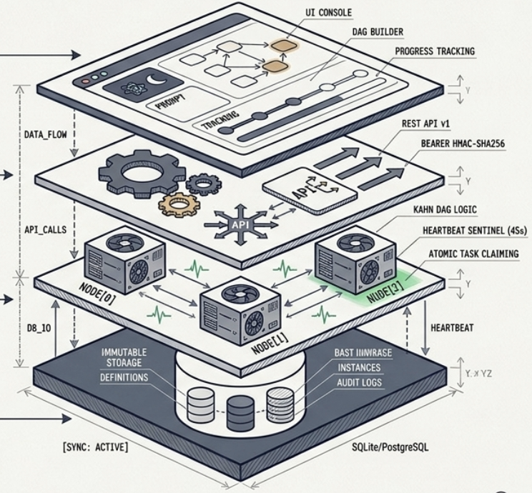
ARCHITECTURAL OVERVIEW: MULTI-TIER BOUNDARY SPECIFICATION
System Architecture Layers
PRESENTATION LAYER
React 18 SPA Console
Visual DAG studio builder, Monaco JSON schema code editor, and live step-by-step progress tracking.
HTTP / WS PROTOCOL
APPLICATION LAYER
FastAPI Master Orchestrator
Python 3.11 ASGI engine, Kahn algorithm validation, idempotency enforcement, and Bearer HMAC security.
STATISTICALLY VALIDATED
EXECUTION LAYER
Distributed Worker Fleet
Multi-node daemons communicating via 45-second heartbeat sentinels and atomic task claiming protocol.
ATOMIC CONCURRENCY
PERSISTENCE LAYER
Relational State Store
Immutable event store and audit records backed by SQLite for local runtime or PostgreSQL for enterprise clusters.
ACID TRANSACTIONAL

Slide 5
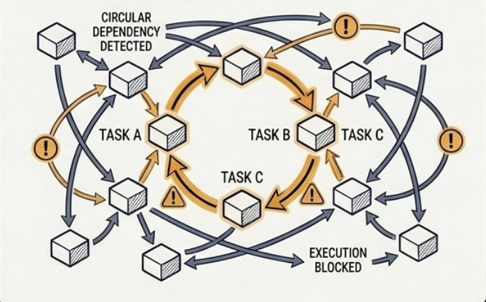
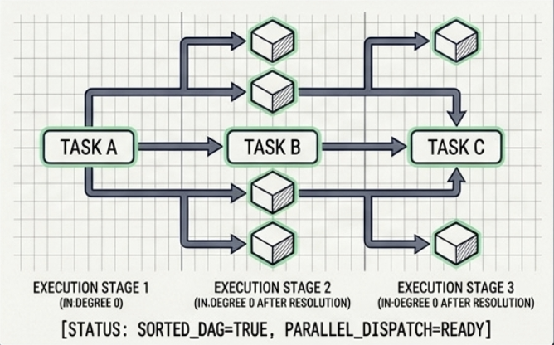

MATHEMATICAL ENGINE: GRAPH RESOLUTION & REJECTION
Kahn's Topological Sort Invariant
INPUT REJECTION
SORTED RESOLUTION
Circular Graph Detection
Parallel Execution Stages
When tasks form mutual cycles, unresolved in-degrees remain greater than zero after root extraction.
Tasks with zero remaining in-degrees are batched into synchronized stages, maximizing concurrent worker dispatch.
VALIDATION
> Node_A → Node_B → Node_C → Node_A
> In-degree evaluation: [A:1, B:1, C:1]
> ERROR: CyclicDependencyFoundException
> Status: REJECTED AT INGESTION
> Stage 1 (in-degree 0): [Task_Ingest]
> Stage 2 (parallelized): [Task_Filter, Task_Norm]
> Stage 3 (join barrier): [Task_Store]
> STATUS: 100% DETERMINISTIC DAG

Slide 6
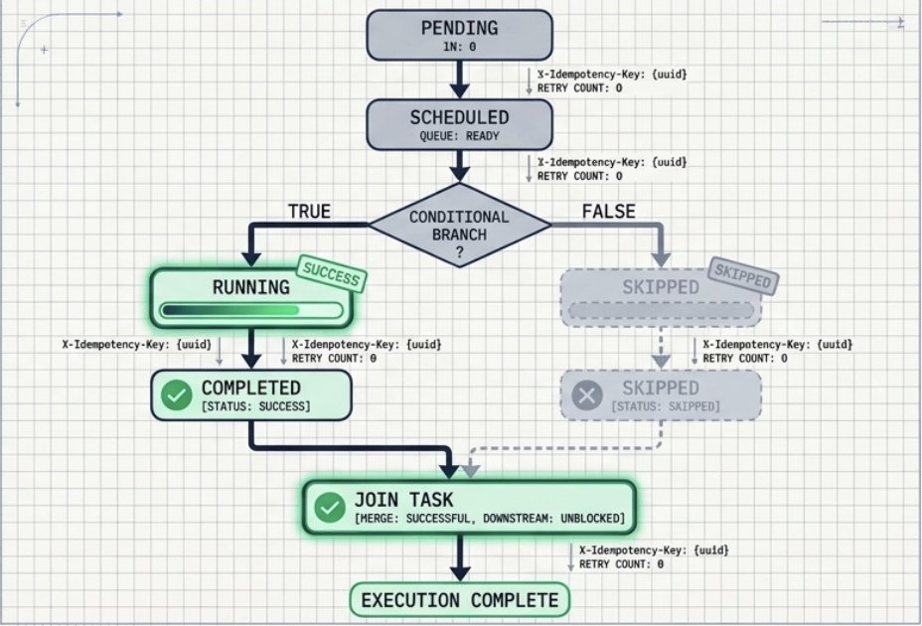
FINITE STATE MACHINE & CONDITIONAL EXECUTION
State Transitions & The SKIPPED Cascade
PENDING → SCHEDULED
Job parsed; task queued in matching lane buffer with generated UUID.
RUNNING → COMPLETED
Heartbeat confirmed; external side-effects locked with Idempotency Key.
CONDITIONAL → SKIPPED
False predicates trigger non-fatal bypass, cascading forward cleanly.

Slide 7
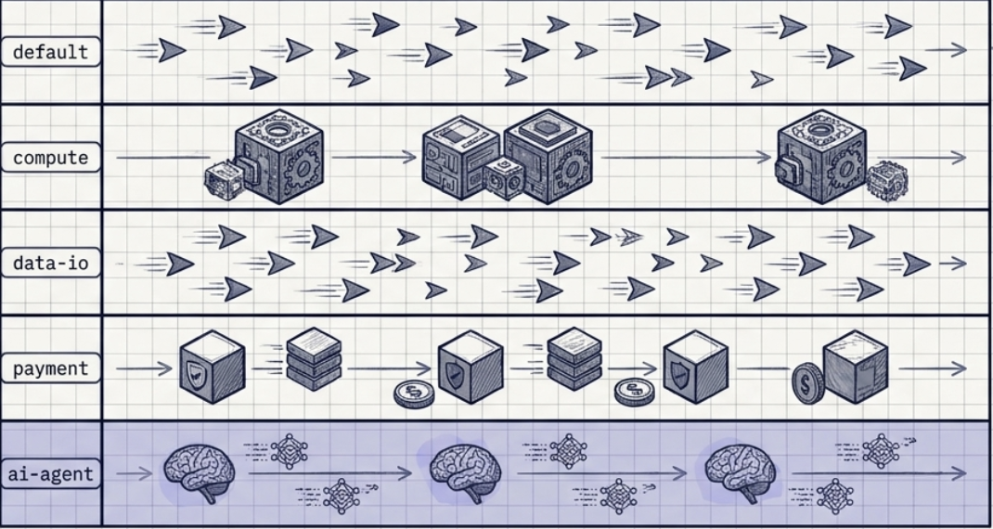
CONCURRENCY & WORKER ARCHITECTURE
5-Lane Queue Isolation
DEFAULT
Webhooks, alerts, short HTTP triggers
COMPUTE
Heavy ETL, tensor operations, CPU batches
DATA-IO
Parquet ingestion, S3/blob read/writes
PAYMENT
PCI/Saga transactions & 2PC commitments
AI-AGENT
LLM embeddings, prompt dispatch, reasoning

Slide 8
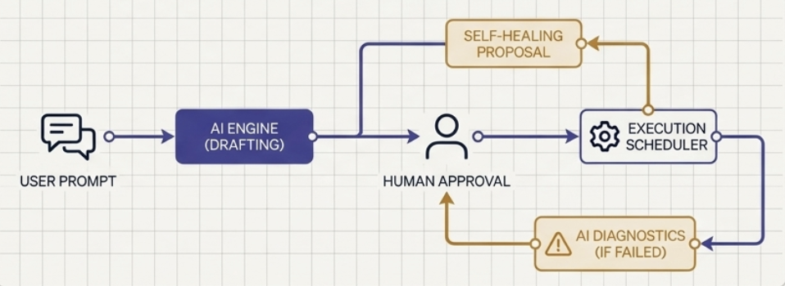
HUMAN-IN-THE-LOOP COGNITIVE FRAMEWORK
AI Orchestration Engine
Prompt-to-DAG Synthesis
Translates operational plain text into fully structured JSON execution pipelines with pre-validated topology.
AI Copilot
Recommends dependency fixes and logic optimization
Human-Gated Self-Healing
Formulates surgical recovery patches; requires explicit operator sign-off before re-injecting into active queues.
Failure Log Diagnostics
Parses crash dumps and node stacktraces in real time to isolate root cause within seconds.
Governance
Self-Healing Proposal
The AI strictly acts as an operational assistant.
The system enforces that AI drafts and proposes, while human operators approve, ensuring deterministic execution reliability.
Generates surgical recovery patches and node reconfiguration plans from diagnostic context.

Slide 9
SECURITY & AUTHORIZATION INFRASTRUCTURE
Role-Based Governance (RBAC) Matrix
CAPABILITY / PRIVILEGE | ADMINISTRATOR | OPERATIONS LEAD | WORKFLOW DEV | OBSERVER
Trigger & Cancel Pipeline Runs
Design DAGs & Edit Prompt Schemas
Approve AI Self-Healing Patches
Manage Cluster Users & Secrets
Inspect Real-Time Telemetry & Logs

Slide 10
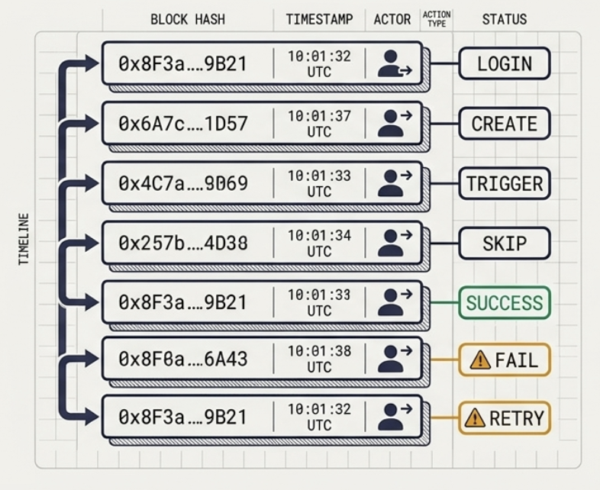
ENTERPRISE COMPLIANCE & ZERO TRUST
Immutable Audit Trail & Security
Stateless HMAC Authentication
PBKDF2 password derivation combined with cryptographic HMAC-SHA256 bearer tokens, completely removing memory-state leakage risks.
Strict 7-Action Audit Schema
Immutable records generated for every single action: LOGIN, CREATE, TRIGGER, CANCEL, SKIP, RETRY, FAIL.
SOC-2 COMPLIANCE / AUDIT READINESS: VERIFIED

Slide 11
TEST AUTOMATION & VALIDATION RIGOR
Target V2 Production Readiness
BACKEND UNIT & INTEGRATION (PYTEST)
FRONTEND LOGIC & SPA (VITEST)
31/31
27/27
100% SUITE PASS RATE
100% HOOK & DAG COVERAGE
INVEST User Story Adherence
Environment Agnostic Delivery
Every capability verified for independent, testable, and valuable feature deployment.
Instant local bootstrap on SQLite or containerized scale on Docker Compose + PostgreSQL.

Slide 12
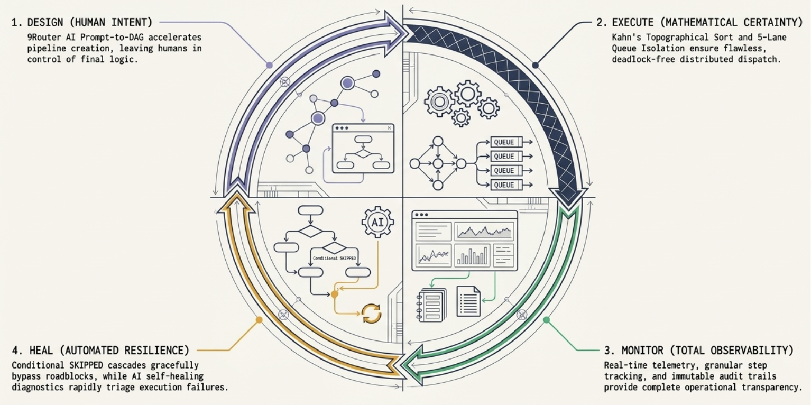
Resilient, High-Throughput Orchestration for Mission-
Critical AI Workflows

