Slide 1



NEW METHOD FOR NATURAL FREQUENCY AND DAMPING RATIO DETERMINATION VIA BUMP ROAD EXCITATION
VIETNAM NATIONAL UNIVERSITY HO CHI MINH CITY
HO CHI MINH CITY UNIVERSITY OF TECHNOLOGY
FACULTY OF TRANSPORTATION ENGINEERING
DEPARTMENT OF AUTOMOTIVE AND ENGINE
GRADUATION THESIS
Student: Do Thai An – ID: 1652005
Instructor: Dr. Tran Huu Nhan
Date: April 2nd, 2022

Slide 2
CONTENTS
INTRODUCTION
THEORETICAL BASIS
MODEL DESCRIPTIONS
CALCULATION FLOW
RESULTS AND DISSCUSSION
CONCLUSIONS AND FUTURE WORKS
1.1 Suspension system
1.2 Suspension components
1.3 Analysis factors
1.4 Thesis objective & limitation

Slide 3
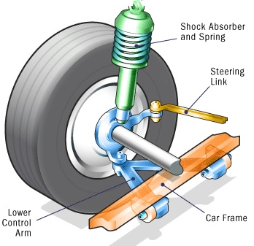
1.1 Suspension system
Suspension system: Connects a vehicle to its wheels and allows relative motion
Function of suspension:
Carry the car and its weight
Maintain correct wheel alignment
Control the vehicle’s direction of travel
Keep the tires in contact with the road
Reduce the effect of shock forces

Slide 4
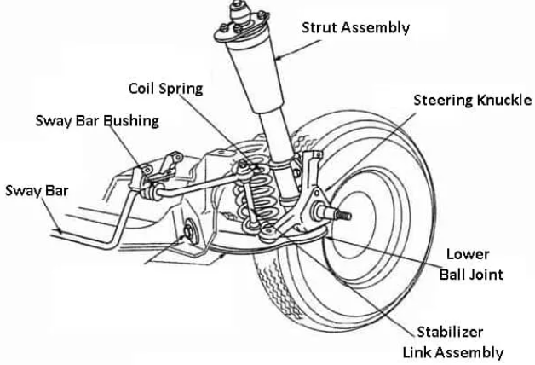
1.2 Suspension components
Guiding elements:
Control arms, links
Struts
Leaf springs
Force elements:
Coil spring, torsion bar, air spring, leaf spring
Anti-roll bar, anti-sway bar or stabilizer
Damper
Bushings, hydro-mounts
Tires
Notes:
Coil springs, torsion bars, and leaf springs absorb additional load by compressing. Thus, the ride height depends on the loading condition. Air springs are rubber cylinders filled with compressed air

Slide 5
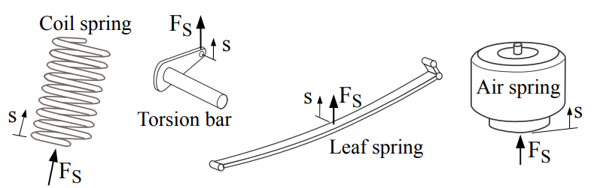
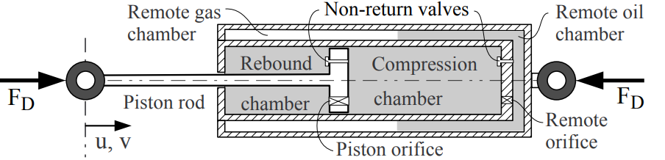
1.2 Suspension components
Elastic
Damping
Notes:
Coil springs, torsion bars, and leaf springs absorb additional load by compressing. Thus, the ride height depends on the loading condition. Air springs are rubber cylinders filled with compressed air

Slide 6
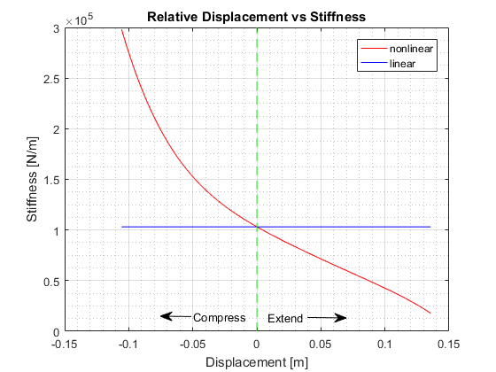
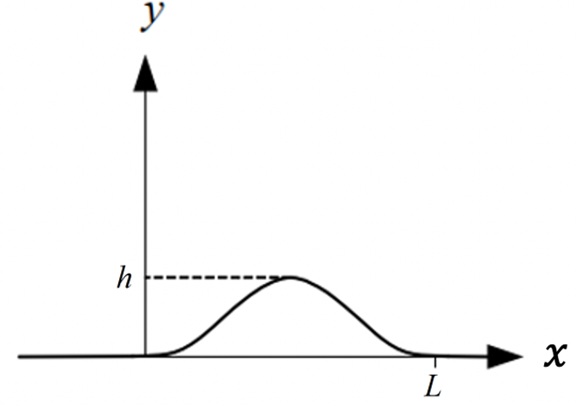
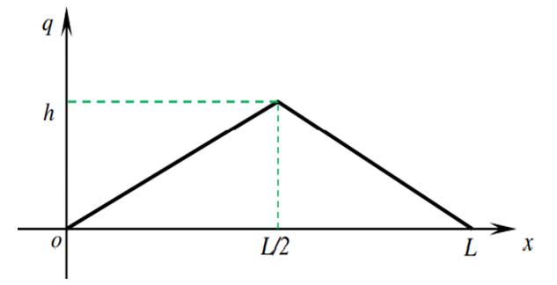
1.3 Analysis factors
1. Stability and Comfort
Compare between air spring and leaf spring
Compare between different input road excitation

Slide 7
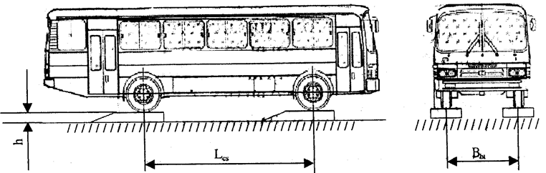
1.3 Analysis factors
2. Natural frequency and damping ratio determination via bump road excitation
=> new method for determination of natural frequency and damping ratio alternative to the old method (22TCN 336:2006)

Slide 8
1.4 Thesis objective & scope
Investigate the effects of leaf spring – air spring parameters and road profiles on ride comfort and stability.
Investigate the appropriate road profile ,apply it to 22TCN 336:2006 industrial standard
Use quarter-car 2 DOF models, take system parameters of Primas bus as basis.
Hypothesis: linear suspension system (constant spring stiffness) and non-linear suspension system (variability spring stiffness, constant damping coefficient), no seat suspension.
Scope: IRC and GB/T road profiles, vehicle speed (20 km/h) and input frequency range from 0 to 16 Hz, 70 PSI air spring pressure.

Slide 9
CONTENTS
INTRODUCTION
THEORETICAL BASIS
MODEL DESCRIPTIONS
CALCULATION FLOW
RESULTS AND DISSCUSSION
CONCLUSIONS AND FUTURE WORKS
2.1 Suspension models
2.2 Natural frequency & damping ratio
2.3 IRC – GB/T road profile
2.4 Evaluation indexes
2.5 Natural frequency and damping ratio determination

Slide 10
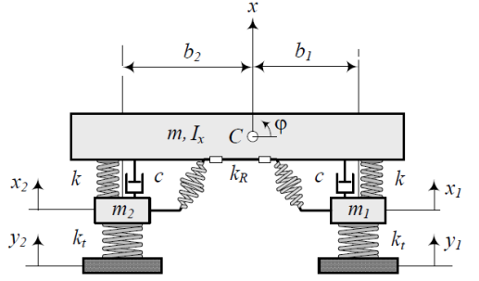
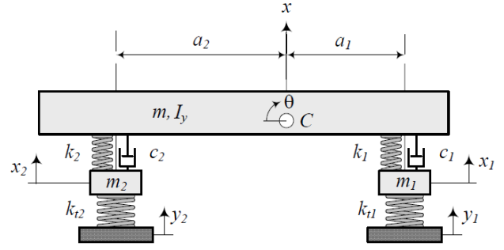
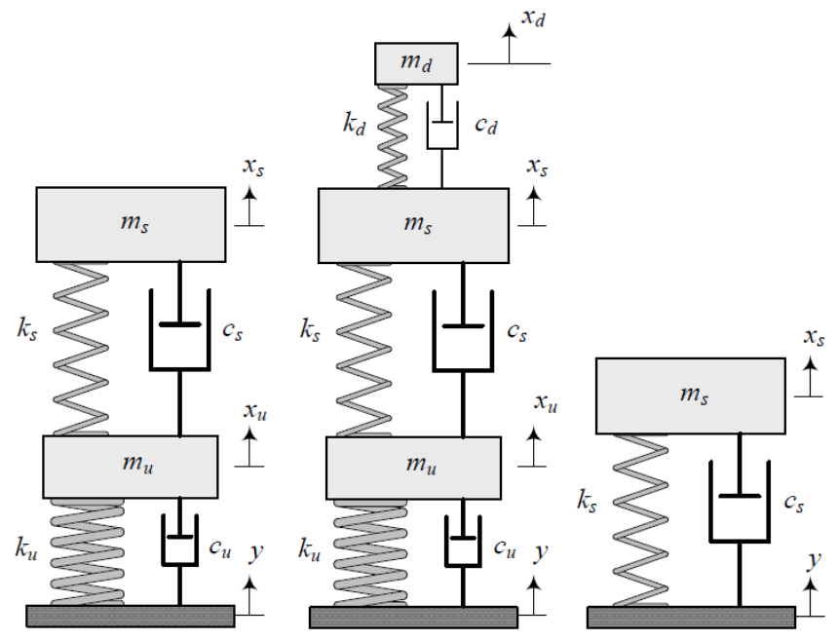
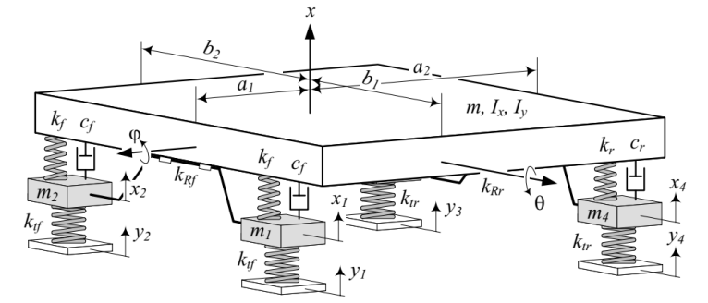
2.1 Suspension models
Vertical motions
Rotational motions
Figure 2.2: Model of car vibration in the horizontal plane, 4DOF
Figure 2.3: Model of car vibration in the vertical plane, 4DOF
Figure 2.1: Quarter-car models (2,3,1 DOF)
Figure 2.4: Model of car vibration 7DOF
Notes:
Study vertical movement
Study vertical/pitch/roll movements

Slide 11
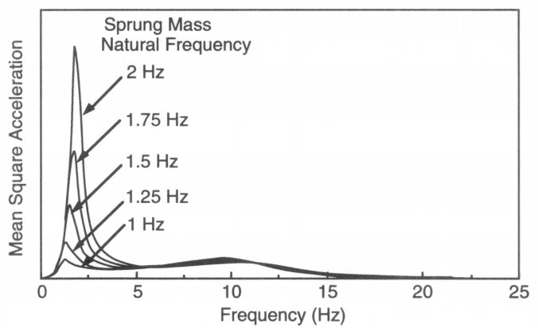
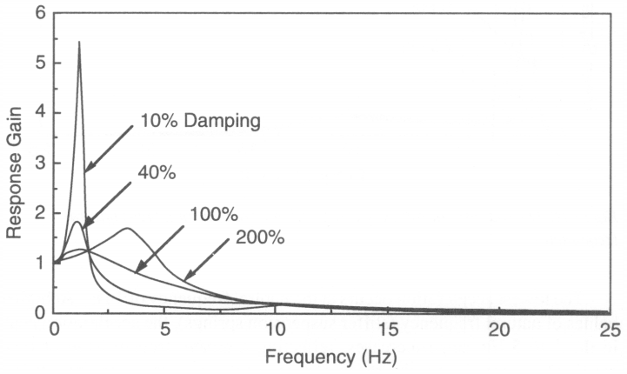

2.2 Natural frequency & damping ratio
Natural Frequency: $f_{n}=\frac{1}{2π}\sqrt{\frac{k}{m}}$
For comfortable, the natural frequency usually fluctuates in the range of 1 – 1.5 Hz
Damping Ratio: $ζ =\frac{c}{2\sqrt{km}}$
For comfortable, the damping ratio usually fluctuates in the range of 0.2 – 0.4
Figure 2.5: Effect of natural frequency
Figure 2.6: Effect of damping ratio
Notes:
Để dễ cho việc nghiên cứu, ta sẽ suy hết về dạng fn và zeta thay vì độ cứng và damping coefficient

Slide 12
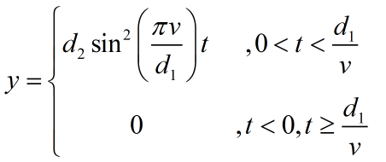
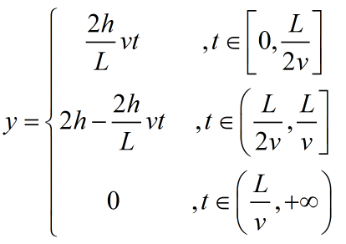
2.3 IRC – GB-T road profile
IRC – Indian Road Congress
GB/T - standard GB/T 4970-2009, China

Slide 13
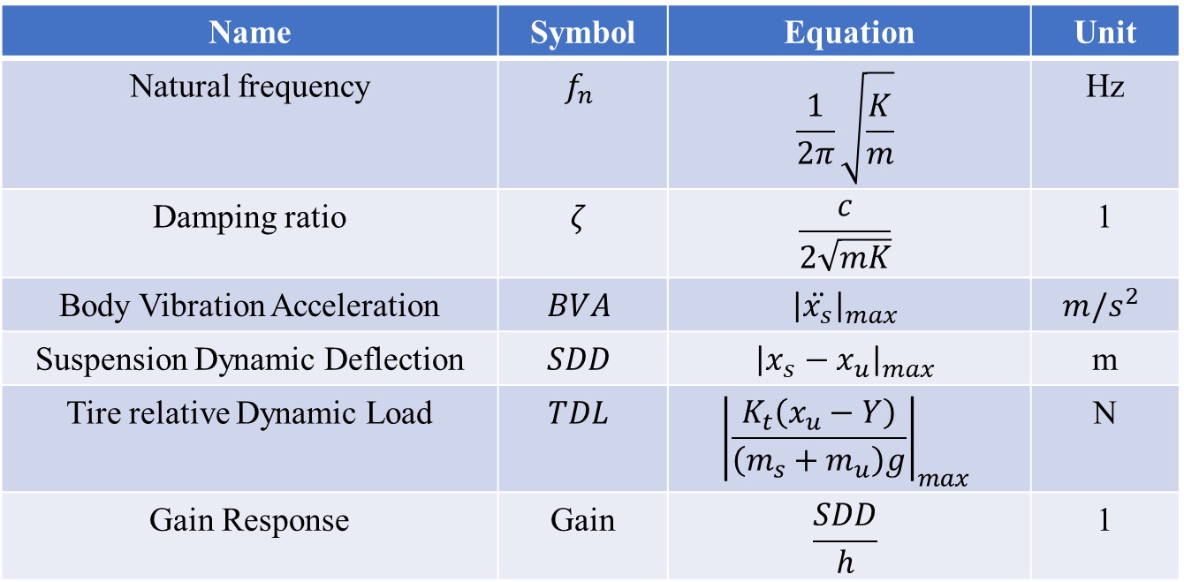
2.4 Evaluation indexes
Name | Symbol | Equation | Unit
Natural frequency | $$f_{n}$$ | $$\frac{1}{2π}\sqrt{\frac{K}{m}}$$ | Hz
Damping ratio | $$ζ$$ | $$\frac{c}{2\sqrt{mK}}$$ | 1
Body Vibration Acceleration | $$BVA$$ | $${\left|\ddot{x_{s}}\right|}_{max}$$ | $$m/s^{2}$$
Suspension Dynamic Deflection | $$SDD$$ | $${\left|x_{s}−x_{u}\right|}_{max}$$ | m
Tire relative Dynamic Load | $$TDL$$ | $${\left|\frac{K_{t}\left(x_{u}−Y\right)}{\left(m_{s}+m_{u}\right)g}\right|}_{max}$$ | N
Gain Response | Gain | $$\frac{SDD}{h}$$ | 1

Slide 14
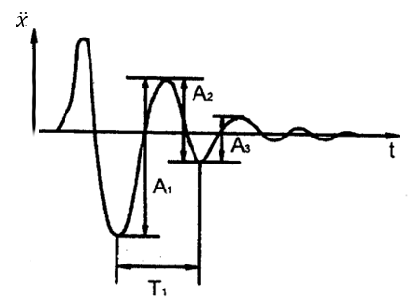
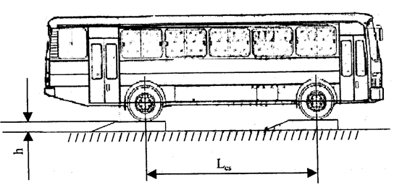
2.5 Natural frequency and damping ratio determination
22TCN 336:2006 Standard method: (Minister of Transport)
Create vertical oscillation
Press down a half of car
Lift a half of car
Record the received oscillation signal
Body acceleration signal
Body displacement signal
Processing test results
Drawbacks
Dangerous while testing
Complicated
Costs for testing components

Slide 15
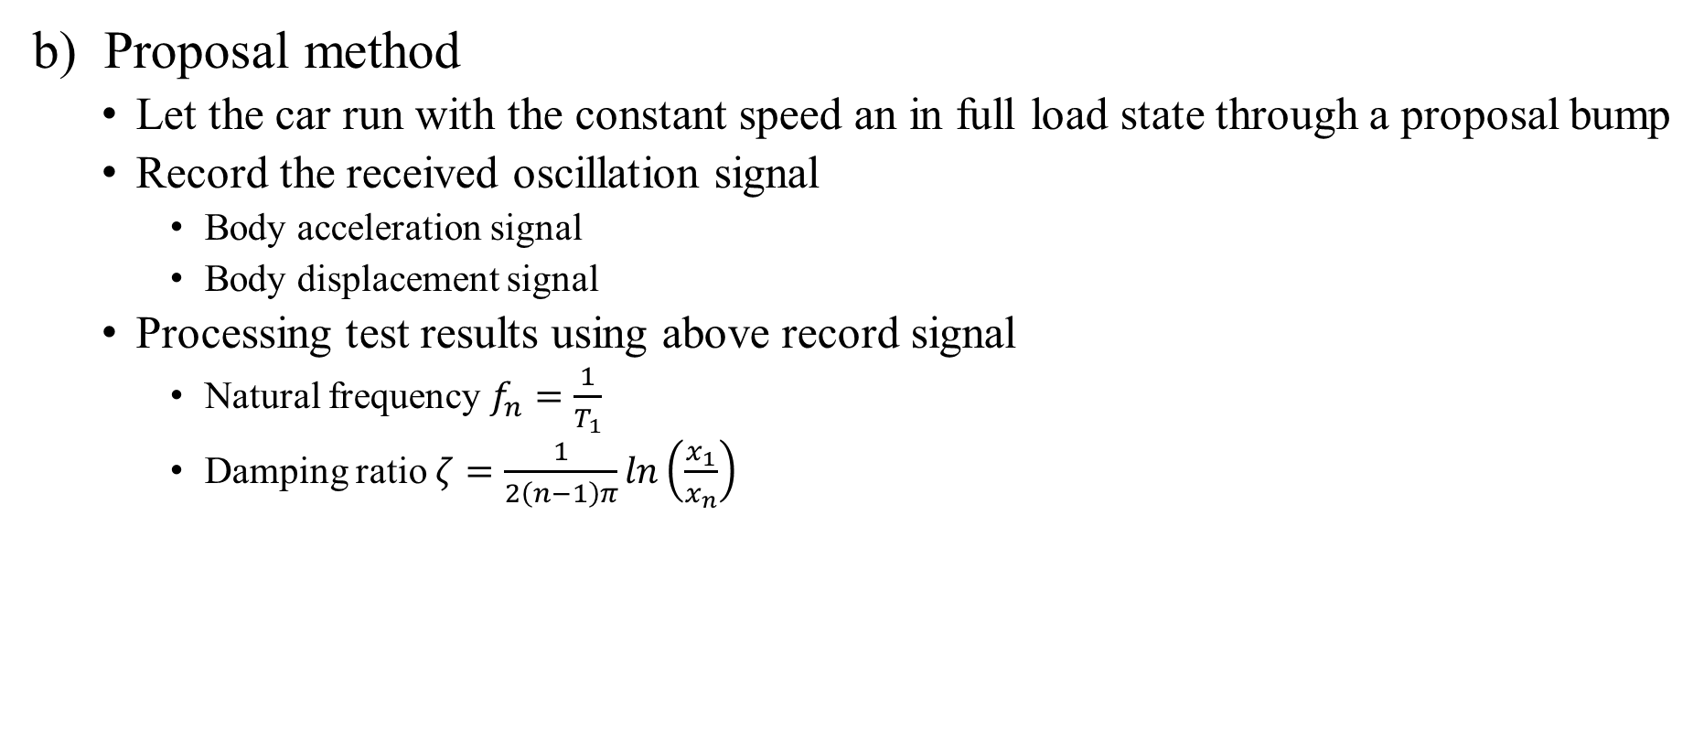
2.5 Natural frequency and damping ratio determination
b) Proposal method
Let the car run with the constant speed an in full load state through a proposal bump
Record the received oscillation signal
Body acceleration signal
Body displacement signal
Processing test results using above record signal
Natural frequency $f_{n}=\frac{1}{T_{1}}$
Damping ratio $ζ=\frac{1}{2\left(n−1\right)π}ln\left(\frac{x_{1}}{x_{n}}\right)$

Slide 16
CONTENTS
INTRODUCTION
THEORETICAL BASIS
MODEL DESCRIPTIONS
CALCULATION FLOW
RESULTS AND DISSCUSSION
CONCLUSIONS AND FUTURE WORKS
3.1 Models
3.2 Air spring parameters
3.3 Road parameters
3.4 Model parameters

Slide 17
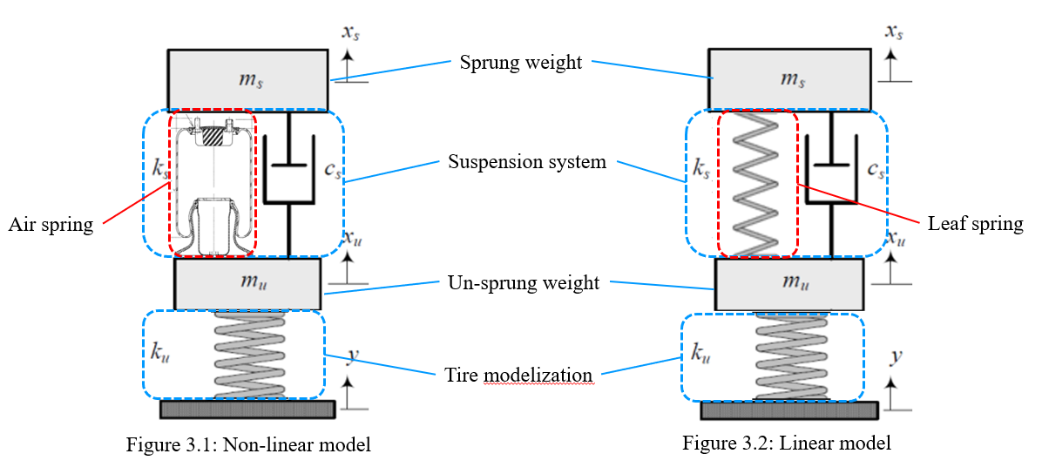
3.1 Models

Slide 18
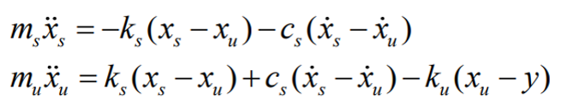
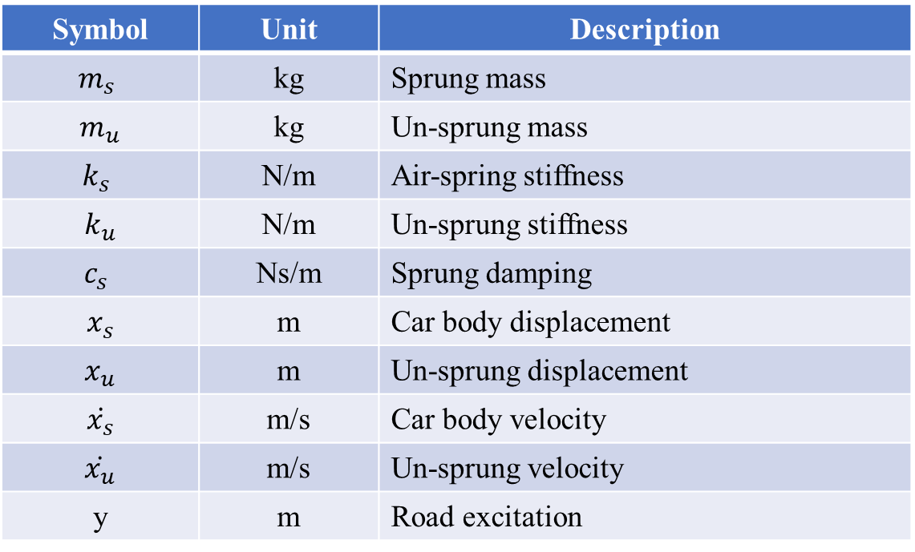
3.1 Models
ODE Equation:
Symbol | Unit | Description
$$m_{s}$$ | kg | Sprung mass
$$m_{u}$$ | kg | Un-sprung mass
$$k_{s}$$ | N/m | Air-spring stiffness
$$k_{u}$$ | N/m | Un-sprung stiffness
$$c_{s}$$ | Ns/m | Sprung damping
$$x_{s}$$ | m | Car body displacement
$$x_{u}$$ | m | Un-sprung displacement
$$\dot{x_{s}}$$ | m/s | Car body velocity
$$\dot{x_{u}}$$ | m/s | Un-sprung velocity
y | m | Road excitation

Slide 19
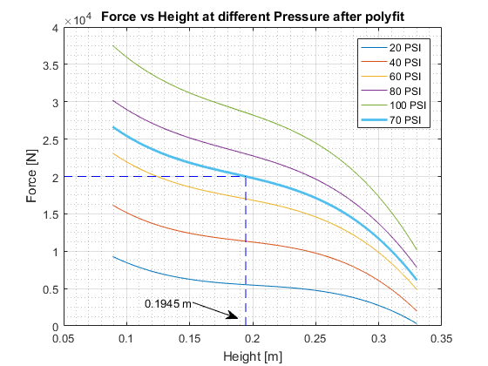
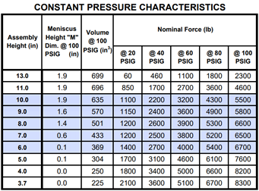
3.2 Air spring parameters
Air spring 1R11-028 – GoodYear product

Slide 20
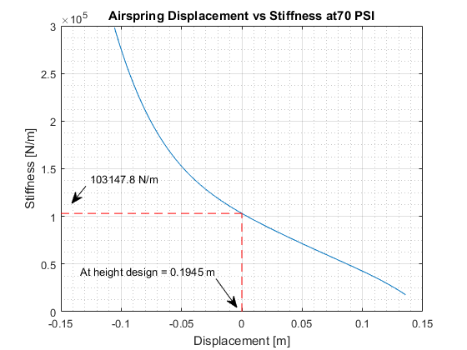
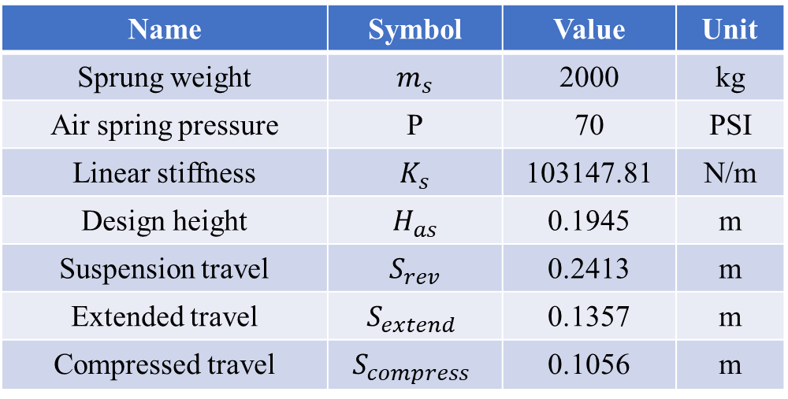
3.2 Air spring parameters
Name | Symbol | Value | Unit
Sprung weight | $$m_{s}$$ | 2000 | kg
Air spring pressure | P | 70 | PSI
Linear stiffness | $$K_{s}$$ | 103147.81 | N/m
Design height | $$H_{as}$$ | 0.1945 | m
Suspension travel | $$S_{rev}$$ | 0.2413 | m
Extended travel | $$S_{extend}$$ | 0.1357 | m
Compressed travel | $$S_{compress}$$ | 0.1056 | m

Slide 21
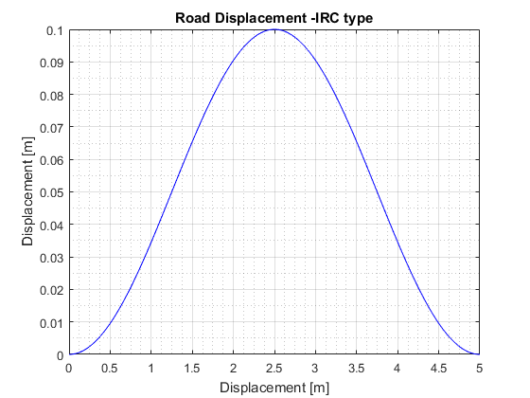
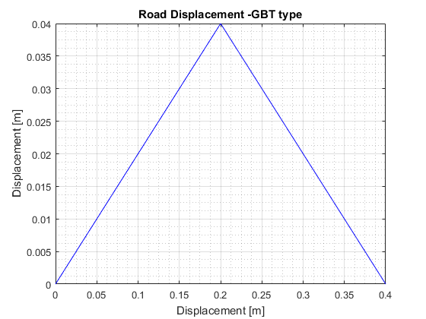
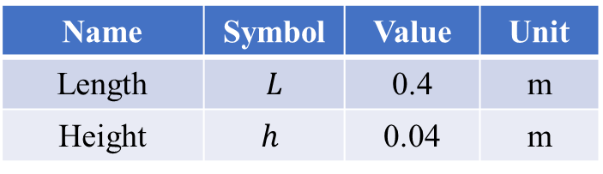
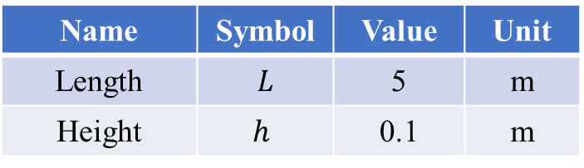
3.3 Road parameters
IRC Road
GB/T Road
Name | Symbol | Value | Unit
Length | $$L$$ | 5 | m
Height | $$h$$ | 0.1 | m
Name | Symbol | Value | Unit
Length | $$L$$ | 0.4 | m
Height | $$h$$ | 0.04 | m

Slide 22
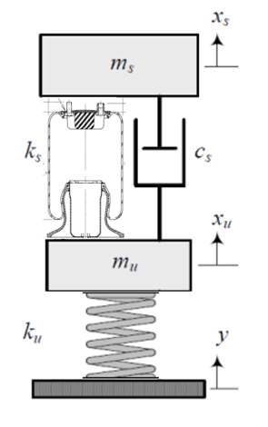
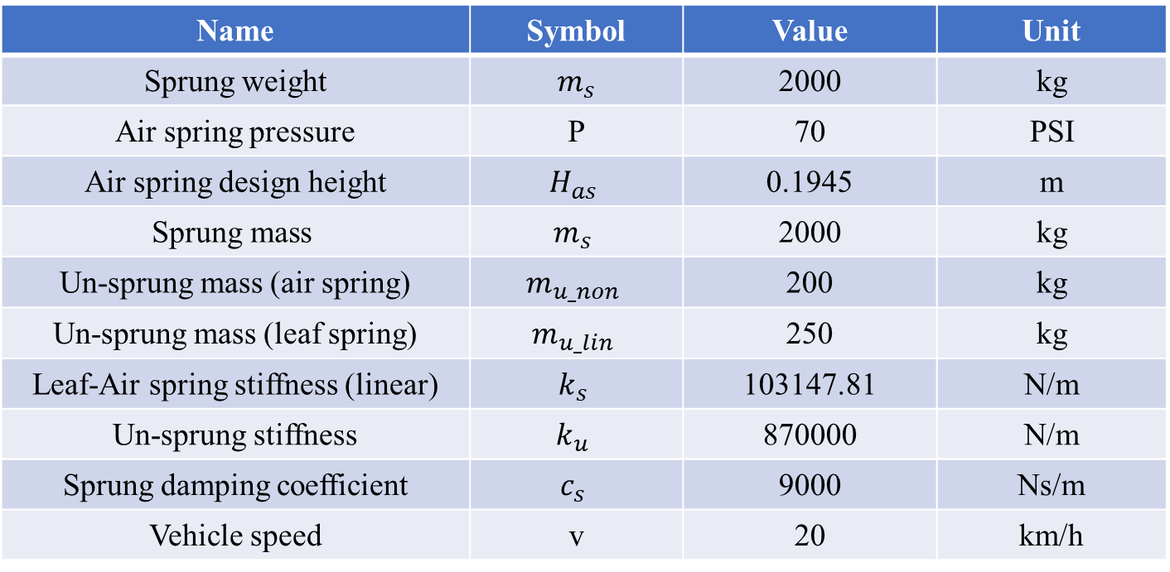
3.4 Model parameters
Name | Symbol | Value | Unit
Sprung weight | $$m_{s}$$ | 2000 | kg
Air spring pressure | P | 70 | PSI
Air spring design height | $$H_{as}$$ | 0.1945 | m
$$\text{Sprung} \text{mass}$$ | $$m_{s}$$ | 2000 | kg
Un-sprung mass (air spring) | $$m_{u_non}$$ | 200 | kg
Un-sprung mass (leaf spring) | $$m_{u_lin}$$ | 250 | kg
Leaf-Air spring stiffness (linear) | $$k_{s}$$ | 103147.81 | N/m
Un-sprung stiffness | $$k_{u}$$ | 870000 | N/m
Sprung damping coefficient | $$c_{s}$$ | 9000 | Ns/m
Vehicle speed | v | 20 | km/h

Slide 23
CONTENTS
INTRODUCTION
THEORETICAL BASIS
MODEL DESCRIPTIONS
CALCULATION FLOW
RESULTS AND DISSCUSSION
CONCLUSIONS AND FUTURE WORKS

Slide 24
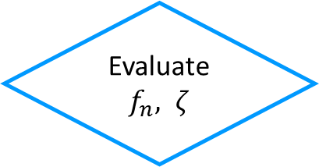
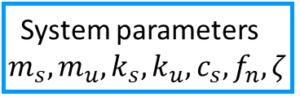
4. CALCULATION FLOW
Input GB/T road profiles
Time response calculation (ODE45 solver)
Frequency response
System parameters $m_{s},m_{u},k_{s},k_{u},c_{s}, f_{n},ζ$
Compare stability characteristics
Time response calculation (ODE45 solver)
Frequency response
Input IRC road profiles
Evaluate the proposal road testing
Evaluate $f_{n}, ζ$
passed
Input proposal road profiles
Time response calculation (ODE45 solver)
Conclusion
failed

Slide 25
CONTENTS
INTRODUCTION
THEORETICAL BASIS
MODEL DESCRIPTION
CALCULATION FLOW
RESULTS AND DISSCUSSION
CONCLUSIONS AND FUTURE WORKS
5.1 Time response results
5.2 Frequency response results
5.3 Natural frequency and Damping ratio determination

Slide 26
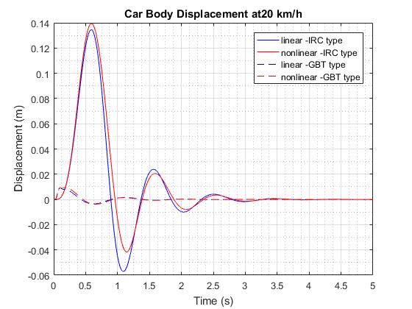
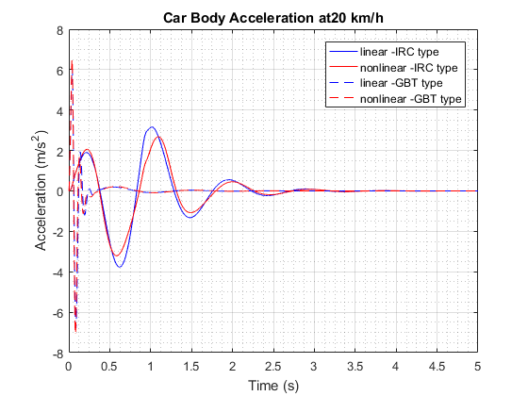
5.1 Time response results

Slide 27
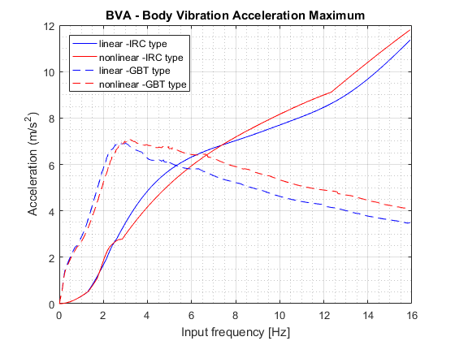
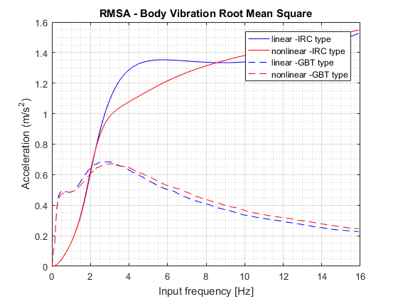
5.2 Frequency response results

Slide 28
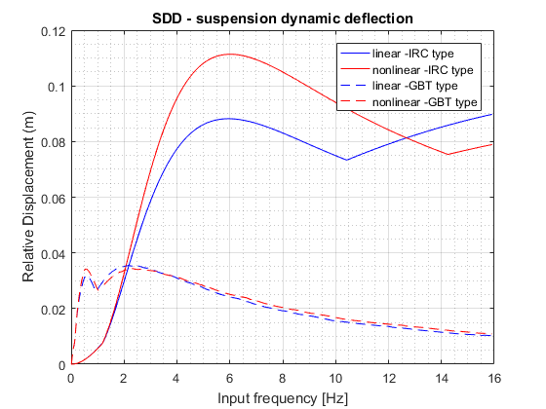
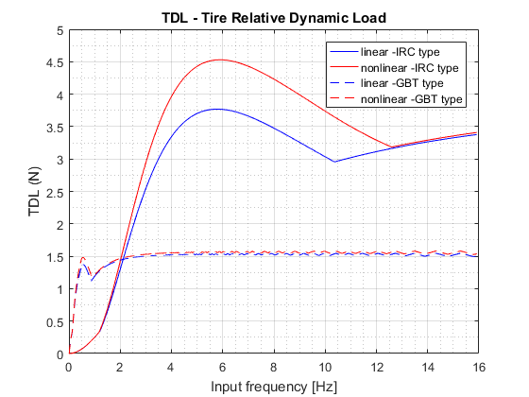
5.2 Frequency response results

Slide 29

5.3 Natural frequency and Damping ratio determination

Slide 30
5.3 Natural frequency and Damping ratio determination

Slide 31
6. CONCLUSIONS
50% progress
Change topic’s name to “DYNAMIC ANALYSIS OF THE PRIMAS BUS USING 2DOF MODEL WITH AIR SPRING AND RESEARCH NEW METHOD FOR NATURAL FREQUENCY AND DAMPING RATIO DETERMINATION VIA BUMP ROAD EXCITATION”

Slide 32
THANK YOU FOR LISTENING

Slide 35
CONTENTS
INTRODUCTION
THEORETICAL BASIS
MODEL DESCRIPTIONS
CALCULATION FLOW
RESULTS AND DISSCUSSION
CONCLUSIONS AND FUTURE WORKS

Slide 38
6. CONCLUSIONS
Conclusion
Ride comfort of T880 truck satisfy comfort requirement on road class A and B under all load cases
Natural frequency increase -> ride comfort decrease
Damping ratio increase -> ride comfort decrease
Calculation results can be used as basis to determine system parameters of suspension in designing process
Future works
Conduct experimental investigation
=> Compare difference between theoretical and practical situations
Modelization of non-linear spring and damper
=> Compare performance between different types of suspension system (air spring, skyhook damper)
Study relationship between ride comfort and handling
=> Utilize 3D model to study rotational motions

Slide 41
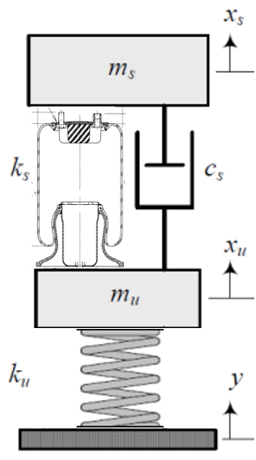
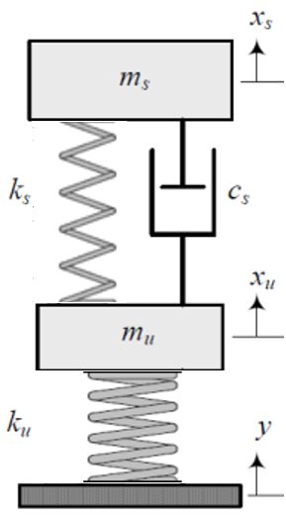
3.3 Road parameters
Sprung weight
Suspension system
Air spring
Leaf spring
Un-sprung weight
Tire modelization
Figure 3.1: Non-linear model
Figure 3.2: Linear model

Slide 42


Slide 44
1. INTRODUCTION

Slide 45
2. THEORETICAL BASIS

Slide 46
3. MODEL DESCRIPTIONS

Slide 47
4. CALCULATION FLOW

Slide 48
5. CONCLUSION & FUTURE WORKS

Slide 49
Tổng quan
Thể loại LVTN: Nghiên cứu mô phỏng
Mục tiêu nghiên cứu:
Phương pháp: mô phỏng số trên mô hình 2dof spring mass damper
Công cụ: MATLAB 2018
Thesis scope
Thesis objective
Research methodology
Những bài toán cần giải quyết

Slide 50
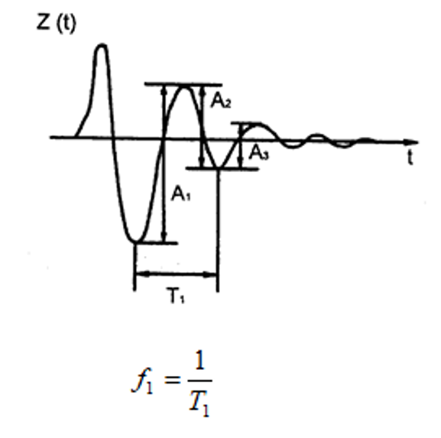
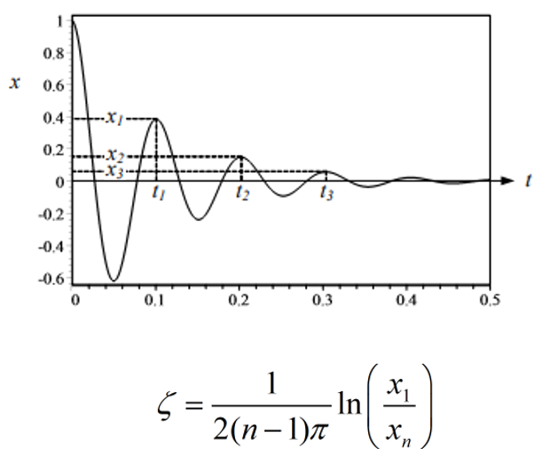
Objective/Scope

Slide 51
2. INPUT

Slide 52
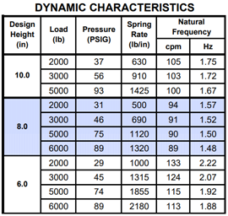
2.1. AIR SPRING INPUT
Air spring 1R11-028 – GoodYear product

Slide 53

AIR SPRING Stiffness Calculating
Stiffness formular:

Slide 54
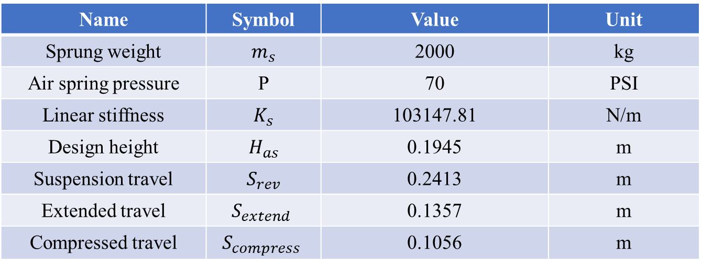
Air spring calculating parameters
Name | Symbol | Value | Unit
Sprung weight | $$m_{s}$$ | 2000 | kg
Air spring pressure | P | 70 | PSI
Linear stiffness | $$K_{s}$$ | 103147.81 | N/m
Design height | $$H_{as}$$ | 0.1945 | m
Suspension travel | $$S_{rev}$$ | 0.2413 | m
Extended travel | $$S_{extend}$$ | 0.1357 | m
Compressed travel | $$S_{compress}$$ | 0.1056 | m

Slide 55
IRC Road INPUT
IRC is the Indian Road profile Congress

Slide 56
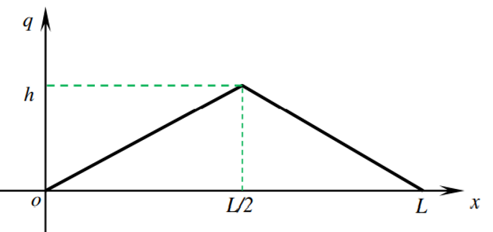
Standard GB/T 4970–2009 Road Input
The triangular bump model is created on the basis of the national standard GB/T 4970-2009, China

Slide 57
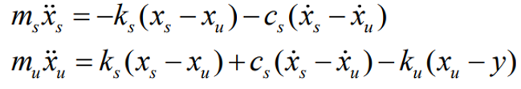

Calculating model
2DOF spring mass damper model
Symbol | Unit | Description
$$m_{s}$$ | kg | Sprung mass
$$m_{u}$$ | kg | Un-sprung mass
$$k_{s}$$ | N/m | Air-spring stiffness
$$k_{u}$$ | N/m | Un-sprung stiffness
$$c_{s}$$ | Ns/m | Sprung damping
$$x_{s}$$ | m | Car body displacement
$$x_{u}$$ | m | Un-sprung displacement
$$\dot{x_{s}}$$ | m/s | Car body velocity
$$\dot{x_{u}}$$ | m/s | Un-sprung velocity

Slide 58

Input Parameters
Name | Symbol | Value | Unit
Sprung weight | $$m_{s}$$ | 2000 | kg
Air spring pressure | P | 70 | PSI
Design height | $$H_{as}$$ | 0.1945 | m
$$\text{Sprung} \text{mass}$$ | $$m_{s}$$ | 2000 | kg
Un-sprung mass air spring | $$m_{u_non}$$ | 200 | kg
Un-sprung mass leaf spring | $$m_{u_lin}$$ | 250 | kg
Leaf-air spring stiffness | $$k_{s}$$ | 103147.81 | N/m
Un-sprung stiffness | $$k_{u}$$ | 870000 | N/m
Sprung damping | $$c_{s}$$ | 9000 | Ns/m

Slide 59

Calculating and result
Name | Symbol | Value | Unit
IRC Road height | h | 0.1 | m
Air spring pressure | P | 70 | PSI
Design height | $$H_{as}$$ | 0.1945 | m
$$\text{Sprung} \text{mass}$$ | $$m_{s}$$ | 2000 | kg
Un-sprung mass air spring | $$m_{u_non}$$ | 200 | kg
Un-sprung mass leaf spring | $$m_{u_lin}$$ | 250 | kg
Leaf-air spring stiffness | $$k_{s}$$ | 103147.81 | N/m
Un-sprung stiffness | $$k_{u}$$ | 870000 | N/m
Sprung damping | $$c_{s}$$ | 9000 | Ns/m

Slide 60
3. Calculating and results

Slide 61

3.1. Compare IRC – GB/T
Name | Symbol | Value | Unit
IRC Length | L | 0.1 | m
IRC Height | h | 5 | m
GB/T Length | L | 0.4 | m
GB/T Height | h | 0.04 | m

Slide 62

3.1.1. IRC – GB/T Time response result

