Slide 1
Layer2Layer
Input Layer
Hidden Layer
Output Layer

Slide 2
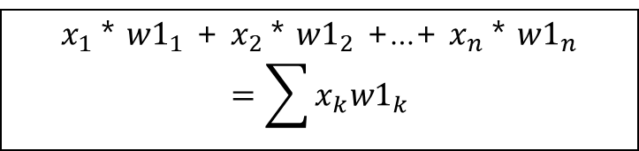
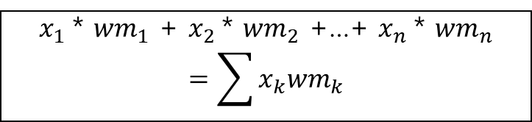


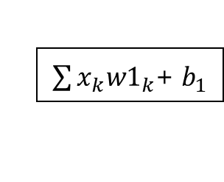










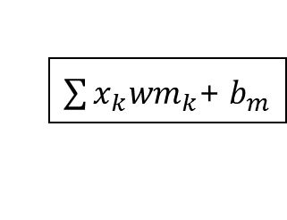
Layer2Layer
Input Layer
Weight(1~m층)
Bias
W1
$x_{1}$* ${w1}_{1}$ + $x_{2}$* ${w1}_{2}$ +…+ $x_{n}$* ${w1}_{n}$
$$=\sum{x_{k}{w1}_{k}}$$
$${ x}_{1}$$
$${ w1}_{1}$$
$${ b}_{1}$$
$\sum{x_{k}{w1}_{k}}$+${ b}_{1}$
Wm
$${ wm}_{1}$$
$$x_{2}$$
$${ w1}_{2}$$
$${ b}_{2}$$
$${ wm}_{2}$$
.
.
.
.
.
.
.
.
.
.
.
.
.
.
.
.
.
.
$${ wm}_{n}$$
$$x_{n}$$
$${ w1}_{n}$$
$x_{1}$* ${wm}_{1}$ + $x_{2}$* ${wm}_{2}$ +…+ $x_{n}$* ${wm}_{n}$
$$=\sum{x_{k}{wm}_{k}}$$
$${ b}_{m}$$
$\sum{x_{k}{wm}_{k}}$+${ b}_{m}$

Slide 3
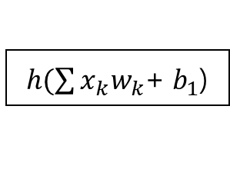




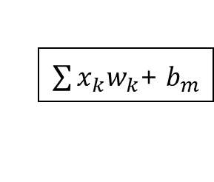

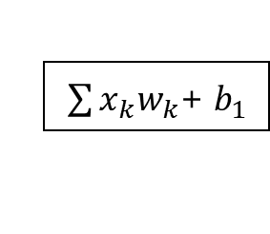


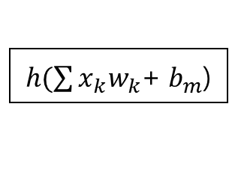
Layer2Layer
Bias
Activation Function
Hidden Layer
$${ b}_{1}$$
$\sum{x_{k}w_{k}}$+${ b}_{1}$
$h(\sum{x_{k}w_{k}}$+${ b}_{1}$)
$${ x′}_{1}$$
$${ b}_{2}$$
$${x′}_{2}$$
.
.
.
$$h$$
.
.
.
.
.
.
.
.
.
$${ b}_{m}$$
$\sum{x_{k}w_{k}}$+${ b}_{m}$
$h(\sum{x_{k}w_{k}}$+${ b}_{m}$)
$${x′}_{m}$$

Slide 4
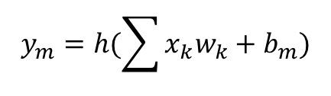
$$y_{m}=h(\sum{x_{k}w_{k}+b_{m})}$$

Slide 5
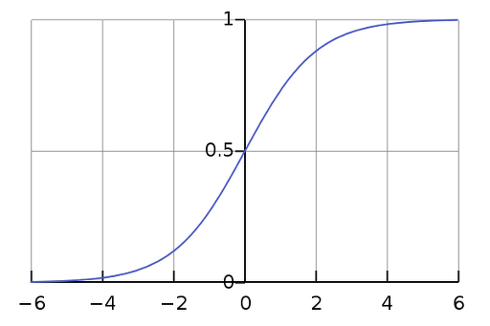
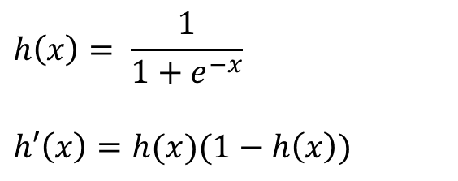
Sigmoid
$$h\left(x\right)= \frac{1}{1+e^{−x}}$$
$$h′\left(x\right)=h(x)(1−h\left(x\right))$$

Slide 6
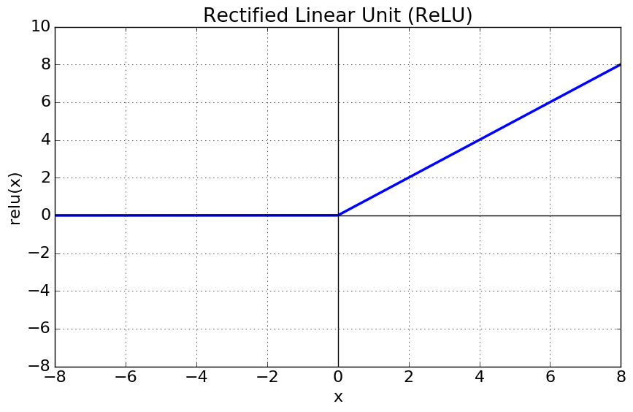
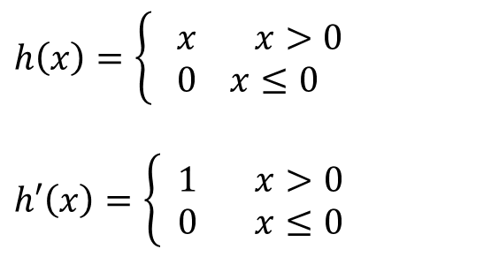
ReLU
$$h\left(x\right)=\left\{\begin{aligned} x x>0 \\ 0 x≤0\end{aligned}\right.$$
$$h′\left(x\right)=\left\{\begin{aligned} 1 x>0 \\ 0 x≤0\end{aligned}\right.$$

Slide 7
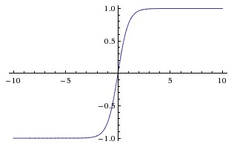
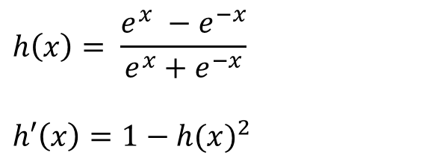
tanh
$$h\left(x\right)= \frac{e^{x} −e^{−x}}{e^{x}+e^{−x}}$$
$$h′\left(x\right)=1−{h(x)}^{2}$$

Slide 8
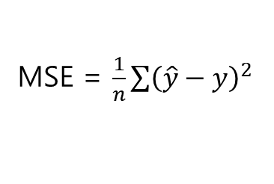
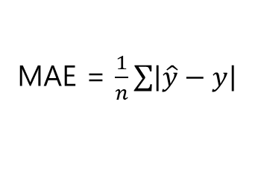
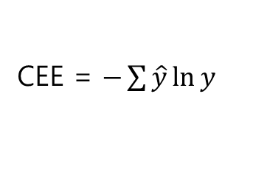
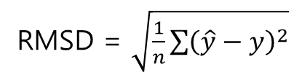
MAE = $\frac{1}{n}\sum{\left|\hat{y}−y\right|}$
MSE = $\frac{1}{n}\sum{{\left(\hat{y}−y\right)}^{2}}$
RMSD = $\sqrt{\frac{1}{n}\sum{{\left(\hat{y}−y\right)}^{2}}}$
CEE = $−\sum{\hat{y}\ln{y}}$

